Slide 2
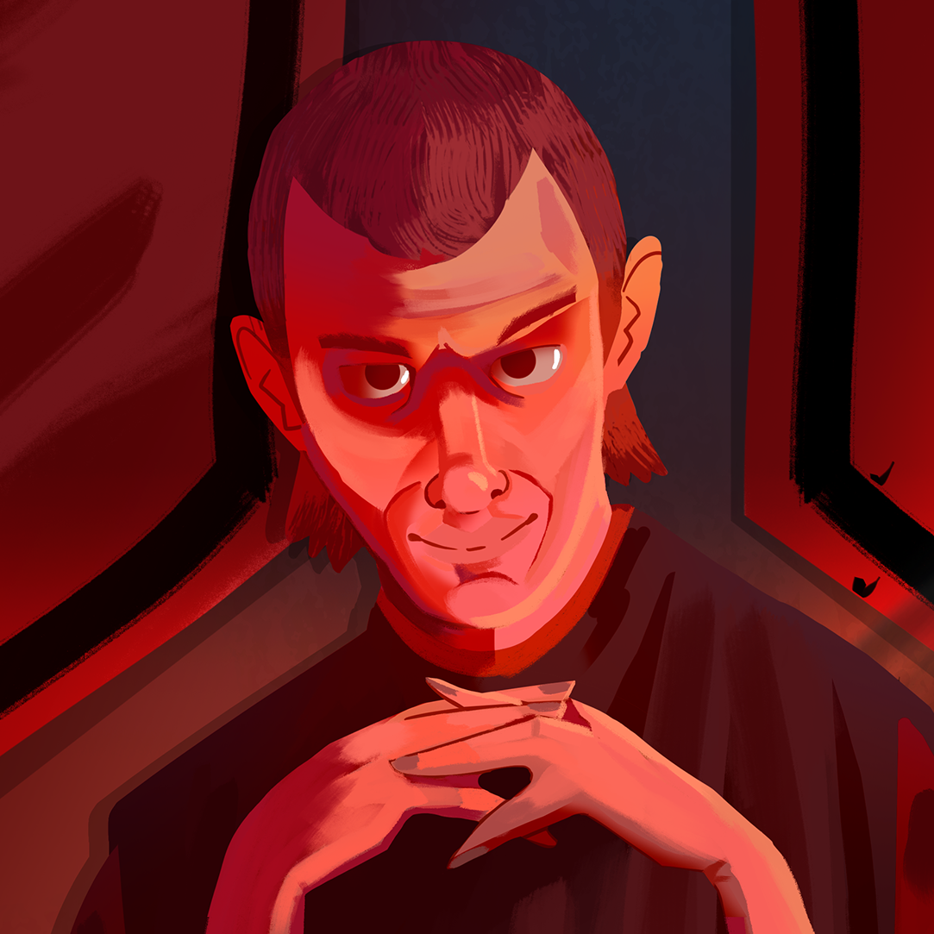
Loved or Feared?
The Political Thought of Machiavelli

Slide 3
Essential Question
How should leaders treat people whom they govern?
How did Machiavelli and his work affect political thought?

Slide 4
Learning Objective
Analyze Machiavelli’s contributions to political thought.

Slide 5

Four Corners
Listen to each of the following five statements.
After hearing a statement, move to the area of the room that aligns best with your agreement level.
Notes:
K20 Center. (n.d.). Four corners. Instructional Strategies. https://learn.k20center.ou.edu/strategy/138

Slide 6
Four Corners
Most people are honest.
Notes:
K20 Center. (n.d.). Four corners. Instructional Strategies. https://learn.k20center.ou.edu/strategy/138

Slide 7
Four Corners
To get someone to like you, tell that person what they want to hear.
Notes:
K20 Center. (n.d.). Four corners. Instructional Strategies. https://learn.k20center.ou.edu/strategy/138

Slide 8
Four Corners
There are no absolute rights or wrongs. Right is what works.
Notes:
K20 Center. (n.d.). Four corners. Instructional Strategies. https://learn.k20center.ou.edu/strategy/138

Slide 9
Four Corners
Most people are extremely selfish.
Notes:
K20 Center. (n.d.). Four corners. Instructional Strategies. https://learn.k20center.ou.edu/strategy/138

Slide 10
Four Corners
A promise is a sacred trust.
Notes:
K20 Center. (n.d.). Four corners. Instructional Strategies. https://learn.k20center.ou.edu/strategy/138

Slide 11
Four Corners
Statements Machiavelli would agree with:
To get someone to like you, tell that person what they want to hear.
There are no absolute rights or wrongs. Right is what works.
Most people are extremely selfish.
Statements Machiavelli would not agree with:
Most people are honest.
A promise is a sacred trust.
How much did you agree with Machiavelli?
Notes:
K20 Center. (n.d.). Four corners. Instructional Strategies. https://learn.k20center.ou.edu/strategy/138

Slide 12
Four Corners
A person who agrees with Machiavelli might be considered practical and not very trusting of human nature in general.
A person who disagrees with Machiavelli might be considered an idealist and have strong opinions about right and wrong.
Notes:
K20 Center. (n.d.). Four corners. Instructional Strategies. https://learn.k20center.ou.edu/strategy/138

Slide 13
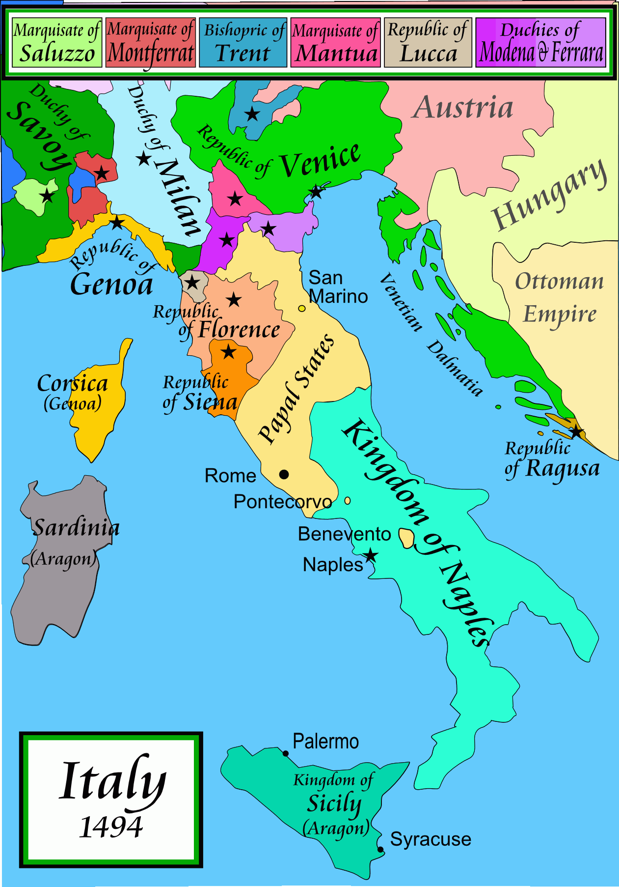
Niccolò Machiavelli
Born in Florence on May 3, 1469.
Served as a diplomat for the Florence government but was exiled when a new family came to power. He was briefly put in jail for conspiring against the new family in control of the government.
While exiled, wrote his most famous book, The Prince, as a guidebook for monarchs.
Often referred to as the “father of modern political theory.”
Notes:
Biography. (2020, June 16). Niccolò Machiavelli. https://www.biography.com/scholar/niccolo-Machiavelli
Wikimedia Commons. (2009, April 21). Italy 1494 AD [Photo]. https://commons.wikimedia.org/wiki/File:Italy_1494_AD.png

Slide 14
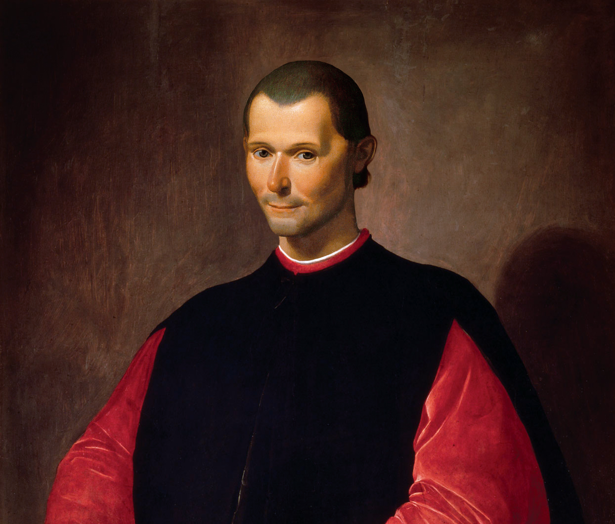
Analyzing Excerpts from The Prince
Read the three excerpts from Machiavelli’s book The Prince.
As you read, highlight any references to how a leader should behave.
Notes:
K20 Center. (n.d.). Categorical highlighting. Strategies. https://learn.k20center.ou.edu/strategy/192
Nickniko. (2019, November 25). Portrait of Niccolò Machiavelli [Photo]. Wikimedia Commons. https://commons.wikimedia.org/wiki/File:Portrait_of_Niccol%C3%B2_Machiavelli.jpg

Slide 15
Analyzing Excerpts from The Prince
What advice does Machiavelli have for leaders?
What does Machiavelli seem to think about people’s general nature?
Notes:
Nickniko. (2019, November 25). Portrait of Niccolò Machiavelli [Photo]. Wikimedia Commons. https://commons.wikimedia.org/wiki/File:Portrait_of_Niccol%C3%B2_Machiavelli.jpg

Slide 16
3-2-1
As you watch the video, look for:
3 ideas from The Prince.
2 reasons Machiavelli might have written The Prince.
1 lesson for readers from The Prince.
Notes:
K20 Center. (n.d.). 3-2-1. Strategies. https://learn.k20center.ou.edu/strategy/117

Slide 17

What “Machiavellian” Really Means
Notes:
TED-Ed. (2019, March 25). What “Machiavellian” really means - Pazit Cahlon and Alex Gendler [Video]. YouTube. https://www.youtube.com/watch?v=fUlGtrHCGzs

Slide 18
Loved or Feared?
Consider the two statements.
Choose a side of the classroom based on your opinion. If you are unsure, stand in the middle of the classroom.
Discuss your reasoning with students in the same area of the classroom and be ready to share your thoughts.
A leader should be loved.
A leader should be feared.

Slide 19
Loved or Feared?
Machiavelli wrote that while it is sometimes necessary for a leader to be feared rather than loved, a leader should try to be both when possible.
  Is this a realistic possibility?

Slide 20
Machiavelli’s Legacy
How did Machiavelli and his work affect political thought?

