Slide 2
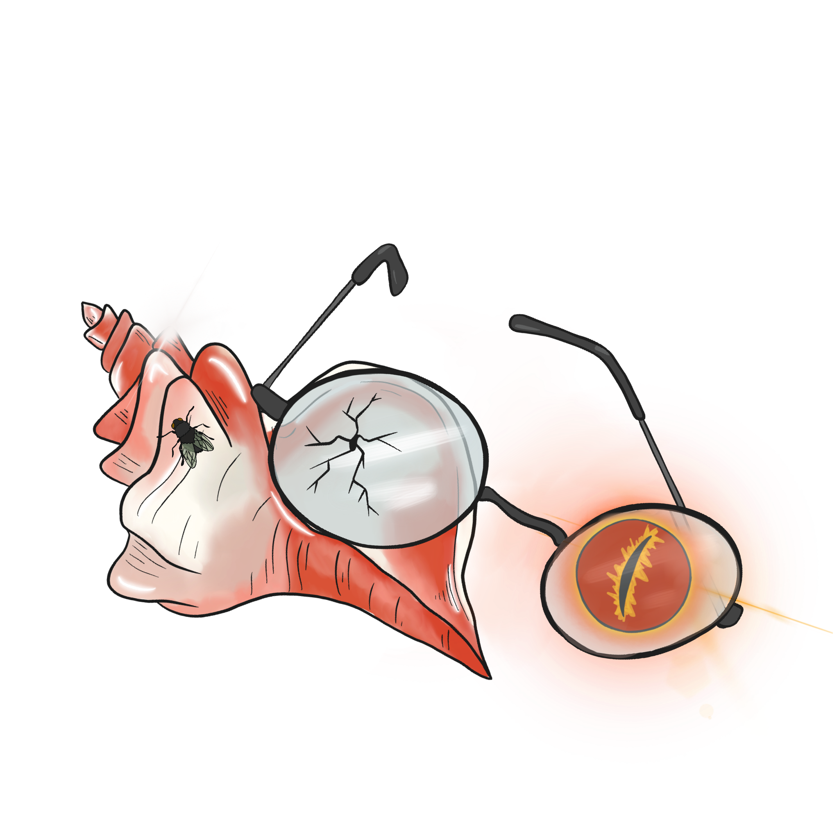
In the End
Lord of the Flies Unit Lesson 8

Slide 3
Essential Question
How does the author use symbolism to develop characterization and theme?

Slide 4
Lesson Objectives
Synthesize knowledge of the characters and symbols in the novel.
Evaluate personal beliefs about what the author says in the novel.

Slide 5
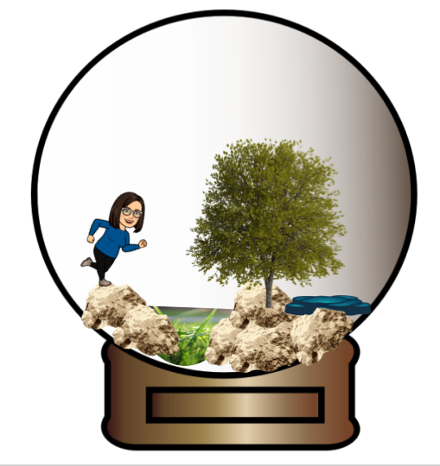
Microcosms Revisited
Revisit your peers’ Microcosms from Lesson 1.
As you look at them, share Two Stars and a Wish you have about them.
  2 things you agree with ()
  1 thing that could/should change ()
Notes:
https://learn.k20center.ou.edu/strategy/83

Slide 6
Microcosms Revisited
Review the feedback left by your peers.
Do you agree or disagree with it?
What revisions would you like to make to your Microcosm?
Why?
Notes:
https://learn.k20center.ou.edu/strategy/118

Slide 7

Honeycomb Harvest
Each hexagon has one of the following on it:
  Character name
  Theme
  Symbol
  Quotes
With your group, organize the hexagons into groups to determine their relationships and how they all connect with one another.
Notes:
https://learn.k20center.ou.edu/strategy/61

Slide 8

Character Representation Through Symbols
Using the information from the Honeycomb Harvest and your reading, create an Anchor Chart for one of the characters and create a symbol that represents him.
Notes:
https://learn.k20center.ou.edu/strategy/58

Slide 9
Character Representation through Symbols
Make an Anchor Chart.
  Identify or create a symbol to represent one character.
  Pull examples from the text to show how the character illustrates the symbol.
Example: Piggy, who represents kids who are bullied, is constantly made fun of, and Jack and the other boys refuse to listen to him.

Slide 10
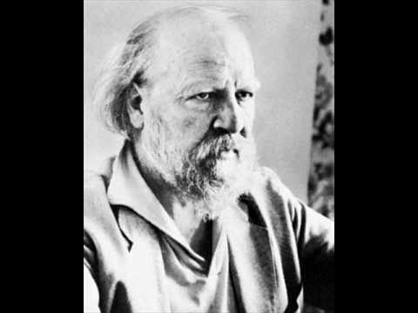
They Say, I Say Writing
As you watch the video of William Golding, listen carefully for the following information:
General topic of the speech
Main point
Examples/quotes that support the main argument
Notes:
https://learn.k20center.ou.edu/strategy/1644
YouTube. (2010). Golding's Introduction to Lord of the Flies. [Video]. YouTube. https://www.youtube.com/watch?v=vYnfSV27vLY&t=2s.

Slide 11
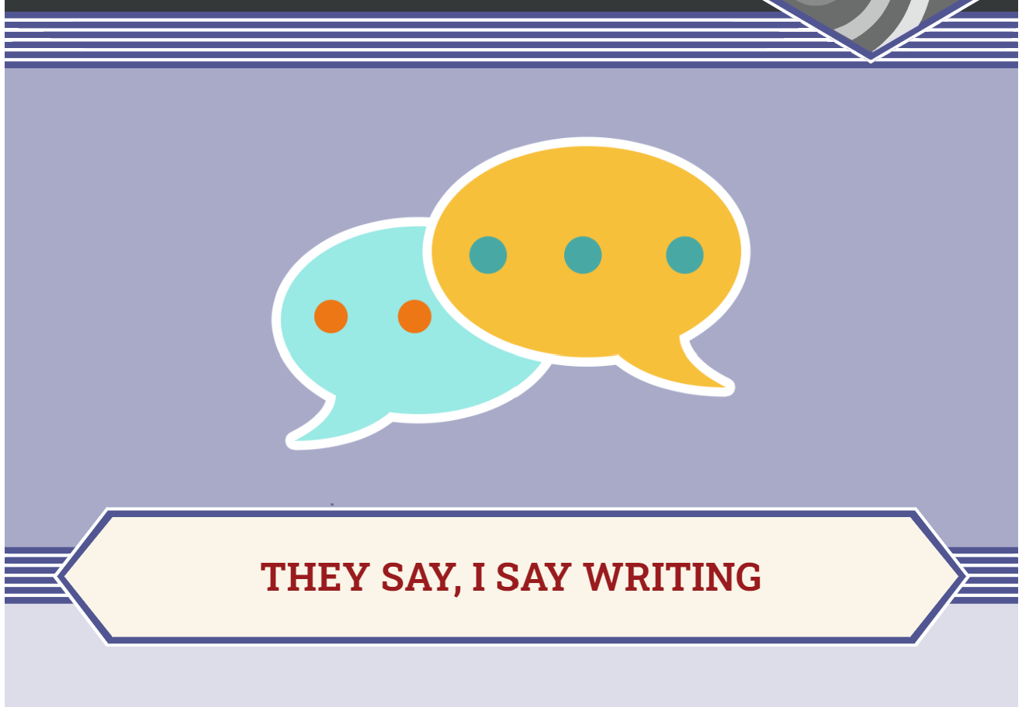
They Say, I Say Writing
Write two paragraphs to summarize Golding’s and your views about the novel.
  Paragraph 1: Summarize the information you gathered from the video and the novel.
  Paragraph 2: Summarize your views on the topic.
Notes:
https://learn.k20center.ou.edu/strategy/1644

Slide 12

They Say, I Say Writing
Write one paragraph that summarizes the information you gathered from the video and the novel.
The general argument made by (author) in the work, (title), is that (general topic). More specifically, (author's last name) argues that (main argument). She/he writes, “ (provide specific example/quote to support main argument).” In this passage, (author's last name) suggests that (explain the purpose of the example/quote). In conclusion, (author's last name)’s belief is that (restate main argument).
Notes:
Golding, W., & Lowry, L. (2016). Lord of the flies. Penguin Books.

Slide 13

They Say, I Say Writing
Write one paragraph that summarizes your view on the topic.
In my view, (author's last name) is wrong/right (choose one) because (provide general argument). More specifically, I believe that (give a specific reason/s). For example, (give a textual or real-life example to support your argument). Although (author's last name) might object that (explain what the author's counter-argument would be),* I maintain that (provide your reasoning to support your side). Therefore, I conclude that (restate your opinion).
*Even if you agree with the author, find a point of contention. Where would you and the author disagree, even if slightly?
Notes:
Golding, W. & Lowry, L. (2016). Lord of the Flies. Penguin Graphic Deluxe Edition. Penguin Classics.

Slide 14
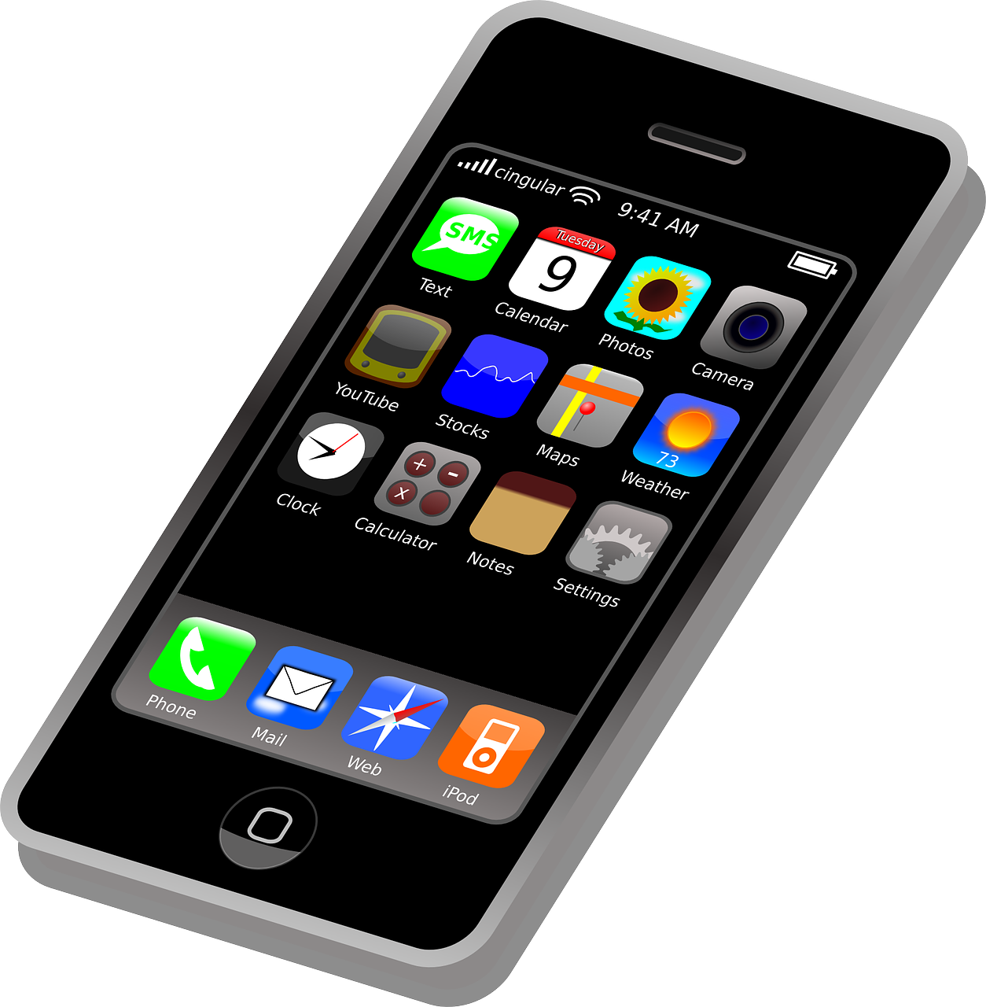

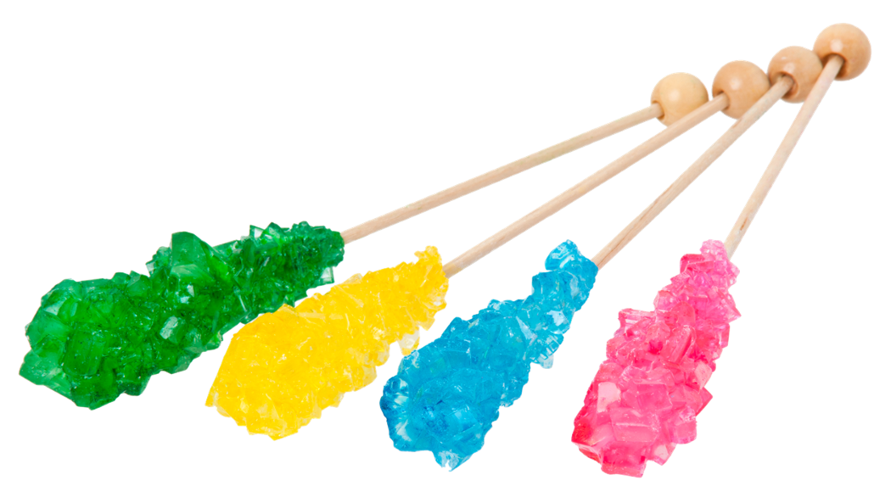
Emergency Items
Take a moment to revisit the three items you chose to bring with you in an emergency in Lesson 1.
Do you think you would change anything about the items you chose?
What would you change?
Why?
If no change, why not?
Notes:
Pixabay. (2012). Smartphone. [Digital Image]. https://pixabay.com/vectors/iphone-cellphone-smartphone-mobile-37856/.
Amos, E. (2012). Rock Candy Sticks. [Digital Image]. https://commons.wikimedia.org/wiki/File:Rock-Candy-Sticks.jpg.
Pixy#org. (n.d.) Weather Symbol on a Hoodie as a Picture for Clipart. [Digital Image]. https://pixy.org/996909/.

Slide 15
Lord of the Flies
How has this story impacted you?

