Slide 2
What Is a Wave?, Lesson 2
Not the Bermuda Triangle

Slide 3
Essential Questions
What are waves?
How does the behavior of waves differ from that of other objects?

Slide 4
Lesson Objectives
Explain the relationship between velocity, frequency, and wavelength.
Understand that frequency and wavelength form an inverse relationship
Understand the “triangle of power” to determine velocity, frequency, or wavelength of a wave.

Slide 5
What do you meme we have homework?
Share your meme with the class.

Slide 6
Strike Out!
While your classmates are sharing their memes, keep a running list of key ideas or themes that you see emerging.
Write them down on a sheet of notebook paper.

Slide 7
Strike Out!
Get into groups of three and share your individual lists of important ideas and themes and work to combine them into one list.
Pass your new list to another group for them to review.
Find the least important idea and “strike it” from another group’s list.
Add these to the Strike Out! board

Slide 8
Driving Question Board
Are there any questions on the Driving Question Board that we can answer right now?

Slide 9
What is velocity?
Velocity is the speed that something travels. Also, if we know the speed something is traveling and the total time the object was moving, we can determine the distance it traveled.

Slide 10
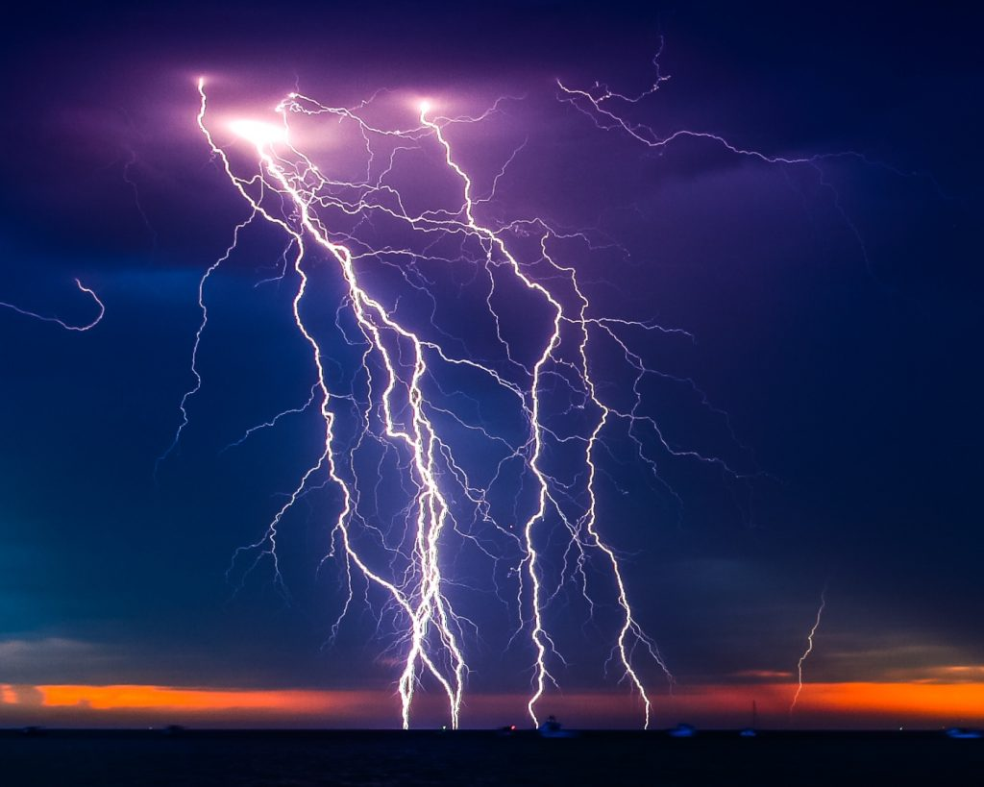
Distance from a storm
Have you ever used lightning and thunder to determine how far away a storm is from you?
What did you do to figure out your distance from the storm?
This Photo by Unknown Author is licensed under CC BY-ND

Slide 11
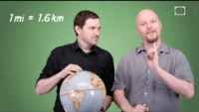
Notes:
https://www.youtube.com/watch?v=2P7nODA4rrc&t=4s

Slide 12
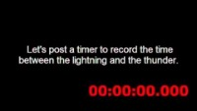
Distance = Velocity · Time
You have previously read that the speed of sound is 338 m/s. Watch the video of lightning to find the time needed to calculated the distance from you and the storm.
Notes:
https://www.youtube.com/watch?v=3TXJ2sk02JA&t=1s

Slide 13
How far away was the lightning strike from the camera?
You know that the speed of sound is 338 m/s and the time to hear the thunder after seeing lightning was 7.1 seconds.
This Photo by Unknown Author is licensed under CC BY-ND
Notes:
https://www.flickr.com/photos/thelightningman/6103581768

Slide 14
Distance = Velocity · Time
Distance = (338m/s)(7.1s)
Distance ≈ 2400m
This Photo by Unknown Author is licensed under CC BY-ND
Notes:
https://www.flickr.com/photos/thelightningman/6103581768

Slide 15
Pipelinefunk
What information from this video would you need to confirm that the speed of sound is 338m/s?
Notes:
https://www.youtube.com/watch?v=p8GcHoSIPDg&t=1s

Slide 16
Let’s practice!
Use the estimated time of 1.15 seconds, and the distance down the pipe and back of 389m to confirm the speed of sound is 338 m/s.

Slide 17
Let’s Practice!
Use the estimated time of 1.15 seconds, and the distance down the pipe and back of 389m to confirm the speed of sound is 338 m/s.

Slide 18
What About Sound?
Frequency is measured in waves per second.
Wavelength is measured in meters.
How do you think we could calculate the velocity of a sound wave using these new words?
Hint: Think about the units.

Slide 19
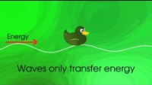
Waves Vocabulary
As the video is playing, add the definitions and images to your graphic organizer.
Notes:
https://www.youtube.com/watch?v=RVyHkV3wIyk

Slide 20
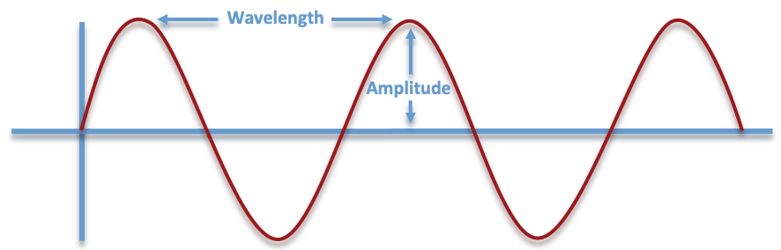
Wavelength
The horizontal distance between start and end points of one full wave cycle; measured in meters (m).

Slide 21
Amplitude
The vertical height of a wave, measured from the center line to the top of a peak or the bottom of a trough; measured in meters (m).

Slide 22
Frequency
The number of wavelengths that passes a fixed point in one second; measured in hertz (Hz).
Frequency 🕐

Slide 23
The Wave Equation
Velocity = Frequency · Wavelength
V = f · λ
Velocity is represented by a V
Frequency is represented by f
Wavelength is represented by λ

Slide 24
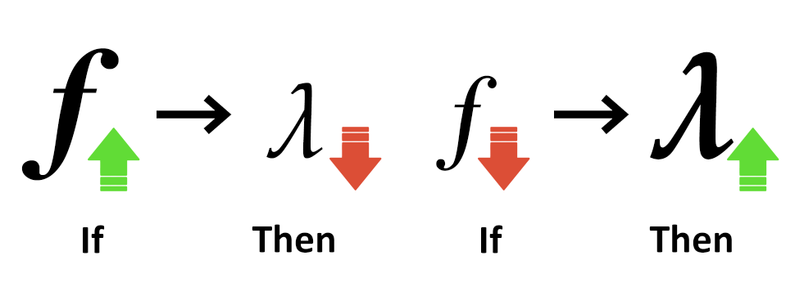
Important Relationships
When wave velocity doesn’t change, frequency and wavelength are inverse (if one decreases, the other increases).
If wave velocity decreases, frequency will remain the same and wavelength will decrease.

Slide 25
What is the Triangle of Power?
To solve for one of the variables, cover that letter. The remaining line separation and variables will help write the equation:
what you covered = remaining variables with the operator; a division symbol for a solid line and a multiplication symbol for a dotted line.
V
f
λ

Slide 26
Triangle of Power
To find the velocity of a wave:
Cover the V.
The solid line represents =
The dashed line represents multiplication.
V = f · λ
V
f
λ

Slide 27
Triangle of Power: Example with Numbers
Determine the velocity of a wave with a frequency of 500 Hz and a wavelength of 3 meters.
V
f
λ
Notes:
Add answer to the problem here.

Slide 28
Triangle of Power: Example with Numbers
Determine the velocity of a wave with a frequency of 500 Hz and a wavelength of 3 meters. V = f · λ
V = (500)(3)
V = 1500 m/s
V
f
λ
Notes:
Add answer to the problem here.

Slide 29
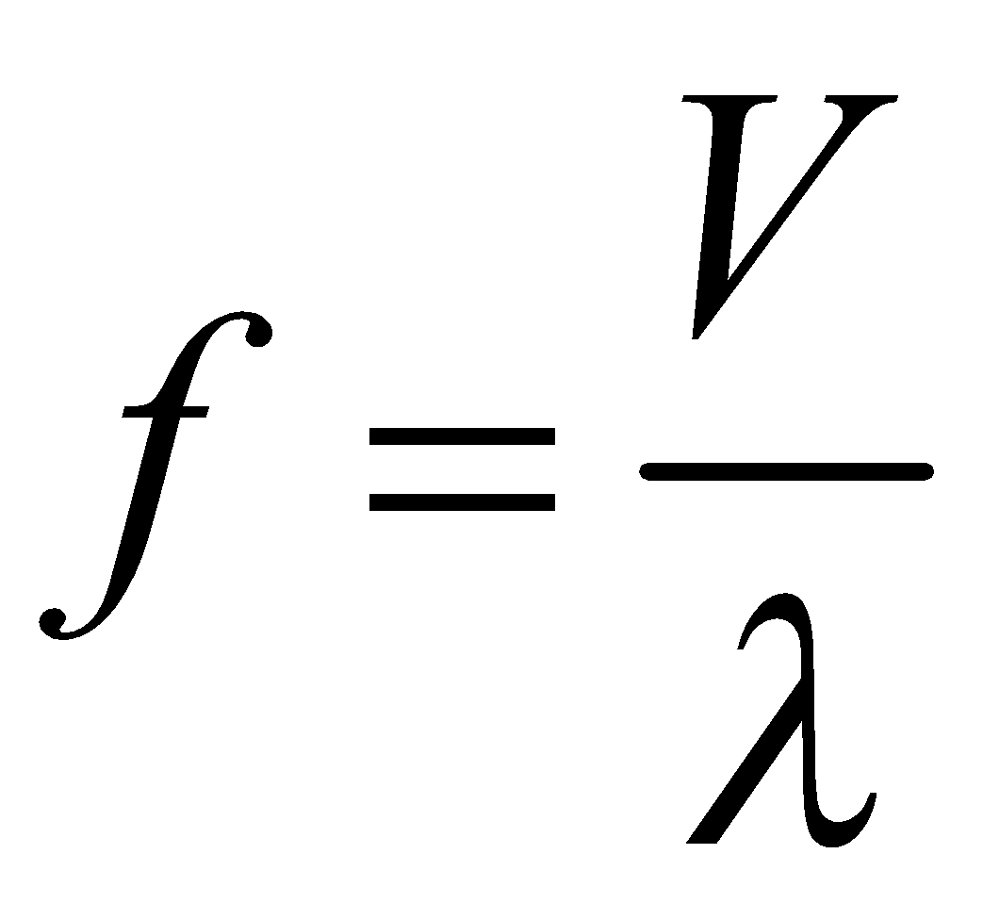
Triangle of Power
What if you have the velocity, and the wavelength, but not the frequency?
To find the frequency of a wave:
Cover the f.
The dashed line represents =
The solid line represents division.
V
f
λ

Slide 30
Triangle of Power: Example with Numbers
Determine the frequency of a wave with a velocity of 30 m/s and a wavelength of 3 meters.
V
f
λ
Notes:
Add answer to the problem here.

Slide 31
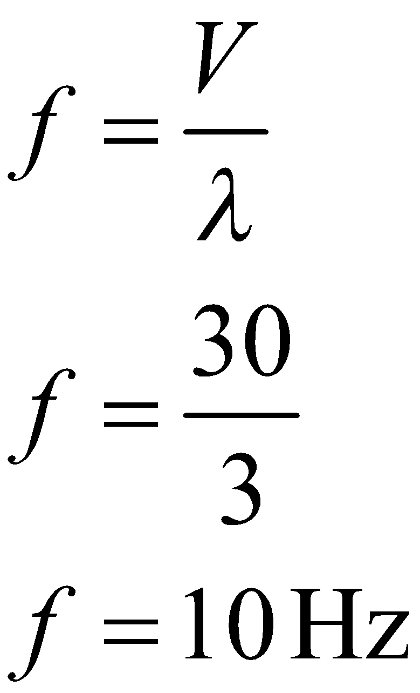
Triangle of Power: Example with Numbers
Determine the frequency of a wave with a velocity of 30 m/s and a wavelength of 3 meters.
V
f
λ
Notes:
Add answer to the problem here.

Slide 32
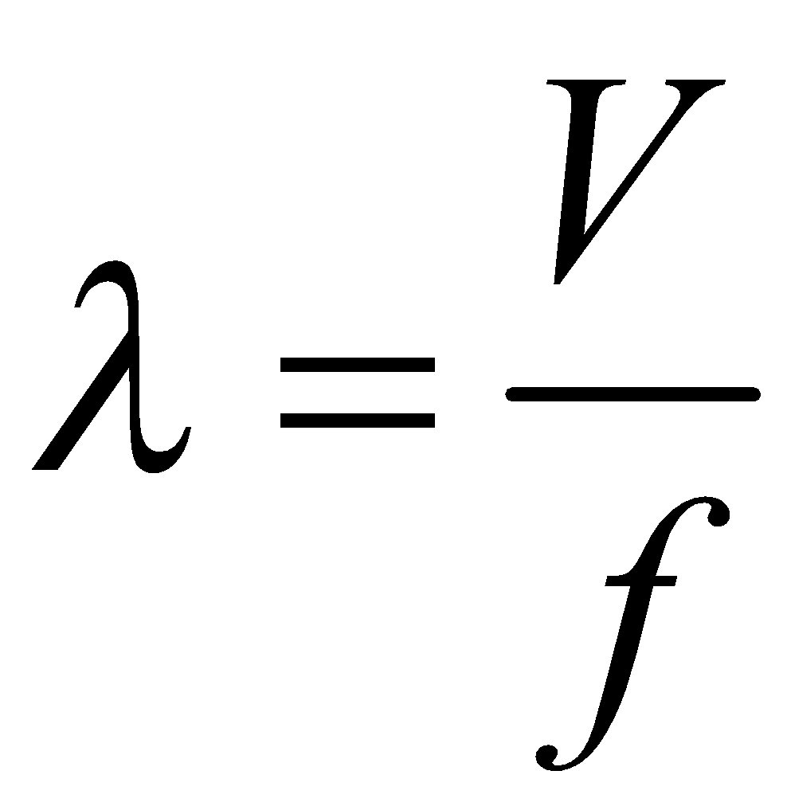
Triangle of Power
What if you have the velocity, and the frequency, but not the wavelength?
To find the wavelength of a wave:
Cover the λ.
The dashed line represents =
The solid line represents division.
V
f
λ

Slide 33
Triangle of Power: Example with Numbers
Determine the wavelength of a wave with a velocity of 100 m/s and a frequency of 50 Hz.
V
f
λ

Slide 34
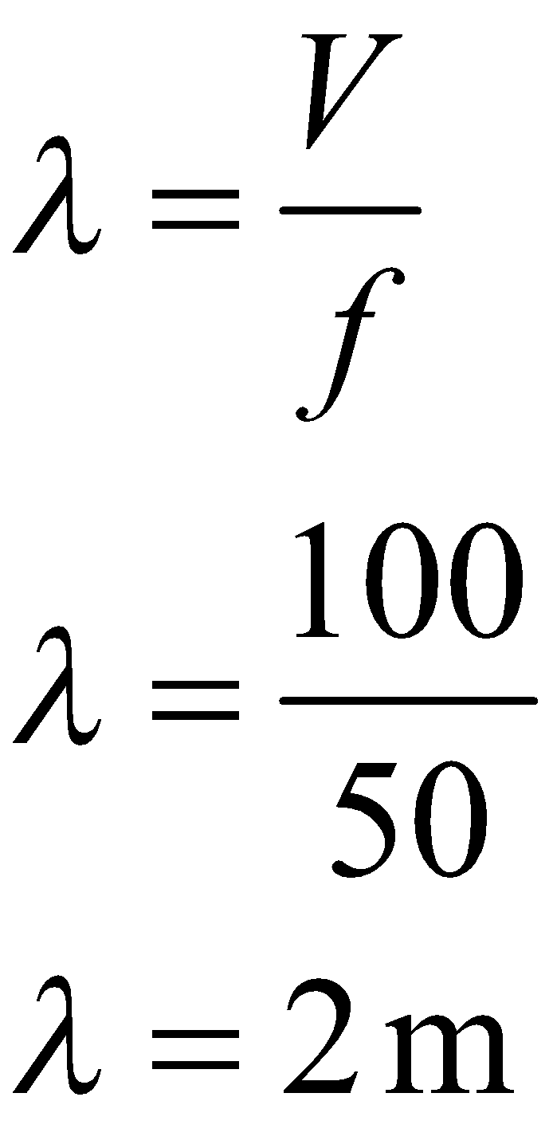
Triangle of Power: Example with Numbers
Determine the wavelength of a wave with a velocity of 100 m/s and a frequency of 50 Hz.
V
f
λ

Slide 35
Triangle of Power: Now you try!
Determine the frequency of a wave with a velocity of 60 m/s and a wavelength of 5 meters.
V
f
λ

Slide 36
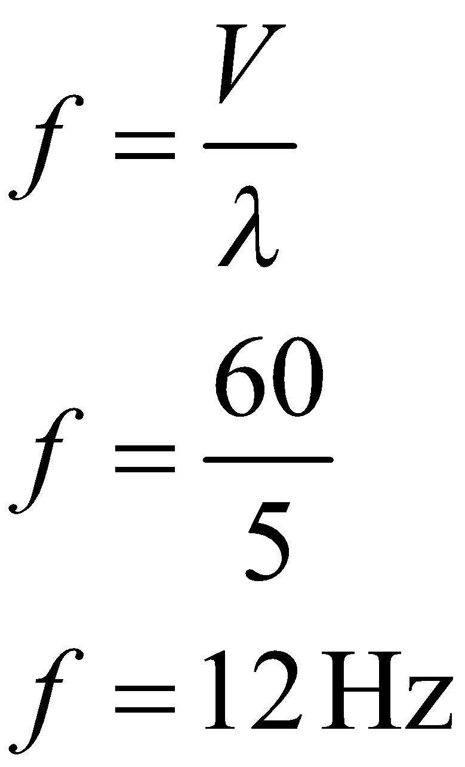
Triangle of Power: Now you try!
Determine the frequency of a wave with a velocity of 60 m/s and a wavelength of 5 meters.
V
f
λ

Slide 37
Muddiest Point
What is something that is a little “muddy” for you still?

Slide 38
Elbow Partner
Will the speed of sound vary for different musical notes (frequencies)?

Slide 39
Notes:
https://www.youtube.com/watch?v=sIopZnMLeQo&t=1s

Slide 40
Elbow Partner
Will the speed of sound vary for different musical notes (frequencies)?
Based on the video, has your answer to the question changed?
Why or why not?

Slide 41
Driving Question Board
Are there any questions on the Driving Question Board that we can answer right now?

Slide 42
Exit Ticket
In your own words, explain what this image signifies:
Solve the following problem:
A sound wave of frequency 440 Hz and wavelength of 3.4 meters travels through water. Determine the speed of sound in water.

