Slide 2
Not the Bermuda Triangle
What Is a Wave? Lesson 2

Slide 3
Essential Questions
What are waves?
How do waves behave differently from particles?

Slide 4
Lesson Objectives
Explain the relationship between velocity, frequency, and wavelength.
Understand that frequency and wavelength form an inverse relationship.
Understand the “triangle of power” to determine velocity, frequency, or wavelength of a wave.

Slide 5
What Do You Meme We Have Homework?
Share your meme with the class.

Slide 6
Strike Out!
While your classmates share their memes, keep a running list of key ideas or themes you notice.

Slide 7
Strike Out!
In your group:
Combine your lists of important ideas and themes.
Add these to the Strike Out! board.

Slide 8
Driving Question Board
Are there any questions on the Driving Question Board that we can answer right now?

Slide 9
What Is Velocity?
Velocity is the speed at which something travels. If we know the speed at which something was traveling and the total time the object was moving, we can determine the distance it traveled.

Slide 10
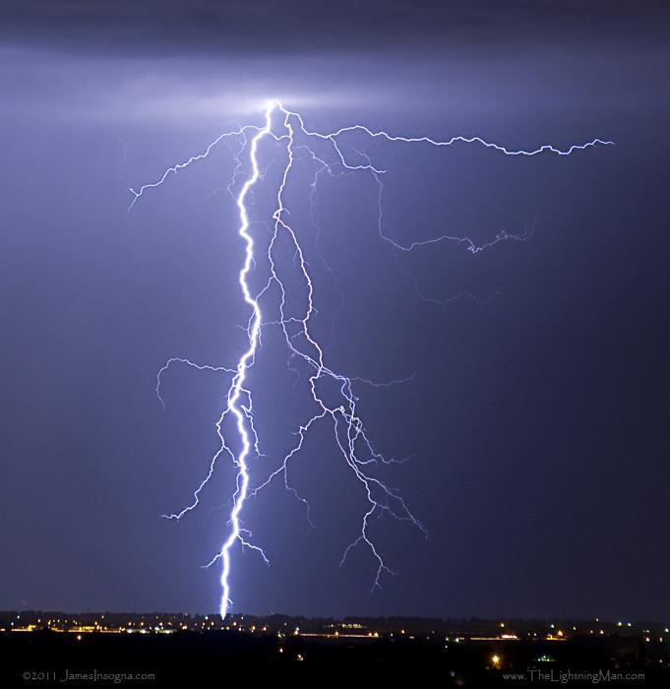
Distance From a Storm
Have you ever used lightning and thunder to determine how far away a storm is from you?
What did you do to figure out your distance from the storm?
Notes:
https://www.flickr.com/photos/thelightningman/6103581768

Slide 11
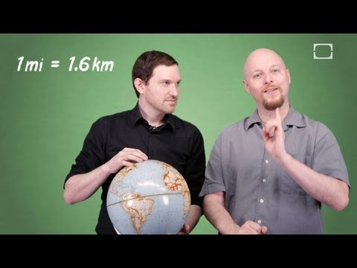
Notes:
[BrainStuff – HowStuffWorks]. (2013, July 5). How Can You Figure Out How Far Away Lightning Struck? [Video]. YouTube. https://www.youtube.com/watch?v=2P7nODA4rrc

Slide 12
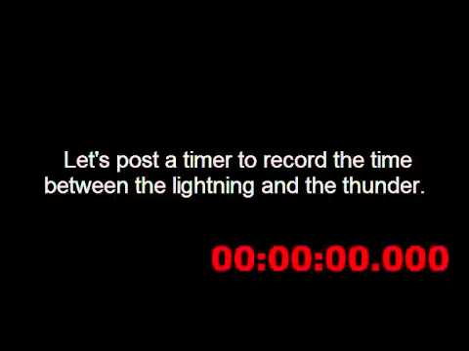
Distance = Velocity · Time
You have previously read that the speed of sound is 338 m/s. Watch the video to find the time needed to calculate the distance between you and the storm.
Notes:
Fay, Aaron. [Aaron Fay]. (2015, May 13). Speed of Sound – Lightning 13May15 [Video]. YouTube. https://www.youtube.com/watch?v=3TXJ2sk02JA

Slide 13
How far away was the lightning strike from the camera?
You know that the speed of sound is 338 m/s, and the time it took to hear the thunder after seeing lightning was 7.1 seconds.
Notes:
https://www.flickr.com/photos/thelightningman/6103581768

Slide 14
Distance = Velocity · Time
Distance = (338m/s)(7.1s)
Distance ≈ 2400m
Notes:
https://www.flickr.com/photos/thelightningman/6103581768

Slide 15
Pipelinefunk
What information from this video would you need to confirm that the speed of sound is 338 m/s?
Notes:
Küpper, Armin. [Armin Küpper]. (2020, June 9). PIPELINEFUNK – concert/ Saxophone Jame with a Crazy Natural Echo from the Pipeline / Armin Küpper. [Video]. YouTube. https://www.youtube.com/watch?v=p8GcHoSIPDg

Slide 16
Use the estimated time of 1.15 seconds and the distance down the pipe and back of 389 m to confirm the speed of sound is 338 m/s.

Slide 17
Use the estimated time of 1.15 seconds and the distance down the pipe and back of 389 m to confirm the speed of sound is 338 m/s.

Slide 18
What About Sound?
Frequency is measured in waves per second.
Wavelength is measured in meters.
How do you think we could calculate the velocity of a sound wave using these new words?
Hint: Think about the units we use to measure them.

Slide 19
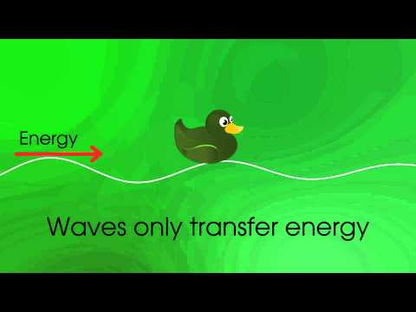
Wave Vocabulary
As the video plays, add the definitions and images to your graphic organizer.
Notes:
[expertmathstutor]. (2014, Jan 2). Physics- Waves- Introduction [Video]. YouTube. https://www.youtube.com/watch?v=RVyHkV3wIyk

Slide 20
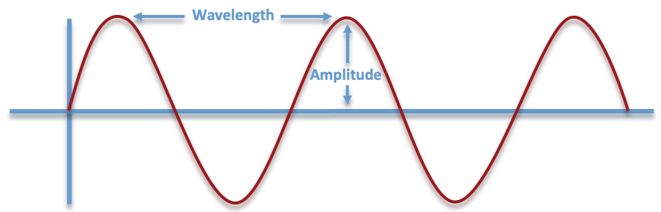
Wavelength
The horizontal distance between the start and endpoints of one full wave cycle; measured in meters (m).

Slide 21
Amplitude
The vertical height of a wave, measured from the center line to the top of a peak or the bottom of a trough; measured in meters (m).

Slide 22
Frequency
The number of wavelengths that passes a fixed point in one second; measured in hertz (Hz).
Frequency 🕐

Slide 23
The Wave Equation
Velocity = Frequency · Wavelength
V = f · λ
Velocity is represented by a V
Frequency is represented by f
Wavelength is represented by λ

Slide 24
What Is the Triangle of Power?
To solve for one of the variables, cover that letter. Use the remaining variables—and take note of the type of line separating them—to help you write the equation.
The variable you covered = the remaining variables either divided or multiplied by each other; for the purposes of the triangle, a horizontal line is a division symbol, while a vertical line is a multiplication symbol.
V
f
λ

Slide 25
Triangle of Power
To find the velocity of a wave:
Cover the V
The solid line represents =
The dashed vertical line represents multiplication
V = f · λ
V
f
λ

Slide 26
Triangle of Power: Example With Numbers
Determine the velocity of a wave with a frequency of 500 Hz and a wavelength of 3 meters.
V
f
λ
Notes:
Add answer to the problem here.

Slide 27
Triangle of Power: Example With Numbers
Determine the velocity of a wave with a frequency of 500 Hz and a wavelength of 3 meters. V = f · λ
V = (500)(3)
V = 1500 m/s
V
f
λ
Notes:
Add answer to the problem here.

Slide 28
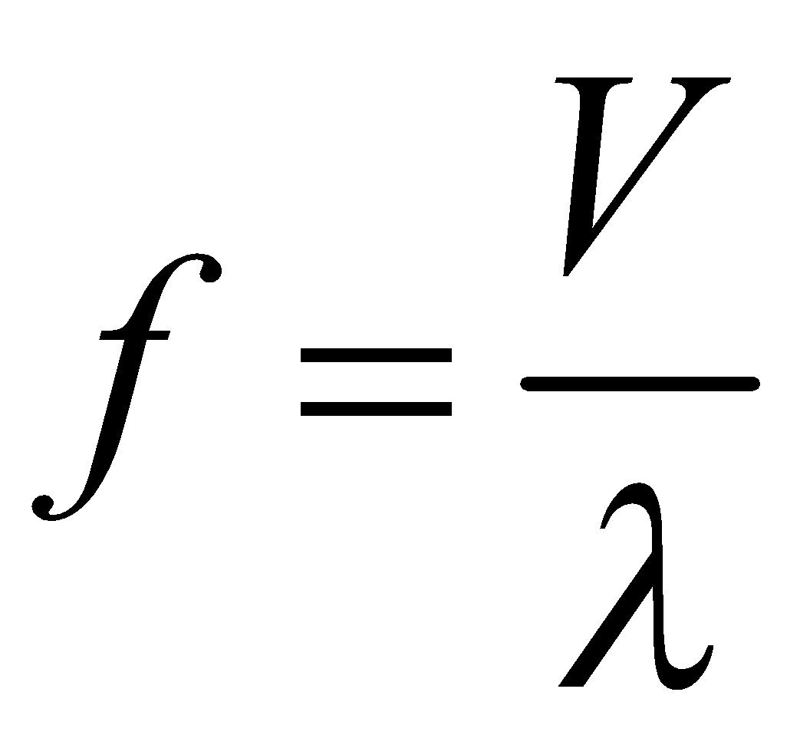
Triangle of Power
What if you have the velocity and the wavelength, but not the frequency?
To find the frequency of a wave:
Cover the f
The dashed line represents =
The solid horizontal line means division
V
f
λ

Slide 29
Triangle of Power: Example With Numbers
Determine the frequency of a wave with a velocity of 30 m/s and a wavelength of 3 meters.
V
f
λ
Notes:
Add answer to the problem here.

Slide 30
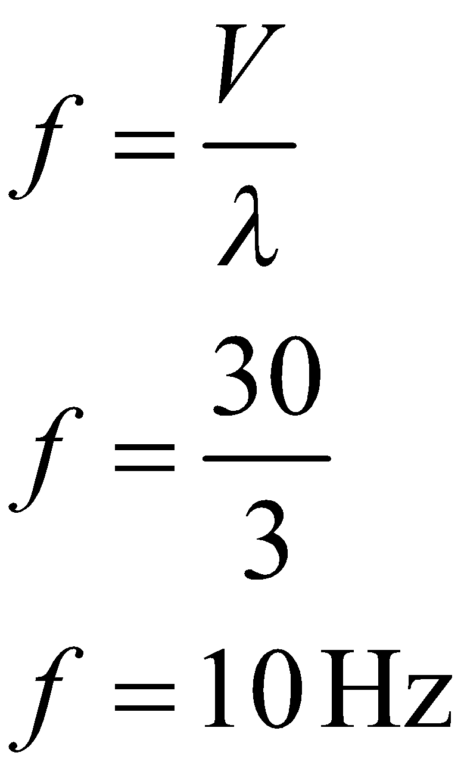
Triangle of Power: Example With Numbers
Determine the frequency of a wave with a velocity of 30 m/s and a wavelength of 3 meters.
V
f
λ
Notes:
Add answer to the problem here.

Slide 31
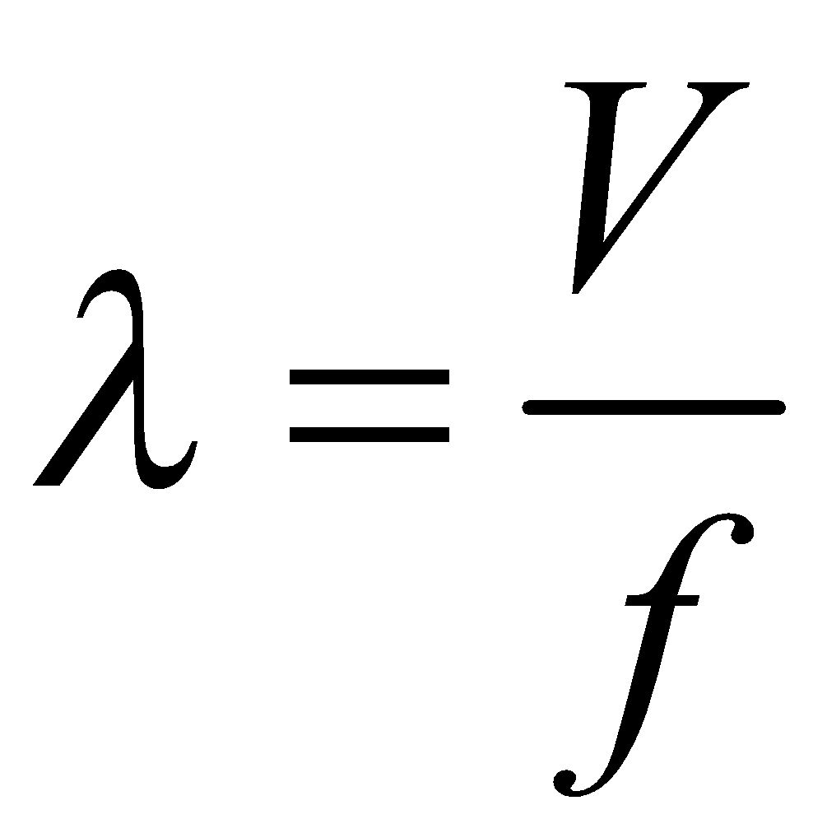
Triangle of Power
What if you have the velocity and the frequency, but not the wavelength?
To find the wavelength:
Cover the λ
The dashed line represents =
The solid horizontal line means division
V
f
λ

Slide 32
Triangle of Power: Example With Numbers
Determine the wavelength of a wave with a velocity of 100 m/s and a frequency of 50 Hz.
V
f
λ

Slide 33
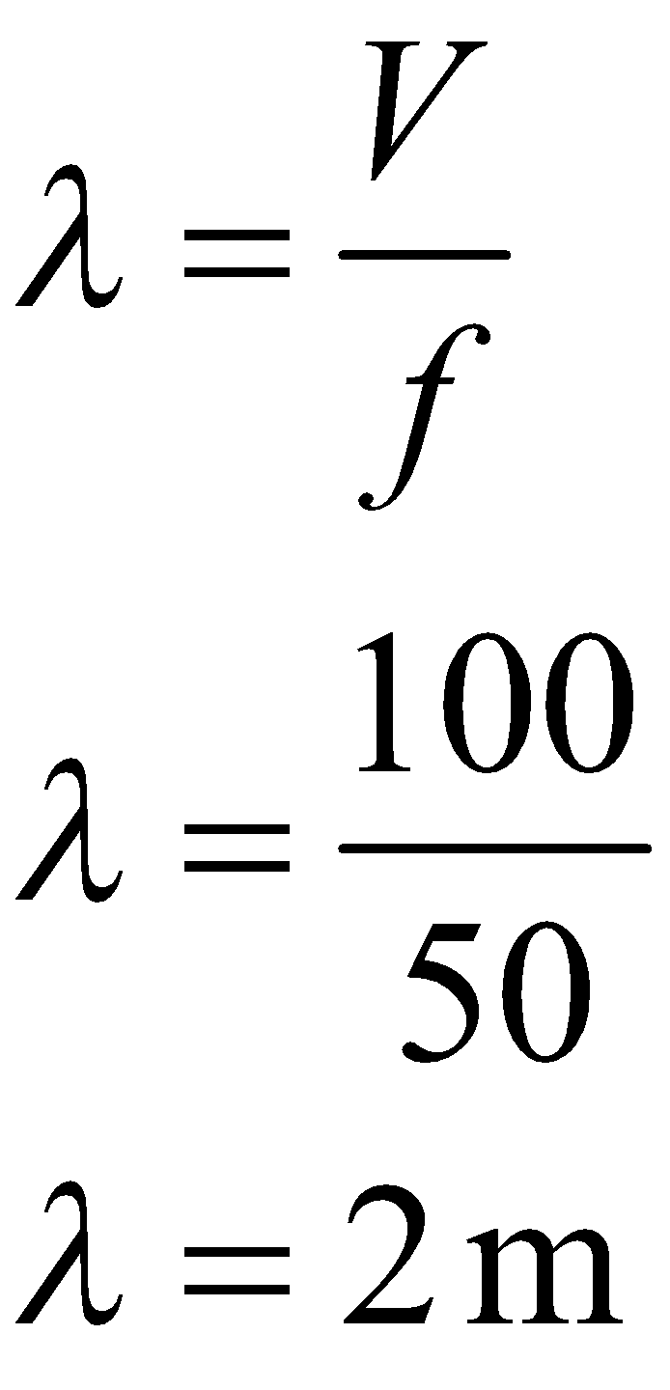
Triangle of Power: Example With Numbers
Determine the wavelength of a wave with a velocity of 100 m/s and a frequency of 50 Hz.
V
f
λ

Slide 34
Triangle of Power: Now You Try!
Determine the frequency of a wave with a velocity of 60 m/s and a wavelength of 5 meters.
V
f
λ

Slide 35
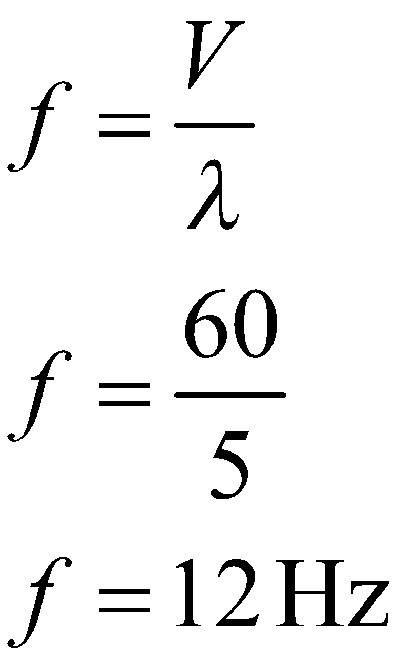
Triangle of Power: Now You Try!
Determine the frequency of a wave with a velocity of 60 m/s and a wavelength of 5 meters.
V
f
λ

Slide 36
Muddiest Point
What is something that is a little “muddy” for you still?

Slide 37
Will the speed of sound vary for different musical notes (frequencies)?

Slide 38
Notes:
Stanford, Nigel John. [Nigel John Stanford] (2014, Nov 12). Cymatics: Ruben’s Tube Vs. Tesla Coil [Video]. YouTube. https://www.youtube.com/watch?v=sIopZnMLeQo

Slide 39
Elbow Partner
Will the speed of sound vary for different musical notes (frequencies)?
Based on the video, has your answer to the question changed?
Why or why not?

Slide 40
Driving Question Board
Are there any questions on the Driving Question Board that we can answer right now?

Slide 41
Exit Ticket
In your own words, explain what this image signifies:
f → λ f → λ
Solve the following problem:
A sound wave of frequency 440 Hz and wavelength of 3.4 meters travels through water. Determine the speed of sound in water.

