Slide 2
Designing Your Area
Area and Perimeter of Regular Polygons

Slide 3
Essential Question
How do you find the area of any regular polygon?

Slide 4
Lesson Objectives
Apply properties of polygons to solve problems.
Solve real-world and mathematical problems involving area and perimeter.

Slide 5

Composite Figures
Find the area and perimeter
of each figure.
  Be sure to show your thinking.
When you have finished, find another pair to discuss…
  your results.
  your process, how you found your results.

Slide 6
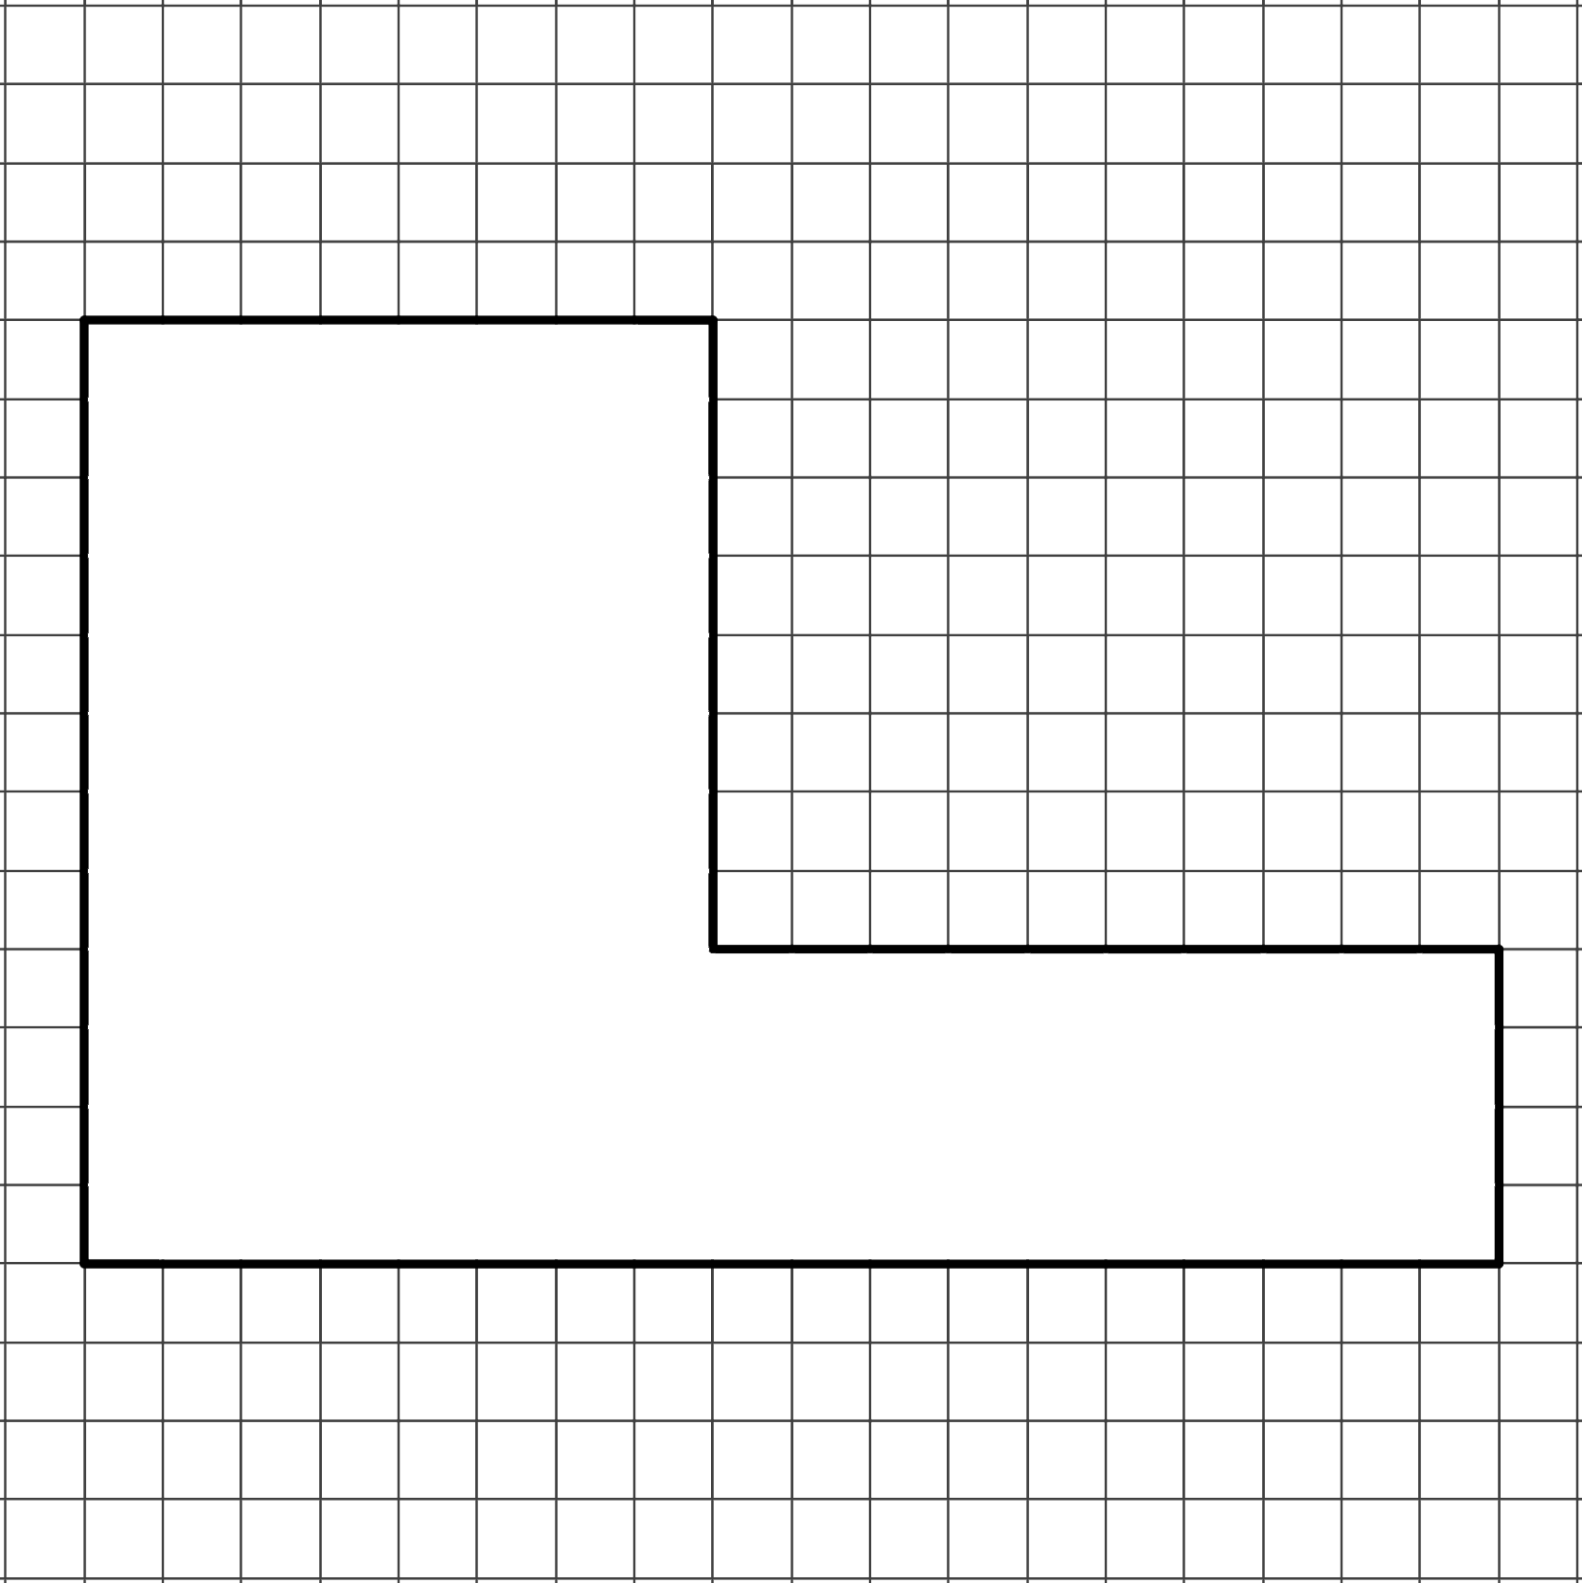
Composite Figures (Solution #1)

Slide 7
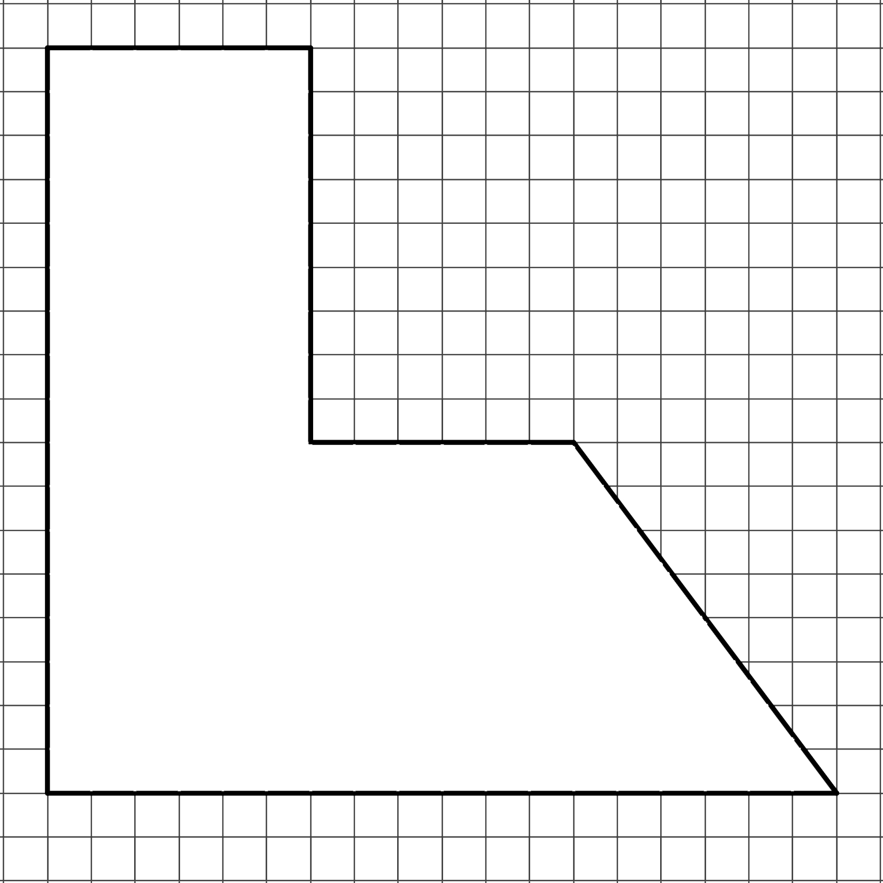
Composite Figures (Solution #2)

Slide 8
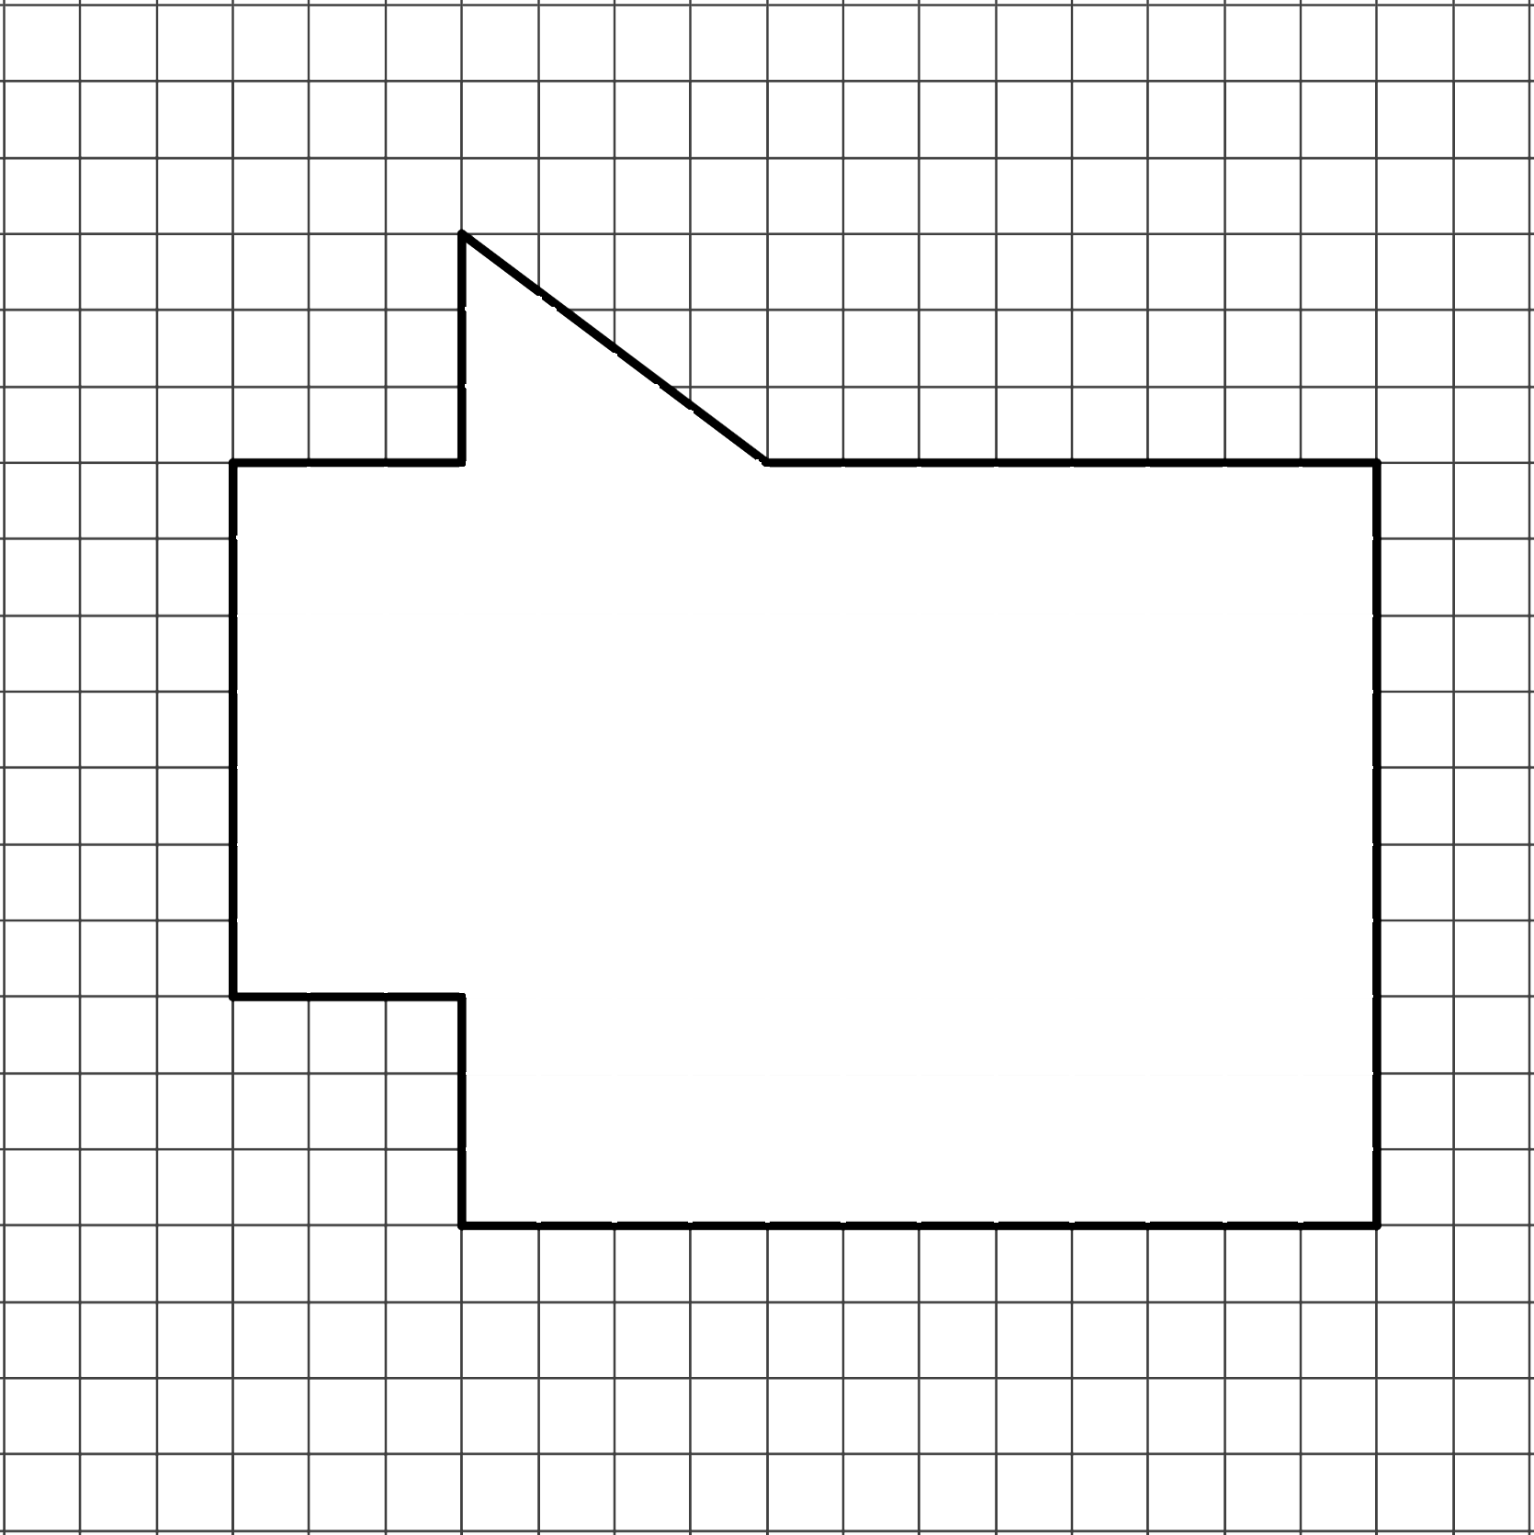
Composite Figures (Solution #3)

Slide 9
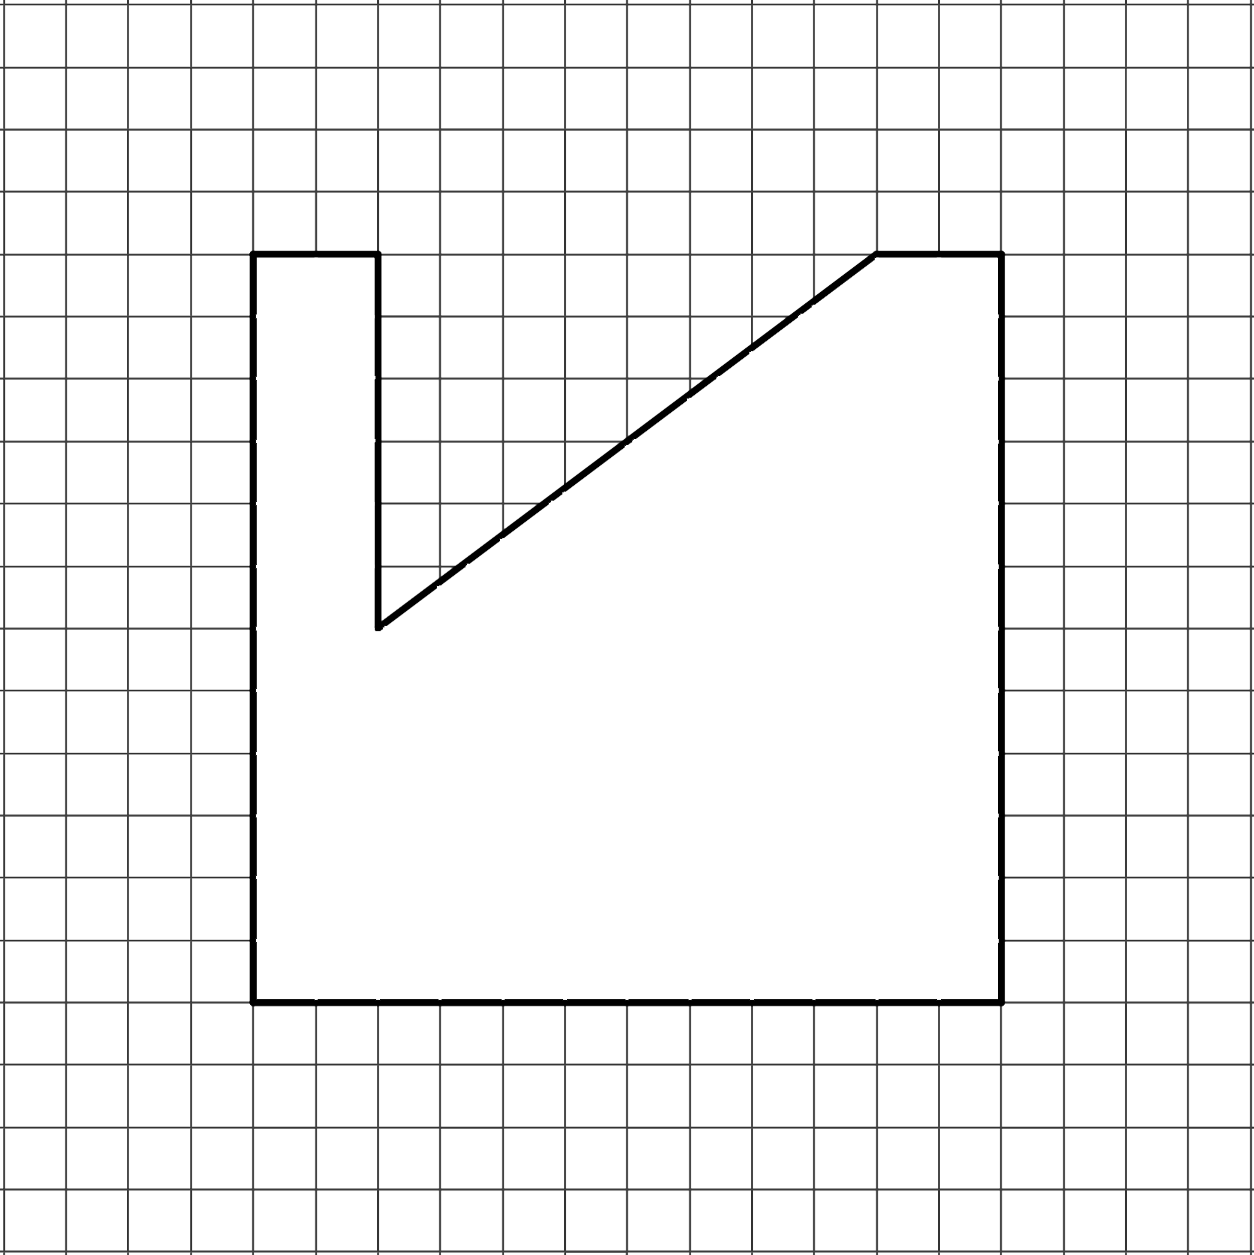
Composite Figures (Solution #4)

Slide 10
GeoGebra Activity
How do we find the area of regular polygons?
Go to https://www.geogebra.org/m/x4tsbeuz and complete the Exploring Patterns handout with your partner.
  Read through and follow the directions in the activity.

Slide 11
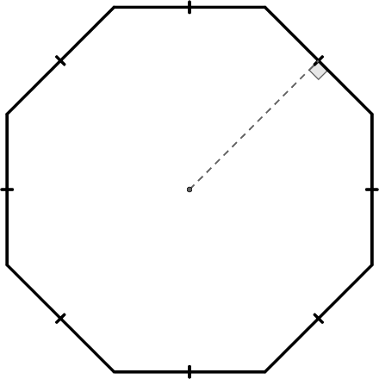
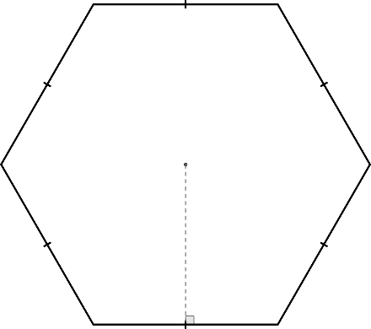
Guided Notes
Let’s complete the Guided Notes together.
apothem
side length

Slide 12
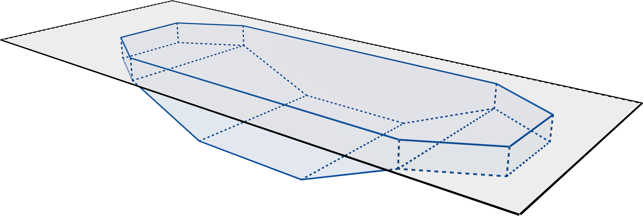
Polygon Pool Party
Apply what you have learned to the Polygon Pool Party handout.
  Find the area of each
  surface of the pool.
  Determine the cost of the tile,
  based on the total area.
  Calculate the square footage of the concrete patio.

Slide 13
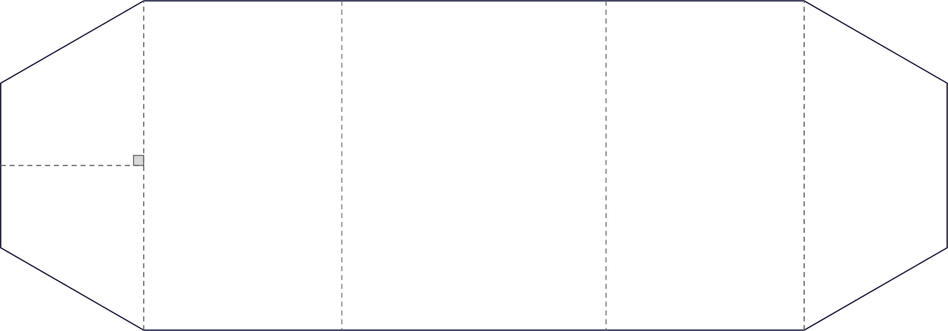
Polygon Pool Party (Solution – Bottom)
Area of the Bottom
of the Pool =

Slide 14
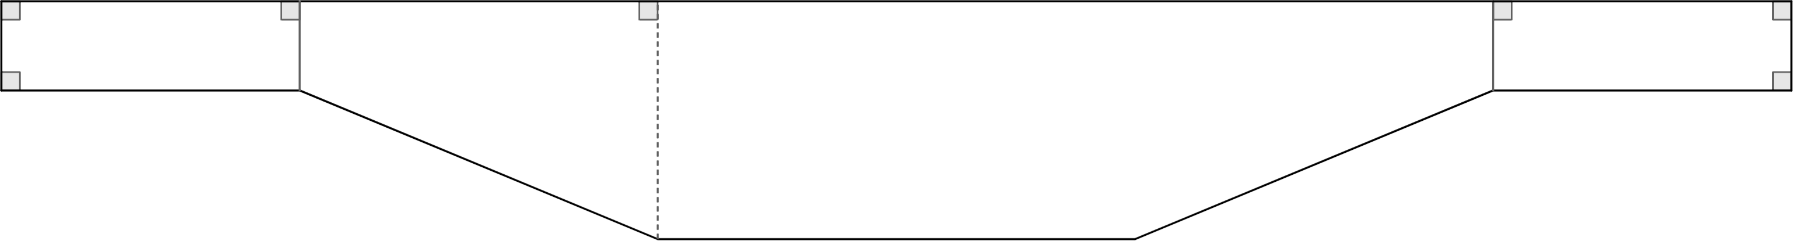
Polygon Pool Party (Solution – Right Side)
Area of the Left Side
of the Pool =

Slide 15

Polygon Pool Party (Solution – Front Side)
Area of the Front Side
of the Pool =

Slide 16
Polygon Pool Party (Solution)
Surface | Square Footage (Area)
Bottom
Right Side
Left Side
Front Side
Back Side
Total Area:
x (Cost of Tile)
Total Cost:

Slide 17
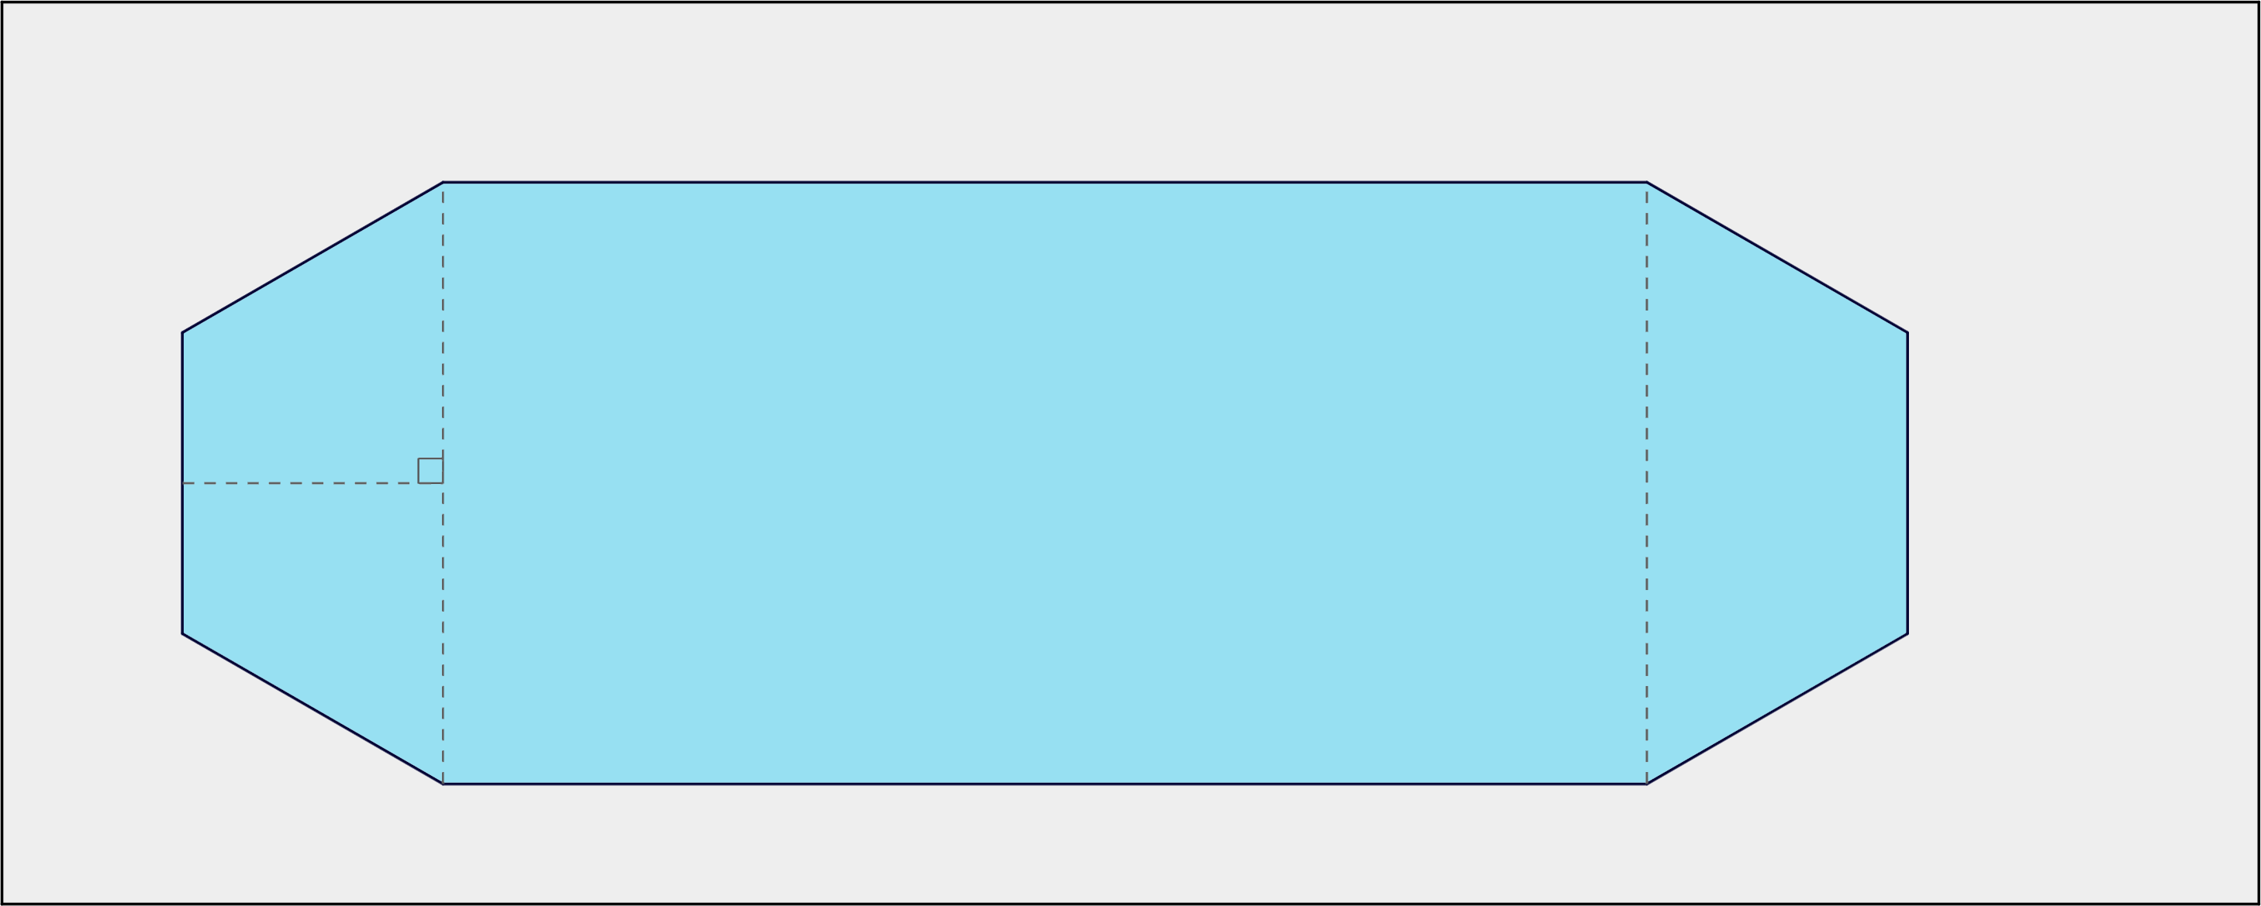
Polygon Pool Party (Solution – Bottom)
Area of the
Concrete Patio =

Slide 18
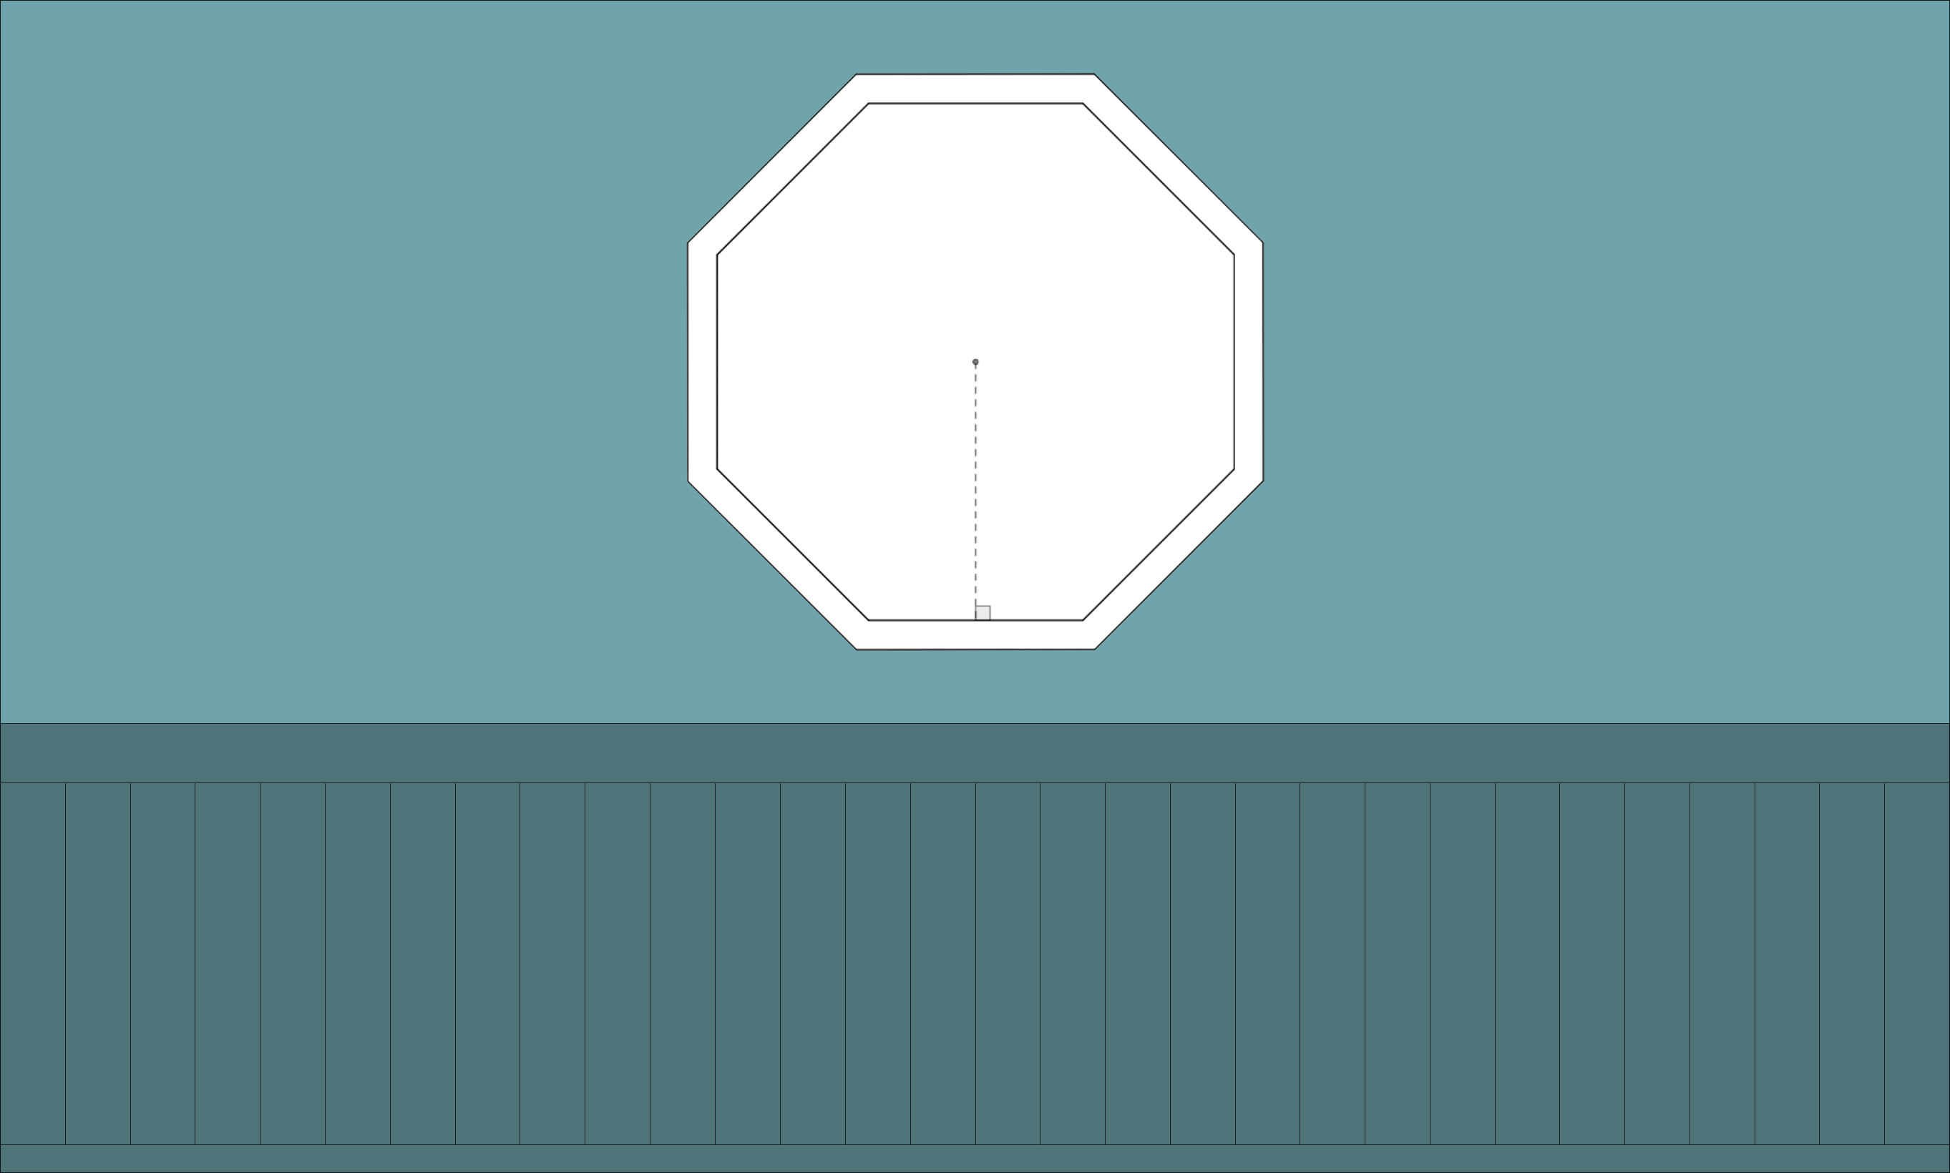

DIY Mirror
Apply what you have learned to the DIY Mirror handout
  Determine the measurements of the frame to buy just enough supplies.

Slide 19
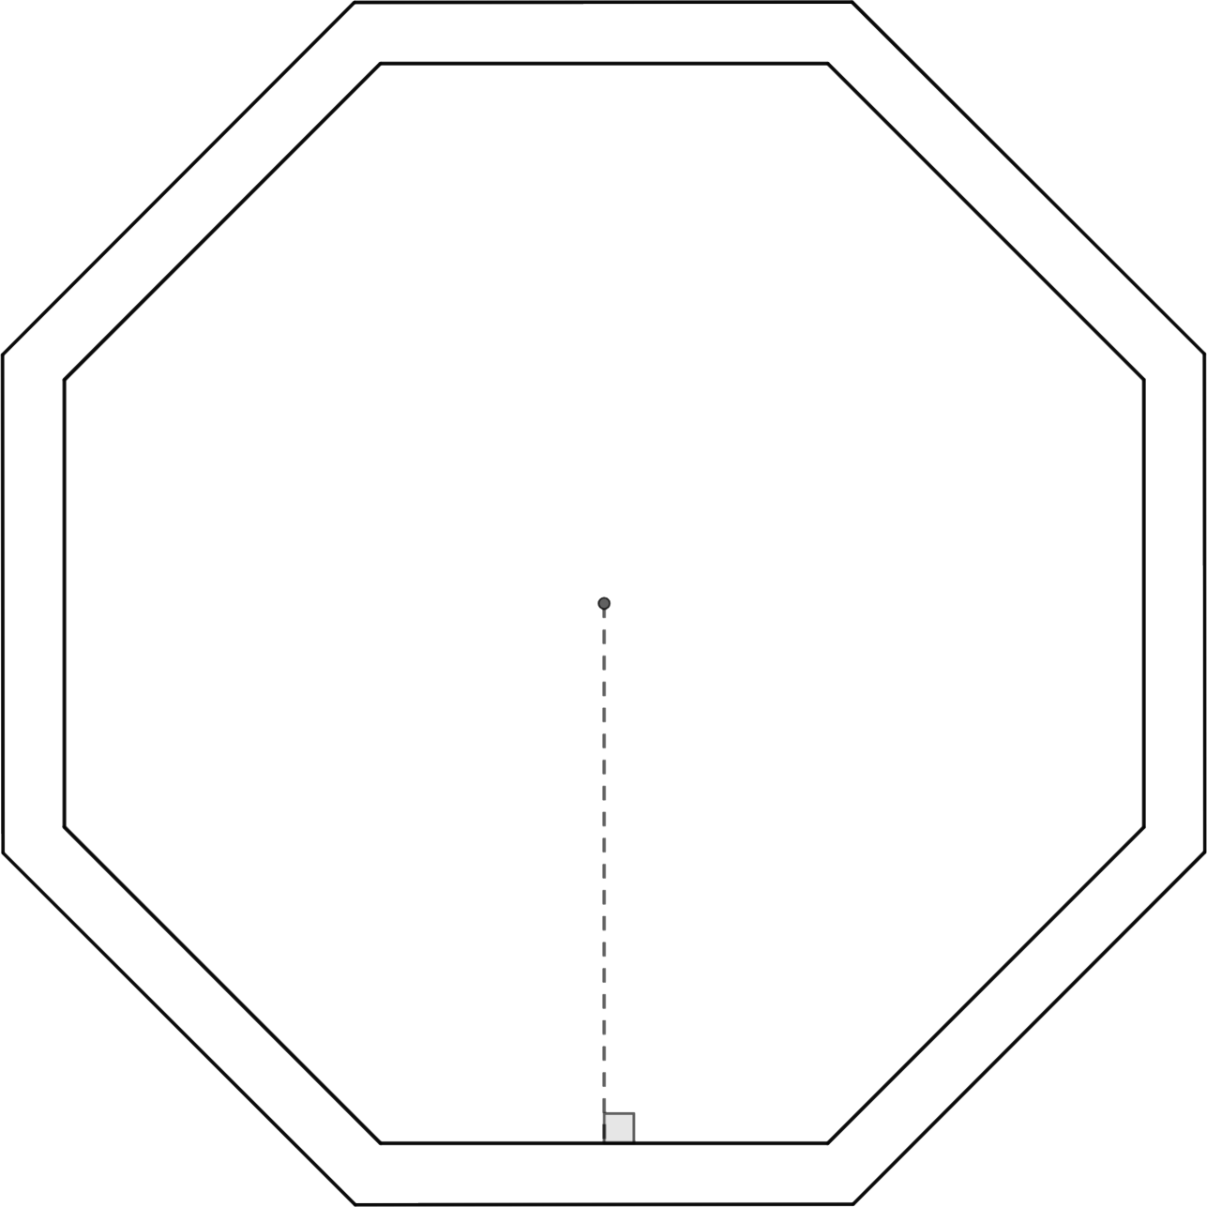
DIY Mirror (Solution)
Length of Trim = Perimeter

Slide 20
DIY Mirror (Solution)

