Slide 2
A Perfect Match
Congruent Polygons

Slide 3
Essential Question
How do the properties of congruent polygons help us solve problems?

Slide 4
Lesson Objectives
Analyze and solve rigorous mathematical problems using properties of congruent polygons.
Use algebraic and logical reasoning to solve mathematical problems.

Slide 5
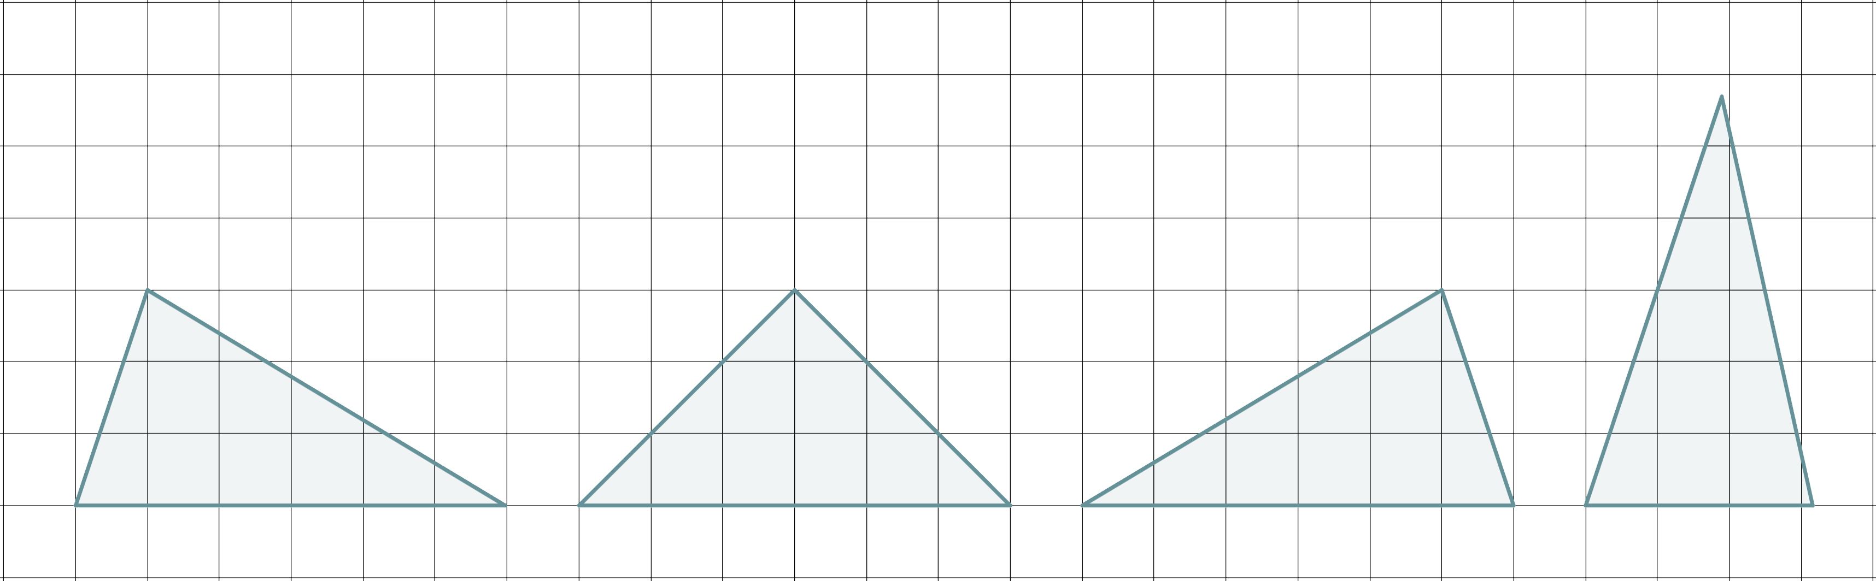
Not Like the Others
Which triangle is not like the others?
  Explain your reasoning.

Slide 6
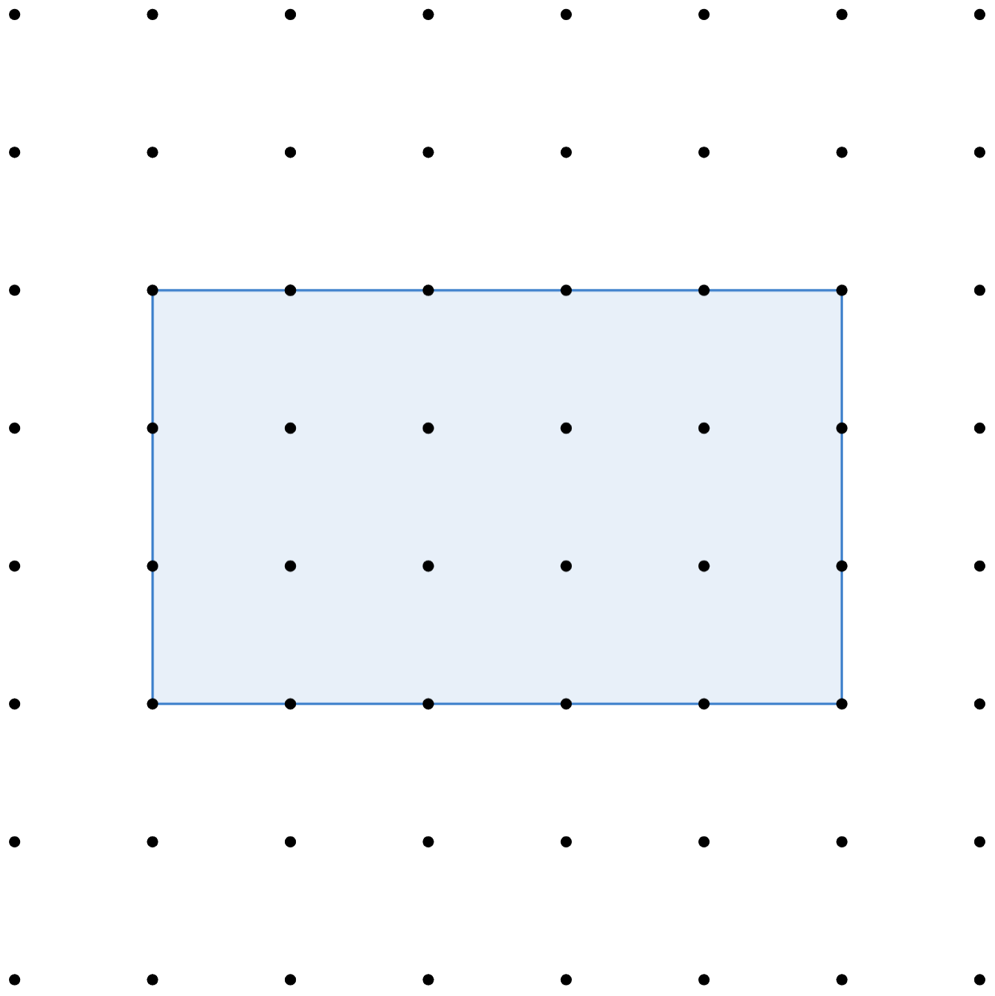
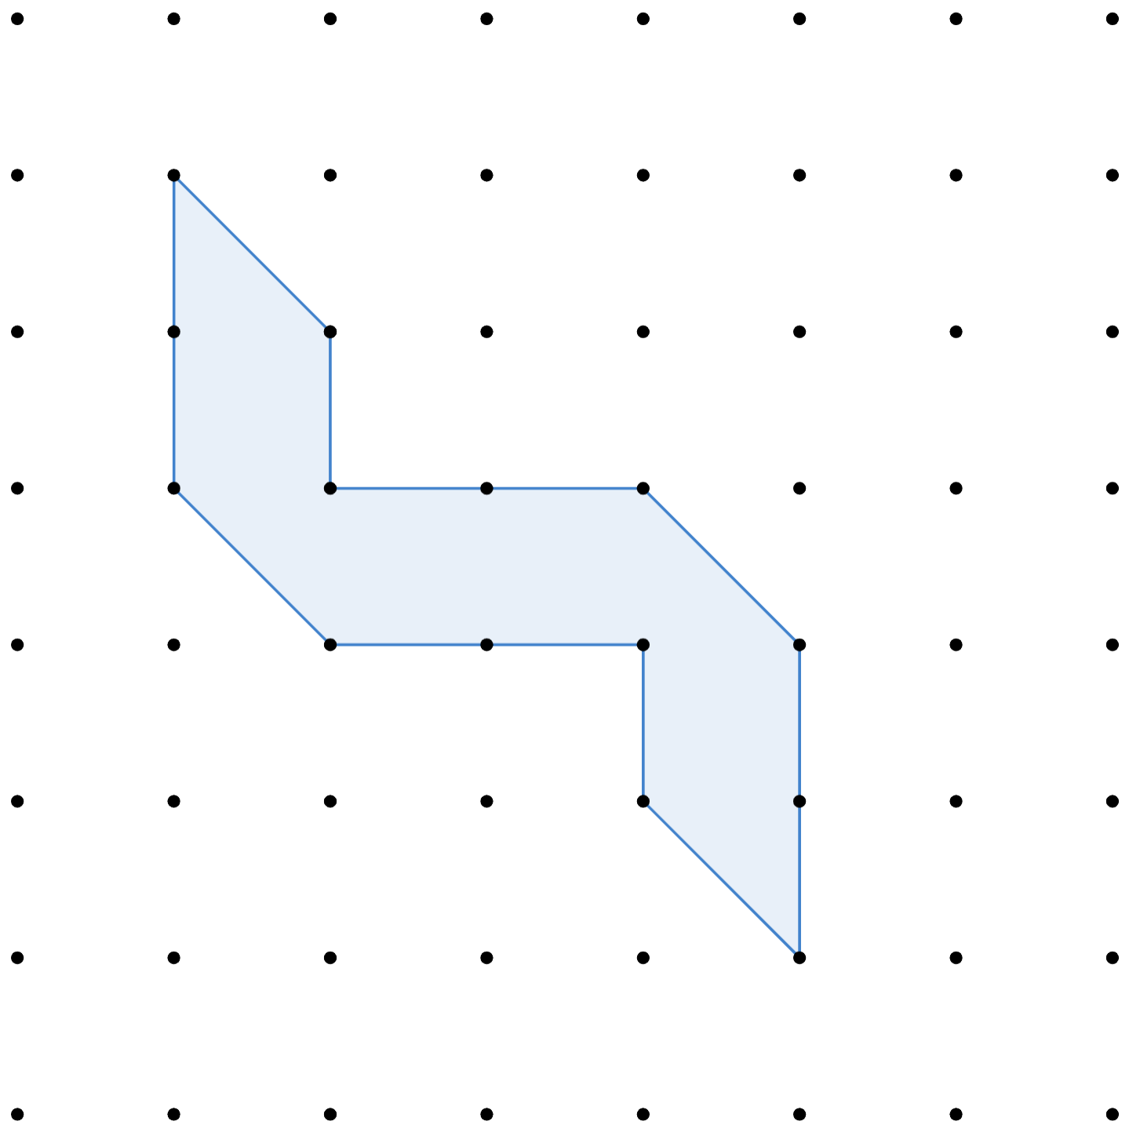
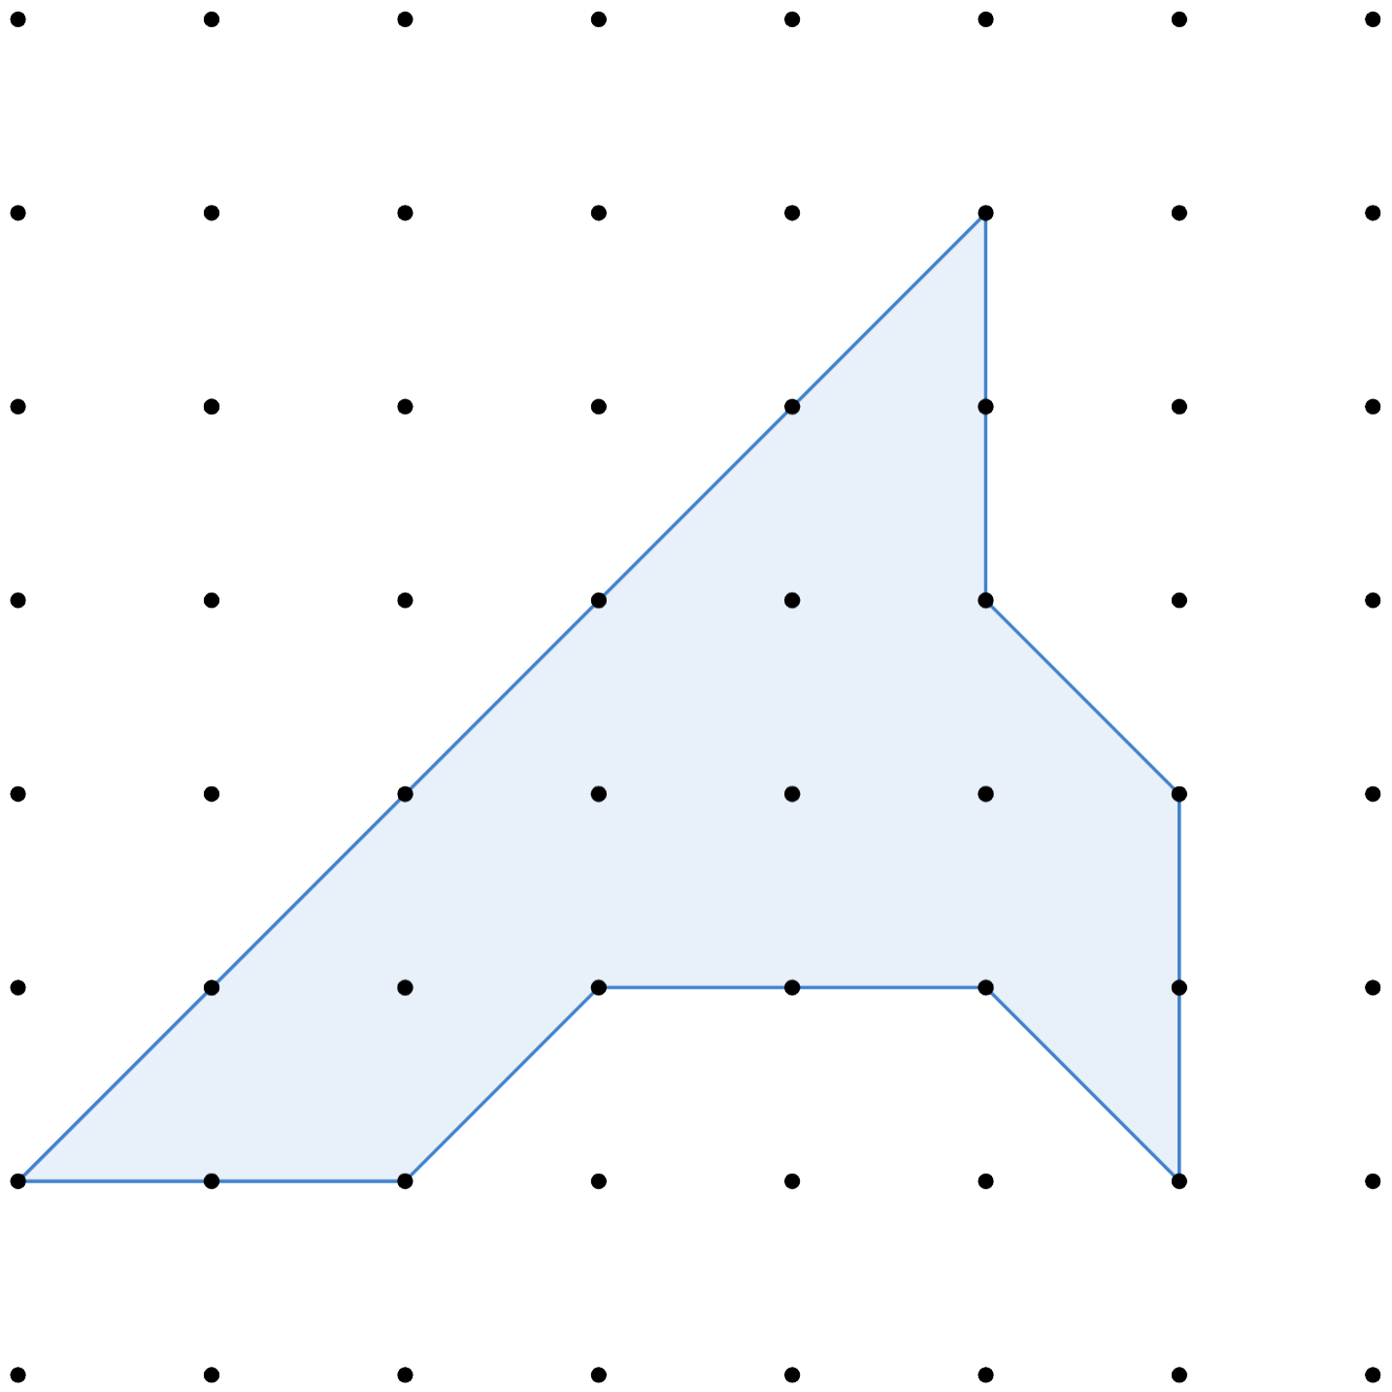
Equal Halves
Draw 1 line segment to divide each polygon into 2 congruent polygons.

Slide 7
Equal Halves – 1 (Solution)

Slide 8
Equal Halves – 2 (Solution)

Slide 9
Equal Halves – 3 (Solution)

Slide 10
Guided Notes
Let’s complete the Congruent Polygons guided notes together.
  You’ll need 5 different colors.

Slide 11
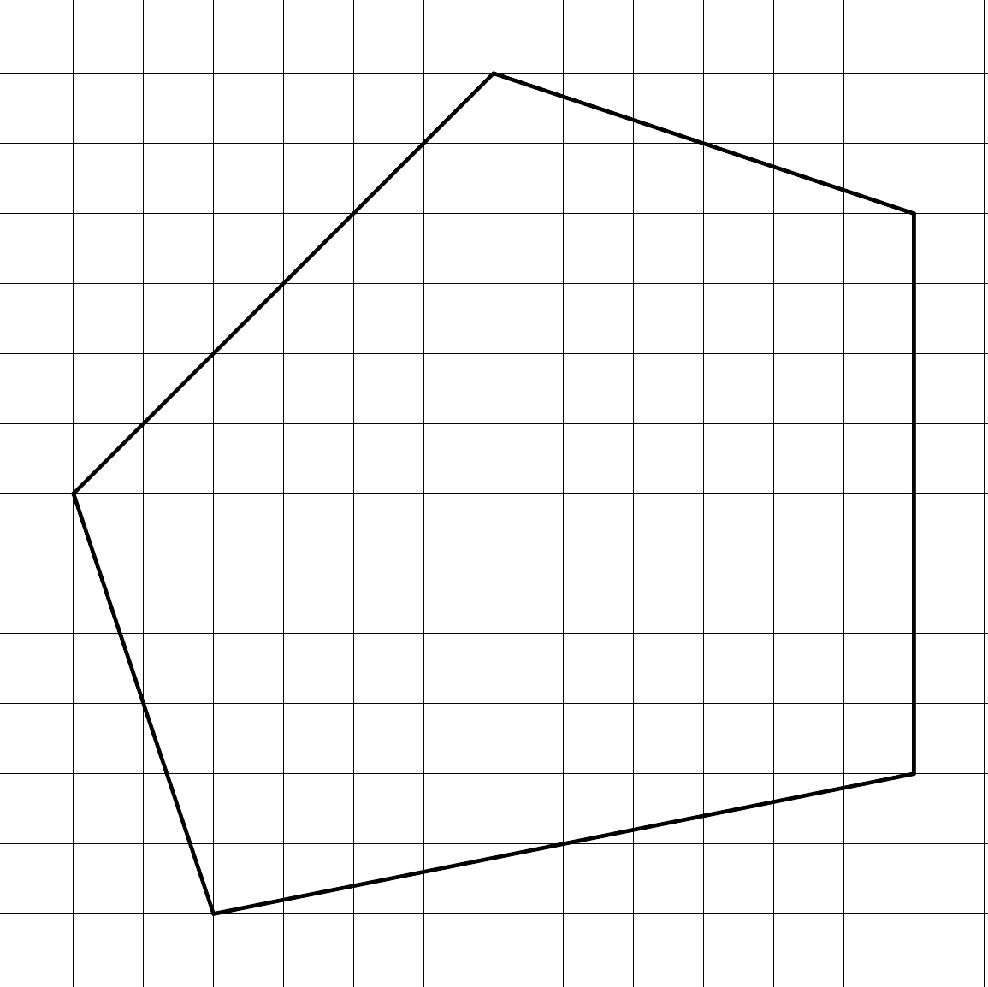
Congruent Polygons – Guided Notes
Use a different color to trace each side of Polygon ABCDE.

Slide 12
Congruent Polygons – Guided Notes
Use a different color to trace each side of Polygon ABCDE.

Slide 13
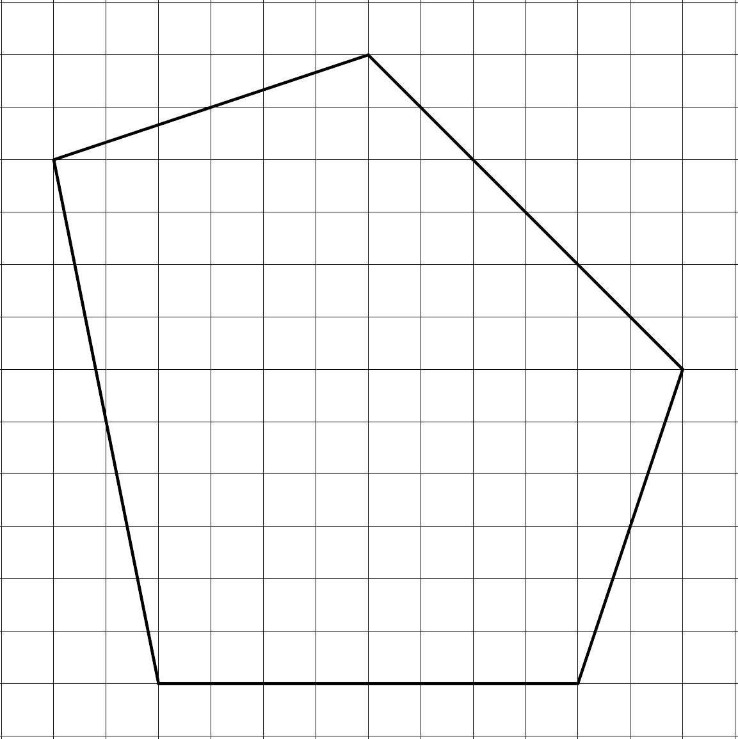
Congruent Polygons – 90° CW
Use those same 5 colors to show the corresponding sides of the new polygon.
  Trace the corresponding sides with the same color.
  Label the corresponding angles with the same angle measurement.

Slide 14
Congruent Polygons – 90° CW

Slide 15
Congruent Polygons – 90° CW

Slide 16
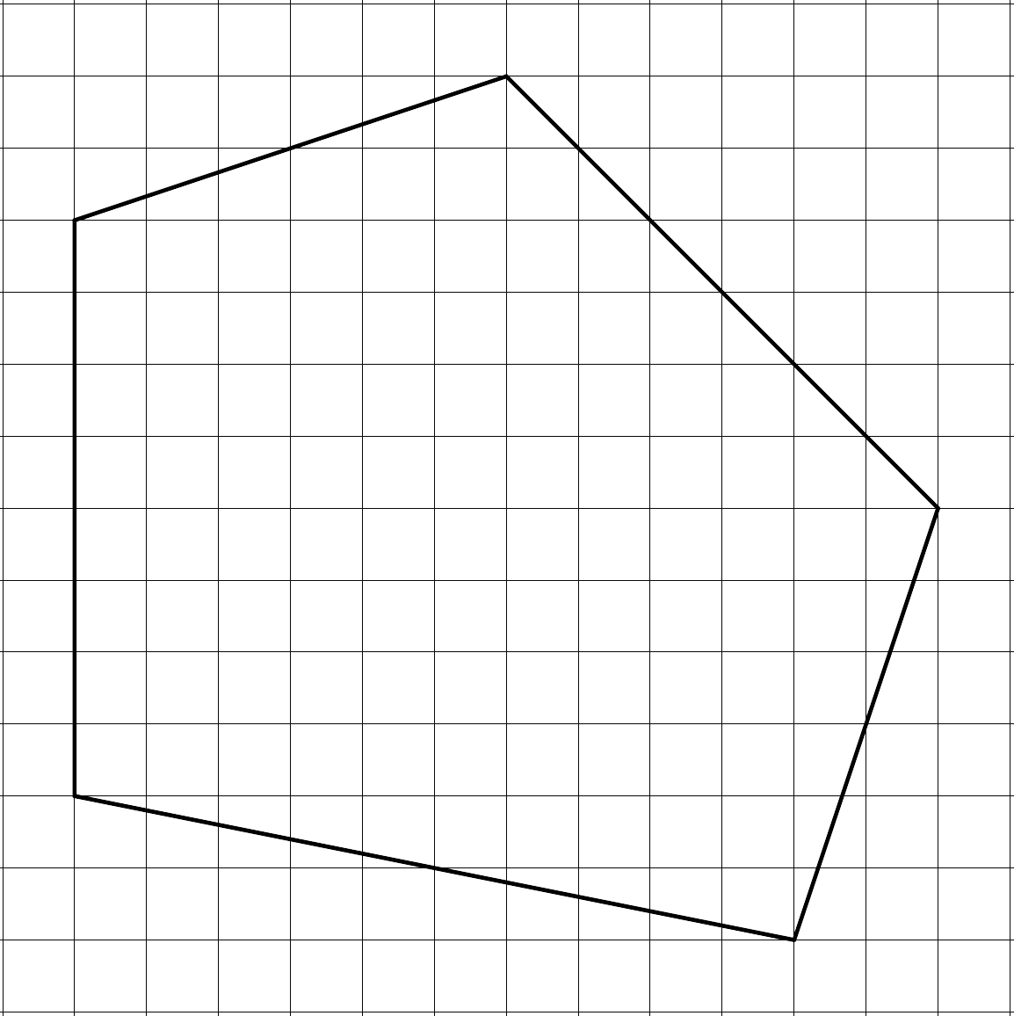
Congruent Polygons – Horizontal Reflection
Use those same 5 colors to show the corresponding sides of the new polygon.
  Trace the corresponding sides with the same color.
  Label the corresponding angles with the same angle measurement.

Slide 17
Congruent Polygons – Horizontal Reflection

Slide 18
Congruent Polygons – Horizontal Reflection

Slide 19
Congruent Polygons – Horizontal Reflection

Slide 20
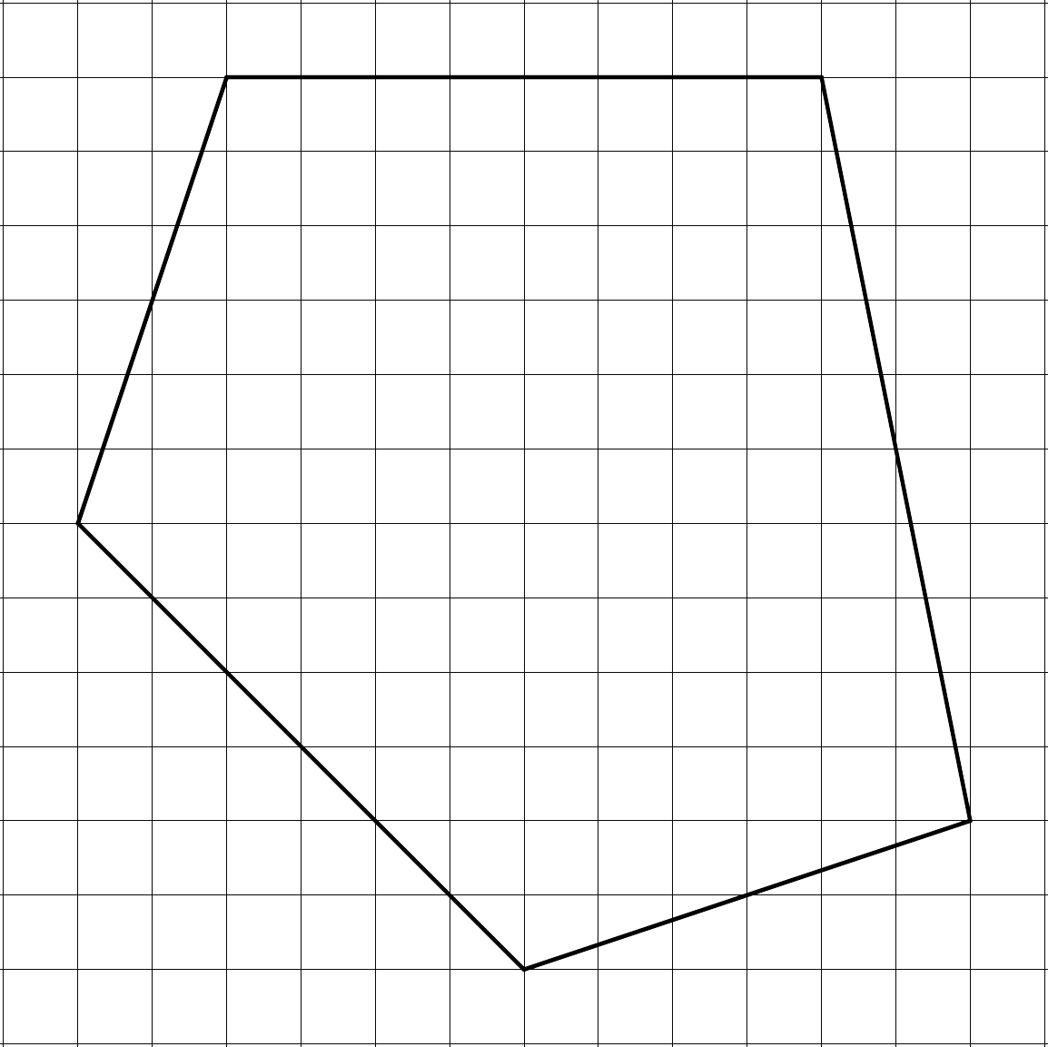
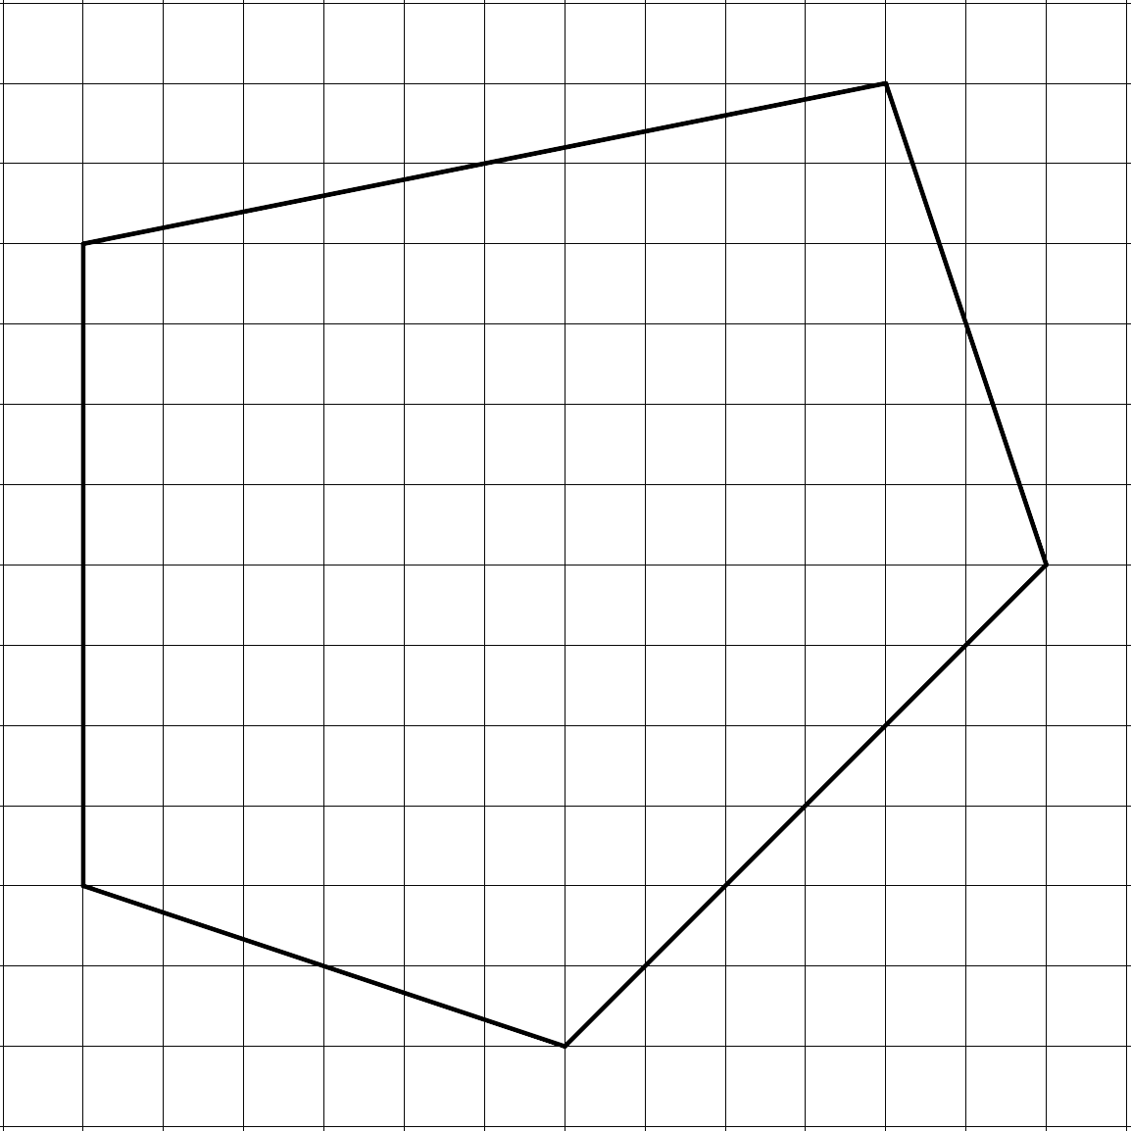
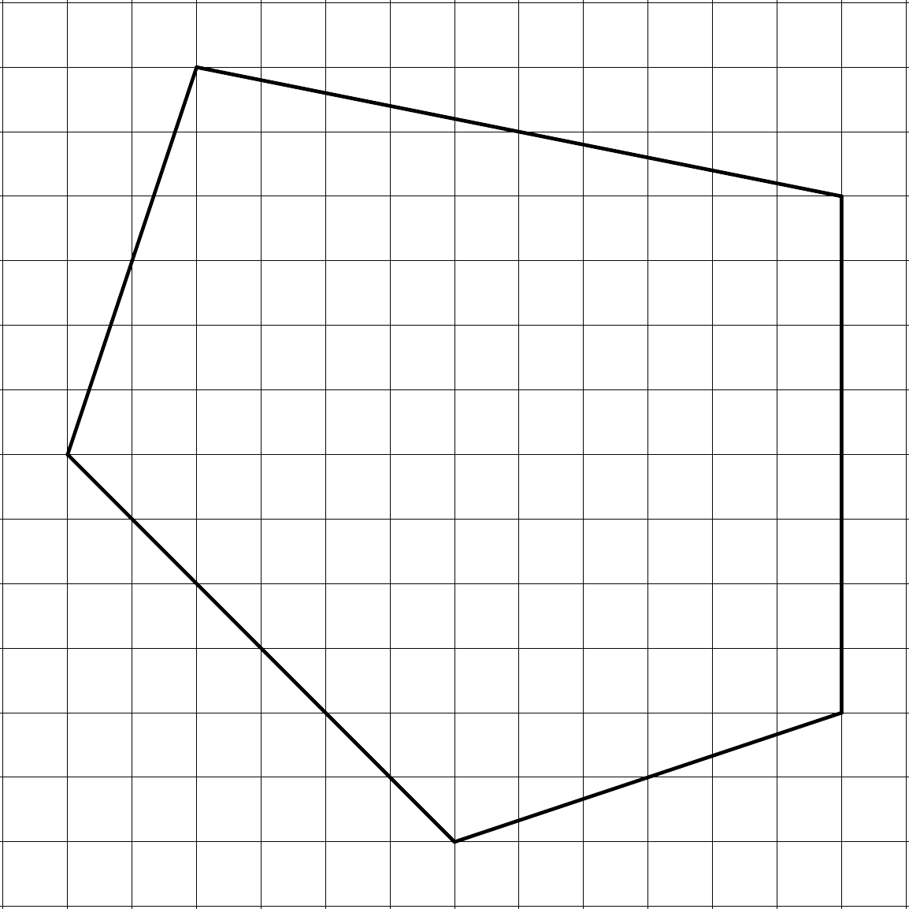
Congruent Polygons – Guided Notes
Continue with the remaining polygons.

Slide 21
Congruent Polygons – 90° CCW

Slide 22
Congruent Polygons – 180° CW

Slide 23
Congruent Polygons – Vertical Reflection

Slide 24
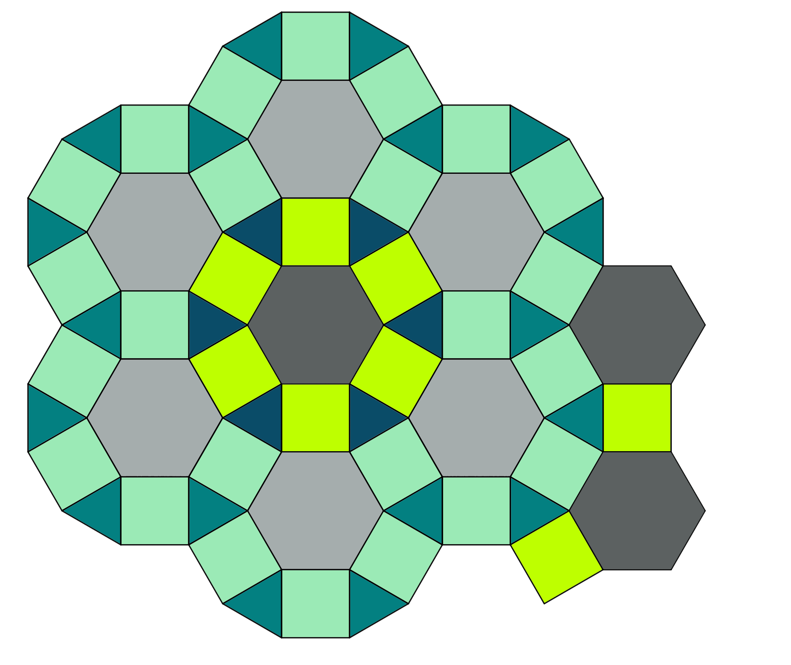
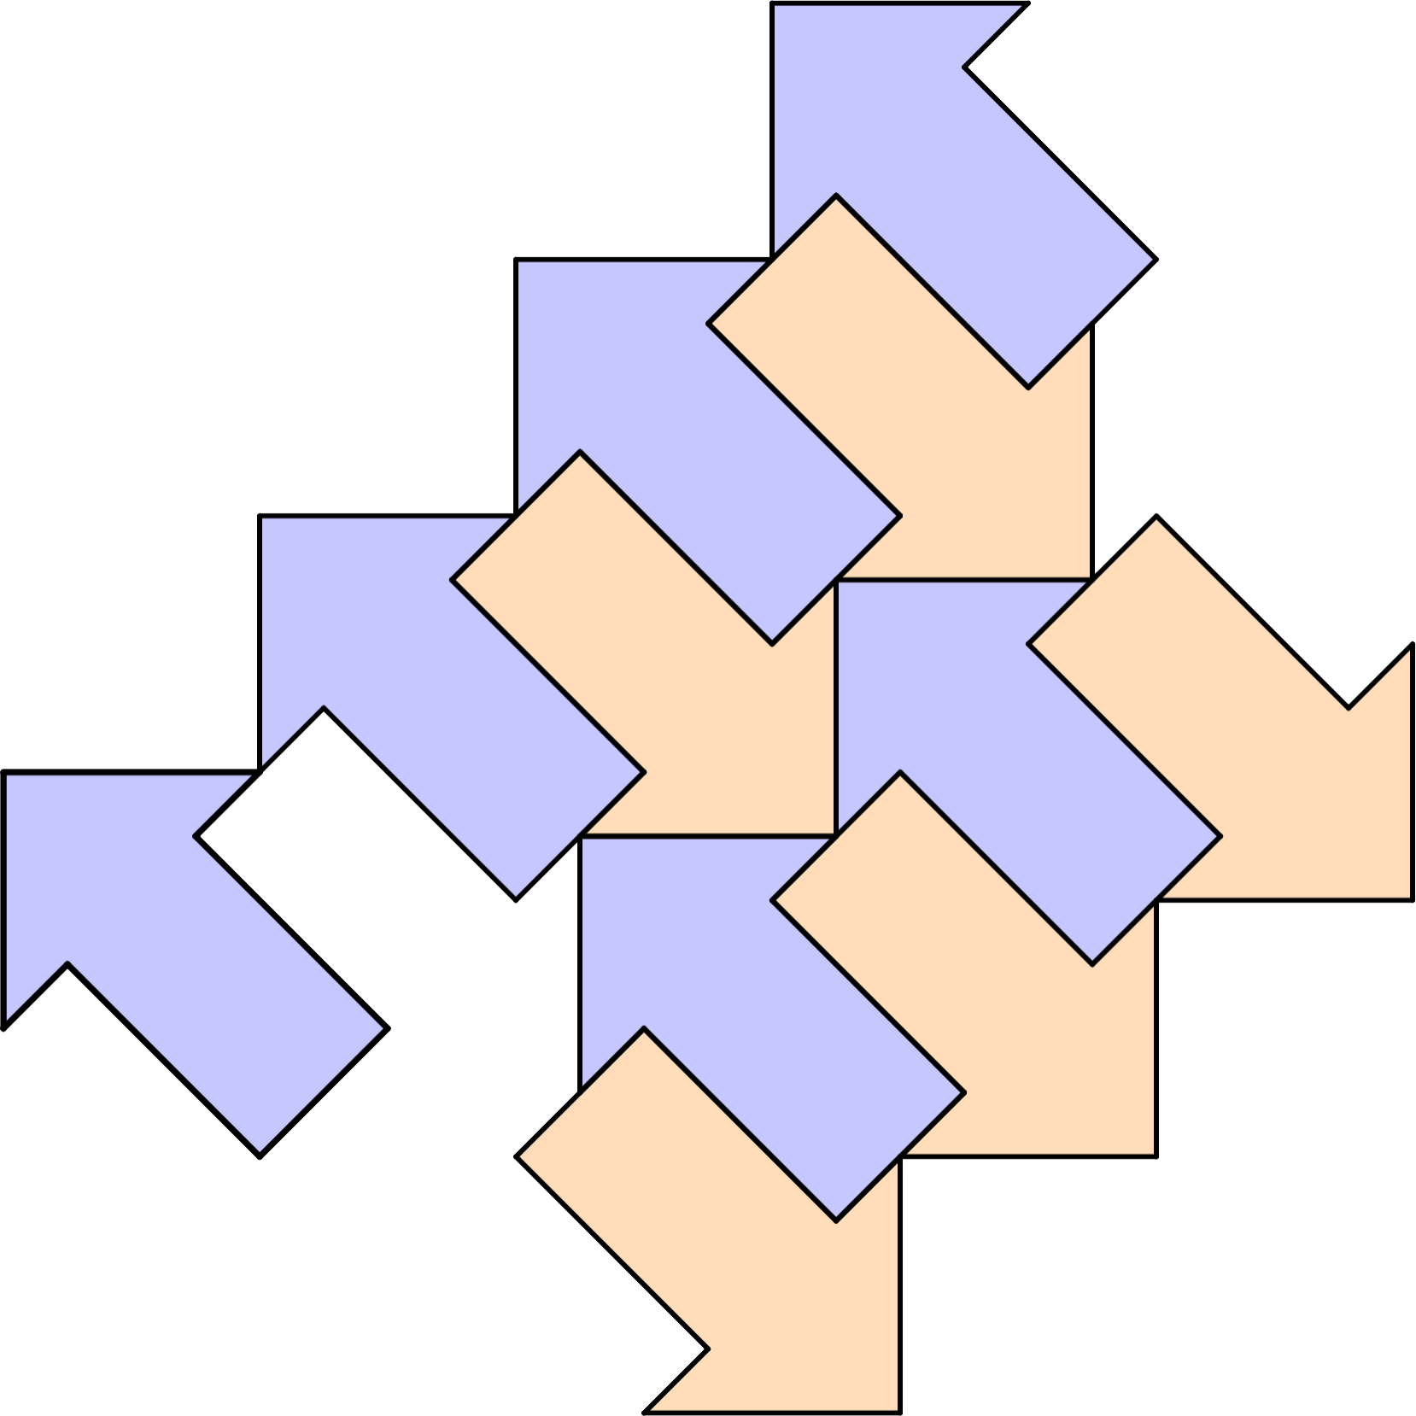
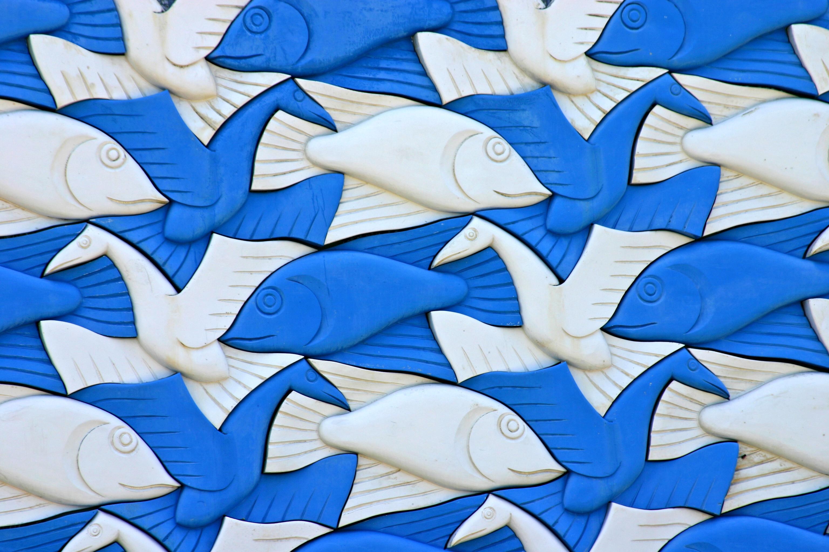
What Are Tessellations?
A tessellation is also known as tiling.
Notes:
Image source: Kees de Vos. (June 26, 2005). Mural - Fish and Birds [Photograph]. Flickr. https://www.flickr.com/photos/devos/24930799

Slide 25
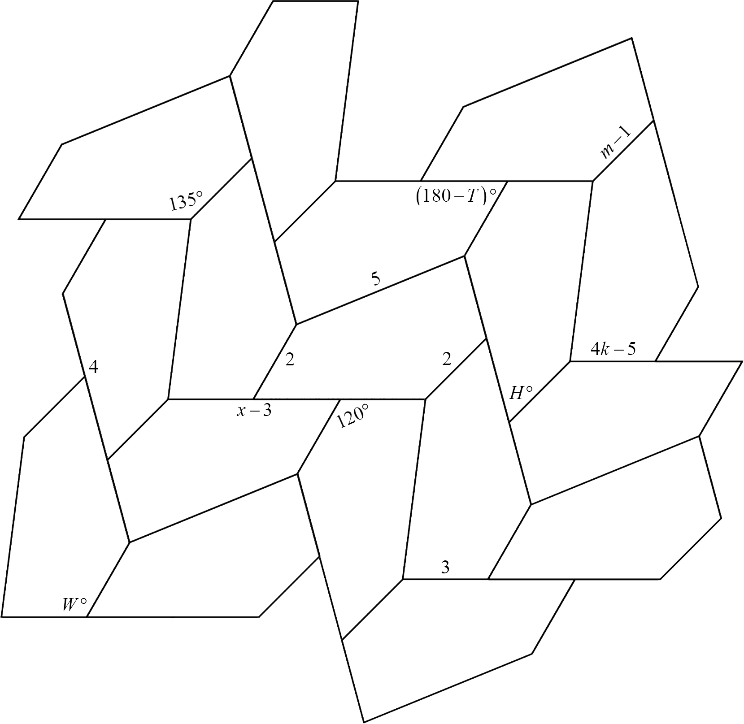
Trying Tessellations
Use your knowledge of congruent polygons to solve for each unknown.

Slide 26
Trying Tessellations
(Solution)
Color-coding the corresponding parts and labeling polygon ABCDE is can be helpful.

Slide 27
Trying Tessellations
(Solution)

Slide 28
Trying Tessellations
(Solution)

Slide 29
Trying Tessellations
(Solution)

Slide 30
Trying Tessellations
(Solution)

Slide 31
Trying Tessellations
(Solution)

Slide 32
Trying Tessellations
(Solution)

Slide 33
Trying Tessellations
(Solution)

Slide 34
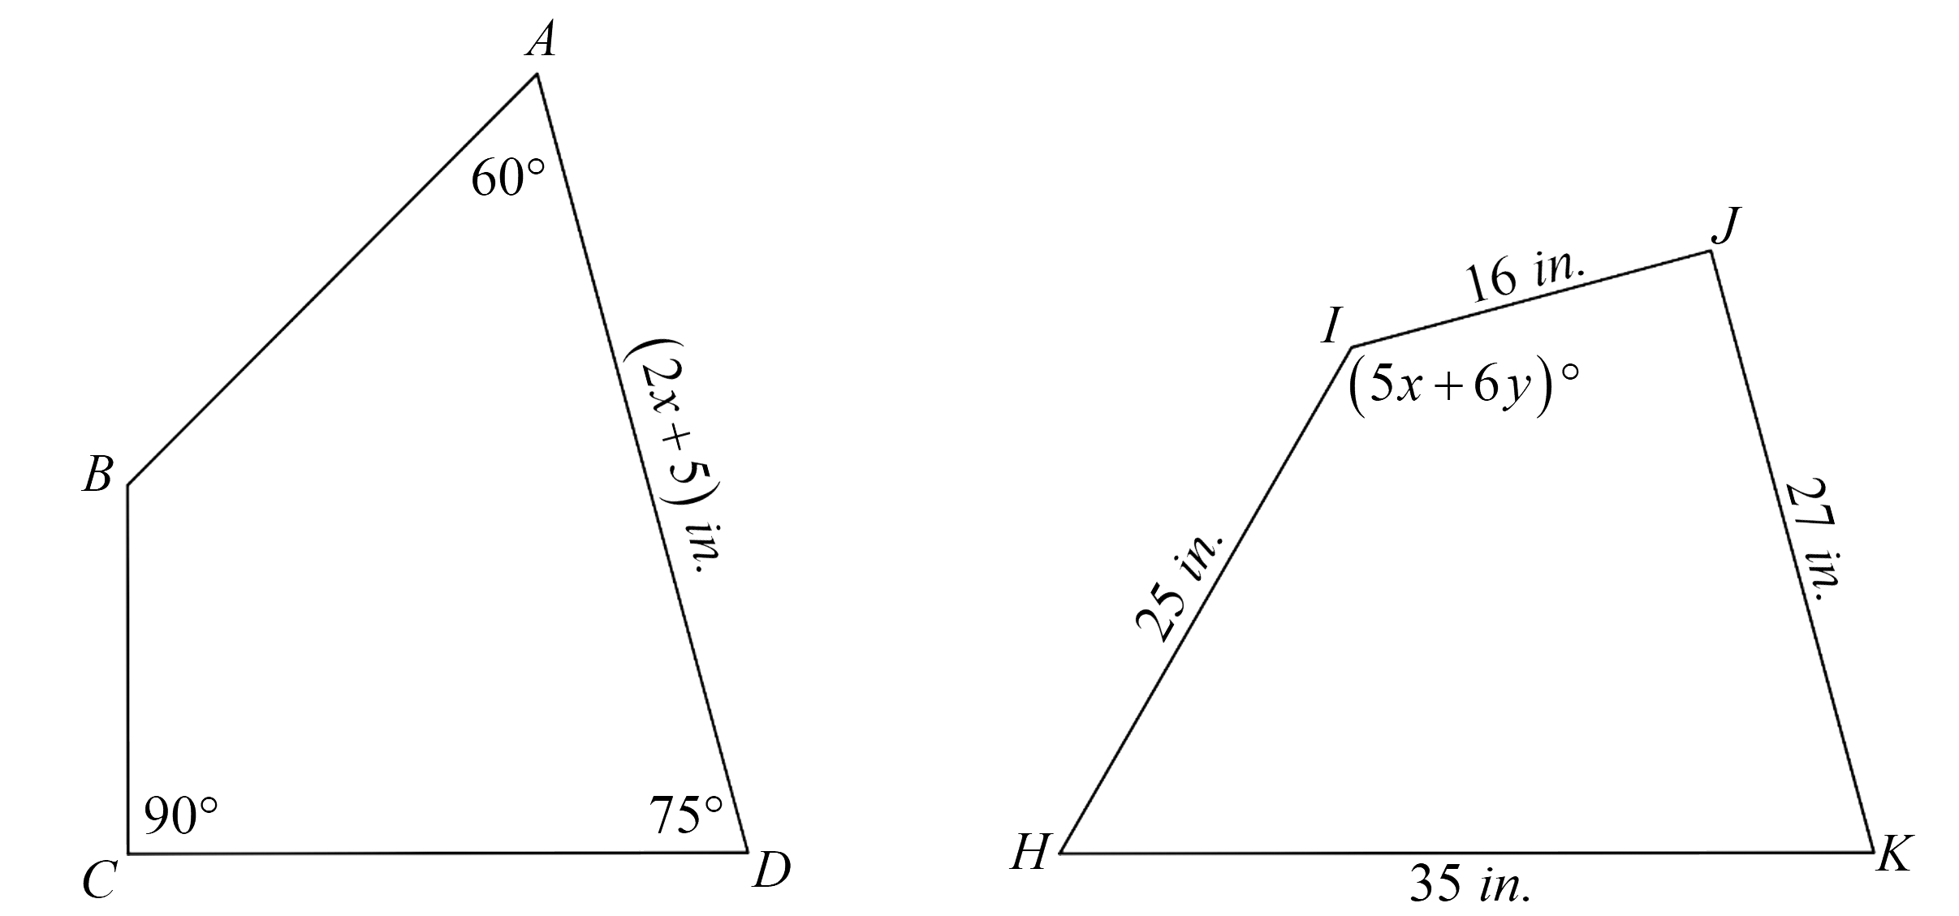
Corresponding Parts – Exit Ticket

Slide 35
Corresponding Parts (Solution)

Slide 36
Corresponding Parts (Solution)

Slide 37
Corresponding Parts (Solution)

