Slide 2
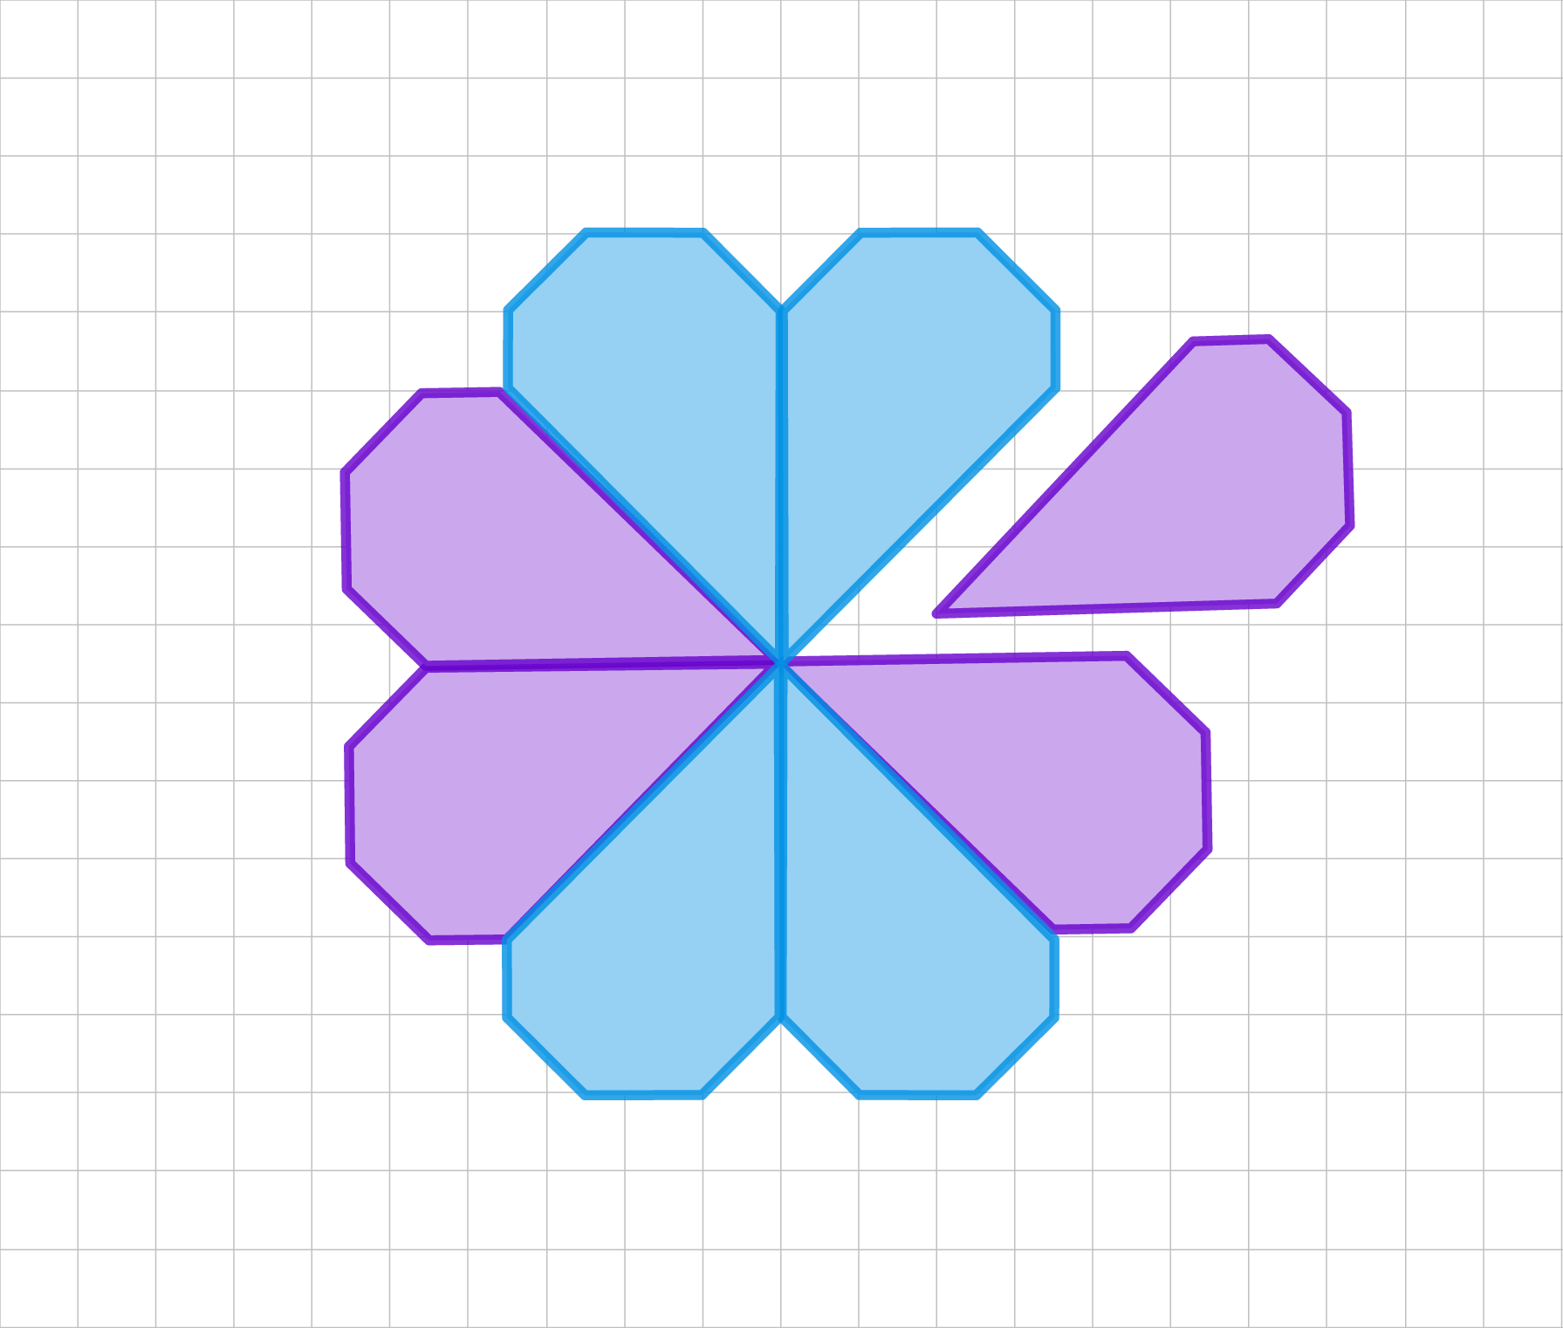
A Perfect Match
Congruent Polygons

Slide 3
Essential Question
How do the properties of congruent polygons help us solve problems?

Slide 4
Learning Objectives
Analyze and solve rigorous mathematical problems using properties of congruent polygons.
Use algebraic and logical reasoning to solve mathematical problems.

Slide 5
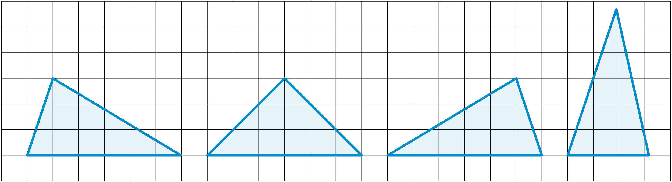
Not Like the Others
Which triangle is not like the others?
  Explain your reasoning.
Notes:
K20 Center. (n.d.). Not like the others. Strategies. https://learn.k20center.ou.edu/strategy/77

Slide 6
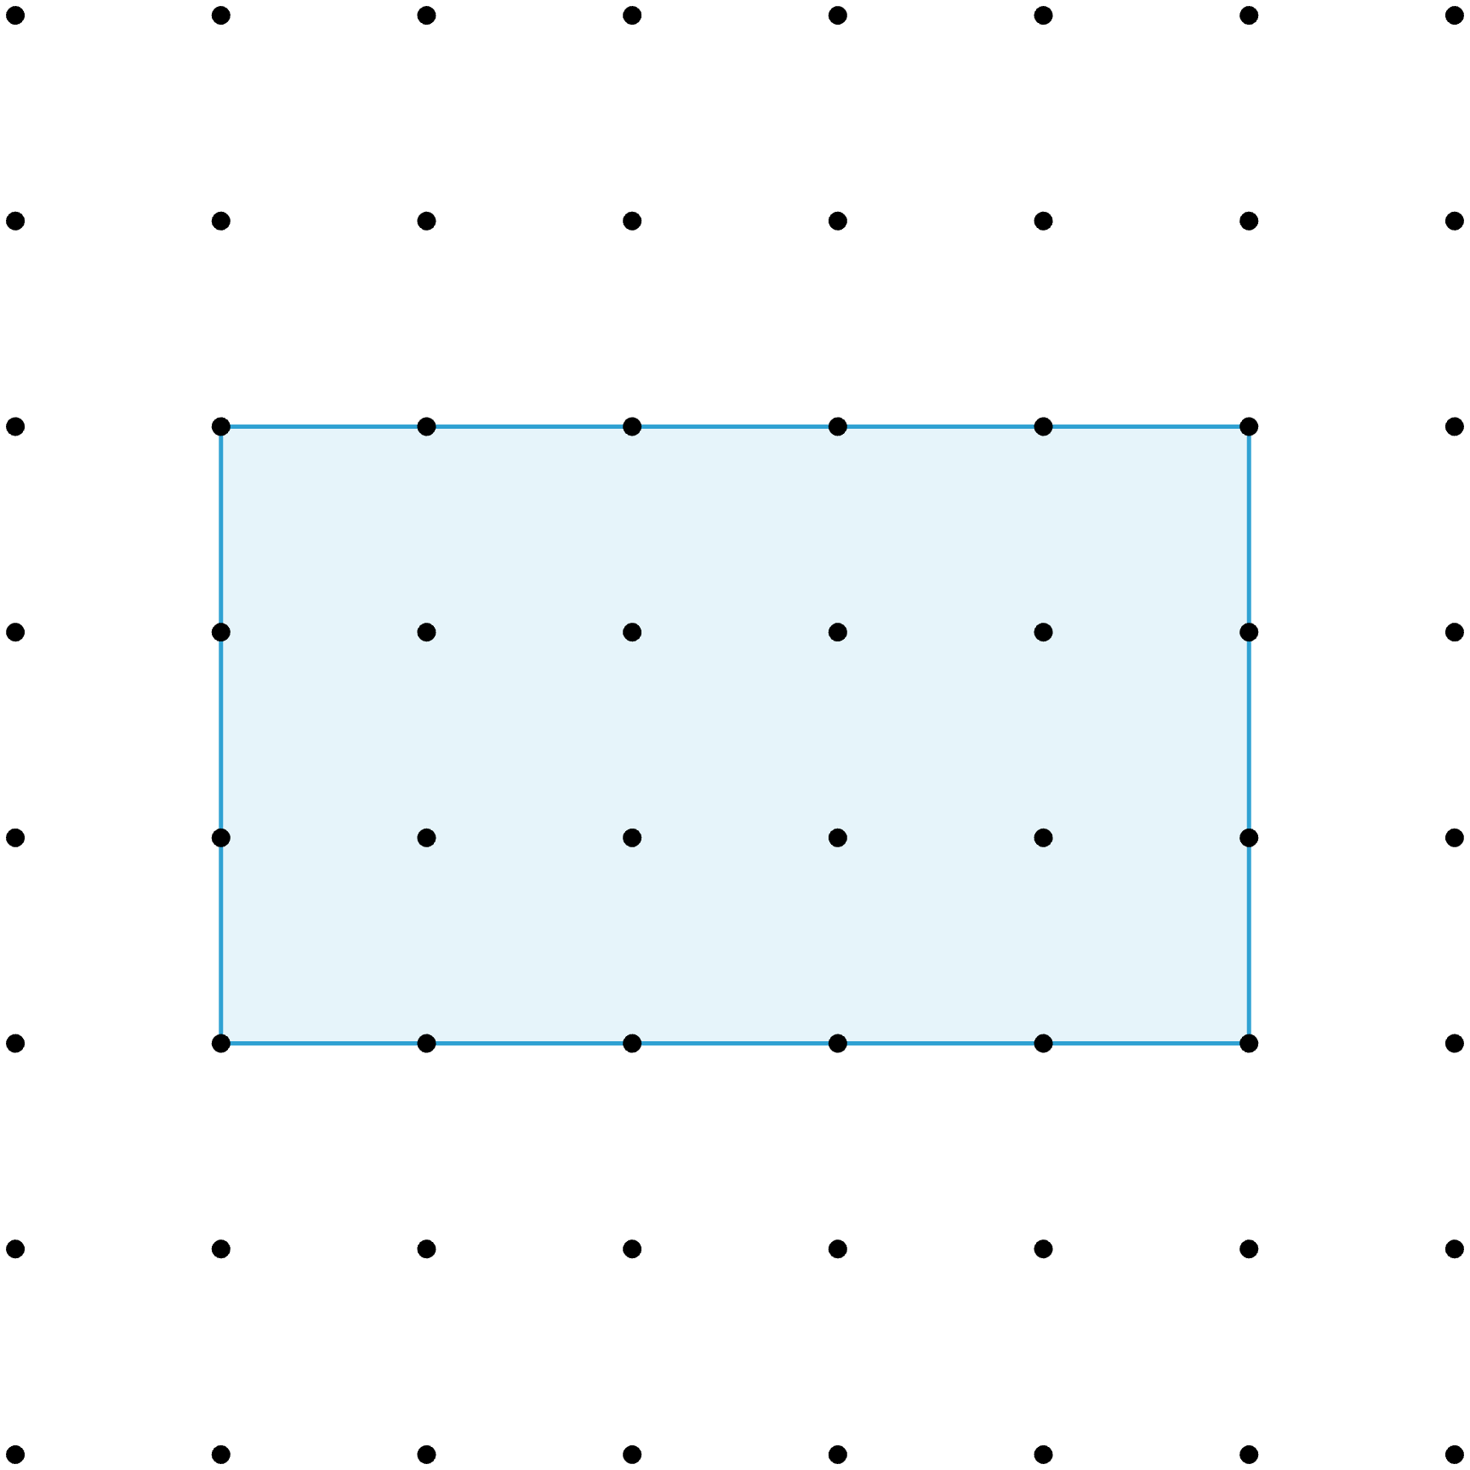
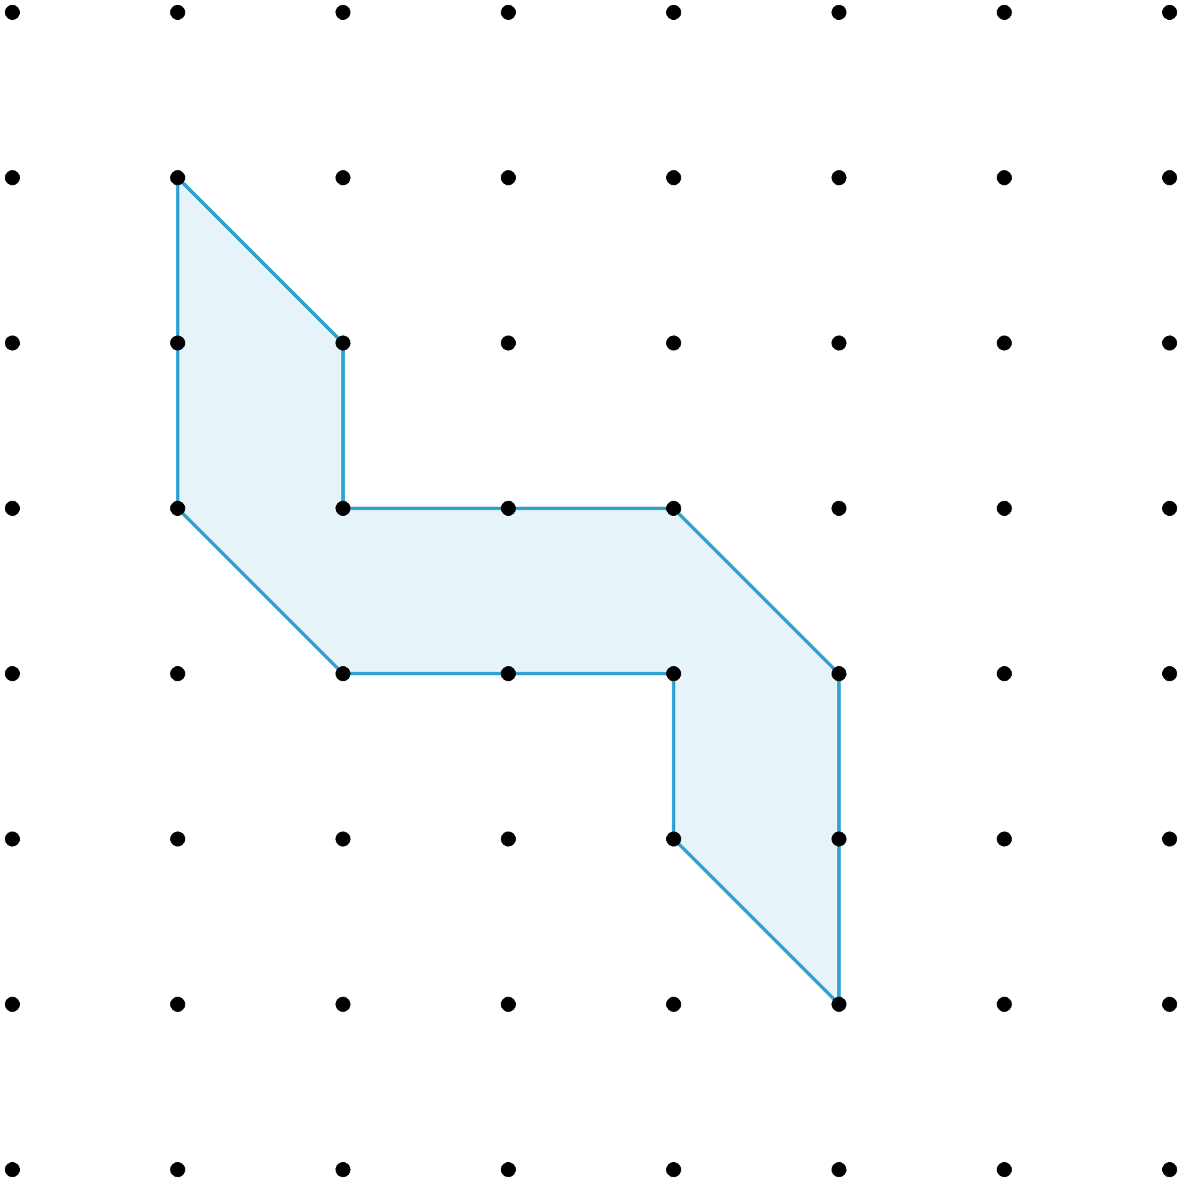
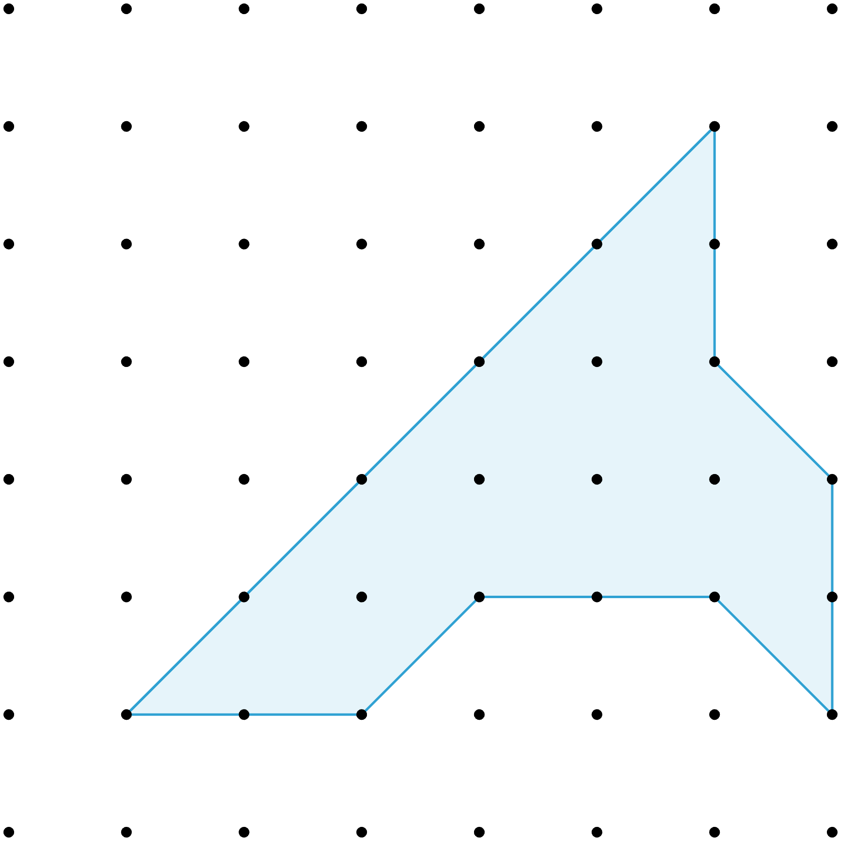
Equal Halves
For each polygon, draw 1 line segment to divide it
into 2 congruent polygons.

Slide 7
Equal Halves: Line Segment

Slide 8
Equal Halves: Line Segment

Slide 9
Equal Halves: Line Segment

Slide 10
Guided Notes
Let’s complete the Guided Notes together.
  You will need 5 different colors.

Slide 11
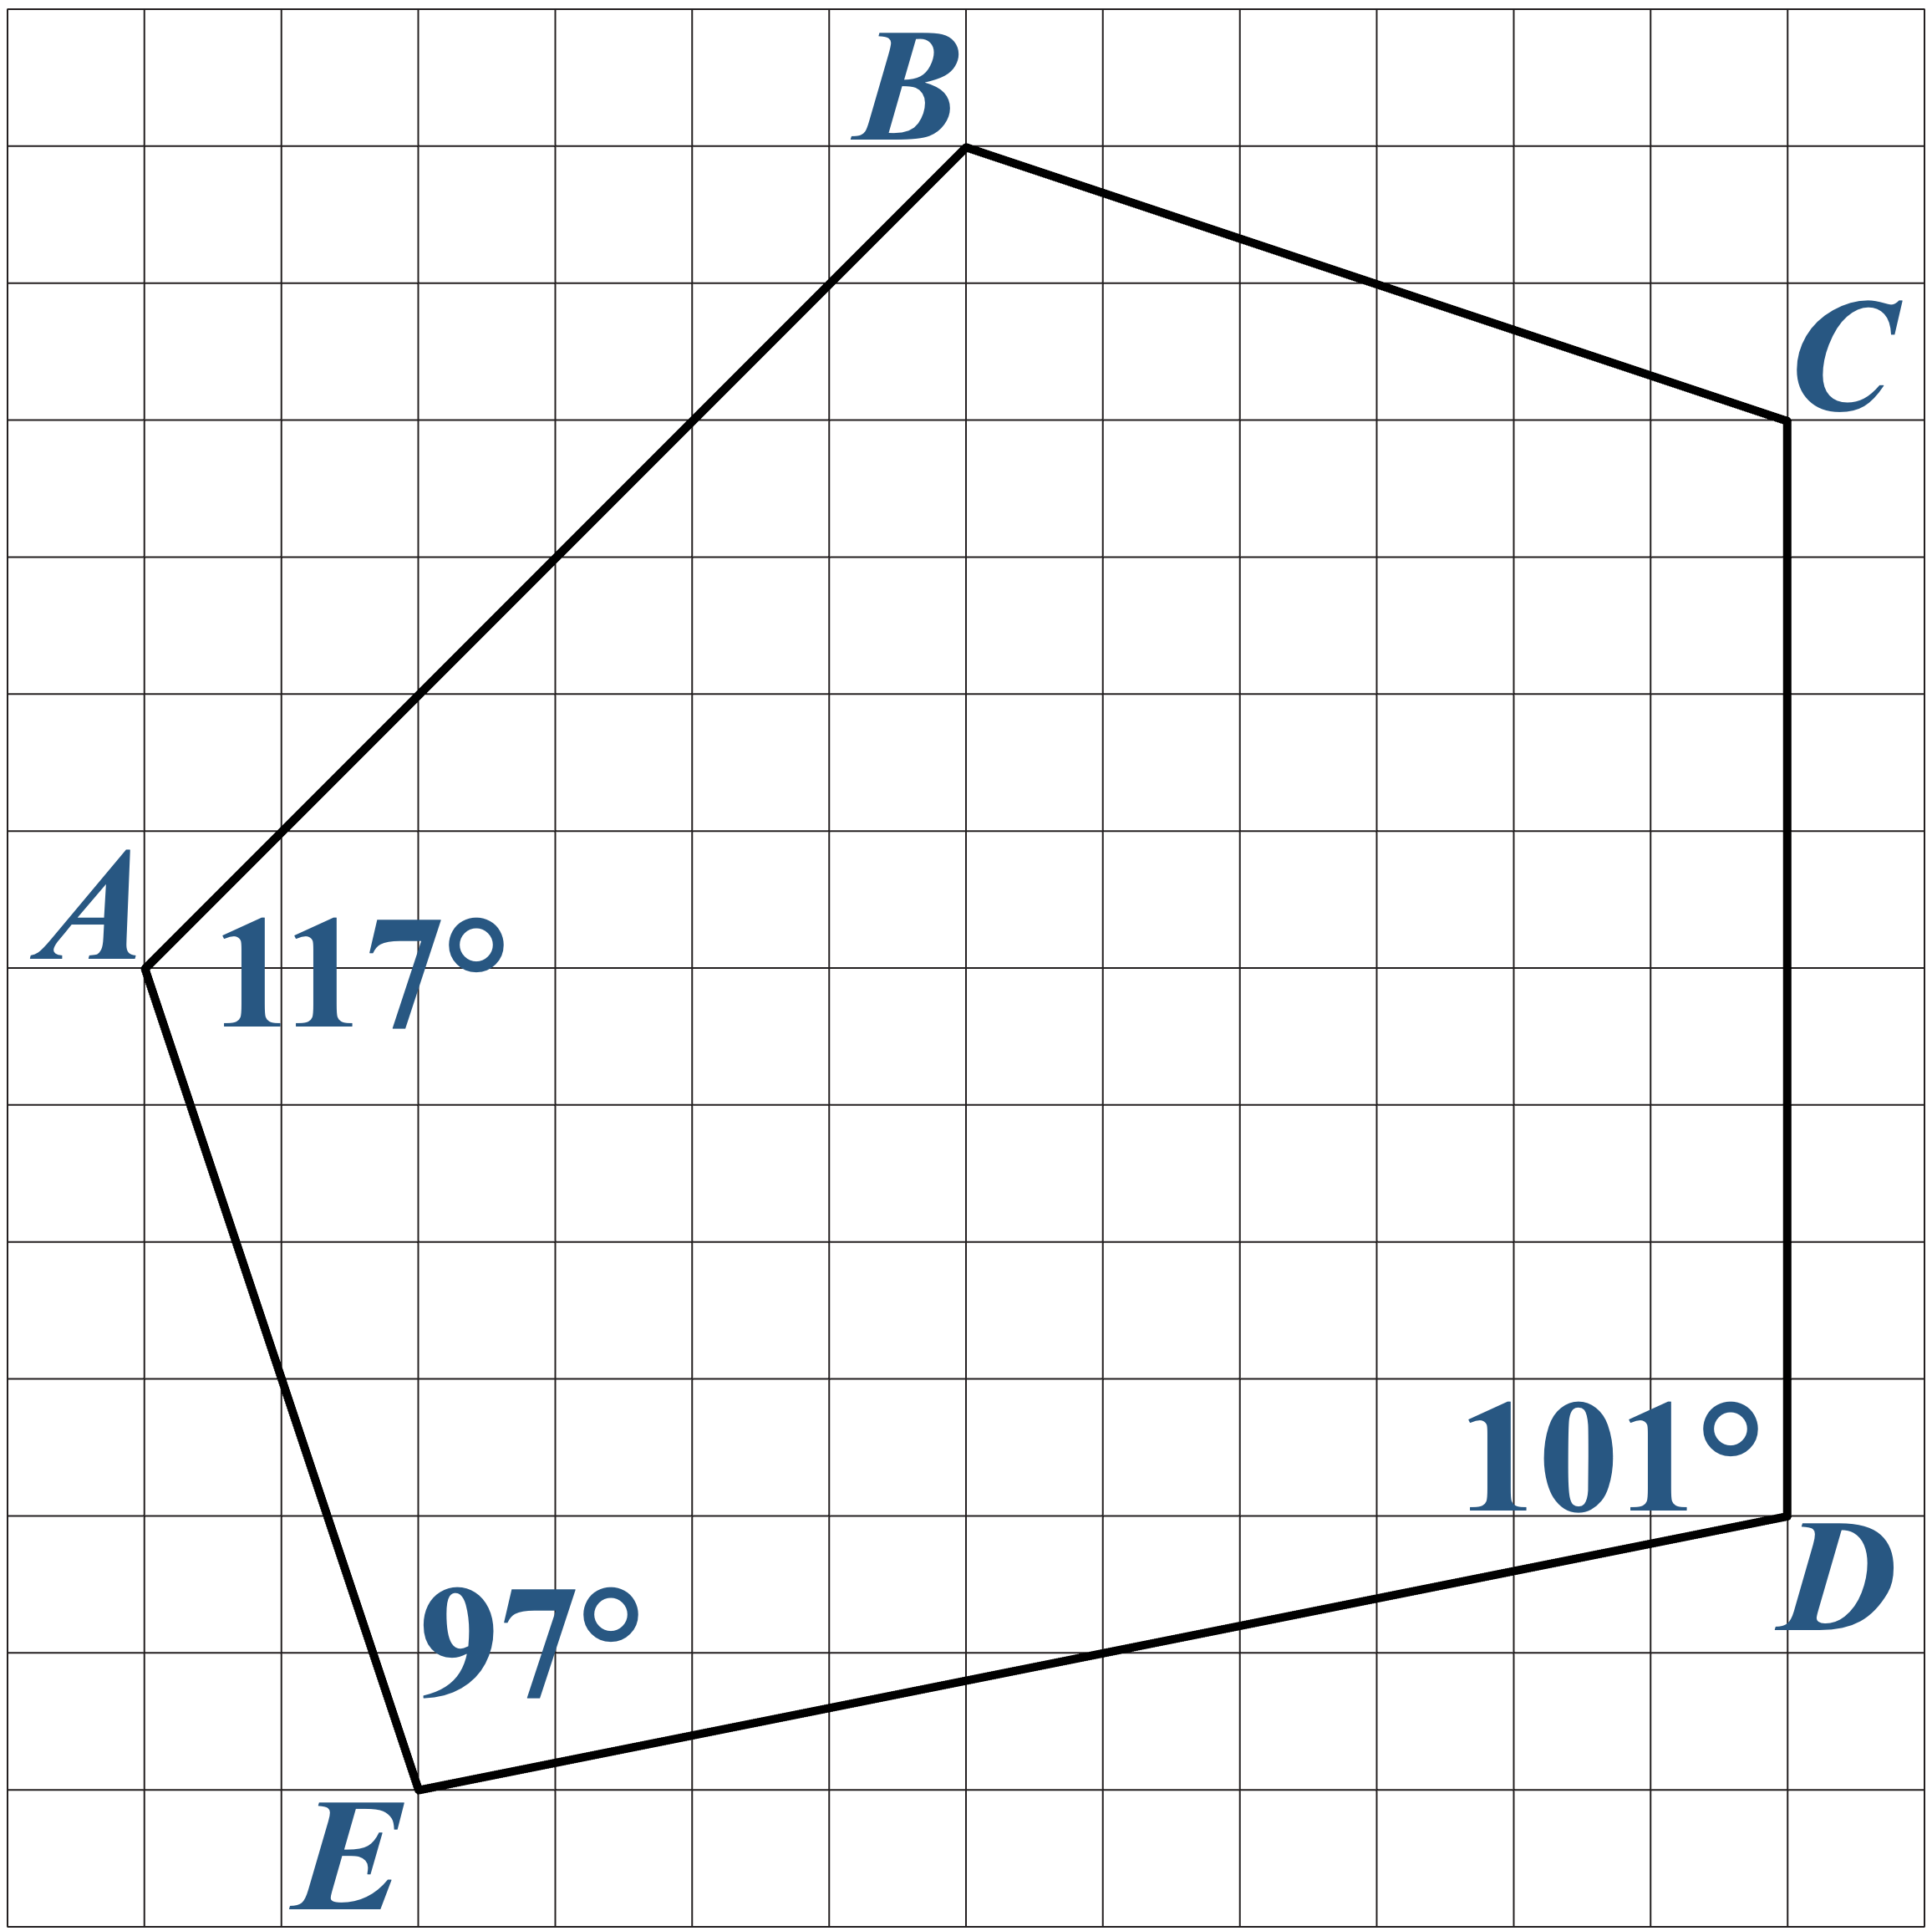
Congruent Polygons: Guided Notes
Use a different color
to trace each side of
Polygon ABCDE.

Slide 12
Congruent Polygons: Polygon ABCDE
Use a different color
to trace each side of
Polygon ABCDE.

Slide 13
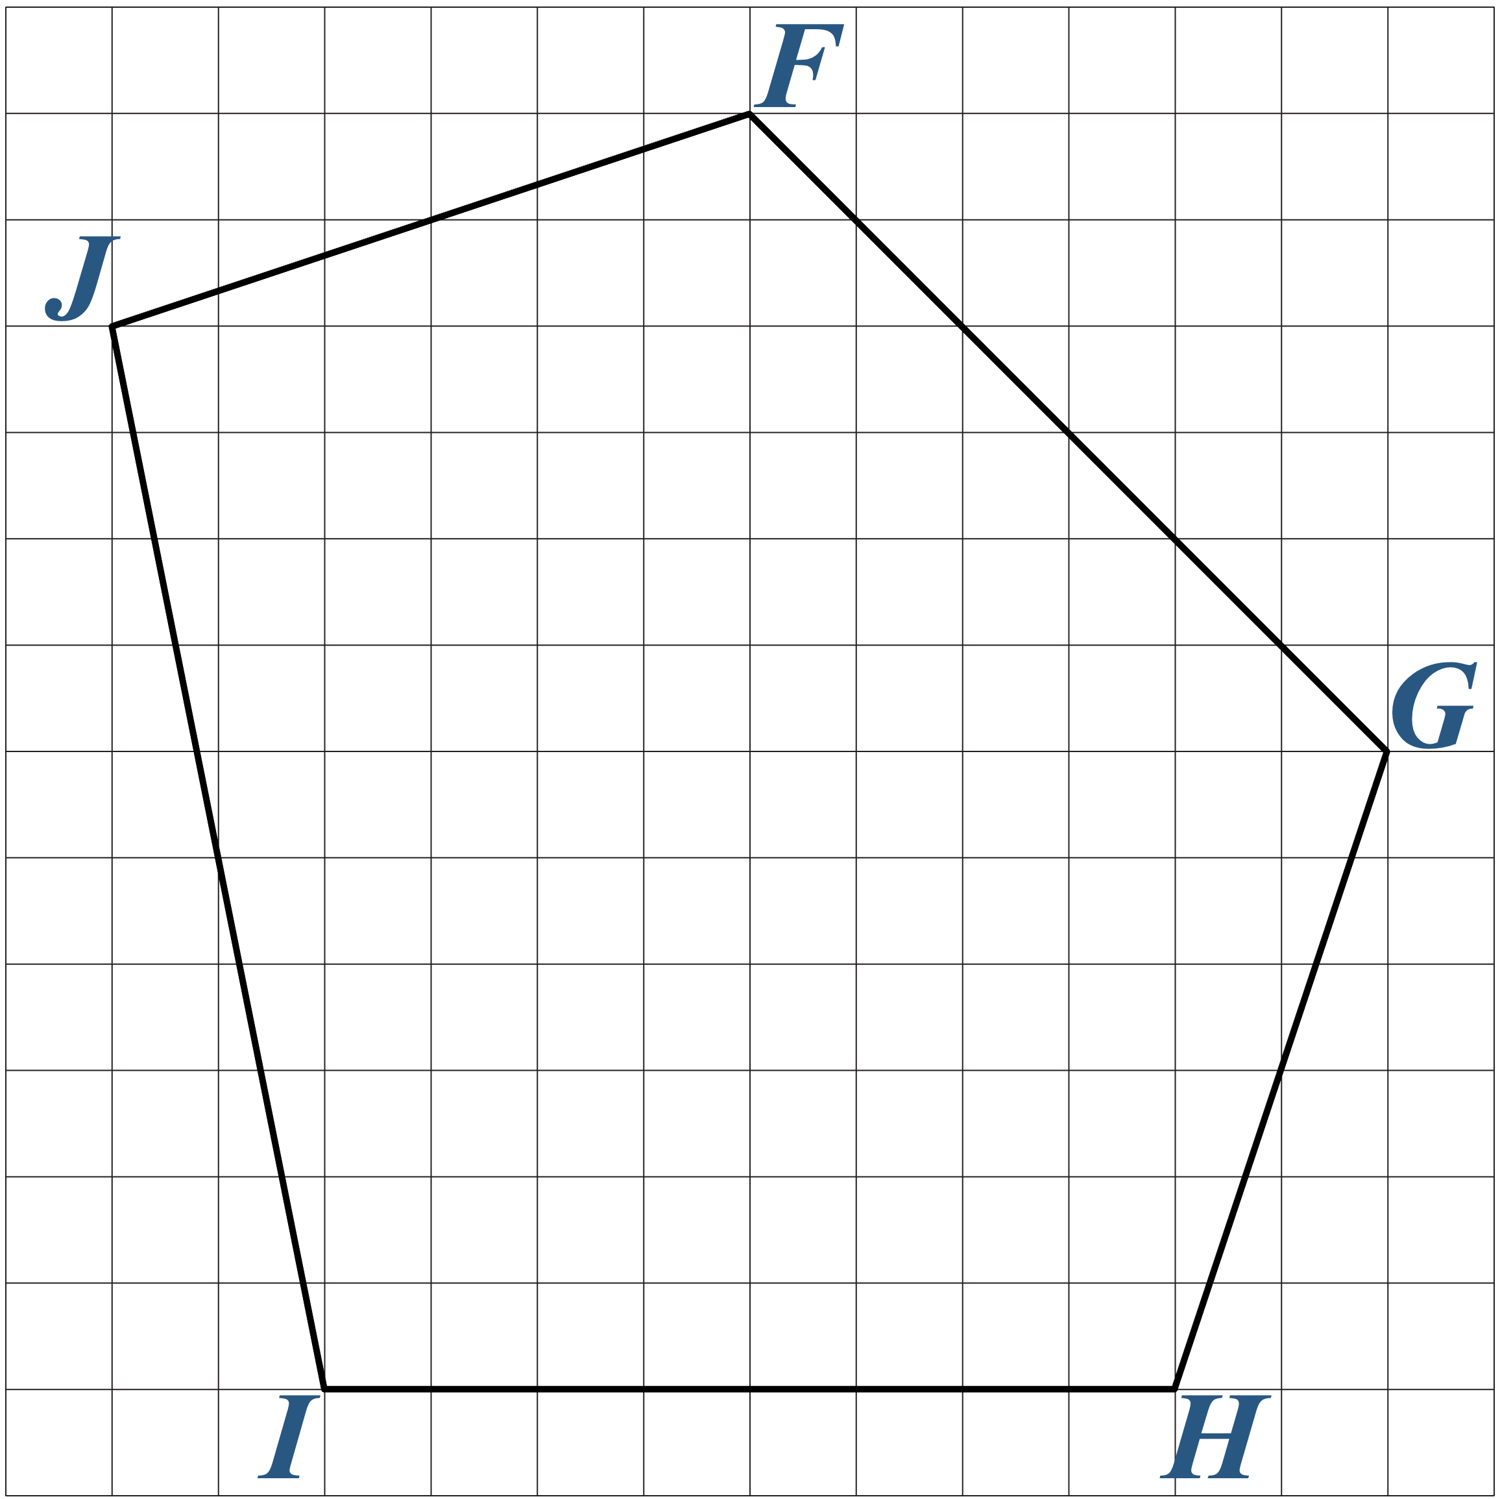
Congruent Polygons: 90° CW
Use those same 5 colors to show the corresponding sides of the new polygon.
  Trace the corresponding sides with the same color.
  Label the corresponding angles with the same angle measurement.

Slide 14
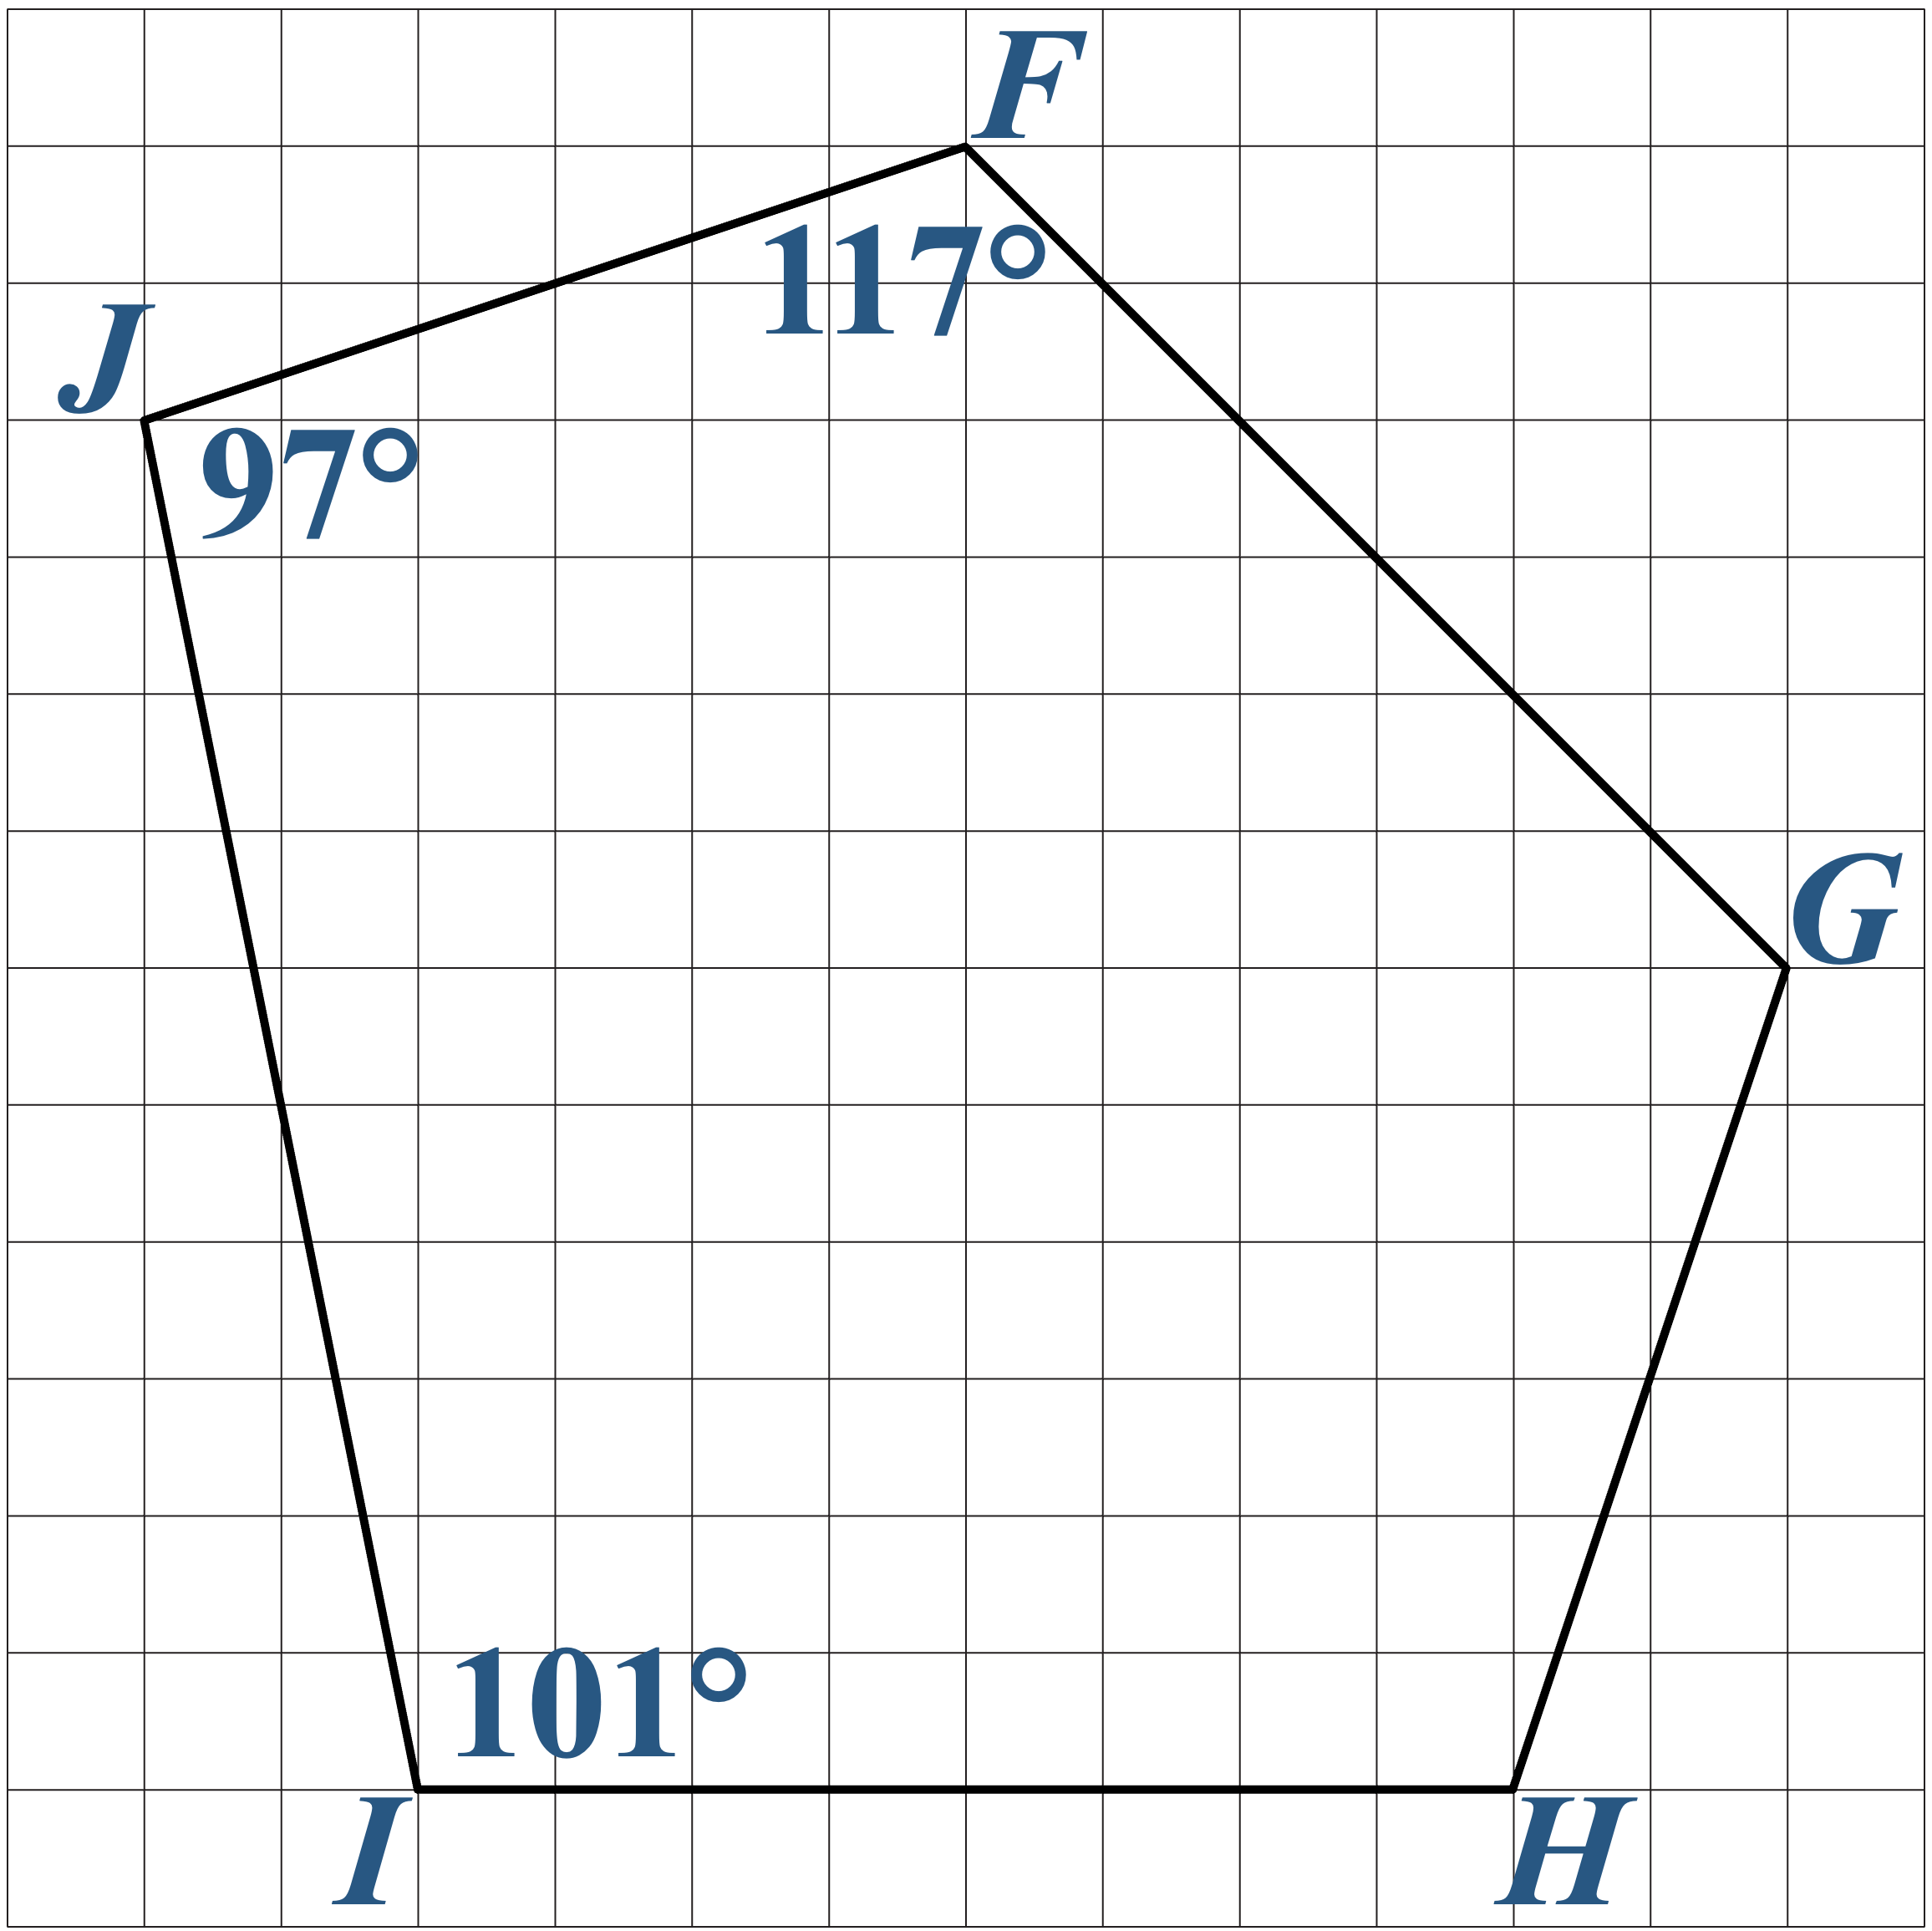
Congruent Polygons: 90° CW

Slide 15
Congruent Polygons: 90° CW

Slide 16
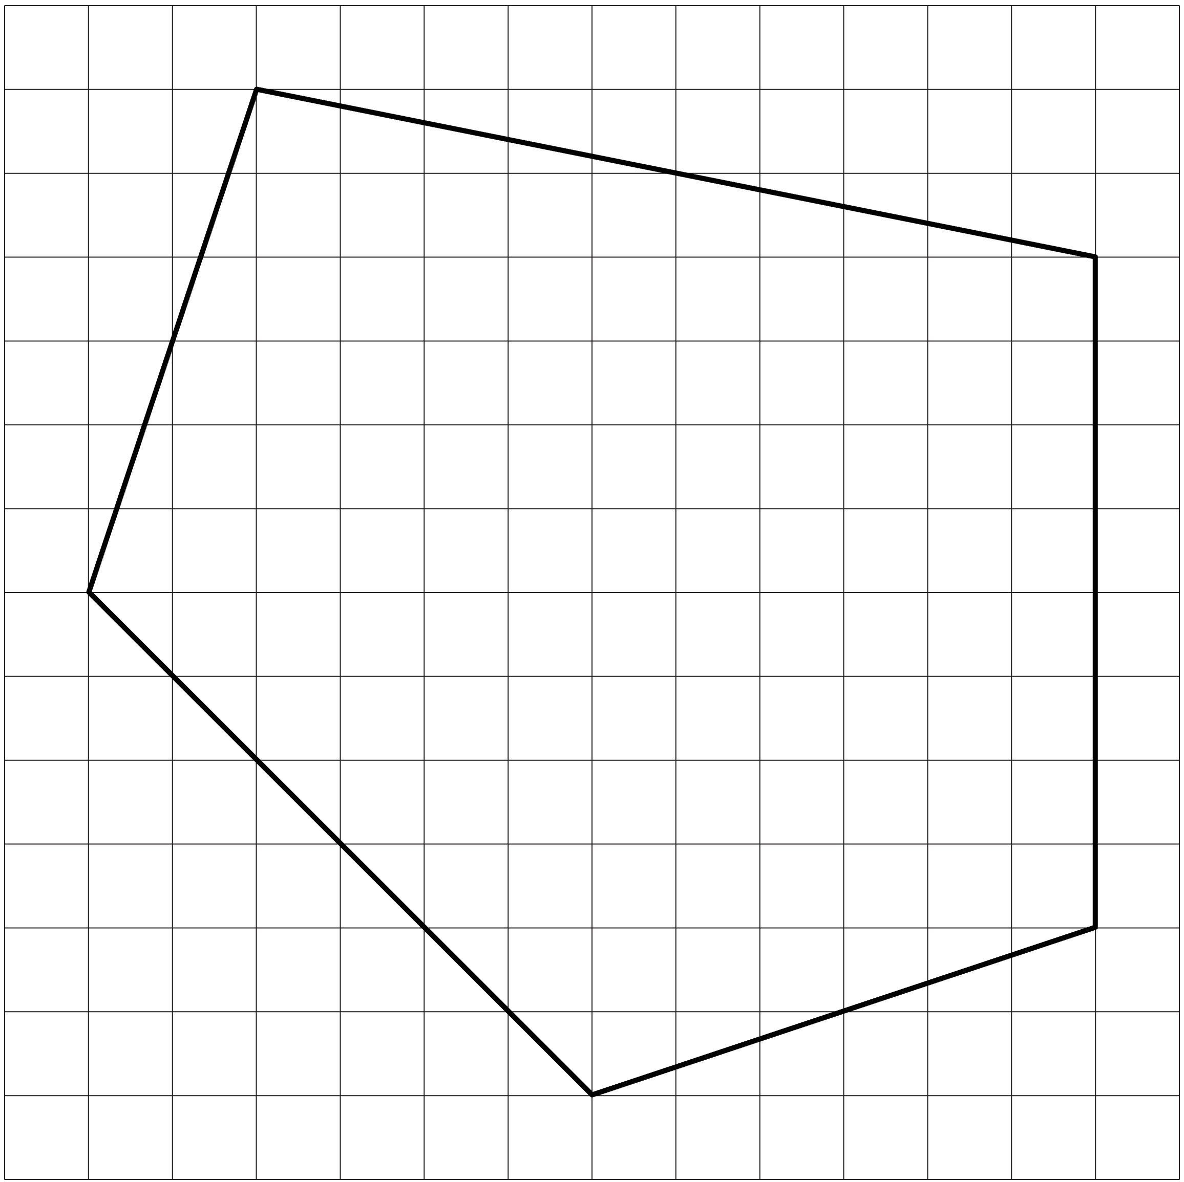
Congruent Polygons: Horizontal Reflection
Use those same 5 colors to show the corresponding sides of the new polygon.
  Trace the corresponding sides with the same color.
  Label the corresponding angles with the same angle measurement.

Slide 17
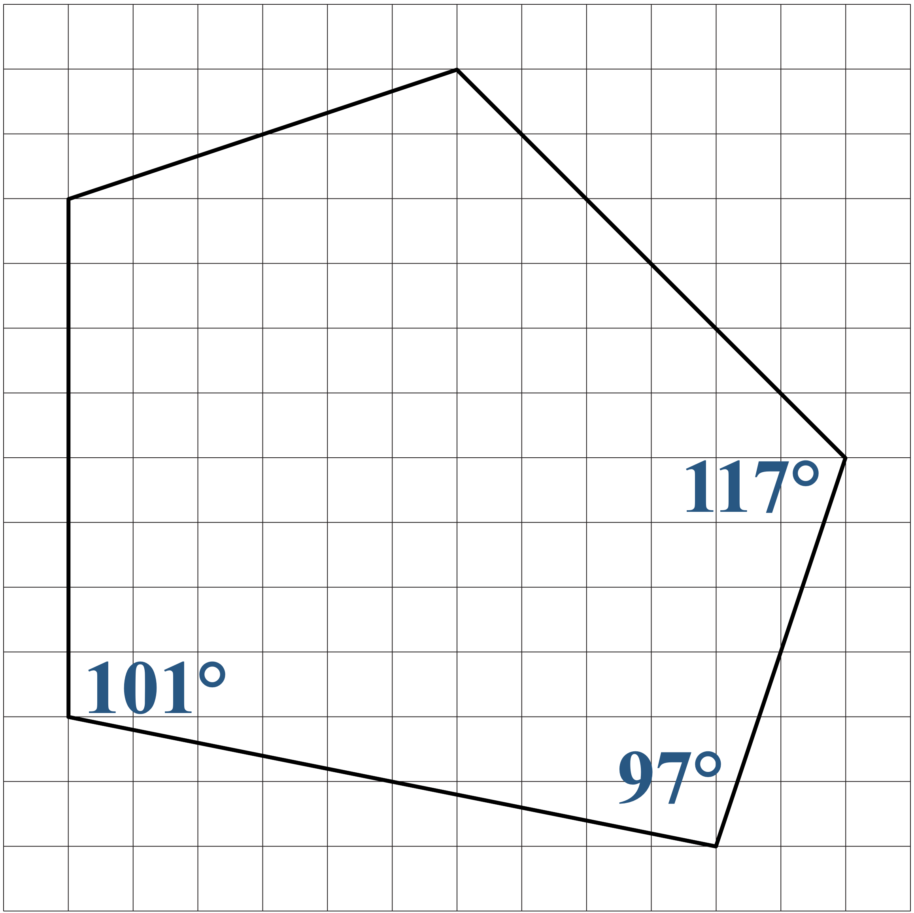
Congruent Polygons: Horizontal Reflection

Slide 18
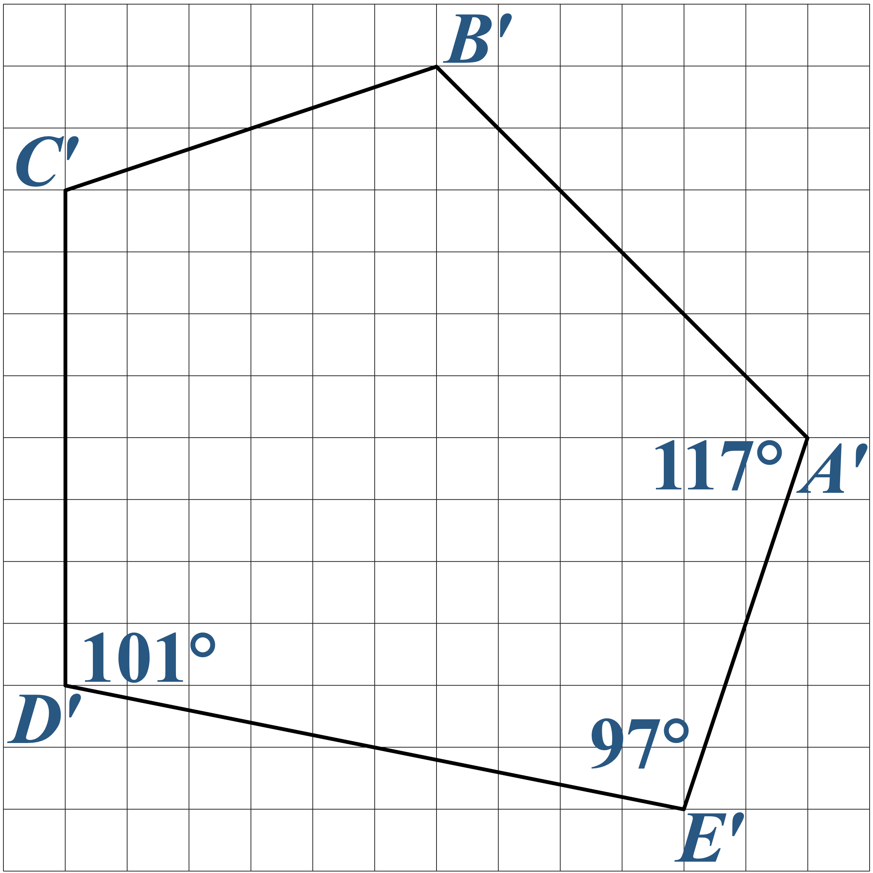
Congruent Polygons: Horizontal Reflection

Slide 19
Congruent Polygons: Horizontal Reflection

Slide 20
Congruent Polygons: Guided Notes
Continue with the remaining polygons.

Slide 21
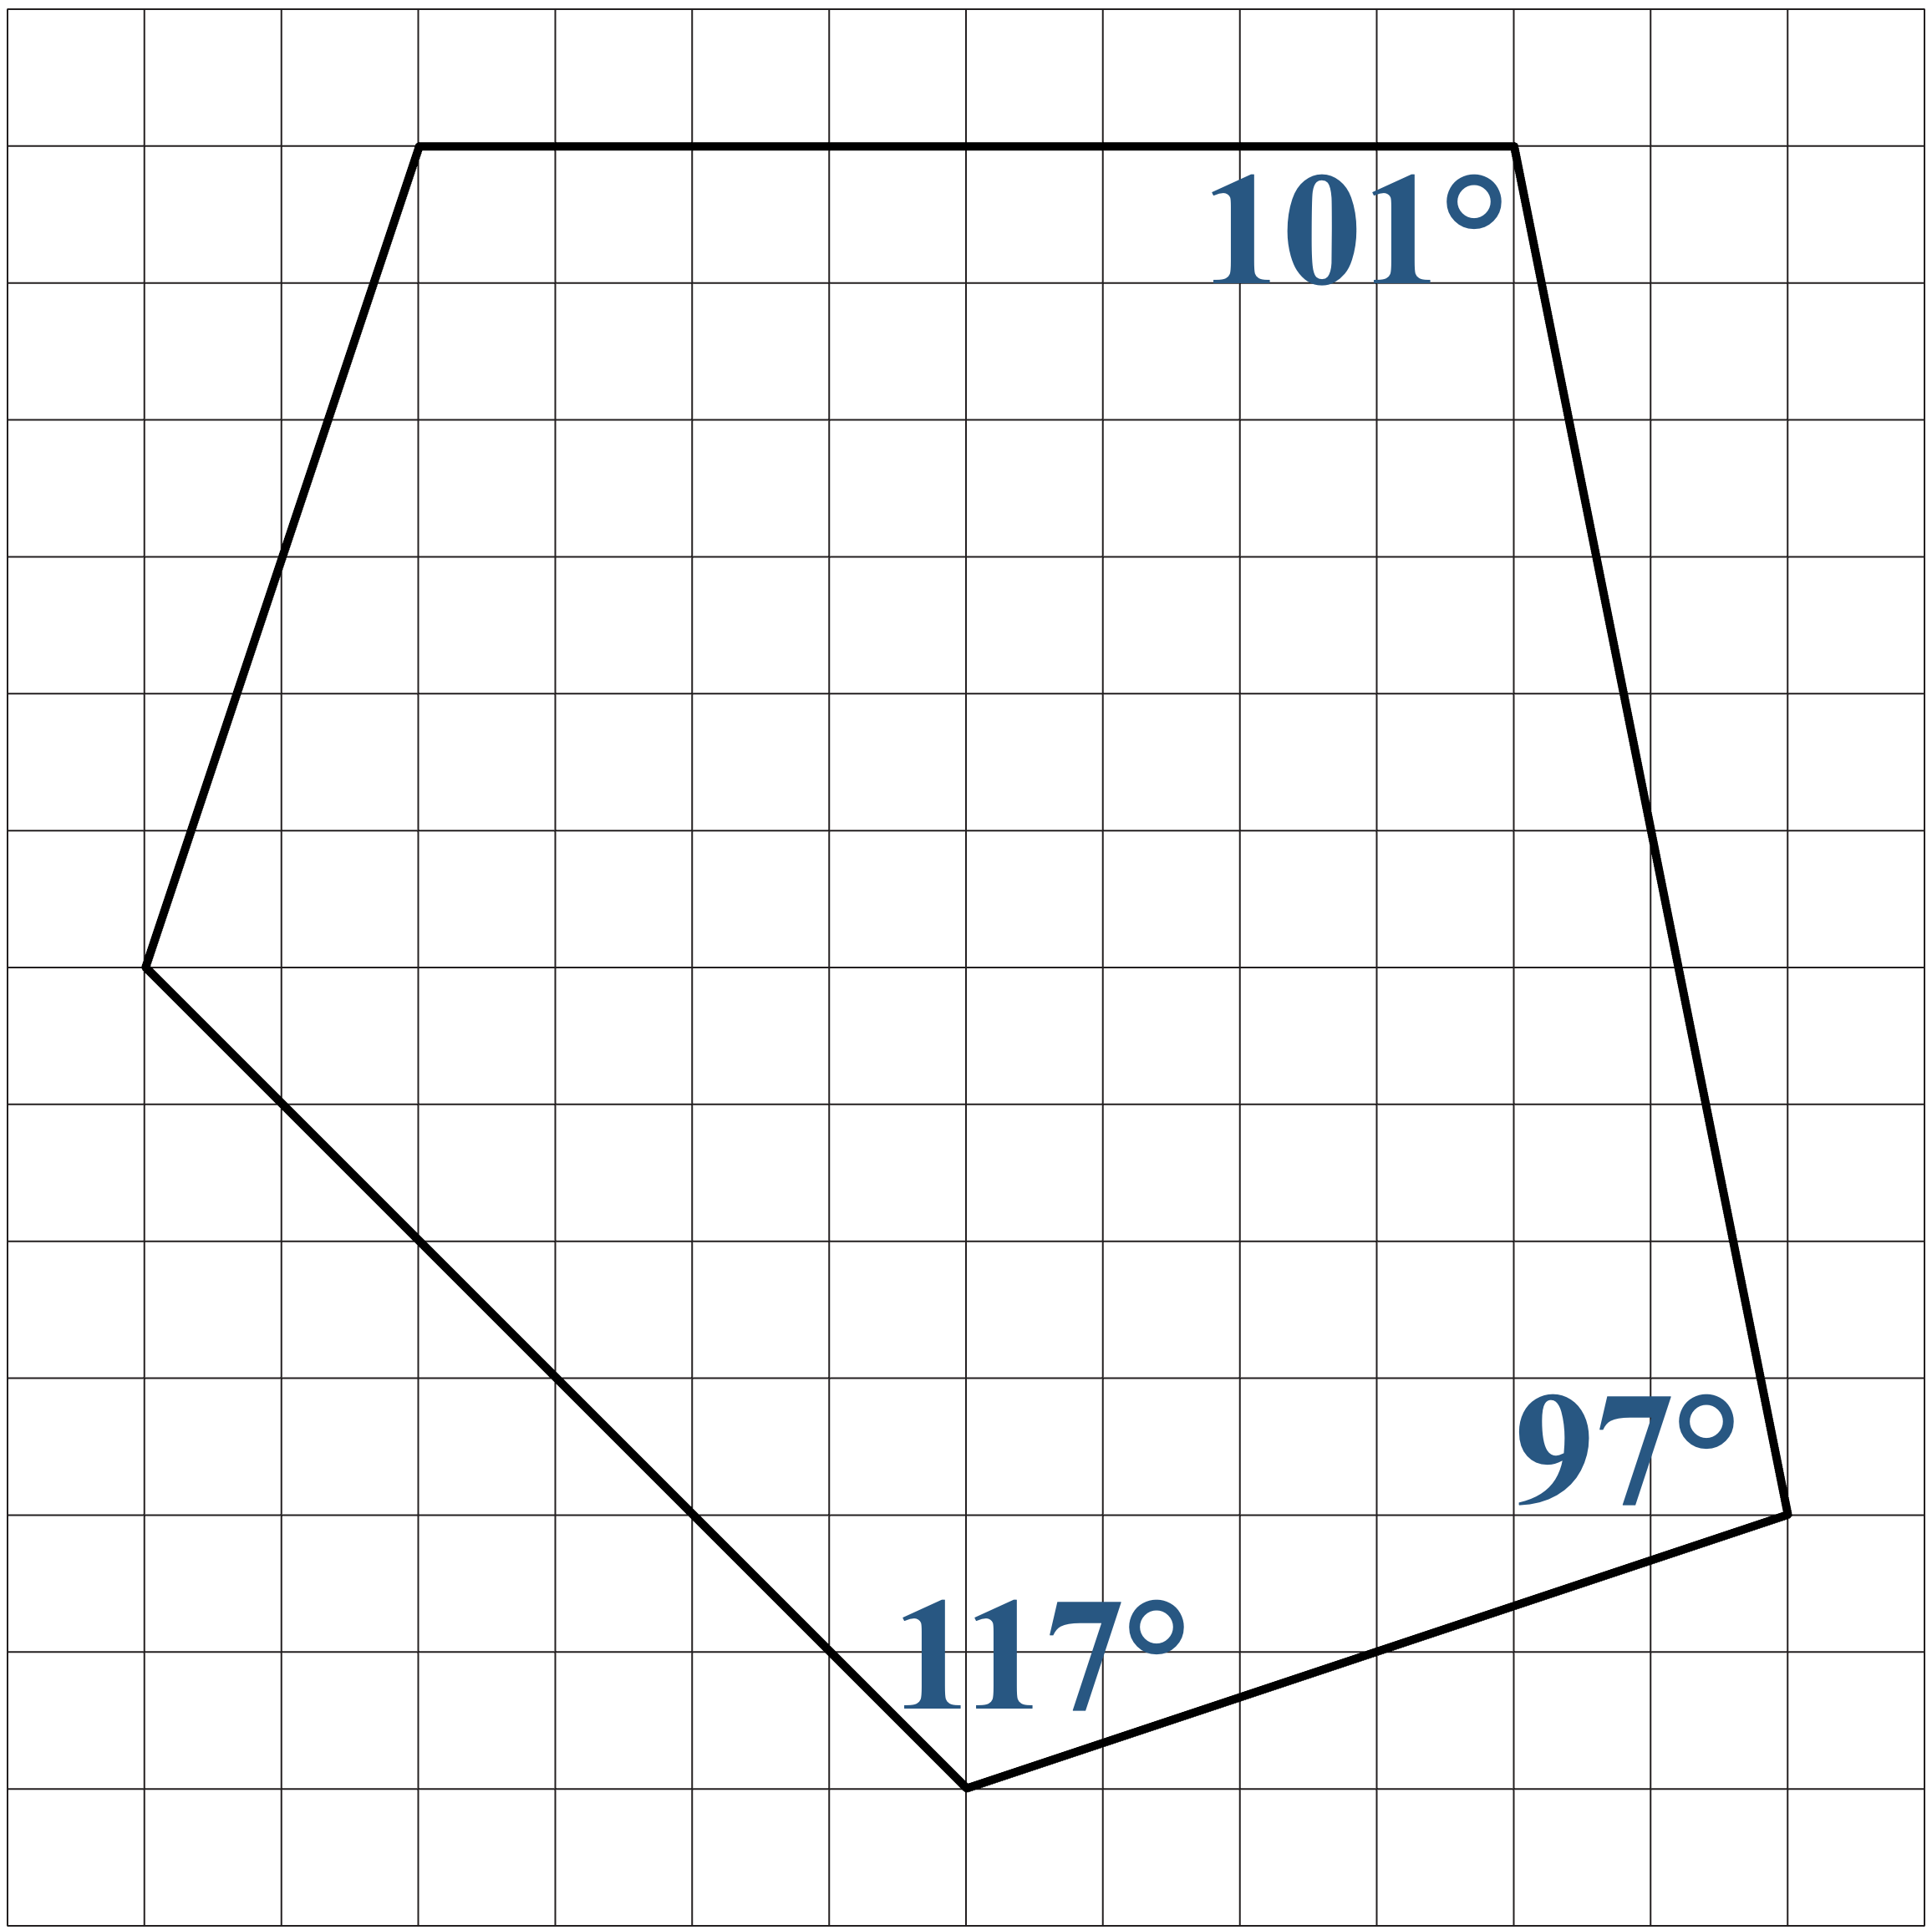
Congruent Polygons: 90° CCW

Slide 22
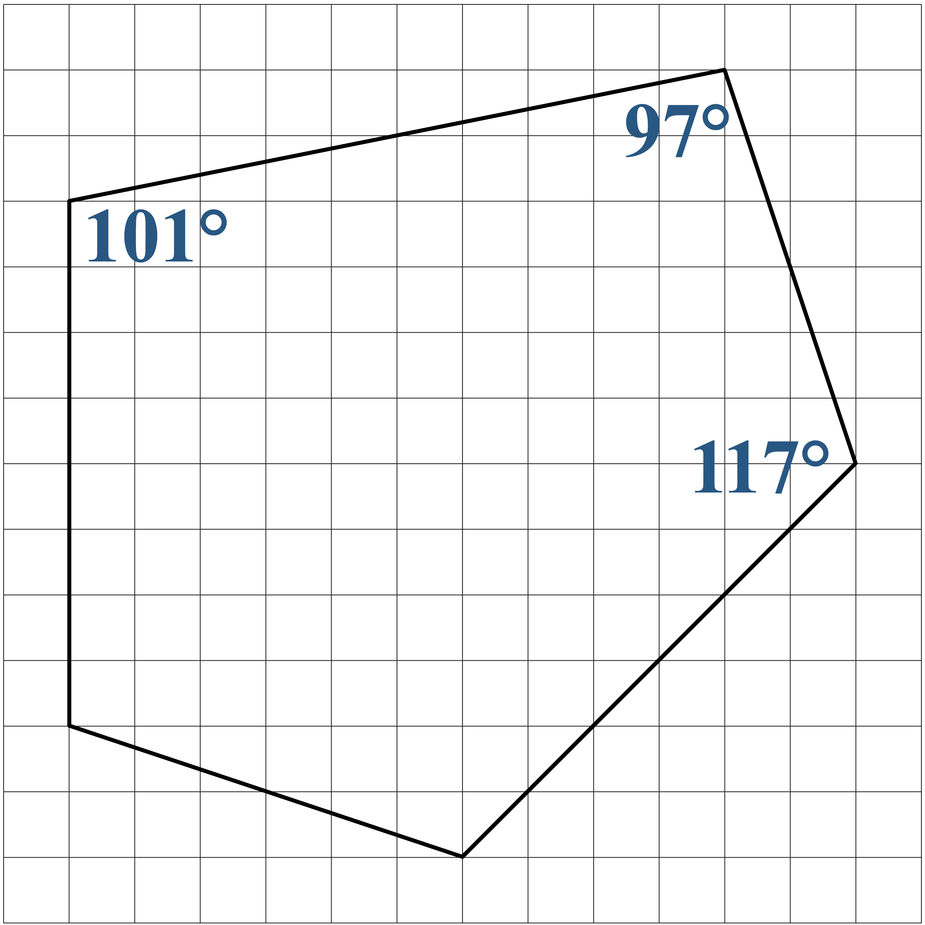
Congruent Polygons: 180° CCW

Slide 23
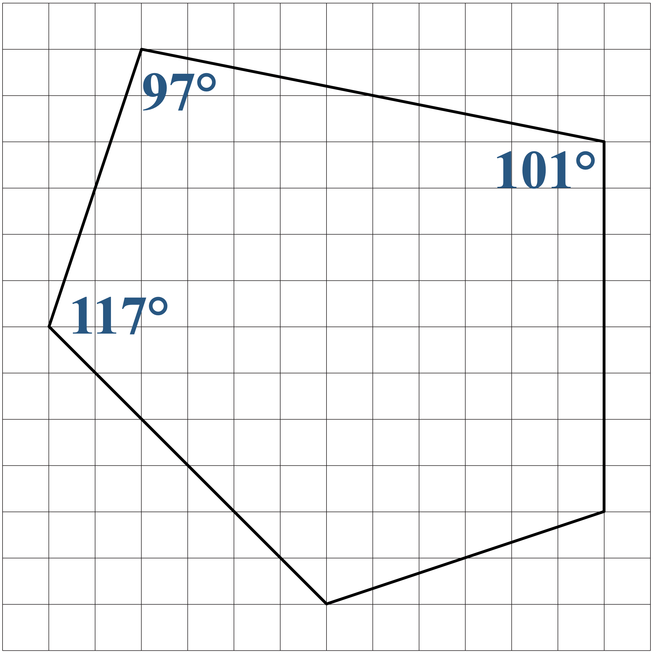
Congruent Polygons: Vertical Reflection

Slide 24
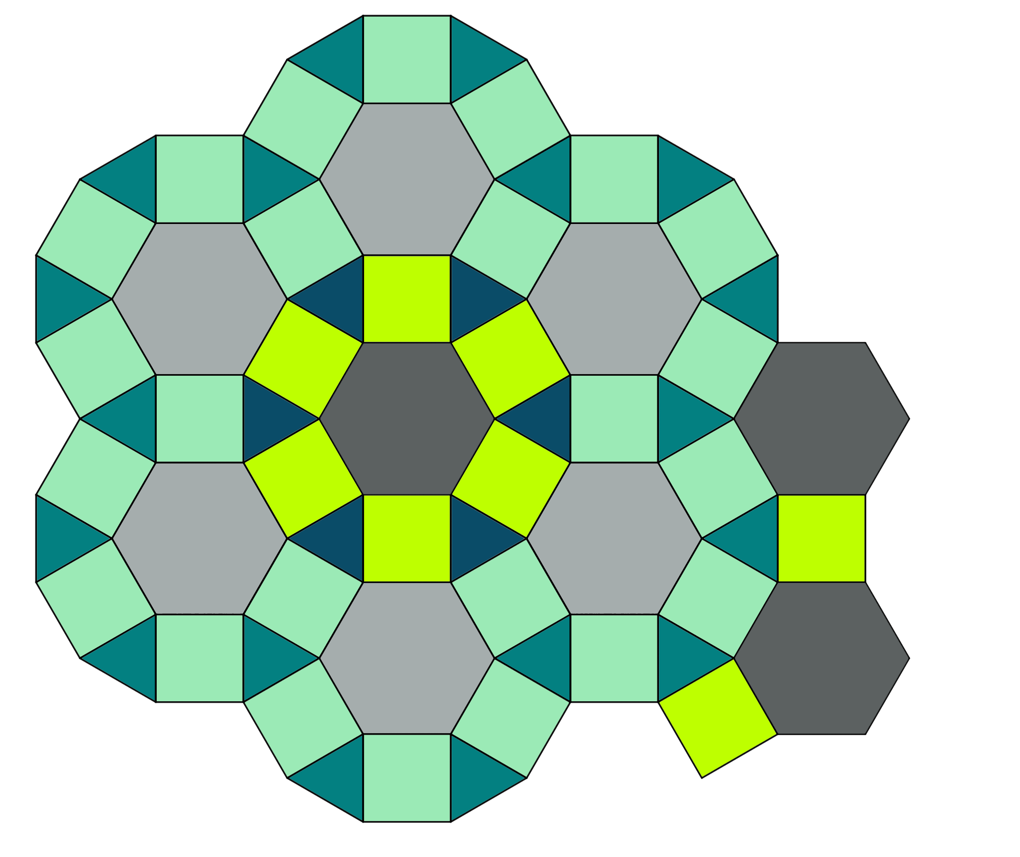
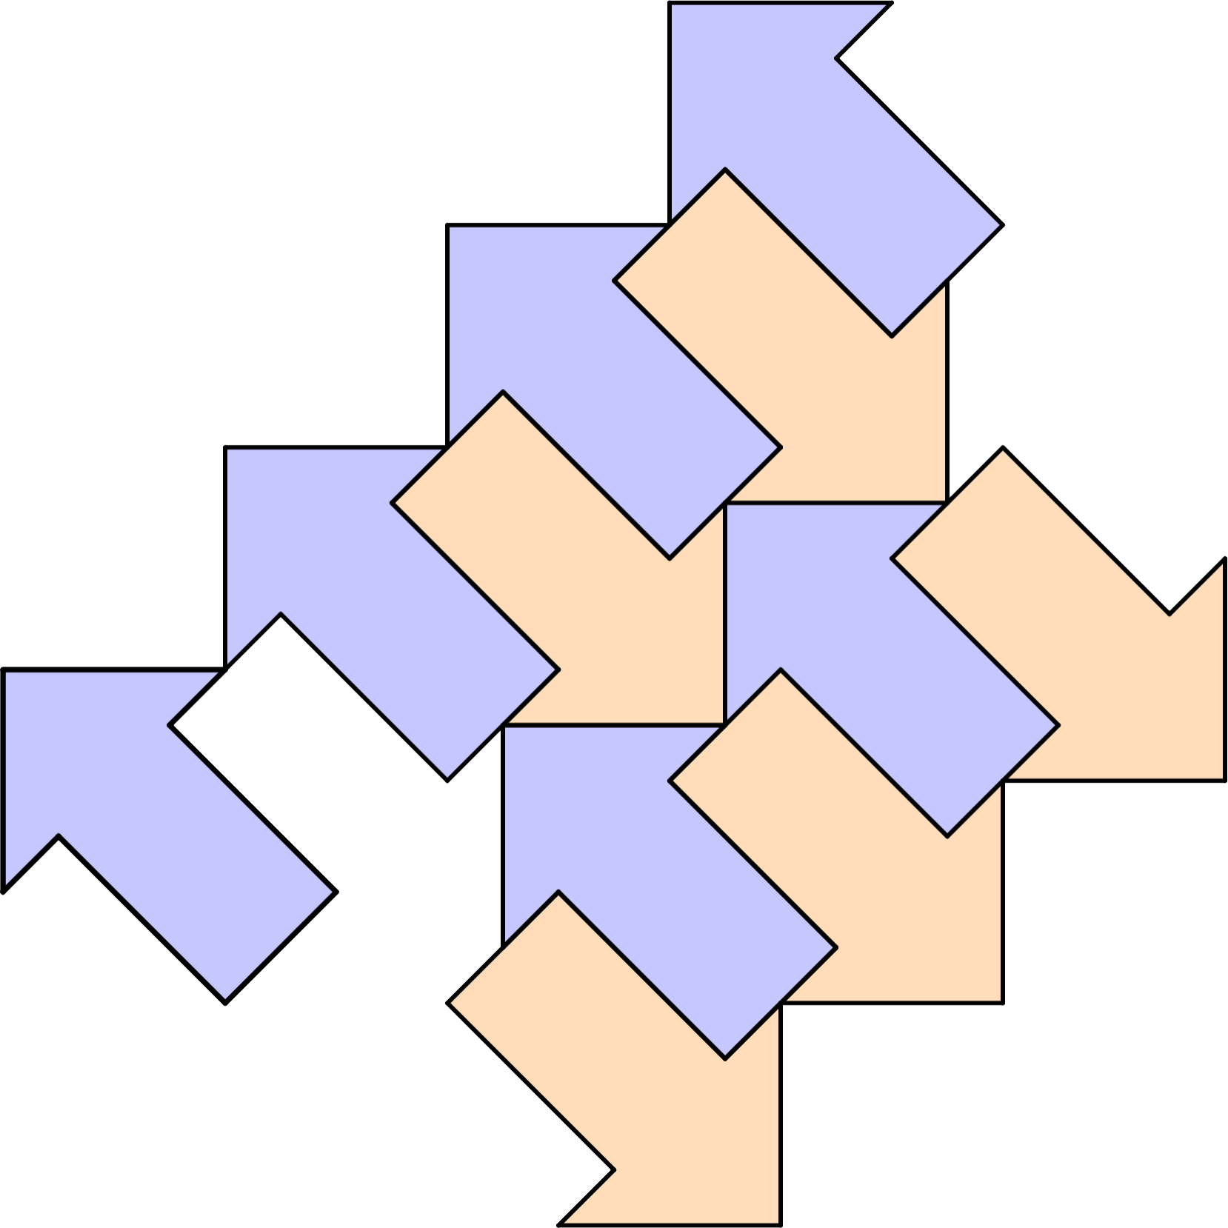
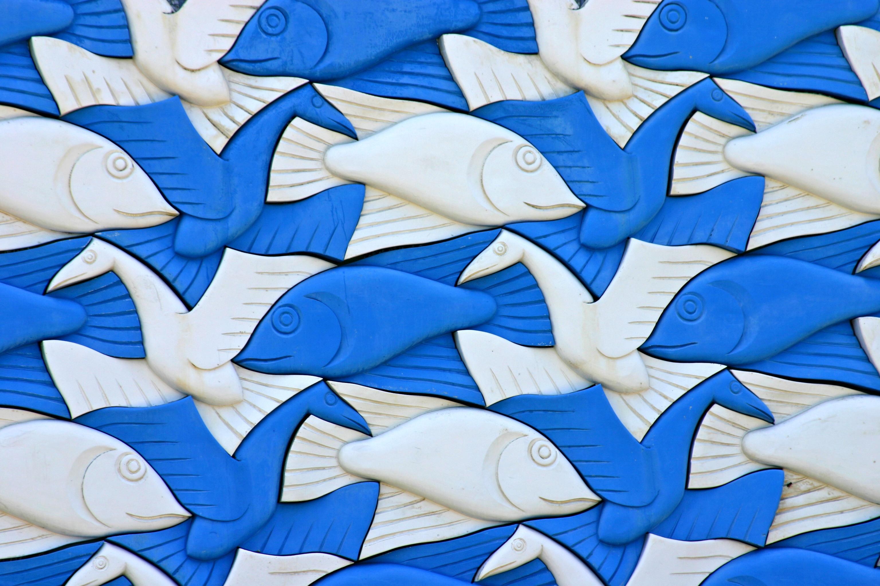
What Are Tessellations?
A tessellation is also
known as a tiling.
Notes:
Image source: Kees de Vos. (June 26, 2005). Mural - Fish and Birds [Photograph]. Flickr. https://www.flickr.com/photos/devos/24930799

Slide 25
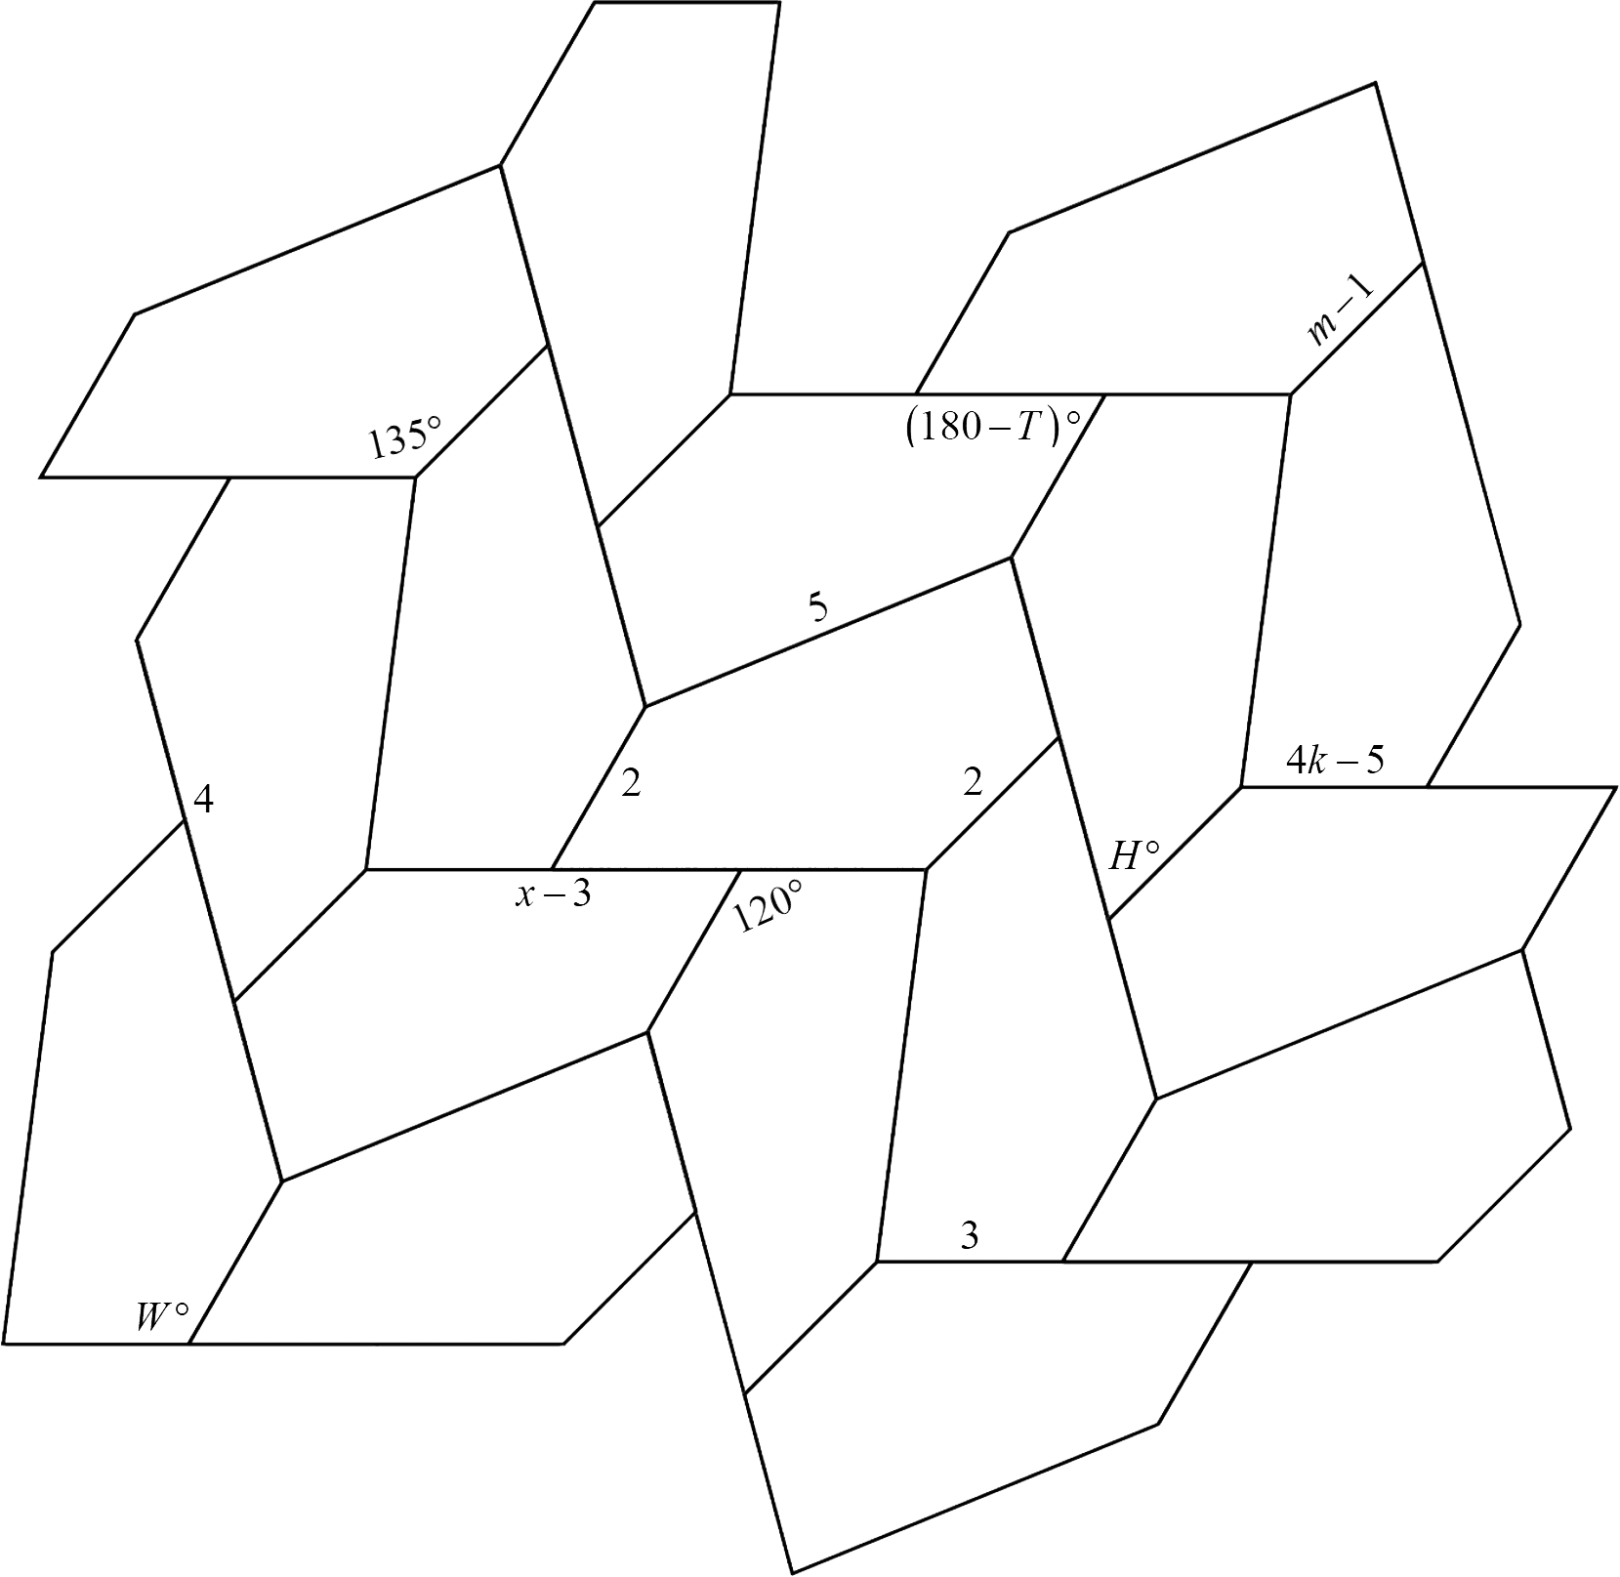
Trying Tessellations
Use your knowledge of congruent polygons to solve for each unknown.

Slide 26
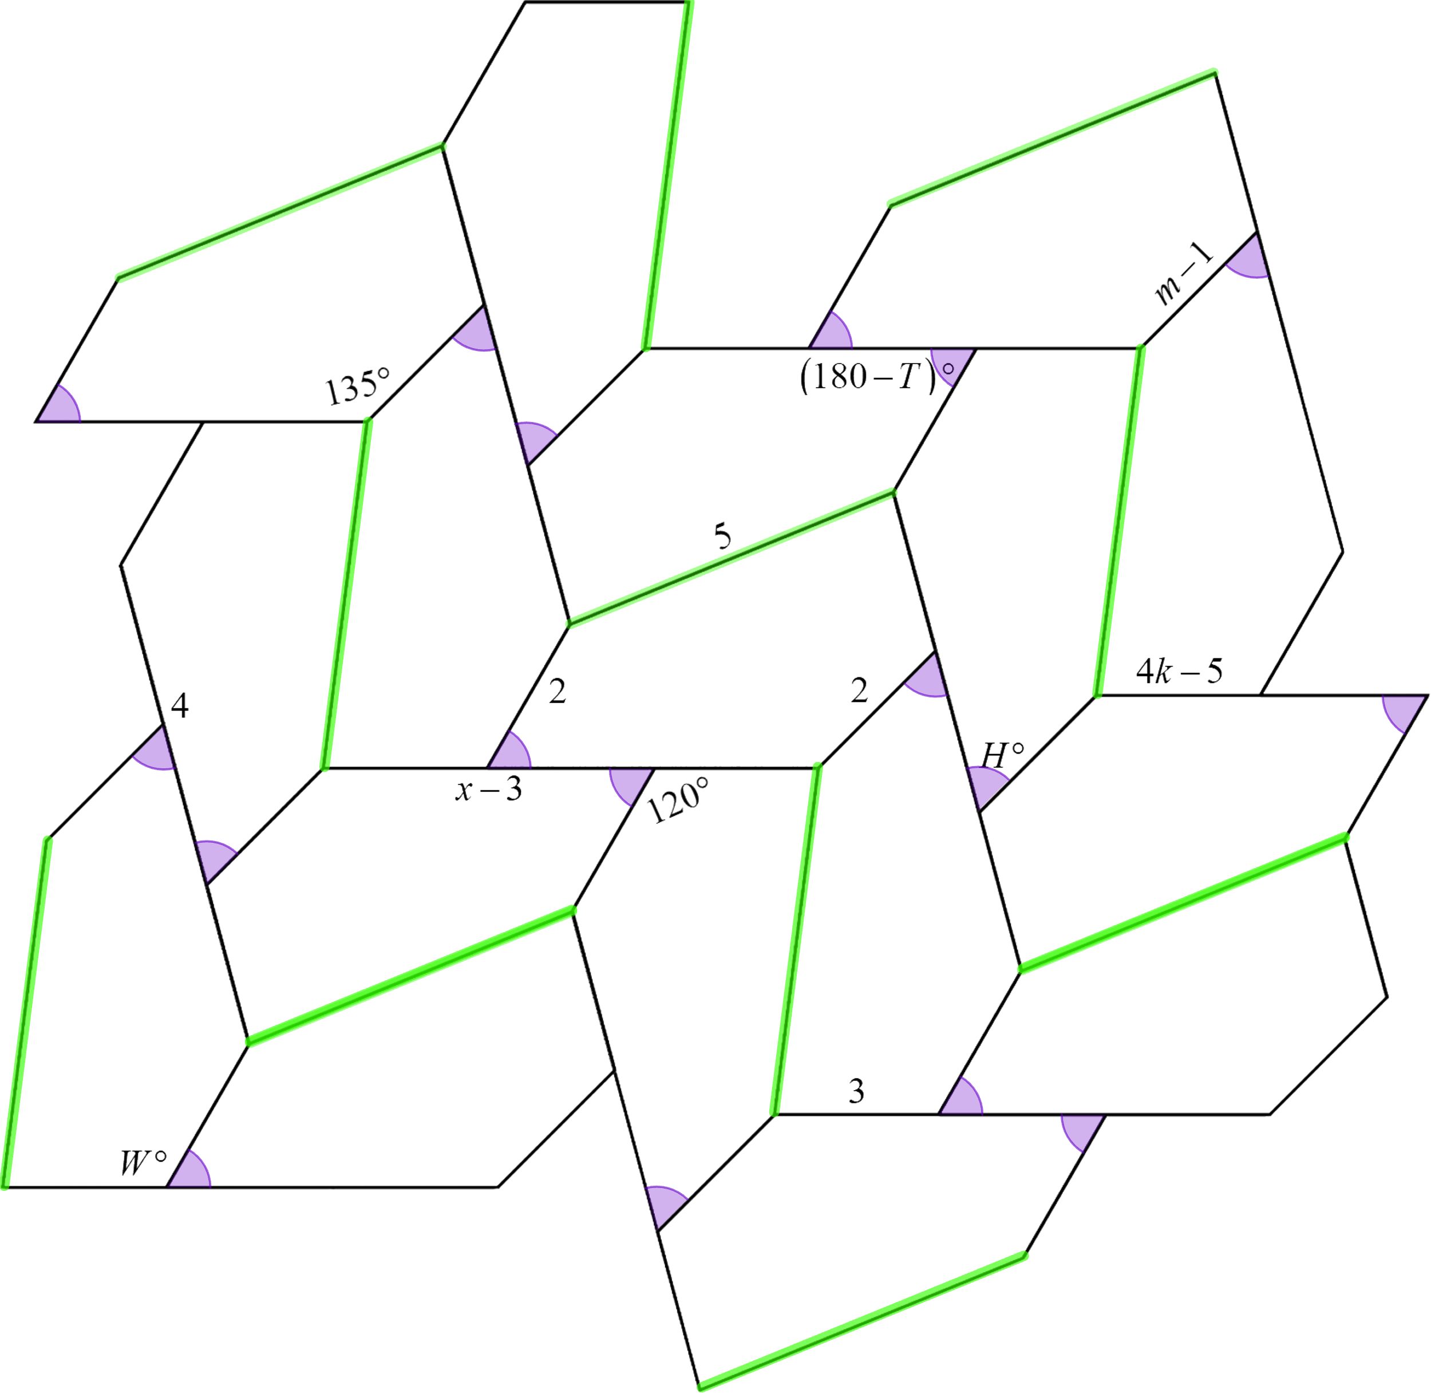
Trying Tessellations
(Solution)
Color-coding the corresponding parts and labeling Polygon ABCDE can be helpful.

Slide 27
Trying Tessellations
(Solution)
CD = 5
DE = 2
AB = 2
AB = m – 1
2 = m – 1
m = 3

Slide 28
Trying Tessellations
(Solution)
BC = 3
BC = 4k – 5
3 = 4k – 5
8 = 4k
k = 2

Slide 29
Trying Tessellations
(Solution)
AE = 4
AE = x – 3
4 = x – 3
7 = x

Slide 30
Trying Tessellations
(Solution)

Slide 31
Trying Tessellations
(Solution)

Slide 32
Trying Tessellations
(Solution)

Slide 33
Trying Tessellations
(Solution)

Slide 34

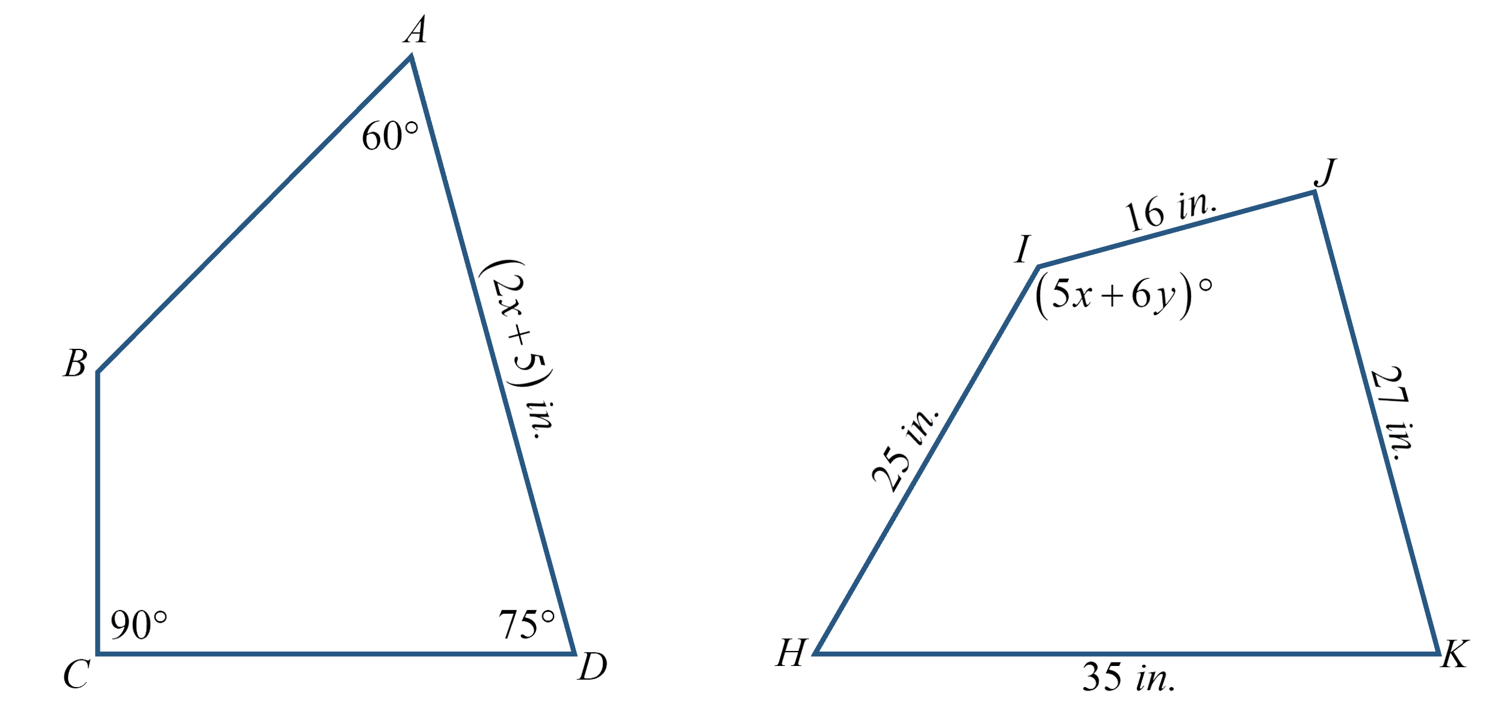
Corresponding Parts
Notes:
K20 Center. (n.d.). Bell ringers and exit tickets. Strategies. https://learn.k20center.ou.edu/strategy/125

Slide 35
Corresponding Parts (Solution)

Slide 36
Corresponding Parts (Solution)

Slide 37
Corresponding Parts (Solution)

