Slide 2
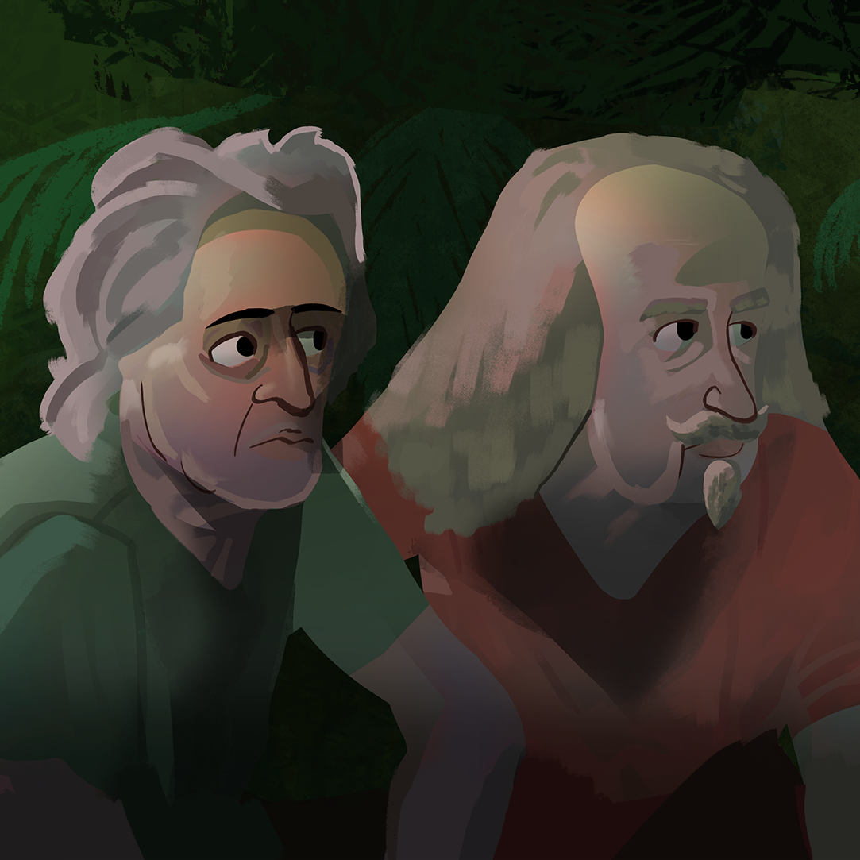
What is the State of Our Nature?
The Political Thoughts of
Thomas Hobbes and John Locke

Slide 3
Essential Question
How much authority should a government have?

Slide 4
Learning Objectives
Explain the idea of the social contract.
Analyze limits on government authority.

Slide 5

Why do People Create Governments?
In pairs, brainstorm a few reasons that explain why people create governments.
Share out what you and your partner come up with.
Notes:
Public Domain Pictures (n.d.) Public institution building [Graphic image]. https://publicdomainpictures.net/en/view-image.php?image=13466&picture=government-building

Slide 6

T-Chart: Democracies and Monarchies
Watch the videos about two different types of governments:
  Monarchies
  Democracies
As you watch, fill out the T-Chart with information you learned about each type of government.
Notes:
K20 Center. (n.d.). T-chart. Strategies. https://learn.k20center.ou.edu/strategy/86

Slide 7
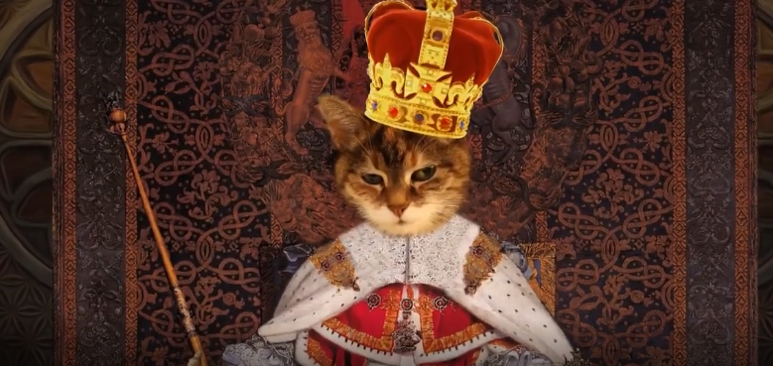
All Hail the King! What is a Monarchy?
Notes:
PBS Learning Media. (n.d.). All Hail the King! What is a Monarchy? [Video]. Politics on Point. PBS. https://oeta.pbslearningmedia.org/resource/all-hail-the-king-what-is-a-monarchy-video/wviz-politics-on-point/.

Slide 8
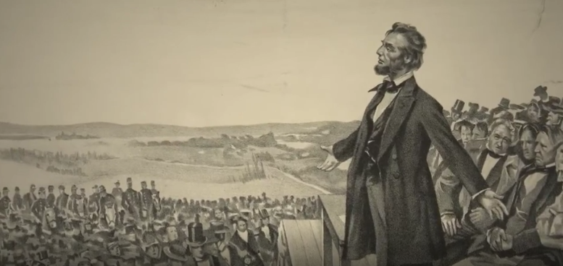
This Is What Democracy Looks Like
Notes:
PBS Learning Media. (n.d.). This is What Democracy Looks Like [Video]. Politics on Point. PBS. https://oeta.pbslearningmedia.org/resource/this-is-what-democracy-looks-like-video/wviz-politics-on-point/

Slide 9
T-Chart: Democracies and Monarchies
Share your T-chart with a partner.
Compare the information you both found.
What are the major differences between a monarchy and a democracy?
Notes:
K20 Center. (n.d.). T-chart. Strategies. https://learn.k20center.ou.edu/strategy/86

Slide 10
Thomas Hobbes
Thomas Hobbes lived in England from 1588–1679.
Of his many books, his most famous is Leviathan, which is about his ideas on government.
Hobbes wrote Leviathan during the English Civil War (1642–1651).
The war was mainly over governance and religious freedom and greatly influenced his opinions.

Slide 11
John Locke
John Locke lived from 1632–1704.
Like Hobbes, Locke wrote many books, including Two Treatises of Government, which was influential in the formation of many governments.

Slide 12

Point of Most Significance
Read “The Philosophies of Hobbes and Locke” handout.
Develop a one-sentence summary of the most important part of the handout.
Share out your summaries.
Notes:
K20 Center. (n.d.). POMS: Point of most significance. Strategies. https://learn.k20center.ou.edu/strategy/101

Slide 13

Debate Team Carousel
Gather in groups of four.
In your group, discuss Hobbes’ and Locke’s arguments, using the Debate Team Carousel handout.
Examine the question: “Who was right about how much power a government should have? Hobbes or Locke?”
Notes:
K20 Center. (n.d.). Debate team carousel. Strategies. https://learn.k20center.ou.edu/strategy/110

Slide 14

Six-Word Memoirs
Write two summaries in exactly six words each:
  One from the perspective of Hobbes.
  One from the perspective of Locke.
Notes:
K20 Center. (n.d.). Six-word memoirs. Strategies. https://learn.k20center.ou.edu/strategy/75

