Slide 2
What is the State of Our Nature?
The Political Thoughts of Thomas Hobbes and John Locke

Slide 3
Essential Question
How much authority should a government have?

Slide 4
Lesson Objectives
Explain the idea of the social contract.
Analyze limits on government authority.

Slide 5
Why Do People Create Governments?
In pairs, brainstorm a few reasons that explain why people create governments.
Share out what you and your partner come up with.
Notes:
Public Domain Pictures (n.d.) Public institution building. [Graphic image]. https://publicdomainpictures.net/en/view-image.php?image=13466&picture=government-building

Slide 6
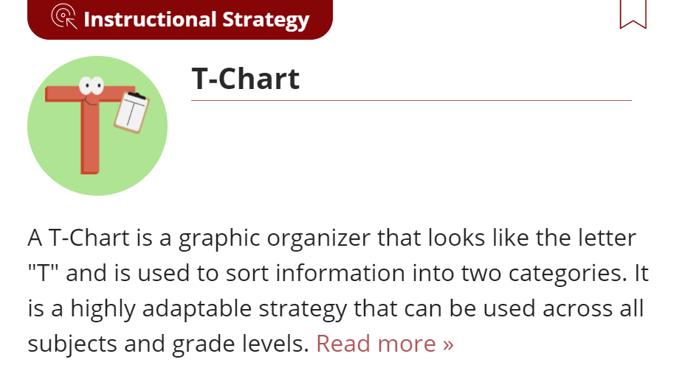
T-Chart: Democracies and Monarchies
Watch the videos about two different types of governments:
Monarchy
Democracy
As you watch, fill out the T-Chart with information you learned about each type of government.
Notes:
https://learn.k20center.ou.edu/strategy/86

Slide 7
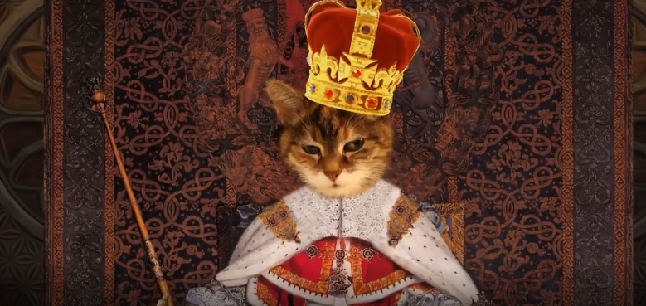
T-Chart Video: All Hail the King! What is a Monarchy?
Notes:
Original PBS url: https://oeta.pbslearningmedia.org/resource/all-hail-the-king-what-is-a-monarchy-video/wviz-politics-on-point/
image from video

Slide 8
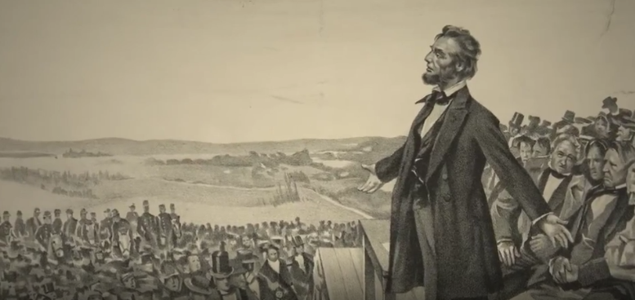
T-Chart Video: This is What Democracy Looks Like.
Notes:
https://oeta.pbslearningmedia.org/resource/this-is-what-democracy-looks-like-video/wviz-politics-on-point/
image from video

Slide 9
T-Chart: Democracy and Monarchy
Share your T-chart with a partner.
Compare the information you both found.
What are the major differences between a monarchy and a democracy?
Notes:
https://learn.k20center.ou.edu/strategy/86

Slide 10
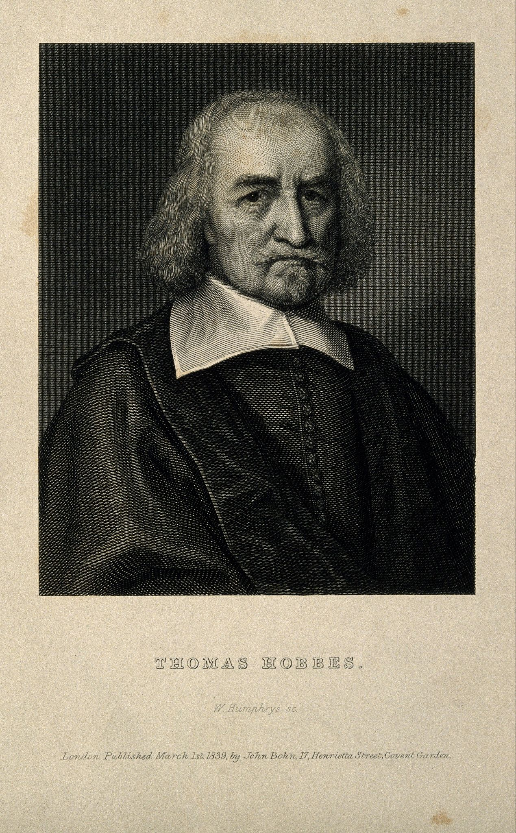
Thomas Hobbes (1588 - 1679)
Thomas Hobbes lived in England from 1588-1679.
Of his many books, his most famous is Leviathan, which is about his ideas on government.
Hobbes wrote Leviathan during the English Civil War (1642-1651).
The Civil War, mainly over governance and religious freedom, lasted 9 years, and greatly influenced his opinions.
Notes:
Wikipedia. (n.d.) Thomas Hobbes. [Digital Image]. https://en.wikipedia.org/wiki/Thomas_Hobbesedia

Slide 11
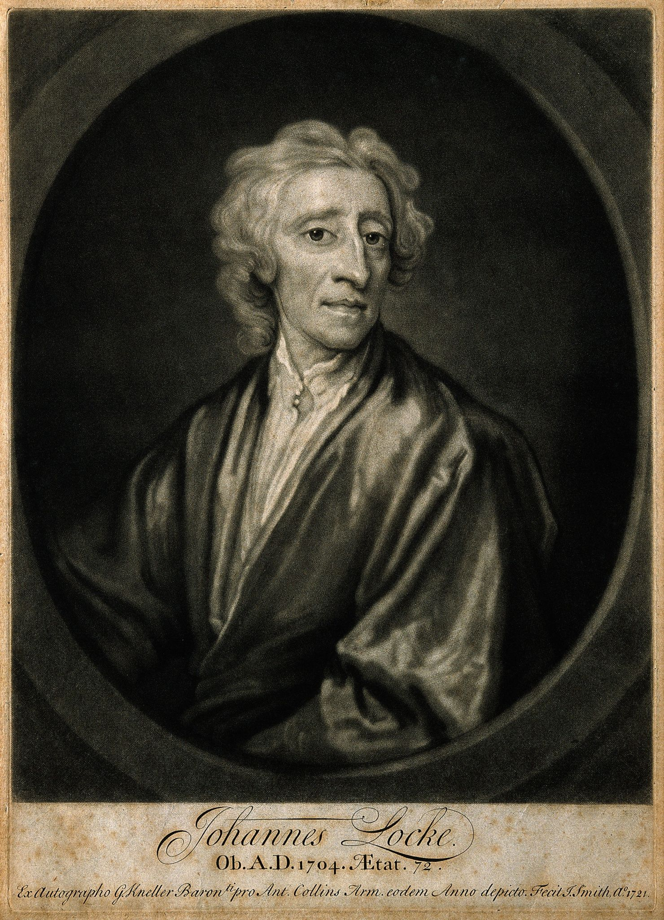
John Locke (1632 - 1704)
John Locke lived from 1632-1704.
Like Hobbes, Locke wrote many books, including Two Treatises of Government, which was influential in the formation of many governments.
Notes:
Wikipedia. (n.d.). John Locke. [Digital Image]. https://en.wikipedia.org/wiki/John_Lockeia

Slide 12
Points of Most Significance (POMS): The Philosophies of Hobbes and Locke
Read “The Philosophies of Hobbes and Locke” handout.
Develop a one-sentence summary of the most important part of the handout.
Share out your summaries.
Notes:
https://learn.k20center.ou.edu/strategy/101

Slide 13
Debate Team Carousel
Gather in groups of 4.
In your group, discuss Hobbes’ and Locke’s arguments, using the Debate Team Carousel handout.
Examine the question: “Who was right about how much power a government should have? Hobbes or Locke?”
Notes:
https://learn.k20center.ou.edu/strategy/110

Slide 14
Six-Word Memoirs
Use sticky notes to create two six- word memoirs, summaries of no more than six words.
One from the perspective of Hobbes
One from the perspective of Locke.
Notes:
https://learn.k20center.ou.edu/strategy/130

