Slide 2
Electric Avenue
What Is a Wave? Lesson 4

Slide 3
Essential Questions
What are waves?
How do waves behave differently from particles?

Slide 4
Lesson Objectives
Explain that light has wave properties and is part of a bigger phenomenon called electromagnetic radiation.
Explain the main features of the EM spectrum.

Slide 5

Puzzled
With your group:
Assemble the pictures.
Summarize what each picture represents.

Slide 6

Puzzled

Slide 7

Puzzled

Slide 8

Puzzled

Slide 9
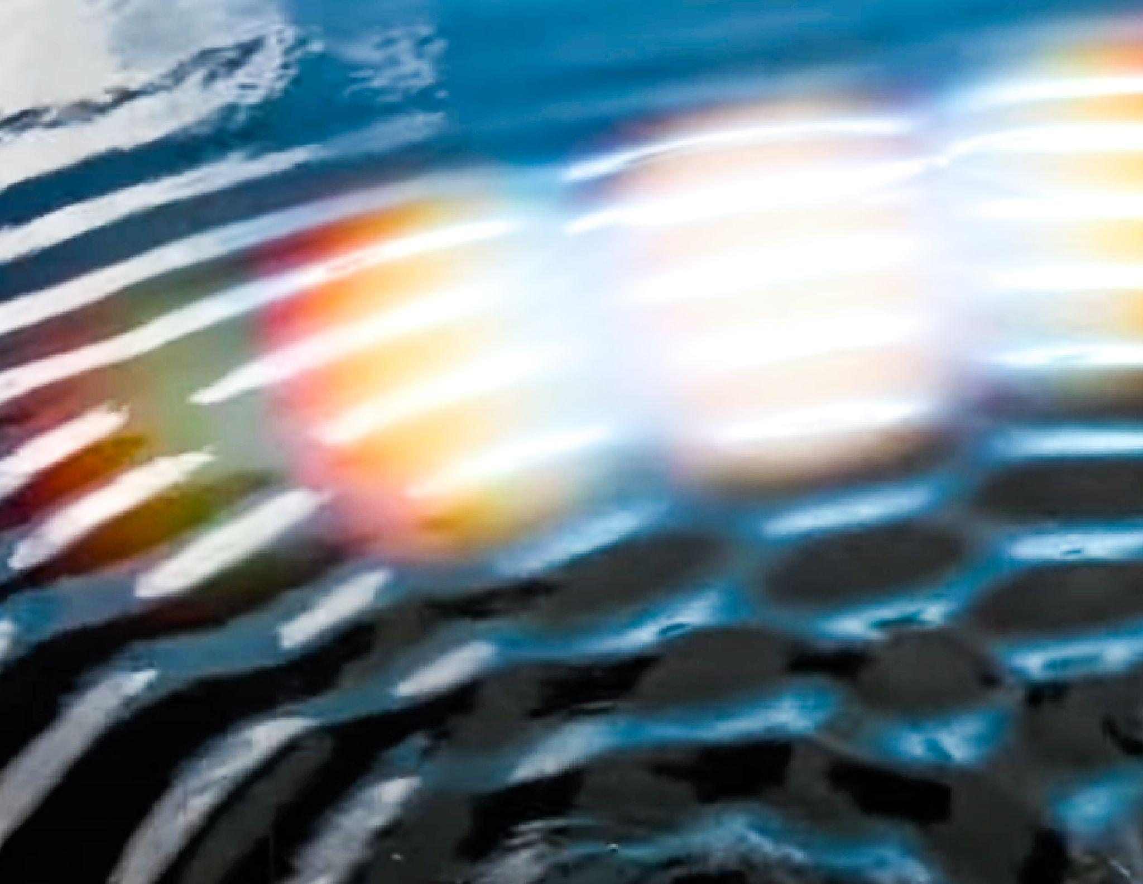
Puzzled

Slide 10
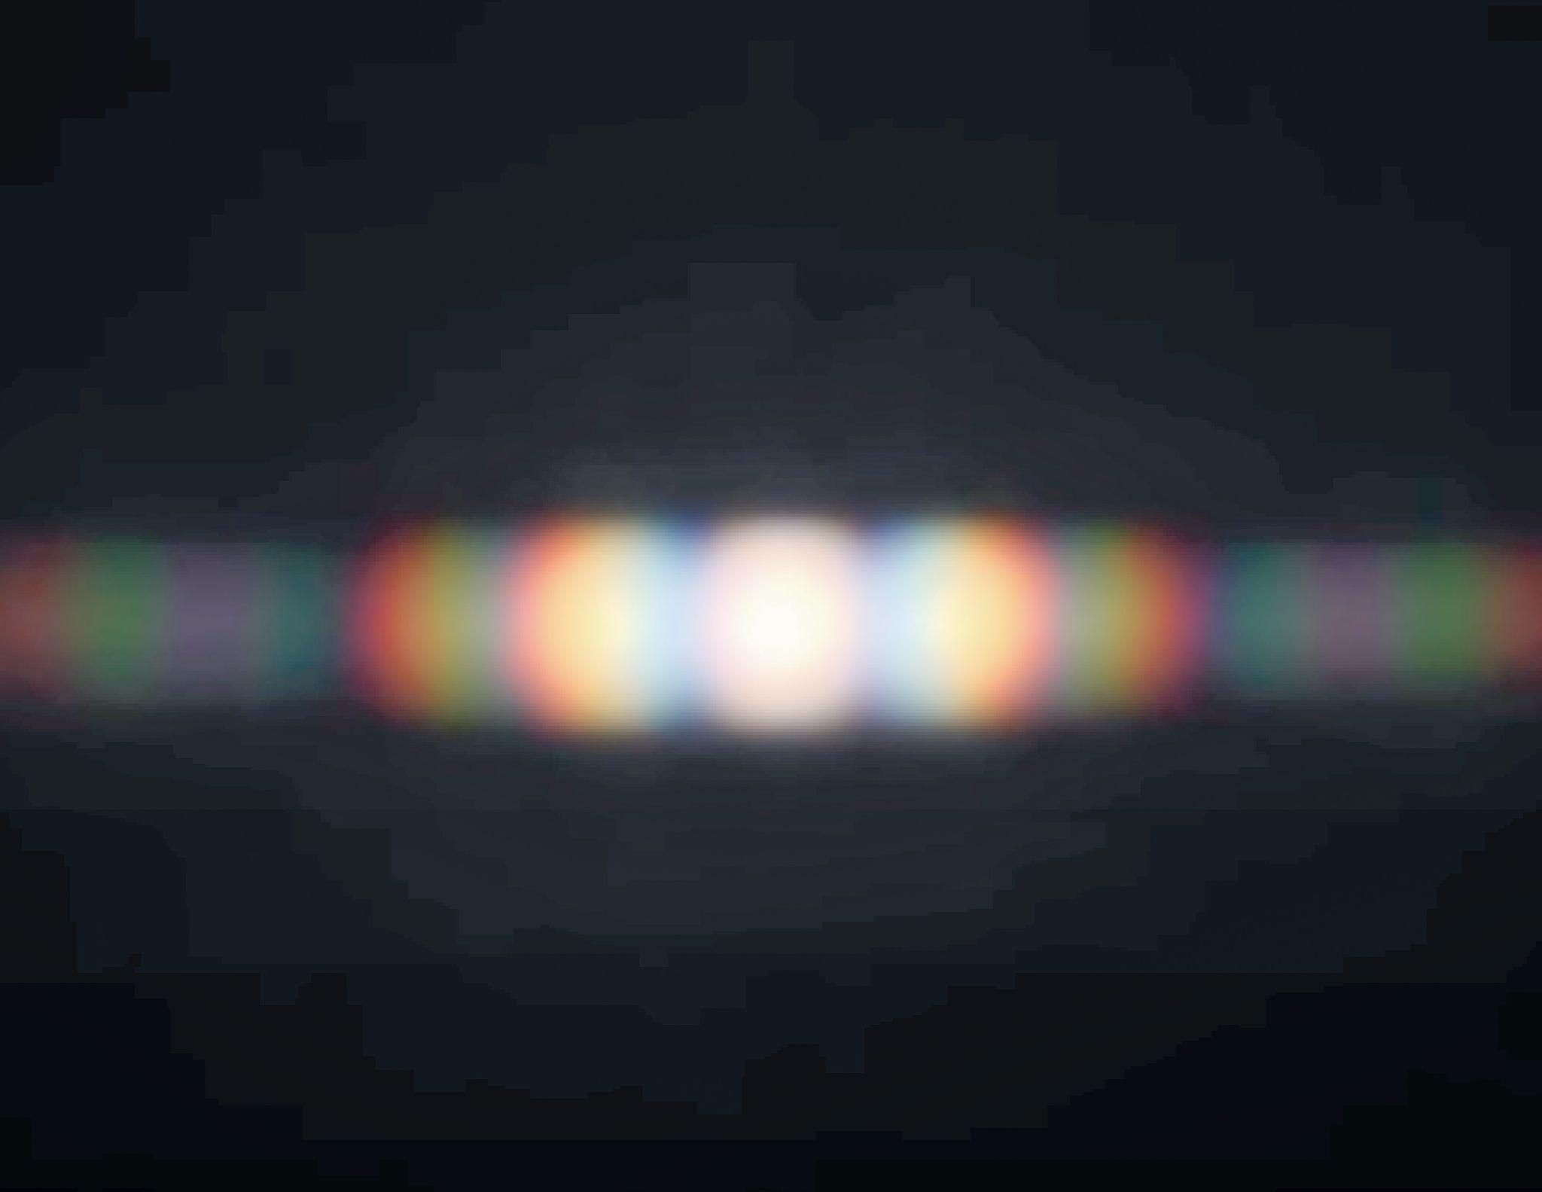
Puzzled

Slide 11

Painting a Picture
View the images that are related to electromagnetic (EM) waves.
In the chart provided, include the following:
  Observations
  Inferences
  Explanation

Slide 12
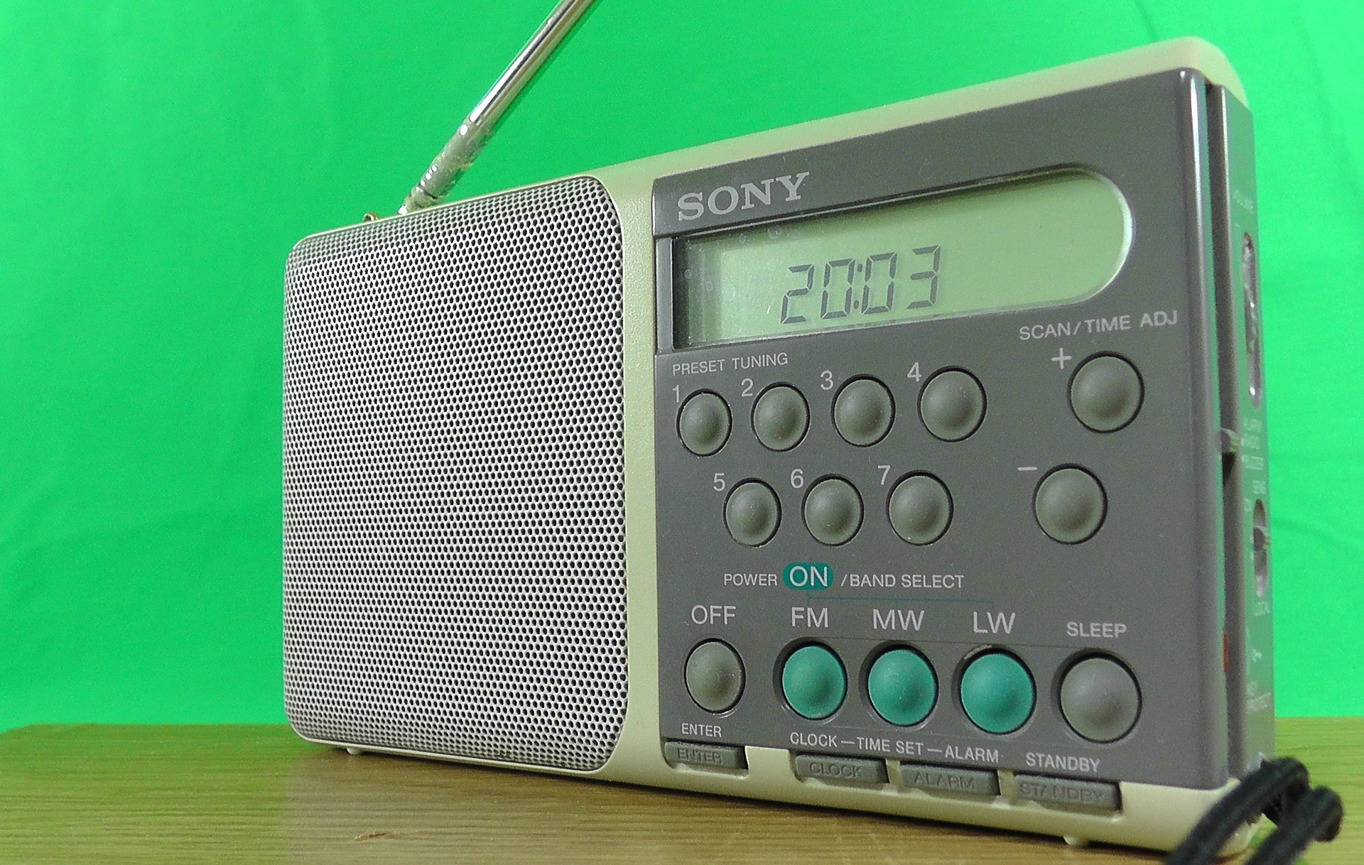
Radio Waves
Frequency Range (Hz)
< 3*10¹¹
Wavelength Range
> 1 mm
Notes:
dansamu. (2016). Radio small green background [Image]. Pixabay. https://pixabay.com/photos/radio-small-green-background-1339186/

Slide 13
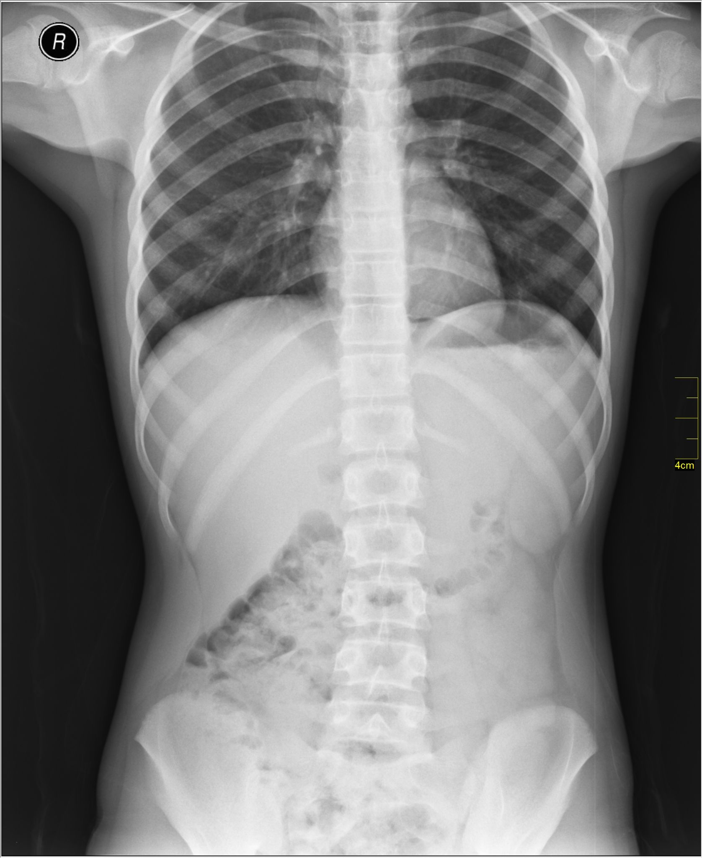
X-Rays
Frequency Range (Hz)
10¹⁷ - 10²⁰
Wavelength Range
1 nm - 1 pm
Notes:
Dilmen, N. (2011). Medical X-ray [Image]. Wikimedia Commons. https://commons.wikimedia.org/wiki/File:Medical_X-Ray_imaging_TOW07_nevit.jpg

Slide 14
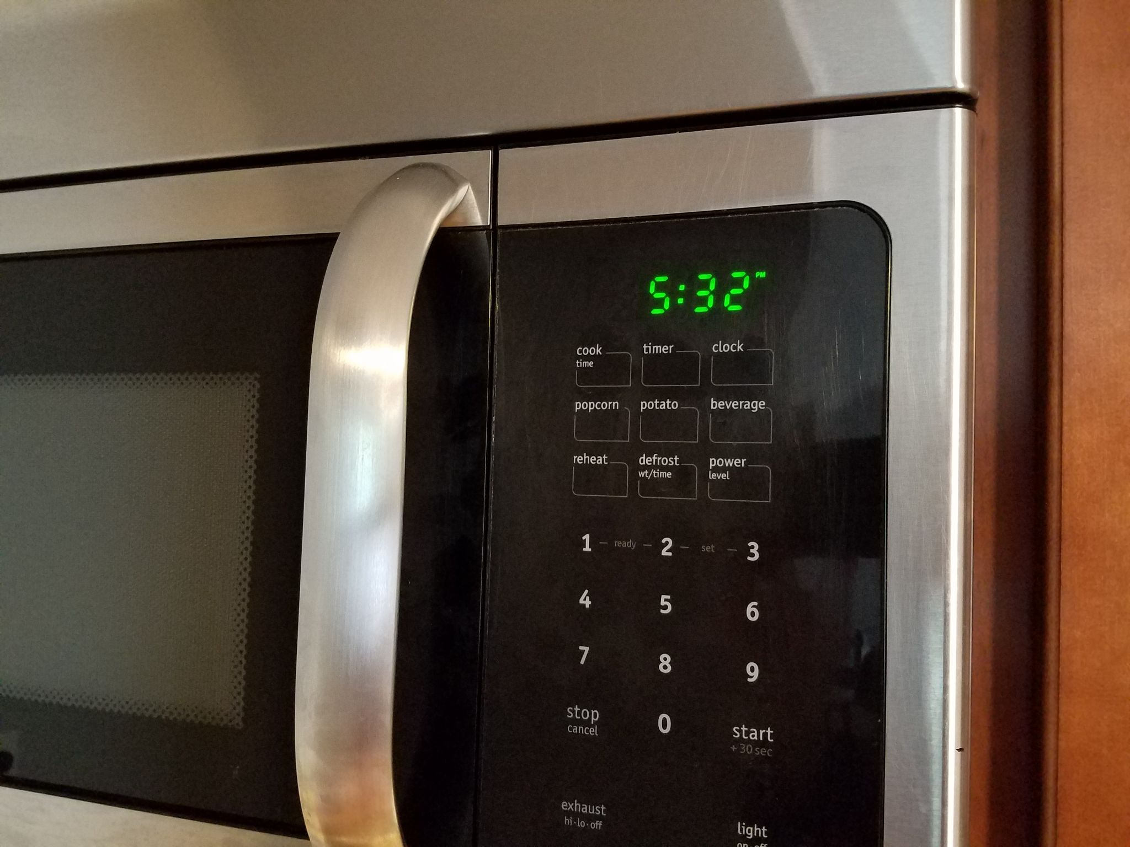
Microwaves
Frequency Range (Hz)
3*10¹¹ - 10¹³
Wavelength Range
1 mm - 25 μm
Notes:
ECTran71. (2020). Frigidaire microwave clock [Image]. Wikimedia Commons. https://commons.wikimedia.org/wiki/File:Frigidaire_microwave_clock_20200418.jpg

Slide 15
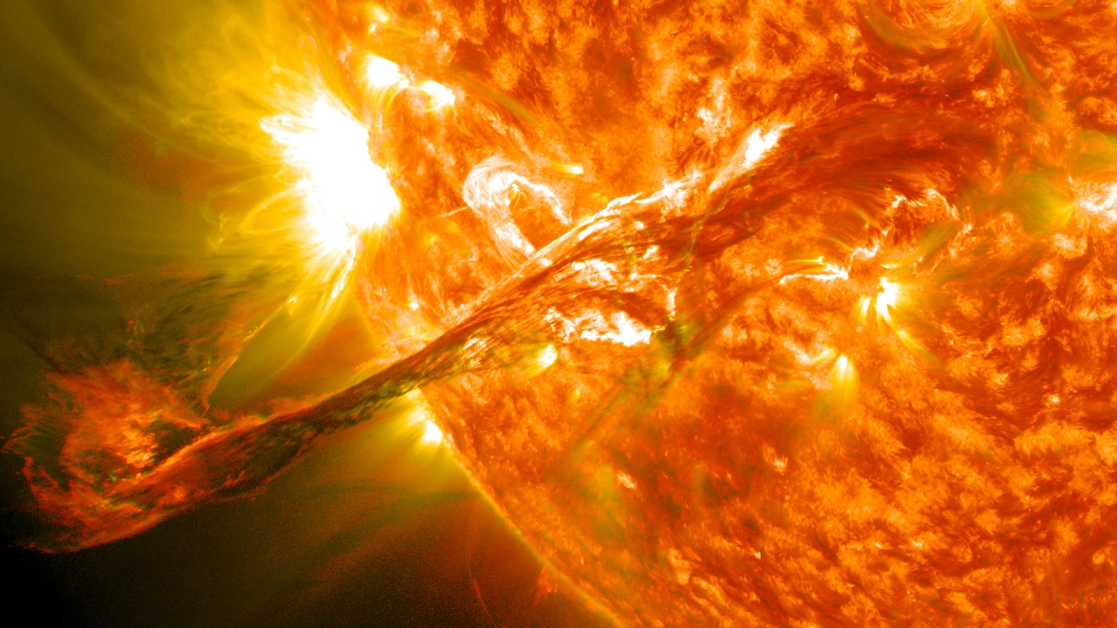
Solar Rays (visible light)
Frequency Range (Hz)
10¹³ - 10¹⁴
Wavelength Range
25 μm - 2.5 μm
Notes:
NASA Goddard Space Flight Center. (2012). Magnificent cme erupts on the Sun [Image]. Wikimedia Commons. https://commons.wikimedia.org/wiki/File:Magnificent_CME_Erupts_on_the_Sun_-_August_31.jpg

Slide 16
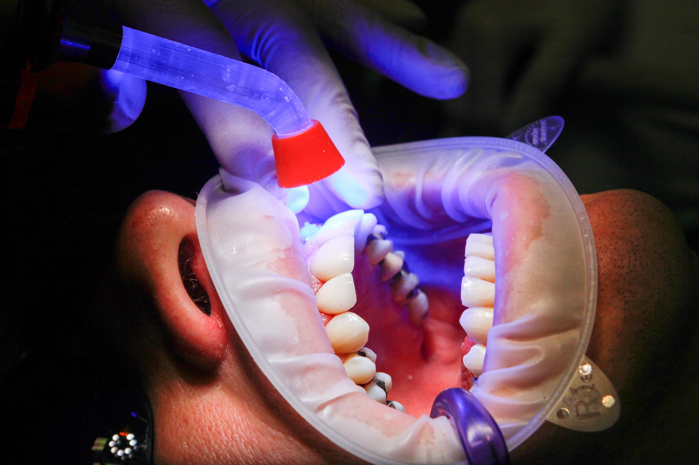
UV Light
Frequency Range (Hz)
10¹⁵ - 10¹⁷
Wavelength Range
400 nm - 1 nm
Notes:
ales_kartal. (2016). UV light curing [Image]. Pixabay. https://pixabay.com/photos/dentist-facet-uv-light-curing-1864921/

Slide 17

Notes:
Best0fScience. (2010, August 1). The electromagnetic spectrum [Video]. YouTube. https://www.youtube.com/watch?v=cfXzwh3KadE

Slide 18
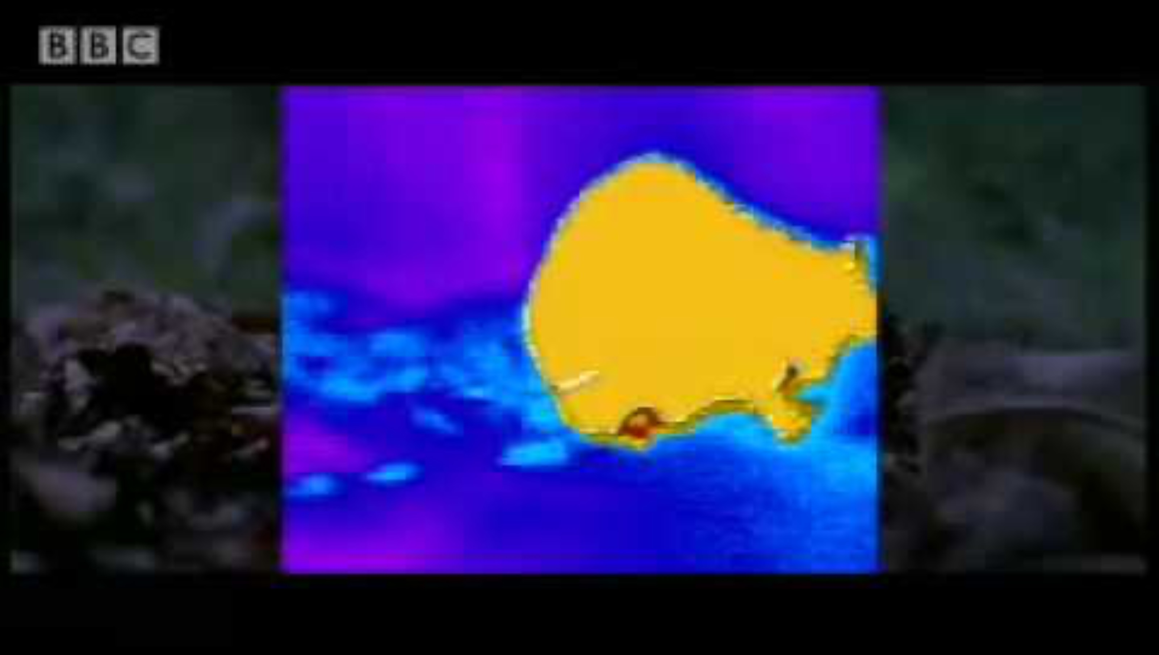
Notes:
BBC Studios. (2008, November 24). Heat sensing pit vipers - deadly vipers - BBC animals [Video]. YouTube. https://www.youtube.com/watch?v=lySW2-eYilg

Slide 19

Cornell Notes
Definition of electromagnetic waves
Electromagnetic (EM) waves are vibrations that travel through electric and magnetic energy fields, which are present everywhere in the universe.

Slide 20
Cornell Notes
EM waves use these fields as their medium for travel
They do NOT need to travel through matter like mechanical waves

Slide 21
Cornell Notes
EM waves travel at “c” through the vacuum of space or close to “c” through matter. The more dense the matter is, the slower EM waves travel.
c = speed of light = 3 x 10⁸ m/s

Slide 22
Cornell Notes
EM waves are generated by atoms.
As atoms absorb energy, their electrons jump to higher energy states. But the electrons want to return to lower energy states.
Electrons give up specific amounts energy when they return to less energetic states.

Slide 23
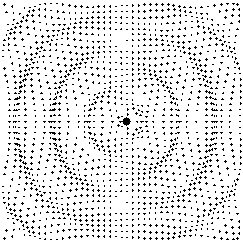
Cornell Notes
The energy released by electrons causes electric and magnetic fields to vibrate at specific frequencies, like ripples in a flag.
Electrons with the low energies produce low energy EM waves, with the longer wavelengths and lower frequencies.
Notes:
(n.d.). Gifer.com. Retrieved August 2, 2022, from https://gifer.com/en/NyPP.

Slide 24
Cornell Notes
Electrons with higher energies produce more energetic EM waves. As the energy of EM waves increases, their wavelength gets shorter and their frequency increases.

Slide 25
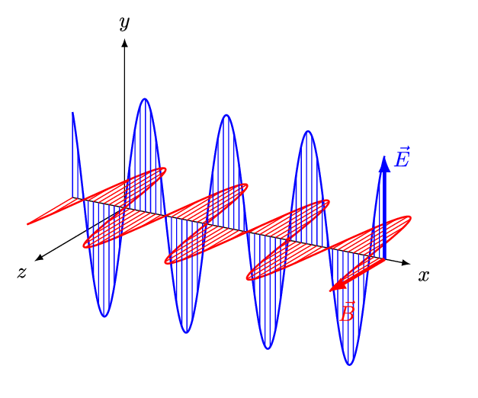
Cornell Notes
Fun fact: the electric and magnetic field vibrations that make up EM waves are permanently linked, and are perpendicular to each other.
Notes:
Em-Wave.gif. (2016). Wikimedia.org. Retrieved August 2, 2022, from https://commons.wikimedia.org/wiki/File:EM-Wave.gif.

Slide 26
Cornell Notes
Radio waves, microwaves, infrared light, visible light, ultraviolet light, x-rays, and gamma rays are all examples of EM waves. Each has a different energy range. They are all part of what we call the electromagnetic spectrum.
Humans can only detect infrared (heat) through our skin and visible light through our eyes. Other types of EM radiation are undetectable by us.

Slide 27
Cornell Notes
The color of visible light that we detect is directly related to its frequency, which is directly related to its energy. Red light has the lowest energy (even though we feel infrared as “heat”), and violet light has the highest energy.

Slide 28
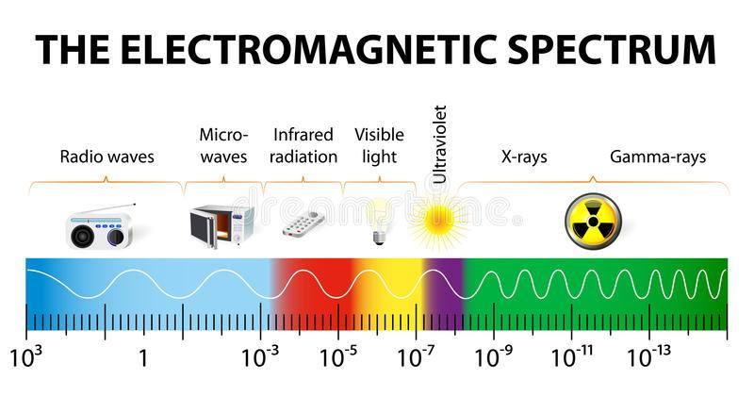
Cornell Notes

Slide 29
Cornell Notes
At the bottom of your notes page, summarize the ideas into one or two sentences.

Slide 30
Cornell Notes
Review your notes and summaries with a partner.
What are the key concepts?
Update your summary based on the discussion.

Slide 31
Electromagnetic Spectrum Charts
In your charts include each of the following:
Definition of electromagnetic waves
Number line with wavelengths and frequencies included
Illustrations of the different uses for electromagnetic waves
The names of the electromagnetic bands
A light spectrum

