Slide 2
Radical Yet Rational, Part 1
Rewriting Rational Exponents and Radicals

Slide 3
Essential Question
Why do we use rational exponents to represent radicals?

Slide 4
Lesson Objectives
Rewrite expressions with rational exponents as radical expressions and vice versa.
Simplify radical expressions and expressions with rational exponents.
Develop deep, flexible conceptual understanding.

Slide 5

Card Matching
Go to student.desmos.com and enter this code: ________
Group the example card and equivalent expression cards with the property they demonstrate.
Notes:
K20 Center. (n.d.). Card Matching. Strategies. https://learn.k20center.ou.edu/strategy/1837

Slide 6
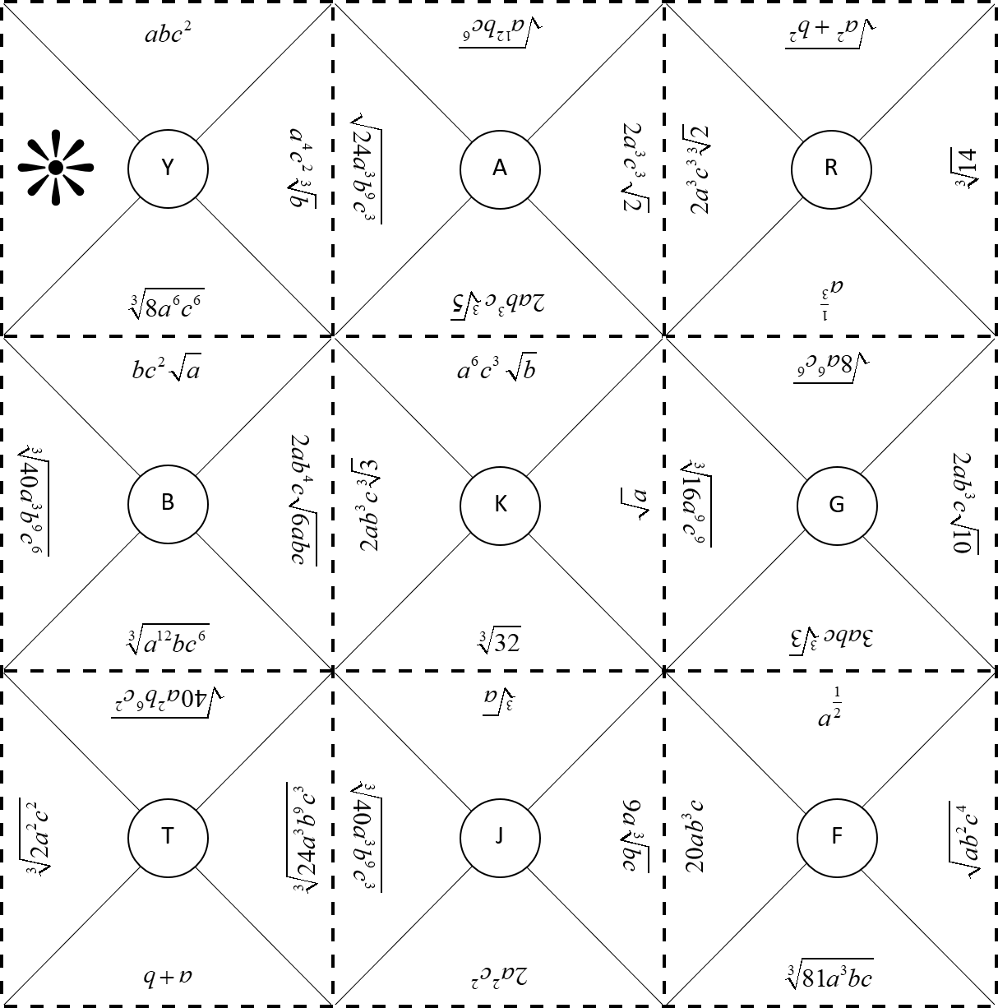
Square Puzzle
Rearrange the puzzle pieces into a square by matching sides with equivalent values.
  Assume all variables are positive.

Slide 7

I Notice, I Wonder
Take a moment to look at the completed puzzle.
  What do you notice?
  What do you wonder?
Notes:
K20 Center. (n.d.). I Notice, I Wonder. Strategies. https://learn.k20center.ou.edu/strategy/180

Slide 8
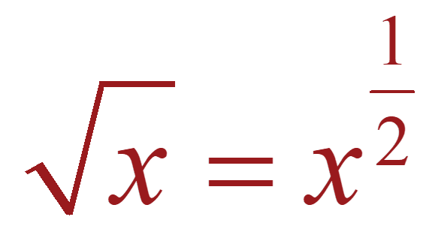
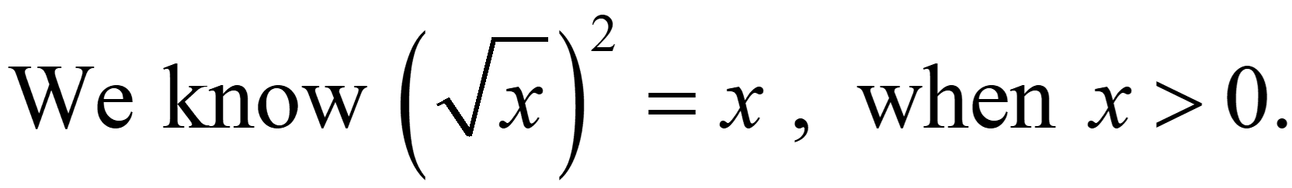
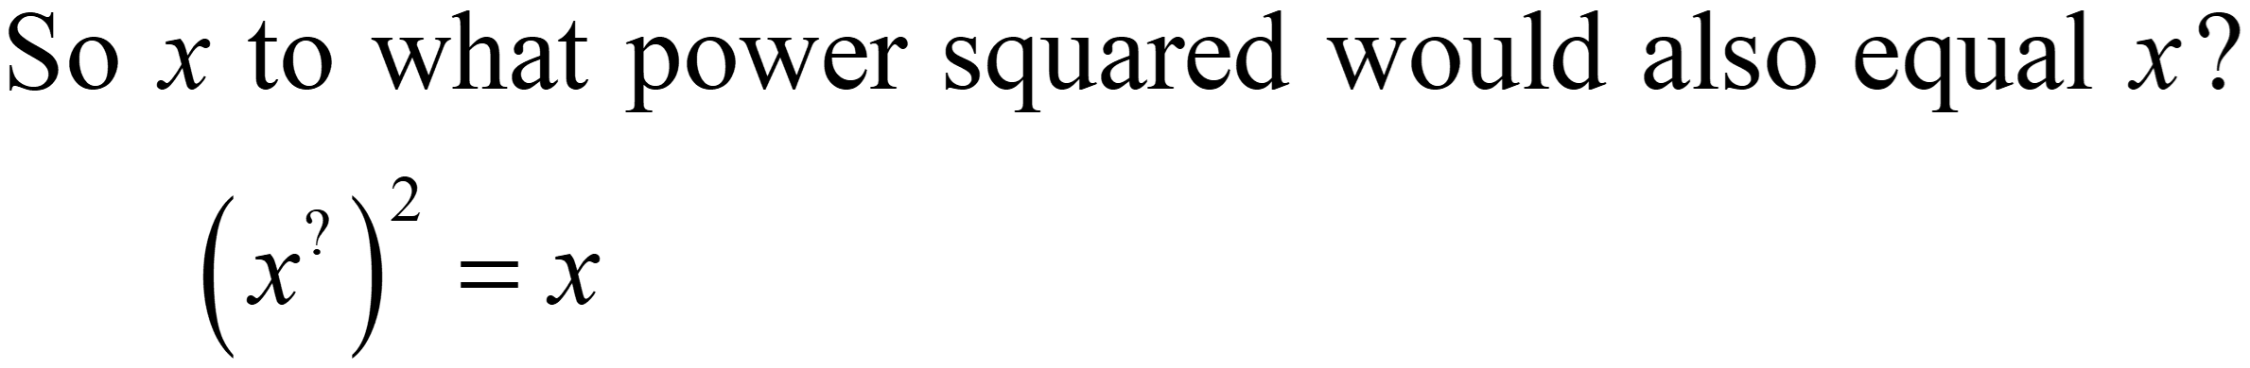
Why does ?
We know when .
So, to what power squared would also equal ?

Slide 9
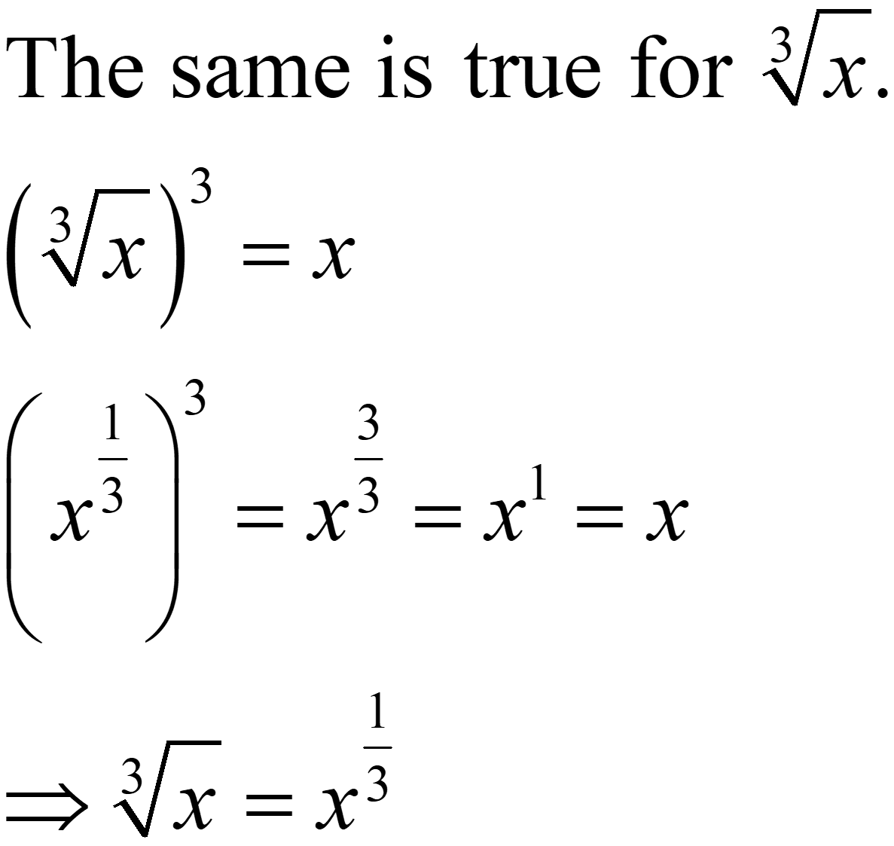
Why does ?
The same is true for .

Slide 10
Guided Notes
Let’s complete the Guided Notes together.

Slide 11
Different Methods, Same Result
Simplify each expression using different methods.
  Decide with your partner which method you each will use.
  Circle your selected method.
  Simplify each expression.
  Check each answer with your partner.

Slide 12
Different Methods (Solution 1)

Slide 13
Different Methods (Solution 2)

Slide 14
Different Methods (Solution 3)

Slide 15
Different Methods (Solution 4)

Slide 16
Pass the Problem
Work together to simplify each expression, taking turns.
  Decide with your partner who is student A and who is student B.
  For question 1, student A will write the first step.
    Pass the paper to student B.
  Student B will write the second step in the simplifying process.
    Pass the paper back to student A.
Continue taking turns until you finish question 1.
  For question 2, student B will start instead.
Notes:
K20 Center. (n.d.). Pass the Problem. Strategies. https://learn.k20center.ou.edu/strategy/151

Slide 17
Pass the Problem: Reflection
Take a moment to write why you selected one method over the other when you started your problem.
  Do you prefer one method over the other?
  Does the type of problem influence your decision?
  Are you flexible in working with both methods?

Slide 18
Pass the Problem (Solution 1)

Slide 19
Pass the Problem (Solution 2)

