Slide 2
From Horses to Airplanes
Technology in WWI and its Effects

Slide 3
Essential Questions
How does war influence innovation?
What are the consequences of war-time innovations?

Slide 4
Lesson Objective
Explain how advancements in technology impacted WWI and the major combatants involved in the war.

Slide 5
Dulce Et Decorum Est – Wilfred Owen
Notes:
Dulce Et Decorum Est recited by Christopher Eccleston
https://www.youtube.com/watch?v=qB4cdRgIcB8&t=120s

Slide 6
Dulce Et Decorum Est Reflection Questions
What is the poem about?
What is the tone of the poem?
What is happening to the person the poet describes in the last paragraph?

Slide 7
Reflection Questions: Dulce Et Decorum Est
Dulce Et Decorum Est – It is sweet and good to die for your country.
How does this last line change the tone of the poem?
What does the poet think of war?

Slide 8
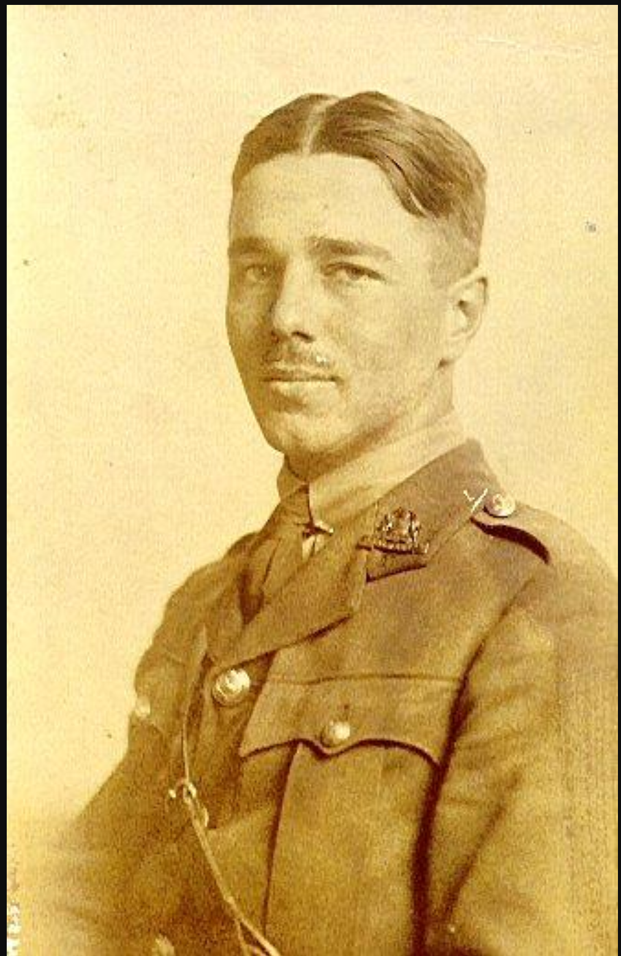
Wilfred Owen Biography
Wilfred Owen was an English poet who lived from 1893-1918.
He enlisted in the army in 1915.
He wrote poetry about his experience in war, which was published after his death.
He was killed leading his troops into France four days before the war ended.
Notes:
Langie, A. (2013, November 16). File:Wilfred Owen à l'Arrouaise. Retrieved July 30, 2021, from https://upload.wikimedia.org/wikipedia/commons/a/a3/Wilfred_Owen_%C3%A0_l%27Arrouaise.jpg
History. (2014). Historic Figures: Wilfred Owen (1893 - 1918). Retrieved July 30, 2021, from http://www.bbc.co.uk/history/historic_figures/owen_wilfred.shtml

Slide 9
New Technologies of WWI
Visit the six image stations posted around the room to view images related to WWI.
Use the Painting a Picture Chart to record observations on the left side and inferences on the right side.
Notes:
https://learn.k20center.ou.edu/strategy/1331

Slide 10
Tech Developments of World War I
Notes:
History. Tech Developments of World War I. [Video]. YouTube. https://www.youtube.com/watch?v=k7v3cq1ZJjM&t=15s

Slide 11
Technologies of WWI
Divide the six readings between group members.
Give two to each student.
Read about the war-time technology and take notes.
Share what you have learned with group members.
Notes:
https://learn.k20center.ou.edu/strategy/179

Slide 12
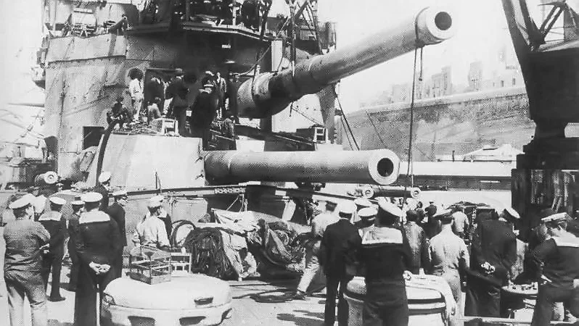
Researching WWI Casualties
Use the casualty handout to research how many people were killed or injured during WWI from each country.
Begin your research with suggested websites on the handout.
Turn your data into a table and analyze how many casualties occurred during the war.
Notes:
Golson, J. (2014). The WWI battleships and saved (and doomed) the British Empire. Wired. https://www.wired.com/2014/08/the-wwi-battleships-that-saved-and-doomed-the-british-empire/

Slide 13
Claim, Evidence, Reasoning
Think about the question, how did new technologies impact World War I?
In the first box, write your claim.
In the second box, write a sentence describing evidence that backs up your claim.
In the third box, explain in one sentence (reasoning) how your claim and evidence connect.
Notes:
https://learn.k20center.ou.edu/strategy/156

