Slide 2
From Horses to Airplanes
Advancements in Technology During WWI

Slide 3
Essential Questions
How does war influence innovation?
What are the consequences of war-time innovations?

Slide 4
Lesson Objectives
Explain how advancements in technology impacted WWI.

Slide 5

Dulce Et Decorum Est – Wilfred Owen

Slide 6

Dulce Et Decorum Est Reflection Questions
What is the poem about?
What is the tone of the poem?
What is happening to the person the poet describes in the last paragraph?

Slide 7
Dulce Et Decorum Est Reflection Questions
Dulce Et Decorum Est –
It is sweet and good to die for your country.
How does this last line change the tone of the poem?
What does the poet think of war?

Slide 8
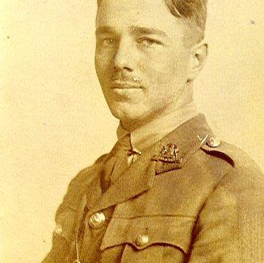
Wilfred Owen Biography
Wilfred Owen was an English poet who lived from 1893-1918.
He enlisted in the army in 1915.
He wrote poetry about his experience in war.
He was killed while leading his troops in France four days before the war ended.
Notes:
Langie, A. (2013, November 16). File:Wilfred Owen à l'Arrouaise. Retrieved July 30, 2021, from https://upload.wikimedia.org/wikipedia/commons/a/a3/Wilfred_Owen_%C3%A0_l%27Arrouaise.jpg
History - Historic Figures: Wilfred Owen (1893 - 1918). (2014). Retrieved July 30, 2021, from http://www.bbc.co.uk/history/historic_figures/owen_wilfred.shtml

Slide 9

New Technologies of WWI
Visit the six image stations to view images related to WWI.
Use the Painting a Picture Chart to record observations on the left side and inferences on the right side.

Slide 10

Tech Developments of World War I

Slide 11

Technologies of WWI
Divide the six readings between group members – 2 for each student.
Read about the technology and take notes.
Share what you have learned with group members.

Slide 12
Researching WWI Casualties
Use the handout to research how many people were killed or injured during WWI from each country.
Suggested websites are included on the handout to find information.
Turn your data into a table and analyze how many casualties occurred during the war.

Slide 13

Claim, Evidence, Reasoning
Think about the question, how did new technologies impact World War I?
Respond with a claim in the first box.
Add a sentence with evidence that backs up your claim in the second box.
Add a sentence with how your claim and evidence connect in the third box.

