Slide 2
From Horses to Airplanes
Advancements in Technology During WWI

Slide 3
Essential Question
How did new technologies impact the way World War I was fought?

Slide 4
Learning Objective
Explain how advancements in technology impacted World War I.

Slide 5

Dulce Et Decorum Est by Wilfred Owen: Read by Christopher Eccleston
Notes:
Channel 4 Documentaries. (2013, November 7). Dulce Et Decorum Est by Wilfred Owen: Read by Christopher Eccleston | Remembering World War 1 | C4 [Video]. YouTube. https://www.youtube.com/watch?v=qB4cdRgIcB8

Slide 6

Dulce Et Decorum Est
What is the poem about?
What is the tone of the poem?
What is happening to the person the poet describes in the last paragraph?

Slide 7
Dulce Et Decorum Est
Dulce Et Decorum Est:
  It is sweet and good to die for your country.
How does this last line change the tone of the poem?
What does the poet think of war?

Slide 8
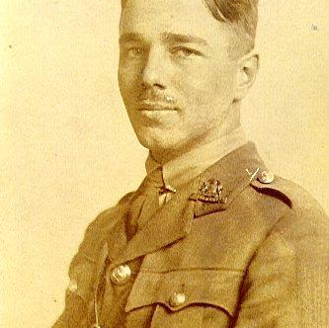
Wilfred Owen Biography
Wilfred Owen was an English poet who lived from 1893-1918.
He enlisted in the army in 1915.
He wrote poetry about his experience in war.
He was killed while leading his troops in France four days before the war ended.
Notes:
Langie, A. (2013, November 16). File:Wilfred Owen à l'Arrouaise [Photograph]. Retrieved July 30, 2021, from https://upload.wikimedia.org/wikipedia/commons/a/a3/Wilfred_Owen_%C3%A0_l%27Arrouaise.jpg
History - Historic Figures: Wilfred Owen (1893 - 1918). (2014). Retrieved July 30, 2021, from http://www.bbc.co.uk/history/historic_figures/owen_wilfred.shtml

Slide 9
World War I Technologies
Go to https://k20.ou.edu/p2
Take notes over each set of images using the handout.
Describe what you see in each set of images.
Write down how you think the technology impacted how World War I was fought.
Notes:
K20 Center. (n.d.). Painting a picture. Strategies. https://learn.k20center.ou.edu/strategy/1331

Slide 10
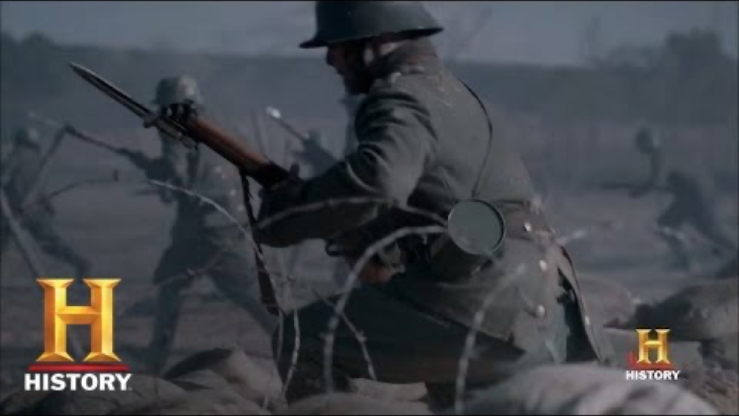
Tech Developments of World War I | History
Notes:
HISTORY. (2014, May 22). Tech Developments of World War I | History [Video]. YouTube. https://www.youtube.com/watch?v=k7v3cq1ZJjM

Slide 11

Technologies of WWI
Divide the six readings between group members—two for each student.
Write down descriptions of the technology and how it was used during World War I.
Share what you have learned with group members.
Notes:
K20 Center. (n.d.). Jigsaw. Strategies. https://learn.k20center.ou.edu/strategy/179

Slide 12

Letter from Wayne to His Folks
Read the letter a WWI soldier wrote to his parents.
Write down something you find:
  Surprising
  Interesting
  Troubling
Notes:
K20 Center. (n.d.). Surprising, interesting, troubling. Strategies. https://learn.k20center.ou.edu/strategy/926

Slide 13

Exit Ticket
How did new technologies impact the way World War I was fought?
Notes:
K20 Center. (n.d.). Bell ringers and exit tickets. Strategies. https://learn.k20center.ou.edu/strategy/125

