Slide 2
Radical Yet Rational, Part 2
Solving With Rational Exponents and Radicals

Slide 3
Essential Question
How do we use rational exponents and radicals
to solve problems?

Slide 4
Lesson Objectives
Understand how rational exponents and radicals can be used as inverse operations to isolate a variable.
Compare the use of rational exponents to the use of radicals when solving problems.

Slide 5
Find the Mistake
Work with a partner to describe and correct the error.
  Assume all variables are positive.

Slide 6
Solving Questions 1 and 2
Find the solution(s) to the following equations.

Slide 7
Question 1 (Solution)

Slide 8
Question 2 (Solution)

Slide 9
Solving Questions 3 and 4
Share your thinking on how to start solving the following equations.

Slide 10
Guided Notes
Let’s complete the Guided Notes together.

Slide 11
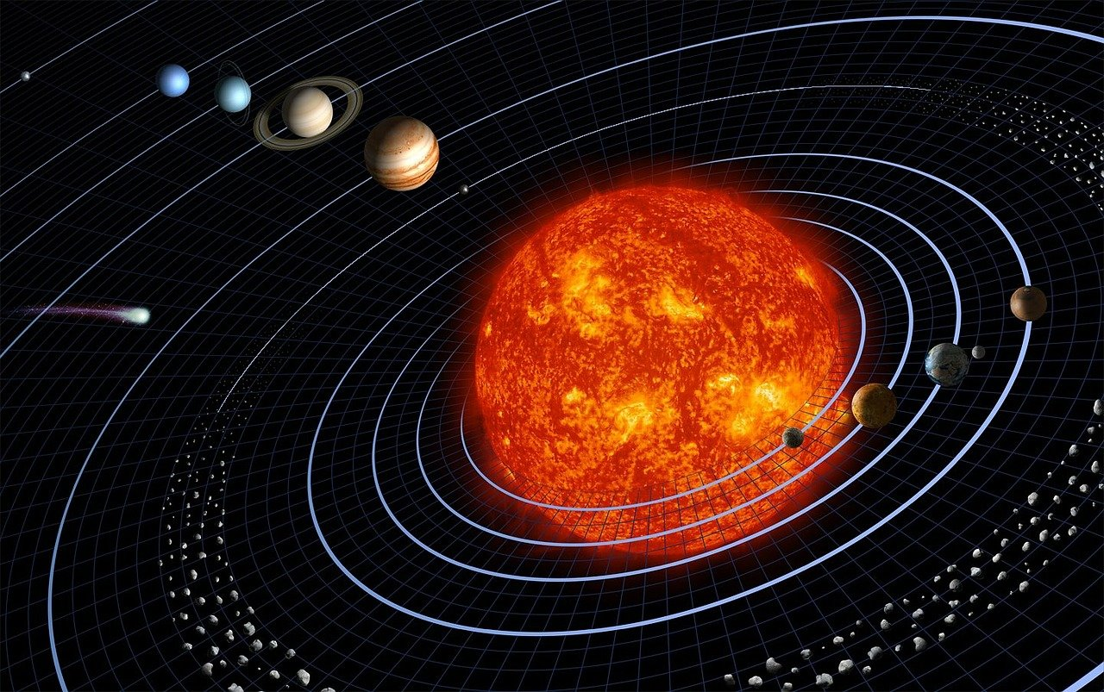

Real-World Rational Exponents
Kepler Industries, Inc.
  Round each distance to the nearest kilometer.
Depreciation
  Round your answer to the nearest cent.
Notes:
Image sources:
WikiImages. (2011, December 15). Solar System Planets [Illustration]. Pixabay. https://pixabay.com/illustrations/solar-system-planets-11111/
Pixabay. (2016, March 30). Mercedes Benz Parked in a Row [Photo]. Pexels. https://www.pexels.com/photo/mercedes-benz-parked-in-a-row-164634/

Slide 12
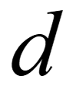
Kepler Industries, Inc. (Solution, Part 1)
Solve the equation for .

Slide 13
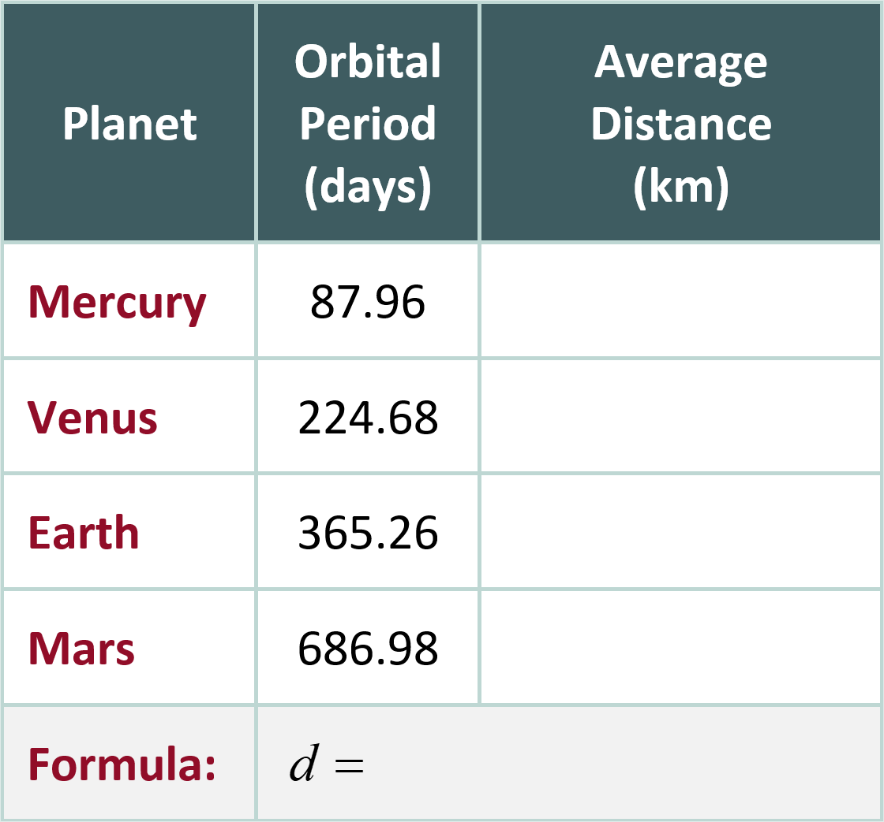
Kepler Industries, Inc. (Solution, Part 2)
Complete any two rows of the table.

Slide 14
Depreciation (Solution, Part 1)
Identify what you know (the given information).
Identify what you do not know (what is being asked).

Slide 15
Depreciation (Solution, Part 2)
Plug in the given and solve for the unknown.

Slide 16

Choice Board
Select and complete three tasks.
  Choose only one task per row.
  Choose only one task per column.
  For example:
    Complete 1B – 2C – 3A.
    Complete 1C – 2A – 3B.
Notes:
Strategy: K20 Center. (n.d.). Choice Boards. Strategies. https://learn.k20center.ou.edu/strategy/73

