Slide 2
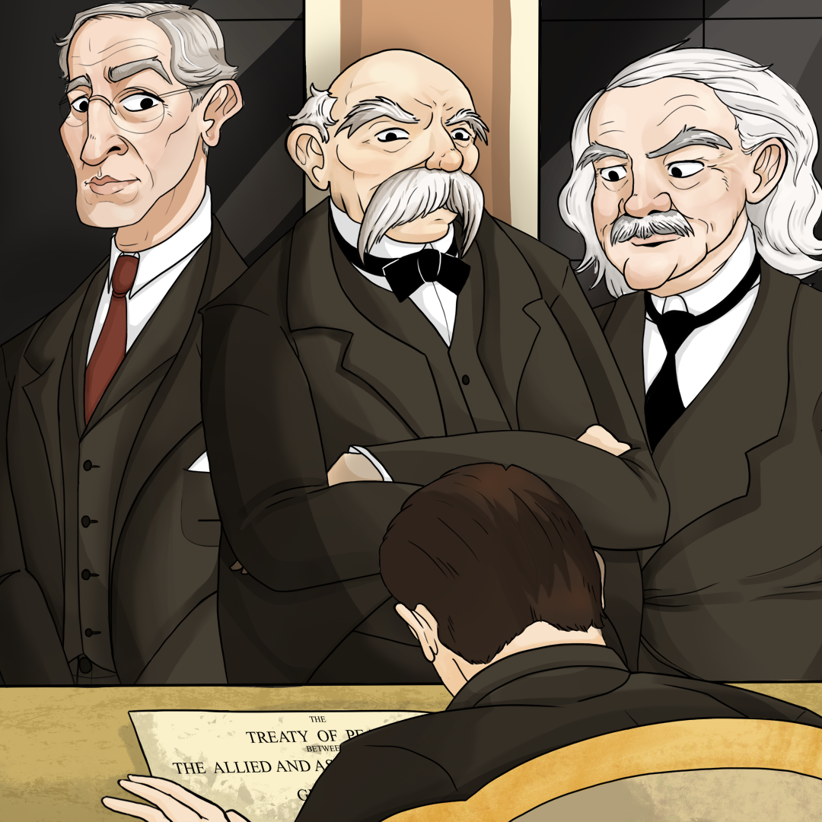
Who Pays for Peace?
Evaluating the Treaty of Versailles

Slide 3

Magnetic Statements
Read the statements posted around the room.
Move to a statement that appeals to you.
Discuss with others in your group why you were drawn to that statement.
Notes:
K20 Center. (n.d.). Magnetic statements. Strategies. https://learn.k20center.ou.edu/strategy/166

Slide 4
Magnetic Statements
Move to a different statement that repels you.
Discuss with others in your group why you felt repelled by that statement.
Notes:
K20 Center. (n.d.). Magnetic statements. Strategies. https://learn.k20center.ou.edu/strategy/166

Slide 5
Essential Question
How can an agreement have unintended consequences?

Slide 6
Learning Objective
Evaluate how the Treaty of Versailles affected Germany.

Slide 7
Treaty of Versailles
Peace document signed at the end of WWI
Took effect on January 10, 1920, after the armistice on 11/11/1918.
Written during the Paris Peace Conference.
The main leaders of the treaty were the “Big Three”.
  Great Britain – David Lloyd George
  France – George Clemenceau
  USA – Woodrow Wilson

Slide 8

Treaty of Versailles S-I-T
As you read the excerpts, highlight something you find:
  Surprising
  Interesting
  Troubling
Notes:
K20 Center. (n.d.). S-I-T (Surprising, interesting, troubling). Strategies. https://learn.k20center.ou.edu/strategy/926

Slide 9

Cornell Notes
Essential question: How can an agreement have unintended consequences?
Questions:
  How did the treaty punish Germany?
  Who ultimately decided the terms of the treaty?
  How did the German people respond to the terms of the treaty?
Notes:
K20 Center. (n.d.). Cornell notes system. Strategies. https://learn.k20center.ou.edu/strategy/56

Slide 10
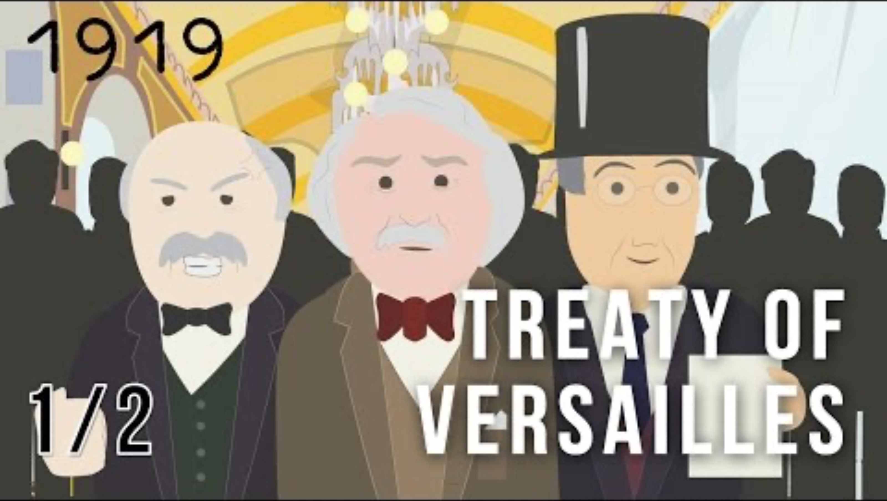
The Treaty of Versailles, What Did the Big Three Want? 1/2
Notes:
Simple History. (2016, November 3). The Treaty of Versailles, what did the big three want? 1/2 [Video]. YouTube. https://www.youtube.com/watch?v=vrYhLNQMRro

Slide 11
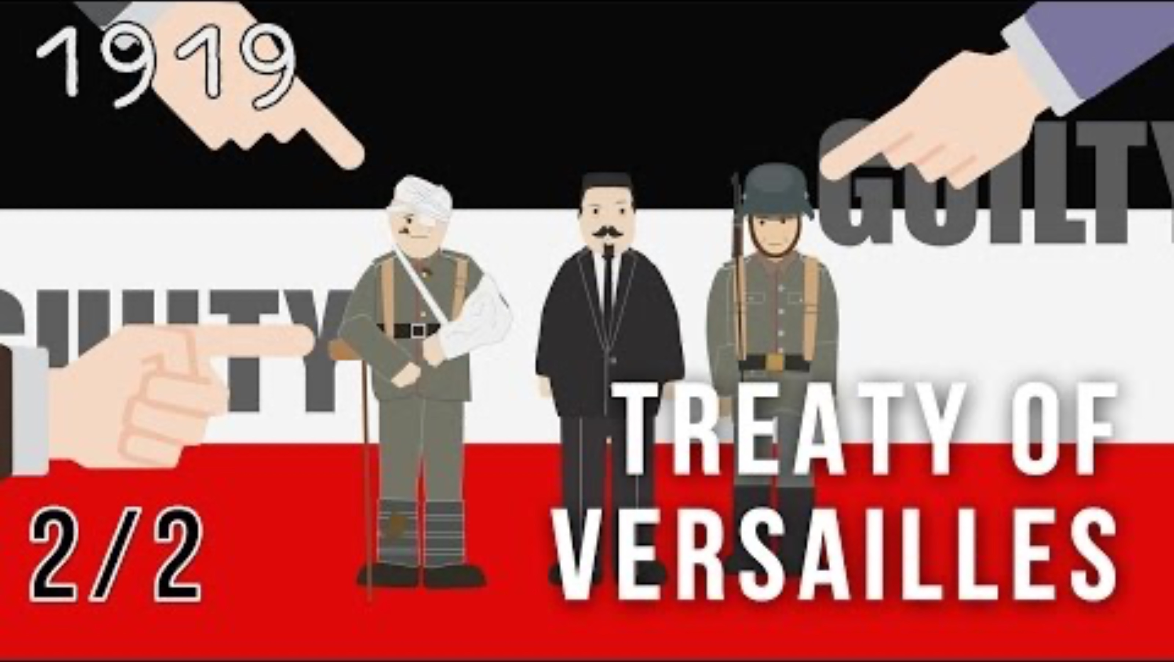
The Treaty of Versailles, Terms of the Treaty 2/2
Notes:
Simple History. (2016, November 5). The Treaty of Versailles, terms of the treaty 2/2 [Video]. YouTube. https://www.youtube.com/watch?v=0jycVFL8CNM

Slide 12

Point of Most Significance
Read the article about Germany reparations.
After reading, write what you think the most important part of the article is regarding the Treaty of Versailles.
Notes:
K20 Center. (n.d.). POMS: Point of most significance. Strategies. https://learn.k20center.ou.edu/strategy/101

Slide 13

Claim, Evidence, Reasoning
What was the impact of the Treaty of Versailles on Germany?
  Complete the Claim, Evidence, Reasoning handout.
Notes:
K20 Center. (n.d.). Claim, evidence, reasoning (CER). Strategies. https://learn.k20center.ou.edu/strategy/156

Slide 14

Claims, Evidence, and Reasoning.
Notes:
K20 Center. (2021, August 19). Claims, evidence, and reasoning [Video]. YouTube. https://www.youtube.com/watch?v=JGOxVIgmGWE

