Slide 2
A Stone’s Throw Away:
The Dangers of Tradition
The Lottery

Slide 3
Essential Question
How does Shirley Jackson’s short story “The Lottery” demonstrate the possible dangers of tradition?

Slide 4
Lesson Objectives
Understand and discuss the value and possible dangers of tradition by synthesizing learning from “The Lottery” and “The Dangers of Tradition.”

Slide 5

Tip of the Iceberg
Using the Tip of the Iceberg handout, write some words that come to mind when you hear the word “lottery”.
Write these words above the waterline on the iceberg.
Be prepared to share with the class.
Notes:
K20 Center. (n.d.). Tip of the iceberg. Strategies. https://learn.k20center.ou.edu/strategy/67

Slide 6
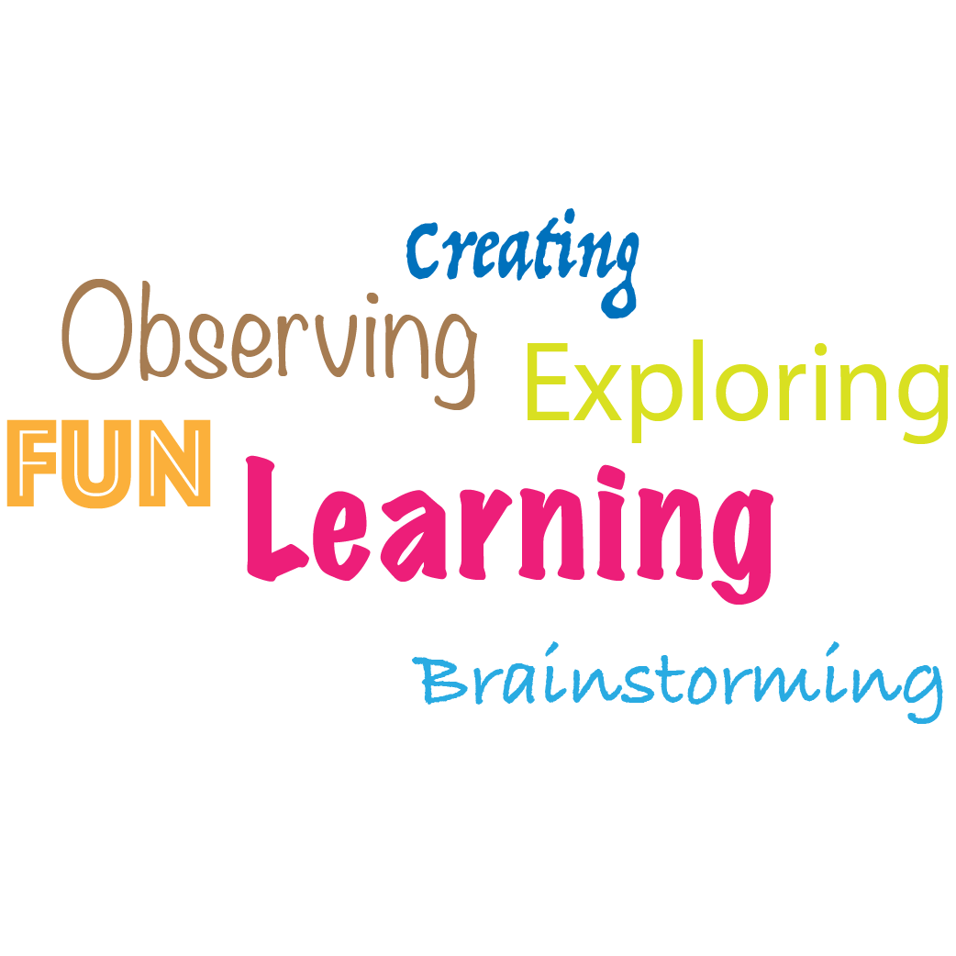
Collaborative Word Cloud
Use the words you came up with in the Tip of the Iceberg exercise to create a collaborative word cloud with your classmates.
Notes:
K20 Center. (n.d.). Collaborative word clouds. Strategies. https://learn.k20center.ou.edu/strategy/103

Slide 7

My lottery dream home
Notes:
HGTV. (2017, Jan 4). My Lottery Dream Home with David Bromstead Ep. 1 Preview | My Lottery Dream Home | HGTV [Video]. YouTube. https://www.youtube.com/watch?v=kSmZ6G2eHwE&t=5s

Slide 8

Commit and Toss
What is the one special thing you would want in your lottery dream home?
Notes:
K20 Center. (n.d.). Commit and toss. Strategies. https://learn.k20center.ou.edu/strategy/119

Slide 9
The Lottery
Read the short story “The Lottery” by Shirley Jackson.
Fill in the waterline portion of your iceberg with new thoughts about tradition that arise from your reading.
Notes:
Jackson, S. (1948). The lottery. CommonLit. https://www.commonlit.org/en/texts/the-lottery
K20 Center. (n.d.). Tip of the Iceberg. Strategies. https://learn.k20center.ou.edu/strategy/67

Slide 10
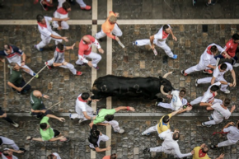
“The Dangers of Tradition”
Read the article “The Dangers of Tradition.”
Using information from both the short story and the article, continue filling out your iceberg-this time below the waterline.
Notes:
Bosa, B. (2019). The dangers of tradition. CommonLit. https://www.commonlit.org/en/texts/fyc-the-dangers-of-tradition
Unsplash. (2018, Aug 6). San Fermin Pamplona-Navarra. [Digital Image].https://unsplash.com/photos/LJrszMj1RJc

Slide 11

Fold the Line
Line up according to how much you agree or disagree with the following prompts.
Notes:
K20 Center. (n.d.). Fold the line. Strategies. https://learn.k20center.ou.edu/strategy/171

Slide 12
Fold the Line
All traditions are good.
Notes:
K20 Center. (n.d.). Fold the Line. Strategies. https://learn.k20center.ou.edu/strategy/171

Slide 13
Fold the Line
All traditions are bad.
Notes:
K20 Center. (n.d.). Fold the Line. Strategies. https://learn.k20center.ou.edu/strategy/171

Slide 14
Fold the Line
Traditions are dangerous.
Notes:
K20 Center. (n.d.). Fold the Line. Strategies. https://learn.k20center.ou.edu/strategy/171

Slide 15
Fold the Line
Traditions are pointless.
Notes:
K20 Center. (n.d.). Fold the Line. Strategies. https://learn.k20center.ou.edu/strategy/171

Slide 16

One-Pager
Petition either for a new school tradition or the removal of an old one.
Include the following:
  Title of your proposed new tradition or old one you want removed
  Border around the page that includes one major belief you now hold about tradition
  Image representing your new tradition or the old one you want removed
  Three or more questions about tradition with the answers included
  A statement arguing for your new tradition or against an old one
Notes:
K20 Center. (n.d.). One-Pager. Strategies. https://learn.k20center.ou.edu/strategy/72

Slide 17
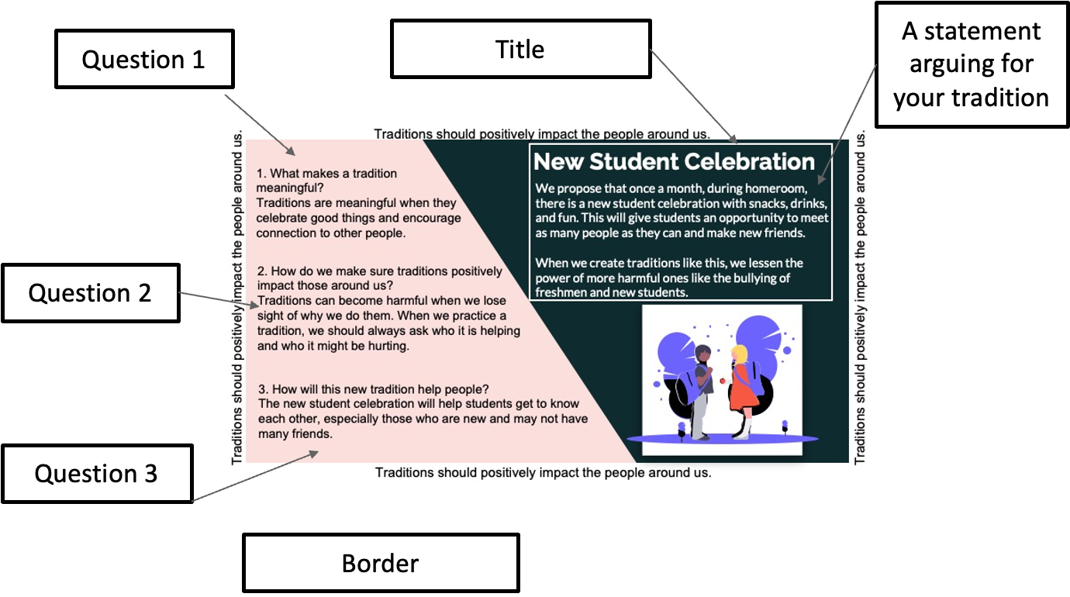

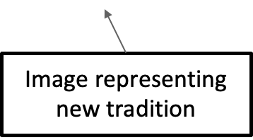

Slide 18
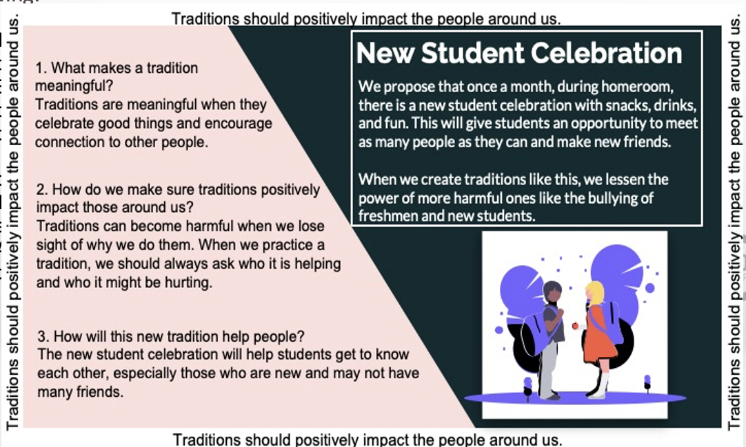
One-Pager
Petition either for a new school tradition or the removal of an old one. Include the following:
Title of your proposed new tradition or old one you want removed
Border around the page that includes one major belief you now hold about tradition
Image representing your new tradition or the old one you want removed
Three (3) or more questions with the answers included
A statement arguing for your new tradition or against an old one.
Example One-Pager

