Slide 2
Exploration Innovation
European Exploration and Navigational Tools

Slide 3

Fiction in the Facts
During the Age of Exploration…
European explorers used the stars to navigate across the Atlantic Ocean.
ships required many sailors to row across the Atlantic Ocean.
European explorers used tools from other countries to navigate across the Atlantic Ocean.

Slide 4
Fiction in the Facts
During the Age of Exploration…
European explorers used the stars to navigate across the Atlantic Ocean. (True)
ships required many sailors to row across the Atlantic Ocean. (False)
European explorers used tools from other countries to navigate across the Atlantic Ocean. (True)

Slide 5
Essential Question
How did the arrival of new technology influence European exploration?

Slide 6
Learning Objective
Analyze the technological innovations that paved the way for increased European exploration.

Slide 7

Exploration Tools
Write down observations about each set of images.
Use those observations to make inferences about each tool’s purpose relating to European exploration.
Record your ideas on the handout.

Slide 8
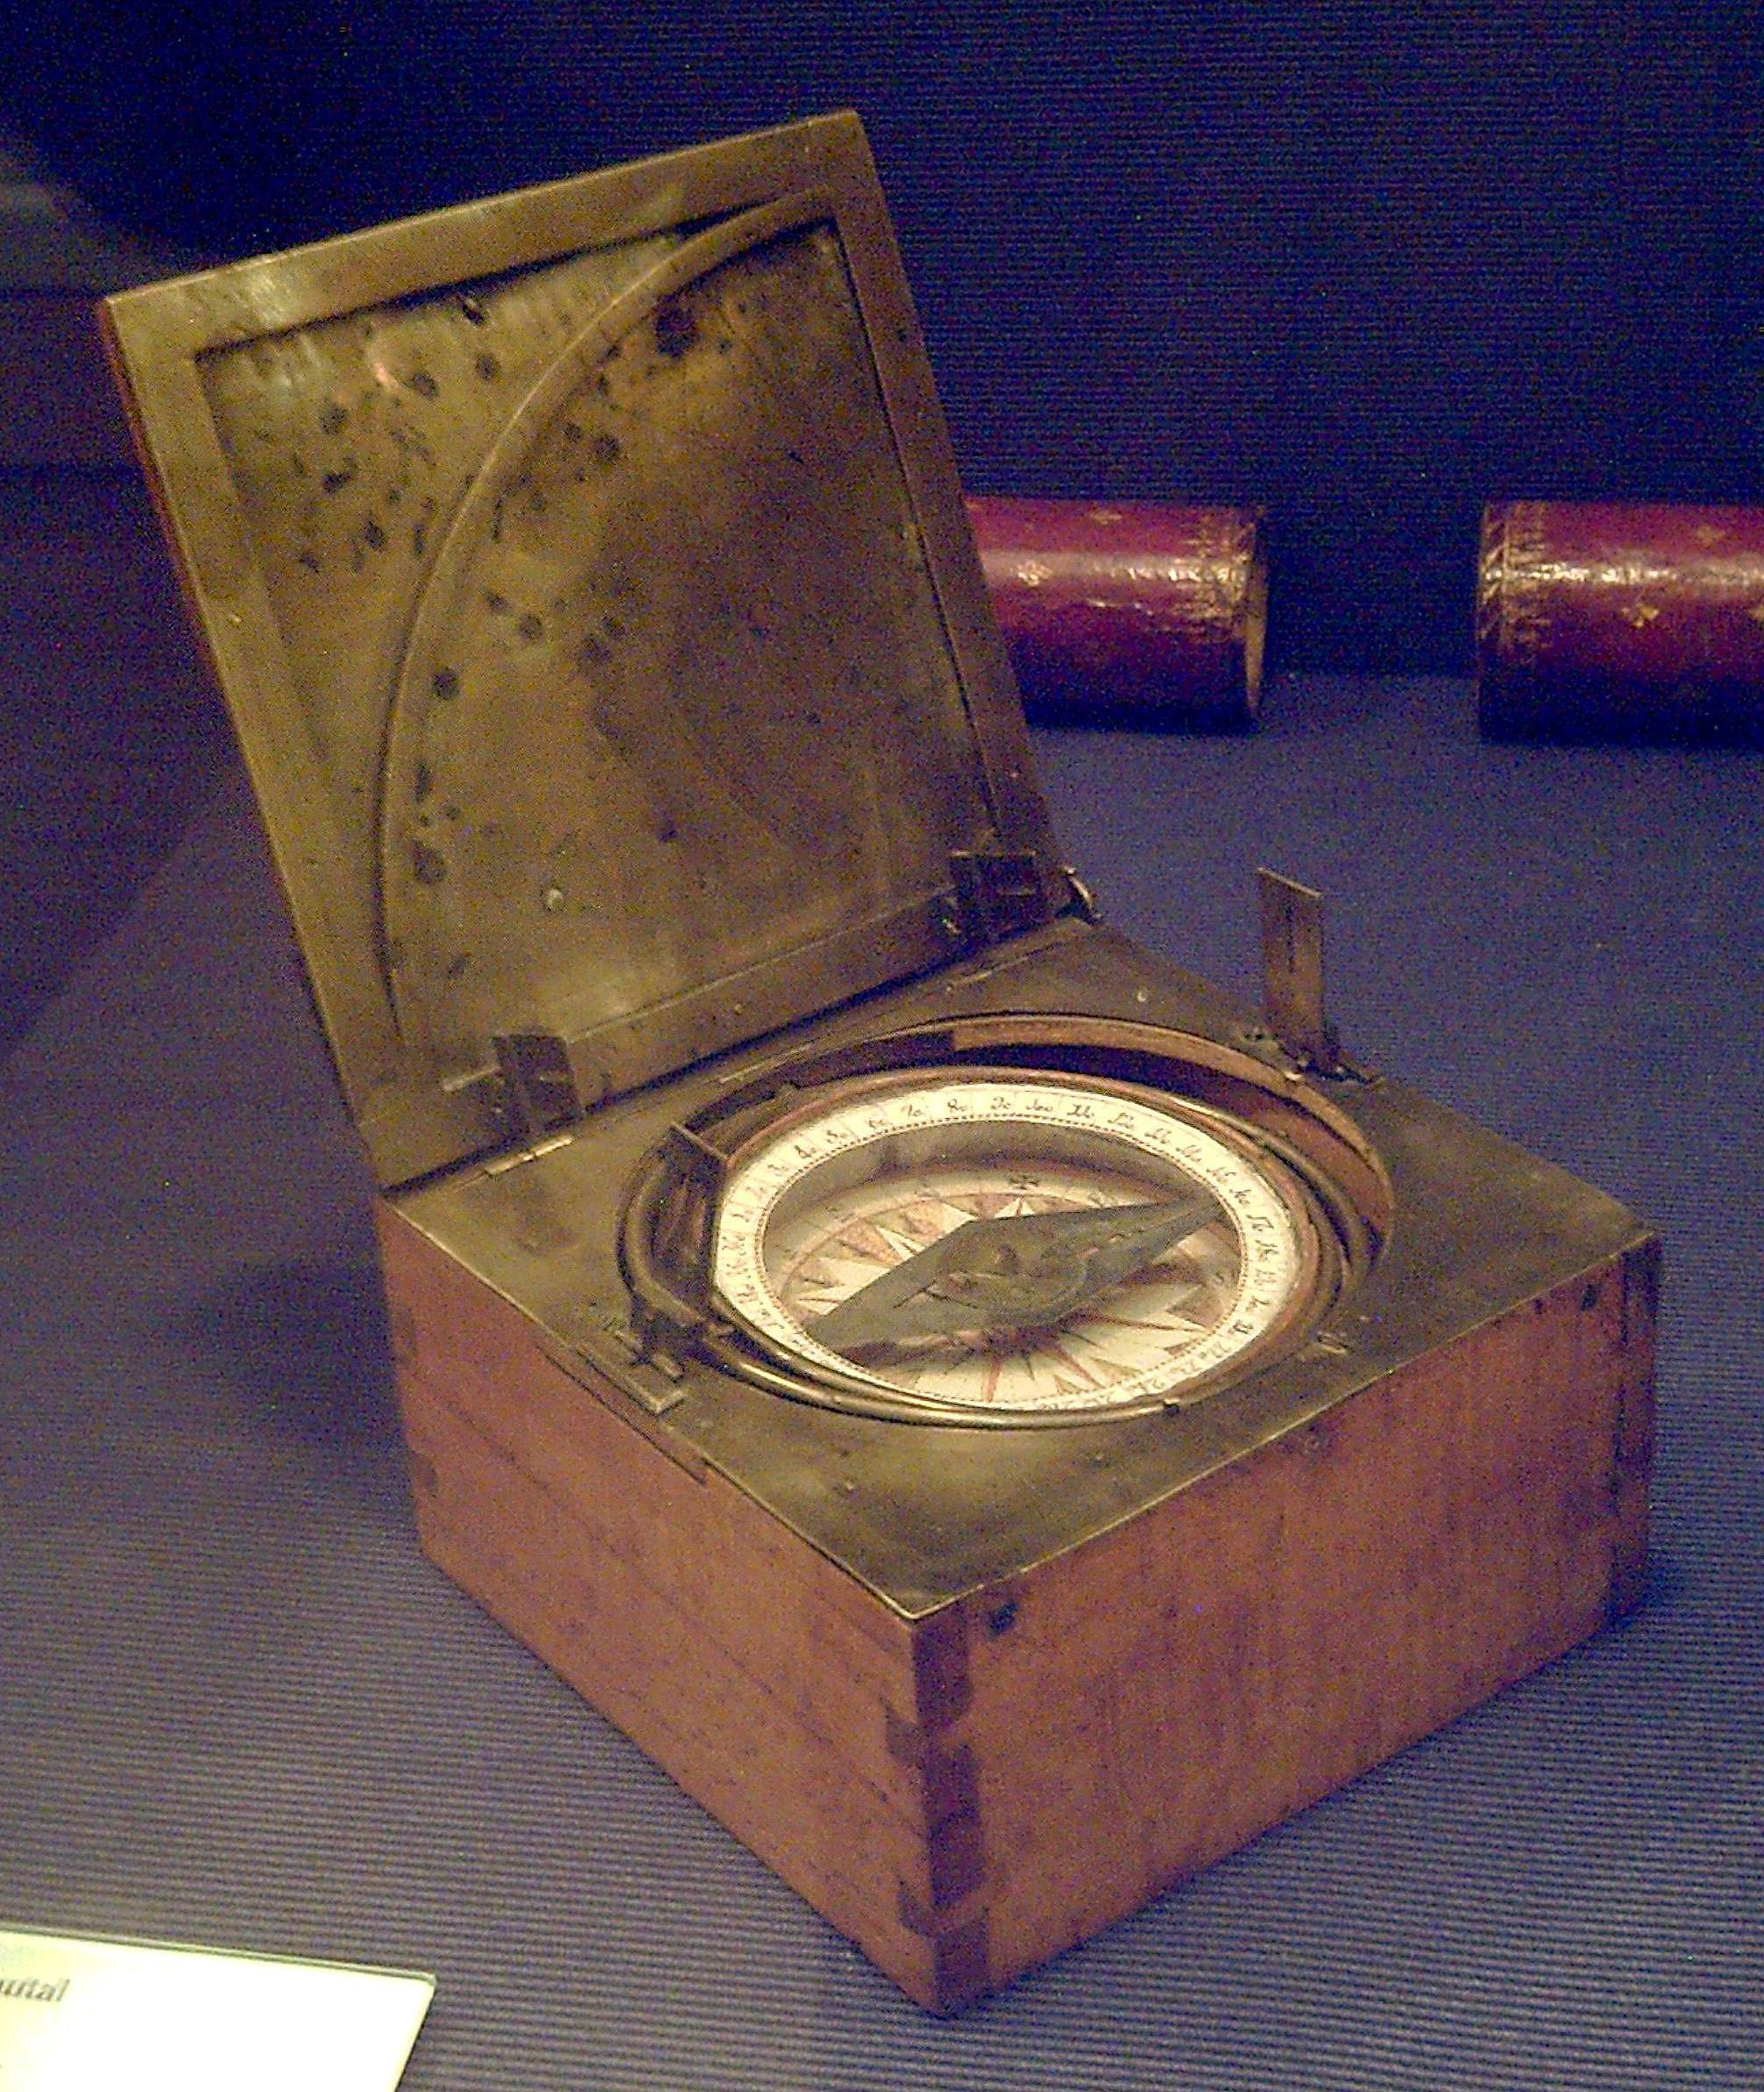
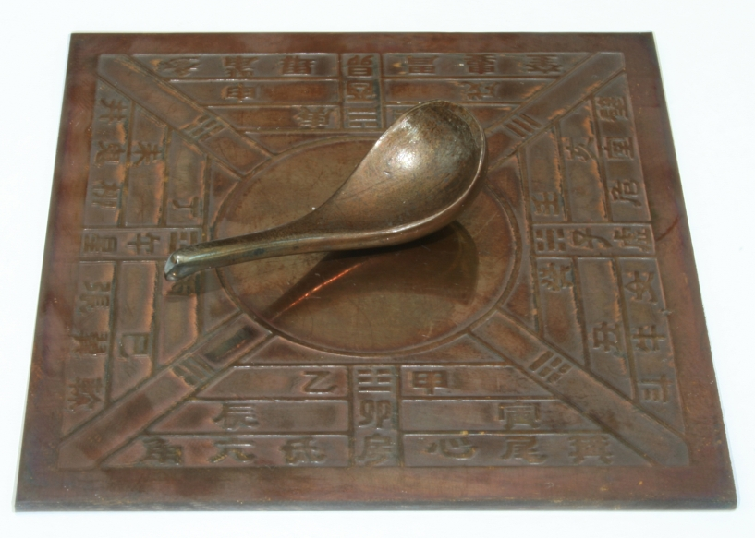
Notes:
Left: Unknown. (2006). Model Si Nan of Han Dynasty [Image]. Wikimedia Commons. https://commons.wikimedia.org/wiki/File:Model_Si_Nan_of_Han_Dynasty.jpg
Right: Garcia, L. (2008). Azimuthal compass [Image]. Wikimedia Commons. https://commons.wikimedia.org/wiki/File:Br%C3%BAjula_azimutal_espa%C3%B1ola_s.XVIII_(M.A.N._Madrid)_01.jpg

Slide 9
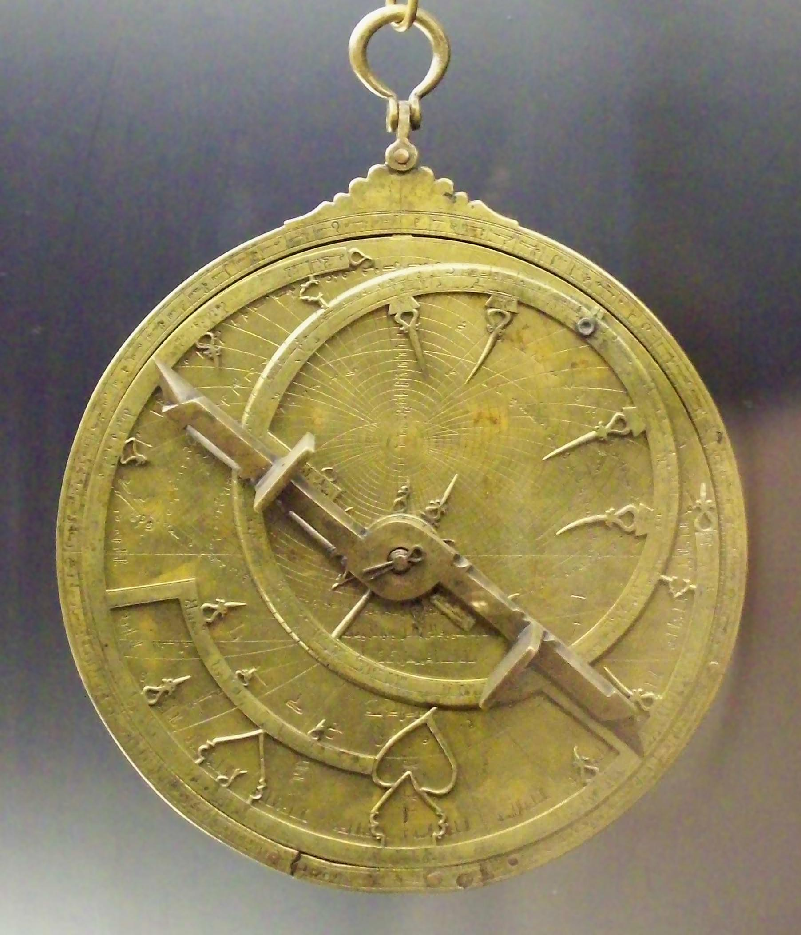
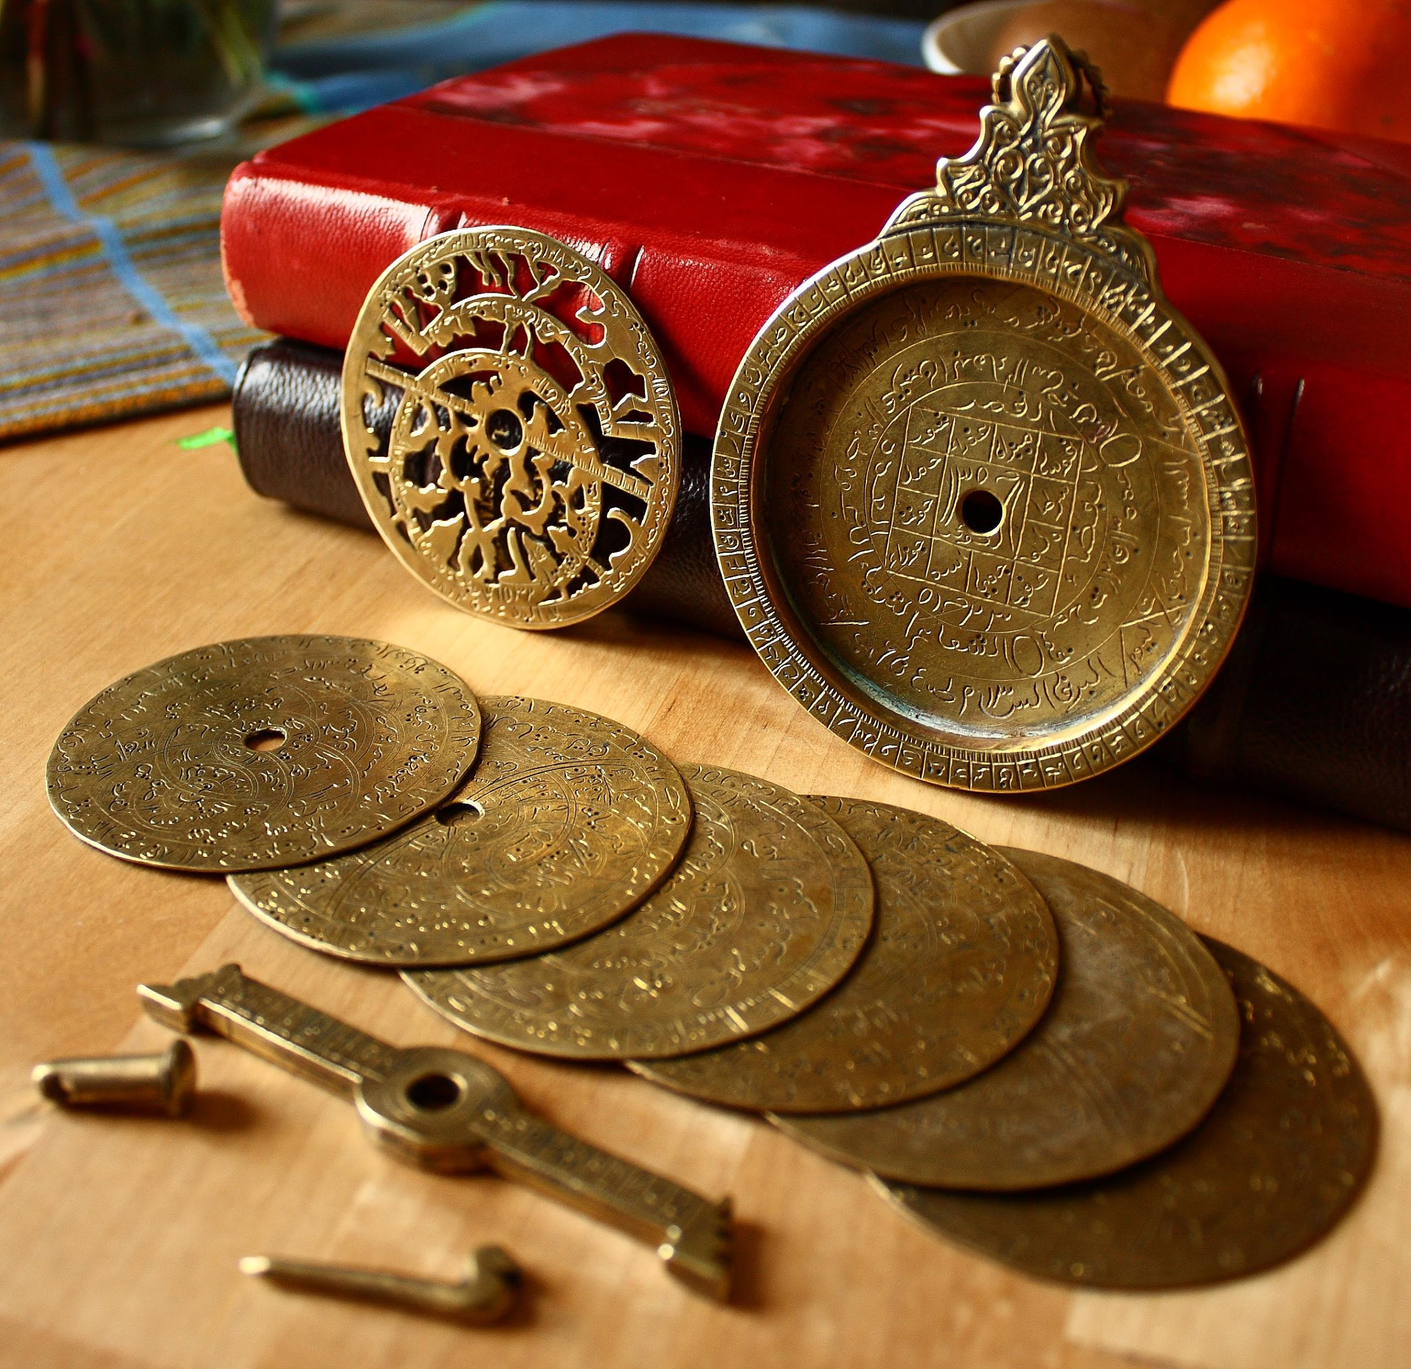
Notes:
Left: Bench, E. (2009). Astrolabe parts [Image]. Flickr. https://www.flickr.com/photos/19762676@N00/3317031220
Right: Garcia, L. (2008). Al-Sahli's Astrolabe [Image]. Wikimedia Commons. https://commons.wikimedia.org/wiki/File:Astrolabio_andalus%C3%AD_Toledo_1067_(M.A.N.)_04.jpg

Slide 10
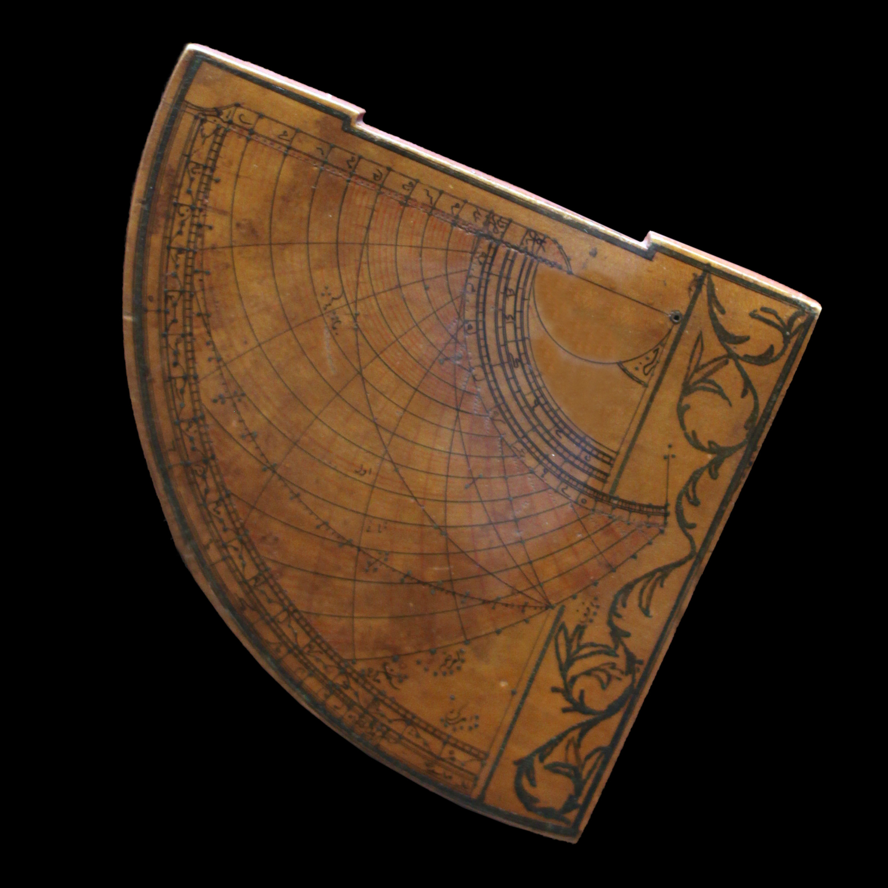
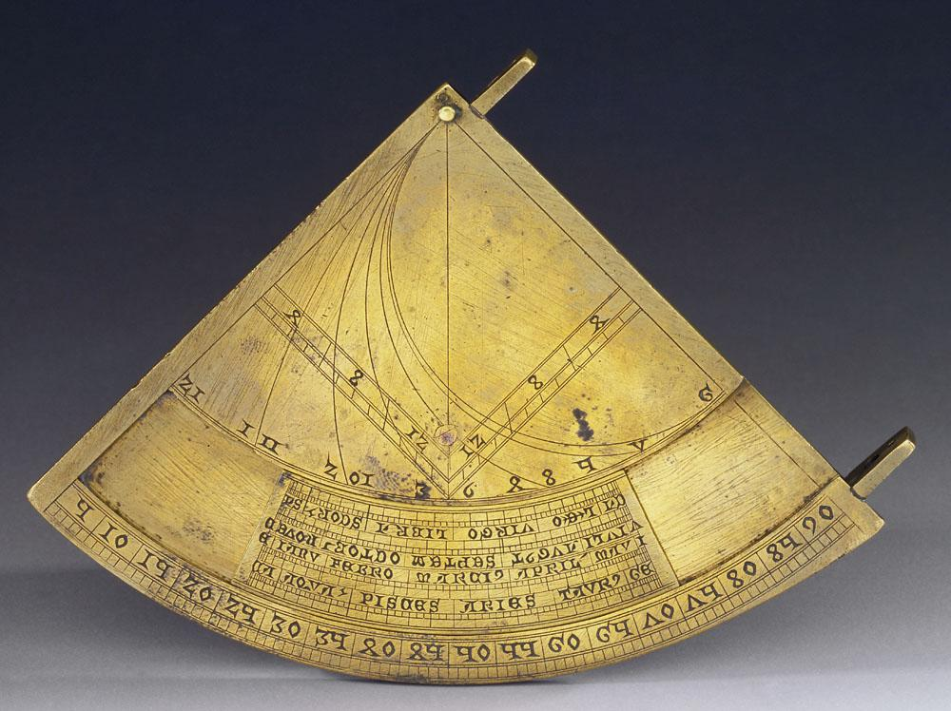
Notes:
Left: Museo Galileo. (2010). Quadrans vetus [Image]. Wikimedia Commons. https://commons.wikimedia.org/wiki/File:Quadrans_Vetus_inv_662_IF_22256.jpg
Right: Rama. (2016). Quadrant astrolabique ottoman [Image]. Wikimedia Commons. https://commons.wikimedia.org/wiki/File:Astrolabe-MnM_9_NA_61-IMG_6075-black.JPG

Slide 11
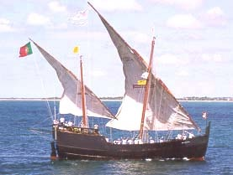
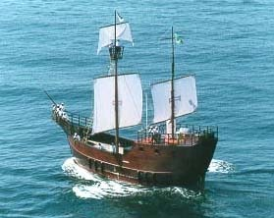
Notes:
Both: Science, civilization, and society. (n.d.). Caravel [Image]. MT Oceanography. https://www.mt-oceanography.info/science+society/lectures/illustrations/lecture17/caravel.html

Slide 12
Tools of Exploration
As you watch the video, fill in the TIP chart.
Write information about each type of navigational technology.
Sketch a picture of each tool.

Slide 13
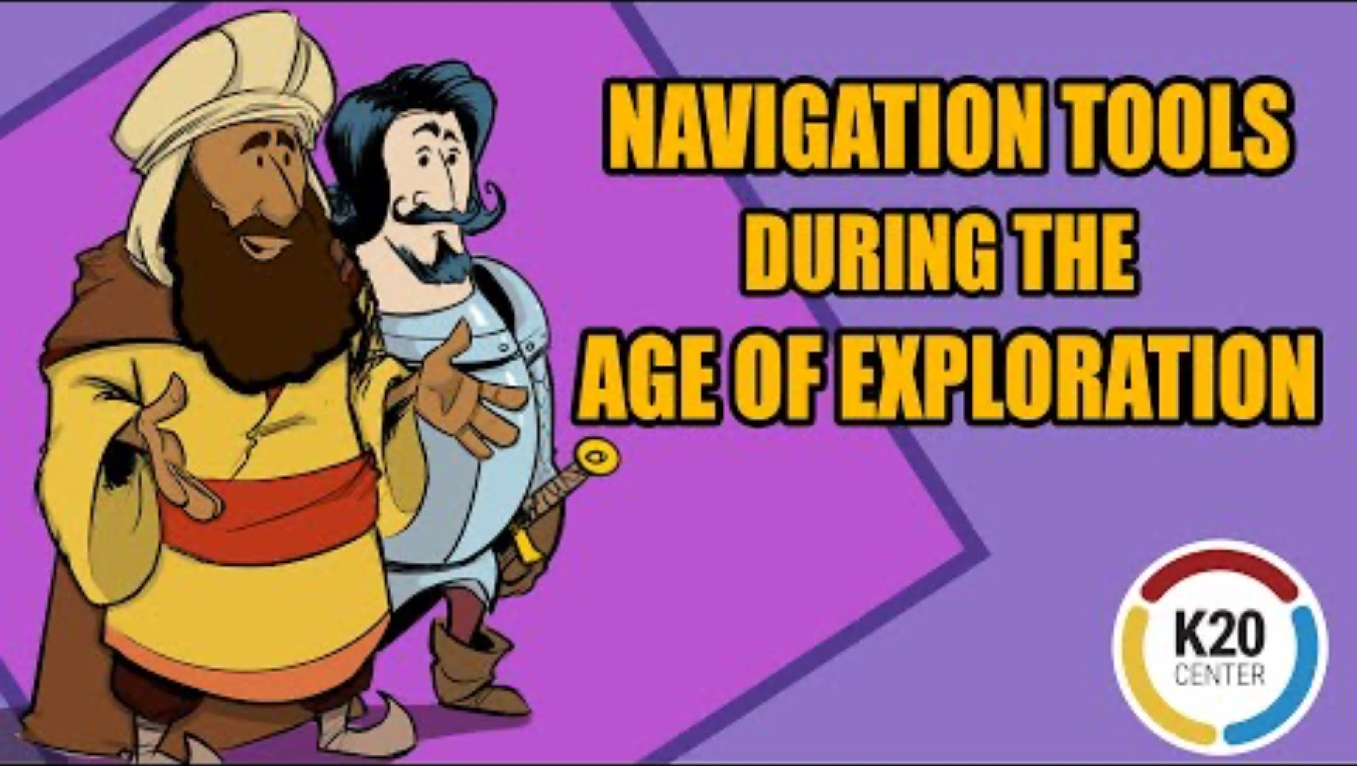
Navigational Tools During the Age of Exploration
Notes:
K20 Center. (2021). Navigation tools during the Age of Exploration [Video]. YouTube. https://www.youtube.com/watch?v=pD04eYrfLz0

Slide 14
Discuss
How was each tool used for exploration?
How did European explorers’ use of this technology affect the world?

Slide 15
Tool Advertisement
Design an advertisement that markets the technology to explorers.
In your ad, explain:
  the technology’s origin,
  how it came to Europe,
  how it can help explorers navigate the ocean, and
  its historical importance.

Slide 16

Exit Ticket
How did the arrival of new technology influence European exploration?

