Slide 2
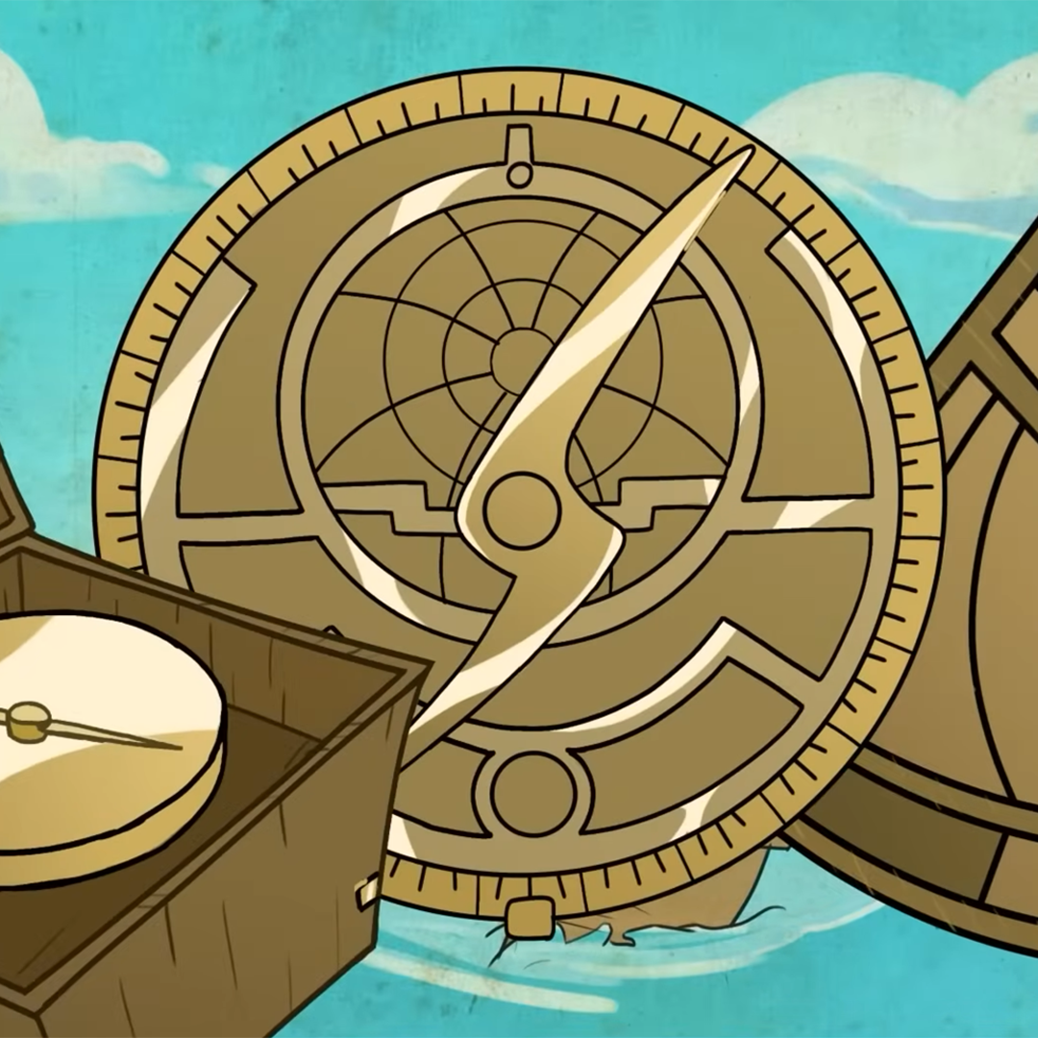
Exploration Innovation
European Exploration and Navigational Tools

Slide 3

Fiction in the Facts
During the Age of Exploration…
European explorers used the stars to navigate across the Atlantic Ocean.
Ships required many sailors to row across the Atlantic Ocean.
European explorers used tools from other countries to navigate across the Atlantic Ocean.
Notes:
K20 Center. (n.d.). Fiction in the Facts. Strategies. https://learn.k20center.ou.edu/strategy/60

Slide 4
Fiction in the Facts
During the Age of Exploration…
European explorers used the stars to navigate across the Atlantic Ocean. (True)
Ships required many sailors to row across the Atlantic Ocean. (False)
European explorers used tools from other countries to navigate across the Atlantic Ocean. (True)
Notes:
K20 Center. (n.d.). Fiction in the Facts. Strategies. https://learn.k20center.ou.edu/strategy/60

Slide 5
Essential Question
How did the arrival of new technology influence European exploration?

Slide 6
Learning Objective
Analyze the technological innovations that paved the way for increased European exploration.

Slide 7

Exploration Tools
Write down observations about each set of images.
Use those observations to make inferences about each tool’s purpose in European exploration.
Record your ideas on the handout.
Notes:
K20 Center. (n.d.). Painting a picture. Strategies. https://learn.k20center.ou.edu/strategy/1331

Slide 8
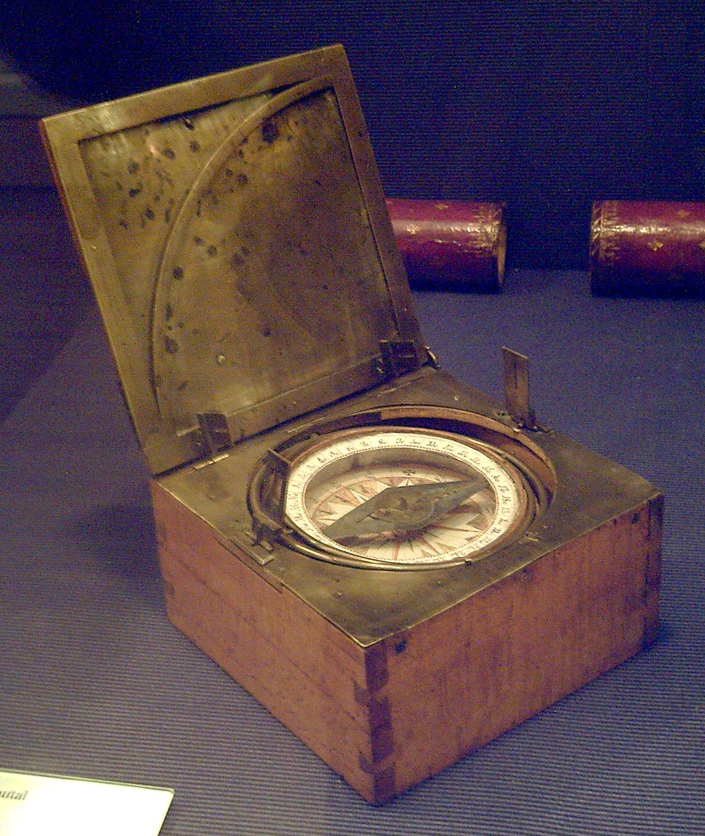
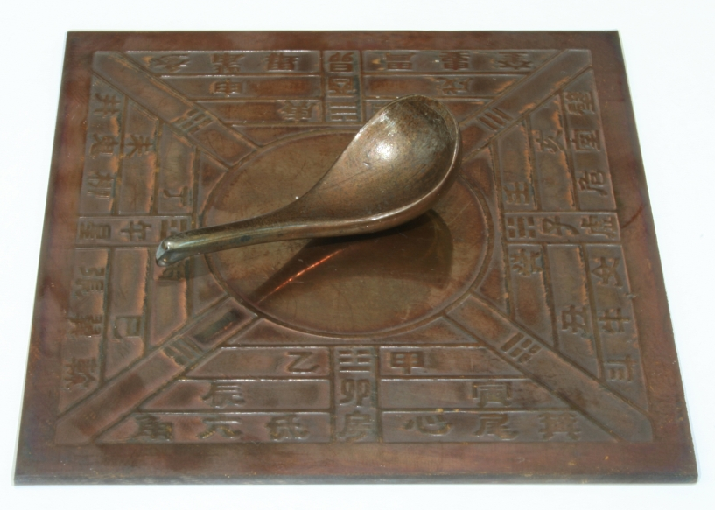
Notes:
Left: Unknown. (2006). Model Si Nan of Han Dynasty [Image]. Wikimedia Commons. https://commons.wikimedia.org/wiki/File:Model_Si_Nan_of_Han_Dynasty.jpg
Right: Garcia, L. (2008). Azimuthal compass [Image]. Wikimedia Commons. https://commons.wikimedia.org/wiki/File:Br%C3%BAjula_azimutal_espa%C3%B1ola_s.XVIII_(M.A.N._Madrid)_01.jpg

Slide 9
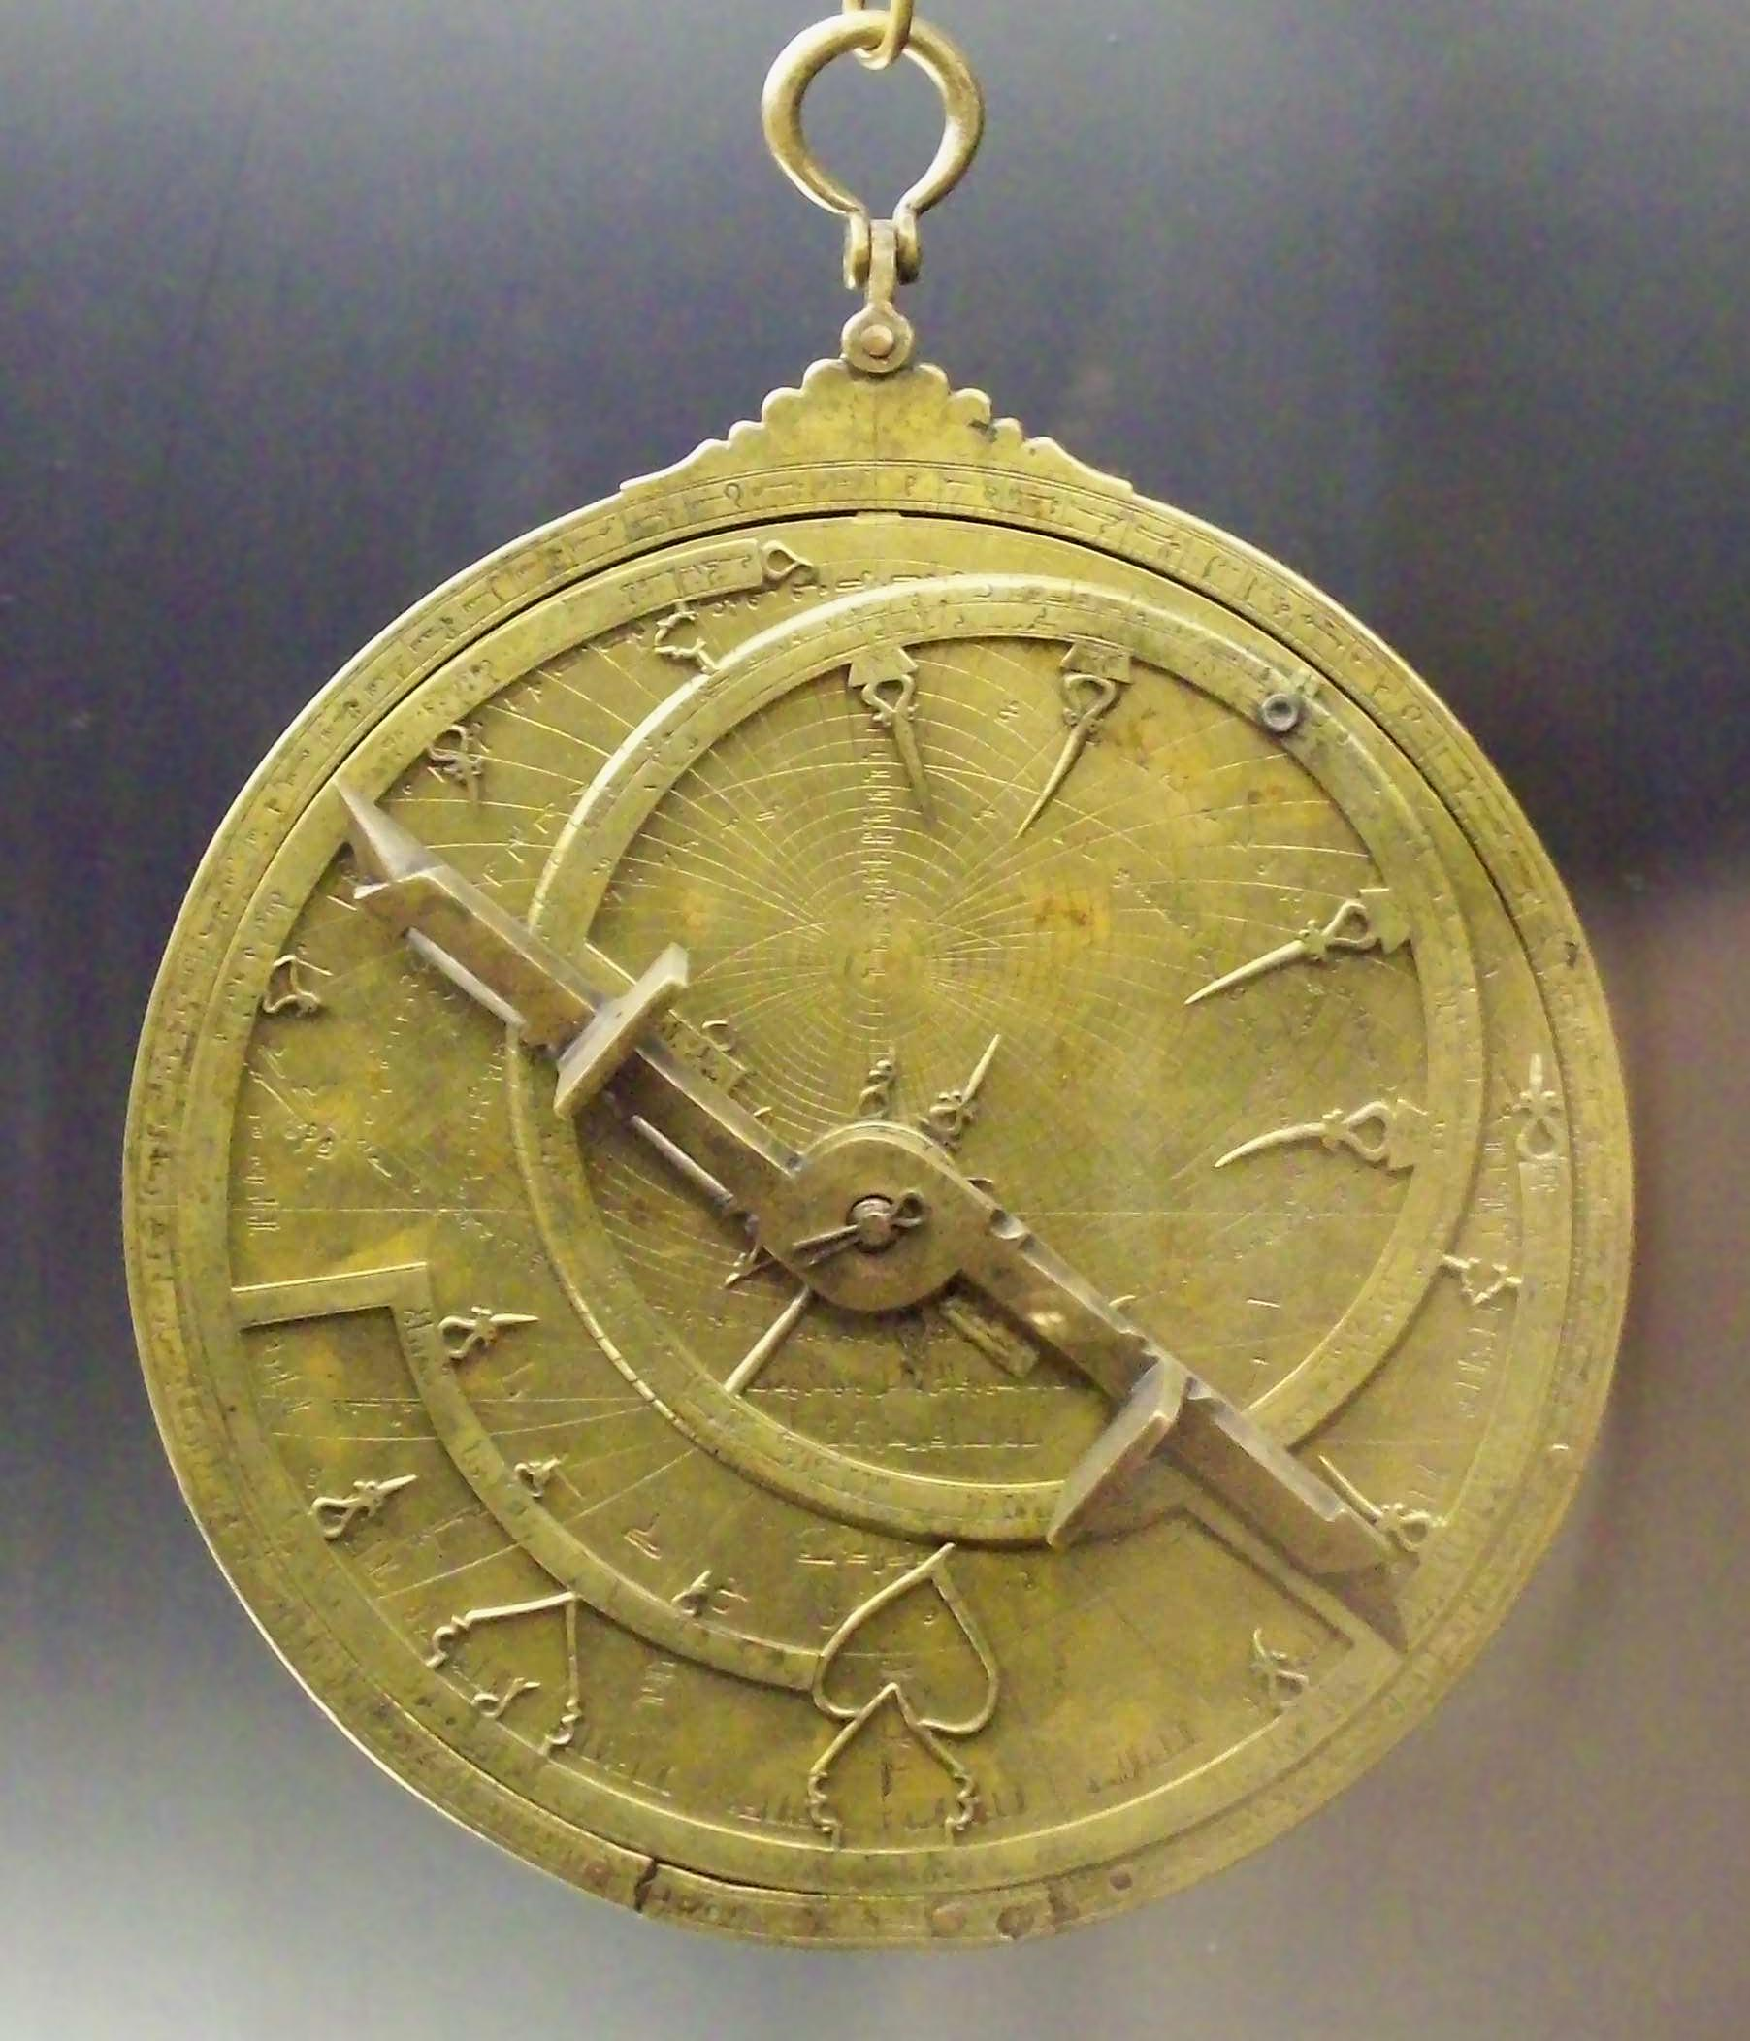

Notes:
Left: Bench, E. (2009). Astrolabe parts [Image]. Flickr. https://www.flickr.com/photos/19762676@N00/3317031220
Right: Garcia, L. (2008). Al-Sahli's Astrolabe [Image]. Wikimedia Commons. https://commons.wikimedia.org/wiki/File:Astrolabio_andalus%C3%AD_Toledo_1067_(M.A.N.)_04.jpg

Slide 10
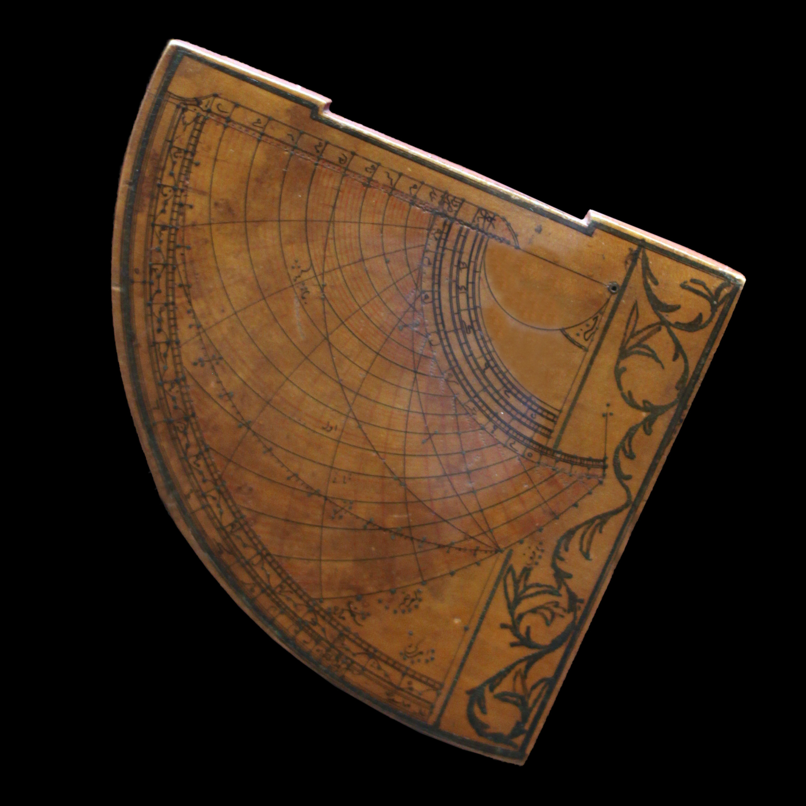
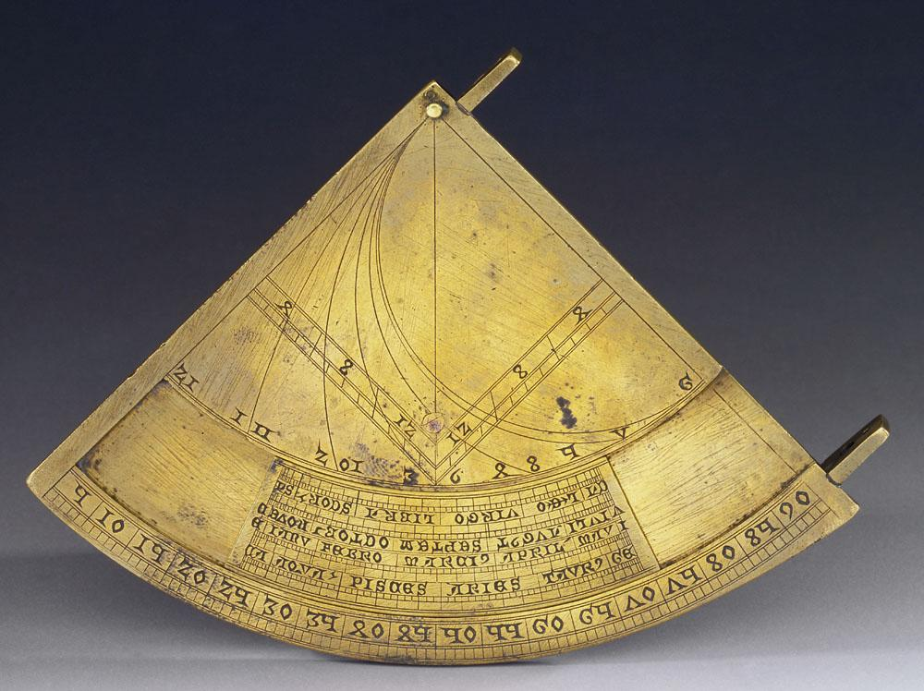
Notes:
Left: Museo Galileo. (2010). Quadrans vetus [Image]. Wikimedia Commons. https://commons.wikimedia.org/wiki/File:Quadrans_Vetus_inv_662_IF_22256.jpg
Right: Rama. (2016). Quadrant astrolabique ottoman [Image]. Wikimedia Commons. https://commons.wikimedia.org/wiki/File:Astrolabe-MnM_9_NA_61-IMG_6075-black.JPG

Slide 11
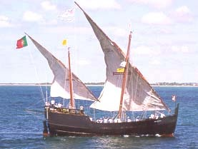
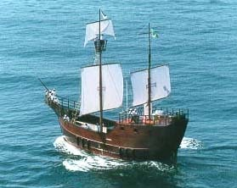
Notes:
Both: Science, civilization, and society. (n.d.). Caravel [Image]. MT Oceanography. https://www.mt-oceanography.info/science+society/lectures/illustrations/lecture17/caravel.html

Slide 12
Tools of Exploration
As you watch the video, fill in the TIP chart.
Write information about each type of navigational technology.
Sketch a picture of each tool.

Slide 13
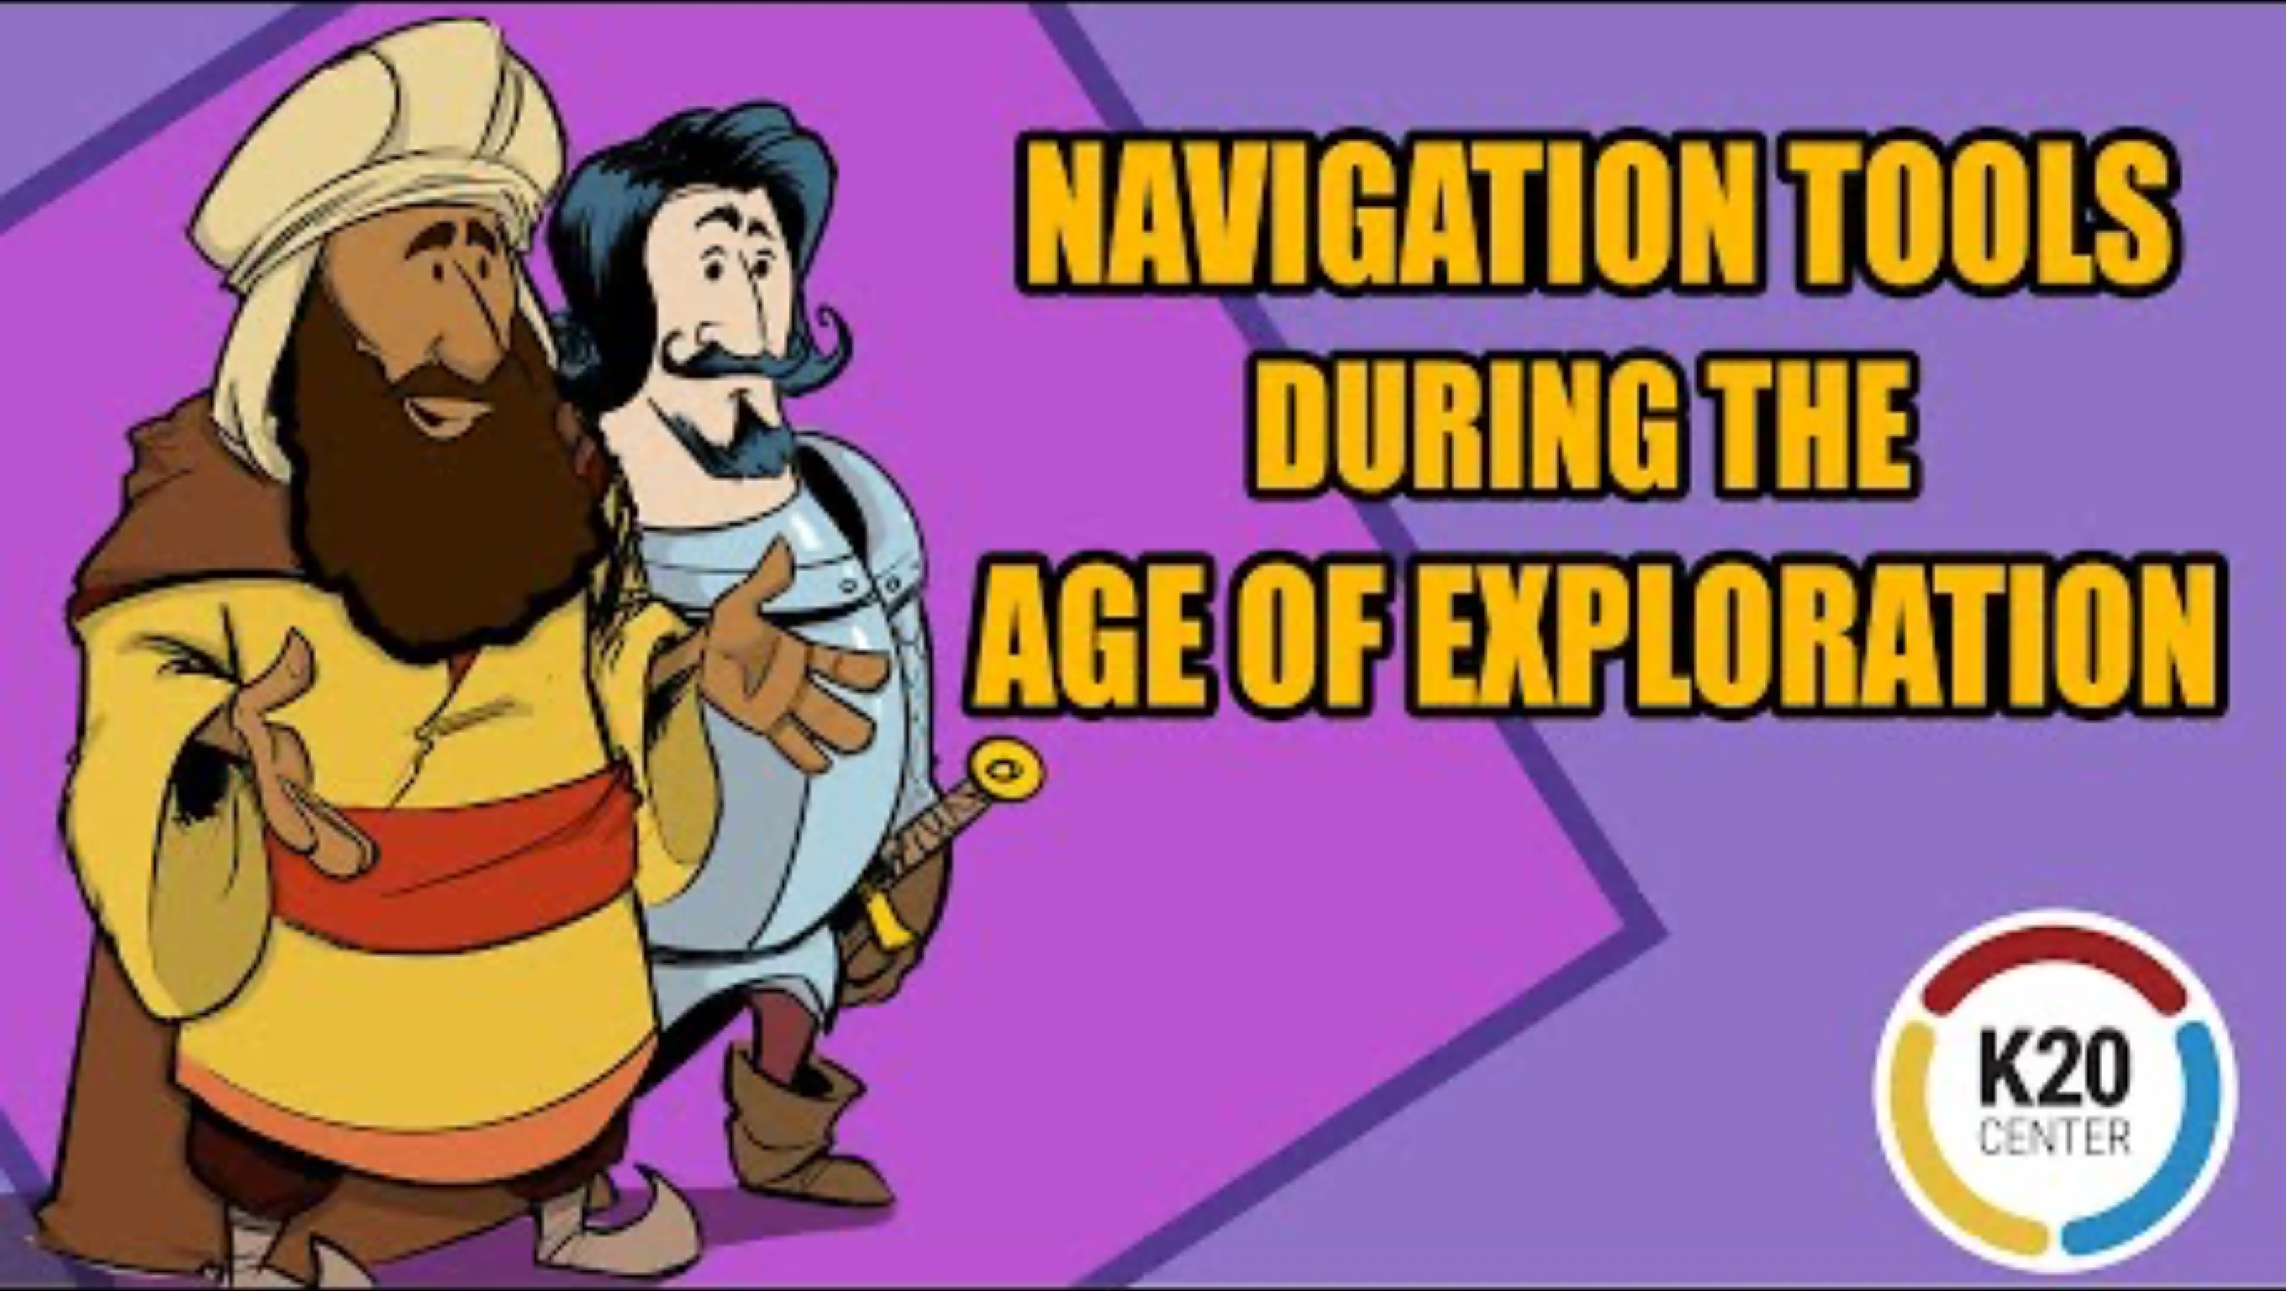
Navigational Tools During the Age of Exploration
Notes:
K20 Center. (2021). Navigation tools during the Age of Exploration [Video]. YouTube. https://www.youtube.com/watch?v=pD04eYrfLz0

Slide 14
Discuss
How was each tool used for exploration?
How did European explorers’ use of these technologies affect the world?
Notes:
K20 Center. (n.d.). TIP Chart. Strategies. https://learn.k20center.ou.edu/strategy/185

Slide 15
Tool Advertisement
Design an advertisement that markets the technology to explorers.
In your ad, explain:
  The tool’s origin
  How it developed or spread
  How it helped explorers navigate the ocean
  Its historical importance

Slide 16

Exit Ticket
How did the arrival of new technology influence European exploration?
Notes:
K20 Center. (n.d.). Bell ringers and exit tickets. Strategies. https://learn.k20center.ou.edu/strategy/125

