Slide 2
Exploration Innovation
European Exploration and Navigational Tools

Slide 3
Essential Question
What technological advancements paved the way for increased European exploration?

Slide 4
Lesson Objective
Analyze the technological innovations that paved the way for increased European exploration.

Slide 5
Fiction in the Facts
During the Age of Exploration, European explorers used the stars to navigate across the Atlantic Ocean.
During the Age of Exploration, ships required many sailors to row across the Atlantic Ocean.
During the Age of Exploration, European explorers used tools from other countries to navigate across the Atlantic Ocean.
Notes:
Inform students that two statements are true and one is false. It is their job to decide which one is false. Give students time to read all three statements and discuss their thoughts with their peers. Then, ask for volunteers to share which statement they think is false and why.
K20 Center. (n.d.). Fiction in the facts. Strategies. https://learn.k20center.ou.edu/strategy/60

Slide 6
Fiction in the Facts (Key)
During the Age of Exploration, European explorers used the stars to navigate across the Atlantic Ocean. (True)
During the Age of Exploration, ships required many sailors to row across the Atlantic Ocean. (False)
During the Age of Exploration, European explorers used tools from other countries to navigate across the Atlantic Ocean. (True)

Slide 7

Painting a Picture
In the chart on your handout, record your observations about each set of images.
Then, use those observations to make inferences about each tool’s purpose relating to European exploration.
Record your ideas in the chart.
Notes:
K20 Center. (n.d.). Painting a picture. Strategies. https://learn.k20center.ou.edu/strategy/1331

Slide 8
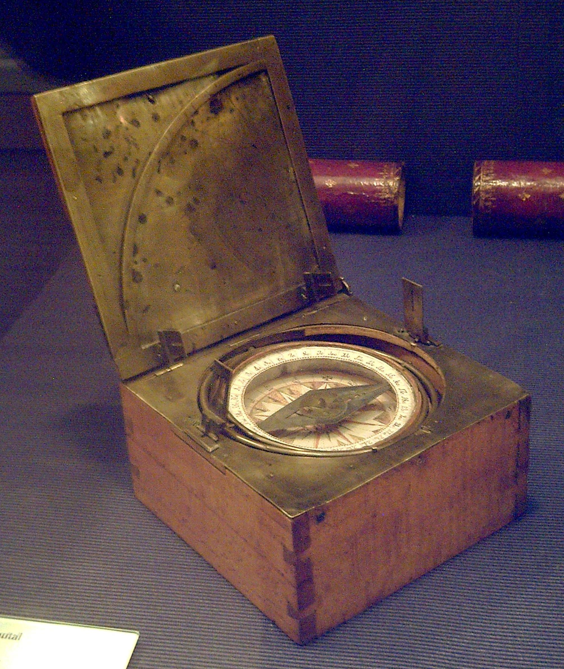

Image Set 1
Notes:
Image Sources
Left: Unknown. (2006). Model Si Nan of Han Dynasty [Image]. Wikimedia Commons. https://commons.wikimedia.org/wiki/File:Model_Si_Nan_of_Han_Dynasty.jpg
Right: Garcia, L. (2008). Azimuthal compass [Image]. Wikimedia Commons. https://commons.wikimedia.org/wiki/File:Br%C3%BAjula_azimutal_espa%C3%B1ola_s.XVIII_(M.A.N._Madrid)_01.jpg

Slide 9
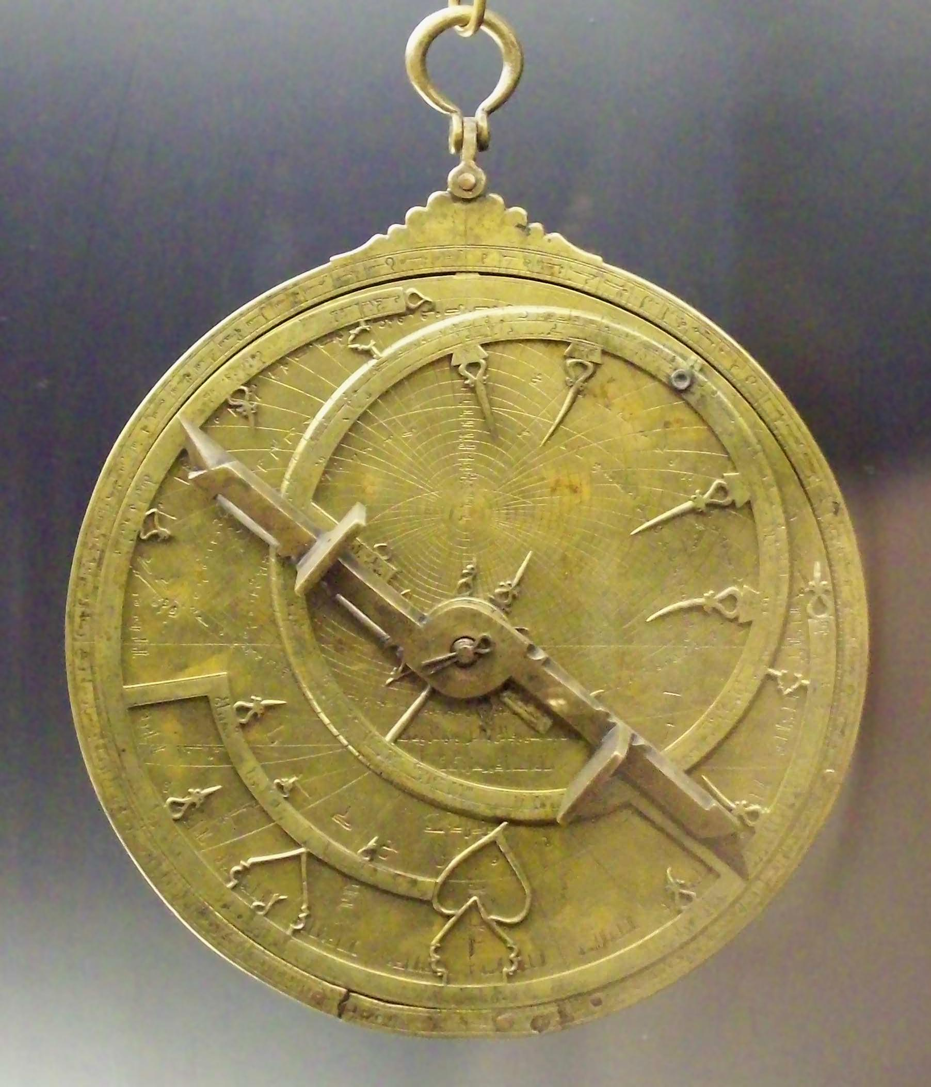

Image Set 2
Notes:
Image Sources
Left: Bench, E. (2009). Astrolabe parts [Image]. Flickr. https://www.flickr.com/photos/19762676@N00/3317031220
Right: Garcia, L. (2008). Al-Sahli's Astrolabe [Image]. Wikimedia Commons. https://commons.wikimedia.org/wiki/File:Astrolabio_andalus%C3%AD_Toledo_1067_(M.A.N.)_04.jpg

Slide 10
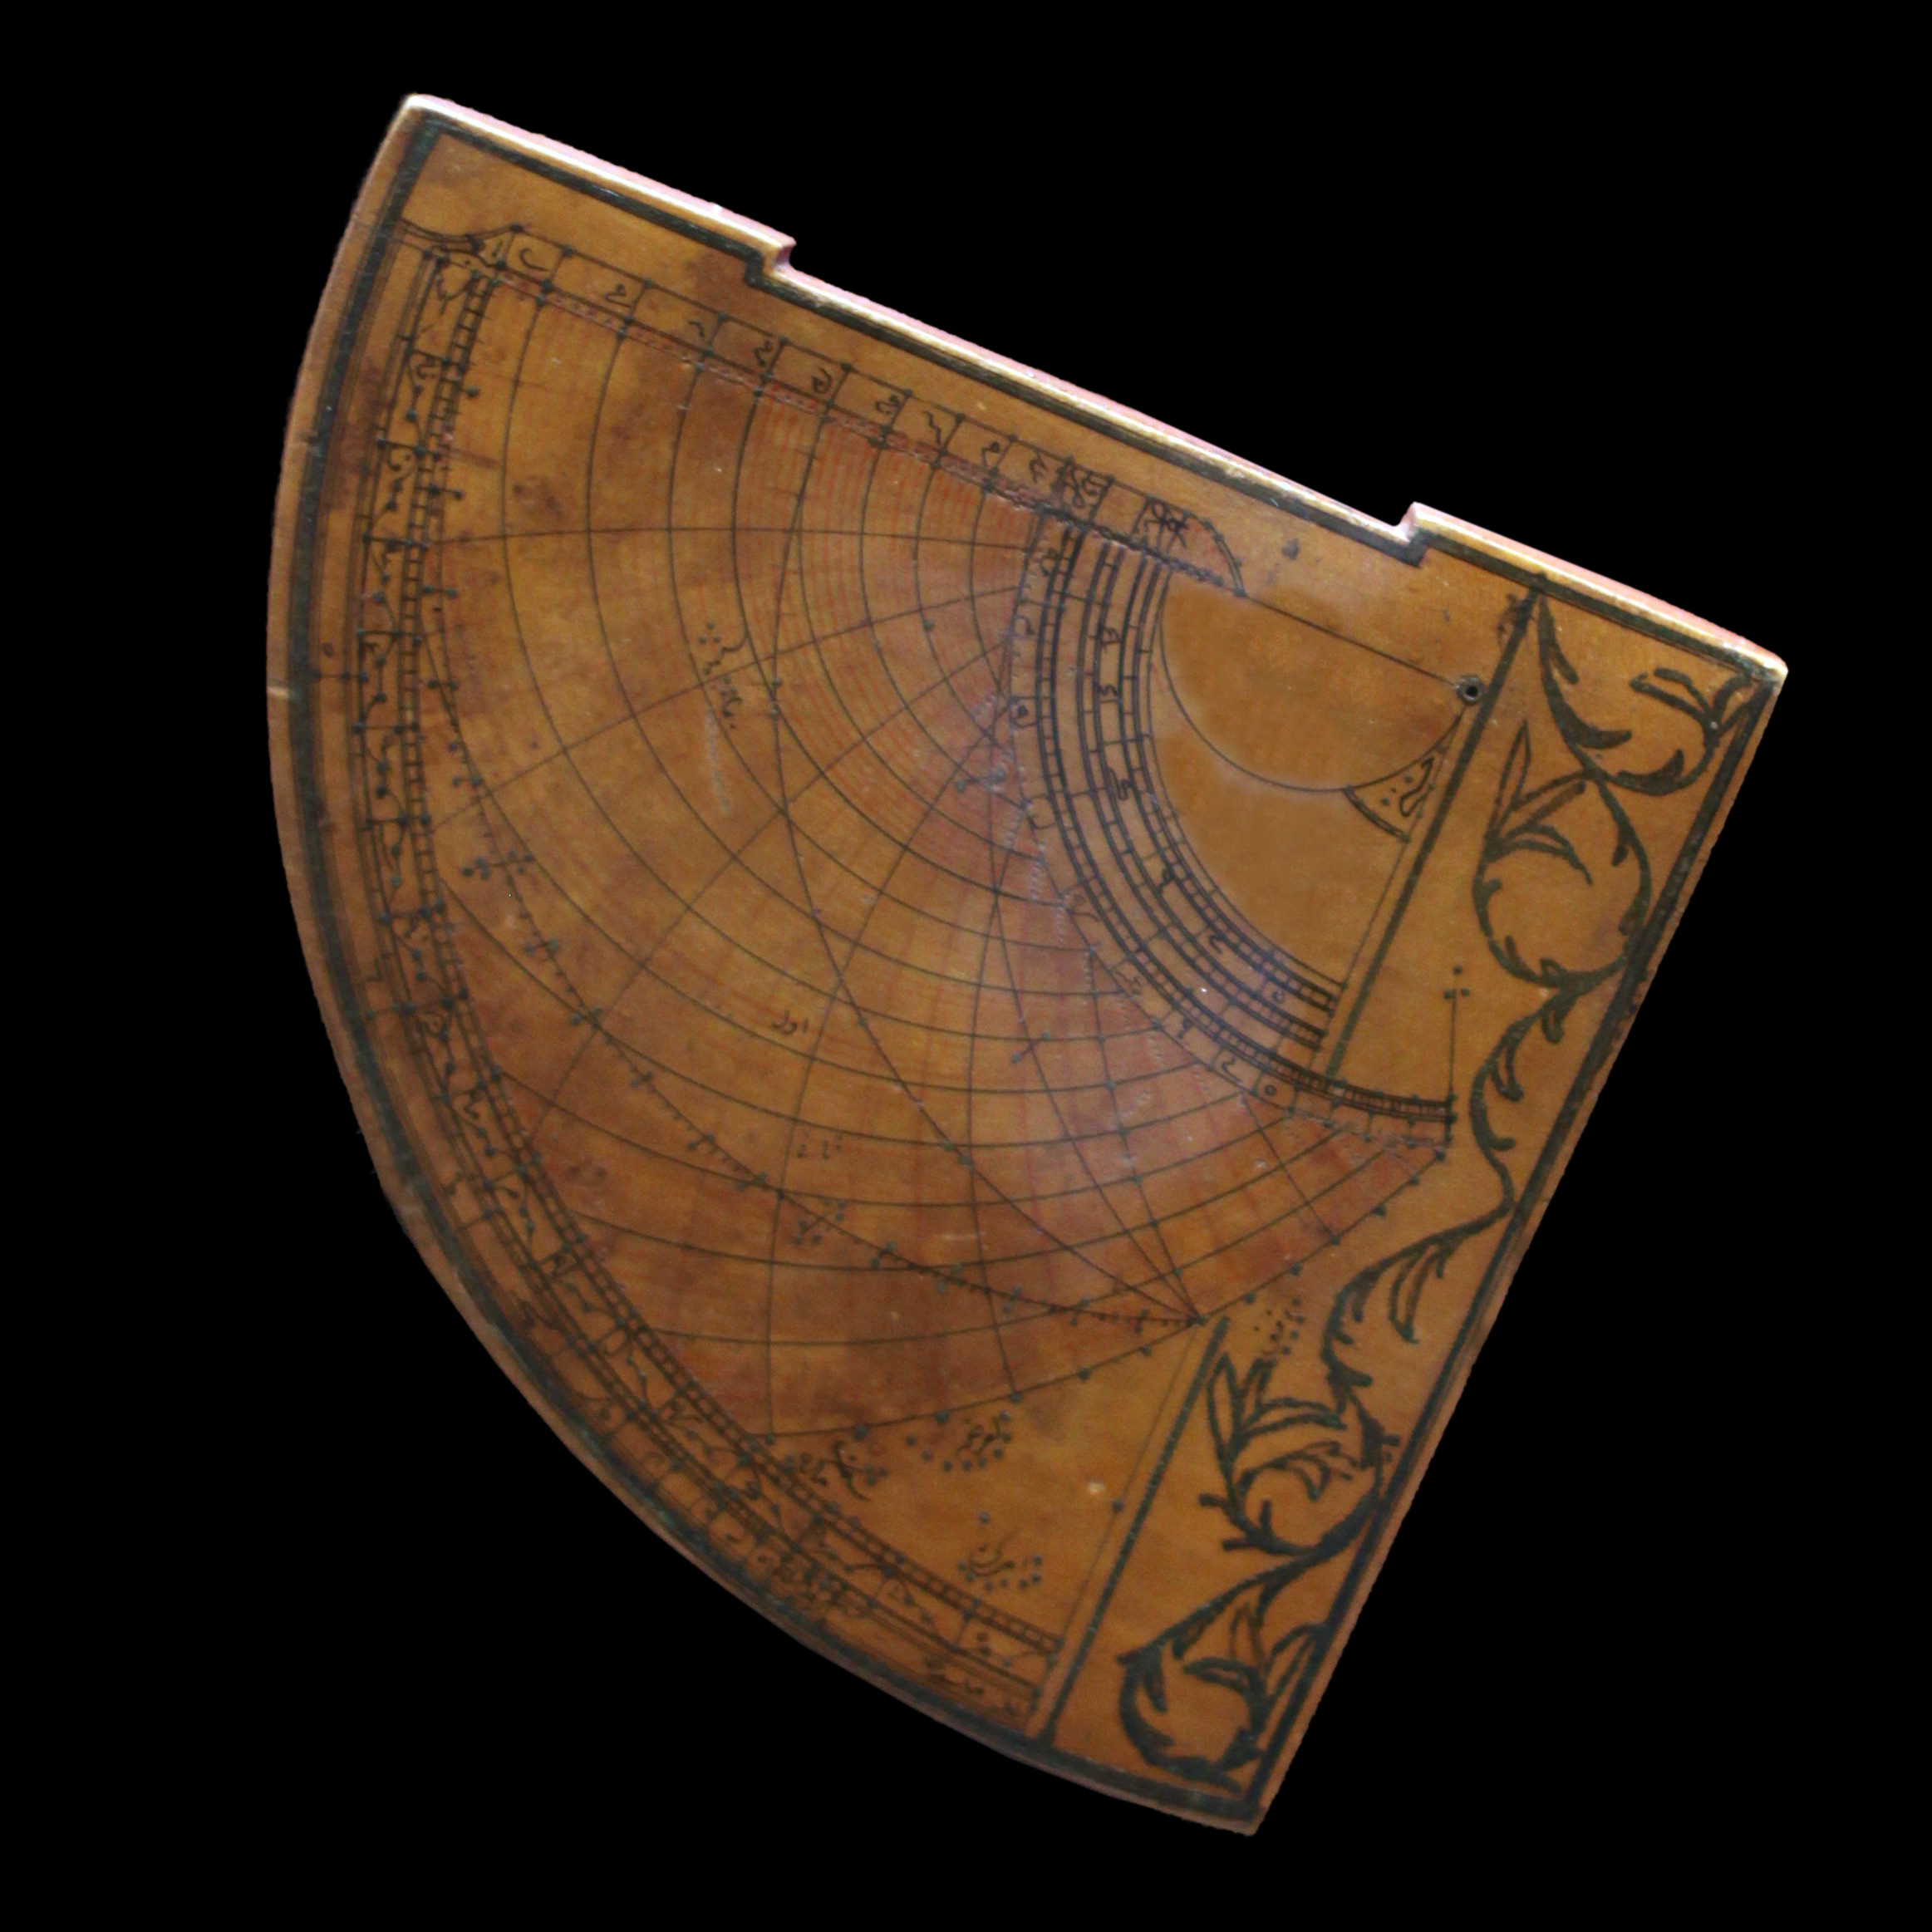
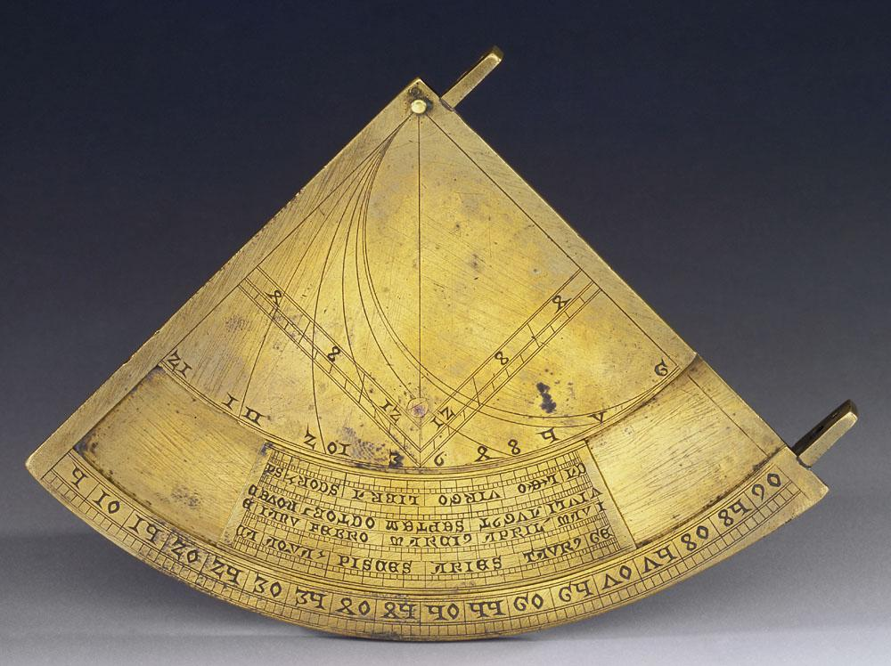
Image Set 3
Notes:
Image Sources
Left: Museo Galileo. (2010). Quadrans vetus [Image]. Wikimedia Commons. https://commons.wikimedia.org/wiki/File:Quadrans_Vetus_inv_662_IF_22256.jpg
Right: Rama. (2016). Quadrant astrolabique ottoman [Image]. Wikimedia Commons. https://commons.wikimedia.org/wiki/File:Astrolabe-MnM_9_NA_61-IMG_6075-black.JPG

Slide 11
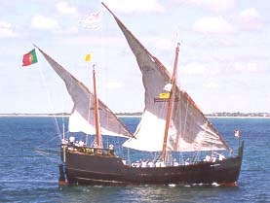
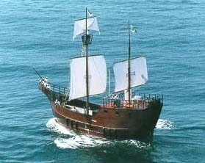
Image Set 4
Notes:
Image Sources
Both: Science, civilization, and society. (n.d.). Caravel [Image]. MT Oceanography. https://www.mt-oceanography.info/science+society/lectures/illustrations/lecture17/caravel.html

Slide 12
Tools of Exploration: TIP Chart
As you watch the video on the next slide, fill out your TIP chart.
In the second column, write any information you learn about each type of navigational technology.
In the third column, sketch a picture of each tool.
Notes:
K20 Center. (n.d.). TIP chart. Strategies. https://learn.k20center.ou.edu/strategy/185

Slide 13
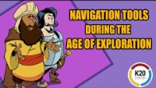
Tools of Exploration: Video
Notes:
To play the video, click the image on the slide or copy and paste this link into your web browser: https://www.youtube.com/watch?v=pD04eYrfLz0
Video source:
K20 Center. (2021). Navigation tools during the Age of Exploration [Video]. YouTube. https://www.youtube.com/watch?v=pD04eYrfLz0

Slide 14
Reflection
How was each tool used for exploration?
How did European explorers’ use of this technology affect the world?

Slide 15
Choice Board
Infographic | Article | Comic Strip
Create an infographic by hand or with a digital tool, such as Canva. In your infographic, explain the technology’s origin, how it came to Europe, how it helped explorers navigate the ocean, and its historical importance. | Write an informational article for a magazine. In your article, explain the technology’s origin, how it came to Europe, how it helped explorers navigate the ocean, and its historical importance. | Create and illustrate a comic strip. In your comic strip, explain and depict the technology’s origin, how it came to Europe, how it helped explorers navigate the ocean, and its historical importance.
Kahoot | Flipgrid | Advertisement
Make a Kahoot with 10 questions. In your Kahoot, include questions about the technology’s origin, how it came to Europe, how it helped explorers navigate the ocean, and its historical importance. | Record a Flipgrid. In your video, explain the technology’s origin, how it came to Europe, how it helped explorers navigate the ocean, and its historical importance. | Design an advertisement that markets the technology to explorers. In your ad, explain the technology’s origin, how it came to Europe, how it can help explorers navigate the ocean, and its historical importance.
Notes:
K20 Center. (n.d.). Choice board. Strategies. https://learn.k20center.ou.edu/strategy/73

Slide 16
Exit Ticket
On a sheet of paper, answer the following question:
How did the arrival of new technology influence European exploration?
  Reflect on what you have learned in the lesson to help you respond.
Notes:
K20 Center. (n.d.). Bell ringers and exit tickets. Strategies. https://learn.k20center.ou.edu/strategy/125

