Slide 2
Radical Yet Rational, Part 3
Extraneous Solutions

Slide 3

Bell Ringer
Find the solution(s) to each of the following equations:
Notes:
Strategy: K20 Center. (n.d.). Bell Ringers and Exit Tickets. Strategies. https://learn.k20center.ou.edu/strategy/125

Slide 4
Bell Ringer Solution (Question 1)

Slide 5
Bell Ringer Solution (Question 2)

Slide 6
Essential Question
How do we know if a solution is extraneous?

Slide 7
Lesson Objectives
Solve equations with even roots.
Decide which, if any, solutions are extraneous.

Slide 8
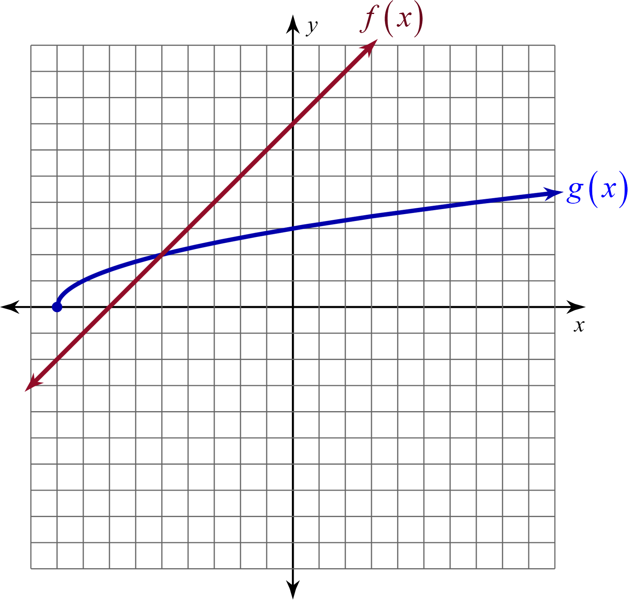
Exploring Functions
Work with your partner to answer the questions on the handout.

Slide 9
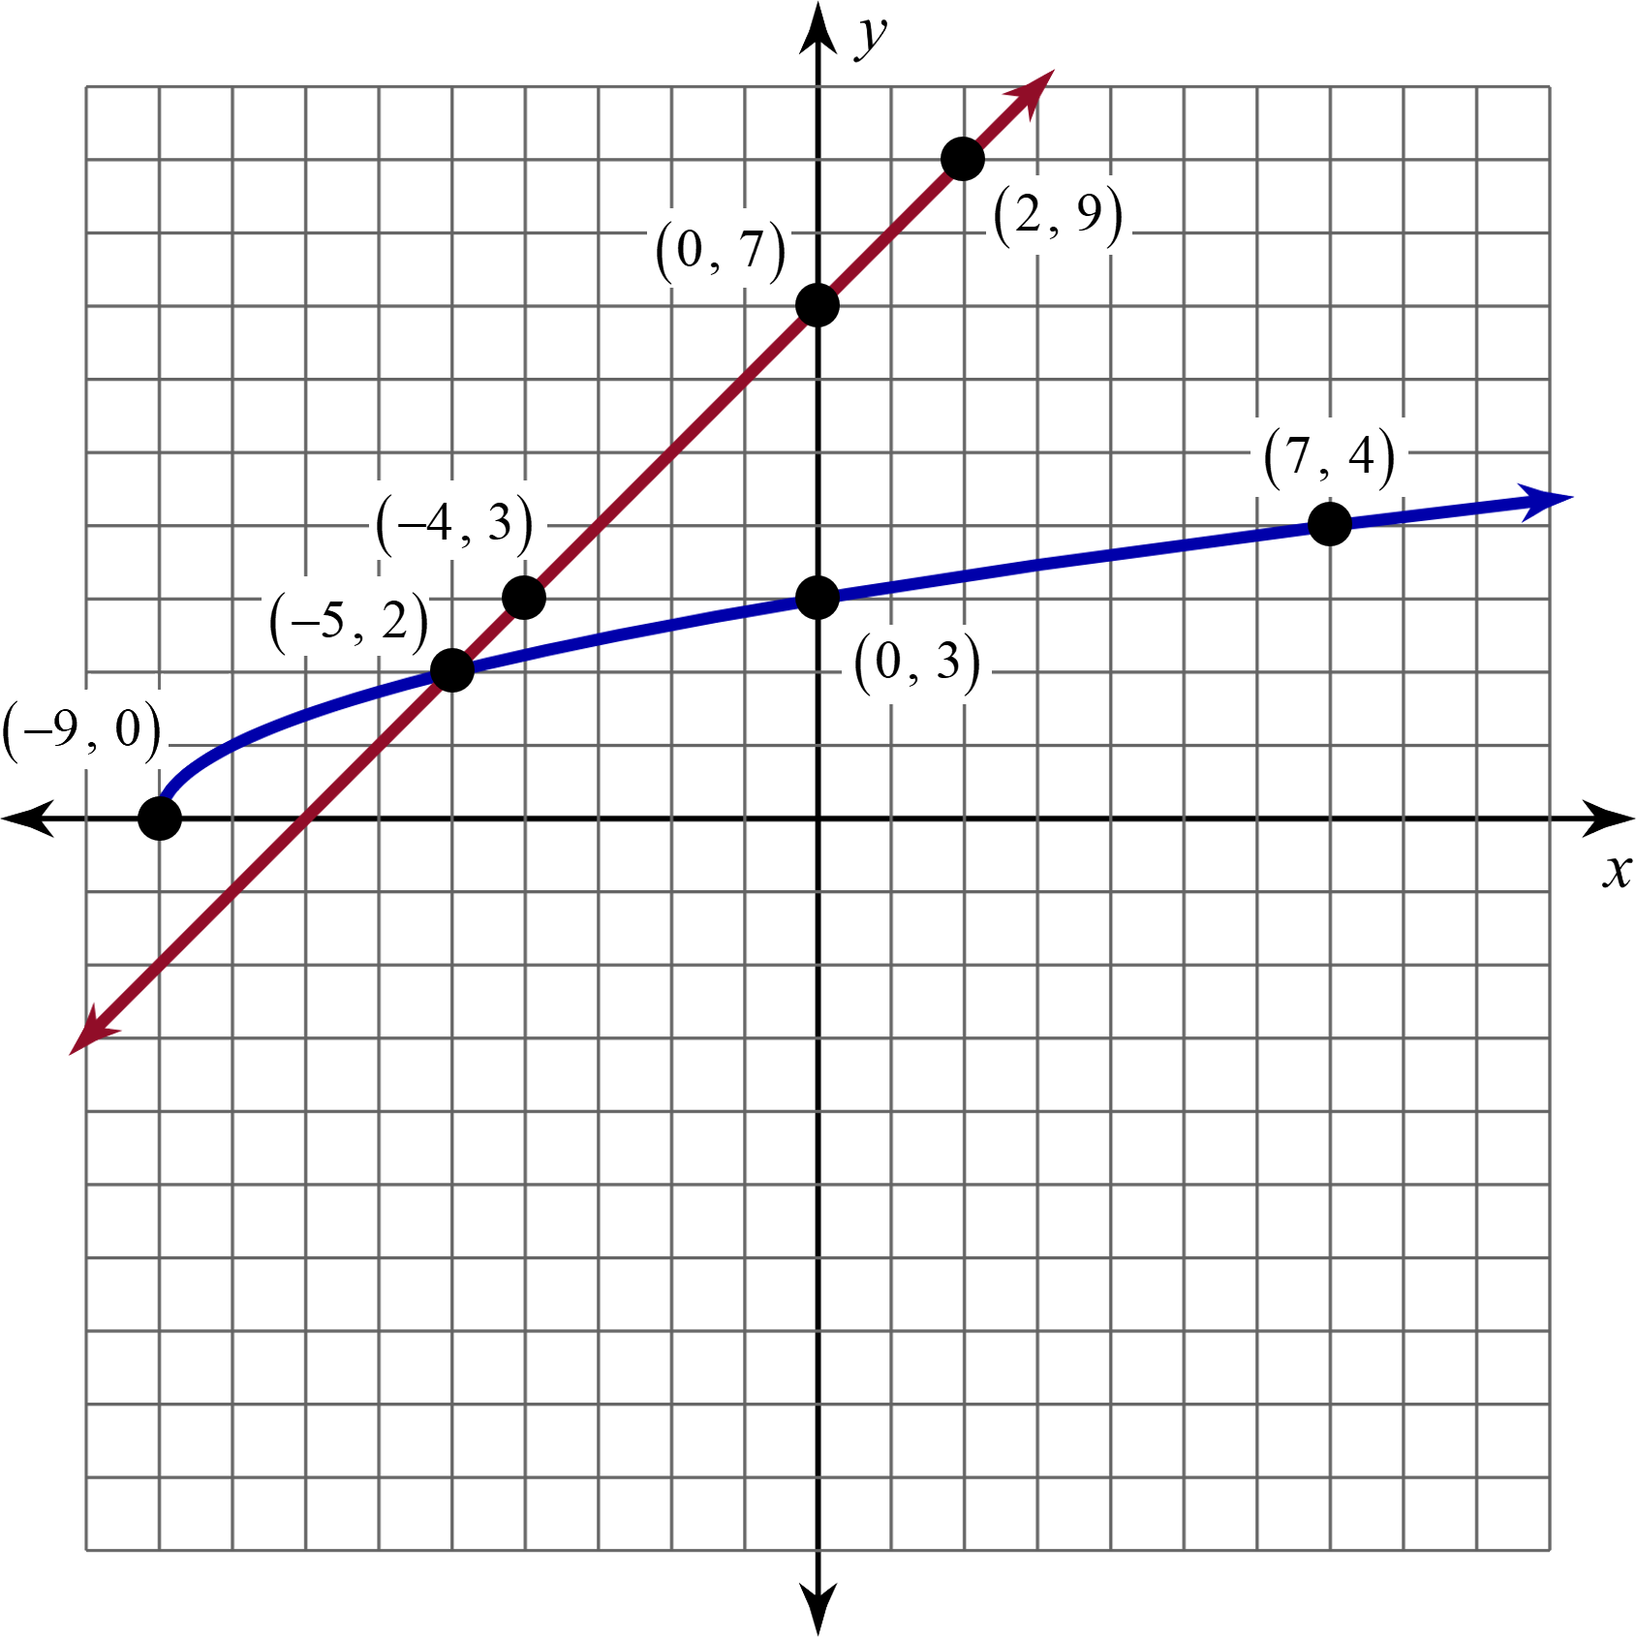
Exploring Functions (Solutions)

Slide 10
Guided Notes
Let’s complete the Guided Notes together.

Slide 11
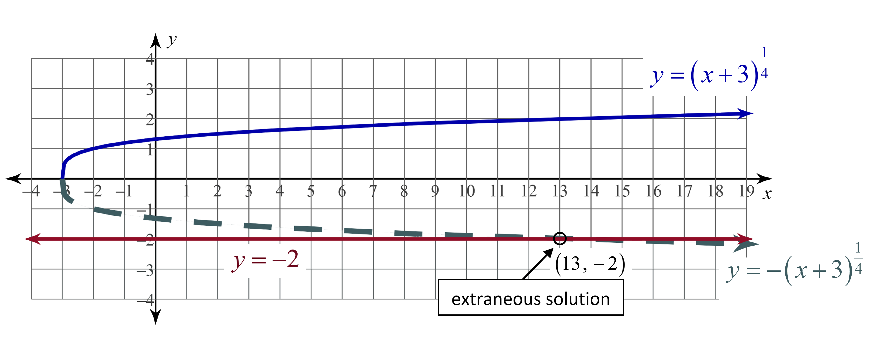
Example 1

Slide 12
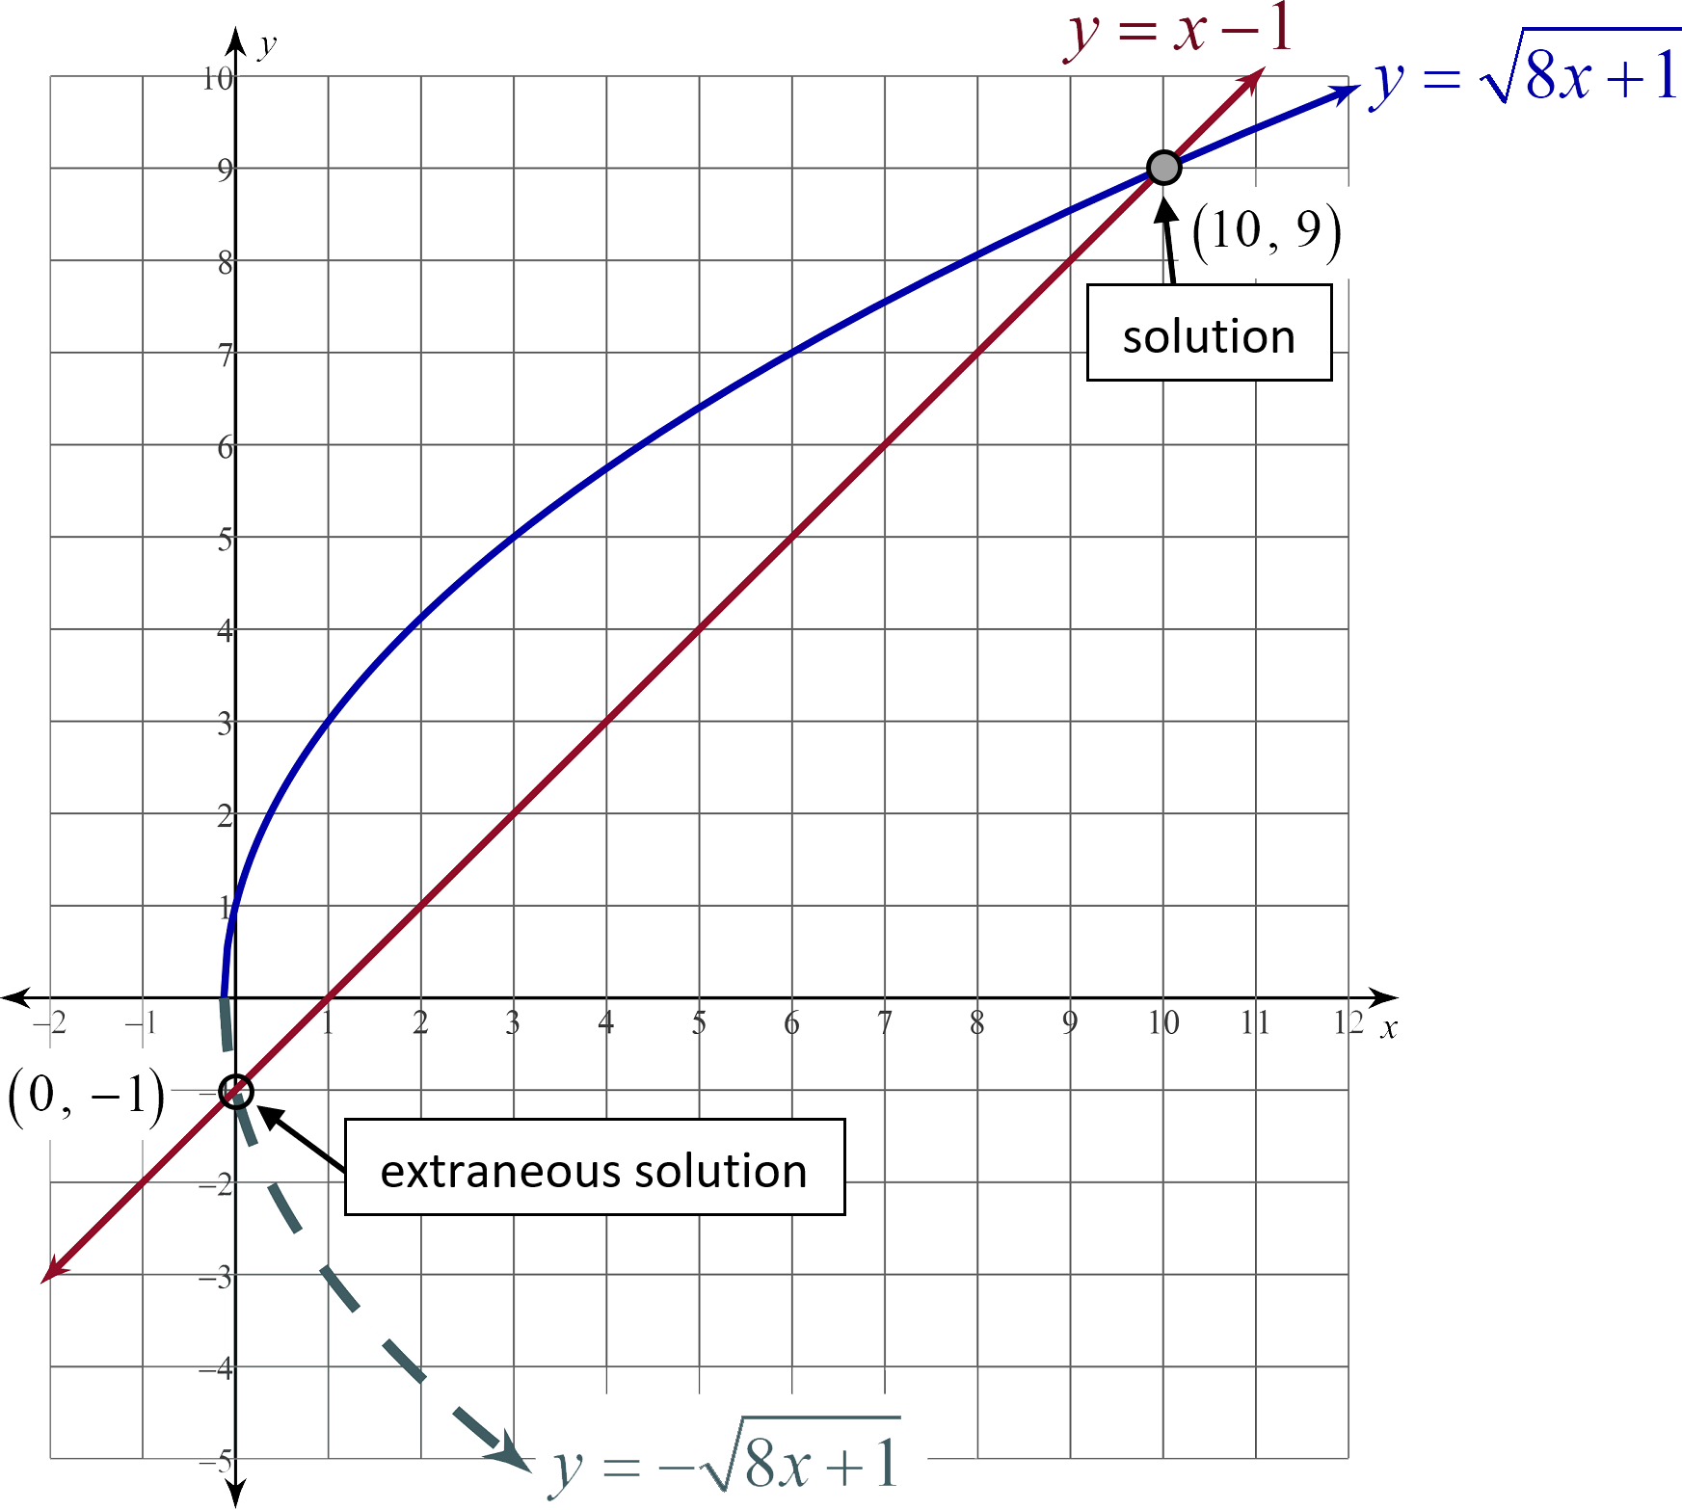
Example 2

Slide 13
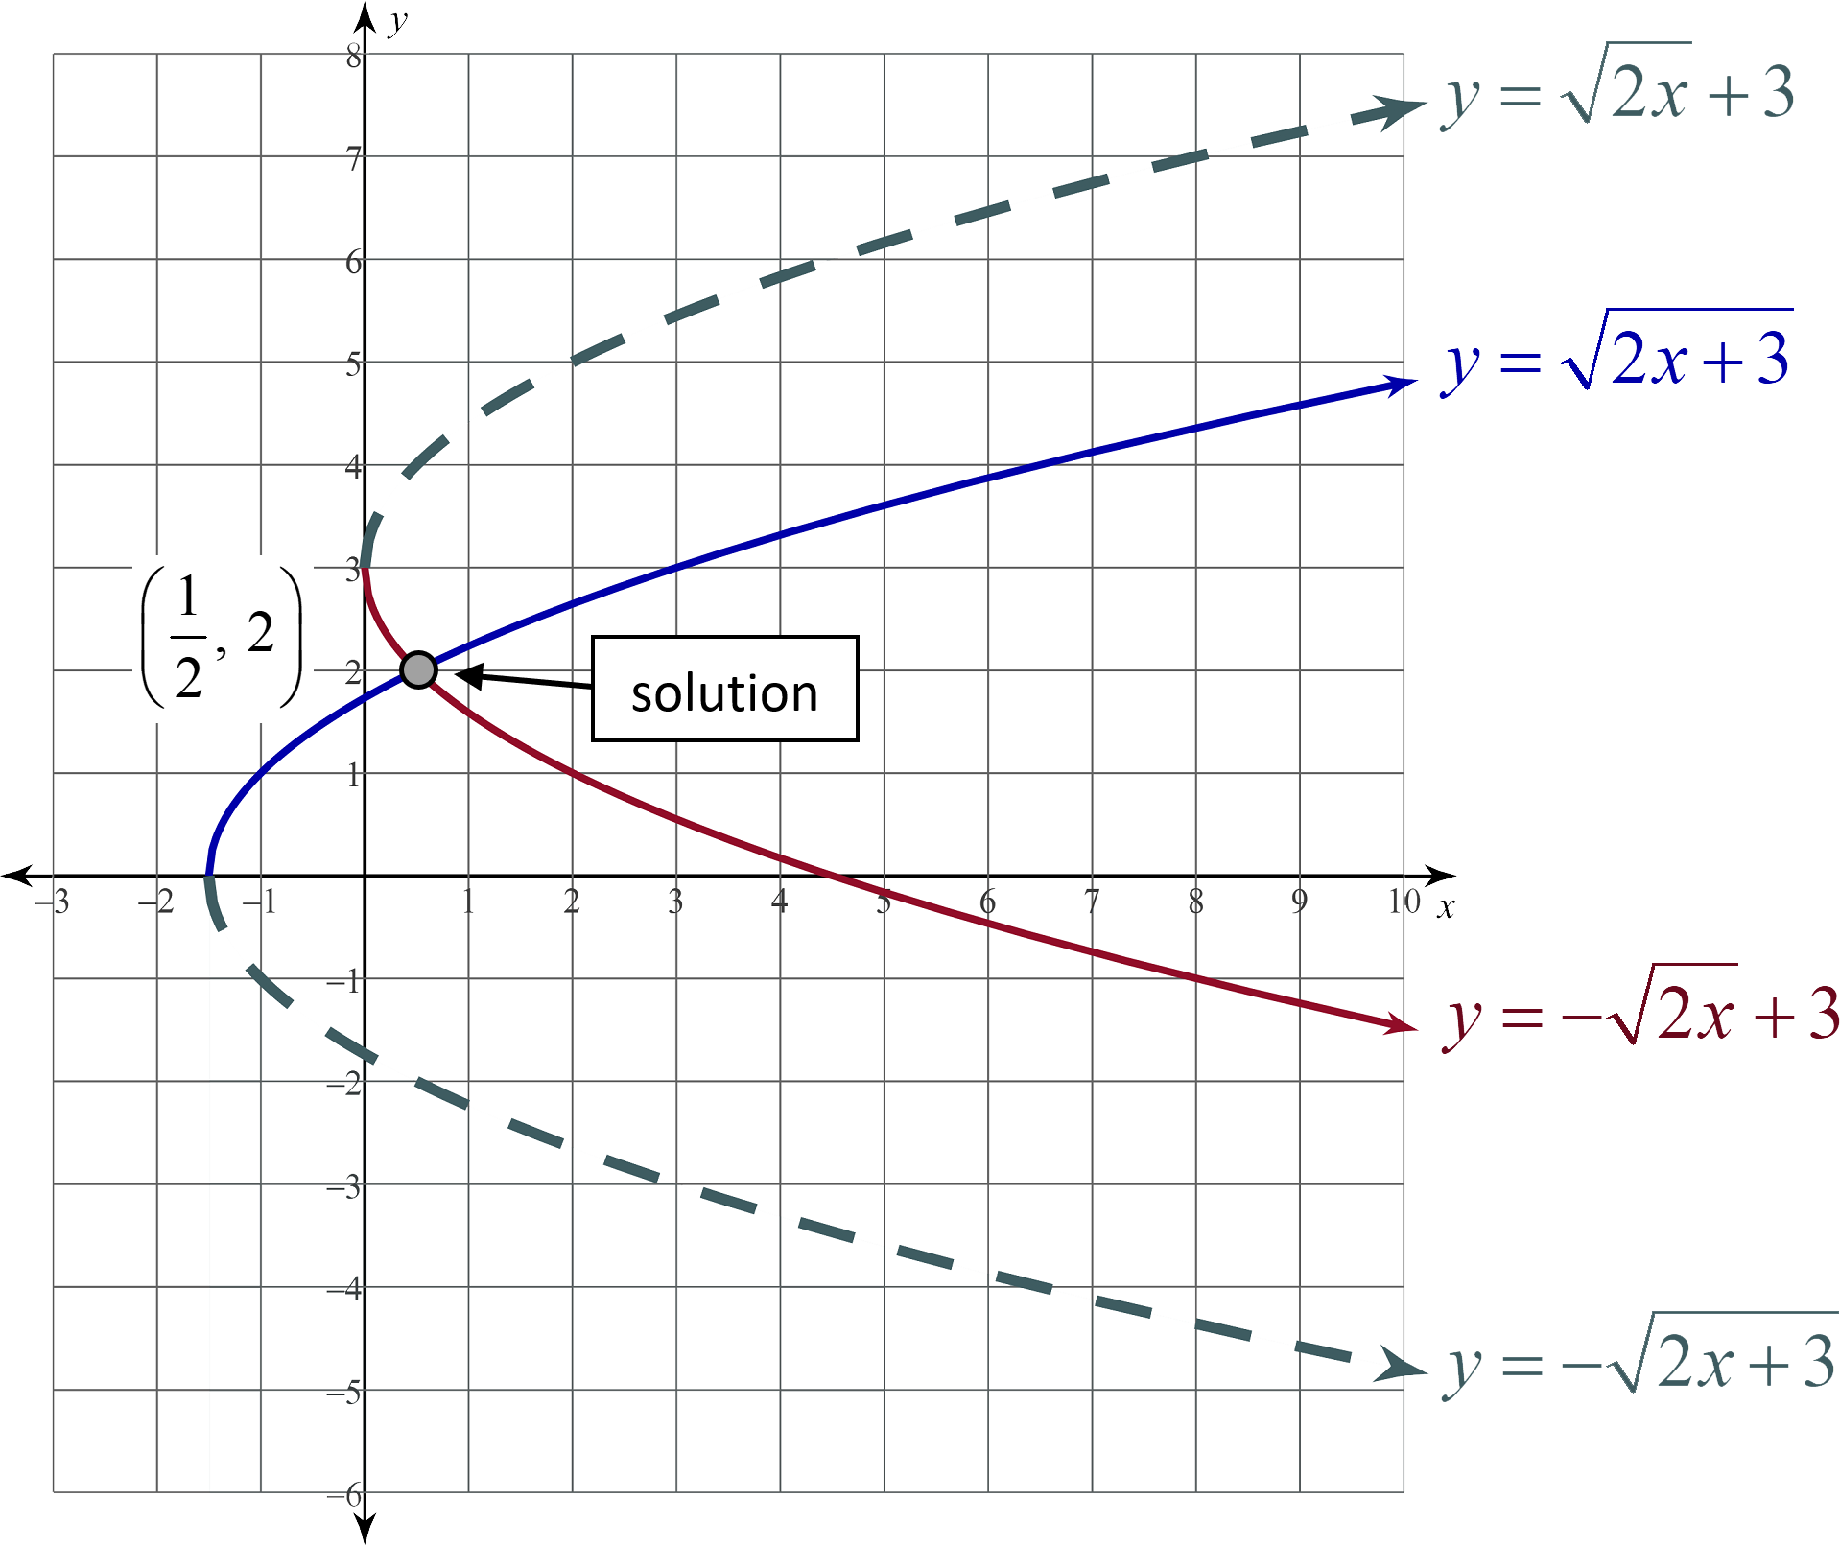
Example 3

Slide 14
Extraneous Solutions
Find the solution(s) to each of the following equations. Check for extraneous solutions.

Slide 15
Extraneous Solutions (Question 1)

Slide 16
Extraneous Solutions (Question 1)
Now, we need to check our solutions:

Slide 17
Extraneous Solutions (Question 2)

Slide 18
Extraneous Solutions (Question 2)
Now, we need to check our solutions:

Slide 19
Extraneous Solutions (Question 3)

Slide 20
Extraneous Solutions (Question 3)
Now, we need to check our solutions:

Slide 21
Extraneous Solutions (Question 4)

Slide 22
Extraneous Solutions (Question 4)

Slide 23
Extraneous Solutions (Question 4)
Now, we need to check our solutions:

Slide 24

Muddiest Point
Crystal Clear
  What do you think is the easiest (clearest) part of solving equations with radicals and/or rational exponents?
Muddiest Point
  What do you think is the most confusing (muddiest) part of solving equations with radicals and/or rational exponents?
Notes:
Strategy: K20 Center. (n.d.). Muddiest Point. Strategies. https://learn.k20center.ou.edu/strategy/109

