Slide 2
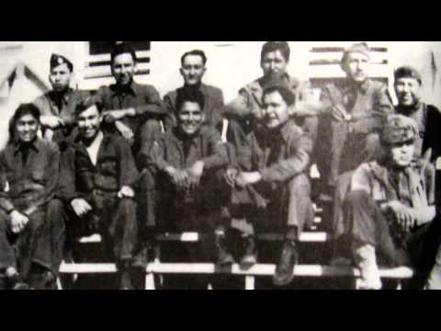
https://youtube/fABizJmghFk
Notes:
Comanche National Museum and Cultural Center. (2013, December 10). Code of honor - Comanche code talkers of WWII [Video]. YouTube. https://www.youtube.com/watch?v=fABizJmghFk

Slide 3
Word Warriors
The Code Talkers of Oklahoma

Slide 4
Essential Questions
Who were the code talkers from Oklahoma?
What were their contributions?
Why is it important for us to acknowledge their contributions?

Slide 5
Lesson Objective
Explain why code talking became an important strategy used by the U.S. military during both world wars.

Slide 6
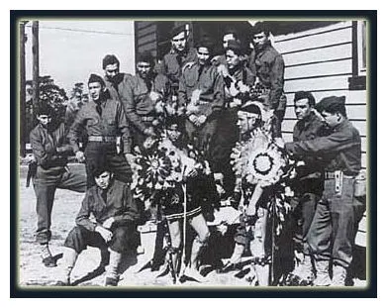
Code Talkers Matching Game
Part 1
Determine the English translation for the code talker term on each card.
Example: The code talker term for Tribe translates to Regiment.
Notes:
Army Heritage Center Foundation. (n.d.) How Comanche heritage helped win the war: Charles J. Chibitty and the Code Talkers. [Digital Image]. https://www.armyheritage.org/soldier-stories/how-comanche-heritage-helped-win-the-war-charles-j-chibitty-and-the-code-talkers/

Slide 7
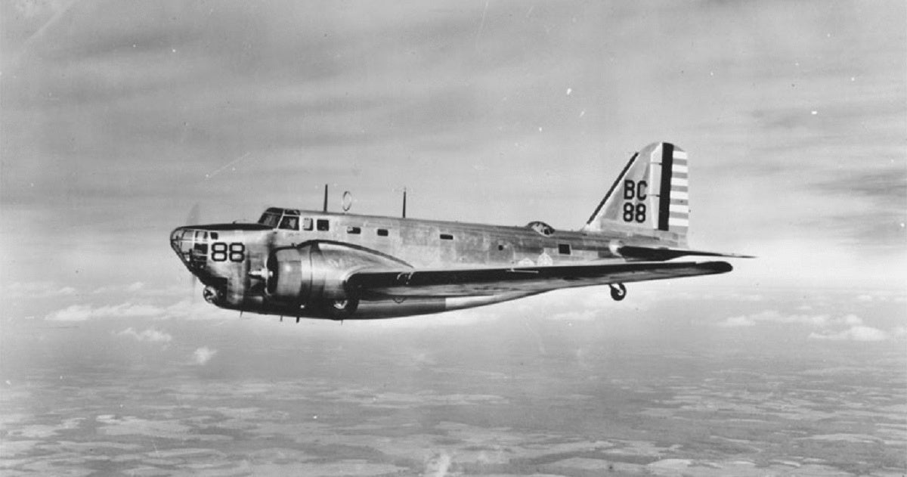
Code Talkers Matching Game
Part 2
Match the translation on each card to one of the code talker terms.
Notes:
Boeing B-17 Flying Fortress.
Hutchison, H. C. (2019, Sept 12). This bomber originally beat the iconic B-17 in World War II. [Digital Image]. https://www.wearethemighty.com/mighty-tactical/this-plane-beat-flying-fortress/

Slide 8
Code Talker Translations
Code Talker Term | Translation
Tribe | Regiment
One grain of corn | 1st Battalion
Bow | Company
Little gun shoot fast | Machine gun
Big gun | Artillery
Stone | Grenade
Fight | Attack
Many scouts | Patrol

Slide 9
Code Talker Translations
Code Talker Term | Translation
Scalps | Casualty
Bad air | Poison gas
Warrior | Soldier
Flies by itself | Airplane
Pregnant bird | Bomber
Gun knife | Bayonet
Without a horse | Car
Metal talking | Telephone

Slide 10
Code Talker Translations
Code Talker Term | Translation
Soldier chief | Officer
Star chief | General
Two-star branded | Two-star general
Big bird | Colonel
Crazy white man | Adolf Hitler
Medicine house | Hospital
Turtle | Tank

Slide 11

Stop and Jot
Read the article “Word Warriors.”
After reading the first paragraph, stop.
Jot down your response to the associated question on the right.
Continue reading, stopping, and jotting one paragraph at a time.
Notes:
K20 Center (n.d.). Stop and Jot. Strategies. https://learn.k20center.ou.edu/strategy/168

Slide 12

It's OPTIC-al
Remain in your groups of 4.
Read the question in each column of the OPTIC-al handout.
  O (Observations)
  P (Parts)
  T (Title)
  I (Interrelationships)
  C (Conclusion)
Discuss and record your responses in the space provided on the handout.
Share your findings with the class.
Notes:
K20 Center. (n.d.). It’s OPTIC-al. Strategies. https://learn.k20center.ou.edu/strategy/99

Slide 13

Two-Minute Paper
Take two minutes to summarize what you have learned by responding to the following prompt:
How did code talkers from Oklahoma help the United States win both World Wars?
Notes:
K20 Center. (n.d.). Two-Minute Paper. Strategies. https://learn.k20center.ou.edu/strategy/152

