Slide 2

Follow the Green,
Not the Dream
Environmental Science

Slide 3
Essential Question
How can science and technology deliver a higher standard of living while protecting the resources available on Earth?

Slide 4
Lesson Objectives
Use engineering practices to construct a model of a tool that reduces the use of natural resources.
Modify design practices to increase benefits while decreasing costs and risks.

Slide 5

Tree T-Pee
bit.ly/3wG87Xk
Notes:
To play the video, copy and paste the bit.ly link into your web browser, or click on the image on the slide.
Sources:
Tree T-Pee. (n.d.). TTP product [Image]. Tree T-Pee. https://www.treetpee.com/products/
Virality. (2017, August 29). Shark Tank The Most Selfless Entrepreneur Ever [Video]. Facebook. https://www.facebook.com/327785634332098/videos/328065774304084

Slide 6

Stand Up, Sit Down
To make an effective sales pitch, what are three essential factors or elements that you noticed the salesperson included?
What are three factors or elements that you think he should not have included?
Notes:
Strategy: K20 Center. (n.d.). Stand up, sit down. Strategies. https://learn.k20center.ou.edu/strategy/1771

Slide 7
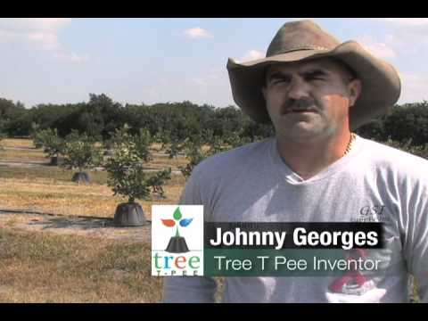
Notes:
Source:
Freel, E. (2010, November 10). Tree T-Pee – The Smart Choice [Video]. YouTube. https://www.youtube.com/watch?v=uTdDcj5UdLI&t=144s

Slide 8

Collective Brain Dump
With your group:
List 5–10 examples of man-made problems that deal with a limited natural resource.
Sort the cards into either global or local problems and label the two categories.
Notes:
Strategy: K20 Center. (n.d.). Collective brain dump. Strategies. https://learn.k20center.ou.edu/strategy/111

Slide 9
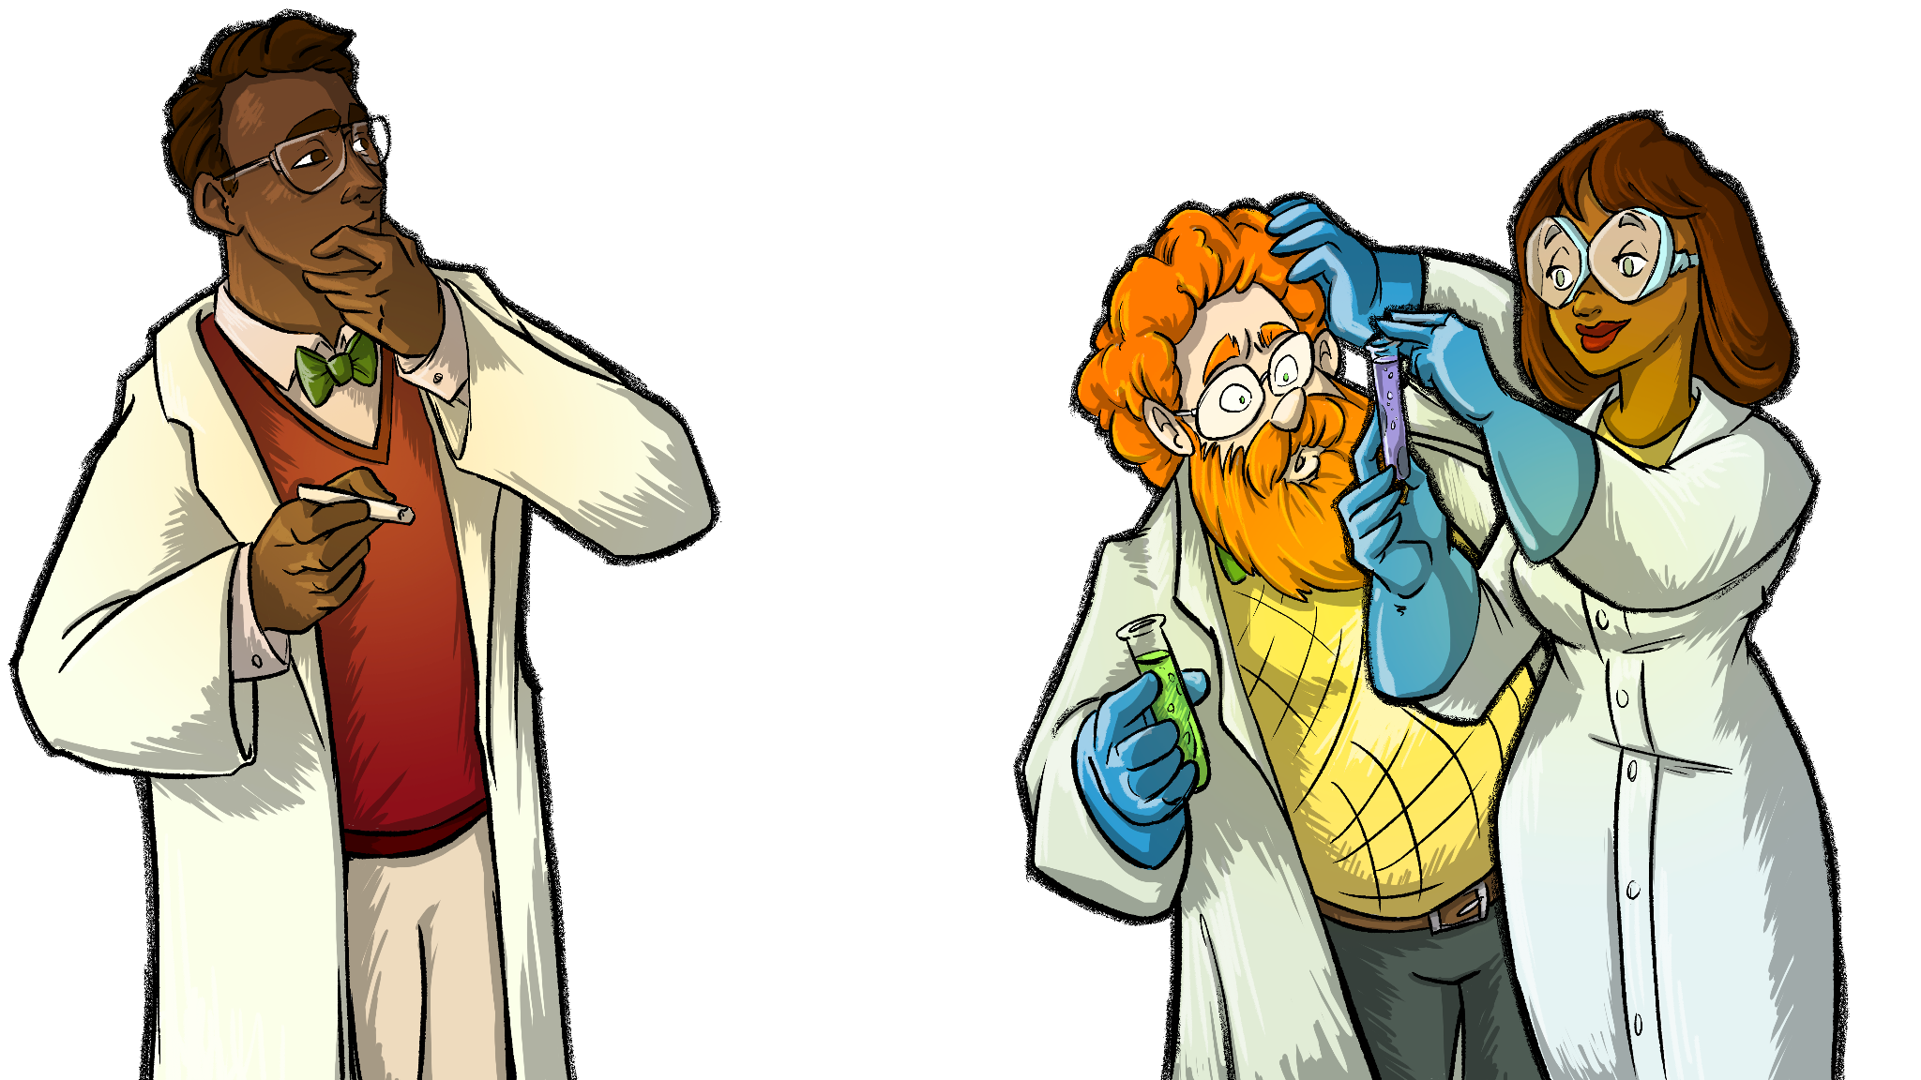
Group Research
As a group, research where your chosen problem occurs, why the resource is limited, and ways to combat this problem.
Fill out the Resource Research handout with the details of your research and turn it in to your teacher for approval.
Avoid blogs or biased information
by using primarily .org, .gov, and
.edu websites for your research.

Slide 10

Getting to Know 3D Printing With Tinkercad
How well do you know the Tinkercad app?
With your group, use the checklist on the handout
to identify and explore key features of the application.
Notes:
Source:
Tinkercad. (n.d.). From mind to design in minutes [Image]. Tinkercad. https://www.tinkercad.com/

Slide 11

Two Stars and a Wish
Take some time to review one another’s designs and then provide constructive feedback
for modifications.
Notes:
Strategy: K20 Center. (n.d.). Two stars and a wish. Strategies. https://learn.k20center.ou.edu/strategy/83

Slide 12

Shark Tank Presentation
Things to keep in mind:
It should take no more than 2 minutes to present your sales pitch.
Each member in the group should contribute to the pitch.
If it’s not your turn, make sure you’re taking notes.
Notes:
Source:
Instrum & Vocal Official Channel. (2018, March 30). Shark Tank (Theme Song, TV Show Version) [Video]. YouTube. https://www.youtube.com/watch?v=c2y8khVvw1U

Slide 13

Getting to Know Green Screen by Do Ink
How well do you know the Do Ink app?
With your partner, use the checklist on the handout to identify and explore key features of the application.
As you work through the list, upload the videos and pictures you took into the Do Ink app.

Slide 14
Step Into the Production Room
Using your digital storytelling experience from Do Ink:
Open iMovie.
Choose “New Project.”
Import your media from Do Ink into iMovie.
Record a script. Use your storyboard template as an outline and guide.
Add visual effects and background sound.
Export to your camera roll to share it with an audience.
Ask questions as needed!

Slide 15
And the winner is...

