Slide 2
Say it with Style
Introducing Syntax: Part 1

Slide 3
Essential Question
How does sentence structure impact a speaker’s or author’s message?

Slide 4
Lesson Objectives
Examine the function of various types of phrases and clauses to convey specific meanings.
Use parallel structure.

Slide 5


Card Sort
In your group:
Sort through the terms and definitions.
Match the term with the correct definition.
Use your context clues and prior knowledge to match as many as you can.
Notes:
K20 Center. (n.d.). Card Sort. Strategies. https://learn.k20center.ou.edu/strategy/147

Slide 6

Self-Guided Inquiry
With your group, look up the definitions of each term to make sure you have the correct matches!

Slide 7
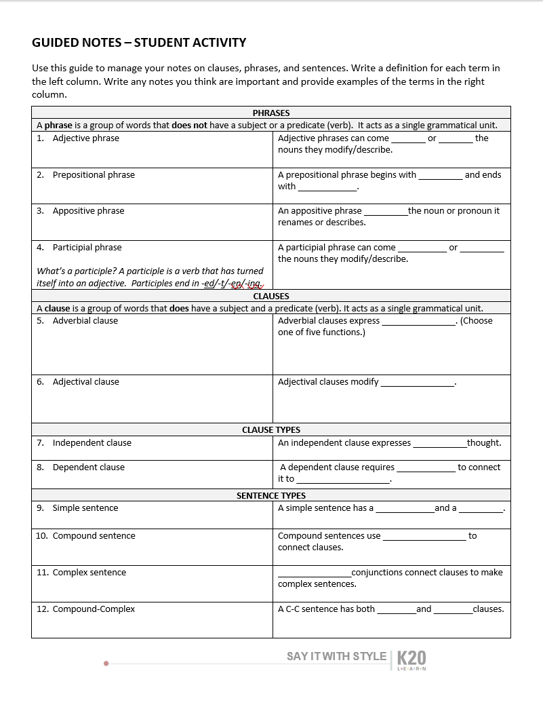
Guided Notes
Using your Guided Notes handout, write a definition for each term listed in the left column.
Check your understanding by filling in the blanks in the right column.
As you progress through slides 8-20, double check your answers.
Add additional information.
Create your own examples to reinforce your understanding.

Slide 8
Adjective Phrase
A group of words headed by an adjective that describes a noun or pronoun.
Adjective phrases can either come before or after the nouns they modify.
Phrases do not have subjects and predicates.
  A large, exotic-looking bluebird flew to its nest in the tree.
  A bluebird, large and exotic-looking, flew to its nest in the tree.

Slide 9
Prepositional Phrase
A group of words consisting of a preposition, its object, and any words that modify the object.
Prepositional phrases can function as both adjectives and adverbs.
Phrases do not have subjects and predicates.
  My parents went to the grocery store on Main Street for pizza.
    “to the grocery store” = prepositional phrase (where?)
    “on Main Street” = prepositional phrase (which store?)
    “for pizza” = prepositional phrase (why did they go?)

Slide 10
Appositive Phrase
A group of words consisting of an appositive and its modifiers.
The appositive adds a more detailed description to a noun or pronoun.
The appositive phrase follows the noun it modifies.
The appositive and its noun can be switched without changing meaning of the sentence.
Appositives are usually set off with commas.
Phrases do not have subjects and predicates.
Pronouns, rarely, if ever, function as appositives.
  Maria, my childhood friend, opened a bakery down the street.
  My childhood friend, Maria, opened a bakery down the street.
  I gave you, my oldest friend, a gold bracelet.

Slide 11
Participial Phrase
A group of words consisting of a participle, any modifiers, and pronouns or nouns.
Phrases do not have subjects and predicates.
  Having been a doctor for twenty years, Jamal knew his child’s tonsils needed to be removed.
  Zion noticed her younger sister walking along the river.
  We walked along the river on shattered and broken streets.
  The plate, thrown against the wall, broke into a hundred pieces.
  We ate burnt toast and fried eggs for breakfast.
What is a participle? A participle is a verb functioning as an adjective. It most often ends in -ing or –ed/-d/-t/-en. A participle can come before or after the noun it modifies.

Slide 12
Adverb
An adverb is a word that modifies (describes) a verb, an adjective, another adverb, or a whole sentence.
Adverbs modifying verbs: He talks loudly.
Adverbs modifying adjectives: The girl is very tall.
Adverbs modifying another adverb: The concert ended too quickly.
Adverbs modifying a whole sentence: Fortunately, I remembered to bring a coat.
Adverbs answer the following questions: when, where, how, and to what extent (how much or how long).

Slide 13
Adverbial Clause
An adverbial clause is a group of words that functions as an adverb. Clauses have subjects and predicates. Adverbial clauses are dependent clauses.
Breya scrubbed the toilet until her arms ached.
The students took notes while they listened to the lecture.
We will go to the concert even if it storms.
This adverb clause describes how Breya scrubbed.
This adverb clause describes when the students took notes.
This adverb clause describes a certain condition, or a “how.”

Slide 14
Adjective Clause
An adjective clause is a group of words that functions as an adjective. Clauses have subjects and predicates. Adjective clauses are introduced with relative pronouns: who, whom, whose, that, which. Adjective clauses always follow the nouns they modify. Adjective clauses are dependent clauses.
Students who ride the bus home will be dismissed early on Friday.
The teacher whose teaching style influenced me most is Mr. Jones.
I knew the book that I lost was overdue at the library.
The children loved hot dogs, which were served for lunch every Friday.
The scientist, whom I knew in high school, became an astronaut.

Slide 15
Independent Clauses
An independent clause is a group of words that contains a subject and verb and expresses a complete thought. A sentence is an independent clause.
Independent - Not requiring or relying on something else; not contingent on other elements to make sense.
    We spent our money at the concession stand.
    The cat meowed at its owner.
    I walked to the store.
    They went to the movies.

Slide 16
Dependent Clause
A dependent clause is a group of words that contains a subject and verb, but does not express a complete thought. It is not a complete sentence.
Think of dependent clauses as cliffhanger sentences.
Dependent clauses rely on another clause in order to express a complete thought.
    Because the soup was cold, I had to heat it up in the microwave.
    If I don’t wake up early tomorrow, I will be late for school.
    Until I finish this project, I cannot go to the movies.
    At the mall, we saw some people who were dressed oddly.
    Dogs that are adopted from the animal shelter often are the best pets.

Slide 17
Simple Sentences
A simple sentence consists of just one independent clause.
    The dog loves the outdoors.
    John’s favorite food is pizza.
    The neighborhood children swam in the pond during the summer vacation.

Slide 18
Compound Sentences
A compound sentence is comprised of two independent clauses, typically with a coordinating conjunction like for, and, nor, but, or, yet.
    The dog from the shelter loves the outdoors, and we take a walk everyday.
    The neighborhood children swam in the pond during the summer vacation, and every day they stayed there until dark.
    The car would not start this morning, but, fortunately, I was not late for work.

Slide 19
Complex Sentences
A sentence with one independent clause and at least one dependent clause.
Example: Because the chicken hadn’t thawed, I wasn’t able to cook it for dinner.
  Dependent Clause
  Because the chicken hadn’t thawed
  Does not express a complete thought
  Independent Clause
  I wasn’t able to cook it for dinner.
  Expresses a complete thought

Slide 20
Compound-Complex Sentences
A sentence having two or more coordinate independent clauses and one or more dependent clauses.
Example:
Mayra forgot her sister’s birthday, so she sent her a card when she finally remembered.
  Independent Clause #1
  Mayra forgot her sister’s birthday
  Expresses a complete thought
  Independent Clause #2
  So she sent her a card
  Expresses a complete thought
  Dependent Clause
  When she finally remembered.
  Does not express a complete thought

Slide 21
Parallel Structure
Parallel structure is a literary technique.
Having the same direction, course, nature, or tendency; corresponding; similar; analogous.
Examples:
  Abraham Lincoln’s Gettysburg Address, “. . . and that government of the people, by the people, for the people, shall not perish from the earth.”
  The dog walked between the furniture, across the room, and out the door.
Think about parallel lines in math. They “mirror” each other.

Slide 22
Parallel Structure
When is parallel structure used in writing?
It can be used to emphasize specific points an author or speaker is trying to make. Almost like strategic repetition to maximize the message’s impact.
It can be used to show that two or more ideas have the same level of importance.
Which sentences are examples of parallel structure?
The child washed their face, brushed their teeth, and prepared for bed.
The professor enjoys reading, writing, and painting.
The athlete loves playing football, go on walks, and listening to music.
The hairstylist loves to cut and color hair.

Slide 23
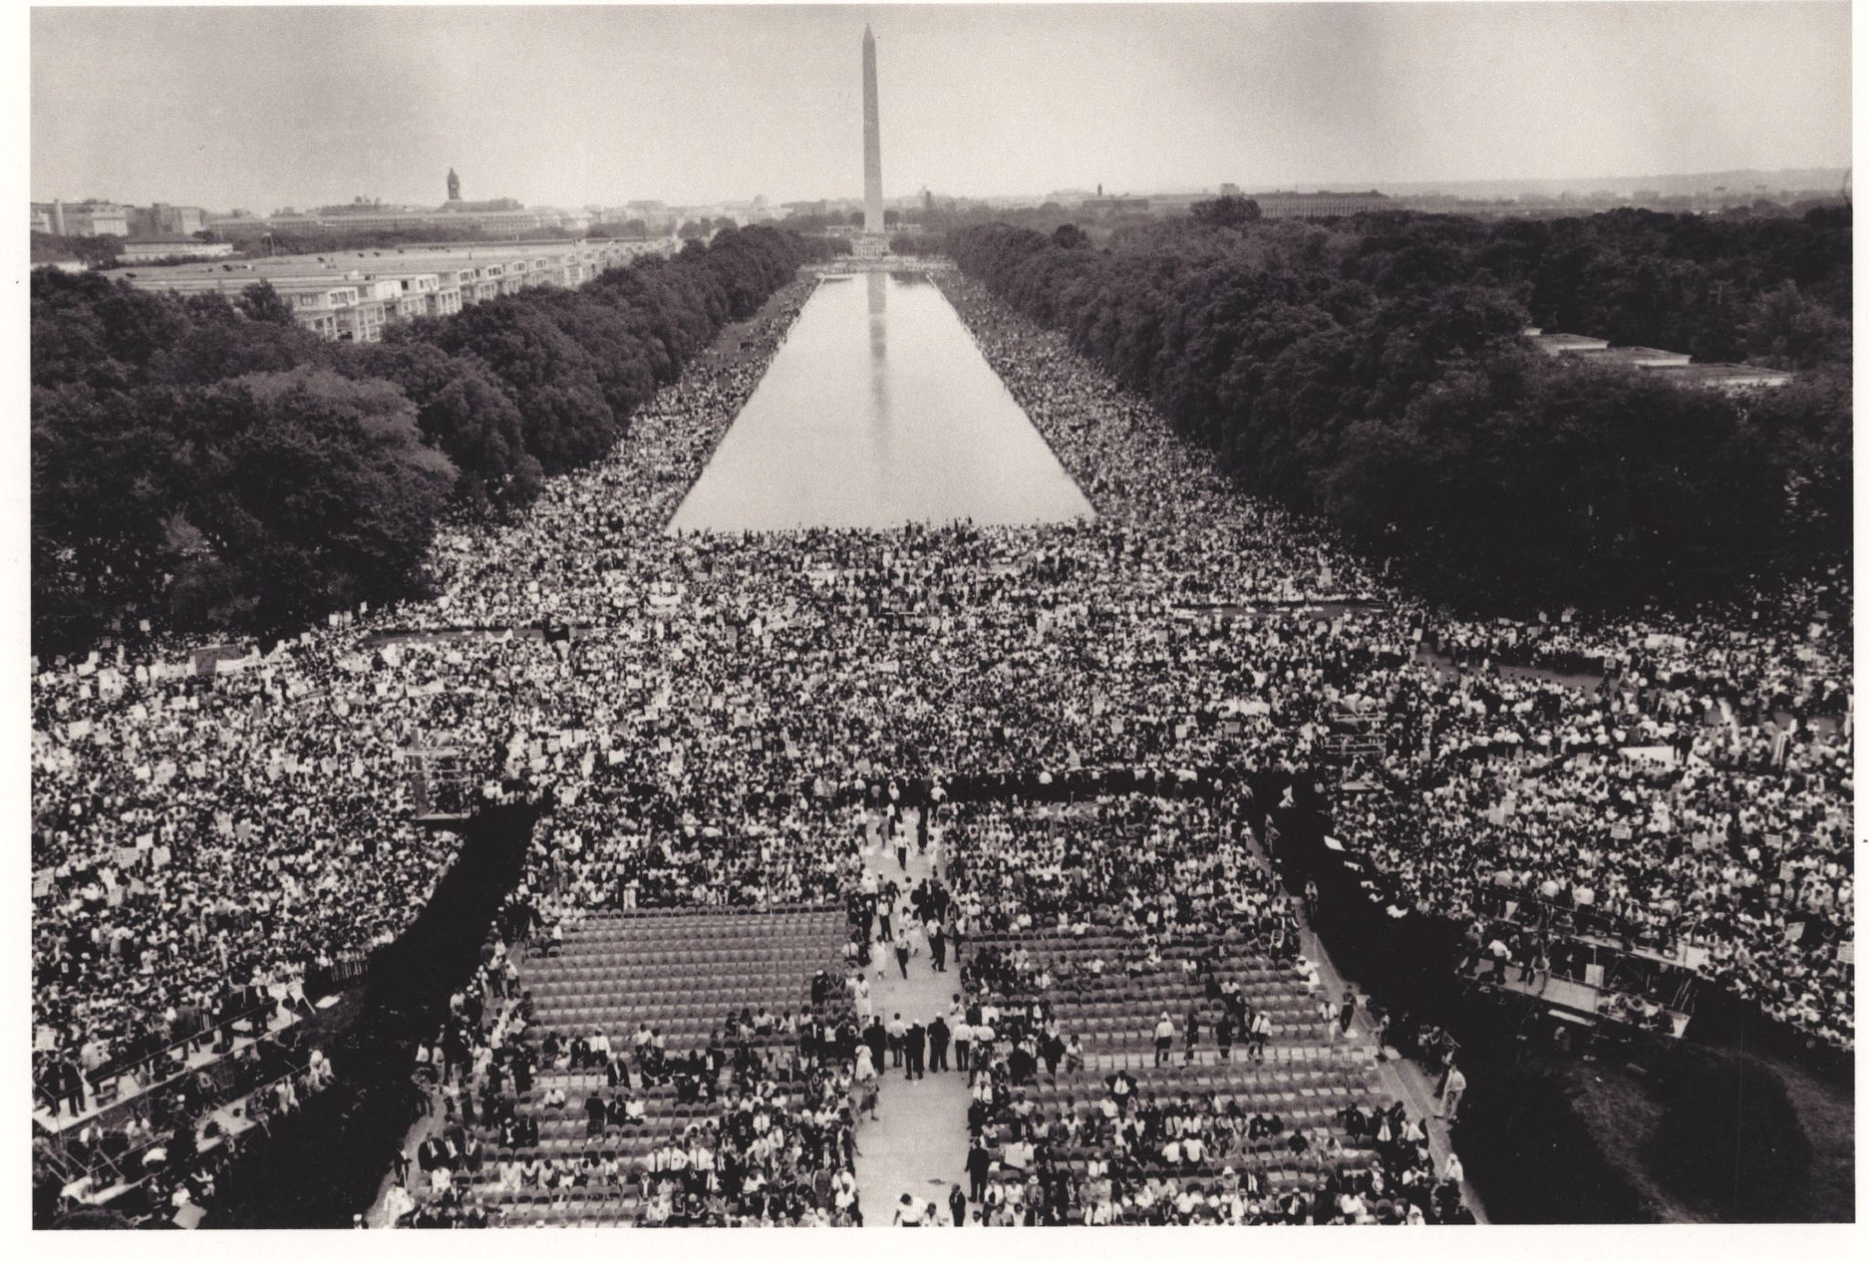
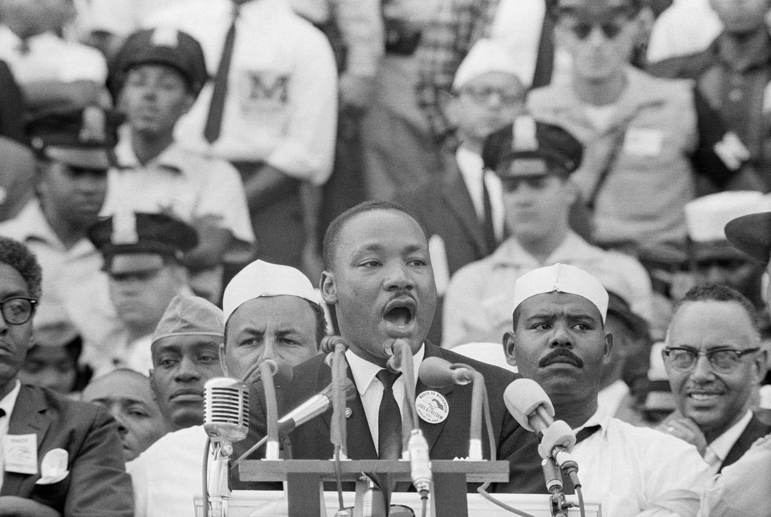
I Have a Dream - Martin Luther King, Jr.
Notes:
Penn State Special Collections. (1963). March on Washington for Jobs and Freedom, Washington, D.C. https://www.flickr.com/photos/pennstatespecial/7365129630.
Saba, T. (2003). Dr. Martin Luther King, Jr. delivers his famous "I Have a Dream" speech in front of the Lincoln Memorial during the Freedom March on Washington in 1963. https://www.flickr.com/photos/97453745@N02/9276897012.

Slide 24


Categorical Highlighting
As you’re listening to Martin Luther King , Jr.'s “I Have a Dream” speech look for the following in your handout:
Parallel Structure
  at least 5 examples
  Highlight blue
Dependent Clause
  at least 3 examples
  Highlight green
Independent Clause
  at least 3 examples
  Highlight pink
Notes:
King, M. L. (1963). I Have a Dream. NPR.
K20 Center. (n.d.) Categorical Highlighting. Strategies. https://learn.k20center.ou.edu/strategy/192

Slide 25
Card Sort Revisited
In your group:
Sort through the terms and definitions;
Match the term with the correct definition;
Use your context clues and prior knowledge to match as many as you can.
Notes:
K20 Center. (n.d.). Card Sort. Strategies. https://learn.k20center.ou.edu/strategy/147

