Slide 2
Bio-Dome
Biology

Slide 3
Essential Question
Can life be sustained in a closed environment/ecosystem?

Slide 4
Lesson Objectives
Construct an explanation for how homeostasis is maintained within an ecosystem.
Determine what materials exist for the input and output in an ecosystem.

Slide 5
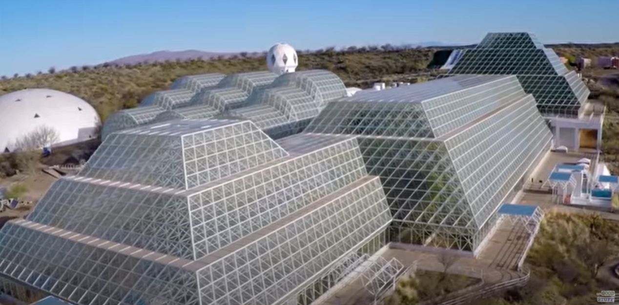
I Notice, I Wonder: Inside Biosphere 2
Notes:
To play the video, click the image on the slide or copy and paste the following link into your web browser: https://www.youtube.com/watch?v=-yAcD3wuY2Q
Video source:
The Good Stuff. (2015, October 13). Inside Biosphere 2: The world’s largest earth science experiment [Video]. YouTube. https://www.youtube.com/watch?v=-yAcD3wuY2Q

Slide 6
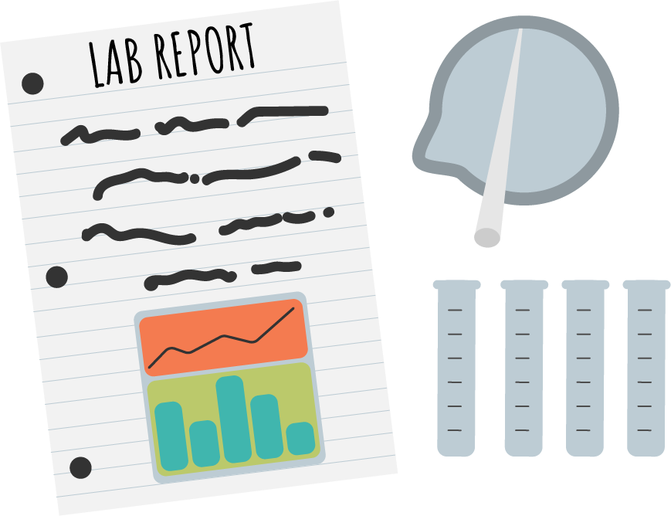
Photosynthesis Lab
Complete the lab by following the instructions on the handout.
As you work, remember to collect and record data on the handout.
Once you’ve completed the lab, answer the analysis questions on the handout.

Slide 7
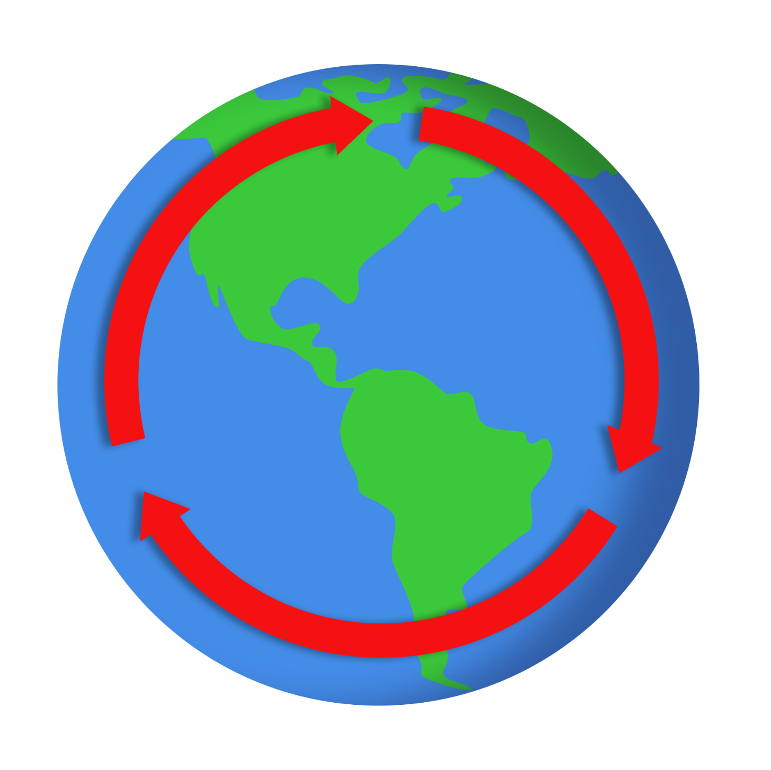
CUS and Discuss
As you read your assigned section of the article, complete the following tasks:
  Circle any new vocabulary. Look up each word’s
  definition and, in the margin, write a sentence
  that uses each circled word correctly.
  Underline evidence that supports the main idea.
  Star the main idea of your assigned section.
Discuss with your group what you marked and why.
Notes:
Allow students about 15 minutes to read the article silently and complete the CUS part, then have them take 15 minutes to discuss.
Strategy: K20 Center. (n.d.). CUS and Discuss. Strategies. https://learn.k20center.ou.edu/strategy/162

Slide 8
Jigsaw Presentation
You and your group will create a PowerPoint slide that summarizes your section of the article:
  Keep your bullet points brief.
  Add at least one image that depicts your group’s topic.
  Make sure each group member contributes and has something to share out.
As other groups present their slides, record your
peers’ findings on your Cornell Notes handout.
Notes:
Allow students about 15 minutes to discuss and create their slides, then have them share out. It may take about 40 minutes total to complete this activity. On the Cornell Notes handout, students’ summaries should reflect all groups’ presentations and pull all the evidence together to explain the article in 3-5 sentences.
Strategy: K20 Center. (n.d.). Jigsaw. Strategies. https://learn.k20center.ou.edu/strategy/179

Slide 9
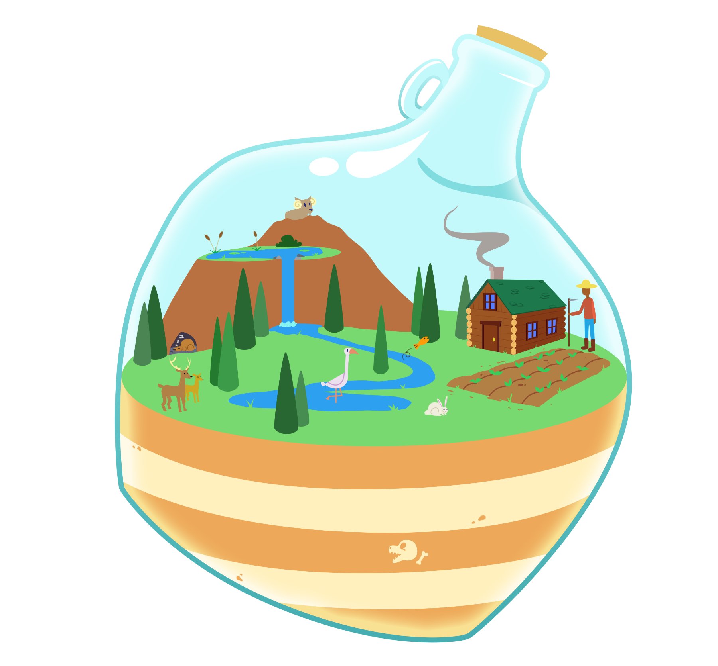
Create Your Own Closed Ecosystem
Develop a model of a closed ecosystem (terrarium or aquarium).
Review one another’s models and
make changes if necessary.
Vote on the model you like best to help your group choose a final design.
Create your closed ecosystem as a group.

Slide 10
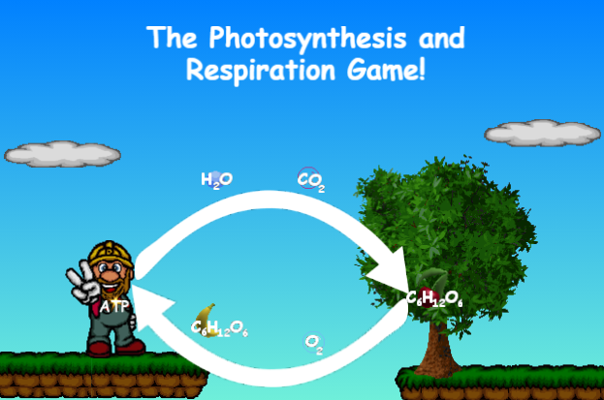
Photosynthesis and Respiration Game
As you play through, answer the questions on the handout.
Notes:
To help students verify they are at the correct game, click the image on the slide or copy and paste the following link into your web browser: https://biomanbio.com/HTML5GamesandLabs/PhotoRespgames/photoresphtml5page.html
Game source:
Bioman. (n.d.). Photosynthesis and Respiration Game [Interactive]. Bioman Biology. https://biomanbio.com/HTML5GamesandLabs/PhotoRespgames/photoresphtml5page.html

Slide 11

Quick Write
Take 5 minutes to write a response to the following question:
How can a closed ecosystem maintain homeostasis through the cycling of carbon?
Notes:
Strategy: K20 Center. (n.d.). Quick Write. Strategies. https://learn.k20center.ou.edu/strategy/1127

