Slide 2
The Power is Ours
Marbury v. Madison

Slide 3
Essential Question
How did Marbury v. Madison change the government’s system of checks and balances?

Slide 4
Lesson Objective
Explain the significance and impact of Marbury v. Madison.

Slide 5
Tip of the Iceberg
Write everything you know about the Supreme Court and judicial system above the water line on the Tip of the Iceberg handout.
Notes:
K20 Center. (n.d.). Tip of the Iceberg. Strategies. https://learn.k20center.ou.edu/strategy/67

Slide 6
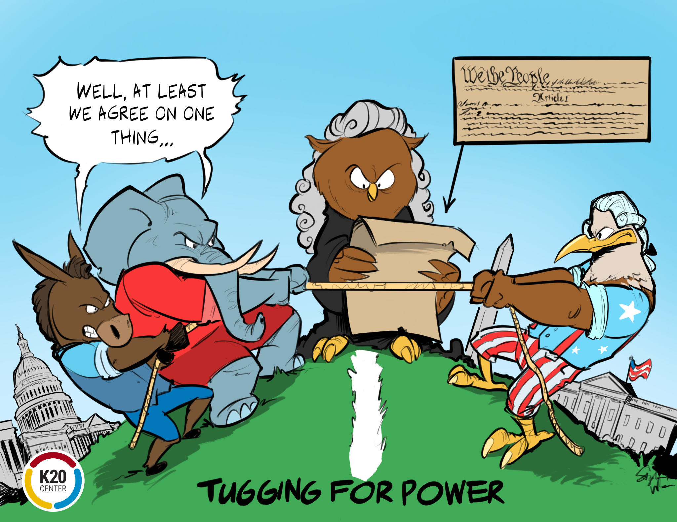
T.A.C.O.S.
Time Period. When does the cartoon take place?
Action. What is happening in the cartoon?
Caption. Is there a caption or title?
Objects. What significant items are shown?
Summary. What message is the cartoon trying to portray?
Notes:
K20 Center. (n.d.). T.A.C.O.S.. Strategies. https://learn.k20center.ou.edu/strategy/1196
K20 Center. (n.d). Photo or Picture Deconstruction. Strategies. https://learn.k20center.ou.edu/strategy/140

Slide 7
Marbury v. Madison: Infographic
Read the Infographic and begin drafting your own Graphic Organizer.
Complete the graphic organizer after watching the Marbury v Madison video.

Slide 8
Marbury v. Madison Video
Notes:
Marbury vs. Madison: What was the Case About?: History. YouTube. (2017, September 14). https://youtu.be/hOvsZyqRfCo.

Slide 9
Judicial Review Discussion
Read the handout with your group.
Discuss the issues using the reflection questions at the end as a guide.
Select a spokesperson to share the group’s thoughts on the reading.

Slide 10
Judicial Review Discussion
Does the fact that Supreme Court judges are appointed, not elected, influence your opinion of the judicial review?
Is it possible for Supreme Court judges to be unbiased in decision-making?
Does the power of judicial review give the Supreme Court too much power over the Legislative and Executive branches?
What changes, if any, would you make to the power of judicial review?

Slide 11
Tip of the Iceberg
Write everything you learned about the Supreme Court and judicial system below the water line on the Tip of the Iceberg handout.
Notes:
K20 Center. (n.d.). Tip of the Iceberg. Strategies. https://learn.k20center.ou.edu/strategy/67

