Slide 2
Can’t Touch This, Part 1
Graphing Rational Functions

Slide 3
Essential Question
What can cause asymptotes?

Slide 4
Lesson Objectives
Graph rational functions.
Identify key characteristics of the graphs of rational functions, both algebraically and graphically.

Slide 5
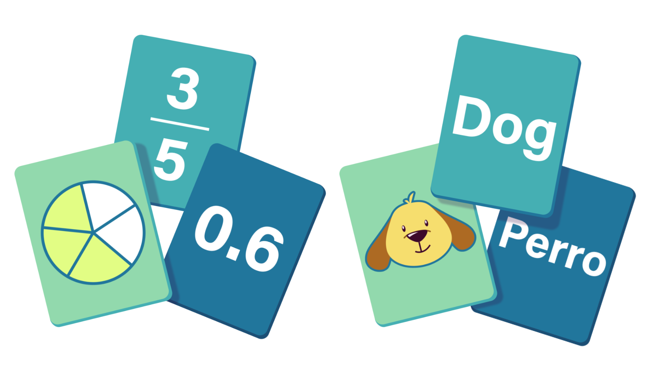
Card Matching
Work with your partner to match the following cards:
  Graph
  Domain/Range
Record your pairs on the Card Matching Results handout.
Notes:
K20 Center. (n.d.). Card Matching. Strategies. https://learn.k20center.ou.edu/strategy/1837

Slide 6
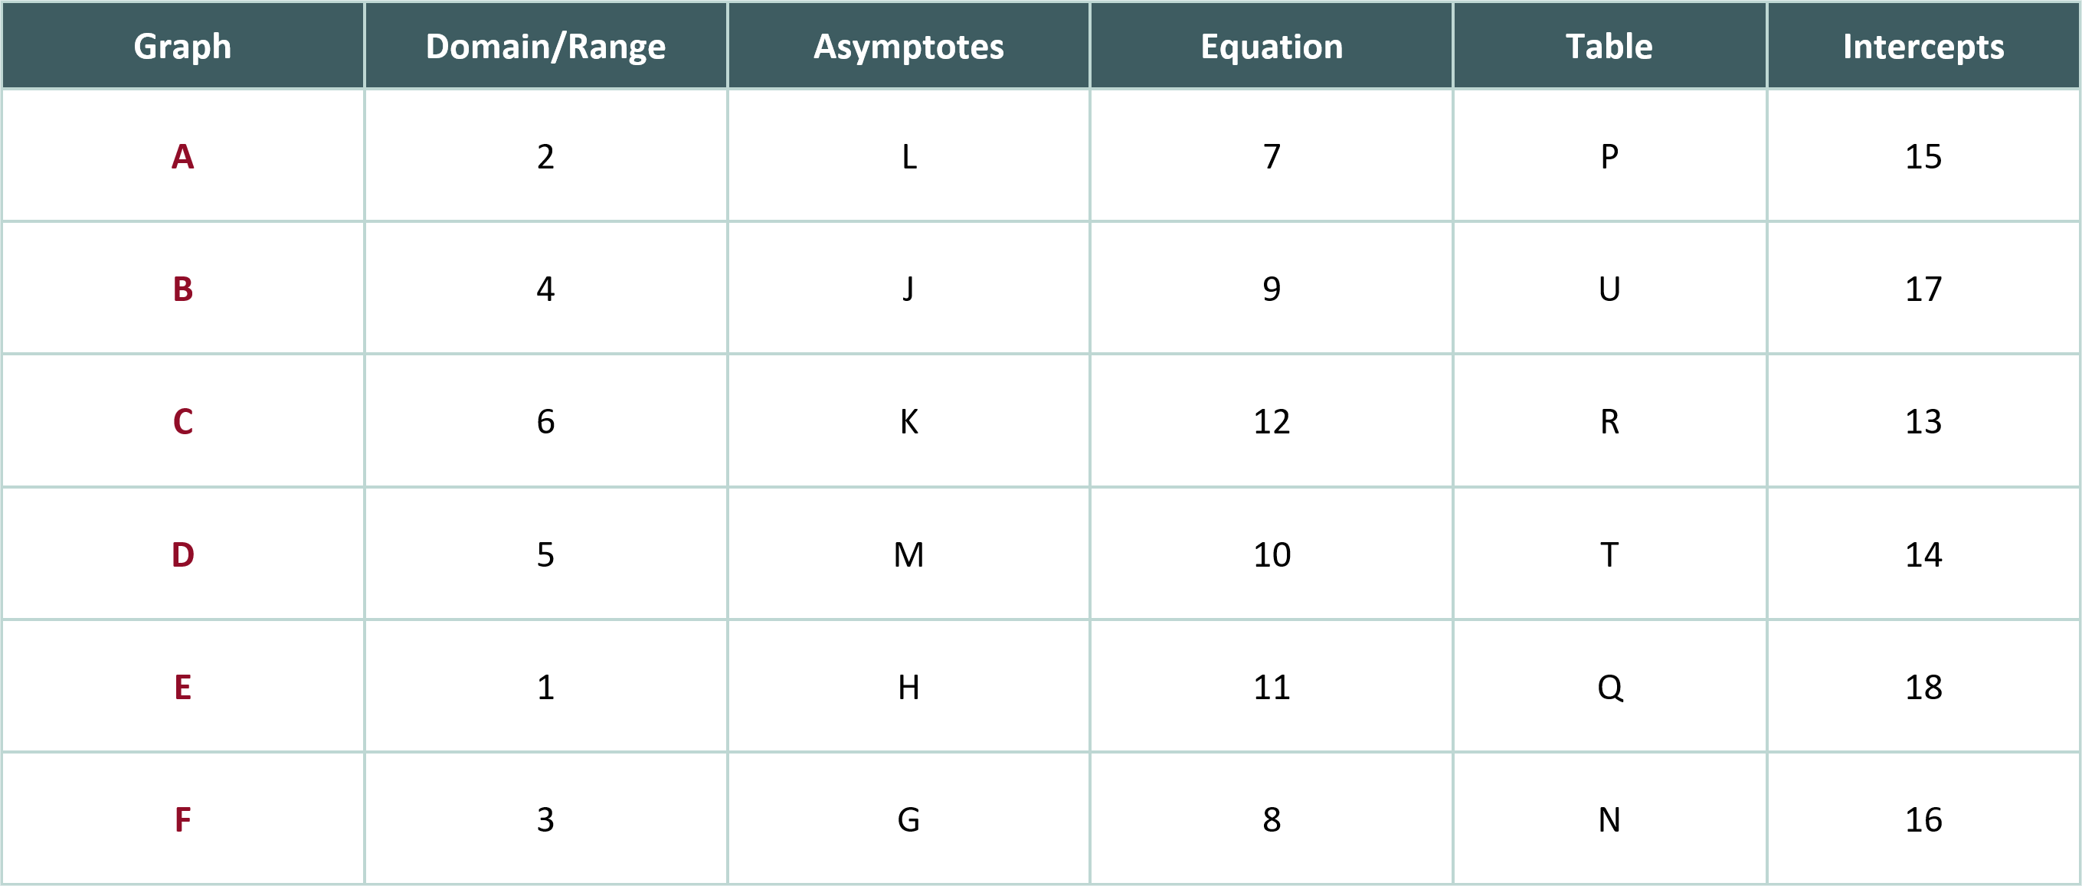
Card Matching Results (Solution)
Notes:
K20 Center. (n.d.). Card Matching. Strategies. Retrieved from https://learn.k20center.ou.edu/strategy/1837

Slide 7

Asymptote Video
Watch until the 1:25 mark:
Notes:
King, K. [KristaKingMath] (2017, February 20). What are vertical asymptotes? [video]. YouTube. https://www.youtube.com/watch?v=xz7fNEaQh3U

Slide 8
Card Matching
Work with your partner to match the following cards:
  Graph
  Domain/Range
  Asymptotes
Record your sets on the Card Matching Results handout.
Notes:
K20 Center. (n.d.). Card Matching. Strategies. Retrieved from https://learn.k20center.ou.edu/strategy/1837

Slide 9
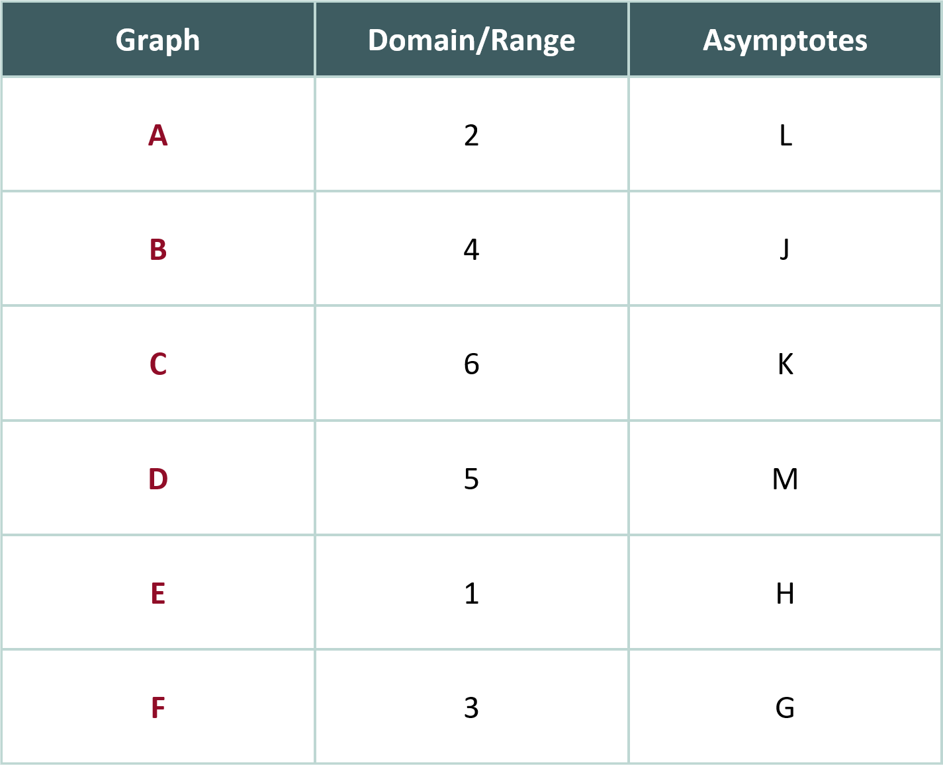
Card Matching Results (Solution)
Notes:
K20 Center. (n.d.). Card Matching. Strategies. https://learn.k20center.ou.edu/strategy/1837

Slide 10
Guided Notes
Set aside your cards and Cart Sort Results handout.
Let’s complete the Guided Notes together.

Slide 11
Graphing With Asymptotes
Graph each rational function.
  Show your thinking.
  Label your asymptotes.
Question 1) Work together as a group of four.
Question 2) Work with a partner.
Question 3) Work with a new partner.
Question 4) Work individually.

Slide 12
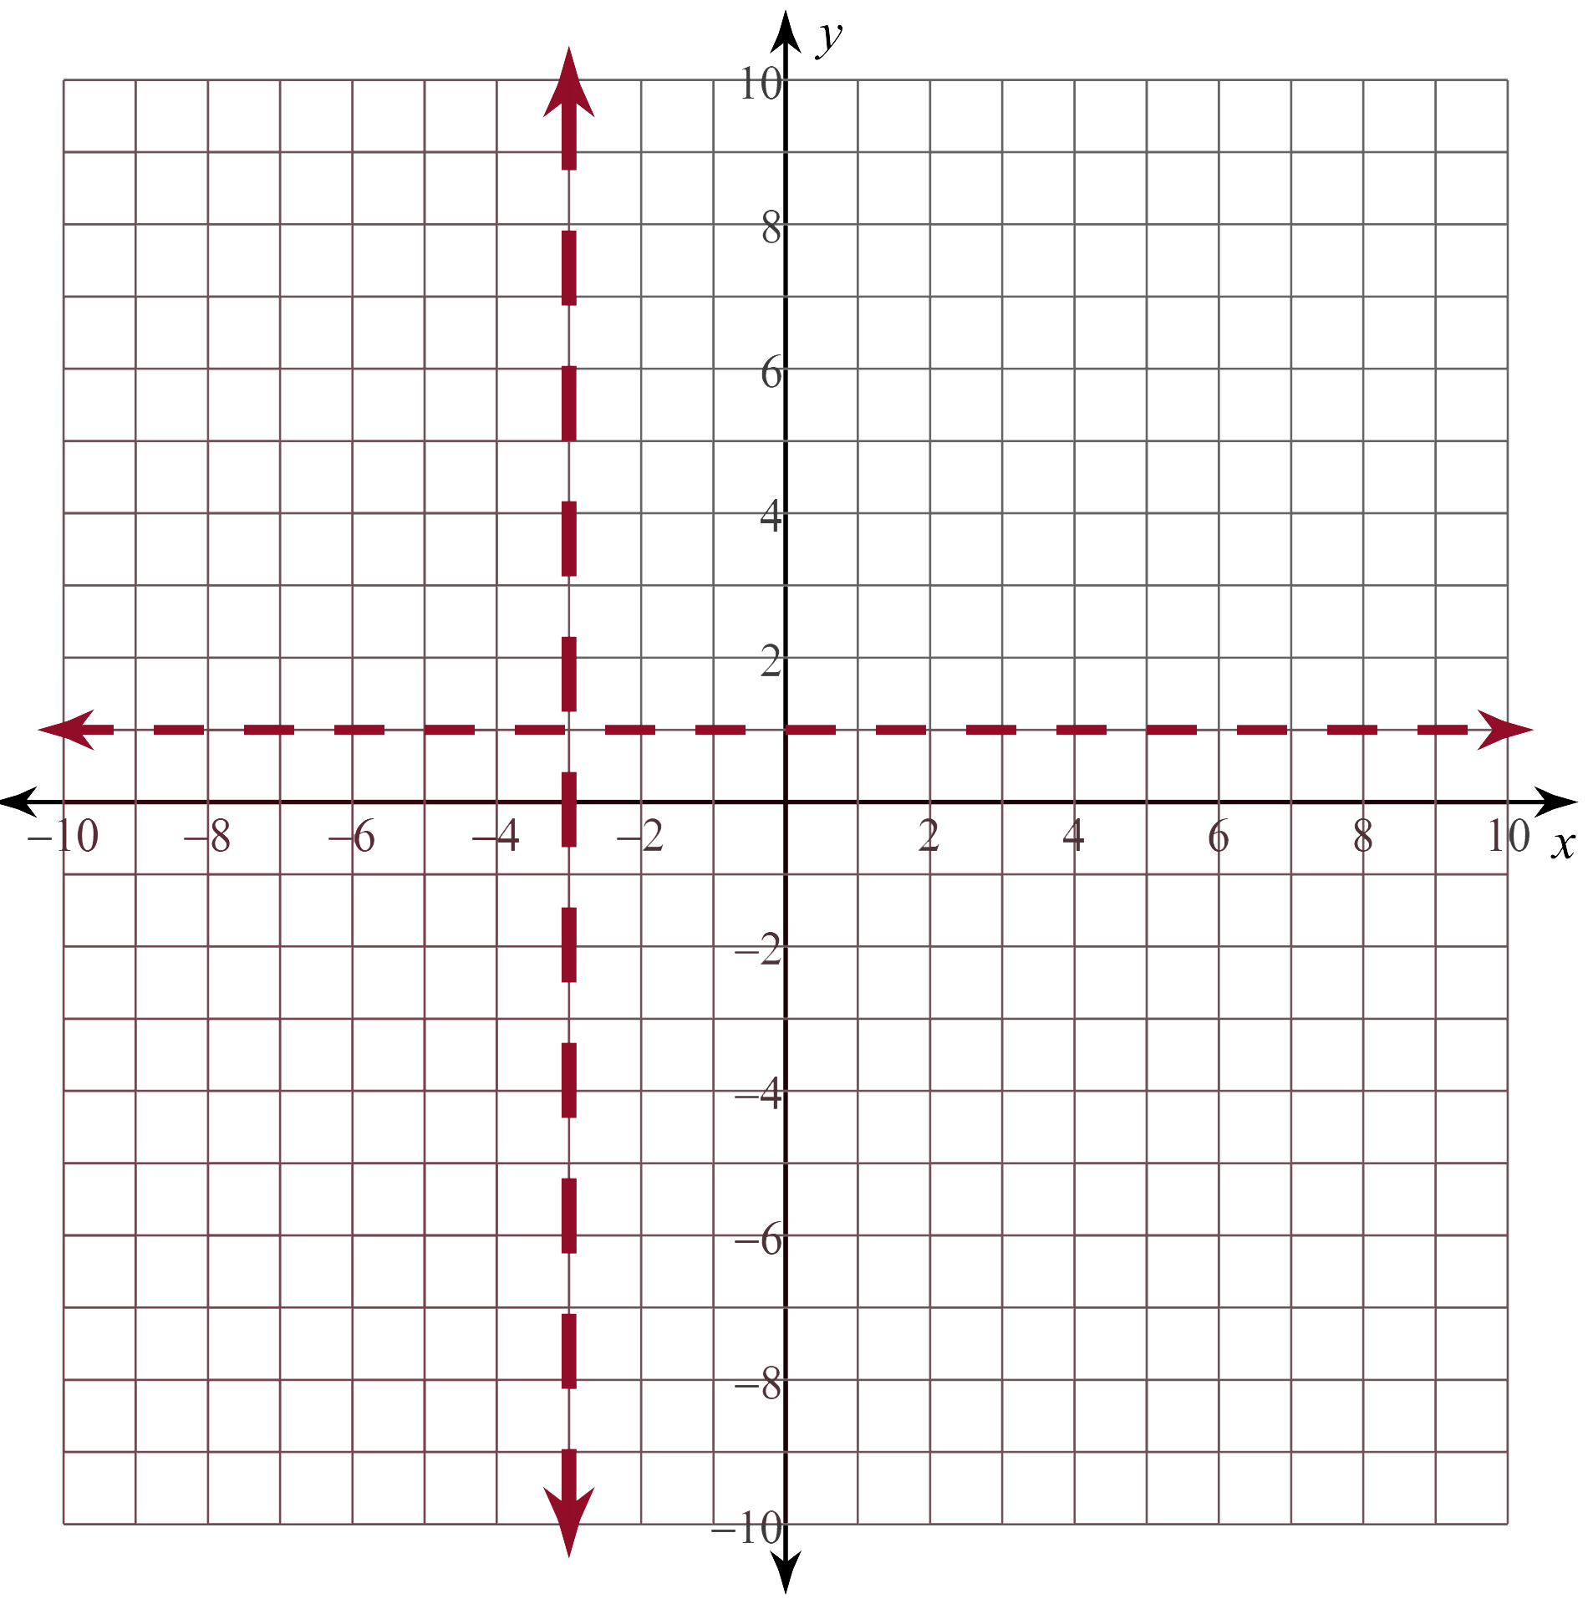
Graphing With Asymptotes (Solution #1)
Step 1)
VA:
HA:
Step 2)

Slide 13
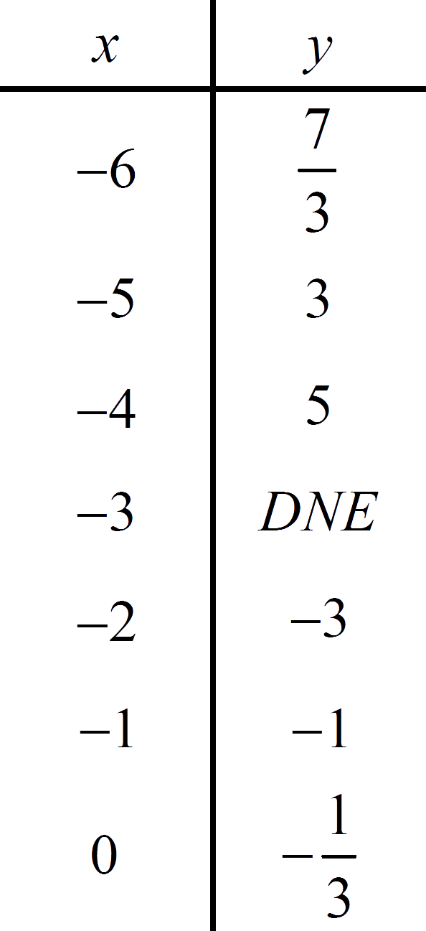
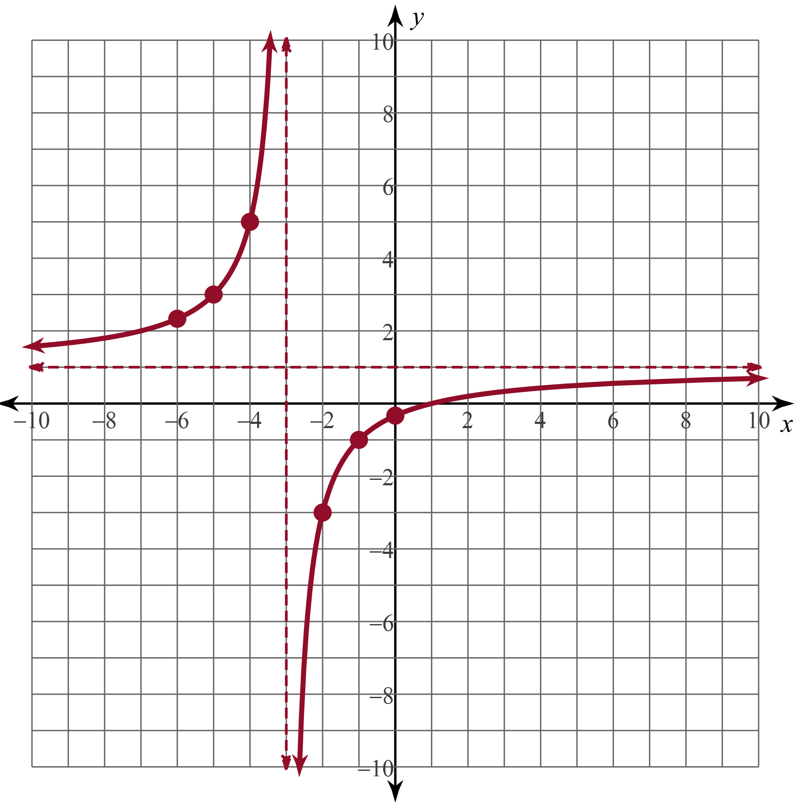
Graphing With Asymptotes (Solution #1)
Step 3)
Step 4)

Slide 14
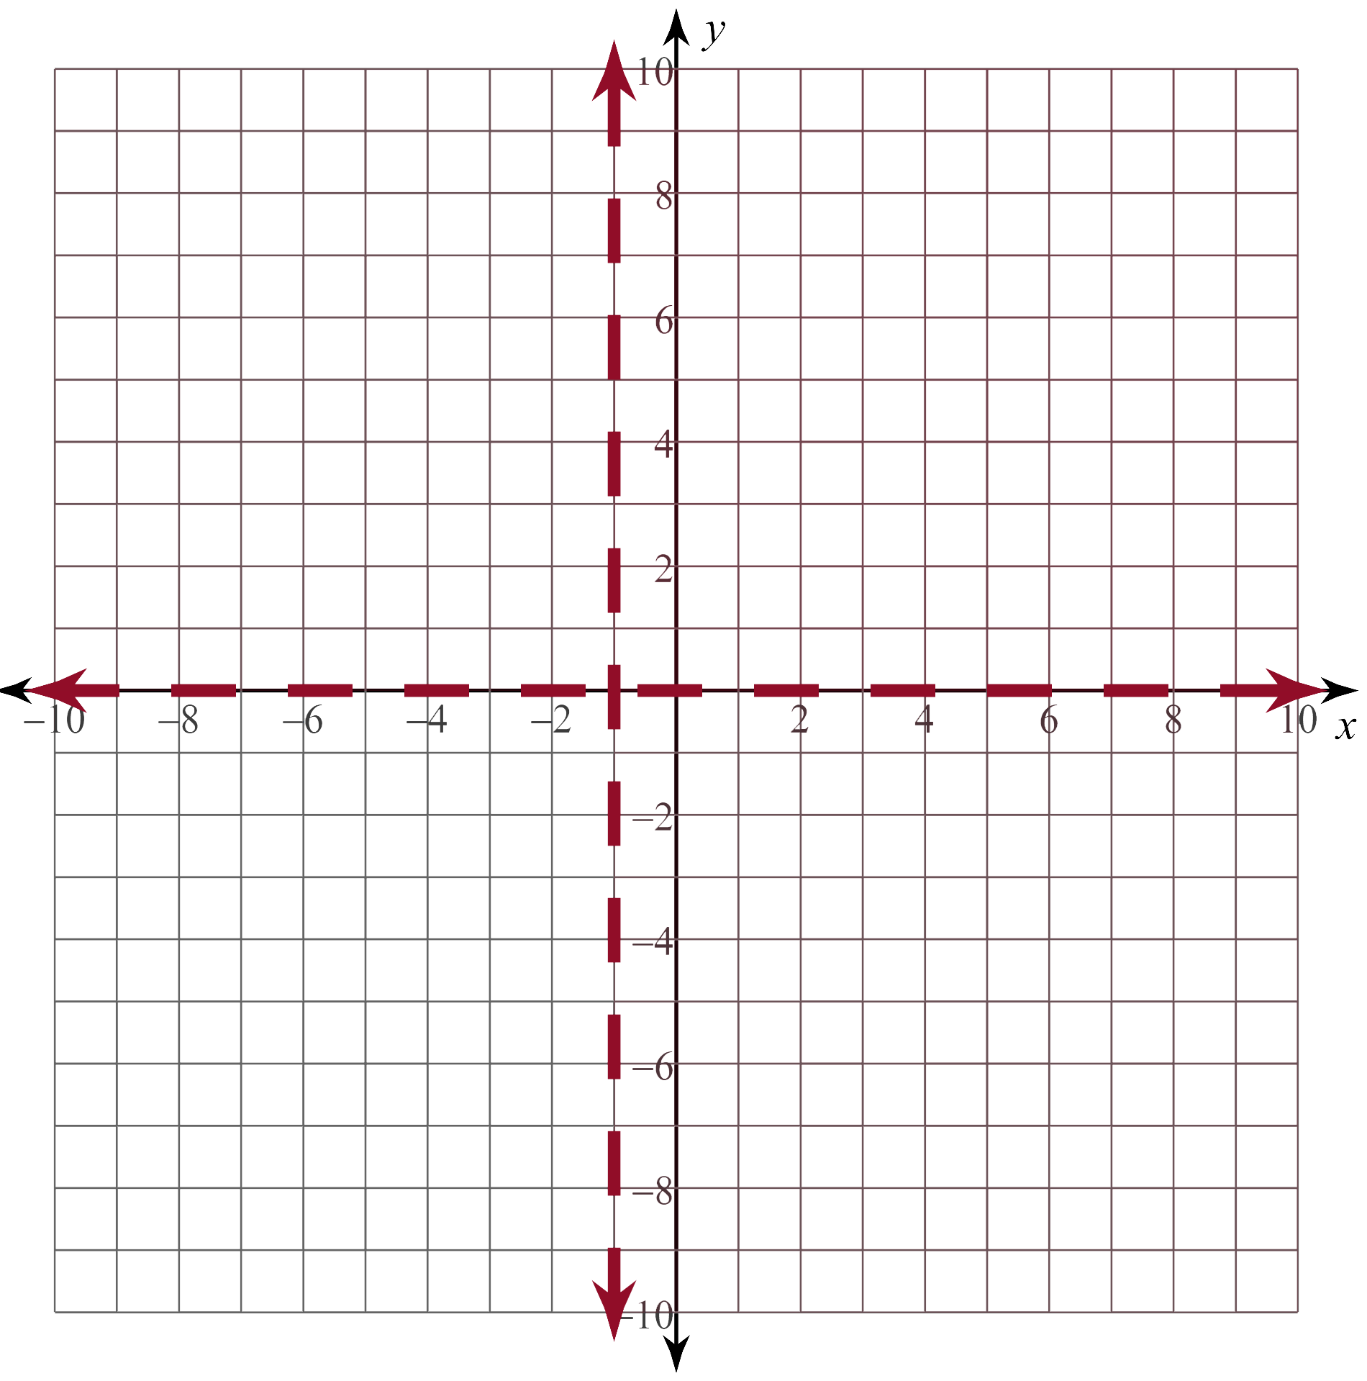
Graphing With Asymptotes (Solution #2)
Step 1)
VA:
HA:
Step 2)

Slide 15
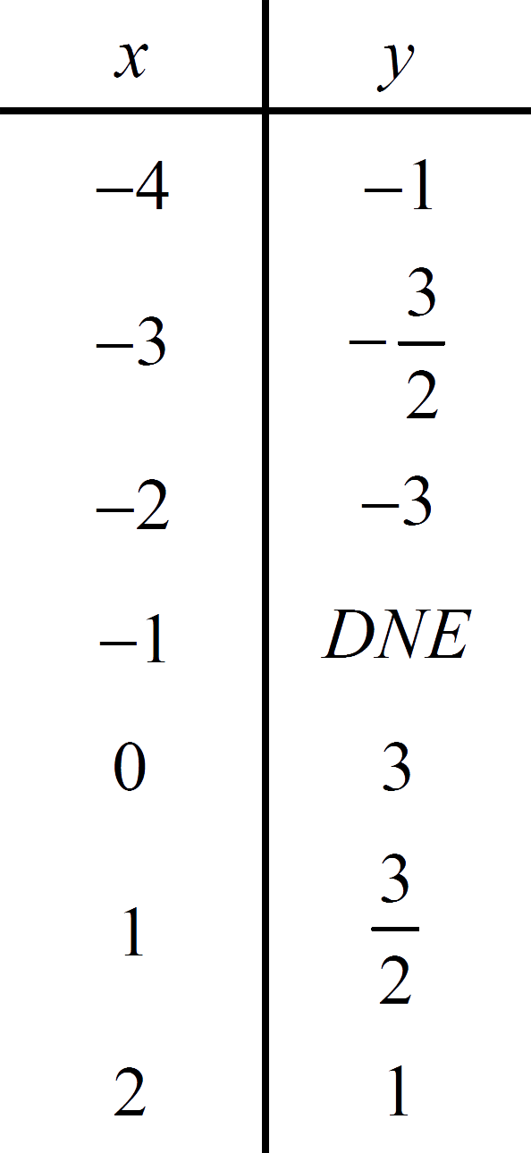
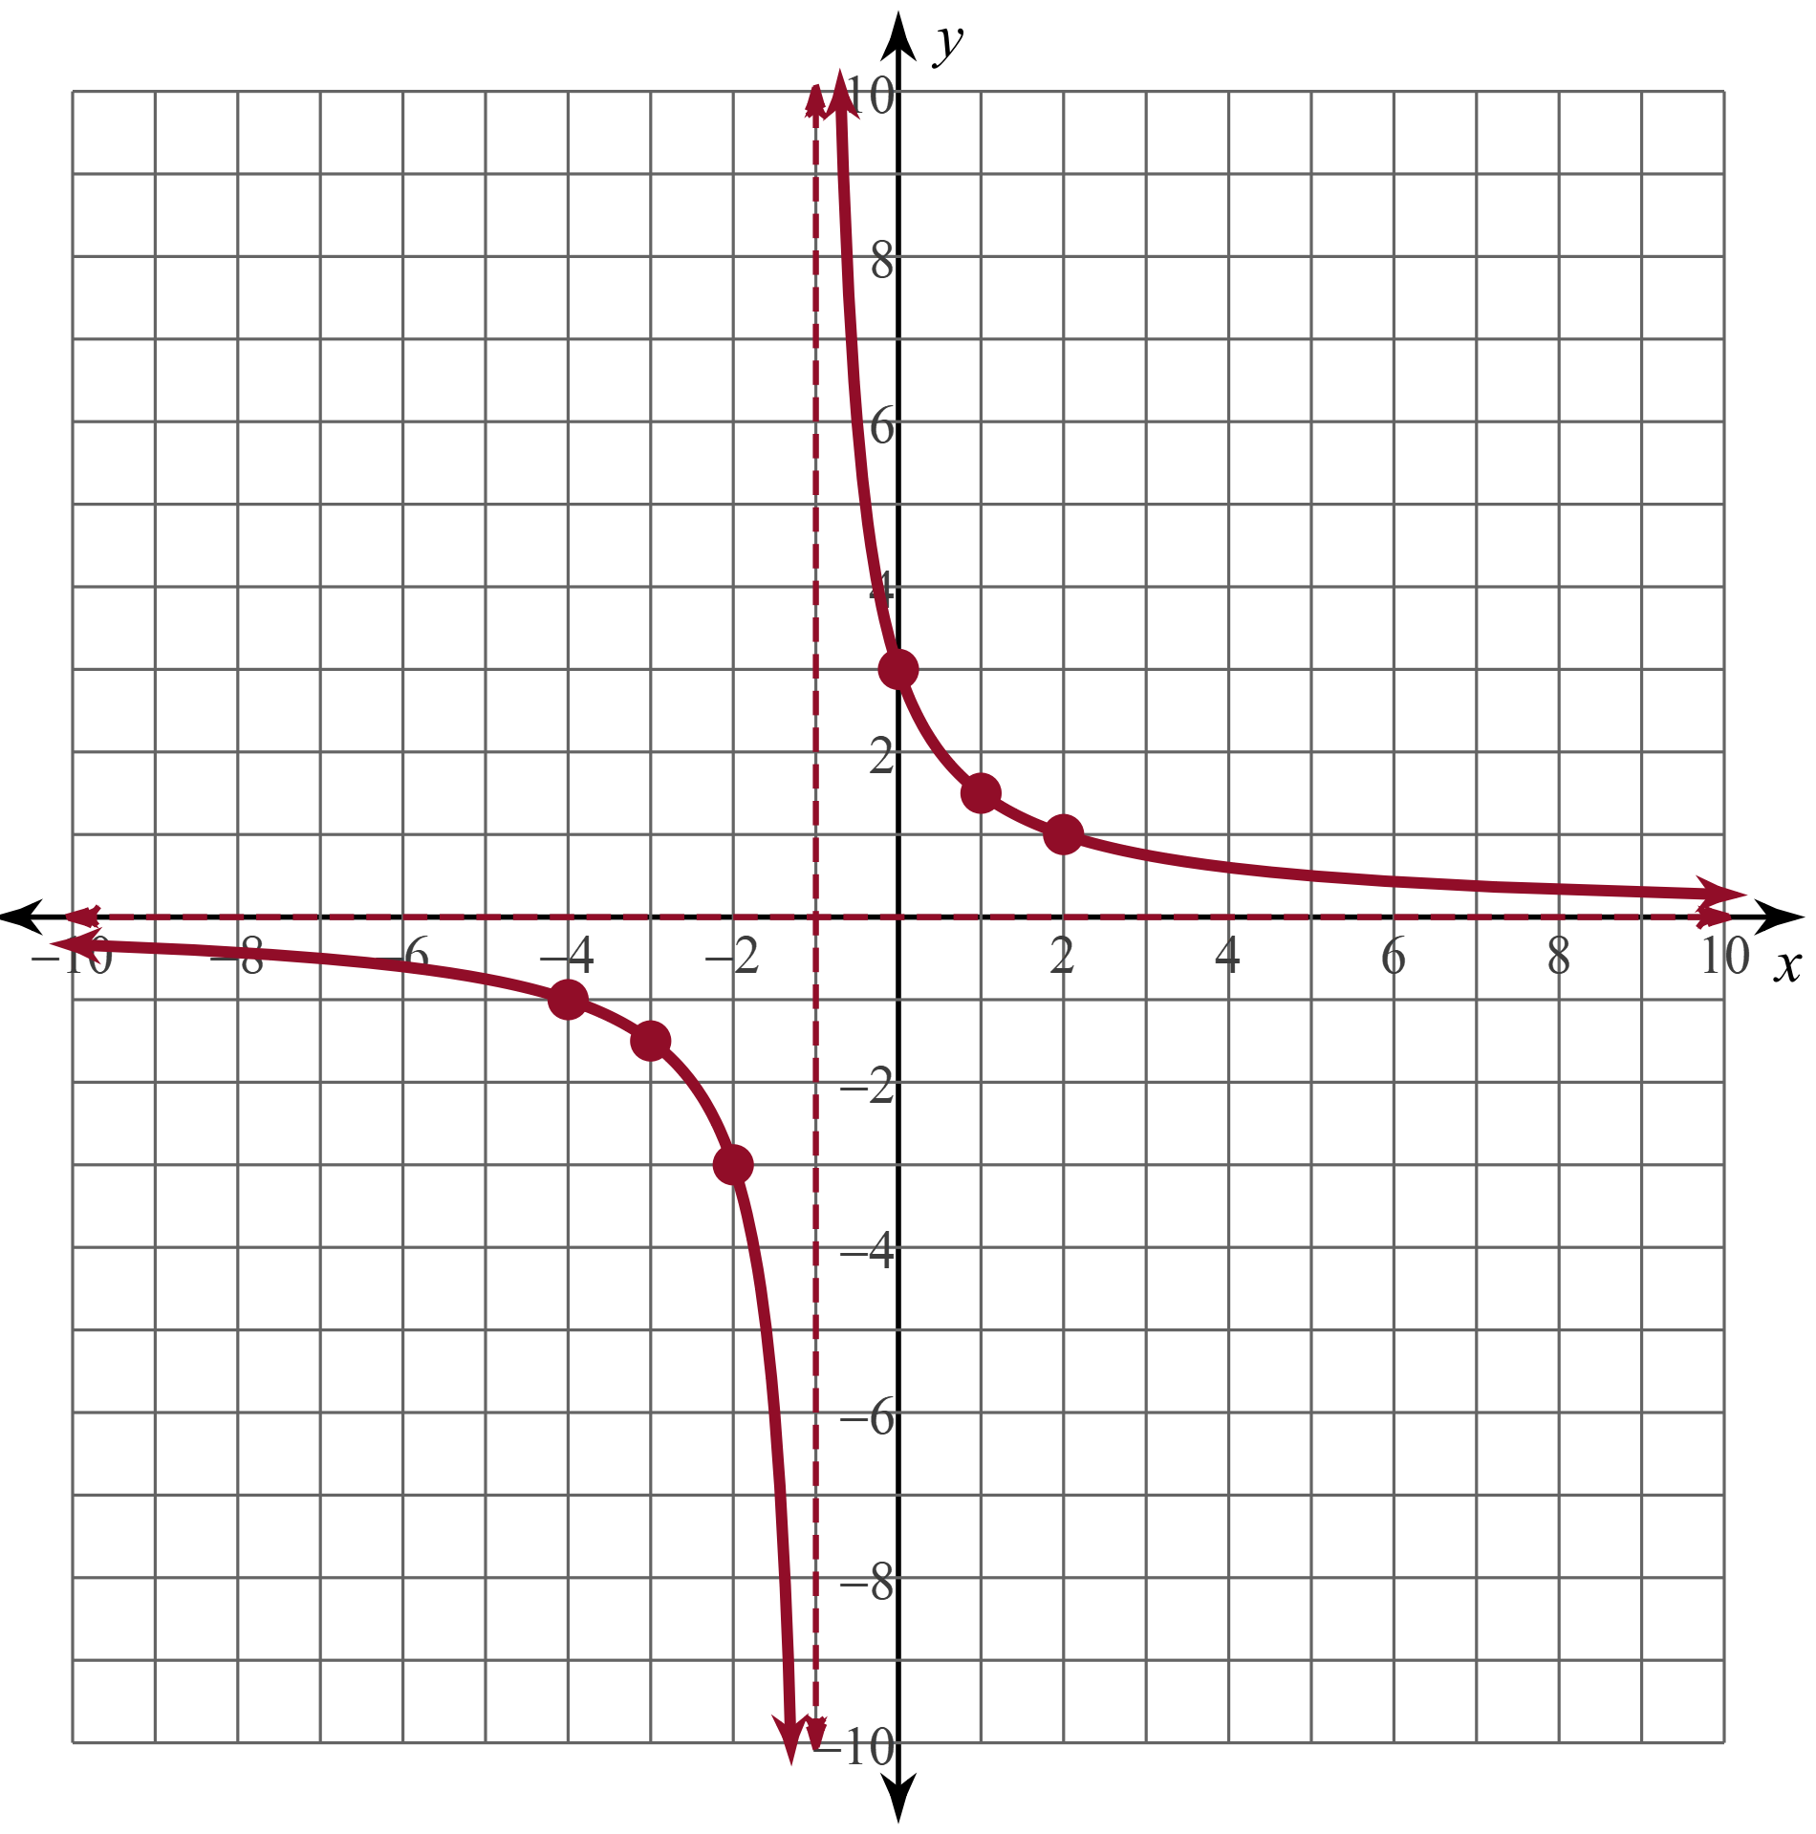
Graphing With Asymptotes (Solution #2)
Step 3)
Step 4)

Slide 16
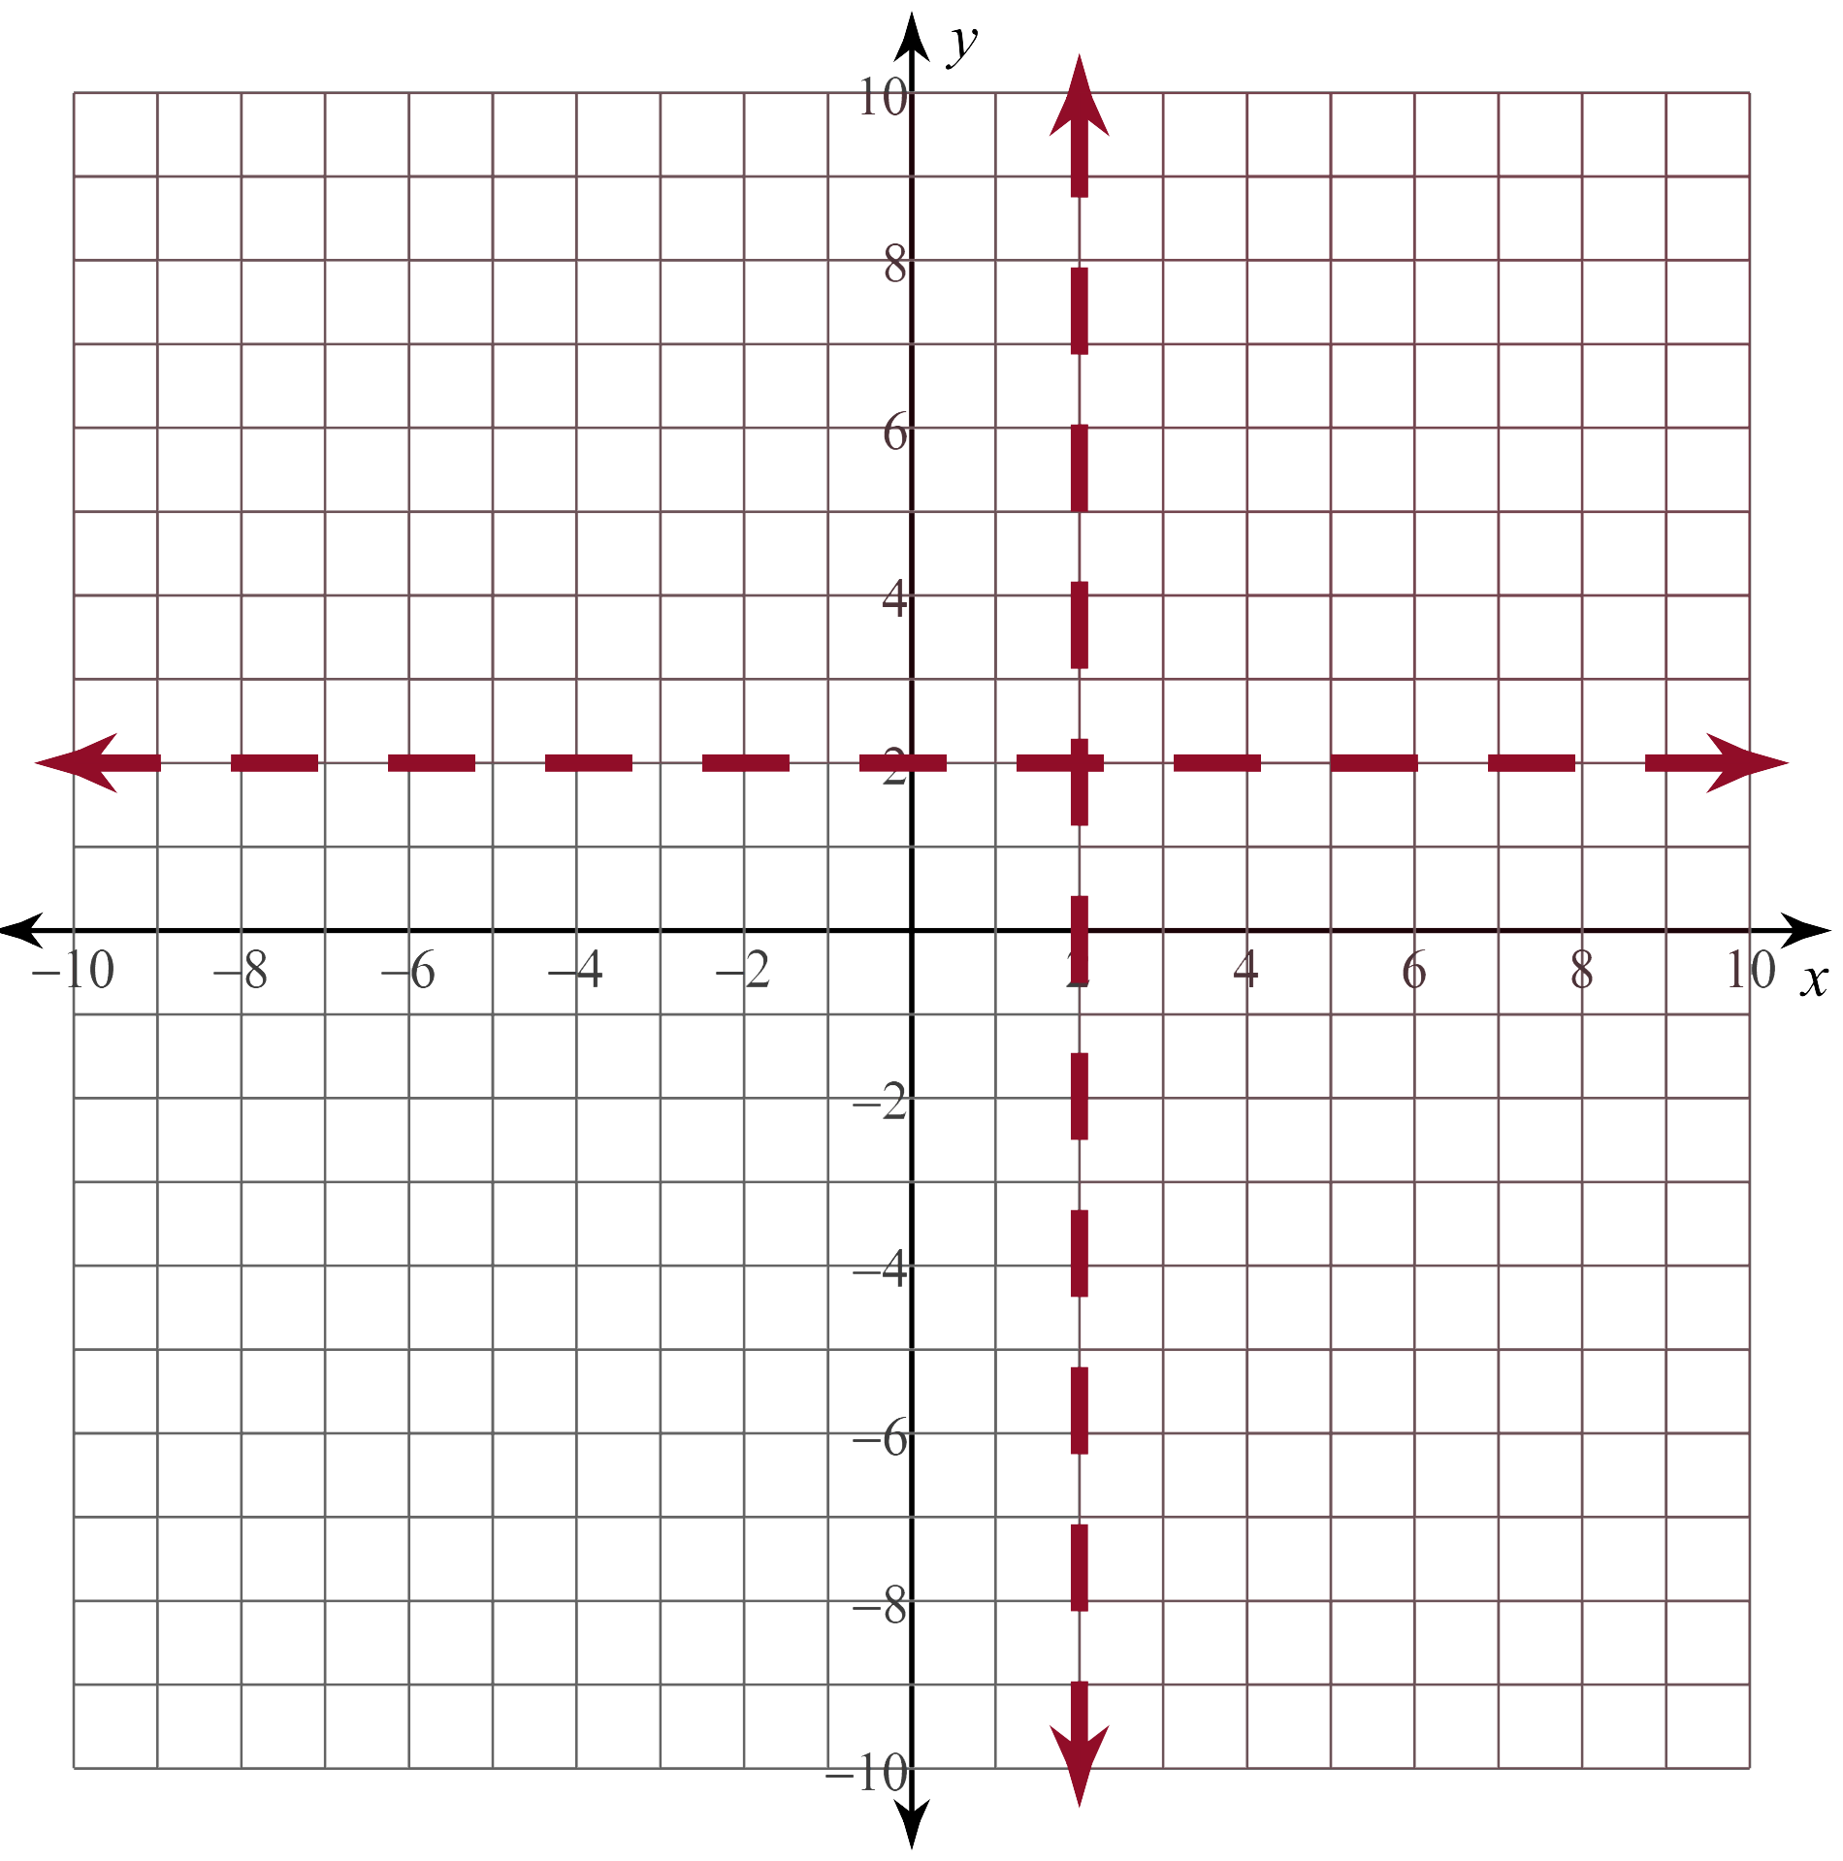
Graphing With Asymptotes (Solution #3)
Step 1)
VA:
HA:
Step 2)

Slide 17
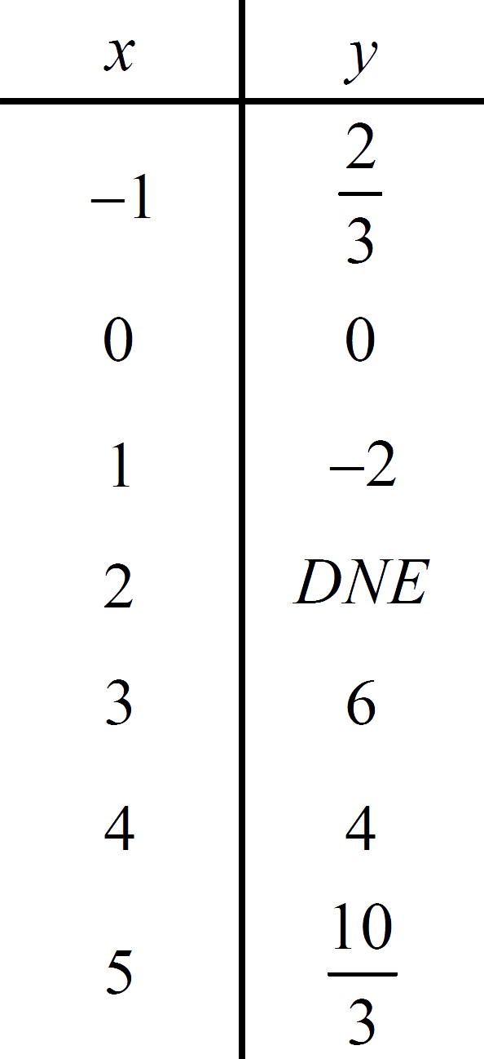
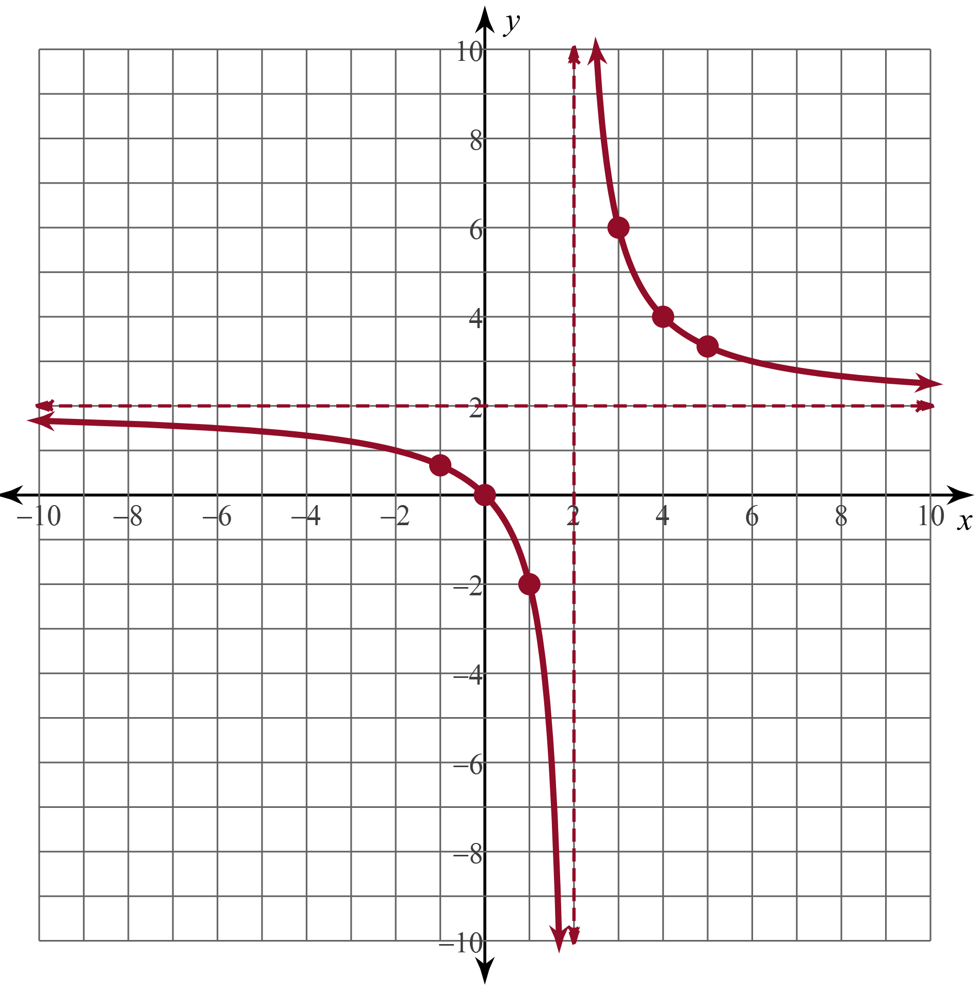
Graphing With Asymptotes (Solution #3)
Step 3)
Step 4)

Slide 18
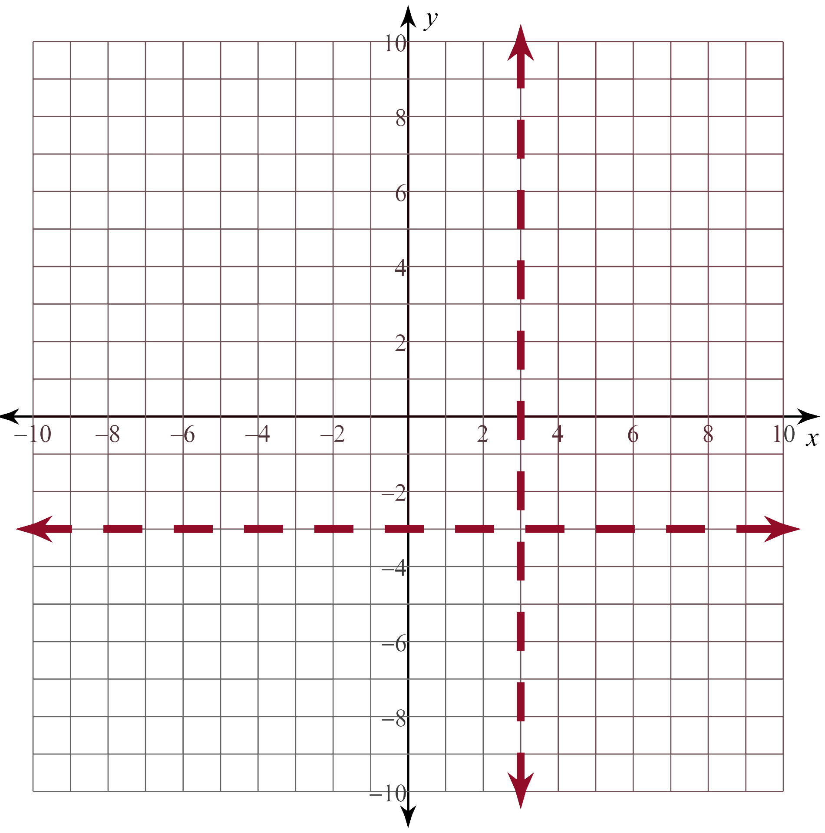
Graphing With Asymptotes (Solution #4)
Step 1)
VA:
HA:
Step 2)

Slide 19
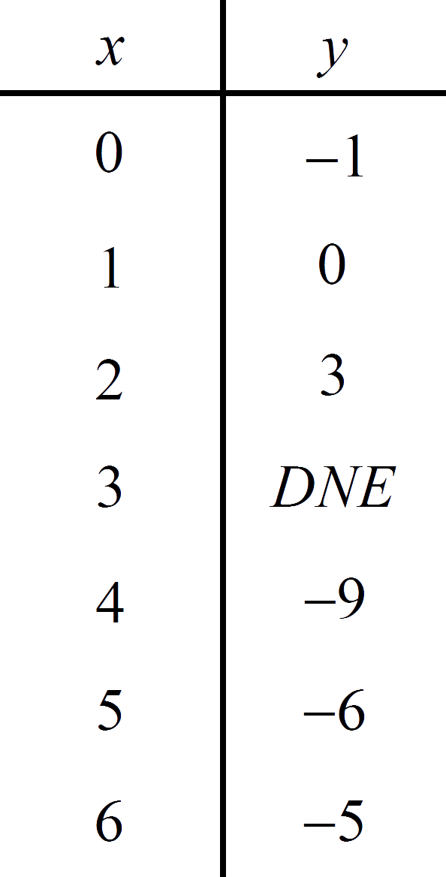
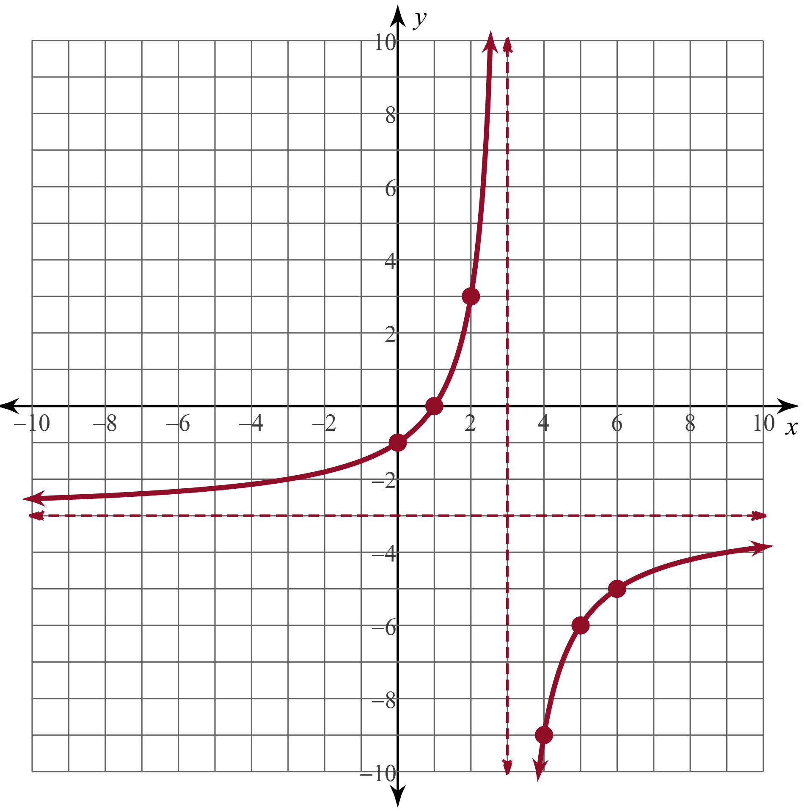
Graphing With Asymptotes (Solution #4)
Step 3)
Step 4)

Slide 20
Card Matching
Work with your partner to match the following cards:
  Graph
  Domain/Range
  Asymptotes
  Equation
  Table
  Intercepts
Record your sets on the Card Matching Results handout.
Notes:
K20 Center. (n.d.). Card Matching. Strategies. https://learn.k20center.ou.edu/strategy/1837

Slide 21
Card Matching Results (Solution)
Notes:
K20 Center. (n.d.). Card Matching. Strategies. https://learn.k20center.ou.edu/strategy/1837

