Slide 2
Tricks of the Trade
Benefits and Drawbacks of International Trade Agreements

Slide 3
Essential Question
What effects do international trade agreements have on the world economy, countries, and individual workers?

Slide 4
Lesson Objectives
Students will understand the benefits of international cooperation in trade agreements, and the challenges that go along with it.

Slide 5

Graphic Organizer
Before we start, with your Elbow Partner, see what you already know about economics and world trade.
Predict the definition of as many terms as you can.
Notes:
K20 Center. (n.d.). Elbow partner. Strategies. https://learn.k20center.ou.edu/strategy/116

Slide 6
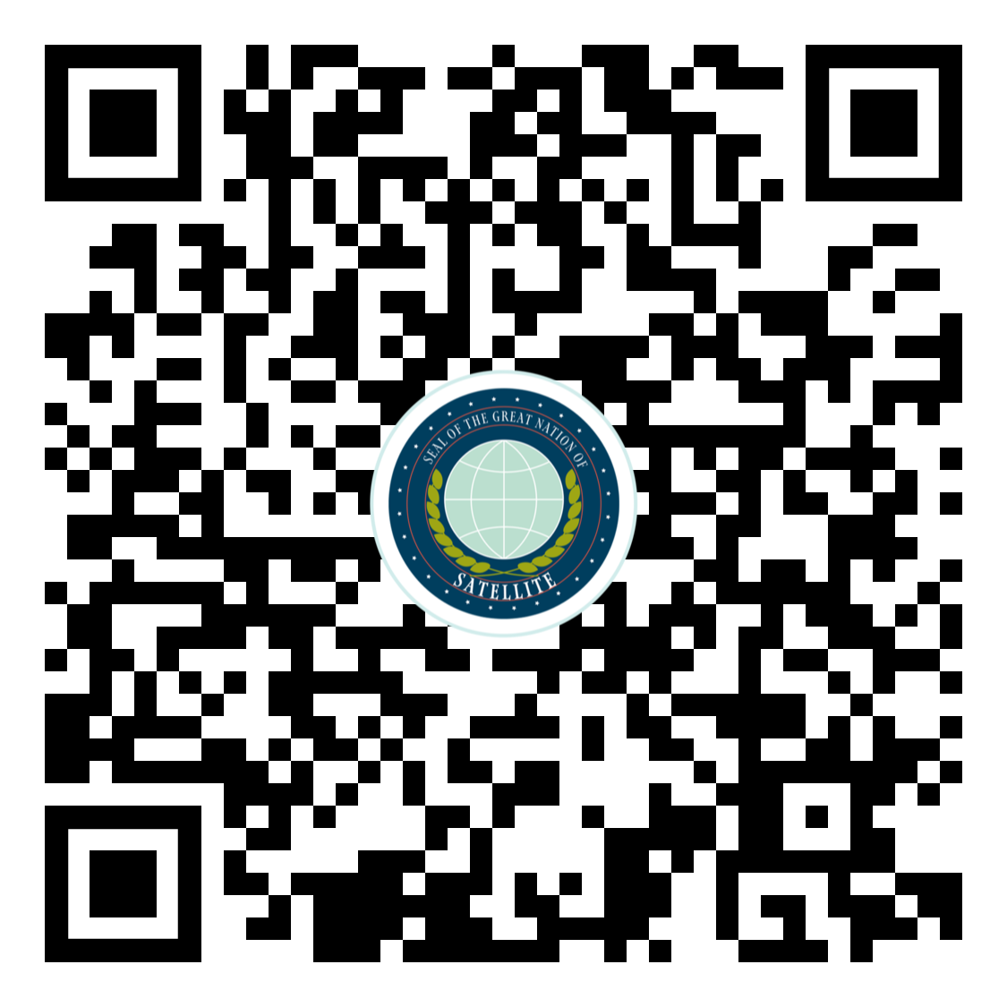
International Trade
You are a world leader in a fictional, up-and-coming nation, Satellite.
As you read, complete the right column in your Graphic Organizer with an Elbow Partner.
Notes:
K20 Center. (n.d.). Elbow partner. Strategies. https://learn.k20center.ou.edu/strategy/116

Slide 7

I Notice, I Wonder
What do you notice about trade agreements?
What do you still wonder?
Continue to respond as you watch the following video.

Slide 8
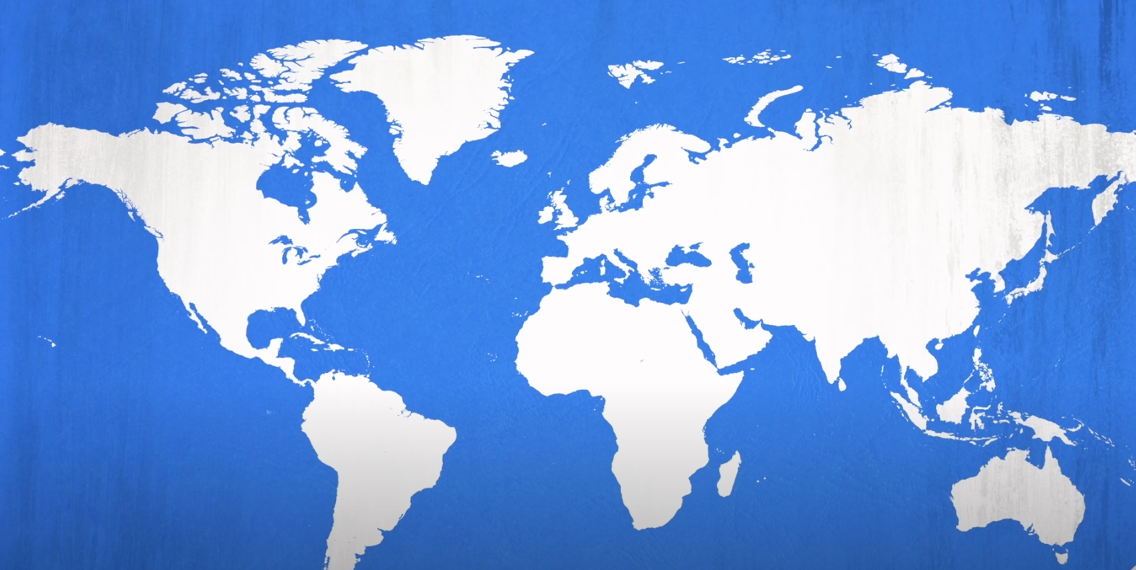
International Trade Explained
Notes:
https://www.youtube.com/watch?v=HfN8BnRJryQ

Slide 9
Graphic Organizer / I Notice, I Wonder
Review these Graphic Organizer and I Notice, I Wonder handouts.
What have you learned about trade agreements?
Notes:
K20 Center. (n.d.). I notice, I wonder. Strategies. https://learn.k20center.ou.edu/strategy/180

Slide 10

Clean Clothes Campaign
Clean Clothes Campaign is a global network of 235 organizations in 45 countries.
The Clean Clothes Campaign “identifies local problems and objectives and transform them into global actions.”
Notes:
Clean Clothes Campaign. (n.d.). Fashion's problems. Clean Clothes Campaign. https://cleanclothes.org/fashions-problems

Slide 11

Driving Question Board
Explore “Fashion’s problems” on Clean
Clothes Campaign
  Start with Poverty Wages.
  Explore three other topics.
Write questions or observations about what you see on sticky notes and stick them on the board.
  We will discuss these topics.

Slide 12

Gist
What are the benefits and challenges of international trade agreements?
With your Elbow Partner, write two gist statements:
  One about benefits of trade agreements.
  One about exposing the drawbacks.
Notes:
K20 Center. (n.d.). Gist. Strategies. https://learn.k20center.ou.edu/strategy/3289

Slide 13

Gallery Walk
As you rotate from one set of Gists to the next with your Elbow Partner, make an observation related to each pair of summaries.
Post observations using a sticky note.

