Slide 2
State of AWAREness
The Influence of Natural Hazards on Human Activity

Slide 3
Essential Question
Why might people choose to live in places at high risk for severe weather events?

Slide 4
Lesson Objective
Construct an evidence-based explanation for how the availability of natural resources, the occurrence of natural hazards, and changes in climate have influenced human activity.

Slide 5
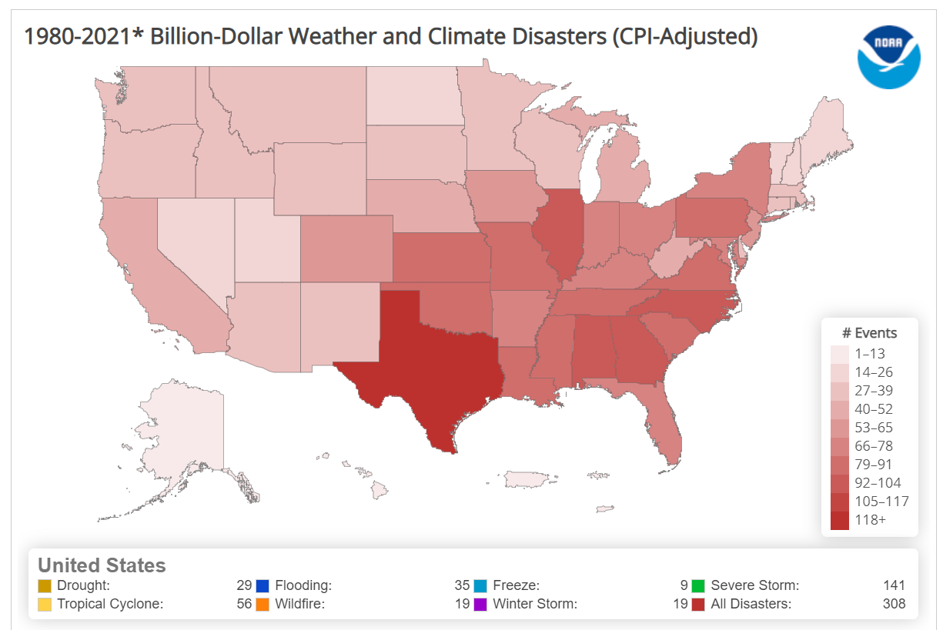
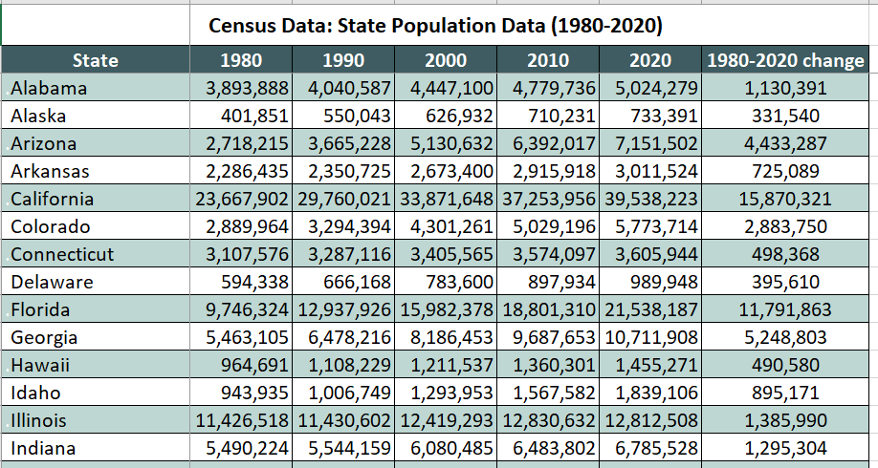
I Notice, I Wonder
Explore the Billion-Dollar Weather and Climate Disasters map and the census data.
What do you notice?
What do you wonder?

Slide 6
Places at Risk for Severe Weather Events
Why might people choose to live in places at high risk for severe weather events?

Slide 7
Places at Risk for Severe Weather Events
Let’s categorize the ideas on our class list into three or four themes.

Slide 8
Time to Play AWARE
Play Eras 1–3 only. As you play, take notes on:
The patterns you see between the Population and Economic overlays
The kinds of technology you research and build
What each type of technology does and/or how it works
Notes:
AWARE: Advanced Weather Awareness & Response Education

Slide 9
Investigating Some States
For your group’s assigned state, research the following:
Its natural resources
Its major industries/economic sectors
One or more themes from the Engage section that apply to the state
Check the provided sources first.
You don’t need to research these concepts in depth—just provide a basic overview of each.

Slide 10
Your AWARE Experience
What patterns did you identify between the population and economic overlays?
What did you notice about how technology changed between eras?
How did the technology affect your ability to forecast, mitigate, and respond to severe weather events?

Slide 11
State Shareout
What similarities did you notice among the states?
What are possible benefits of moving to these states?

Slide 12
Places at Risk for Severe Weather Events
Why might people choose to live in places at high risk for severe weather events?
What are some benefits of moving to these states?
Based on our research and class discussion, should we add any new ideas or make any changes to our list of themes?

Slide 13
Time to Play AWARE
Play Eras 4–5. As you play, take notes on:
The patterns you see between the Population and Economic overlays
The kinds of technology you research and build
What each type of technology does and/or how it works
Notes:
AWARE: Advanced Weather Awareness & Response Education

Slide 14
Investigating Some States
Return to the Billion-Dollar Disasters map.
For your group’s state, record your answers to the following questions on your AWARE Research Notes:
Which types of severe weather have increased in frequency?
What were the specific impacts of these severe weather events?
Which natural resources, industries, etc. would be most affected by these severe weather events?

Slide 15
Connecting AWARE to State Data
As a group, look at your AWARE Gameplay Notes and answer the following questions:
What technology is most relevant to the severe weather events and their effects in your state?
How would this technology be used to forecast, mitigate, and/or respond to those threats and impacts?
Create a poster to present your findings.

Slide 16
Gallery Walk
Visit each group’s poster.
Take notes on any new information that you think would help you answer the essential question.

Slide 17
Essential Question
Why might people choose to live in places at high risk for severe weather events?

Slide 18
Answering the Essential Question
Include the following information in your answer:
The reasons why people might choose to live in these places despite the risks.
An explanation of how weather and climate technology help people make these places safer.
Use evidence from AWARE, your state research, your classmates’ research, the disaster map, and/or the population data to support your answer.

