Slide 2
Peace, Democracy, and Freedom For All
Apartheid in South Africa

Slide 3
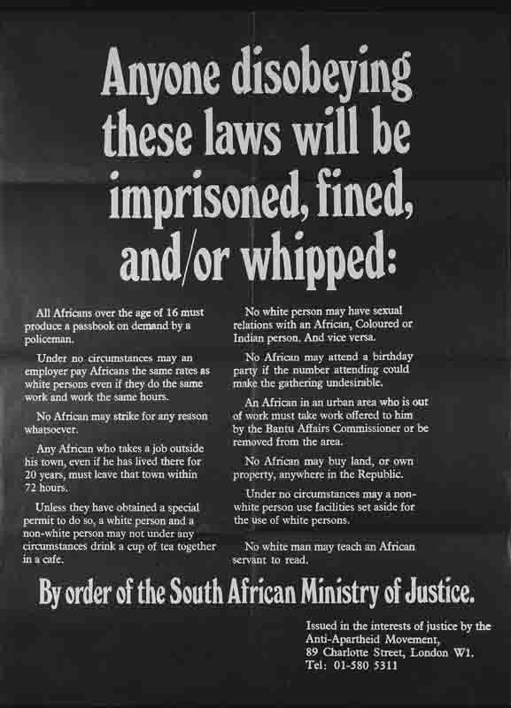
I Notice/I Wonder
Record the following about the poster on the right:
  Two (2) things you noticed
  Two (2) things you wondered
Compare your responses with a partner.
Notes:
PO015. 'anyone disobeying these laws will be imprisoned, fined and/or whipped.'. Forward to Freedom. (n.d.). Retrieved September 16, 2021, from https://www.aamarchives.org/archive/history/apartheid/po015-anyone-disobeying-these-laws-will-be-imprisoned-fined-and-or-whipped.html.

Slide 4
Essential Question
What is the lasting impact of apartheid in South Africa?

Slide 5
Lesson Objective
Explain the purpose and consequences of the apartheid system in South Africa.

Slide 6
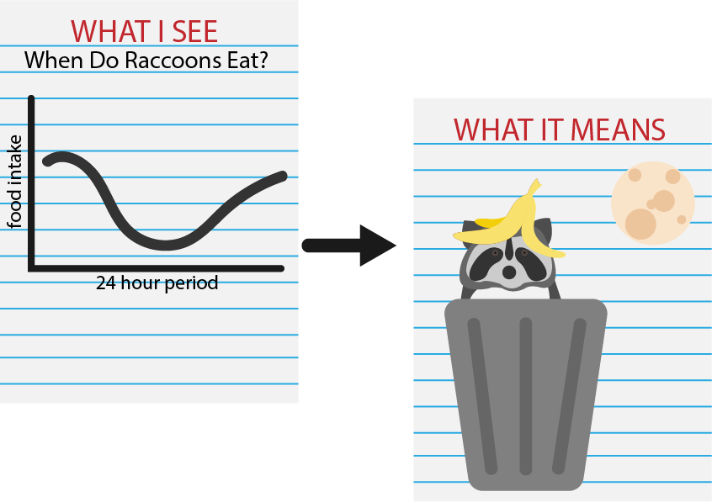
WIS-WIM
Look at the table.
Write notes around the table about what data you see.
Add notes about what this data means.
Create a title for the table.
Under the table, summarize what you see and what it means in a paragraph.

Slide 7

Notes:
bbcnews. (2013, December 6). Apartheid 46 years in 90 seconds - BBC News. YouTube. https://www.youtube.com/watch?v=2f2k6iDFCL4.

Slide 8

Timeline of Apartheid
Read the Timeline of Apartheid with a partner.
Use the Window Notes handout to take notes as you read the timeline.

Slide 9
Timeline of Apartheid
What was the system of apartheid?
How did apartheid treat people differently?
What was the view of apartheid around the world?
What was the process to end apartheid like?
What questions do you have about apartheid?
What has been the impact of apartheid in South Africa?

Slide 10

Notes:
YouTube. (2018, December 3). Trevor chats with his grandma about apartheid and tours her home, "Mtv cribs"-style | the daily show. YouTube. https://www.youtube.com/watch?v=1s5iz6ml-qA.

Slide 11

Claim, Evidence, Reasoning
Respond to the question with a claim, a piece of evidence, and reasoning for your claim and evidence.
  How did the system of apartheid affect the lives of South Africans?

