Slide 2
Industrialization and the
Rise of Labor Unions
The Labor Movement

Slide 3
Photo Analysis
After observing and discussing the photo assigned to your group, use your observations to answer this question:
What problems did industrialization create for workers?

Slide 4
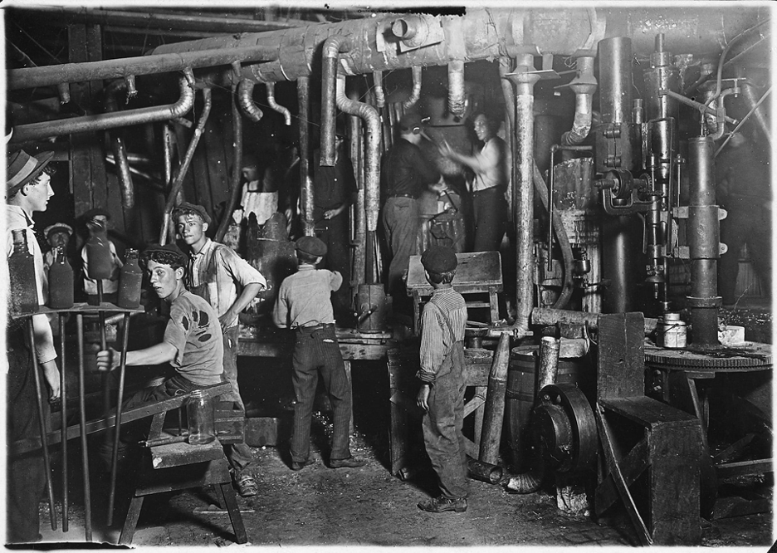
Photo #1
Notes:
Hine, L. (1908). 9 P.M. in an Indiana Glass Works, Aug. 1908. Location: Indiana. Library of Congress Prints and Photographs Division Washington, D.C. 20540 USA. https://hdl.loc.gov/loc.pnp/nclc.01166

Slide 5
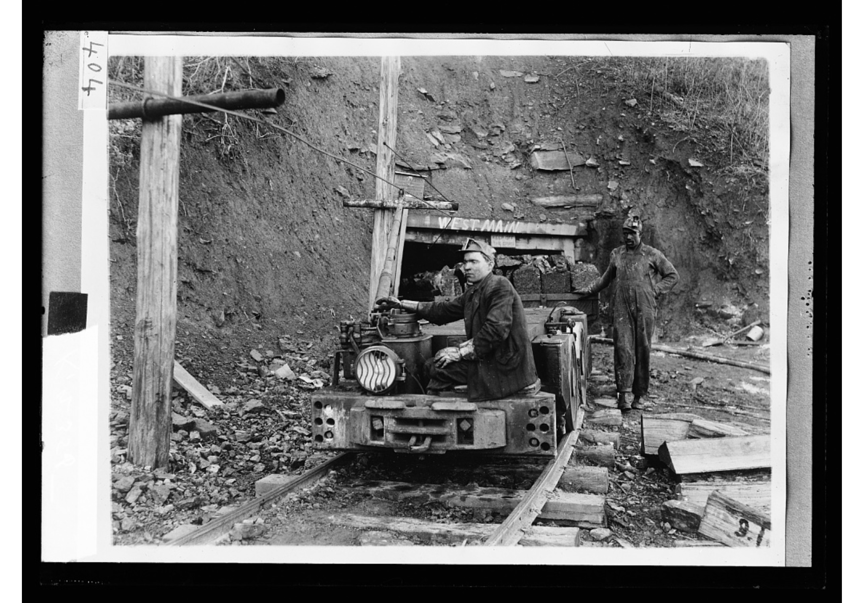
Photo #2
Notes:
Detroit Publishing Co. (1915-1925). [Hauling coal]. Library of Congress Prints and Photographs Division Washington, D.C. 20540 USA. https://www.loc.gov/item/2016816922/

Slide 6
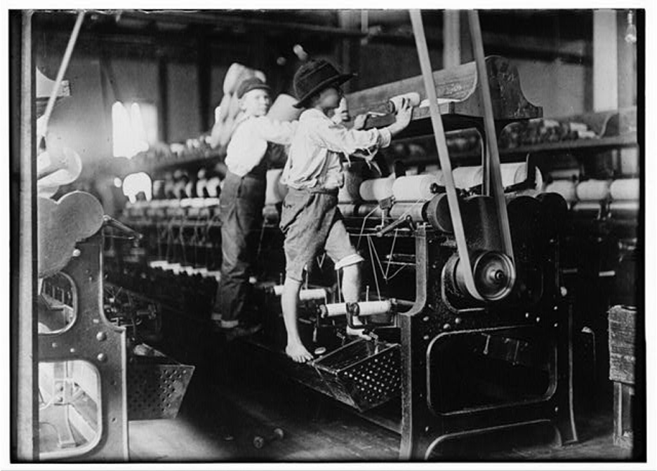
Photo #3
Notes:
Hine, L. (1909, January 19). 488 Macon, Ga. Lewis W. Hine 1-19-1909. Bibb Mill No. 1 Many youngsters here. Some boys were so small they had to climb up on the spinning frame to mend the broken threads and put back the empty bobbins. Location: Macon, Georgia.. Library of Congress Prints and Photographs Division Washington, D.C. 20540 USA. https://hdl.loc.gov/loc.pnp/nclc.05394

Slide 7
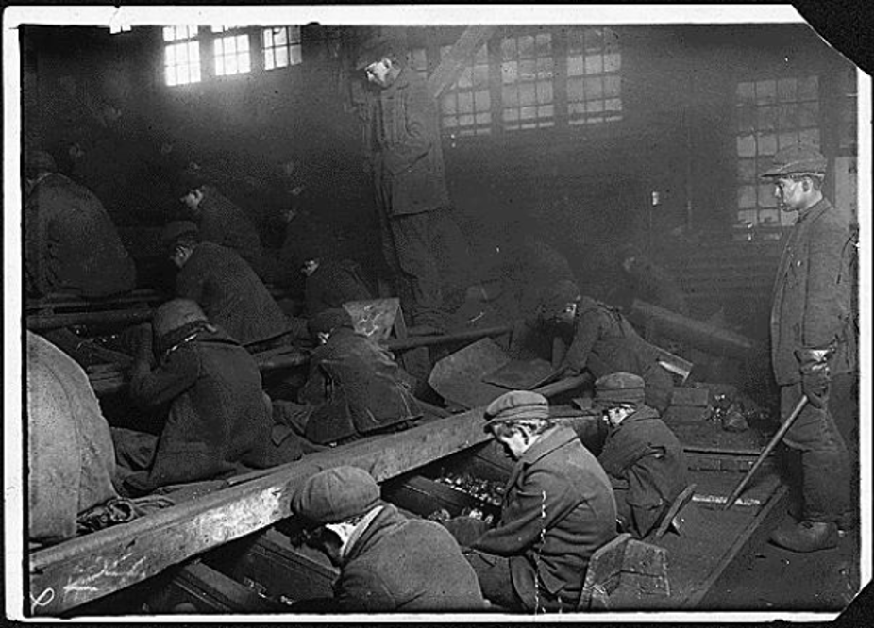
Photo # 4
Notes:
Hine, L. (1912.). View of the Ewen Breaker of the Pa. Coal Co. The dust was so dense at times as to obscure the view. This dust penetrated the utmost recesses of the boy's lungs. A kind of slave-driver sometimes stands over the boys, prodding or kicking them into obedience. S. Pittston, Pa.. National Archives Catalog. https://catalog.archives.gov/id/523378

Slide 8
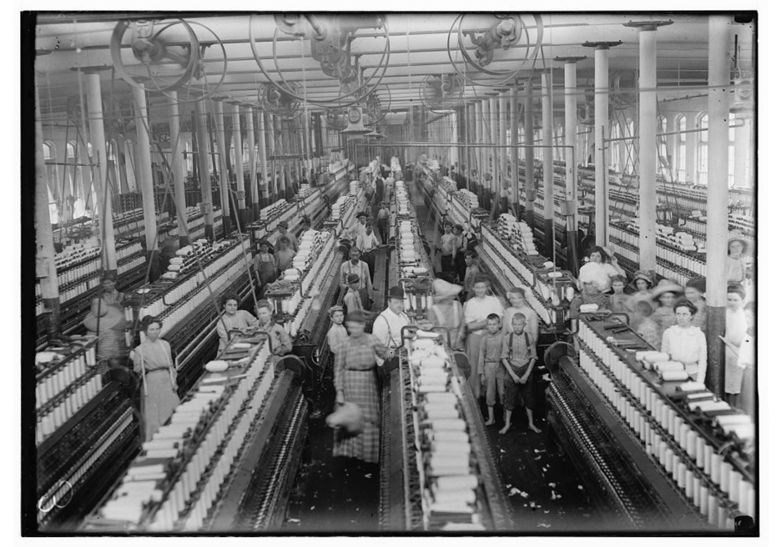
Photo #5
Notes:
Hine, L. (1911, March). Interior of Magnolia (Miss.) Cotton Mills spinning room. See the little ones scattered through the mill. All work. Library of Congress Prints and Photographs Division Washington, D.C. 20540 USA. https://hdl.loc.gov/loc.pnp/nclc.05394

Slide 9
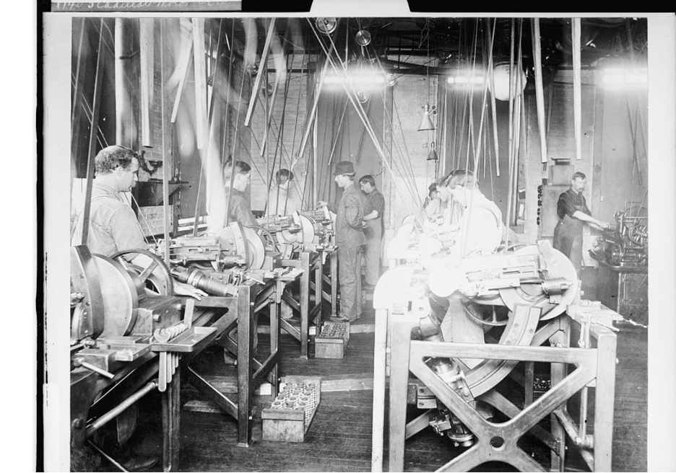
Photo #6
Notes:
Detroit Publishing Co. (1903). [Factory workers assembling engines at Leland & Faulconer Manufacturing Co., Detroit, Mich.] Library of Congress Prints and Photographs Division Washington, D.C. 20540 USA. https://www.loc.gov/resource/det.4a26764/

Slide 10
What problems did industrialization create for workers?
Notes:
Use the available text box to add student responses.

Slide 11
What problems did industrialization create for workers?
child labor
long hours
low pay
dirty environment
dangerous working conditions
economic exploitation

Slide 12
Essential Questions
Should governments regulate business to protect the rights of workers?
How do citizens, individually and collectively, influence government policy?

Slide 13
Lesson Objectives
Explain how the Haymarket Affair, Homestead Strike, Pullman Strike and the Triangle Shirtwaist Factory Fire characterized the relationship between labor, big business and the government during industrialization.
Describe the goals of the labor movement and its significance in organizing workers.

Slide 14
Labor Conflict in the Industrial Age
Read about the Haymarket Affair, the Homestead Strike, the Pullman Strike, and the Triangle Shirtwaist Factory Fire to answer the following questions in the chart provided:
What happened during each of these events?
What do these stories tell us about the relationship between workers, big business, and the government as the American economy became more industrialized?

Slide 15
Rise of Labor Unions
Read The Rise of Labor Unions article with your group.
As you read, highlight any information that helps you answer this question:
What were the overarching goals of labor unions?

Slide 16
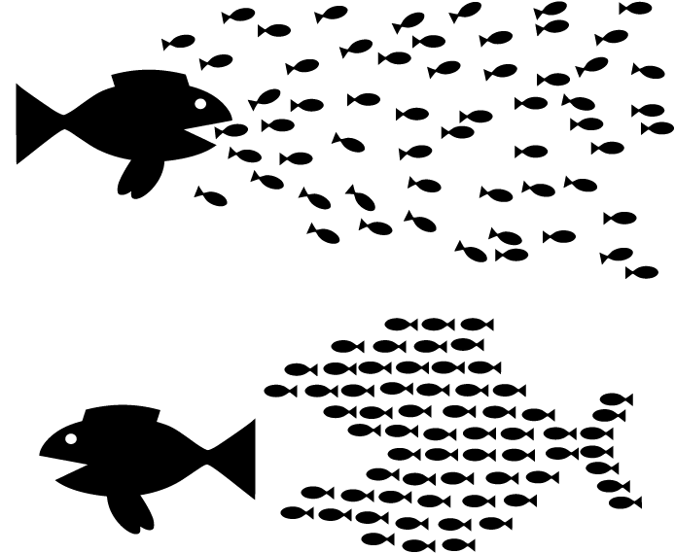
Rise of Labor Unions
Using the Caption This strategy, create a 2-3 sentence summary that explains how this image represents the goals of labor unions.
Use evidence from the reading and prior class activities and discussions to support your response.

Slide 17
Issues that Labor Unions Protested
Issue | Resolution
Notes:
You can type students responses in the “issue” column.

Slide 18
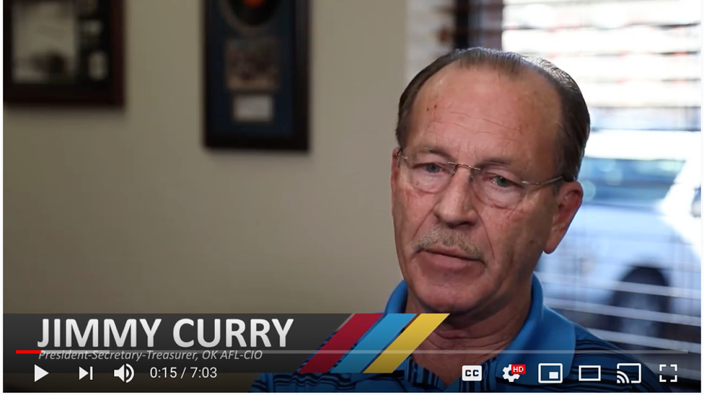
Video Interview with AFL-CIO OK President
Notes:
K20 Center. (2020, February 27). ICAP—Impacts of industrialization on workers [Video file]. Retrieved from https://youtu.be/XPpiKKsClTY

Slide 19
Issues that Labor Unions Protested
Issue | Resolution
low pay
long hours
dirty environment
dangerous working environment
child labor
economic exploitation

Slide 20
Issues that Labor Unions Protested
Issue | Resolution
low pay | minimum wage laws
long hours | 40 hour work weeks + laws requiring breaks, vacation, sick leave, parental leave
dirty environment | laws requiring health inspections
dangerous working environment | building codes, safety requirements
child labor | laws preventing child labor
economic exploitation | formation of unions leveraged the collective power of workers

Slide 21
Class Discussion
Should governments regulate business to protect the rights of workers?
How do citizens, individually and collectively, influence government policy?

Slide 22
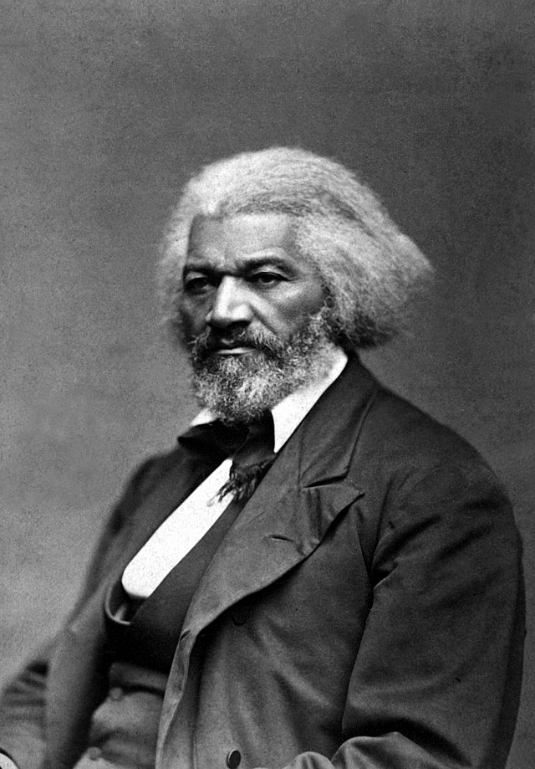
Exit Ticket
How does this quote from activist, Frederick Douglass, relate to the goal of labor unions during industrialization?
Power concedes nothing without demands.
Notes:
Legg, F. (1879). Frederick Douglass. National Archives Catalog. Retrieved from https://catalog.archives.gov/id/558770

