Slide 2
Take Those Basics and Shift Them Around
Writing an Outline

Slide 3
Notes:
Vasilachi, Andrei. (2019, December 11). Billie Eilish: The Philosophy of an Outsider. Medium. https://medium.com/@avasilachi/billie-eilish-the-philosophy-of-an-outsider-4eebed80a588

Slide 4
How a mainstream artist is expressing what many of us feel deep down in our darkest moments.
Notes:
Vasilachi, Andrei. (2019, December 11). Billie Eilish: The Philosophy of an Outsider. Medium. https://medium.com/@avasilachi/billie-eilish-the-philosophy-of-an-outsider-4eebed80a588

Slide 5
Essential Question
In what ways can a piece of writing be clear and purposeful for the reader?

Slide 6
Lesson Objectives
Define the essential points of a topic or question.
Organize a logical flow of a topic’s claim and supporting subtopics that support that claim.
Compose an outline that identifies the purpose and sequence of an introduction, thesis statement, body paragraphs, and conclusion.

Slide 7
Two-Minute Paper
What does it mean to be an insider or an outsider?
Write for two-minutes on one or both terms.
Use your own personal experiences or focus on experiences of celebrities or historical figures.
Share your thoughts with an Elbow Partner.
Notes:
K20 Center. (n.d.). Two-Minute Paper. Strategies. https://learn.k20center.ou.edu/strategy/152
K20 Center. (n.d.) Elbow Partners. Strategies. https://learn.k20center.ou.edu/strategy/116

Slide 8
Insider | Outsider

Slide 9
Both

Slide 10
Insider | Outsider
Both

Slide 11
Essential Question
In what ways can a piece of writing be clear and purposeful for the reader?

Slide 12
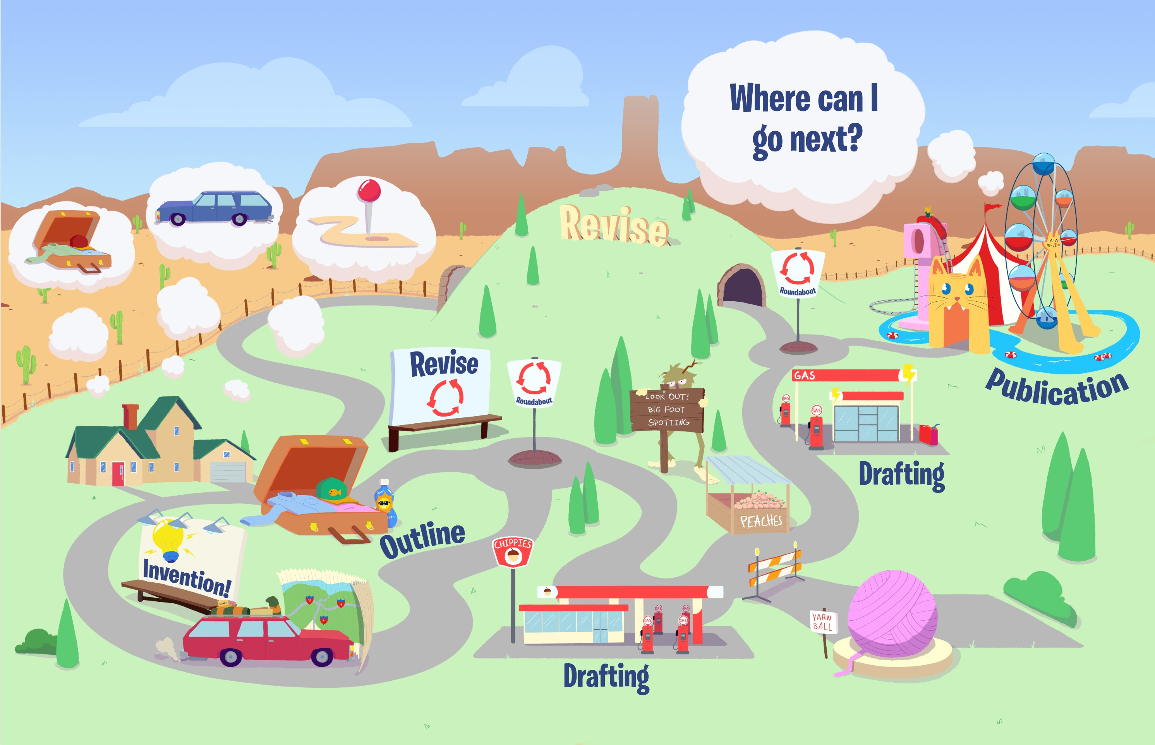
Notes:
K20 Center. (2022). Roadmap to Writing. [Infographic].

Slide 13
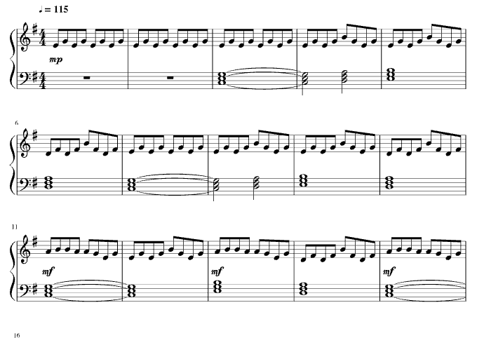
Interview with Billie Eilish
https://edpuzzle.com/media/609ffffc74b39b417874fa47
Notes:
British Vogue. (2021, May 3). “Billie Eilish answers questions from Justin Bieber & 22 other famous fans..” [Video]. https://musescore.com/user/28640190/scores/5185173
Sophiejoslin1 (2018). Lovely. [Photograph]. Musescore. https://musescore.com/user/28640190/scores/5185173

Slide 14
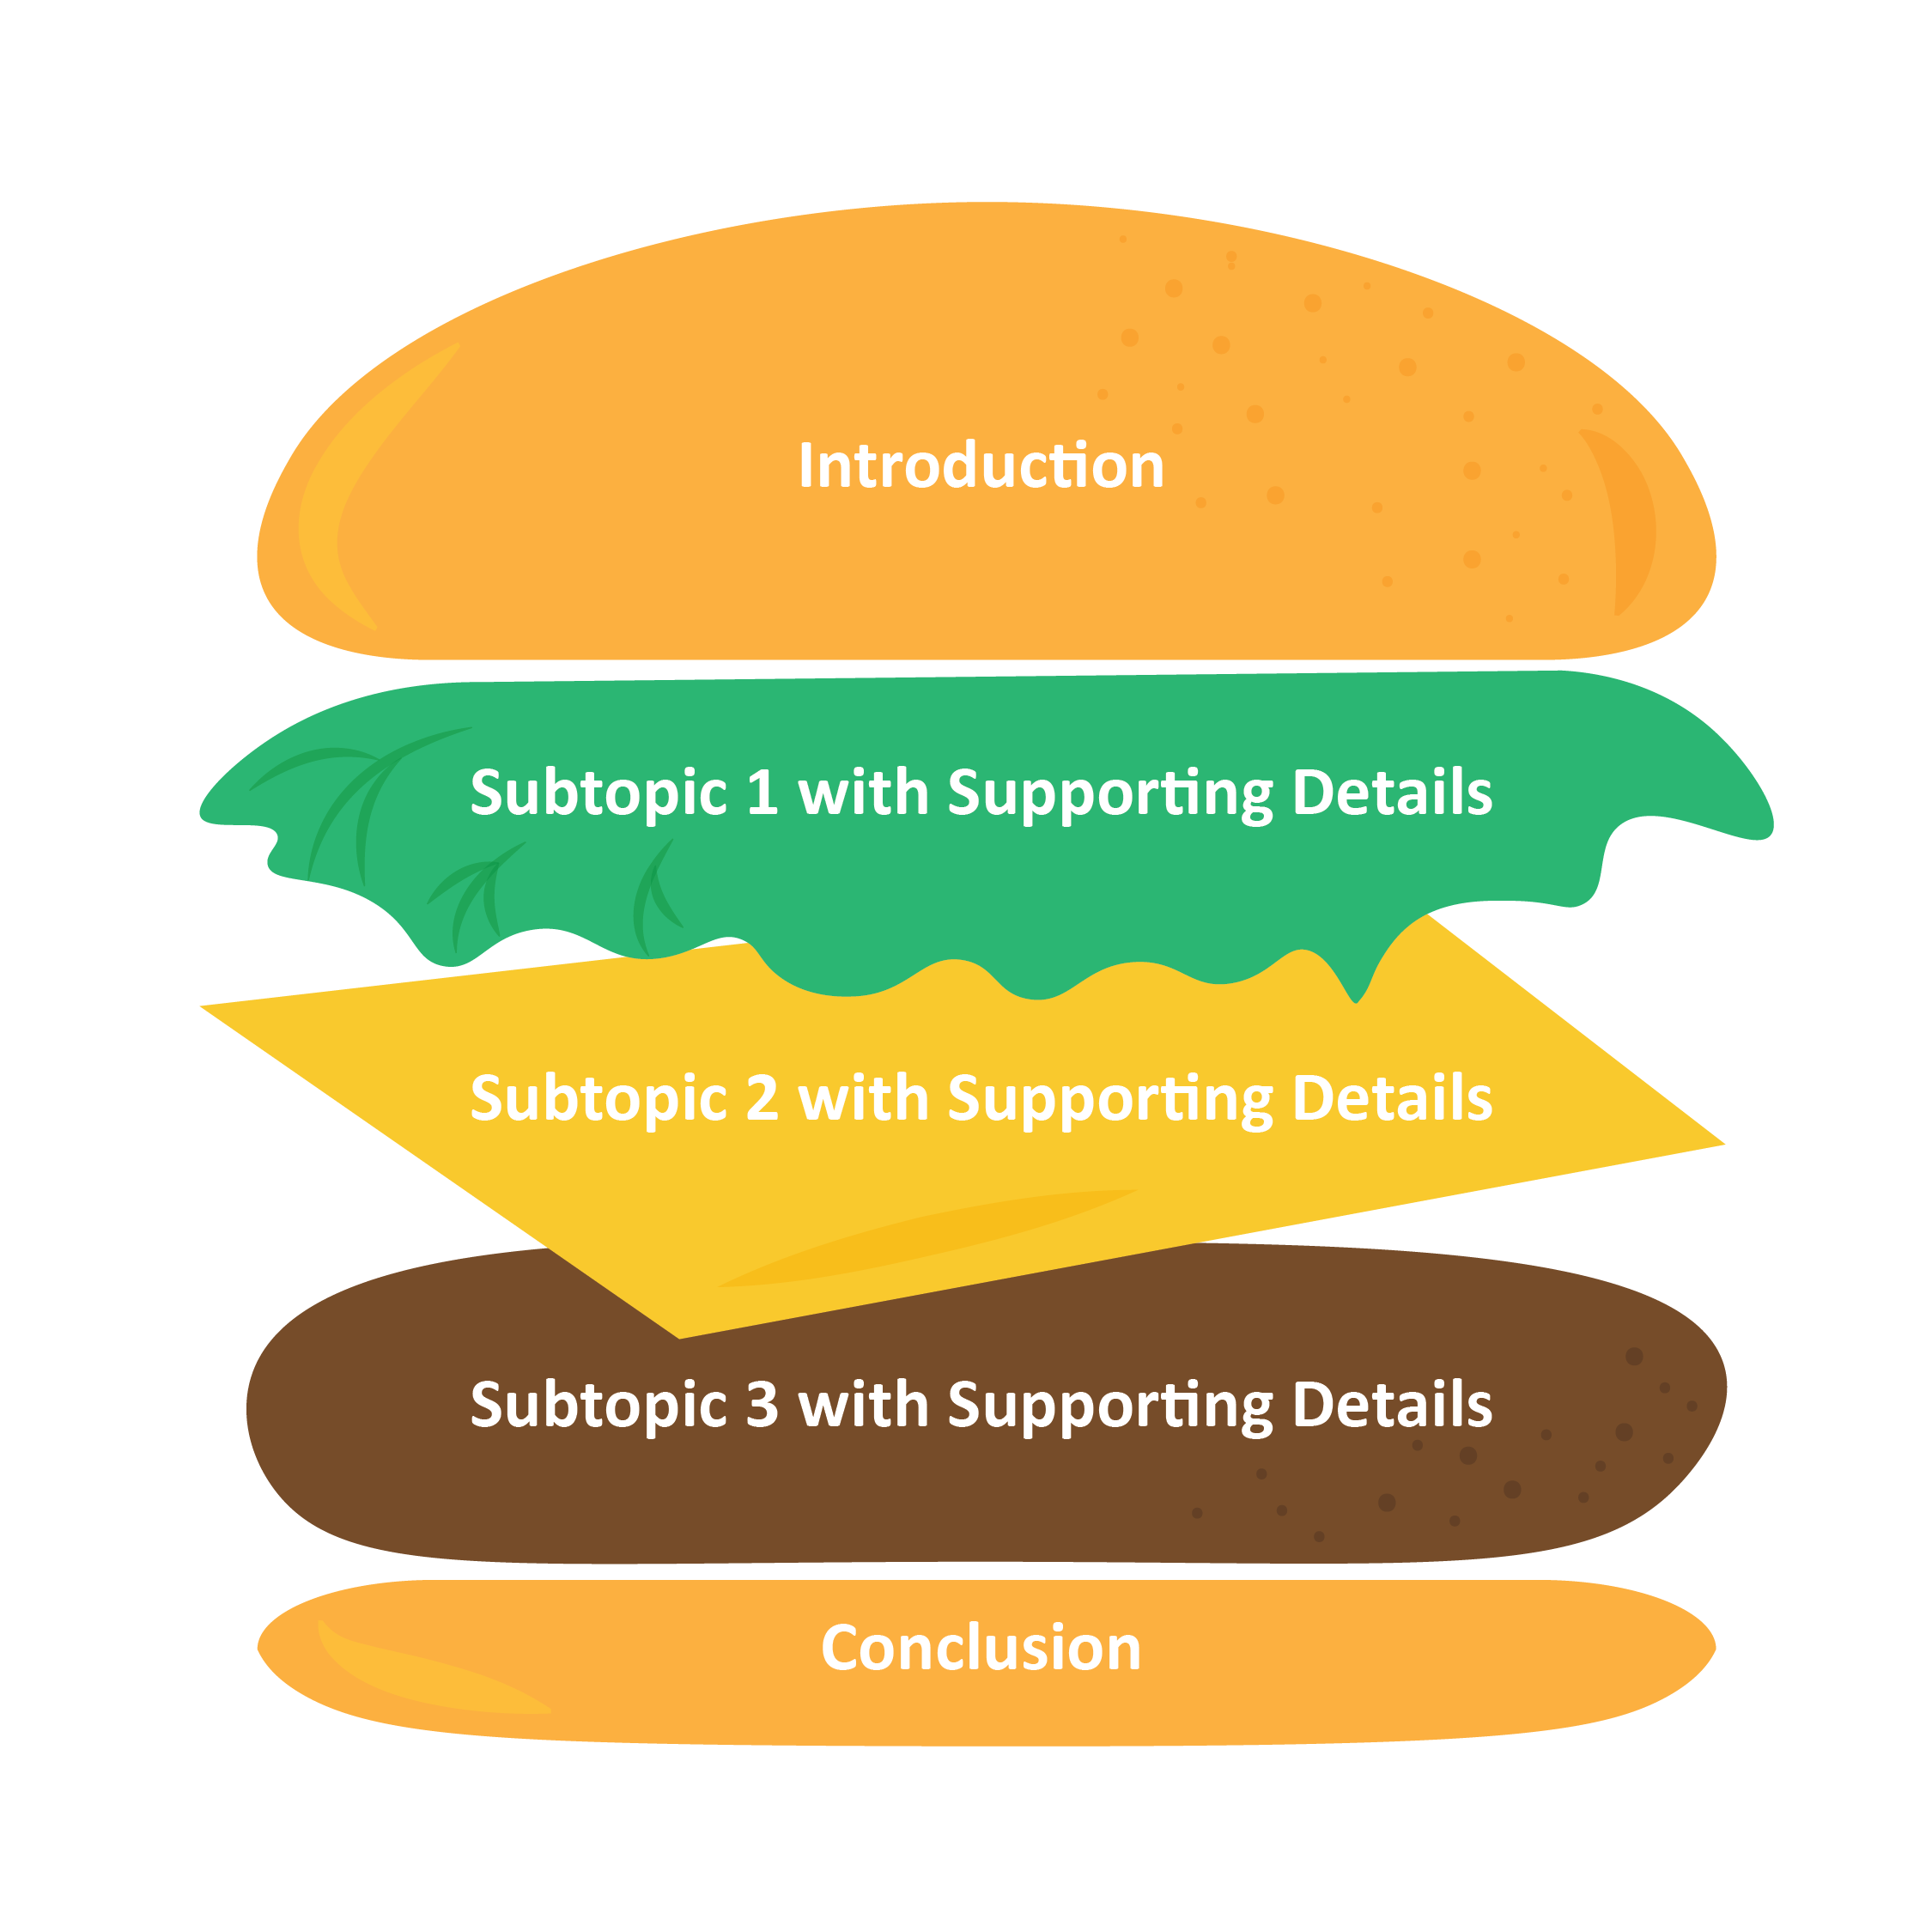
The “Hamburger” Outline

Slide 15
The “Traditional” Outline
Introduction
Subtopic 1
Supporting Detail
Supporting Detail
Supporting Detail
Subtopic 2
Supporting Detail
Supporting Detail
Supporting Detail
Subtopic 3
Supporting Detail
Supporting Detail
Supporting Detail
Conclusion

Slide 16
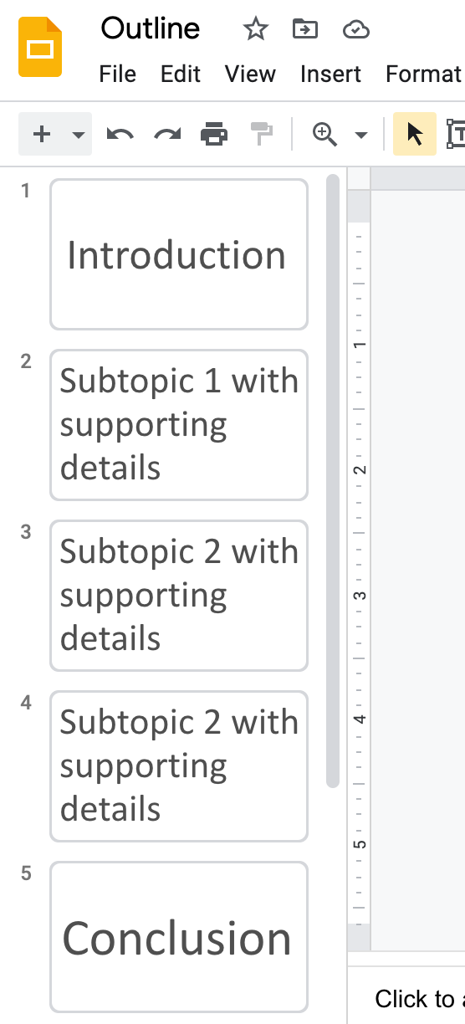
The “Google Slides” Outline

Slide 17
Exit Ticket
[Insert prompt here.]

