Slide 2
The Dangers of Tradition
The Lottery

Slide 3
Essential Question
How Does Shirley Jackson’s “The Lottery” demonstrate the possible dangers of tradition?

Slide 4
Lesson Objectives
Understand and discuss the value and possible dangers of tradition by synthesizing learning from “The Lottery” and “The Dangers of Tradition.”

Slide 5
Tip of the Iceberg
Using the tip of the iceberg handout, write some words that come to mind when you hear the word “Lottery.”
Write these words at the the tip of the iceberg.
Be prepared to share with the class.

Slide 6
Collaborative Word Cloud
Use the words you came up with to create a collaborative word cloud with your classmates.

Slide 7
My Lottery Dream Home
Notes:
HGTV. (2017, Jan 4). My Lottery Dream Home with David Bromstead Ep. 1 Preview | My Lottery Dream Home | HGTV. Retrieved from YouTube: https://www.youtube.com/watch?v=kSmZ6G2eHwE&t=5s

Slide 8
Commit and Toss
What is one special thing you would want in your lottery dream home?

Slide 9
“The Lottery”
Read the short story “The Lottery” by Shirley Jackson.
As you read, fill in the waterline portion of your iceberg with new thoughts about tradition that arise from your reading of this story.
Notes:
https://books.hamlethub.com/booksink/readers/41999-gilmore-girls-reading-challenge-the-lottery-by-shirley-jackson

Slide 10
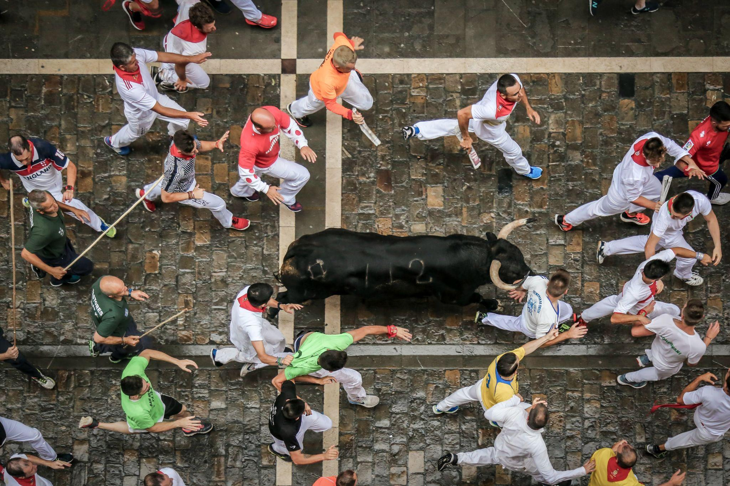
“The Dangers of Tradition”
Read the article “The Dangers of Tradition.”
Using information from both the story and the article, continue filling out your iceberg--this time below the waterline.
Notes:
San Fermin Pamplona - Navarra. (2018). Unsplash: https://unsplash.com/photos/LJrszMj1RJc

Slide 11
Fold The Line
Line up according to how much you agree or disagree with the following prompts.

Slide 12
Fold The Line
All traditions are good.

Slide 13
Fold The Line
All traditions are bad.

Slide 14
Fold The Line
Traditions are dangerous.

Slide 15
Fold The Line
Traditions are pointless.

Slide 16
One-Pager
Petition either for a new school tradition or the removal of an old one. Include the following:
Title of your proposed new tradition or old one you want removed
Border around the page that includes one major belief you now hold about tradition
Image representing your new tradition or the old one you want removed
Three (3) or more questions about tradition with the answers included
A statement arguing for your new tradition or against an old one

Slide 17
A statement arguing for your tradition
Question 1
Title
Question 2
Question 3
Image representing new tradition
Border

Slide 18
One-Pager
Example One-Pager
Petition either for a new school tradition or the removal of an old one. Include the following:
Title of your proposed new tradition or old one you want removed
Border around the page that includes one major belief you now hold about tradition
Image representing your new tradition or the old one you want removed
Three (3) or more questions with the answers included
A statement arguing for your new tradition or against an old one

