Slide 2
Galloping Gertie
What is a Wave? Lesson 3

Slide 3
Essential Questions
What are waves?
How do waves behave differently from particles?

Slide 4
Lesson Objectives
Explain the concept of wave interference as a model to explain how multiple waves can occupy the same space.
Define constructive and destructive interference, reflection, and phase.
Explain that resonance results from interference and reflection of trapped waves and that only certain wavelengths of trapped waves can cause resonance.
Demonstrate knowledge of interference to explain how freely traveling waves form interference patterns when they intersect.

Slide 5
I Notice, I Wonder
As you watch the video, note what you are observing.
List any questions you have about what is happening.
Notes:
https://learn.k20center.ou.edu/strategy/180

Slide 6
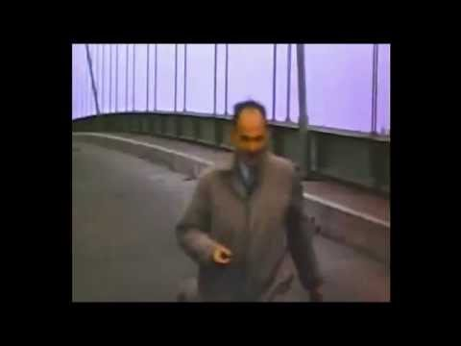
I Notice, I Wonder
Notes:
Atkinson, J. (2015, Nov. 8). Tacoma-Narrows Bridge Collapse. [Video]. YouTube. https://youtu.be/13J76PXE6OA.

Slide 7
Galloping Gertie
What did you observe and what questions do you have?
How could a bridge trap and then amplify vibrations caused by wind?
Notes:
Galloping Gertie was the nickname for the Tacoma-Narrows Bridge.

Slide 8
Making Your Own Waves - Setting Up
Mark off a 6-meter spot on the floor.
Use masking tape to mark the following spots:
0 Meters (starting location)
3 Meters (center location)
6 Meters (ending location)
Each mark should be 1 Meter long.
1 Meter long, centered on the 6 Meter long line
3 Meters Distance
3 Meters Distance
Starting Location - 0 Meters
Center Location - 3 Meters
Ending Location - 6 Meters

Slide 9
Making Your Own Waves - Round 1
Student Roles
Student A - Holds one end of the long spring.
Student B - Makes and records observations.
Student C - Snaps one end of the long spring.
Start at the center of the meter marker.
Snap to the far left of the meter marker.
Return immediately to the center of the meter marker.
Student A - 0 Meters
Student B - 3 Meters
Student C - 6 Meters

Slide 10
Making Your Own Waves - Round 1
What type of wave was made?
Student A - 0 Meters
Student B - 3 Meters
Student C - 6 Meters

Slide 11
Making Your Own Waves - Round 2
Student Roles
Student A - Quickly snaps the long spring.
Start at the center of the meter marker.
Snap to the far left of the meter marker.
Return immediately to the center of the meter marker.
Student B - Makes and records observations.
Student C - Holds one end of the long spring.
Student A - 0 Meters
Student B - 3 Meters
Student C - 6 Meters

Slide 12
Making Your Own Waves - Round 2
How does the displacement at Student B’s location compare to the displacement at Student A’s location?
Draw three (3) pictures of the wave as it travels down and back.
Student A - 0 Meters
Student B - 3 Meters
Student C - 6 Meters

Slide 13
Making Your Own Waves - Reflection
What happens to the peak of the wave when it is reflected at Student C’s location?
Student A - 0 Meters
Student B - 3 Meters
Student C - 6 Meters

Slide 14
Wave Interactions - Round 1
Student Roles
Student A and Student C- Quickly snap the long spring at the same time in the same direction.
Start at the center of the meter marker.
Snap to the far left of the meter marker.
Return immediately to the center of the meter marker.
Student B - Makes and records observations of the displacement.
Student A - 0 Meters
Student B - 3 Meters
Student C - 6 Meters

Slide 15
Wave Interactions - Round 1
How does the displacement at Student B’s location compare to the displacement at Student A’s location?
Draw three (3) pictures of the waves:
Before they meet in the middle.
When they meet in the middle.
After they meet in the middle.
Student A - 0 Meters
Student B - 3 Meters
Student C - 6 Meters

Slide 16
Wave Interactions - Round 1
What do you think has happened to the two waves when they combine?
Student A - 0 Meters
Student B - 3 Meters
Student C - 6 Meters

Slide 17
Wave Interactions - Round 2
Student Roles
Student A and Student C- Quickly snap the long spring at the same time but in OPPOSITE directions.
Student B - Makes and records observations of the displacement.
Student A - 0 Meters
Student B - 3 Meters
Student C - 6 Meters

Slide 18
Wave Interactions - Round 2
How does the displacement at Student B’s location compare to the displacement at Student A’s location?
Draw three (3) pictures of the waves:
Before they meet in the middle.
When they meet in the middle.
After they meet in the middle.
Student A - 0 Meters
Student B - 3 Meters
Student C - 6 Meters

Slide 19
Wave Interactions - Round 2
Does your hypothesis about what happened when the waves combined from Wave Interactions - Round 1 still make sense?
Student A - 0 Meters
Student B - 3 Meters
Student C - 6 Meters

Slide 20
Wave Interference - Student Roles
Organizer - Keeps the group on track.
Scribe - Records the group’s responses.
Reporter - Answers questions based on the group’s answers, if asked.
Organizer
Scribe
Reporter

Slide 21
Wave Interference - Prediction 1
How would the waves combine?
Think about math: how do positive and negative numbers combine?

Slide 22
Wave Interference - Prediction 2
How would the waves combine?

Slide 23
Wave Interference - Prediction 1
This represents Constructive Wave Interference.
In your own words, define this term.

Slide 24
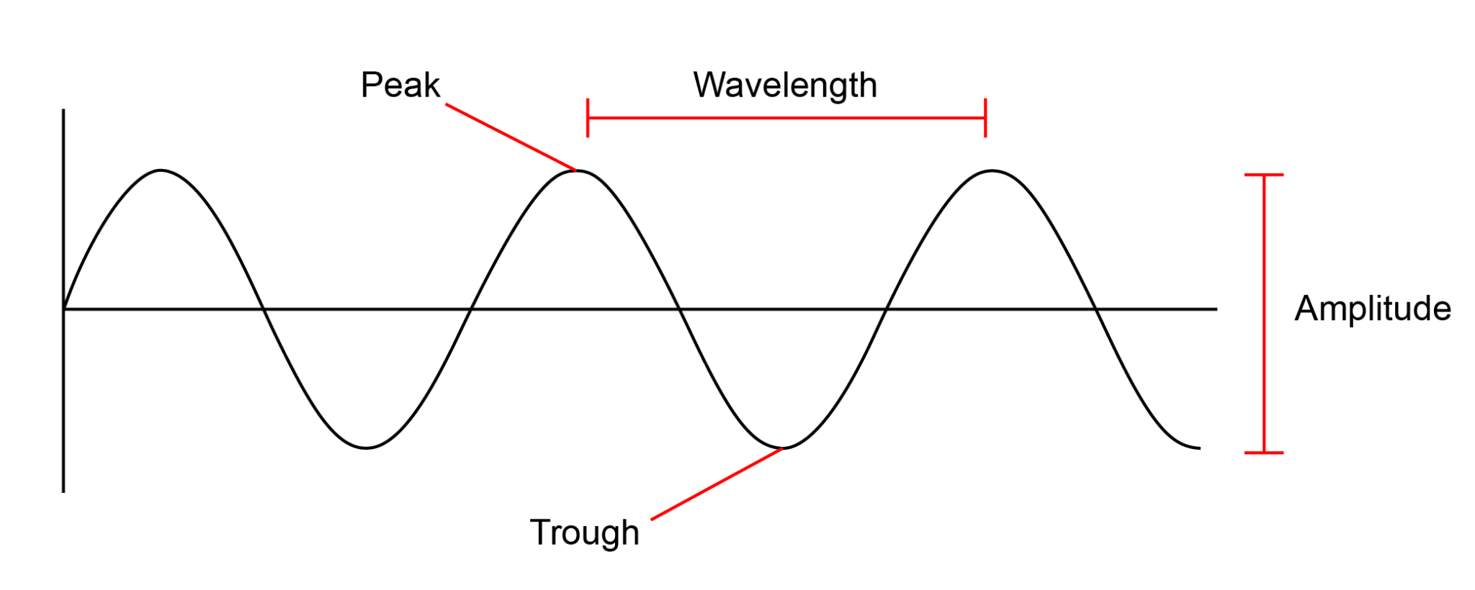
Constructive Interference
Waves combine peak + peak or trough + trough to produce a wave of larger amplitude.

Slide 25
Wave Interference - Prediction 2
This represents Destructive Wave Interference.
In your own words, define this term.

Slide 26
Destructive Interference
Waves combine peak + trough so that amplitudes cancel one another.

Slide 27
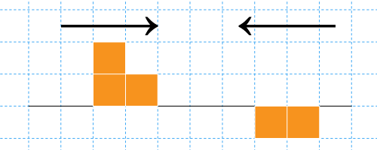
Wave Interference
If two pulse waves are sent through a spring in opposite directions, what would the result be the instant they combine?
Is this constructive or destructive interference?

Slide 28
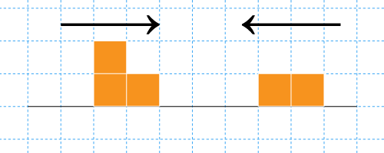
Wave Interference
If two pulse waves are sent through a spring in opposite directions, what would the result be the instant they combine?
Is this constructive or destructive interference?

Slide 29
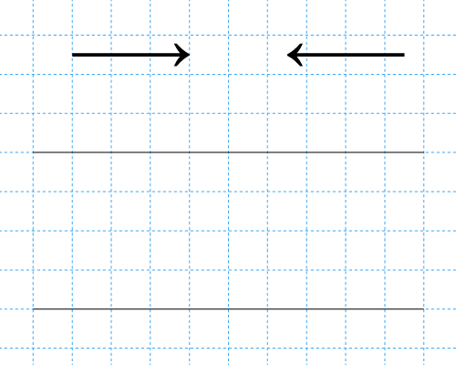
Wave Interference - Original Pulse Wave
Sketch an original pulse wave pattern using blocks to represent peak and trough area.

Slide 30
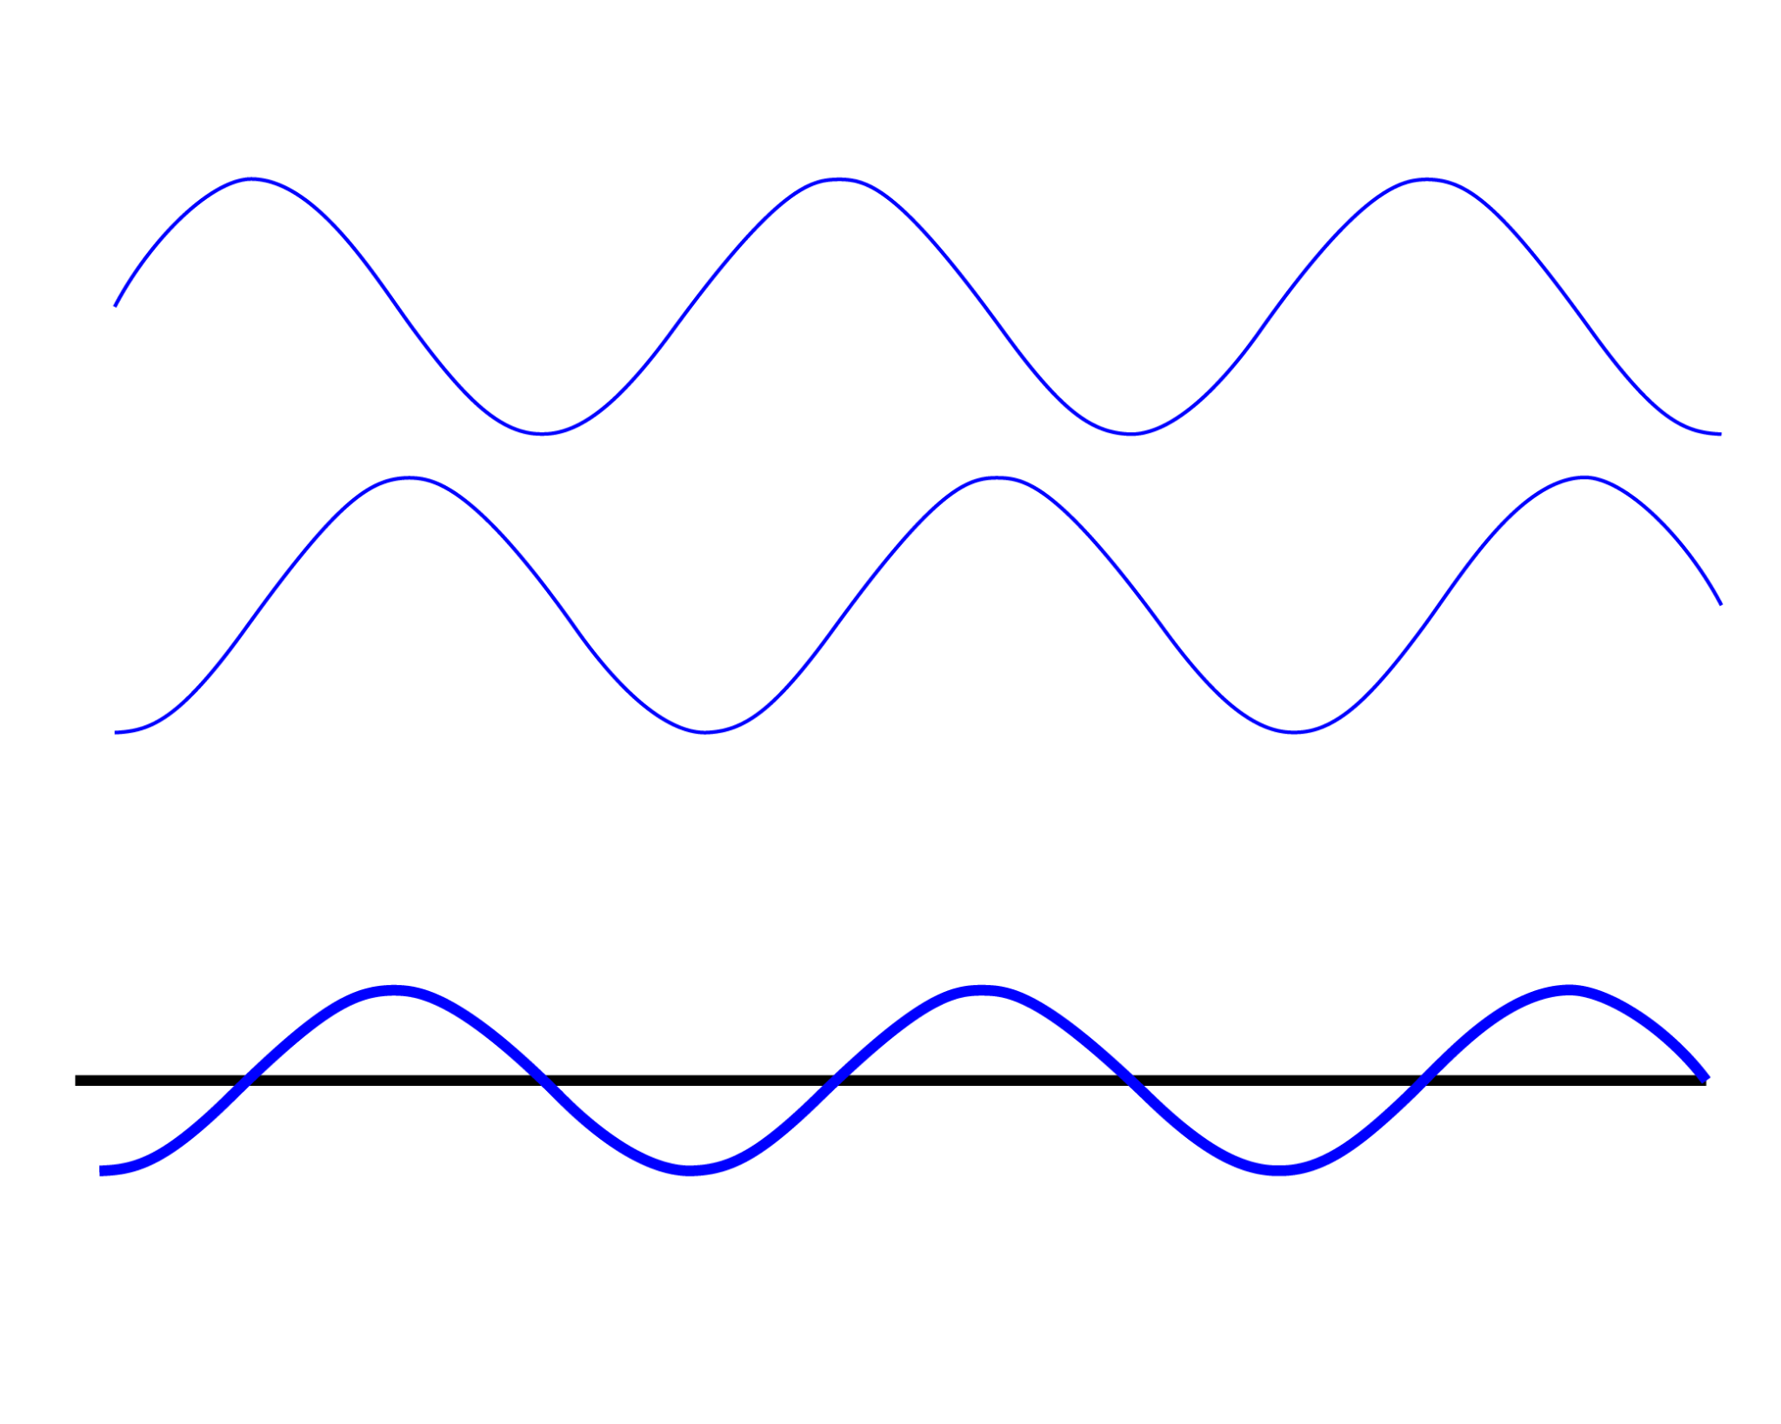
Interference-Definition
When two or more waves combine additively. Like positive and negative numbers, the wave amplitudes can either increase or cancel out.
Notes:
GIF Image Source: https://www.acs.psu.edu/drussell/Demos/superposition/superposition.html
Images at this website may have a Creative Commons license.

Slide 31
Reflection - Definition
When a wave bounces off a barrier and changes direction of travel.
A wave that encounters a hard barrier is flipped on itself.
Notes:
GIF Image Source: https://www.acs.psu.edu/drussell/Demos/reflect/reflect.html
Images at this website may have a Creative Commons license.

Slide 32
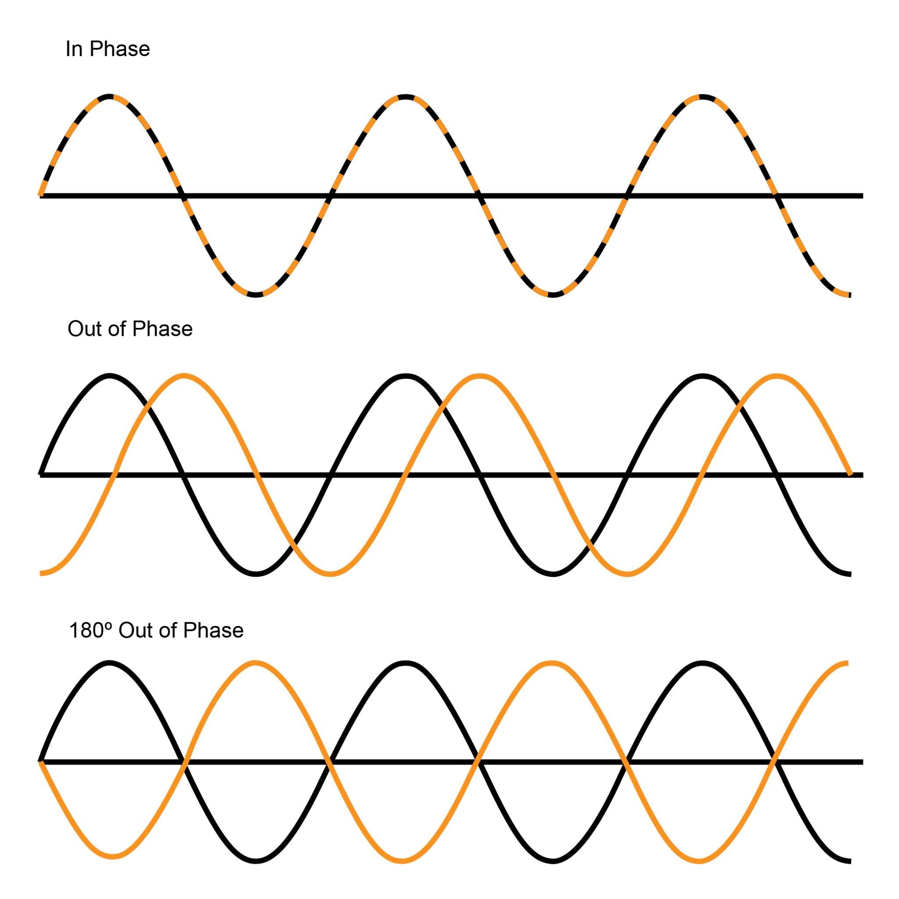
Phase-Definition
The position of one wave relative to another
“In phase”- peaks and troughs directly line up
“Out of phase”- peaks and troughs do not line up
“180° out of phase”- peaks and troughs exactly opposite
Can also be the position of a wave relative to its reflection

Slide 33
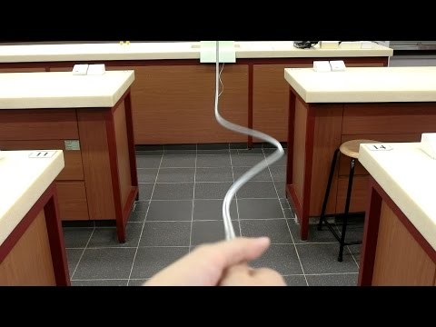
Wave Reflection
Notes:
Xmdemo138. (2016). Wave reflection. [Video]. YouTube. https://youtu.be/1PsGZq5sLrw.

Slide 34
Wave Reflection
What is a reflection?
What happens to the phase of a wave on a spring when it reflects off a hard barrier?
What do we call this flip?
What is constructive interference?

Slide 35
Whirly Tube
Hold the sound tube at one end.
Whirl the free end of the tube in a circle until you hear a low pitch sound.
Slowly increase the speed of the whirl.
What is happening?
Notes:
Wikimedia. (n.d.). Whirlytube. [Digital Image]. https://commons.wikimedia.org/wiki/File:Whirlytube.png

Slide 36
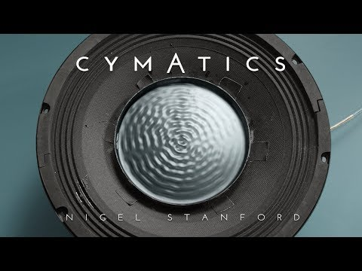
Resonance
When a system vibrates at a single frequency, we call this frequency a standing wave.
Only wavelengths that fit within an object (a bottle or pipe, the length of a bridge, the length of a string) will resonate.
Notes:
Stanford, N.G. (2014, Nov. 12). Cymatics: Science Vs. Music. [Video]. YouTube. https://www.youtube.com/watch?v=Q3oItpVa9fsuTube

Slide 37
Interference Patterns
We have observed resonance caused by standing waves in situations where waves or vibrations are trapped. What happens when two freely traveling waves intersect?

Slide 38
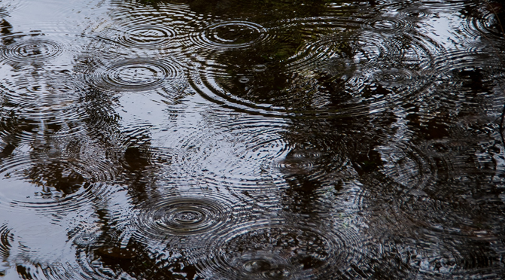
Interference Patterns
When two or more freely traveling waves interfere and merge via constructive and destructive interference.
Notes:
Surface Waves Water Wet Circles Drops Ripples. (n.d.). Megapixel. https://www.maxpixel.net/Surface-Waves-Water-Wet-Circles-Drops-Ripples-3753813 .

Slide 39
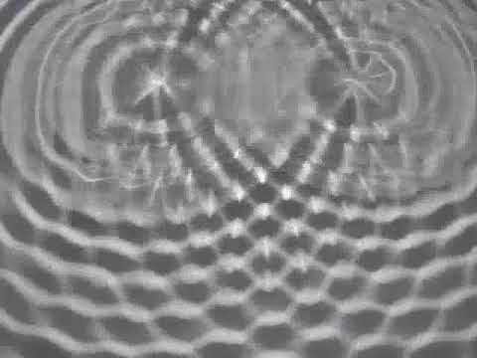
Interference Patterns in Water Waves
Notes:
launchscience. (2017, Dec. 8). PS4 1 lab physics waves ripple tank interference patterns wis. [Video]. YouTube. https://youtu.be/0c0gvy_OOKc.

Slide 40
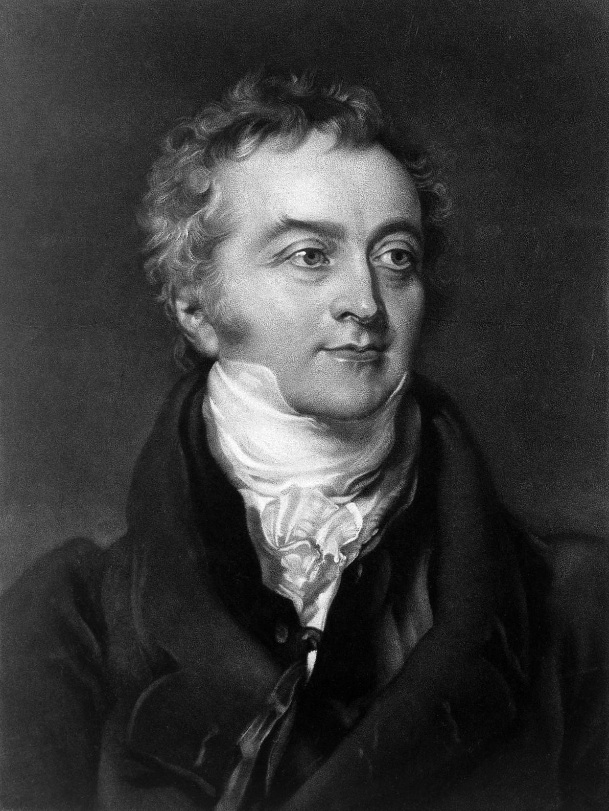
The Last Man Who Knew Everything
Thomas Young was a British polymath who made notable contributions to the fields of vision, light, solid mechanics, energy, physiology, language, musical harmony, and Egyptology.
His work influenced Albert Einstein.
He discovered the wave theory of light.
Notes:
Wikimedia. (2014). Portrait of Thomas Young, 1855. [Digital Image]. https://commons.wikimedia.org/wiki/File:Portrait_of_Thomas_Young,_1855_Wellcome_L0008178.jpg

Slide 41
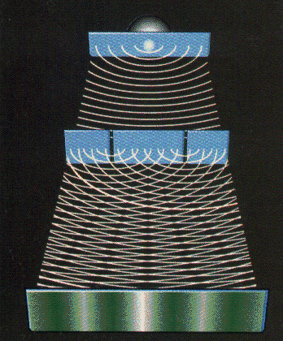
Wave Theory of Light
In 1801, Thomas Young observed a distinct pattern of bright and dark bands as light passed through two very narrow openings. This was the first good evidence that light travels through space in the form of a wave.
Notes:
University of Oregon. (n.d.). Young Two-Slit Experiment. [Digital Image.] http://abyss.uoregon.edu/~js/21st_century_science/lectures/lec13.html.

Slide 42
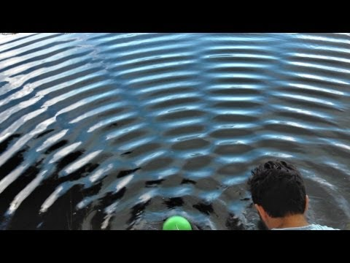
What causes patterns of dark and light bands?
Notes:
Veritasium. (2013, Feb. 13). The original double slit experiment. [Video]. YouTube. https://youtu.be/Iuv6hY6zsd0.

Slide 43
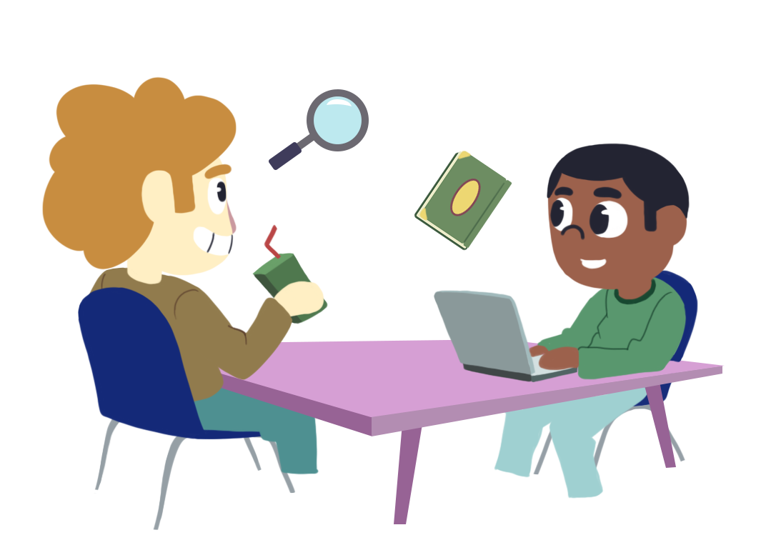
Driving Question Board
Are there any questions on the Driving Question Board that we can answer right now?
Notes:
https://learn.k20center.ou.edu/strategy/1511

Slide 44
Justified True or False Statements
Read each statement carefully and decide whether it is true or false.
Provide a reasoning for your answer.
Notes:
https://learn.k20center.ou.edu/strategy/174

Slide 45
Justified True or False Statements
Two waves can occupy the same space at the same time.
Notes:
https://learn.k20center.ou.edu/strategy/174

Slide 46
Justified True or False Statements
Reflected waves can combine with incoming waves to create new wave patterns.

Slide 47
Justified True or False Statements
Light passing through two narrow openings projects only two bright bands on a screen.

Slide 48
Justified True or False Statements
When resonance occurs, many different frequencies of waves are produced.

Slide 49
Justified True or False Statements
Two intersecting waves can cancel one another out completely.

