Slide 2
Comparing Communities
Connecting Social Issues and Health Inequities

Slide 3
Essential Question
How do inequitable environmental factors affect human health?

Slide 4
Lesson Objectives
Identify environmental threats within Oklahoma County.
Compare and contrast the Oklahoma City community with that of Washington D.C.
Write a proposal that will improve air quality and raise awareness of environmental racism.

Slide 5
2018 Life Expectancy at Birth by Zip Code
Hover your mouse over the map to change
The county
Zip code
Average life expectancy
Explore the following zip codes:
73111
73012
Record your observations
https://tinyurl.com/OK2Share

Slide 6
S-I-T (Surprising, Interesting, Troubling)
Record the following about your exploration of the OK2Share website:
One fact or idea that you found surprising;
One fact or idea that you found interesting;
One fact or idea that you found troubling.
Share your thoughts with a partner or small group.
Notes:
K20 Center. S-I-T (SURPRISING, INTERESTING, TROUBLING). Strategies. https://learn.k20center.ou.edu/strategy/926

Slide 7
2018 Life Expectancy at Birth by Zip Code
What do these data tell us?
How could you determine the average life expectancy by zip code?
How does everything that we have learned up to this point connect?

Slide 8
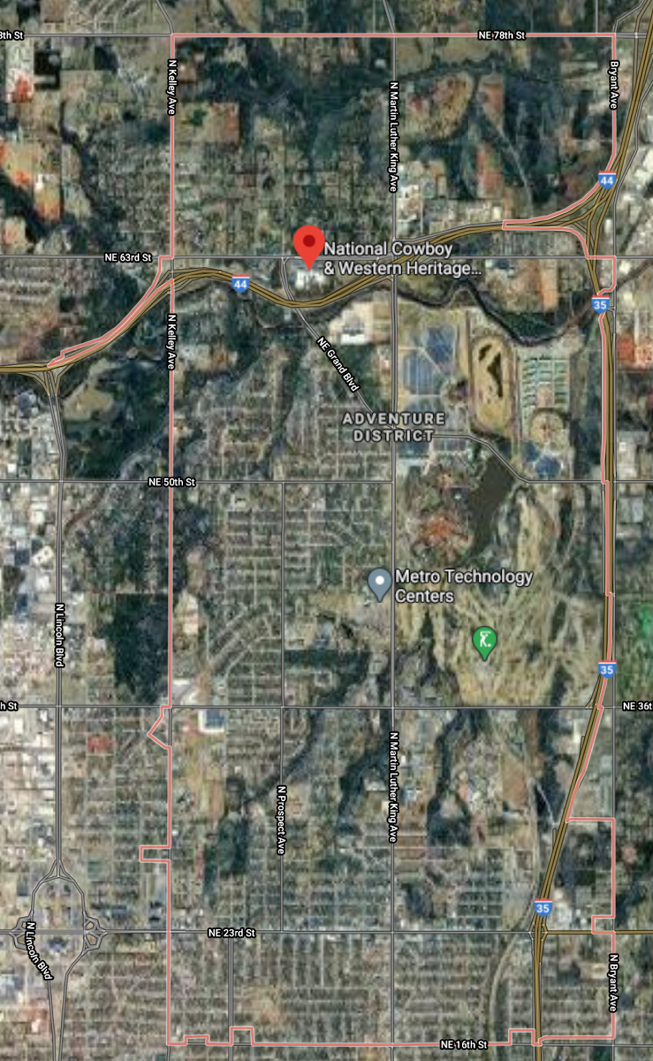
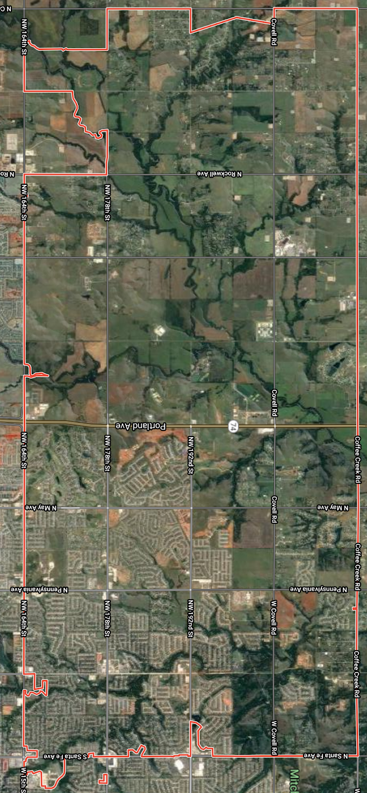
Comparing Communities
Using the aerial photos from the previous lesson and other available resources to determine the following:
Environmental threats
Average home values
Notes:
Google maps satellite. (n.d.). Oklahoma City, OK. https://earth.google.com/web/@35.48264792,-97.4791978,363.52415431a,121151.59788577d,35y,0h,0t,0r

Slide 9
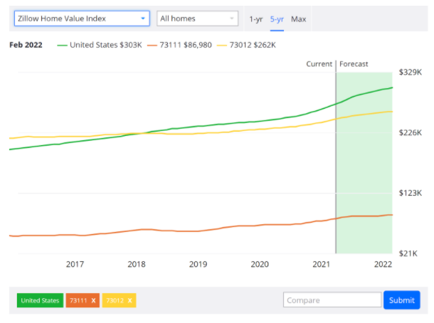
February 2022: Forecasted Property Value
Notes:
Zillow. (n.d.). Property values .[Chart]. https://www.zillow.com/?utm_medium=cpc&utm_source=msn&utm_content=319854745|1300722401909701|kwd-81295207640272:loc-190|81295221403667|&utm_campaign=zxw_br_natip_usa_x_nat_x_e_b_1&semQue=zillow&msclkid=55d5df2eb42418fafb9ebfac6894cea4

Slide 10
Comparing Communities
How do the environmental threats affect air quality?
How are we able to determine life expectancy by zip code?
What does all of this mean?

Slide 11
Paired Texts H-Chart
Now that you have a better understanding of the science behind asthma, you can focus on the social aspects.
Using your Paired H-Chart, compare and contrast what you notice between OKC and Washington D.C.
Notes:
K20 Center. (n.d.). Paired Texts H-Chart. Strategies. https://learn.k20center.ou.edu/strategy/132

Slide 12
Notes:
https://www.youtube.com/watch?v=fMufgnJId58

Slide 13
Paired Texts H-Chart
Share what you wrote down with a partner and add any new information that you might be missing.

Slide 14
Driving Question Board
Are there any questions on the Driving Question Board that we can answer at this point?
Notes:
K20 Center. (2021). Driving Question Board. Strategies. https://learn.k20center.ou.edu/strategy/1511?rev=8567

Slide 15
Project Proposal
What is the problem?
What do you know about the problem that other people should know?
What evidence can you provide to support your claim?
What are some possible solutions to this problem?
Continue to work on your proposal, adding more information and expanding your initial responses.

