Slide 2
Can’t Touch This, Part 2
Graphing Rational Functions

Slide 3
Essential Question
What can cause asymptotes?

Slide 4
Lesson Objectives
Graph rational functions.
Identify key characteristics of the graphs of rational functions, both algebraically and graphically.

Slide 5

Card Sort
Sort the graph cards into 2–4 groups
Be prepared to share your thinking.
  How did you decide which cards should go into each group?
  How would you describe each group?
Notes:
K20 Center. (n.d.). Card Sort. Strategies. Retrieved from https://learn.k20center.ou.edu/strategy/147

Slide 6
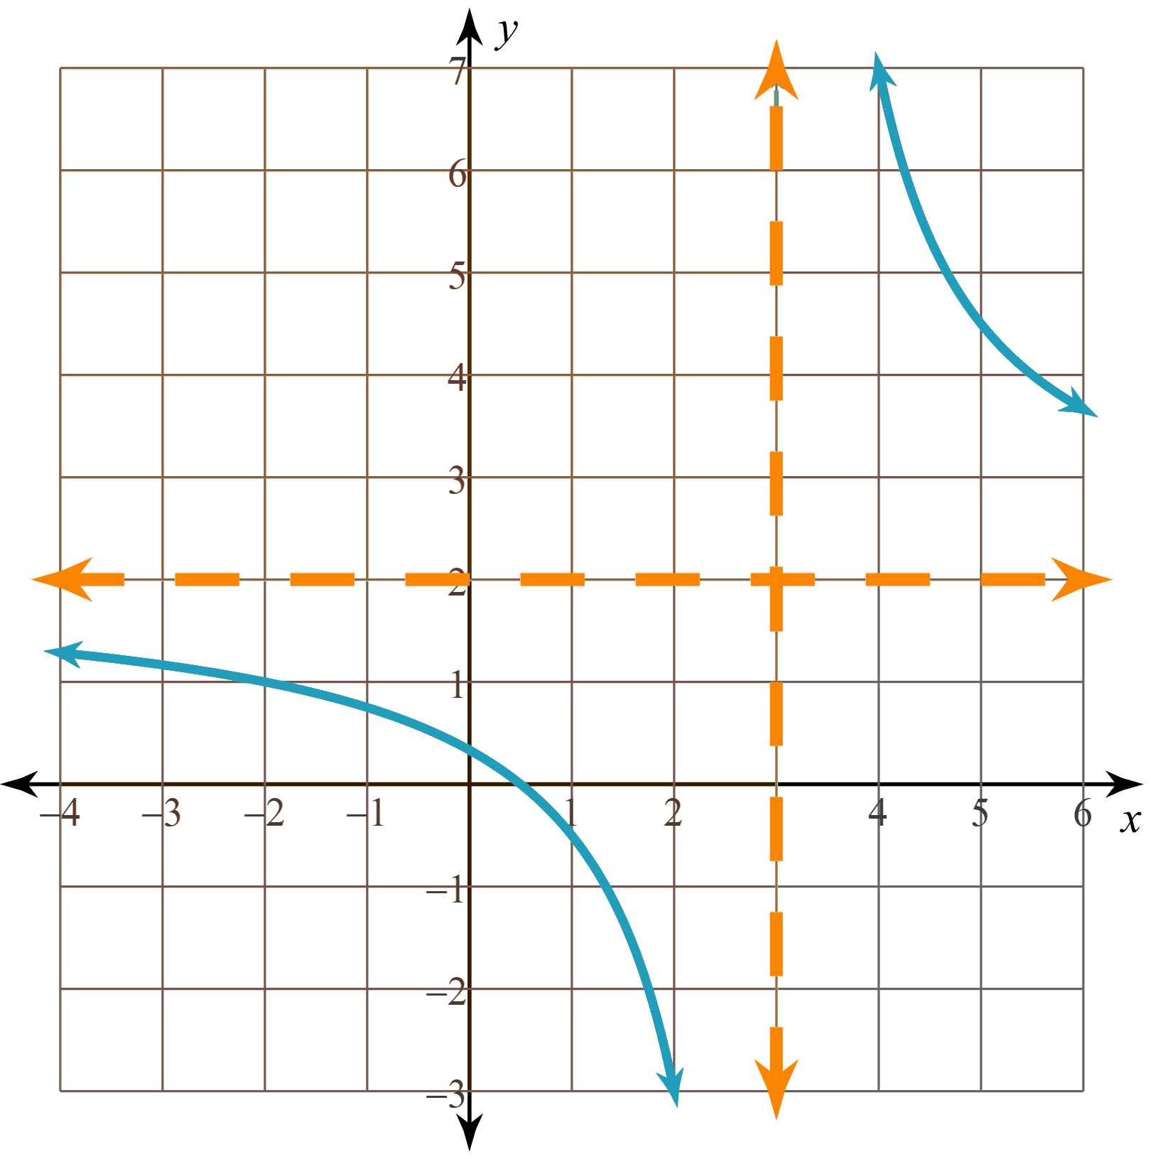
Exploring Rational Functions
Go to the GeoGebra activity: geogebra.org/m/d9ywzkrc
Spend time exploring the GeoGebra applets and seeing how things work.
Use the GeoGebra activity to complete the Exploring Rational Functions handout.

Slide 7
Guided Notes
Let’s complete the Guided Notes together.

Slide 8
Graphing With Asymptotes, Part 2
Graph each rational function.
  Show your thinking.
  Label your asymptotes.
Question 1) Work together as a group of four.
Question 2) Work with a new partner.
Question 3) Work individually.

Slide 9
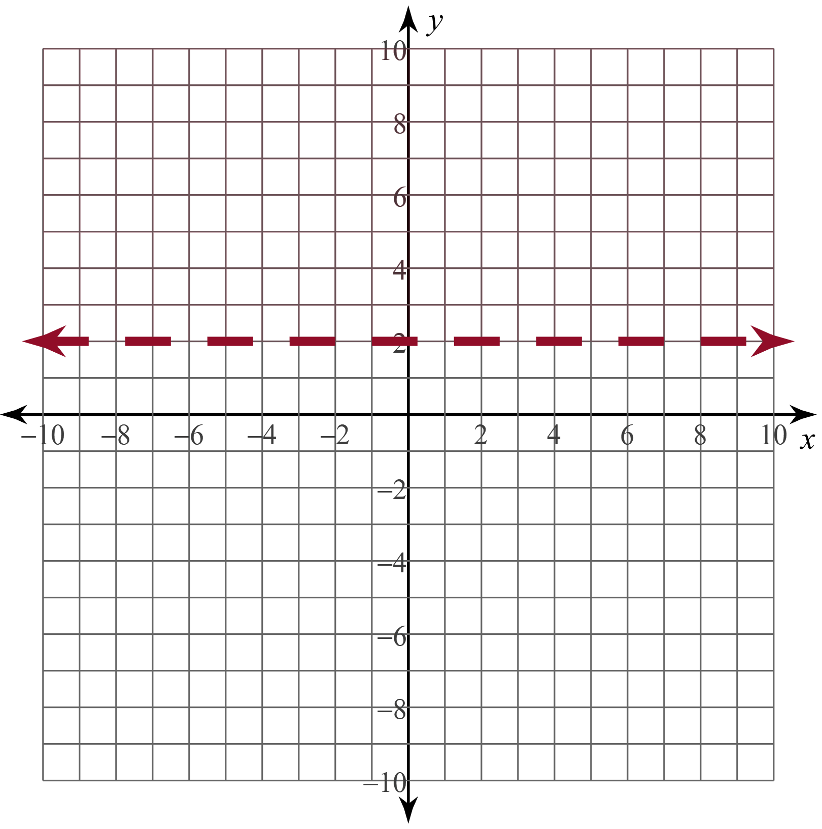
Graphing With Asymptotes (Solution #1)
Step 1)
VA:
HA:
Step 2)

Slide 10
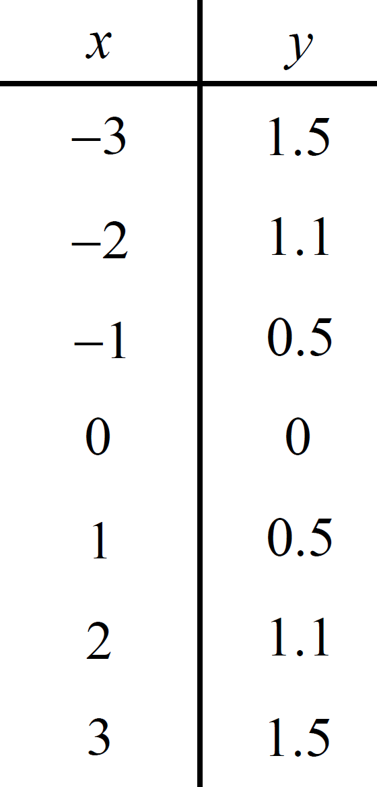
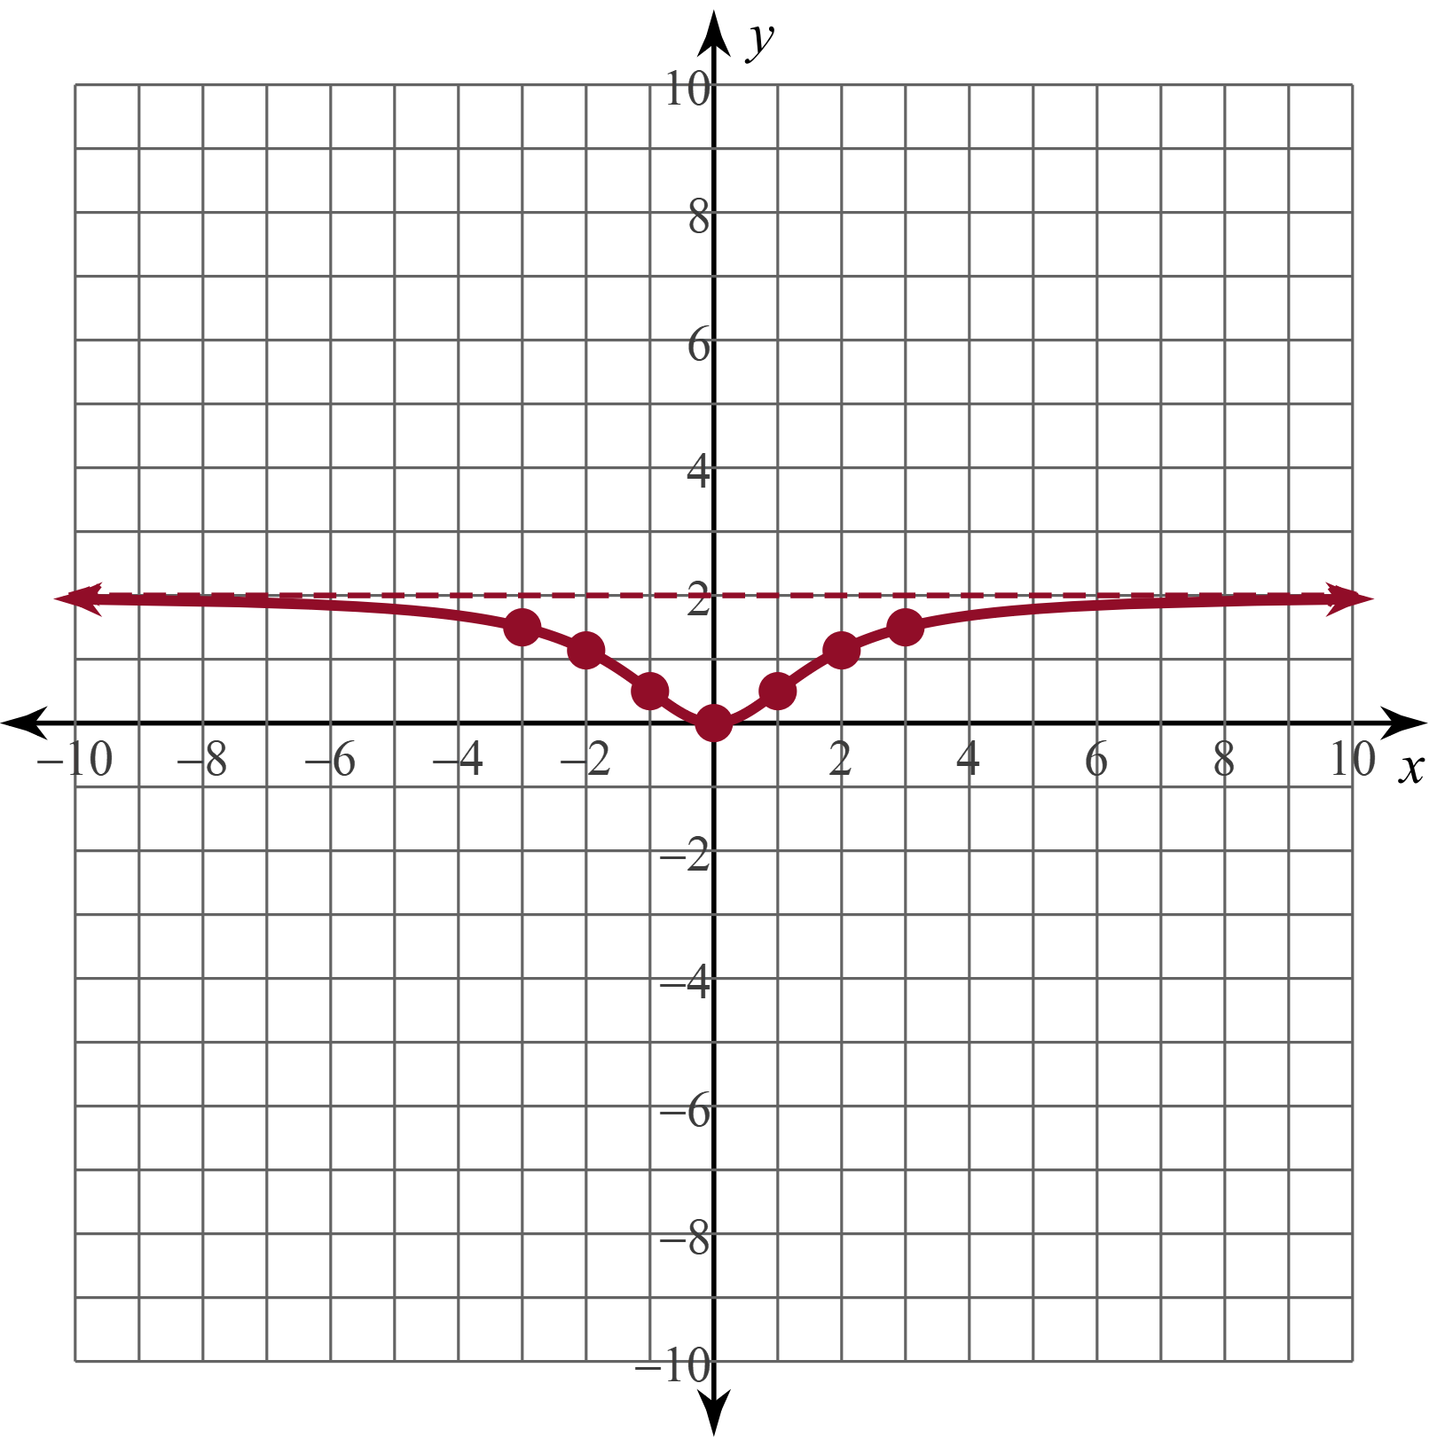
Graphing With Asymptotes (Solution #1)
Step 3)
Step 4)

Slide 11
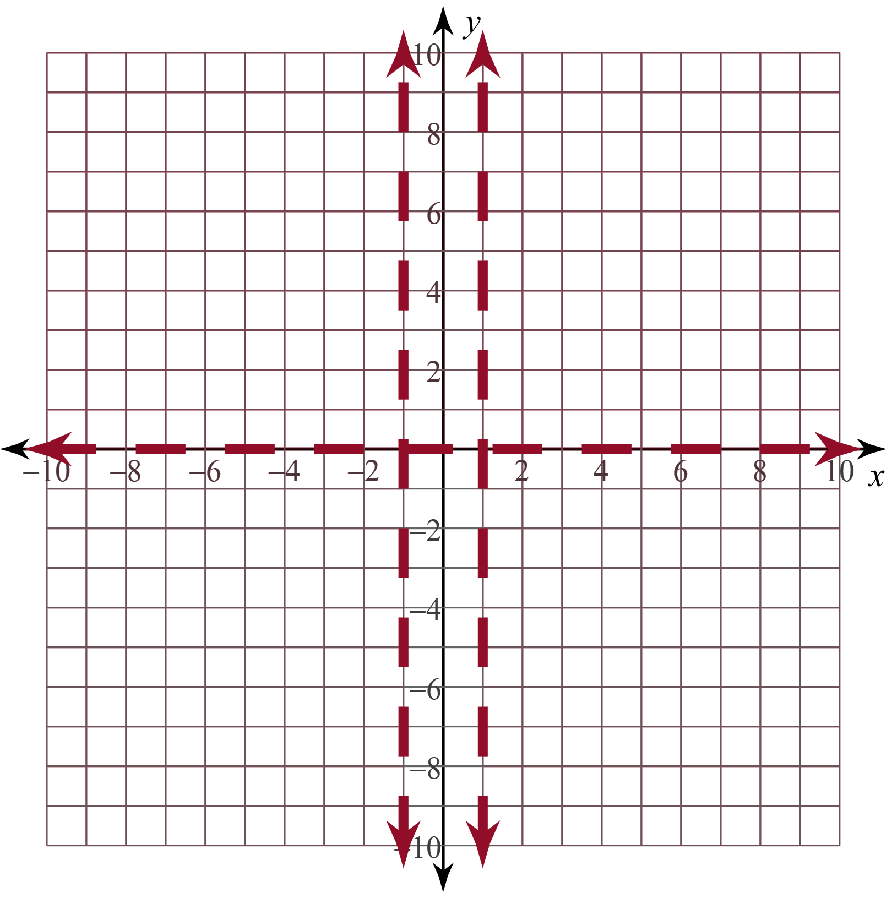
Graphing With Asymptotes (Solution #2)
Step 1)
VA:
HA:
Step 2)

Slide 12
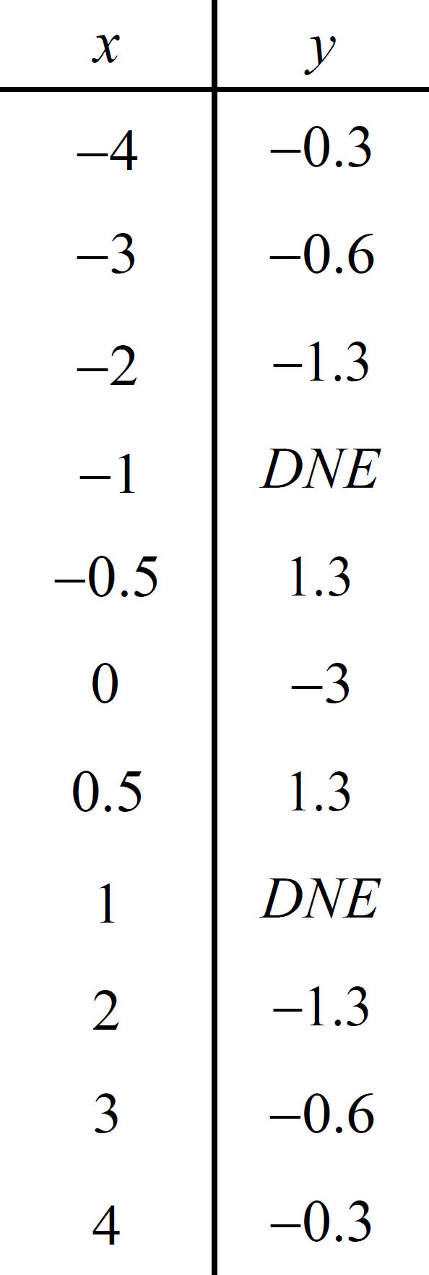
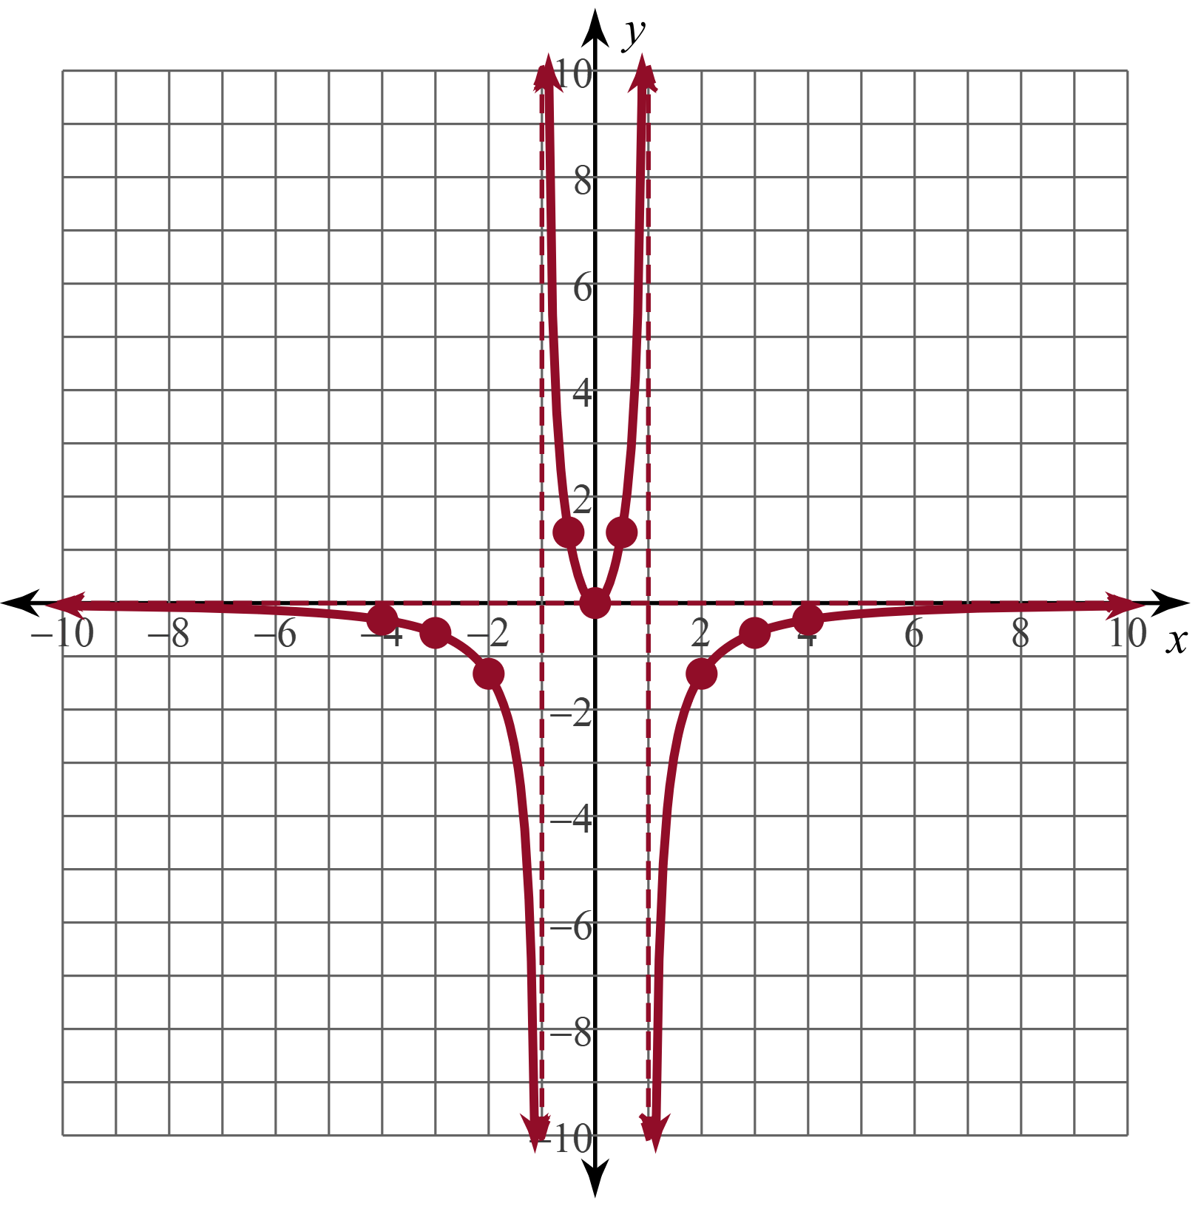
(Solution #2)
Step 3)
Step 4)

Slide 13
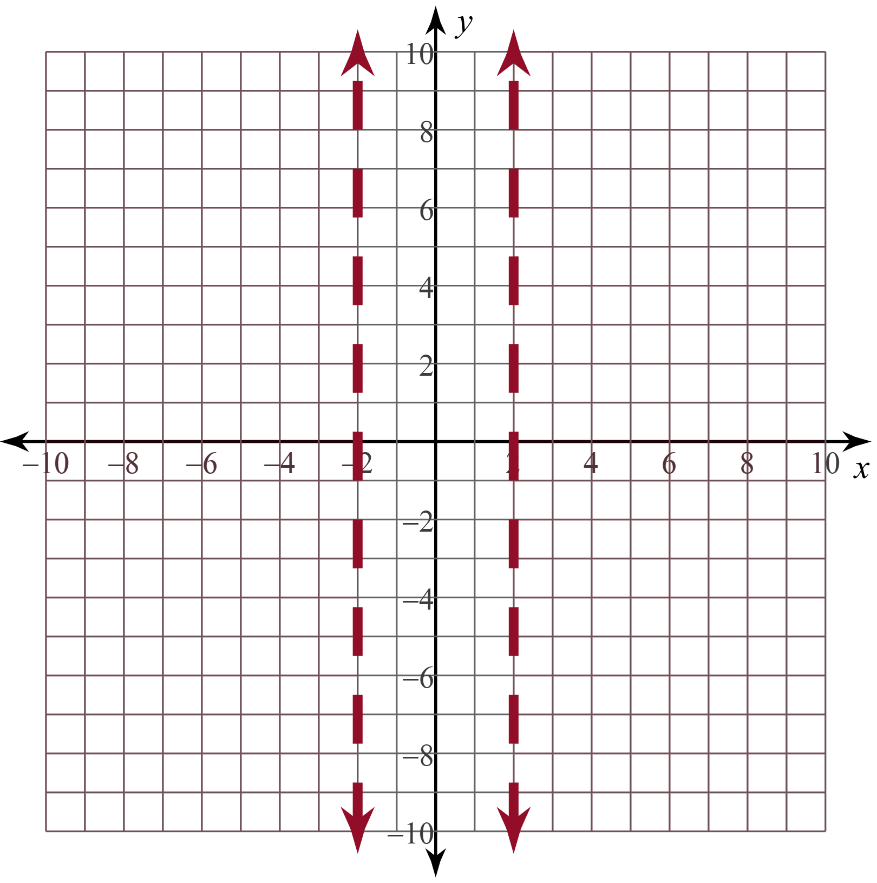
Graphing With Asymptotes (Solution #3)
Step 1)
VA:
HA:
Slant:
Step 2)

Slide 14
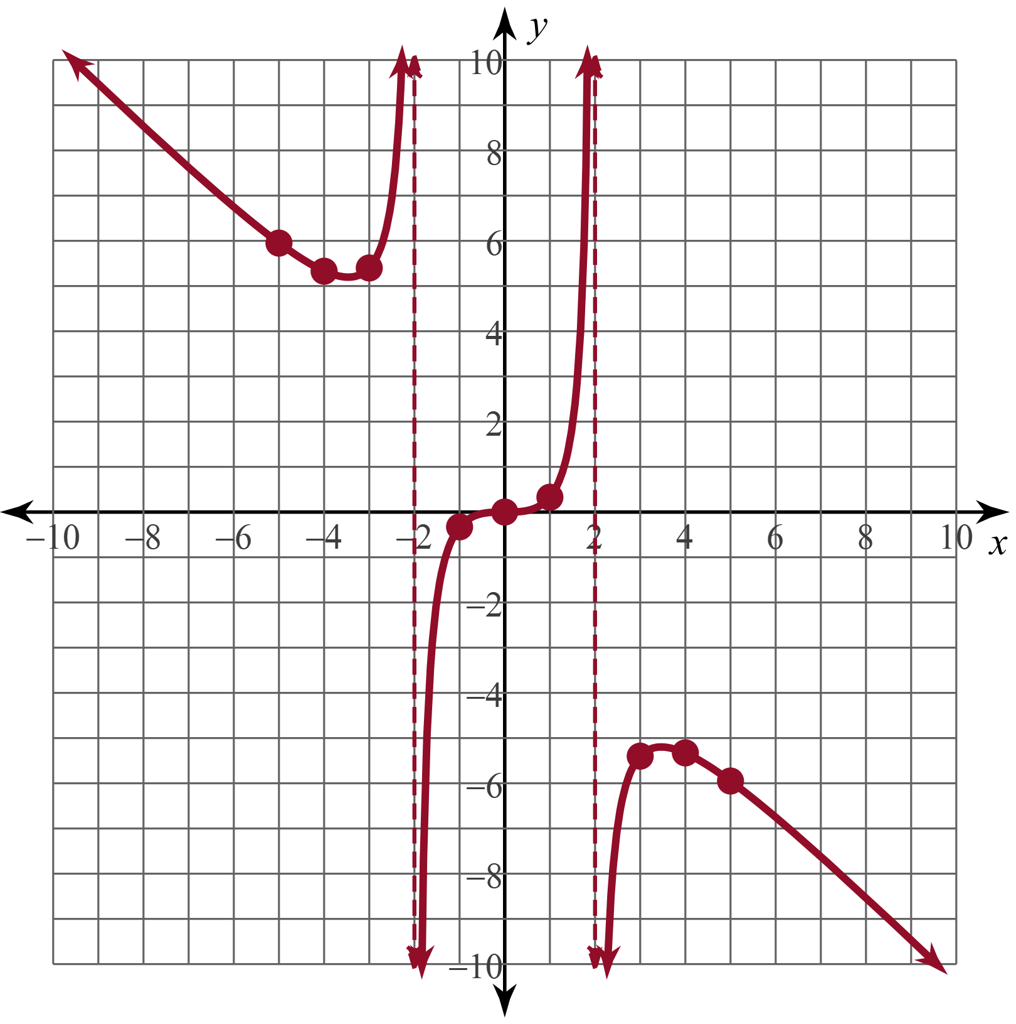
(Solution #3)
Step 3)
Step 4)

Slide 15
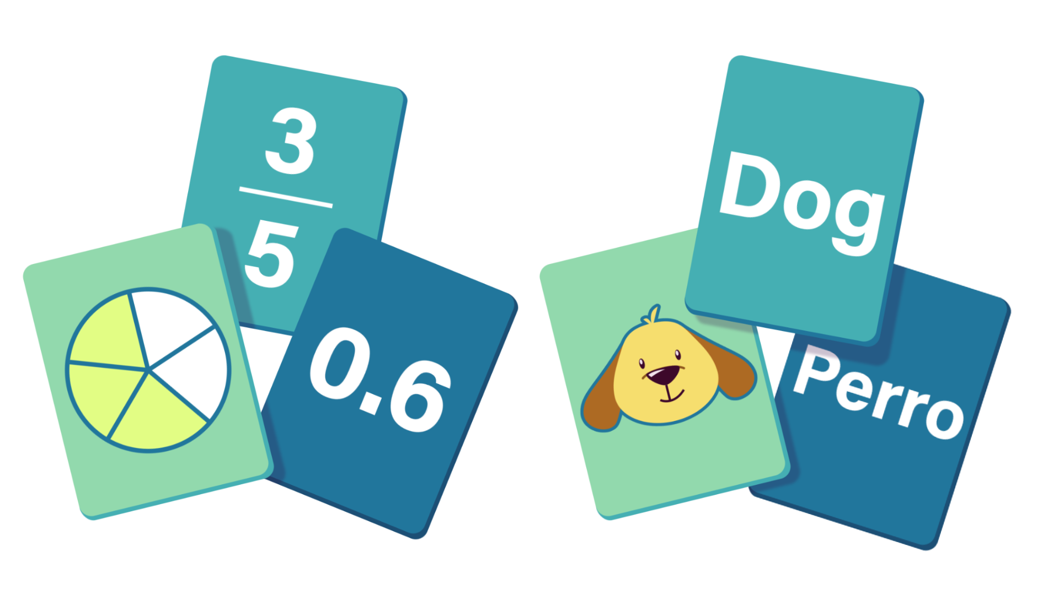
Card Matching
Work with your partner to match the following cards:
  Graph
  Asymptotes
  Equation
There will be three extra graph cards without a match.
Notes:
K20 Center. (n.d.). Card Matching. Strategies. Retrieved from https://learn.k20center.ou.edu/strategy/1837

Slide 16
Card Matching (Solution)
Graph | A | C | E | F | H | J
Asymptotes | P | Q | L | K | N | M
Equation | U | Z | T | V | W | R
Extras | B, D, and G
Notes:
K20 Center. (n.d.). Card Matching. Strategies. Retrieved from https://learn.k20center.ou.edu/strategy/1837

