Slide 2
Memory Haiku
Grades 9-11 English Language Arts

Slide 3
Essential Question
What can a person's sense of smell reveal about their memories and emotions?

Slide 4

Think: Quick Write
Choose one of the events below and describe how that event smells.
What scents are conjured in your mind when you visualize the event?
The first day of school
Winter holidays
Summer vacation
Notes:
Clipart Library. (n.d.). Idea. http://clipart-library.com/clipart/440786.htm.

Slide 5

Pair
Find an Elbow Partner and share your Quick Write.
Notes:
Clipart Library. (n.d.). Partner work. http://clipart-library.com/clipart/1016675.htm.

Slide 6

Share
Share your thoughts with the whole class.
Notes:
Clipart Library. (n.d.). Public speaking. http://clipart-library.com/clipart/1284060.htm.

Slide 7
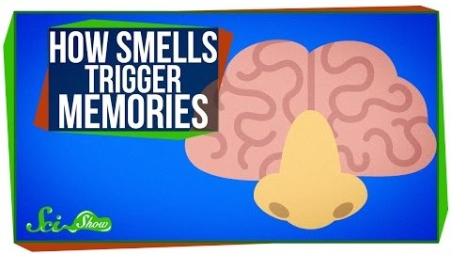
How Smell Triggers Memories
Notes:
SciShow. (2015, July 20). How smells trigger memories [Video file]. YouTube. https://www.youtube.com/watch?v=vY-HbcPInXw

Slide 8
“Nothing revives the past so completely as a smell that was once associated with it.”
- Vladimir Nabokov
Notes:
Nabokov, V. (1970). Mary. McGraw Hill.

Slide 9
“With enchanting murmurs Daisy admired this aspect or that of the feudal silhouette against the sky, admired the gardens, the sparkling odor of jonquils and the frothy odor of kiss-me-at-the-gate.”
- F. Scott Fitzgerald
Notes:
Fitzgerald, F. S. (1925). The great Gatsby. Charles Scribner’s Sons.

Slide 10

Japanese Haiku
Often emphasizes simplicity, intensity, and directness of expression
3-line poem with 17 syllables
  The first line has 5 syllables.
  The second line has 7 syllables.
  The third line has 5 syllables
Notes:
Helen B. (n.d.). Quill. https://www.kindpng.com/imgv/ibwTTTR_creative-writing-png-creative-writing-icon-transparent-png/.

Slide 11
Haiku Examples
October’s Gold
Like crunchy cornflakes
Gold leaves rustle underfoot
Beauty in decay.
-Paul Holmes
Starting Anew
When it’s all over
what will begin in its place?
Will it be better?
-Lecco Morris
Sensations of Summer
Golden rays of sun
Sweet breeze caresses softly
Perfect summer’s day
-Katharina A. Louis
Notes:
Holmes, P. (2019, May 14). October’s gold. Family Friend Poems. https://www.familyfriendpoems.com/poem/octobers-gold
Louis, K. (2020, August 8). Sensations of summer. Family Friend Poems. https://www.familyfriendpoems.com/poem/sensations-of-summer
Morris, L. (2020, July 27). Haiku about starting anew. Family Friend Poems. https://www.familyfriendpoems.com/poem/haiku-about-starting-anew

Slide 12

Brainstorm
Think of a character in The Great Gatsby who has a “side” to him/her that the other characters in the novel may not see.
How do critical reading skills help readers see these “hidden” sides?
Notes:
Clipart Library. (n.d.). Brainstorming session. http://clipart-library.com/clipart/1889269.htm.

Slide 13
Write Your Own Memory Haiku!
You will be writing a haiku that connects scent and memory in The Great Gatsby.
Use the Brainstorming space on your handout to plan for your haiku.
Make sure to do the following:
  First, find a character who has a “side” to him/her.
  Next, find a piece of supporting text evidence that shows a connection (clear or inferred) between scent and memory.
  List your character, text evidence, scent, memories evoked, and imagery.
  Finally, in the following portion of the handout, write out your haiku, and make sure to give it a title.

Slide 14
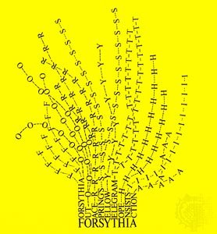
Notes:
Solt, M. E. (1966). Forsythia. Encyclopaedia Britannica. https://www.britannica.com/art/concrete-poetry

Slide 15
Concrete Poetry
Concrete poetry takes the visual shape of the object or theme described in the poem.
Turning your haiku into a concrete poem will give it a visual boost.
Here are some more examples.
Notes:
Helen B. (n.d.). Quill. https://www.kindpng.com/imgv/ibwTTTR_creative-writing-png-creative-writing-icon-transparent-png/.

