Slide 2
Where in the World Do We Find the Things We Need?
Natural and Man-Made Resources: Local and Global
Map Study Lesson #2

Slide 3
Essential Questions
How do we rely on natural resources to meet our daily needs?
Where do we find the things we need and use?

Slide 4
Lesson Objectives
Describe a variety of the earth’s natural resources (e.g., water, forests, and oil) and the ways which people use them.
Identify the difference between a natural resources and a man-made resource.
Explain the natural and man-made characteristics of a community.
Explain why these ideas are important.

Slide 5
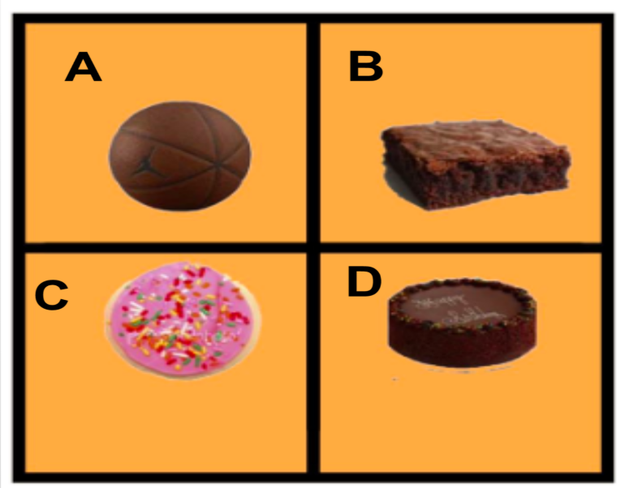
Engage: Which one does not belong?
Notes:
Which one does not belong possible responses
The pink cookie. The others are brown.
The square brownie because it is square. The others are round.
The pink cookie because it has sprinkles.
The top round cookie because it is smooth and looks like a basketball.
The bottom brown one because it is a cake, not a cookie.
Source: https://wodb.ca/shapes.html

Slide 6
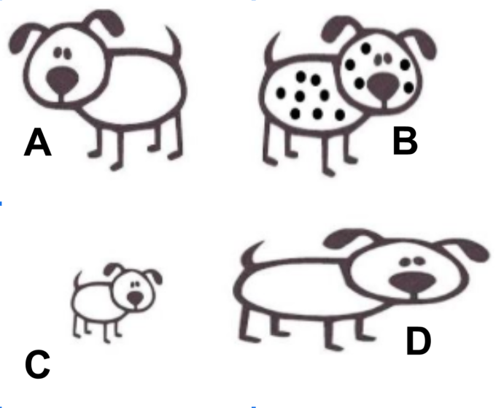
Which one does not belong?
Notes:
Which one does not belong possible responses.
B: Dog does not belong because it has spots.
C: Dog does not belong because it is smaller than the other dogs.
D: Dog does not belong because body is skinnier than the other dogs.
A: Dog does not belong because it is facing a different direction.
There are other differences as well. The students will figure them out.
Source: https://wodb.ca/shapes.html

Slide 7
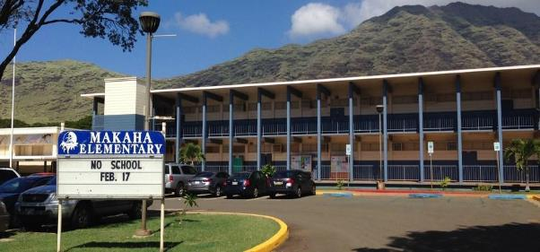
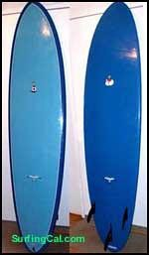
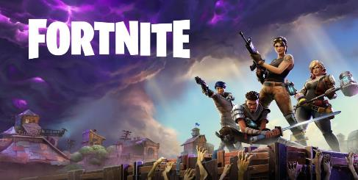
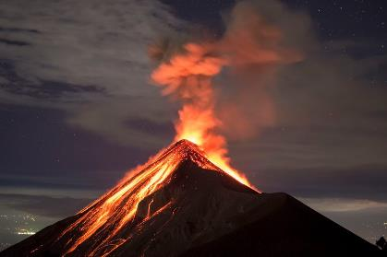
Which one does not belong?
Notes:
Which one does not belong possible responses.
The Volcano does not belong because it is the only one not made by people.
The surfboard does not belong because it does not have a mountain in the background.
The surfboard does not belong because there are no clouds in the background.
The Fortnite image does not belong because it is imaginary, not real.
Sources:
School: Photo by teacher
Surfboard: https://c1.staticflickr.com/3/2542/3977540409_4df7a3dfb0.jpg
Fortnite: https://4.bp.blogspot.com/-V_uav6eH7g8/WvSYRAtqTZI/AAAAAAAAPMM/tW-M-WN3wDIIy1iQGX7qwveFp37jFNRQgCLcBGAs/s1600/2b02f09dda89cfbef21b7bc3eea90fc4.jpg
Volcano:https://upload.wikimedia.org/wikipedia/commons/thumb/a/a9/Eruption_of_a_volcano_above_a_village%3B_lava_covering_Wellcome_V0044790.jpg/800px

Slide 8
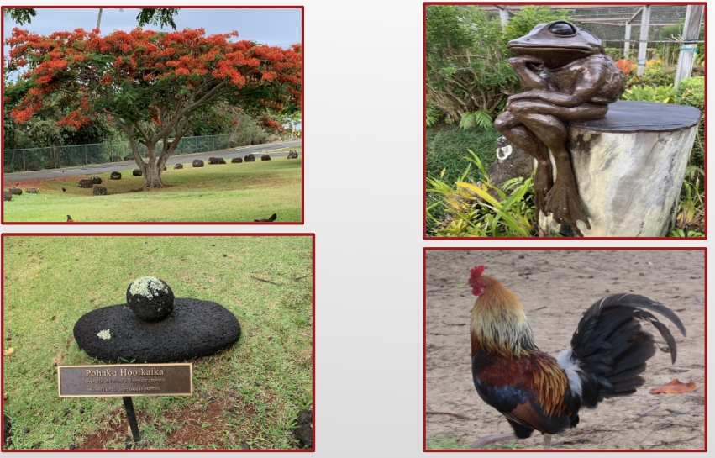
Which one does not belong?
Notes:
Which one does not belong possible responses:
The sculpture of the frog does not belong because it is the only thing made by people.
The chicken does not belong because it is actually alive and can move and eat.
The tree does not belong because it is the only tree.
The chicken does not belong because it is the only thing that is not made a of a hard substance.
The chicken picture does not belong because it doesn’t have any plants in the picture.
Source:
Personal photographs taken by lesson developer

Slide 9
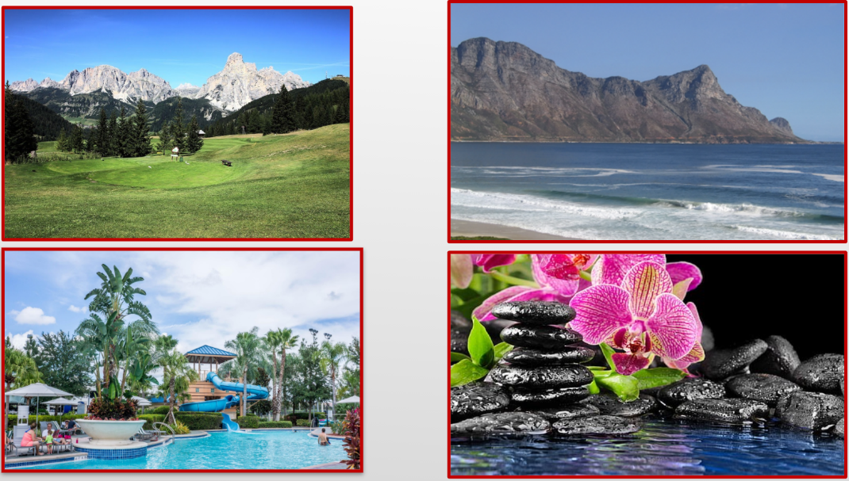
Which one does not belong?
Notes:
Which one does not belong possible responses:
The flowers do not belong because they don’t have any sky around them.
The Wet and Wild Waterpark does not belong because people built it.
The beach and mountain do not belong because there are no plants.
The flowers do not belong because it is the only picture with flowers in it.
The mountains and grass do not belong because there is no water in the picture.
Sources:
Mountain and grass: https://cdn.pixabay.com/photo/2018/04/09/16/43/nature-3304622_960_720.jpg
Ocean and beach: https://get.pxhere.com/photo/beach-landscape-sea-coast-water-sand-rock-ocean-shore-wave-vacation-shoreline-cliff-seaside-surf-cove-bay-blue-seashore-terrain-summit-body-of-water-current-rocks-sandy-strand-waves-mountains-deep-marine-peaks-curl-cape-swell-rollers-landform-crags-breakers-geographical-feature-wind-wave-819310.jpg
Wet and Wild Water Park: https://get.pxhere.com/photo/beach-water-outdoor-sky-wet-summer-vacation-travel-recreation-pool-amusement-park-swimming-pool-tropical-park-holiday-lagoon-leisure-swimming-activity-clouds-fun-aqua-resort-estate-caribbean-water-park-slide-amusement-entertainment-water-slide-resort-town-850277.jpg
Orchid:https://www.wallpaperflare.com/three-black-rocks-towel-orchid-leaves-spa-stones-candle-wallpaper-zyhx

Slide 10
Explore: Card Sort
Cut out the photograph cards.
Sort your cards any way you want.
Think about your reasons for sorting choices.
Explain to your partner your sorting choices.

Slide 11
Natural Objects
Some things occur naturally in our world.
Things not made by people are “naturally occurring.”
Nature has created water, rocks, plants, and trees.
Notes:
Source: Personal photographs.

Slide 12
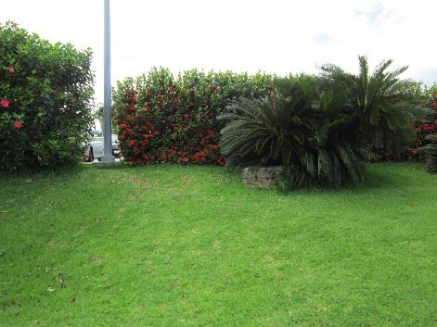
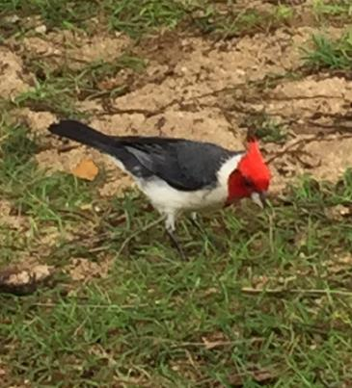
Turn & Talk: Can you name other natural objects?
Notes:
Possible answers: sand, air, grass, mountains, soil, or animals.
Source of photographs: Personal photographs taken by lesson developer.

Slide 13
Man-Made Objects
Items not occurring naturally in our world are made by people.
There are many of these objects on the earth’s surface.
These items are “man-made.”
How many man-made objects can you name?
Notes:
Possible answers: buildings, cars, books, furniture, clothing.

Slide 14
Turn & Talk: Can you name other man-made objects?
Notes:
Sources of photographs:
Soccer ball: https://www.publicdomainpictures.net/pictures/80000/velka/soccer-ball-2.jpg
Sailboat: https://upload.wikimedia.org/wikipedia/commons/e/eb/Laser_3000_sailing_dinghy_1.jpg
Ruled paper: https://cdn.pixabay.com/photo/2012/04/15/18/56/paper-34910_1280.png
Cell Phone: https://cdn.pixabay.com/photo/2017/07/02/16/56/iphone-2464968_1280.png

Slide 15
Notes:
This is an example of the the T-chart.

Slide 16
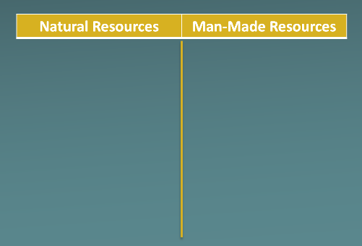
Essential Question Where do we find the things we need and use?
Explain
Where do you think all of these objects come from?
What all-natural items come from our state?
Are all man-made items you use made only in our state?

Slide 17
The Earth’s surface contains both natural and man-made resources.

Slide 18
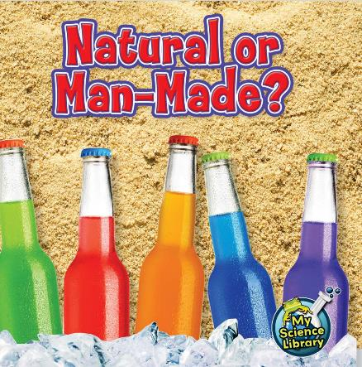
Natural or Man-Made?
PDF of book
Notes:
Source: https://core-docs.s3.amazonaws.com/documents/asset/uploaded_file/375126/Natural_or_Man-Made-.pdf
this book can also be found free on Epic: https://www.getepic.com/book/20982348/natural-or-man-made

Slide 19
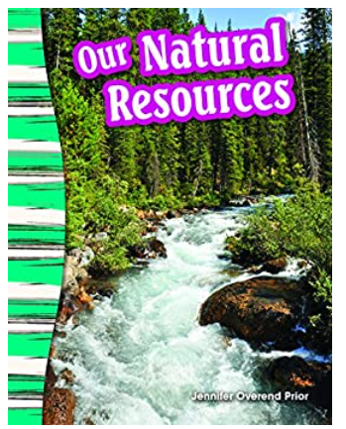
Our Natural Resources
Link to You-tube
Notes:
Source:
https://www.youtube.com/watch?v=i5BmWsqnqVk
Our Natural Resources by Jennifer Overend Prior read aloud by Danelle Cantu

Slide 20
Say it as a class! Create our definitions:
What are natural resources?
What are man-made resources?

Slide 21
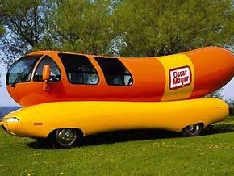
Let’s Play “I Spy!”
Extend I
I Spy with my little eye something man-made from plastic.
I Spy with my little eye something that grows in nature.
I Spy with my little eye something made from metal.
Source: https://images.uncyc.org/commons/2/25/1-61-062897_Weinermobile.jpg
Notes:
Source: https://images.uncyc.org/commons/2/25/1-61-062897_Weinermobile.jpg

Slide 22
Local and Global
Extend II
Material World: Portraits Online
Notes:
Source: https://images-na.ssl-images-amazon.com/images/I/518EAzI9uRL._SX373_BO1,204,203,200_.jpg

Slide 23
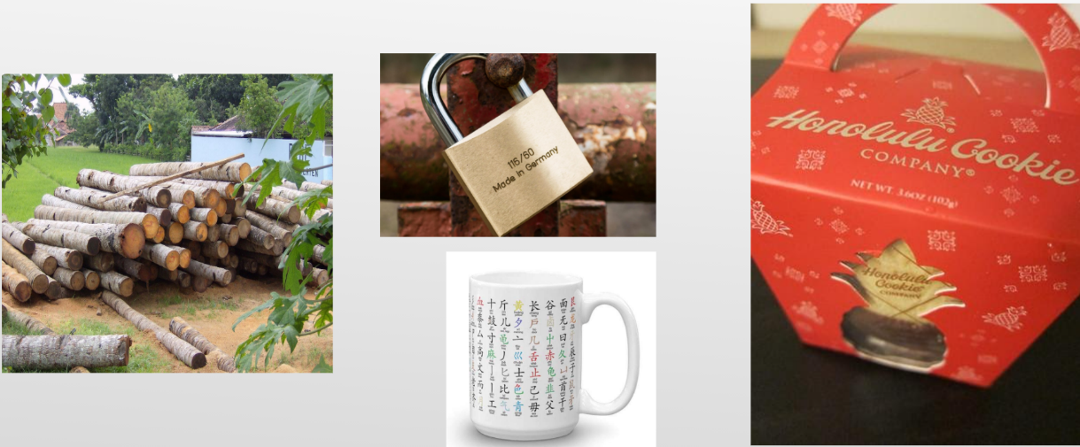
Local or Global?
Notes:
Source:
https://live.staticflickr.com/7007/6586073689_079cede96c.jpg
http://mmm-yoso.typepad.com/.a/6a00d83451b81169e2017ee619540f970d-500wi

Slide 24
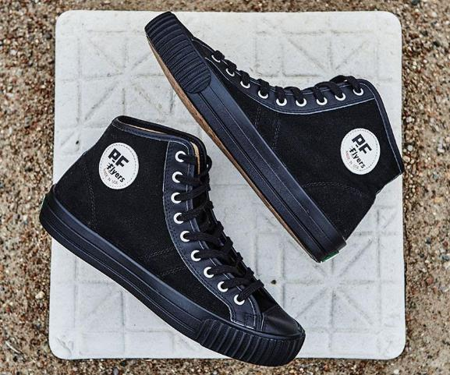
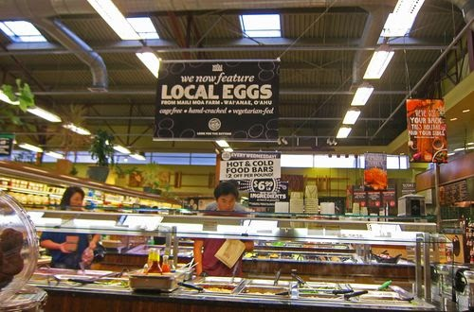
Local or Global?

Slide 25
Record your answers as we look through the picture slides.
Evaluate
Natural?
Man-Made?

Slide 26
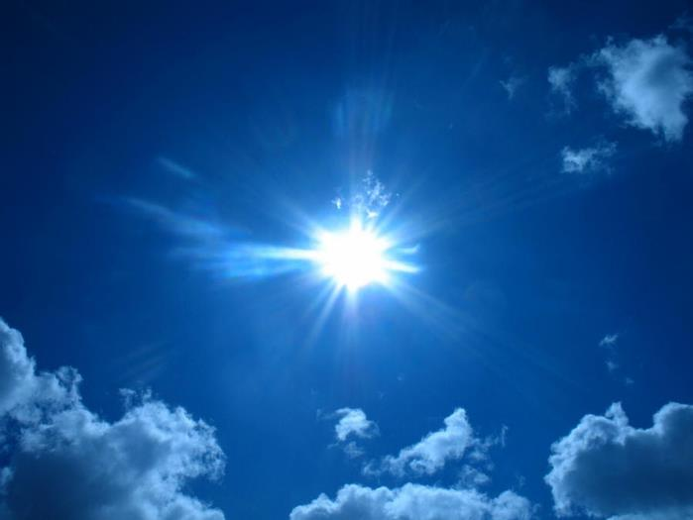
Nature? Man-Made?
Notes:
http://fc04.deviantart.net/fs70/i/2010/320/6/0/the_cool_sun_by_deohboeh-d330n3t.jpg
This Photo by Unknown Author is licensed under CC BY-SA-NC

Slide 27
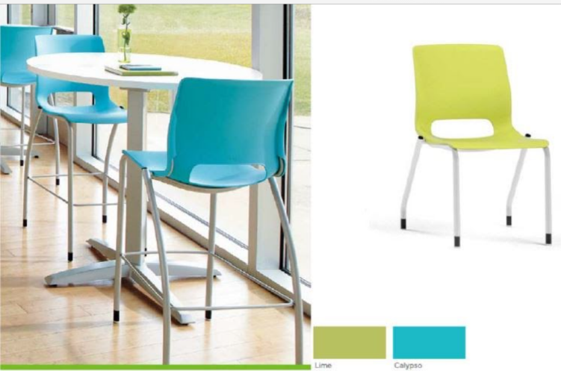
Nature? Man-Made?

Slide 28
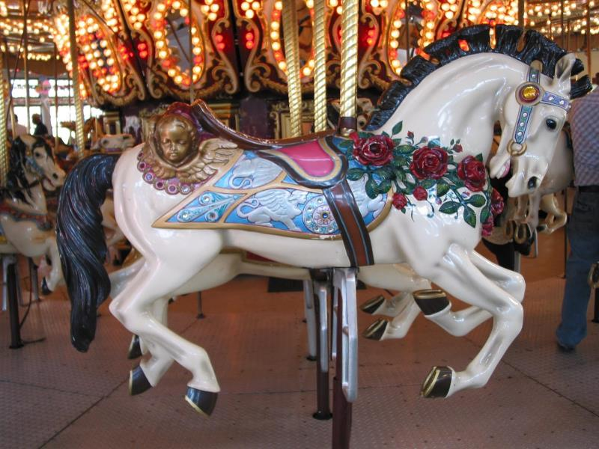
Nature? Man-Made?
Notes:
https://upload.wikimedia.org/wikipedia/commons/7/74/Carousel_Horse_Alc2.JPG

Slide 29
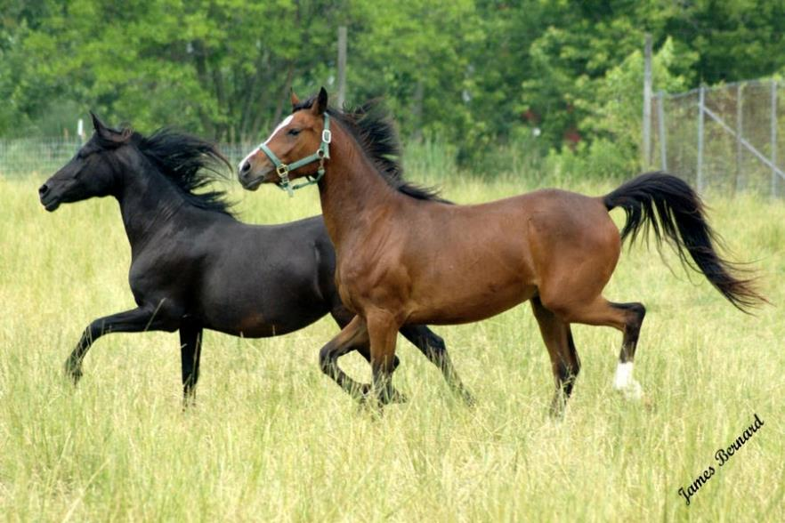
Nature? Man-Made?
Notes:
Source: http://fc03.deviantart.net/fs71/i/2010/179/4/6/Two_Horses_by_DragonLove151.jpg

Slide 30
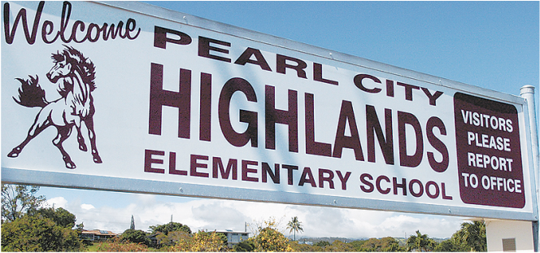
Nature? Man-Made?
Notes:
Source: http://teach.leeward.hawaii.edu/uploads/2/2/5/4/22549928/1469148240.png

Slide 31
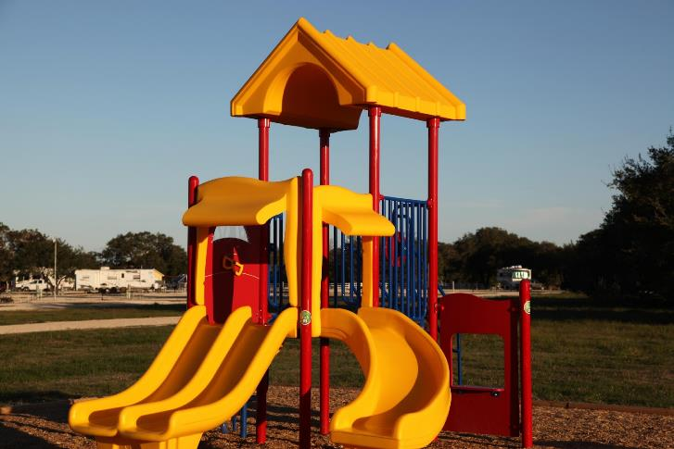
Nature? Man-Made?
Notes:
Source: https://get.pxhere.com/photo/outdoor-play-city-summer-recreation-equipment-park-child-playing-yellow-lifestyle-leisure-public-space-kids-children-fun-playground-chute-slide-amusement-campground-outdoor-play-equipment-playground-slide-760305.jpg

Slide 32
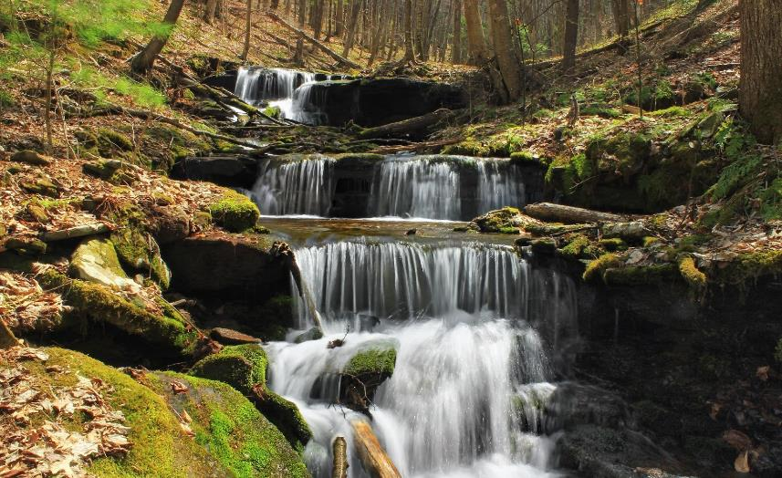
Nature? Man-Made?
Notes:
Source:

Slide 33
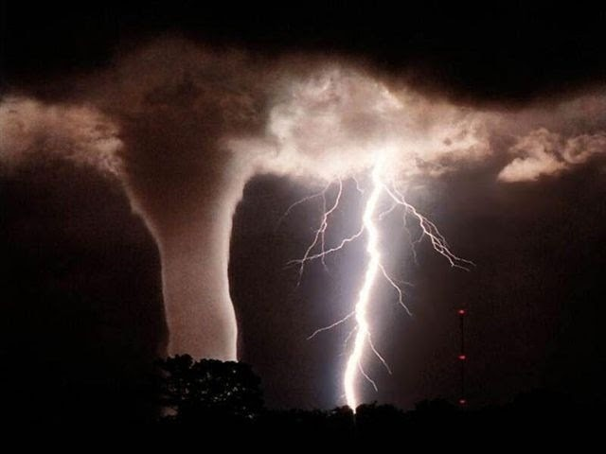
Nature? Man-Made?

Slide 34
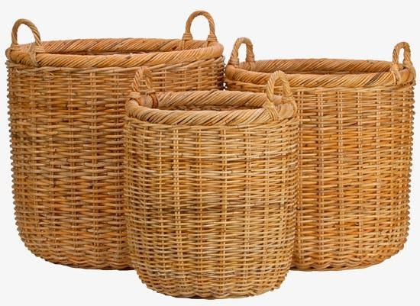
Nature? Man-Made?

Slide 35
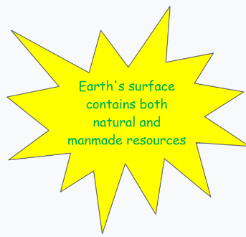
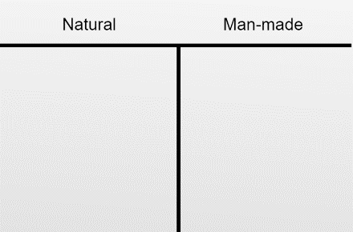
Write or Draw: Nature and Man-Made
On one sticky note, write or draw a natural object.
On another sticky note, write or draw a man-made object.

Slide 36
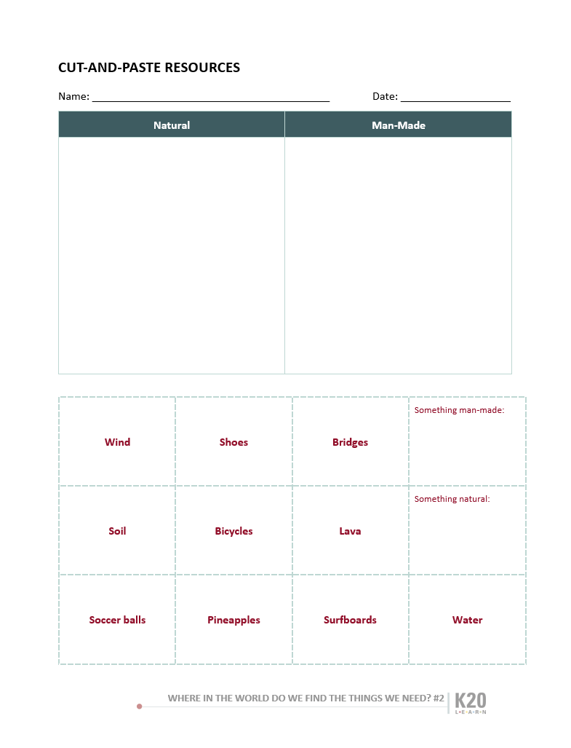
Activity!
Cut on the dotted lines and glue the word cards in the correct column.
Fill in the two blank cards with words of your own and glue them in the correct column.
Glue the whole sheet in your journal or turn it in.

