Slide 2
A Peace of the Pie
Causes and Effects of the Congress of Vienna

Slide 3
Essential Questions
Is peace possible after a major conflict?
Can countries have a balance of power after war?

Slide 4
Lesson Objective
Evaluate the causes and effects of the Congress of Vienna.

Slide 5

I Think/We Think
How did Europe respond to the French Revolution and Napoleon?
  Write your response in the left column
  Discuss your response with an Elbow Partner.
  Write your combined response in the right column.
Notes:
K20 Center. (n.d.) I Think/We Think. Strategies. https://learn.k20center.ou.edu/strategy/141
K20 Center. (n.d.) Elbow Partners. Strategies. https://learn.k20center.ou.edu/strategy/116

Slide 6

Congress of Vienna
As you view the video about the Congress of Vienna, look for the following:
  One fact or idea that is surprising
  One fact or idea that is interesting
  One fact or idea that is troubling
Notes:
K20 Center. S-I-T (Surprising, Interesting, Troubling). Strategies. https://learn.k20center.ou.edu/strategy/926ling)
OVO Video Encyclopedia. (n.d.). The congress of Vienna. [Video]. https://strm02-ens.minoto-video.com/s/45c56a96cbb3d7478e4dd8a3eadda6d061844174/w9krYayvxtAW_web_mq.mp4

Slide 7

Congress of Vienna Reading
Read the article, “The Congress of Vienna,” in the left-hand column of your handout.
Stop and Jot notes in the right-hand column as you read.
Discuss your notes with a partner after reading the article.
Be ready to discuss as a class.
Notes:
Encyclopædia Britannica, inc. (n.d.). Decisions of the Congress. https://www.britannica.com/event/Congress-of-Vienna/Decisions-of-the-congress.
K20 Center. (n.d.). Stop and Jot. Strategy. https://learn.k20center.ou.edu/strategy/168
Lumen. (n.d.). The congress of Vienna. Boundless World history. https://courses.lumenlearning.com/boundless-worldhistory/chapter/the-congress-of-vienna/.

Slide 8
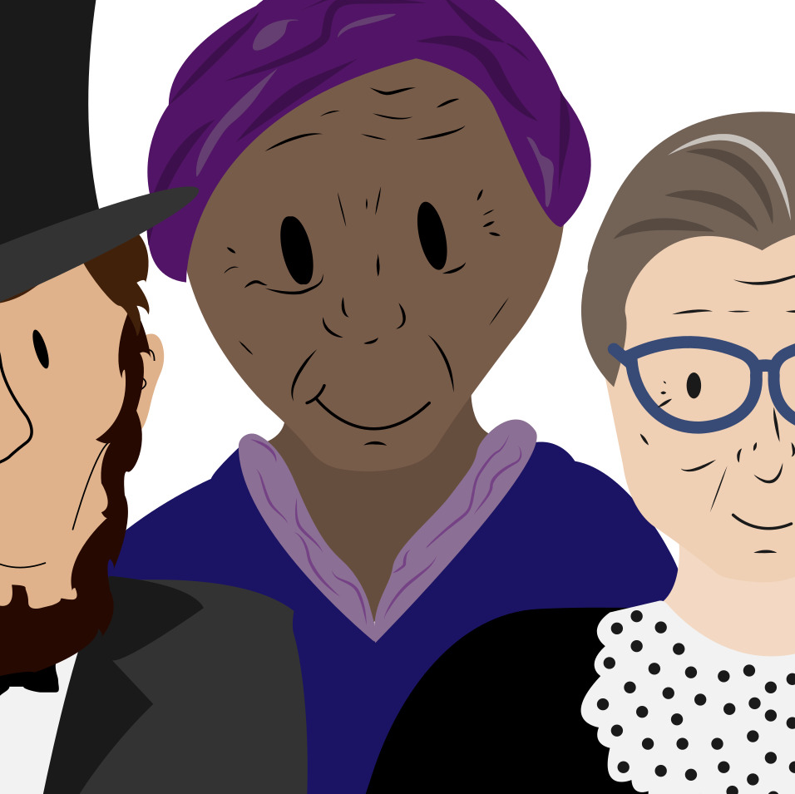
Historical Mingle
Assemble in groups of four.
Each group member will be assigned a different biography card.
Read the biography card for your assigned representative to the Congress of Vienna.
Talk and mingle with the other representatives about your goals for the Congress.
Collect information on your graphic organizer as you mingle.
Notes:
K20 Center. (n.d.). Historical Mingle. Strategies. https://learn.k20center.ou.edu/strategy/184

Slide 9

Claim-Evidence-Reasoning
Choose one statement to support:
  Is peace possible after the French Revolution and the reign of Napoleon?
  Can Europe have a balance of power after the French Revolution and the reign of Napoleon?
Respond to the statement as follows:
  Make a claim.
  Add evidence to support your claim.
  Add your reasoning, which explains how your evidence supports your claim.
Notes:
K20 Center. (n.d.). Claim-Evidence-Reasoning. Strategies. https://learn.k20center.ou.edu/strategy/156

Slide 10

Writing a Claim-Evidence-Reasoning
Notes:
K20 Center. (2021, Aug 19). Claims, Evidence, Reasoning. [Video]. https://www.youtube.com/watch?v=JGOxVIgmGWE&t=3s- YouTube

