Slide 2
A Peace of the Pie
Causes and Effects of the Congress of Vienna

Slide 3
Essential Questions
Is peace possible after a major conflict?
Can countries have a balance of power after war?

Slide 4
Learning Objective
Evaluate the causes and effects of the Congress of Vienna.

Slide 5

I Think/We Think
How did Europe respond to the French Revolution and Napoleon?
  Write your response in the left column.
  Discuss your response with a partner.
  Write your combined response in the right column.
Notes:
K20 Center. (n.d.). I think / we think. Strategies. https://learn.k20center.ou.edu/strategy/141

Slide 6

Congress of Vienna
Watch the video on the following slide and identify the following:
  One fact or idea that is surprising
  One fact or idea that is interesting
  One fact or idea that is troubling
Notes:
K20 Center. S-I-T (Surprising, Interesting, Troubling). Strategies. https://learn.k20center.ou.edu/strategy/926ling)

Slide 7
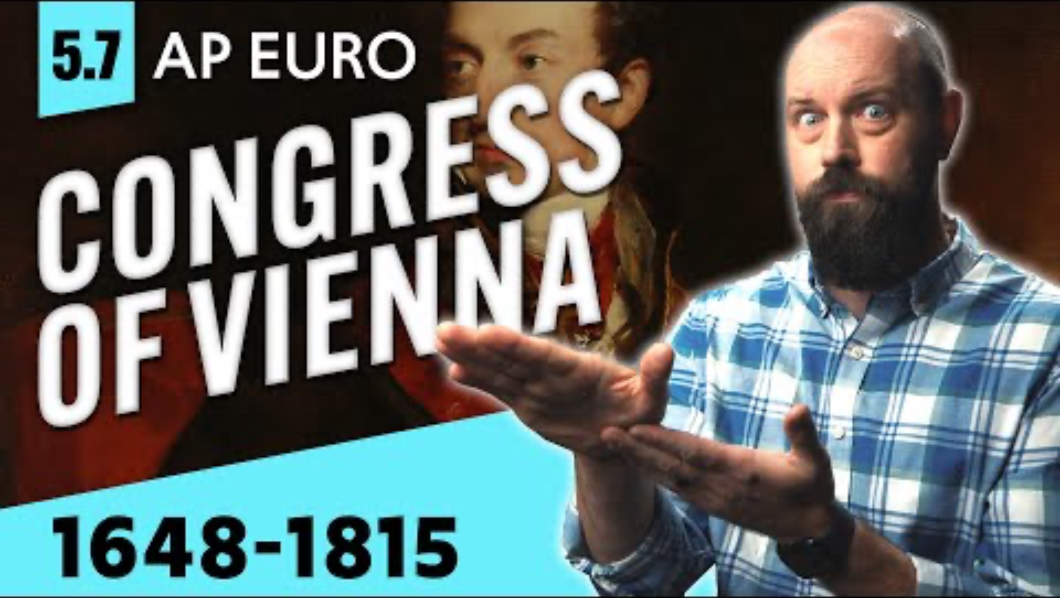
Notes:
Heimler’s History. (2022, November 10). The Congress of Vienna, explained [AP Euro review—Unit 5 topic 7] [Video]. YouTube. https://www.youtube.com/watch?v=hfZdCd6eLxw

Slide 8

Congress of Vienna Reading
Read the article titled “The Congress of Vienna” in the left column of the handout.
Stop and jot notes in the right column as you read.
Discuss your notes with a partner after reading the article.
Prepare to discuss the article with the class.
Notes:
K20 Center. (n.d.). Stop and jot. Strategy. https://learn.k20center.ou.edu/strategy/168

Slide 9
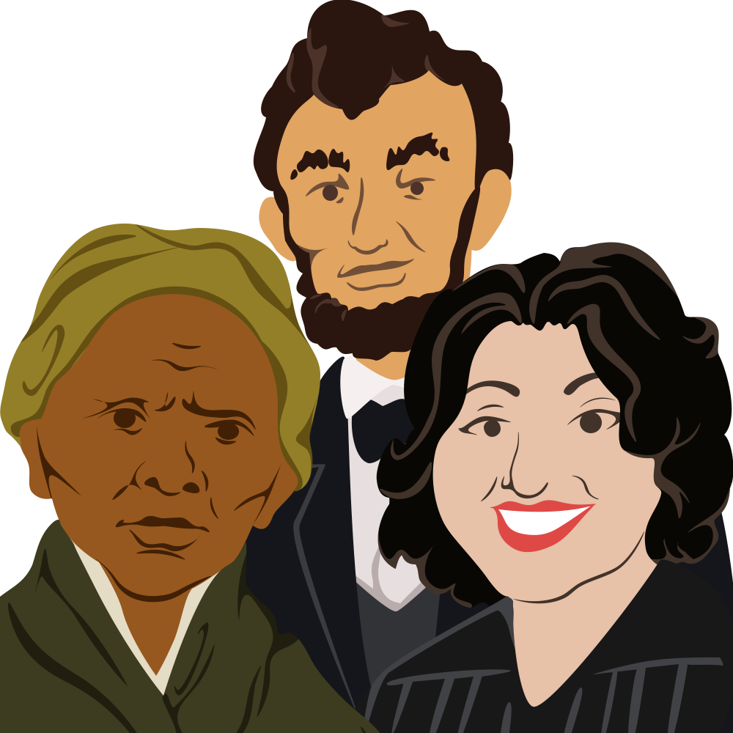
Historical Mingle
Read the biography card of your assigned representative to the Congress of Vienna.
Talk with the other representatives about your goals for the Congress.
Collect information on your graphic organizer as you mingle.
Notes:
K20 Center. (n.d.). Historical mingle. Strategies. https://learn.k20center.ou.edu/strategy/184

Slide 10

Claim-Evidence-Reasoning
Respond to one of the following questions:
  Is peace possible after the French Revolution and the reign of Napoleon?
  Can Europe have a balance of power after the French Revolution and the reign of Napoleon?
Respond to the statement as follows:
  Make a claim.
  Add evidence to support your claim.
  Add your reasoning, which explains how your evidence supports your claim.
Notes:
K20 Center. (n.d.). Claim-Evidence-Reasoning. Strategies. https://learn.k20center.ou.edu/strategy/156

Slide 11

Claims, Evidence, Reasoning
Notes:
K20 Center. (2021, August 19). Claims, Evidence, Reasoning. [Video]. YouTube. https://youtu.be/JGOxVIgmGWE?si=yq2int89eAbSSuwY

