Slide 2
Inside Out
In the smallest circle of the Inside Out handout, answer
the question:
What do you know about historic Jamestown?
Find a partner. Add any new information you learn from them to the middle circle.
Examine the artifacts and answer the following questions in the last circle:
What is different about this nail versus others you can buy at the store today?
What does the second image look like it does?
Notes:
citation

Slide 3
Jumping into Jamestown
Artifacts and History

Slide 4
Essential Questions
What was life in Jamestown like?
What made Jamestown a success?

Slide 5
Lesson Objectives
Learn about the historic Jamestown settlement.
See how artifacts can show us history.
Discover how Jamestown became successful.

Slide 6
Artifacts and History
https://youtu.be/Uvf53mm6aX0
What does an archeologist do?
How can archeologists help us understand what happened at Jamestown?
Notes:
Historic Jamestowne. (2021). Jamestown rediscovery. [Video]. https://historicjamestowne.org/

Slide 7
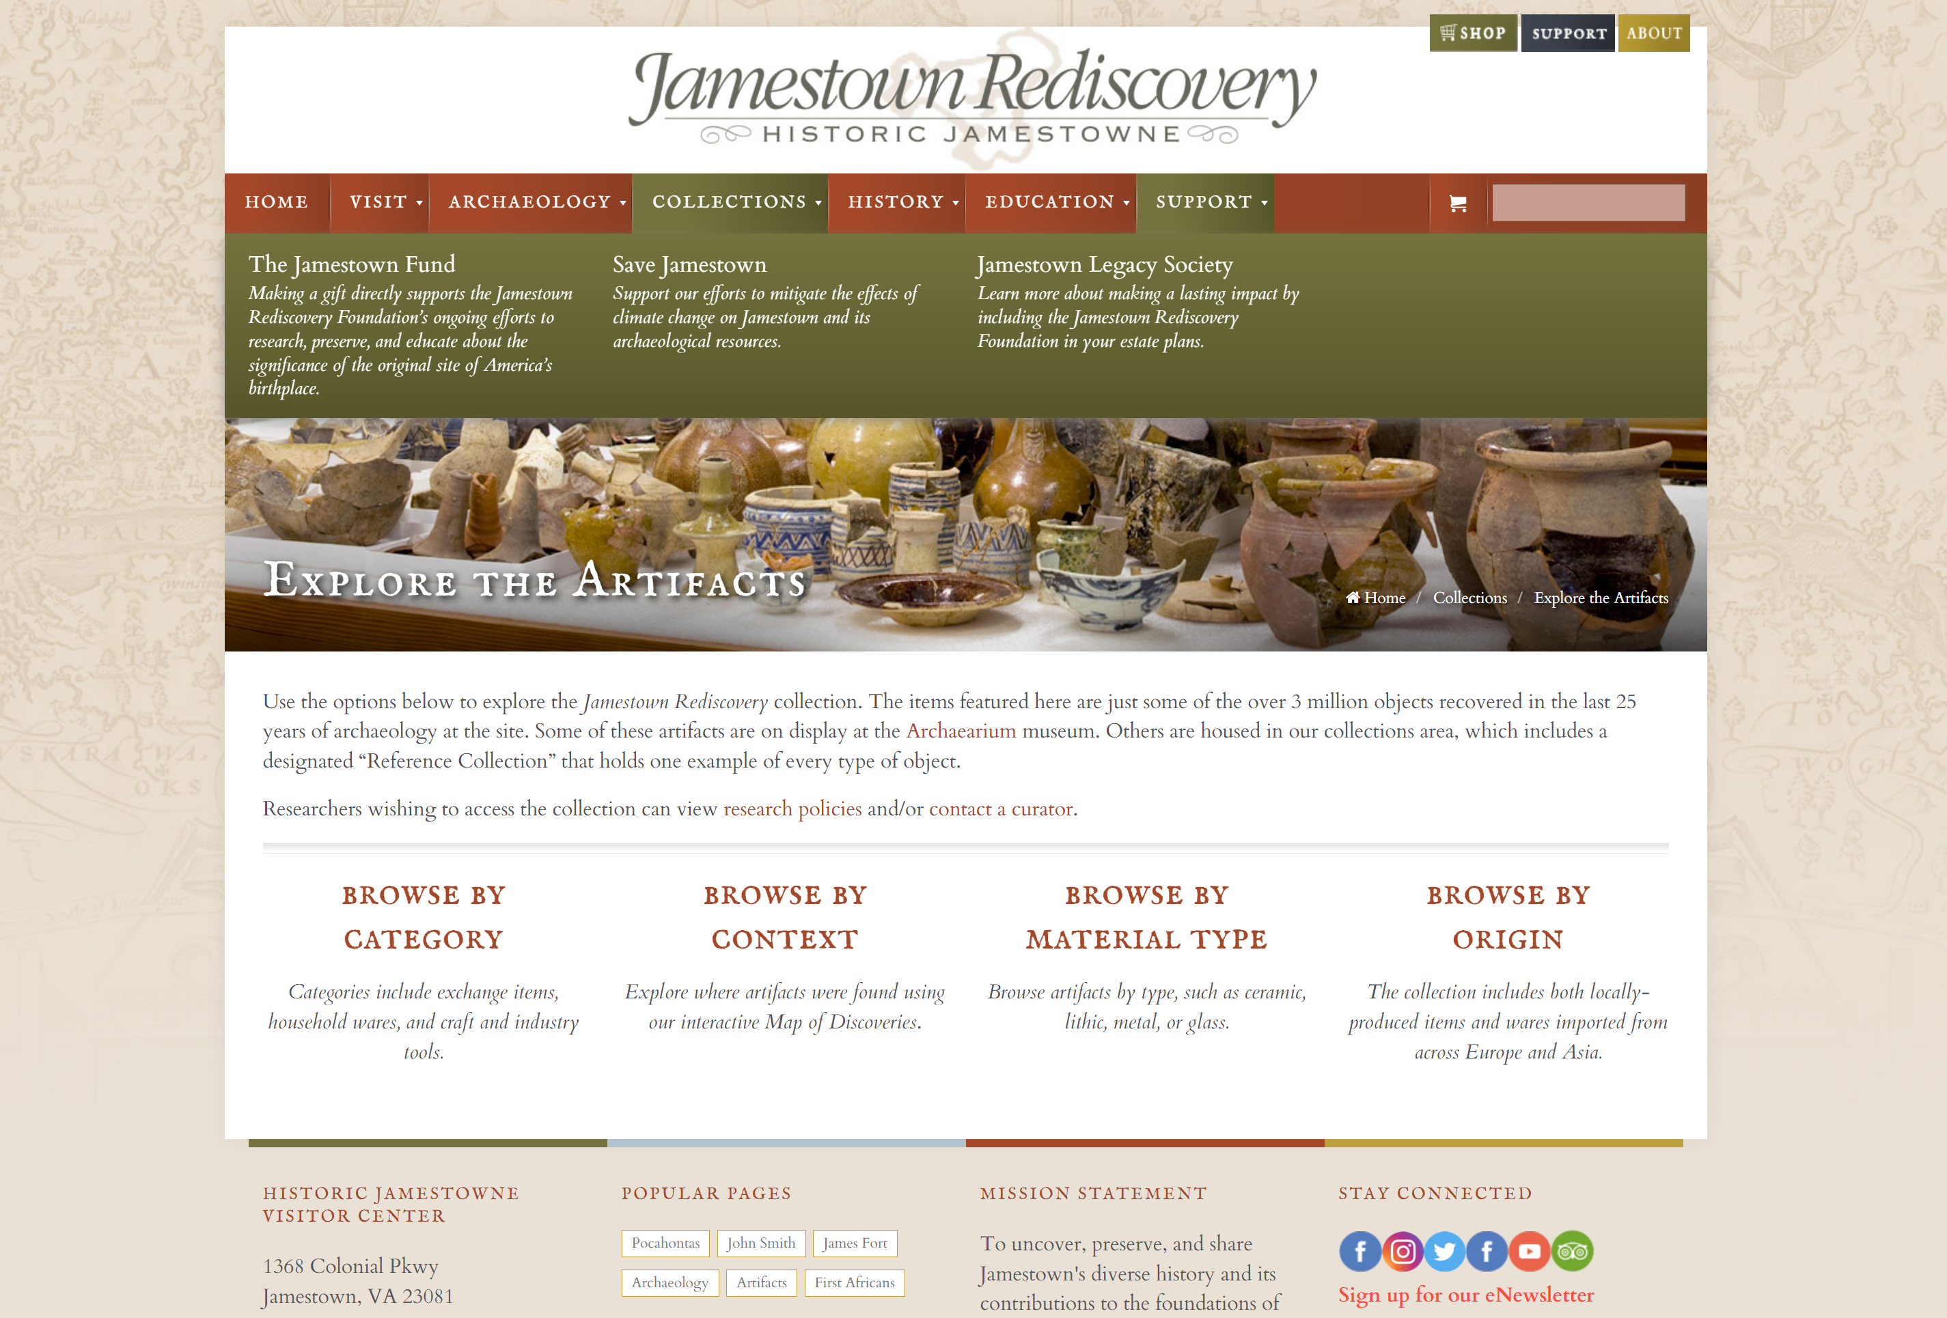
Be an Archeologist
Go to the web site:
Browse by “Material Type” (i.e., Ceramic, Glass, Metal)
https://historicjamestowne.org/collections/artifacts/

Slide 8
Research Your ​Artifact
Work with an elbow partner, on your right or left.
Choose one artifact from the Historic Jamestowne Website, “Explore the Artifacts.”
Write down as much as you can about the artifact on the back of your Inside Out handout.
Notes:
K20 Center. (n.d.). Elbow partners. Strategies. https://learn.k20center.ou.edu/strategy/116

Slide 9
Create a Virtual Jamestown Museum
Insert link to Google Slides

Slide 10
Create a Slide Showing Your Artifact
Using Google slides, cut and paste the image of your artifact into one slide.
Describe and briefly explain what the artifact on your slide is.
Explain what you think the artifact shows about life in Jamestown.
Notes:
K20 Center. (n.d.). Google slides. Tech Tool. https://learn.k20center.ou.edu/tech-tool/2335

Slide 11
Jamestown Fact and Fiction
https://www.youtube.com/watch?v=2At5Ymp3c_E&t=11s
Notes:
NBC News LEARN. (2020). John Smith, Jamestown and the roots of America [Video]. YouTube.com. https://www.youtube.com/watch?v=2At5Ymp3c_E&t=11s

Slide 12
Be a Detective
Find out all that you can about how tobacco came to save Jamestown.
Find out how the Jamestown settlers grew tobacco.
Find out who grew the tobacco.
Use your notes to create a poster about tobacco.

Slide 13
Show What You Know
On the template provided, make a poster that answers these
questions:
What was tobacco and what did it look like?
How did they grow and harvest it?
Why was this crop valuable?
How did this crop make Jamestown successful?
Include pictures of tobacco and any other artifacts related to growing it.

Slide 14
Do a Gallery Walk
Put your tobacco posters around the room and walk around.
Use sticky notes to put comments or questions on others’ posters.
Notes:
K20 Center. (n.d.). Gallery walk / carousel. Strategies. https://learn.k20center.ou.edu/strategy/118

Slide 15
Answer this question:
What three things do you know that you didn’t know before about Jamestown?
Use your Inside Out handout to put 3 things around the outer circle.

