Slide 2
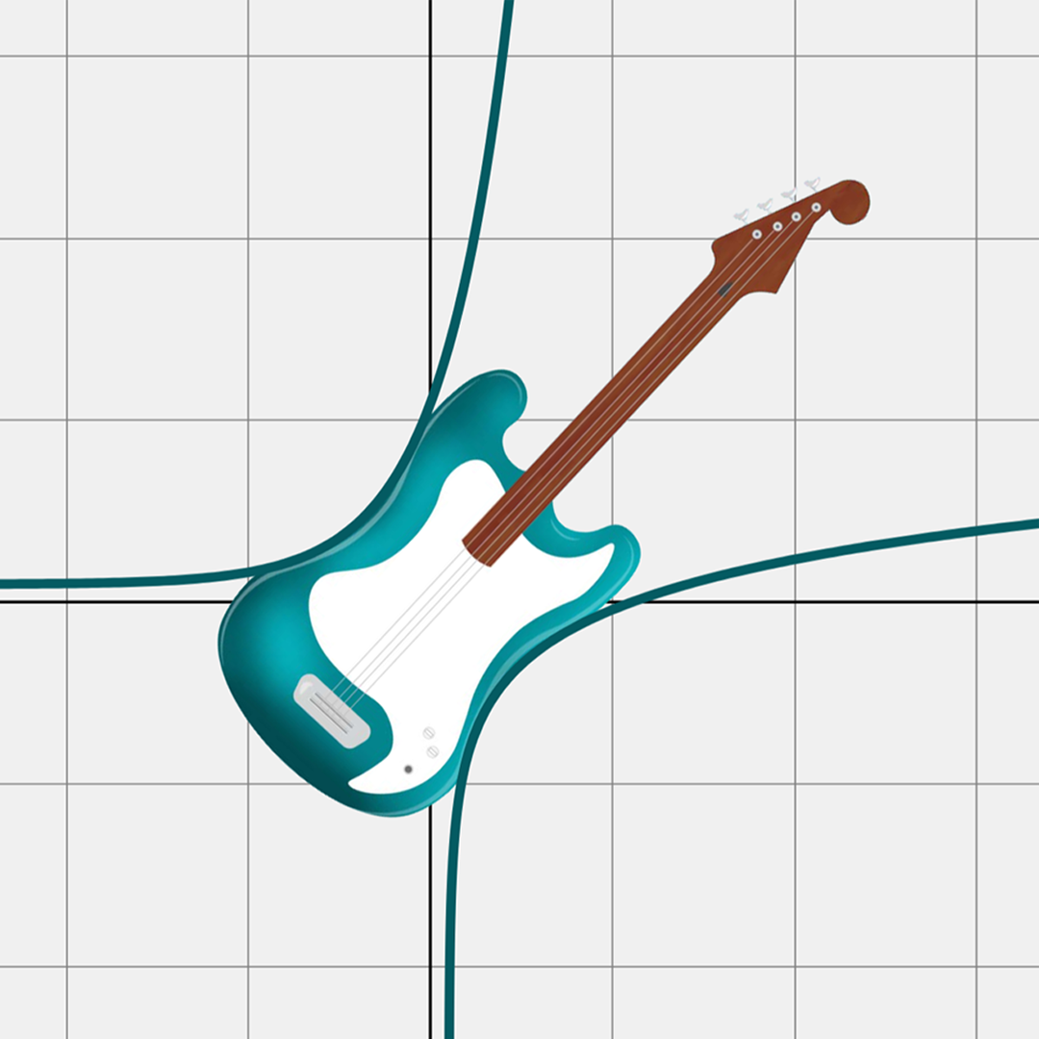
All About That Base, Part 1
Solving Exponential Equations

Slide 3
Essential Question
How do we use logarithms to solve exponential equations?

Slide 4
Learning Objectives
Rewrite exponential equations as logarithmic equations and vice versa.
Use logarithms to solve exponential equations algebraically.
Solve real-world problems involving exponential equations.

Slide 5
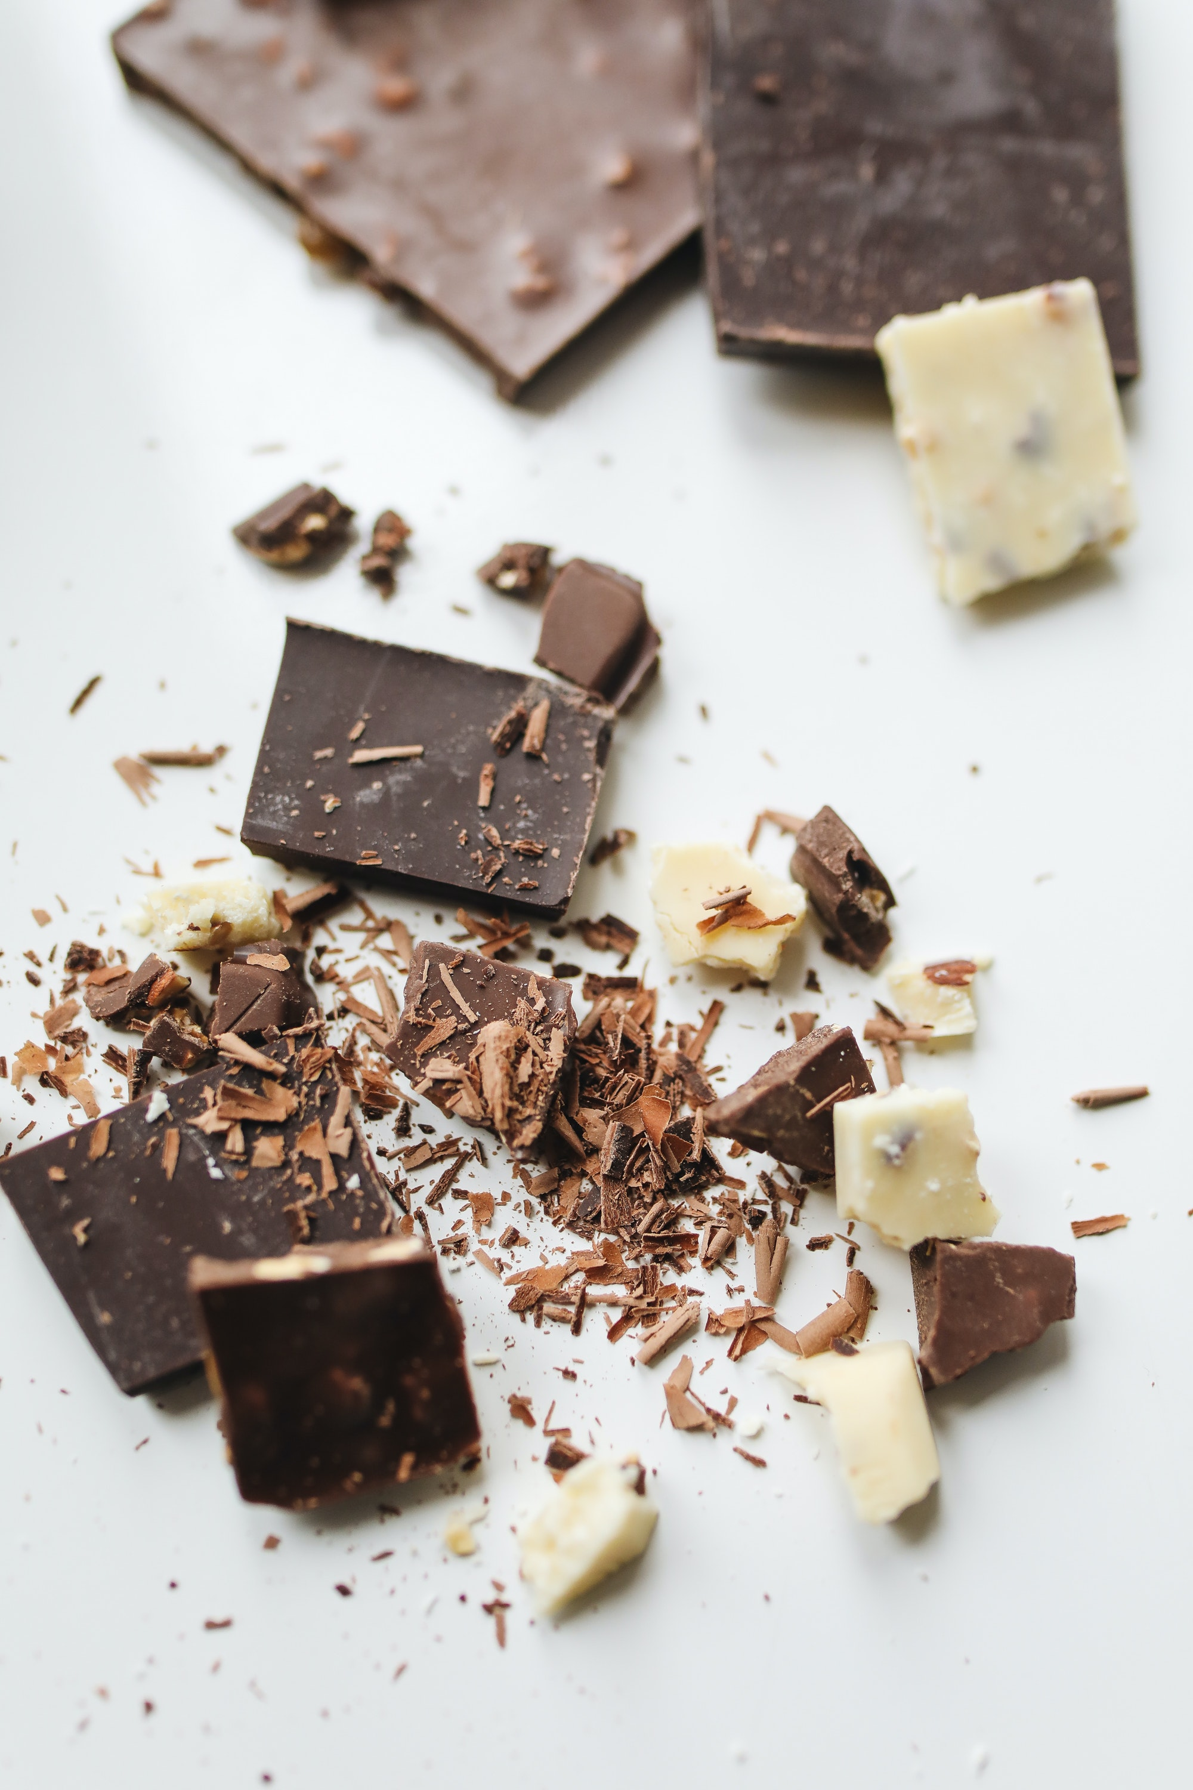
Exponential Decay
What if we took a candy bar and cut it in half, then cut that half in half, and that half in half, and that half in half again, and so on?
What do you think we could
would end up with?
Notes:
Image source: Tankilevitch, P. (2020, March 30). Close-up photo of sliced chocolates [Photograph]. Pexels. https://www.pexels.com/photo/close-up-photo-of-sliced-chocolates-4110092/

Slide 6
What Power?
Use the first two questions to help you evaluate the remaining expressions on the What Power? handout.

Slide 7
What Power? (Solutions)

Slide 8
What Power? (Solutions)

Slide 9
The WhatPower Function Is ACTUALLY
the Logarithm Function!
Now that we have a formal name for the WhatPower function, evaluate the following expressions:

Slide 10
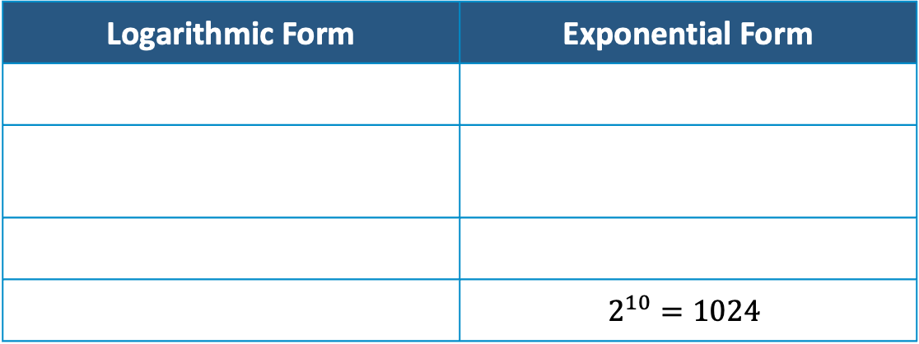
Now What?
Rewrite each logarithmic equation in exponential form and each exponential equation in logarithmic form.
Logarithmic Form | Exponential Form
 | $$2^{10}=1024$$

Slide 11
Guided Notes
Let’s complete the Guided Notes together.

Slide 12
Real-World Scenario Cards
Work in groups of 3–4 to solve the given problems.
Show your work.
You will use your scenario to create a mini-poster that will be displayed for your classmates to view.

Slide 13
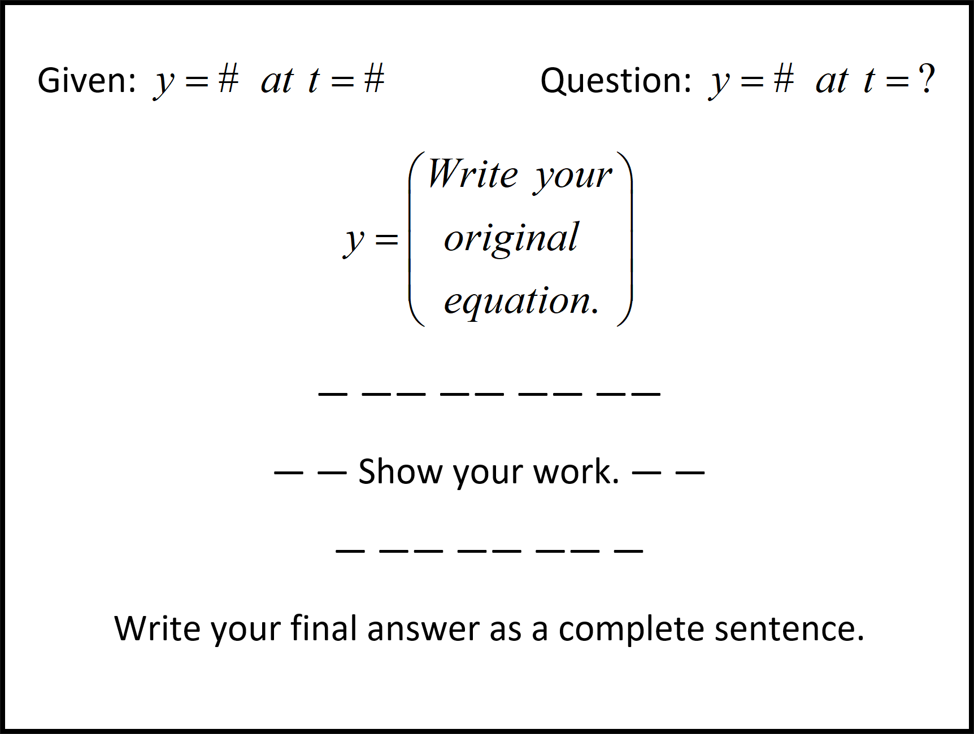
Scenario Mini-Posters
Unknown
Create a mini-poster that contains the following:
Given Information
Identified Unknown
Original Given Equation
  Label the variables.
Steps for Solving
Solution Sentence
  Answer the question in a complete sentence.
Label the variables.
Solution Sentence

Slide 14

Gallery Walk
Divide your group in “half.”
Decide who will be presenters
and who will be analysts for the first round.
Presenters will hang their group’s mini-poster on the wall and stay with the poster, ready to answer questions.
Analysts will visit each poster and analyze the process that each group used to solve the exponential equation, asking questions as needed.
Notes:
K20 Center. (n.d.). Gallery walk / carousel. Strategies. https://learn.k20center.ou.edu/strategy/118

Slide 15
Gallery Walk
Switch roles.
Presenters will stay with their
group’s mini-poster, ready to answer questions.
Analysts will visit each poster and analyze the process that each group used to solve the exponential equation, asking questions as needed.
Notes:
K20 Center. (n.d.). Gallery walk / carousel. Strategies. https://learn.k20center.ou.edu/strategy/118

Slide 16
Solving Exponential Equations:
Explanation
Based on your analysis, write a short paragraph explaining the process of solving exponential equations.
Generalize what you observed during the Gallery Walk.
If possible, do not use specific examples.
Could a friend read your explanation and use it to solve any exponential equation?

Slide 17

Exit Ticket
Solve each of the following equations.
Notes:
K20 Center. (n.d.). Bell ringers and exit tickets. Strategies. https://learn.k20center.ou.edu/strategy/125

Slide 18
Exit Ticket (Solutions)
Any non-zero number to the power of zero is one.
Notes:
K20 Center. (n.d.). Bell ringers and exit tickets. Strategies. https://learn.k20center.ou.edu/strategy/125

