Slide 2
Be ProACTive
Connecting Coursework to Future Goals in College and Career

Slide 3
Commit and Toss
On your Commit and Toss handout, answer the following questions:
How am I doing in my core classes so far?
What are my plans and goals after high school?
Am I on track for plans and goals after high school?
Notes:
K20 Center. Commit and Toss. Strategies. https://learn.k20center.ou.edu/strategy/119)

Slide 4
Essential Question
How will the PreACT help connect my current coursework to my future goals in college and career?

Slide 5
Lesson Objectives
Reflect on current level of academic performance and post-secondary goals as they relate to students’ PreACT results.
Understand the purpose of the PreACT.

Slide 6
PreACT - What is it? What does it do?
The PreACT is a nationally-normed exam which provides the following information:
Important information on high school course decisions;
Academic and career indicators;
Identification of individual strengths and areas that would benefit from improvement;
A view of college and career readiness;
A view of personalized interests.
Notes:
Let your students know that this is the test they take before the ACT.
ACT, Inc. (2017). PreACT At a Glance. ACT, Inc.

Slide 7
PreACT - What does it look like?
Multiple Choice
Predicts performance on the ACT in the following subjects:
Reading
English
Math
Science
Notes:
If your students want to know how long the test will take see the breakdown below:
Reading (30 minutes)
English (30 minutes)
Math (40 minutes)
Science (30 minutes)
ACT, Inc. (2017). PreACT At a Glance. ACT, Inc.

Slide 8
Time to take the PreACT
Good Luck!

Slide 9
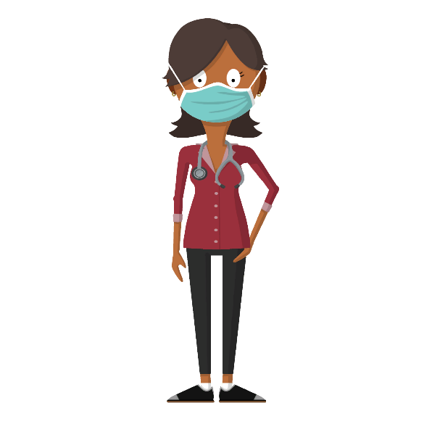
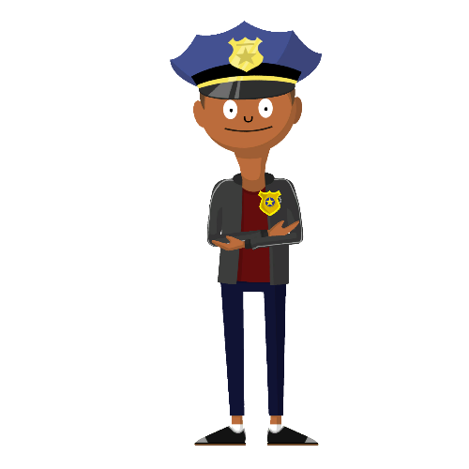
Get a Life!
A lesson in balancing goals for future career development

Slide 10
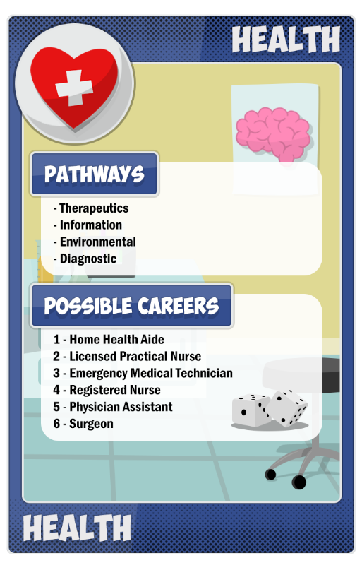
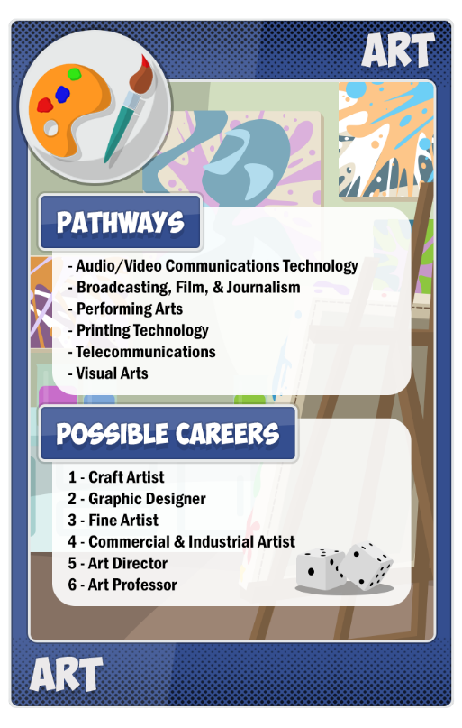
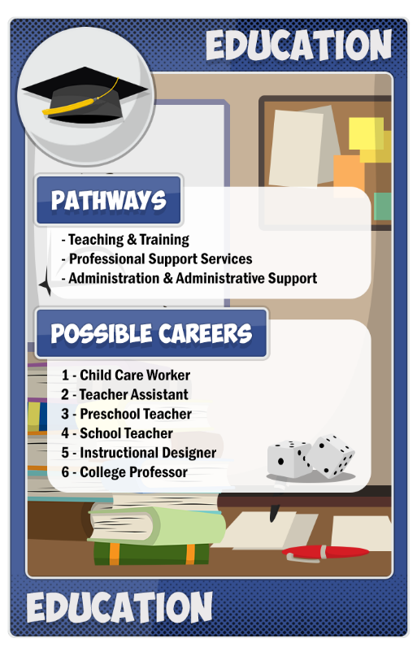
Career Roulette
Choose a career cluster.
Roll the die.
Check the table on your character sheet to find out what career you rolled.

Slide 11
Fill Out Your Character Card
How much do you expect to be paid for this job?
Do you think this is higher or lower than the average income?
What kind of education does this career require?
How will this career affect your life outside of work (time with family/friends, good health, personal fulfillment)?
How will this career enable you to help society or your community?
What else would you like to know about this career?

Slide 12
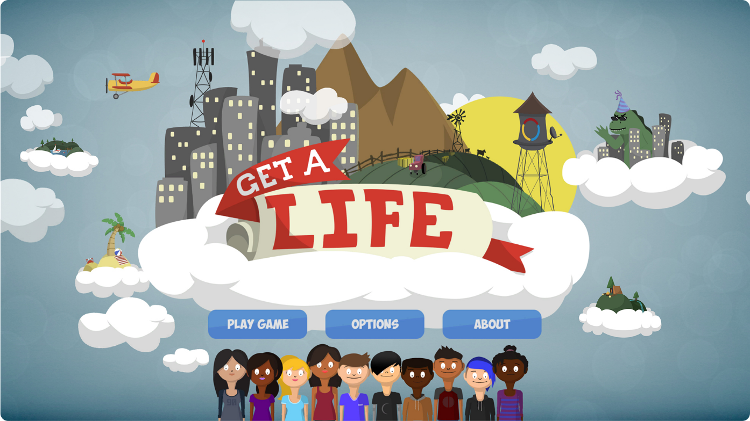
Let’s Play!

Slide 13
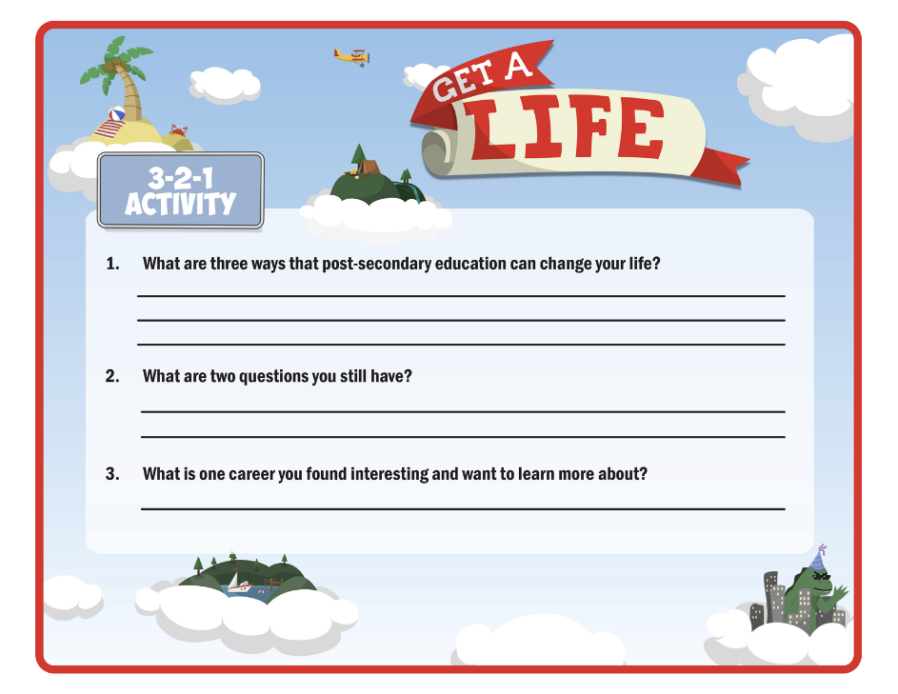
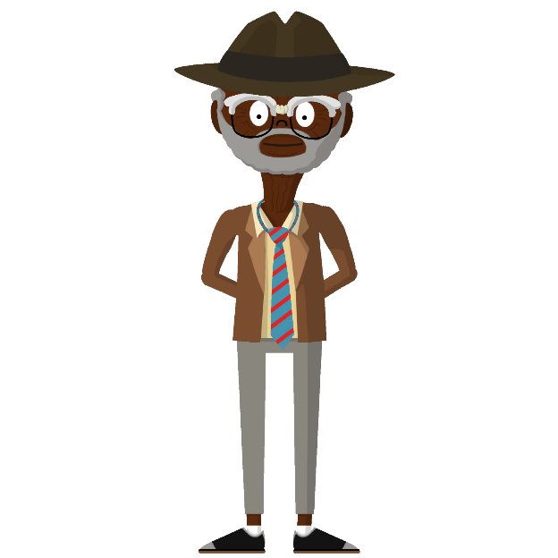
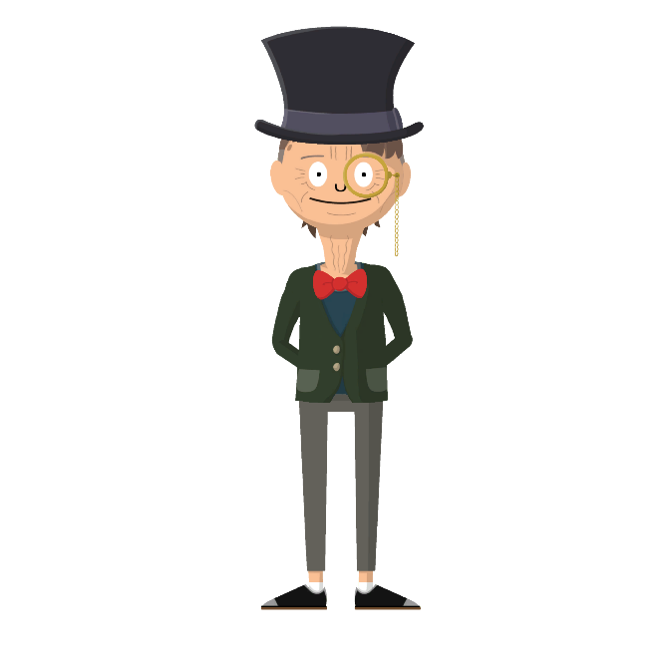
3-2-1
What three things did you learn or notice about the relationship between income, career, and education?
What are two questions you still have?
What is one thing you found interesting?

Slide 14
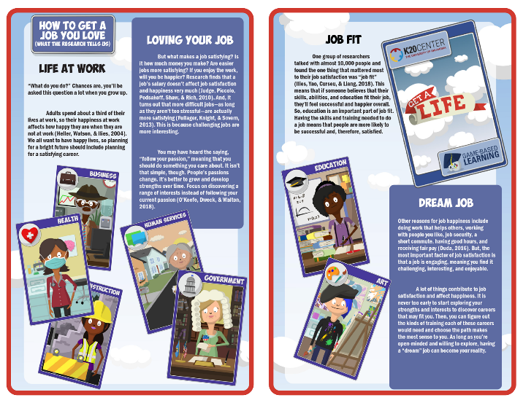
Research
Read the research brief and career cluster overview sheet assigned to your group.
Highlight at least three ideas in the report that are the most interesting to you.
Note in the margins why you highlighted those ideas.
On the cluster overview, highlight at least one career you would like to learn more about.
Discuss with your group what you highlighted and why.

Slide 15
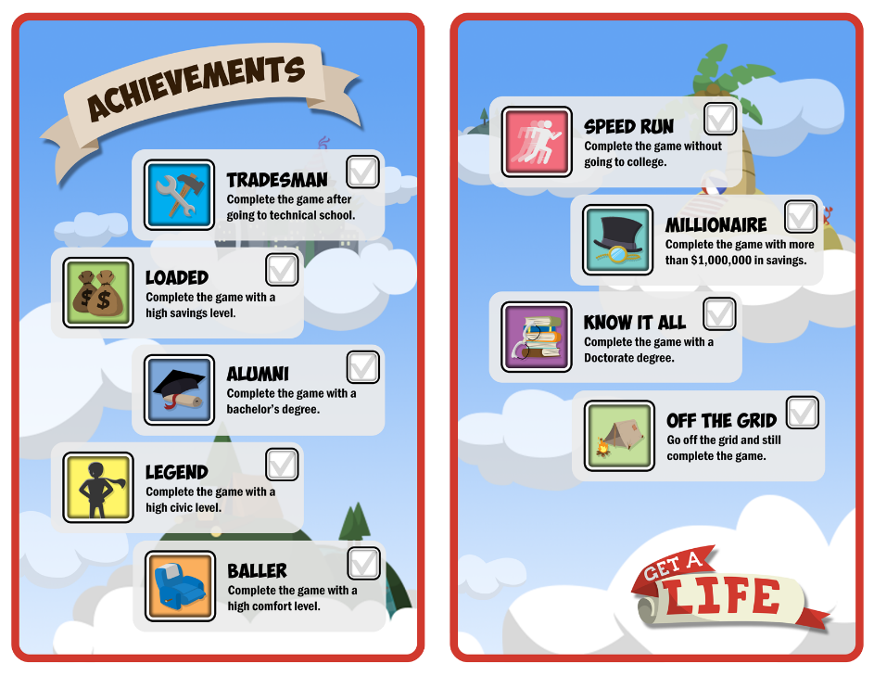
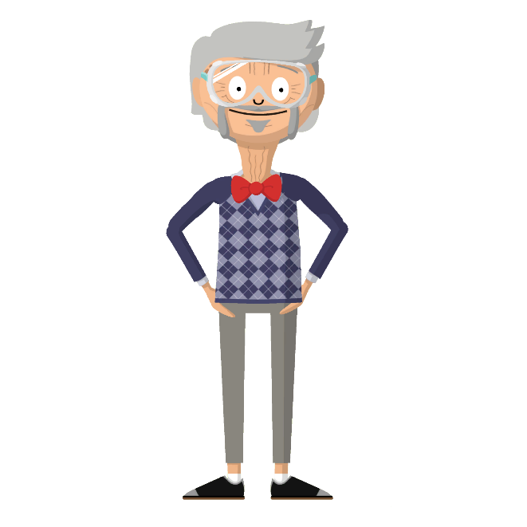
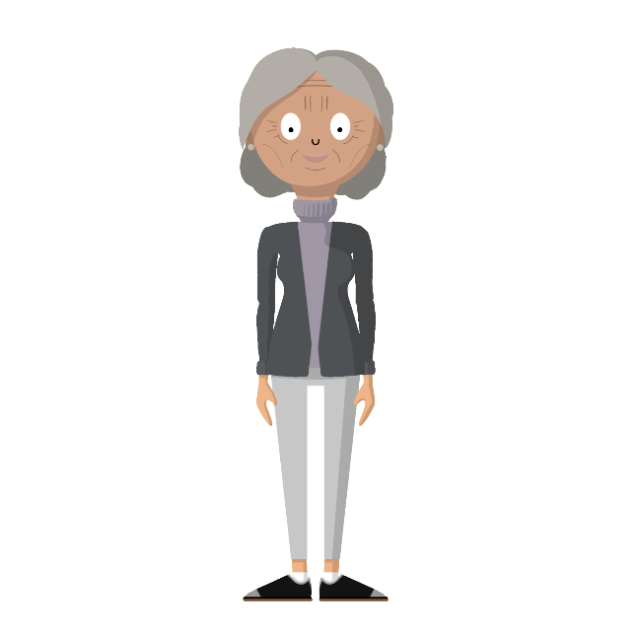
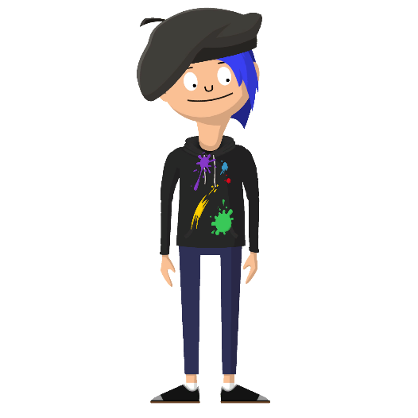
Game Challenges
Look at the game challenges provided on the back of your character sheet.
Pick a few to guide you as you play through the game a few more times.
Record your results after every successful playthrough.

Slide 16
Agree or Disagree?
The higher the education, the higher the pay.
College is too expensive for me.
I plan to pursue the same career I considered before playing the game.
I was right about the level of education required for this job.
My thoughts on higher education have (not) changed.
I learned of jobs I never knew existed before playing the game.

Slide 17
What can you do over the next two years to increase your chances of attaining your preferred career and lifestyle with comfort, balance, and purpose?

Slide 18
What Do Your Scores Mean?
Your scores will range between 1 and 35.
1 - Lowest Score
35 - Highest Score
Score Range. This is an estimate of your educational performance. Your score falls within this range.
Benchmark Score. This is the score you need in order to be ready for your first-year college courses.
Composite Score. This score represents the average of the English, math, reading, and science test scores.
STEM Score. This score represents the average of math and science test scores.
Notes:
ACT, Inc. (2021). Using Your PreACT Results. ACT, Inc.

Slide 19
Understanding Your Student Report
Reading Score - 21
Reading Score on the graph is indicated by the bright pink line.
Score Range is an estimate of how you are doing in school and indicated by a light pink box.
Benchmark Score is where an average student who is on track should be right now. This score is indicated by a grey line and the number 19.
Notes:
Based on Ann C. Taylor’s reading score, is she doing well at this time in school?
ACT, Inc. (2021). Using Your PreACT Results. ACT, Inc.

Slide 20
Notes:
Based on Ann C. Taylor’s current composite and STEM scores, is she where she needs to be? How do you know?
Pass out your student’s score sheets and have them review where they are.
Have your students take a few minutes to find their composite and STEM scores. Is this where they want to be? Why or why not?
ACT, Inc. (2021). Using Your PreACT Results. ACT, Inc.

Slide 21
What Is A Predicted ACT Composite Score Range?
Use the PreACT scores to predict how you are likely to perform on the ACT as an 11th grade student.
This score is an estimate, NOT a guarantee!
Use the predicted scores to determine if you are likely to receive the scores you want when you take the ACT.
If not, consider taking additional courses to improve your skills.
Notes:
Both the PreACT and ACT measure your college readiness skills as you progress through high school.
ACT, Inc. (2021). Using Your PreACT Results. ACT, Inc.

Slide 22
Detailed Results Page
Each of the subject tests are broken down into reporting categories. These are the topics that the questions are based on.
Next to the topic is a fraction.
The top number represents the total number of questions answered correctly.
The bottom number represents the total number of questions for that topic.
To the right of the fraction is a percentage and bar graph depicting the percentage.
These percentages help you identify strengths and areas needing improvement.
Notes:
ACT, Inc. (2021). Using Your PreACT Results. ACT, Inc.

Slide 23
Understanding Your Detailed Report
Subject
Reporting Categories
⅘ correct answers = 80%
Ann C. Taylor answered 4 of the 5 questions about Functions correctly.
Notes:
ACT, Inc. (2021). Using Your PreACT Results. ACT, Inc.

Slide 24
Notes:
Based on this data, which areas need additional support? Which areas are this student strongest subjects?
ACT, Inc. (2021). Using Your PreACT Results. ACT, Inc.

Slide 25
What Is The Career Map?
Career Maps show how career areas differ in their involvement with four basic work tasks:
People. Does this career help, serve, care for, or sell things to people?
Data. Does this career focus on facts, numbers, files, and business procedures?
Things. How critical are machines, tools, living things, and materials (like food, wood, or metal) for this career?
Ideas. Is this career heavily invested in knowledge, insights, and new ways of expressing things (using words, music, etc.)?
These four tasks are the main points of the map.
All of the occupation categories fall somewhere within these points.
Notes:
ACT, Inc. (2021). Using Your PreACT Results. ACT, Inc.

Slide 26
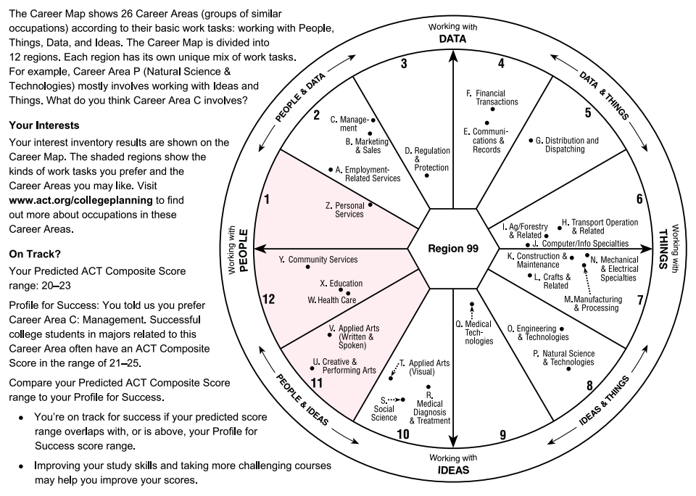
Notes:
ACT, Inc. (2021). Using Your PreACT Results. ACT, Inc.

Slide 27
Exit Ticket
Complete the Exit Ticket Reflection Handout as you review your score sheet.
Use these questions to guide you in your reflection video.
How do your scores compare to the PreAct Benchmarks?
Are any of your score ranges at or above the benchmark scores?
Which ones?
What steps are you taking to ensure you maintain or improve in this area?
Are any of your score ranges below the benchmark scores?
Which ones?
What steps will you take to ensure improvement?
Are you on target for your plans and goals after high school?
Notes:
K20 Center. Exit Ticket. Strategies. https://learn.k20center.ou.edu/strategy/125

