Slide 2
Show and Tell Museum
Investigating Primary Sources

Slide 3
Essential Question
What do personal objects tell us about the people who use them?

Slide 4
Lesson Objectives
Examine personal artifacts and determine the “message” they send about the people who owned them.
Reflect on the cultural information that can be discovered through the study of artifacts.

Slide 5
What do artifacts tell us about ourselves?
Assume that you are a detective.
Look at the artifacts placed around the room.
What do the artifacts tell you about your teacher or classmate?
What do the artifacts tell you about the time period they represent?
Share your observations with classmates and compare your perceptions.

Slide 6
What do artifacts tell us about others?
Set up your “Show and Tell” exhibit at your desk.
As you tour the room, make notes on your I Notice/I Wonder page.
What did you notice?
What questions did you ask?
What did you wonder about?
What did you learn?

Slide 7
What can artifacts tell us about history?
Brainstorm with your partner/group to answer the question: How can we learn about people who lived long ago?
Build a “Mind Map” on chart paper that captures your understanding of ancient cultures.

Slide 8
Creating a Label Card
Look at the artifact cards and write down an answer for the following questions:
What is this artifact called?
What do you think the artifact is made of?
What do you think the artifact was used for?
What does the artifact tell us about the people who created it?
What questions do you have about the artifact?

Slide 9
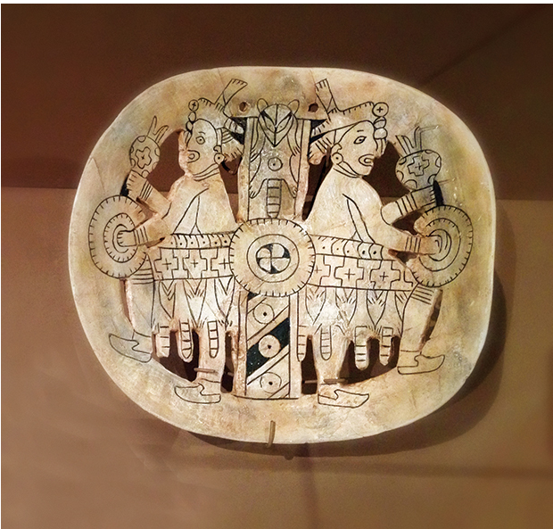
Artifact #1
Source: https://www.405magazine.com/the-treasure-of-spiro-mounds/

Slide 10
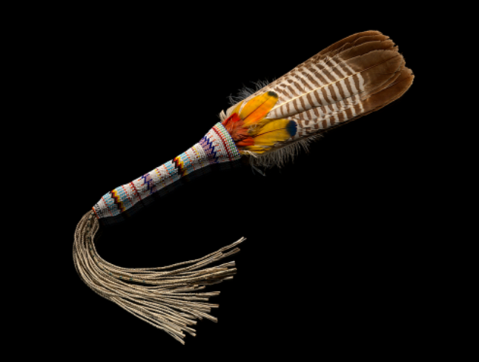
Artifact #2
Source: https://www.smithsonianmag.com/blogs/national-museum-american-indian/2018/11/30/native-perspectives-american-indian-religious-freedom-act/

Slide 11
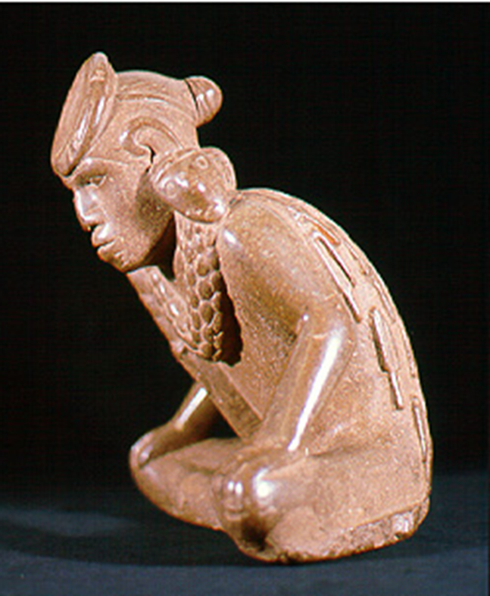
Artifact #3
Source: https://archeology.uark.edu/who-we-are/50moments/spiromounds/

Slide 12
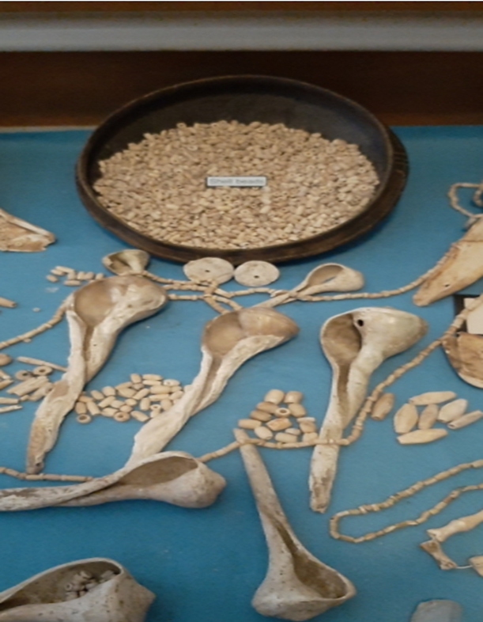
Artifact #4
Source: https://okwnews.com/news/whatzup/the-first-major-exhibit-displaying-the-history-art-and-artifacts-of-the-spiro-mounds-is-at-the-national-cowboy-western-heritage-museum-through-may-9

Slide 13
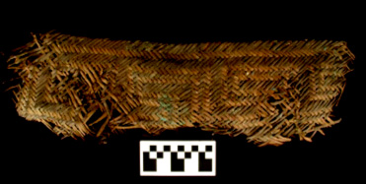
Artifact #5
Source: https://archeology.uark.edu/who-we-are/50moments/spiromounds/

Slide 14
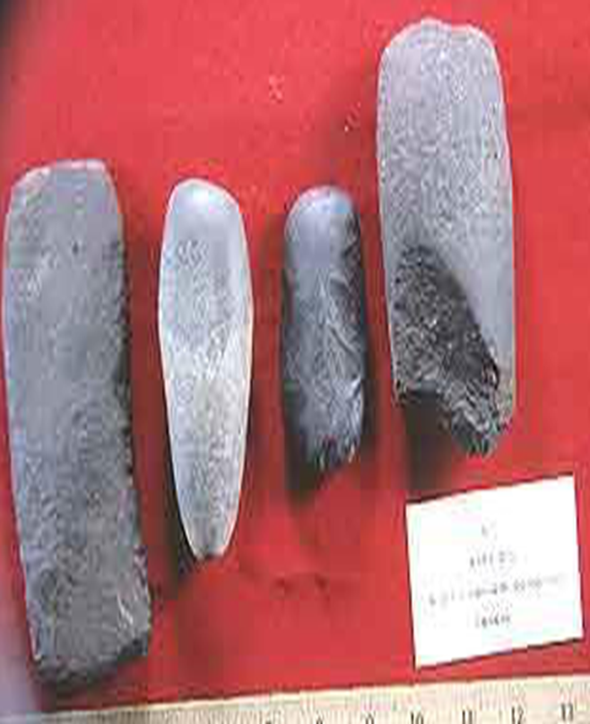
Artifact #6
Source: https://archeology.uark.edu/who-we-are/50moments/spiromounds/

Slide 15
Artifact #7
Source:
https://ktul.com/archive/gallery/spiro-mounds-artifact-turns-up-at-goodwill?photo=1

Slide 16
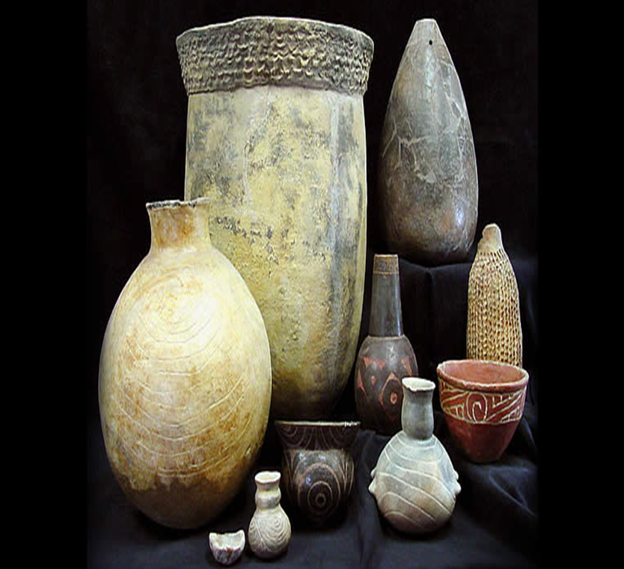
Artifact #8
Source: https://www.texasbeyondhistory.net/tejas/clay/tradition.htm

Slide 17
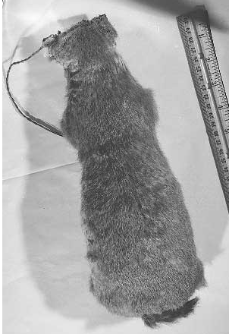
Artifact #9
Source: https://www.okhistory.org/learn/archaeology3

Slide 18
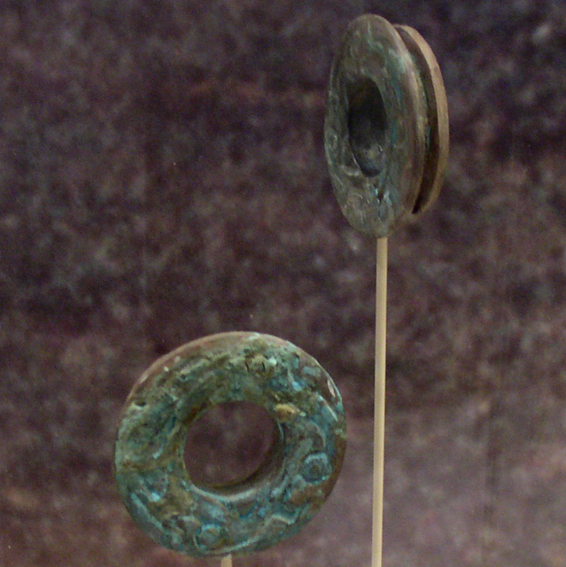
Artifact #10
Source: https://en.wikipedia.org/wiki/Spiro_Mounds

Slide 19
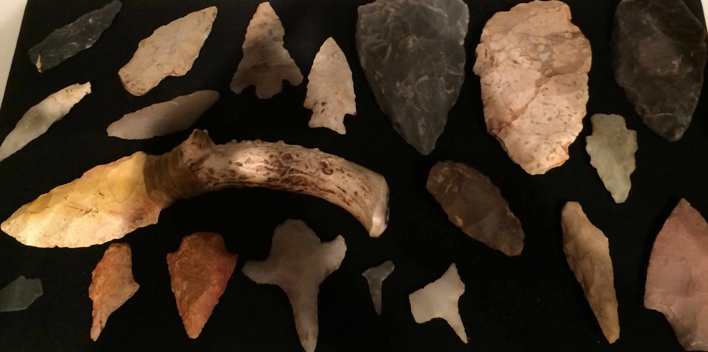
Artifact #11
Source: https://www.gannmuseum.com/native-americans-of-benton/

Slide 20
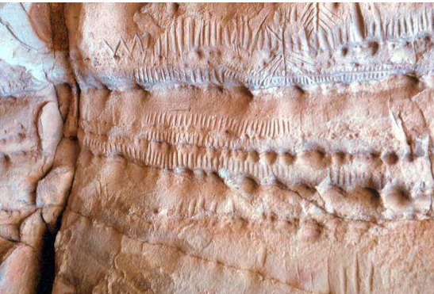
Artifact #12
Source: http://ou.edu/content/dam/archsurvey/docs/archsur-Sites_By_County.pdf

Slide 21
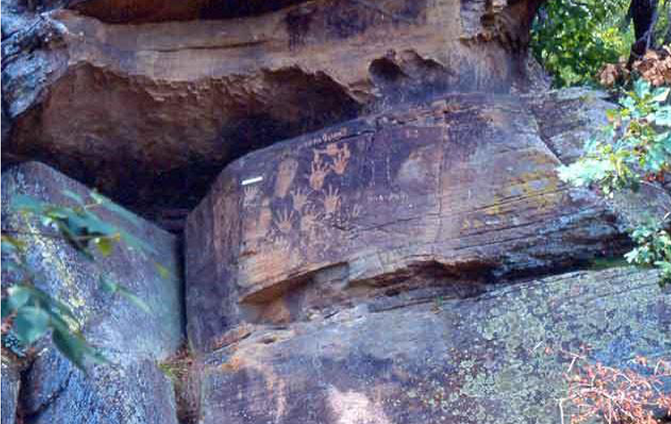
Artifact #13
Source: http://ou.edu/content/dam/archsurvey/docs/archsur-Sites_By_County.pdf

Slide 22
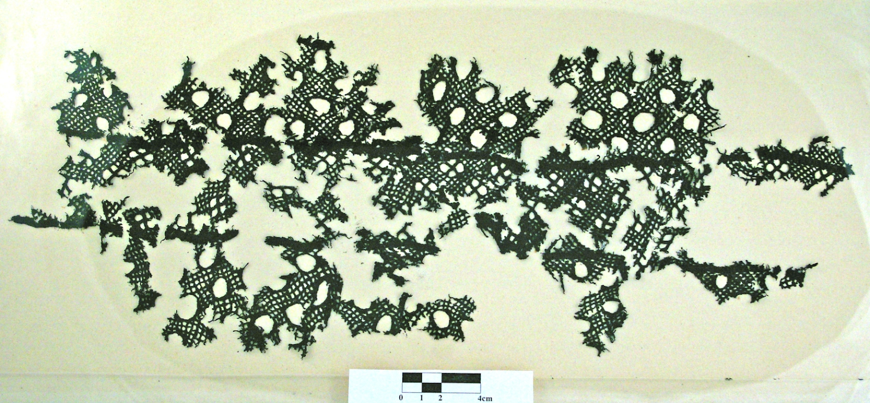
Artifact #14
Source: http://ou.edu/content/dam/archsurvey/docs/archsur-Sites_By_County.pdf

Slide 23
Evaluating Your Label Cards
Was it easier to investigate artifacts from your peers or from the artifact cards? Explain.
Did your team agree on what to write on the label card? Why or why not?
Do you think that archeologists and historians all agree when investigating an artifact?
What information would have helped in labeling the artifacts?

