Slide 2
Show and Tell Museum
Investigating Primary Sources

Slide 3
Artifact Cards
for
Show and Tell Museum Lesson
Teacher Prep for the EXTEND section
Print, in color, if possible, enough sets of the slides so that each group will get an entire set. You can choose not to use all of the cards.
Optional Lamination of the cards
Cut the pages in half, so each artifact is separate.
If you prefer a digital use of the artifact cards, upload the artifact slides into Google Classroom or your school's classroom management system.

Slide 4
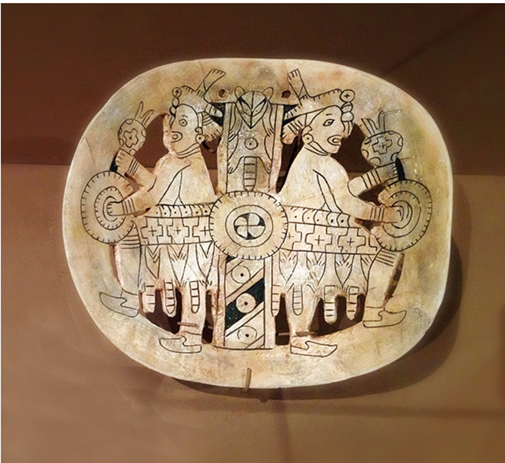
Artifact #1: https://www.405magazine.com/the treasure-of-spiro-mounds/

Slide 5
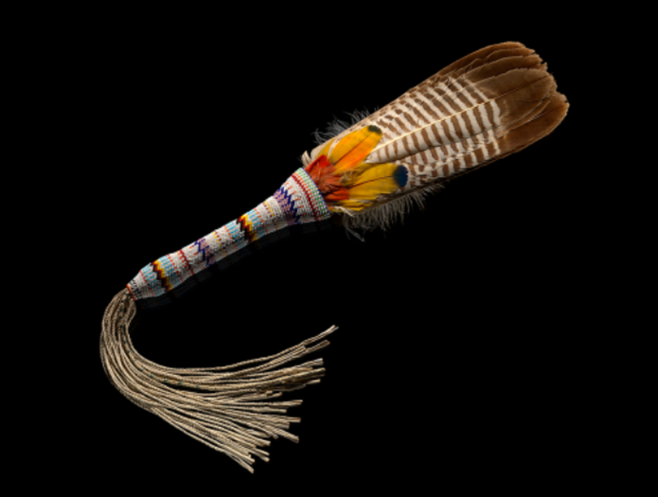
Artifact #2: https://www..smithsonianmag.com/blogs/national-museum-american-indian/
2018/11/30/native-perspectives-american-indian-religious-freedom-act

Slide 6
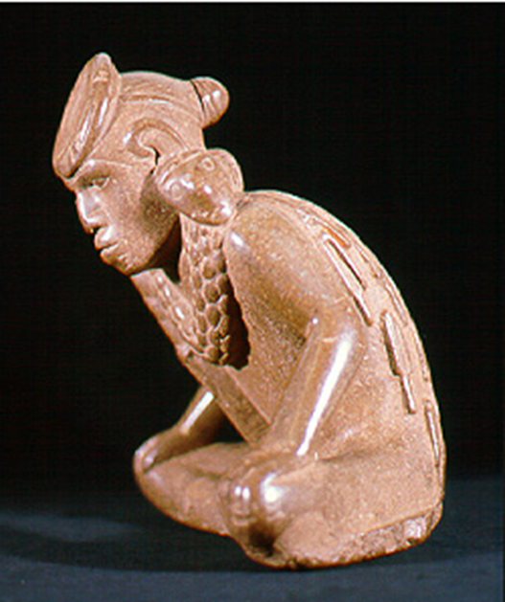
Artifact #3: https://archeology.uark.edu/who-we-are/50moments/spiromounds/

Slide 7
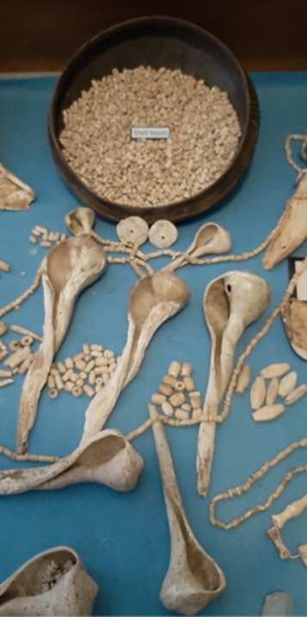
Artifact #4: https://okwnews.com/news/whatzup/the-first-major-exhibit-displaying-the-
history-art-and-artifacts-of-the-spiro-mounds-is-at-the-national-cowboy-western-heritage-museum-through-may-9

Slide 8
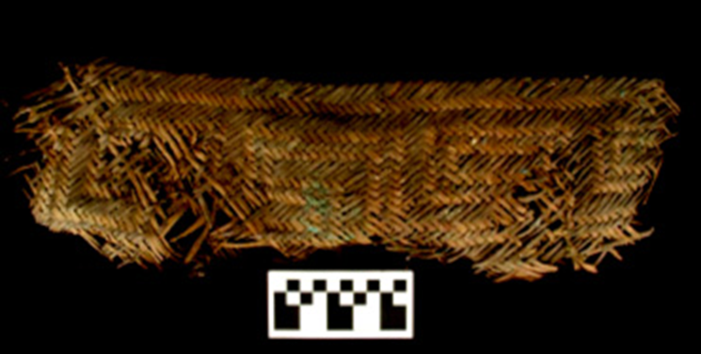
Artifact #5: https://archeology.uark.edu/who-we-are/50moments/spiromounds/

Slide 9
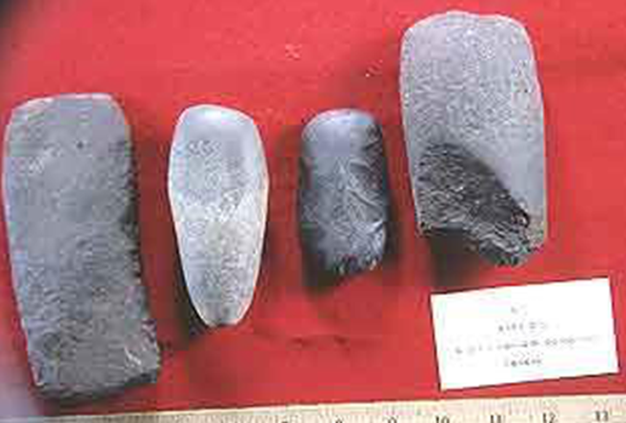
Artifact #6: https://archeology.uark.edu/who-we-are/50moments/spiromounds/

Slide 10
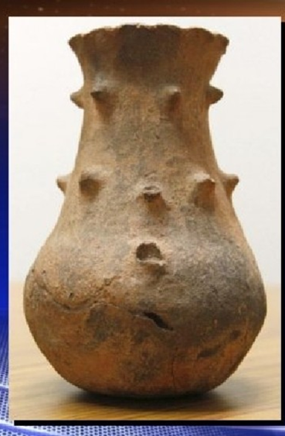
Artifact #7: https://ktul.com/archive/gallery/spiro-mounds-artifact-turns-up-at-goodwill?photo=1

Slide 11
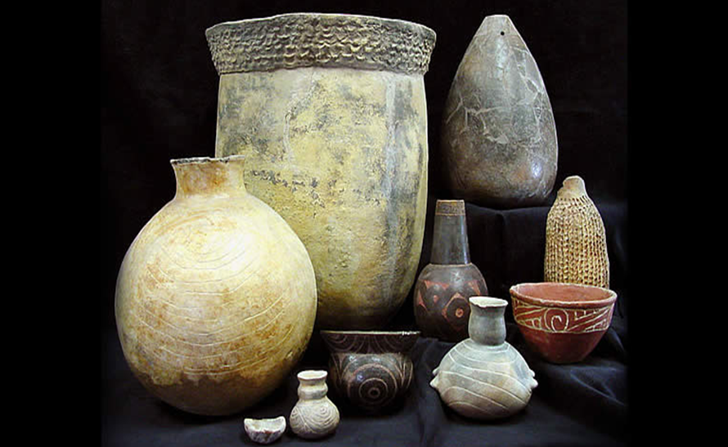
Artifact #8: https://www.texasbeyondhistory.net/tejas/clay/tradition.html

Slide 12
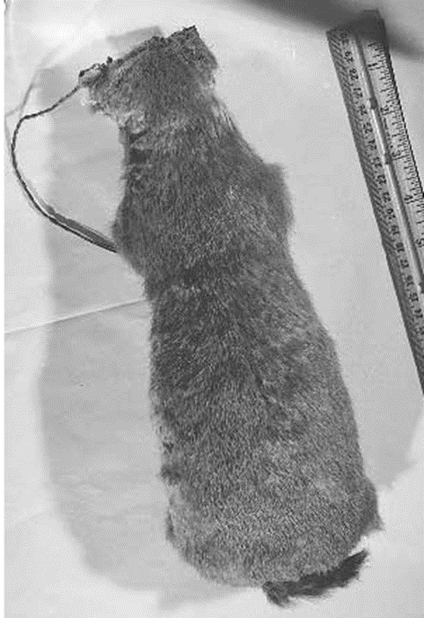
Artifact 9: https://www.okhistory.org/learn/archaeology3

Slide 13
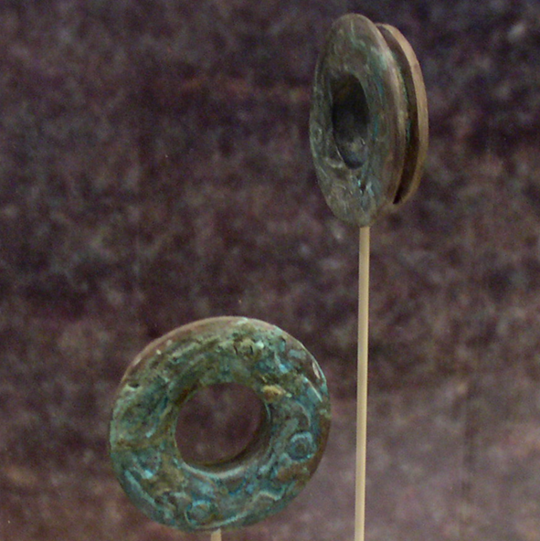
Artifact #10: https://en.wikipedia.org/wiki/Spiro_Mounds

Slide 14
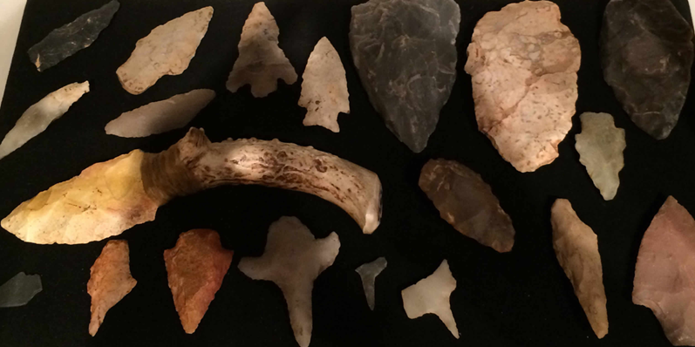
Artifact #11: https://www.gannmuseum.com/native-americans-of-benton/

Slide 15
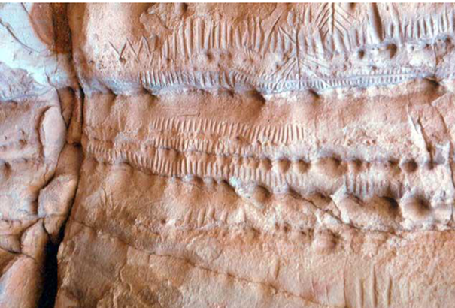
Artifact #12: https://ou.edu/content/dam/archsurvey/docs/archsur-Sites_By_County.pdf

Slide 16
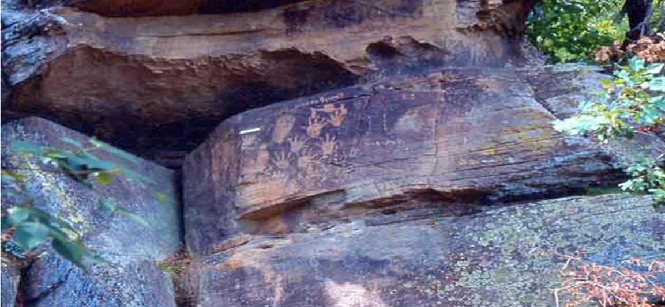
Artifact #13: http://ou.edu/content/dam/archsurvey/docs/archsur-Sites_By_County.pdf

Slide 17
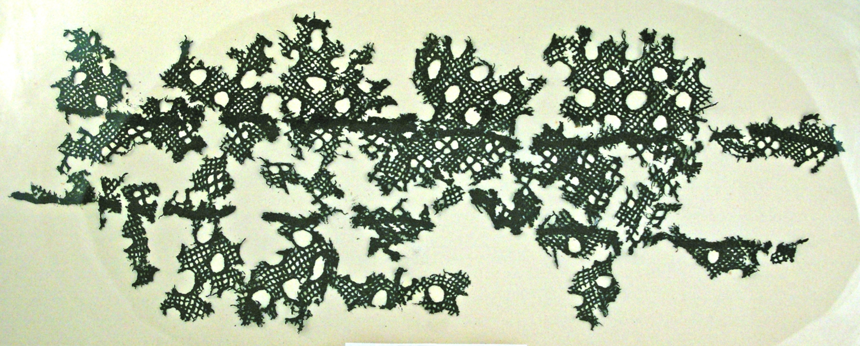
Artifact #14: http://ou.edu/content/dam/archsurvey/docs/archsur-Sites_By_County.pdf

Slide 18
Evaluating Your Label Cards
•Was it easier to investigate artifacts from your peers or from the artifact cards? Explain.
•Did your team agree on what to write on the label card? Why or why not?
•Do you think that archeologists and historians all agree when investigating an artifact?
•What information would have helped in labeling the artifacts?

