Slide 1
Achilles Wasn’t Just a Heel
And Other Greek Heroes
5th Grade ELA

Slide 2
Essential Question
How do characters become and remain “heroes?”

Slide 3
Learning Objectives
Synthesize information about a Greek hero to share with the class;
Make inferences about Greek heroes to answer complex questions;
Compare Greek and modern-day heroes.

Slide 4
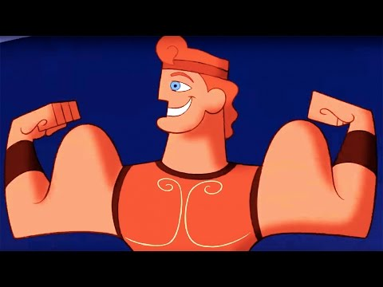
Notes:
YouTube. (2014). Hercules | Zero to Hero | Lyric Video | Disney Sing Along. YouTube. Retrieved November 22, 2021, from https://www.youtube.com/watch?v=yOL-EJZjmp0.

Slide 5

What makes a hero?
On your paper, write down what you believe are the three most important characteristics of a hero.

Slide 6

Stand Up, Sit Down
Share out one of your characteristics.
If someone shares something you wrote down, cross it off your paper.
Once all three of your ideas have been crossed out, sit back down.
Notes:
K20 Center. (n.d.). Stand Up, Sit Down. Strategies. https://learn.k20center.ou.edu/strategy/1771?rev=11586

Slide 7

What makes a hero?
Using the list of characteristics, come up with a definition of the word “hero.”
What are some examples of a hero?
What are some non-examples of a hero?
Notes:
K20 Center. (n.d.). Frayer Model. Strategies. https://learn.k20center.ou.edu/strategy/126

Slide 8
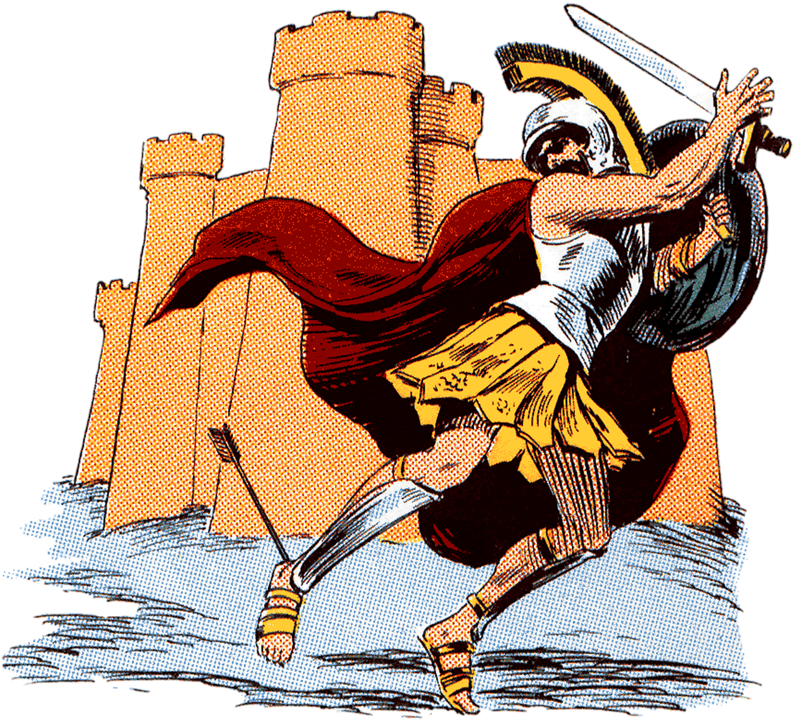
Greek Heroes and Heroines
Achilles
Hercules
Odysseus
Perseus
Pandora
Notes:
ArtsyBee. (2017). Achilles' Heel. pixabay. Retrieved November 11, 2021, from https://pixabay.com/illustrations/achille-achille-s-heel-medieval-2165043/.

Slide 9
Greek Heroes and Heroines
Create a baseball card about one of the Greek Heroes or Heroines and include the following information:
Name
Where They Are From
Strengths
Weaknesses
Greatest Accomplishments
Notes:
ArtsyBee. (2017). Achilles' Heel. pixabay. Retrieved November 11, 2021, from https://pixabay.com/illustrations/achille-achille-s-heel-medieval-2165043/.

Slide 10
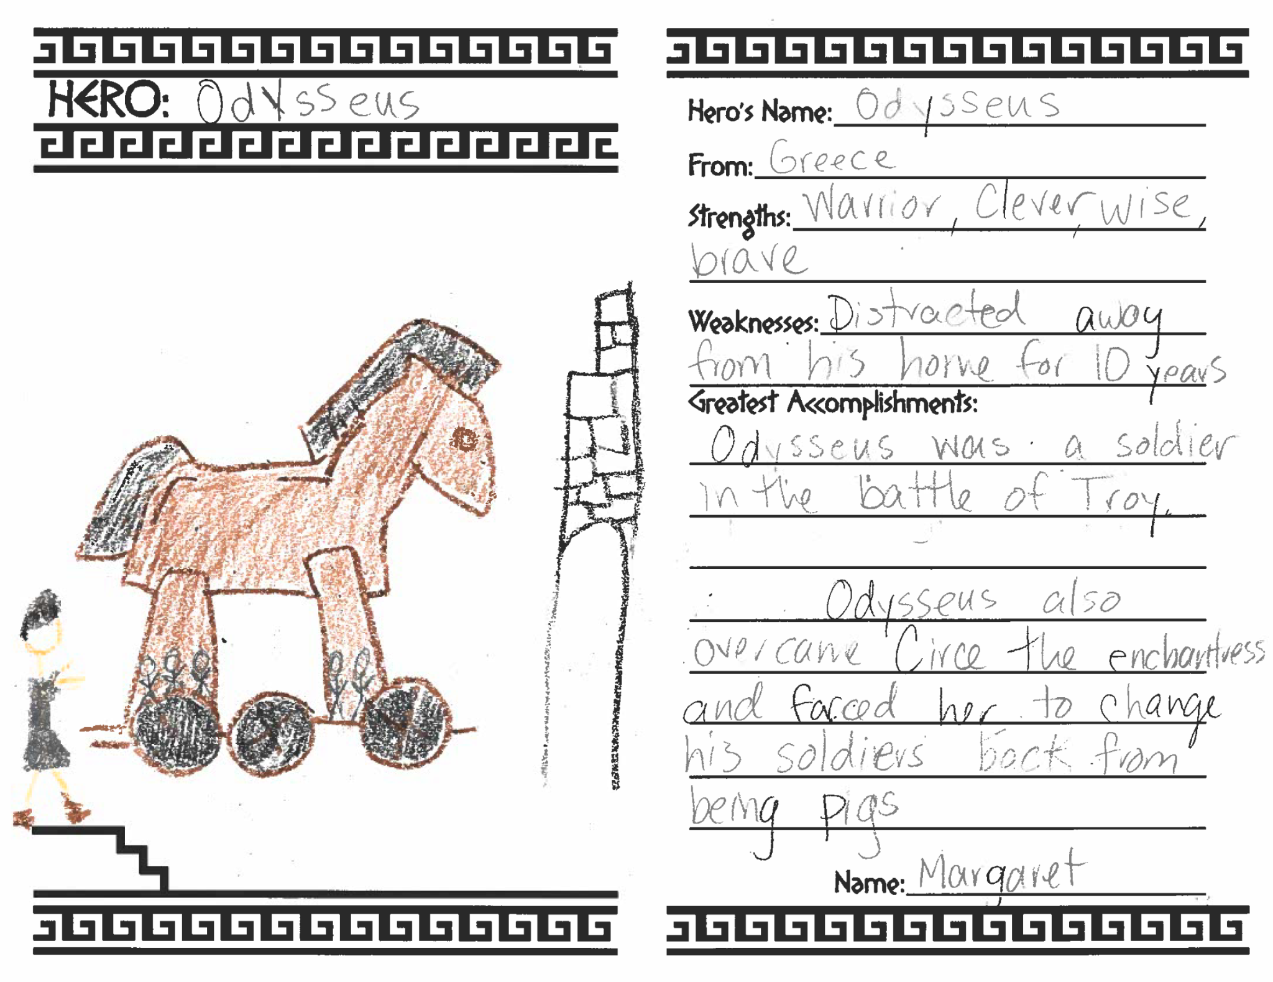

Slide 11
Greek Heroes and Heroines
Create a baseball card on one of the Greek Heroes or Heroines and include the following information:
Name
Where They Are From
Strengths
Weaknesses
Greatest Accomplishments

Slide 12

True For Who?
As a group, determine which hero or heroine is being described by the statement.
Achilles
Hercules
Odysseus
Perseus
Pandora
Notes:
K20 Center. (n.d.). True for Who? Strategies. https://learn.k20center.ou.edu/strategy/1586

Slide 13
True For Who?
A seemingly small weakness was my downfall.

Slide 14
True For Who?
I fought in the Trojan War.

Slide 15
True For Who?
Two words to describe me are: brave and powerful.

Slide 16
True For Who?
I am a son of Zeus.

Slide 17
True For Who?
I have defeated many monsters.

Slide 18
True For Who?
Hephaestus created me on the instruction of Zeus.

Slide 19
True For Who?
I’ve been blamed for people's pain and heartache.

Slide 20
True For Who?
I had to complete dangerous feats with quick thinking and talents.

Slide 21

Exit Ticket?
Answer the following question in a paragraph using details from your research:
Do these Greek Heroes match what your definition of “hero” is?
Notes:
K20 Center. (n.d.). Bell Ringers and Exit Tickets. Strategies. https://learn.k20center.ou.edu/strategy/125

