Slide 2
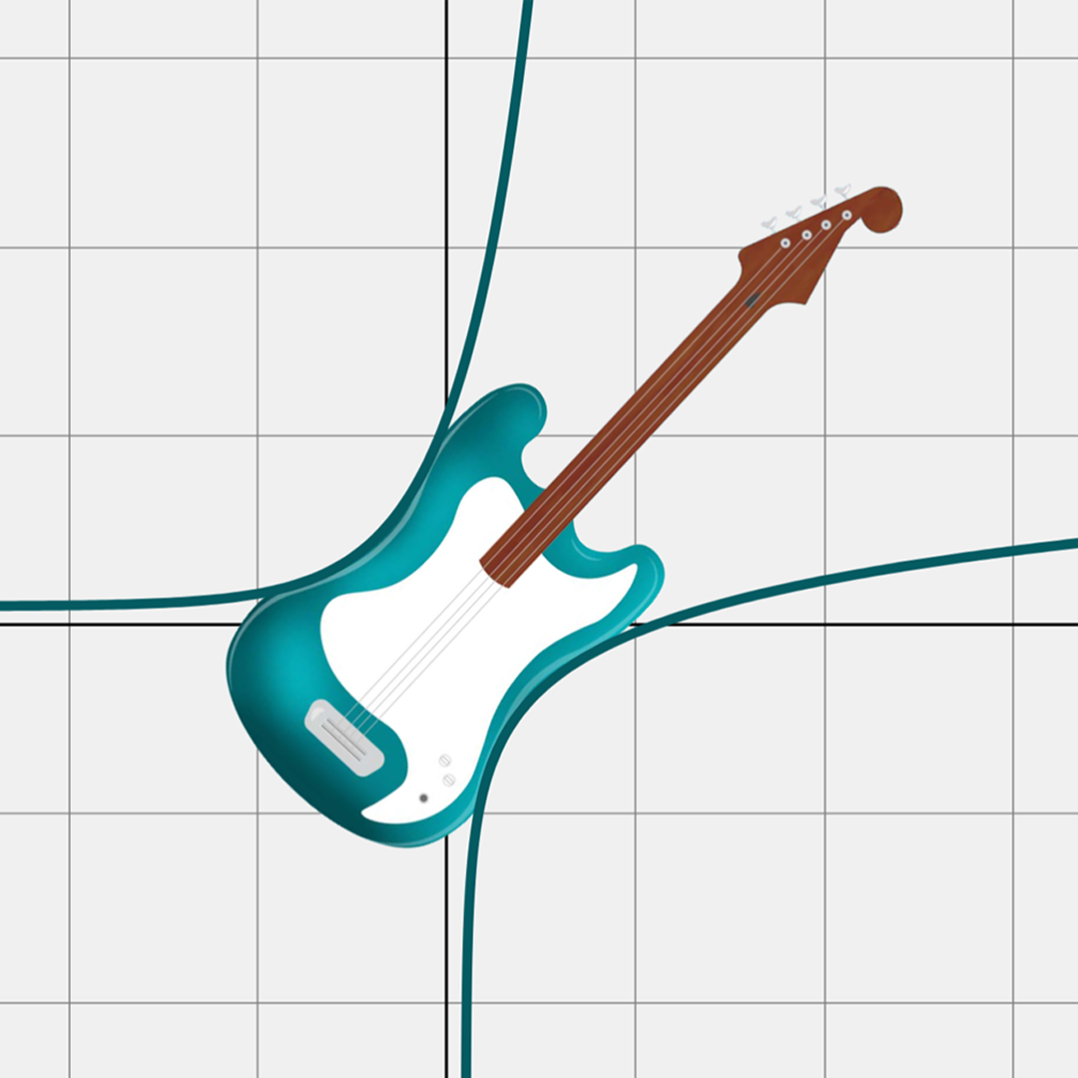
All About That Base, Part 2
Solving Logarithmic Equations

Slide 3

Bell Ringer
Notes:
K20 Center. (n.d.). Bell ringers and exit tickets. Strategies. https://learn.k20center.ou.edu/strategy/125

Slide 4
Bell Ringer
Notes:
K20 Center. (n.d.). Bell ringers and exit tickets. Strategies. https://learn.k20center.ou.edu/strategy/125

Slide 5
Essential Question
How do we use properties of logarithms and exponential functions to solve logarithmic equations?

Slide 6
Learning Objectives
Use properties of logarithms to rewrite expressions.
Use exponential functions to solve logarithmic equations.

Slide 7
Finding Patterns
Work with your partner to find the patterns in the tables on your handout.
Each pattern has three example tables for you to use.
  Make a conjecture of what you think is happening in the first table—does that reasoning hold up in the other two tables for that pattern?

Slide 8
Finding Patterns: Pattern 1
Expression | Result |  | Expression | Result |  | Expression | Result
 | 3 |  |  | 2 |  |  | 6
 | 4 |  |  | 8 |  |  | 12
 | 7 |  |  | 10 |  |  | 18
Notice that the inputs for the logarithms have
a pattern, as do the outputs.

Slide 9
Finding Patterns: Pattern 2
Expression | Result |  | Expression | Result |  | Expression | Result
 | 20 |  |  | 16 |  |  | 36
 | 8 |  |  | 9 |  |  | 15
 | 12 |  |  | 7 |  |  | 21
Notice that the inputs for the logarithms have
a pattern, as do the outputs.

Slide 10
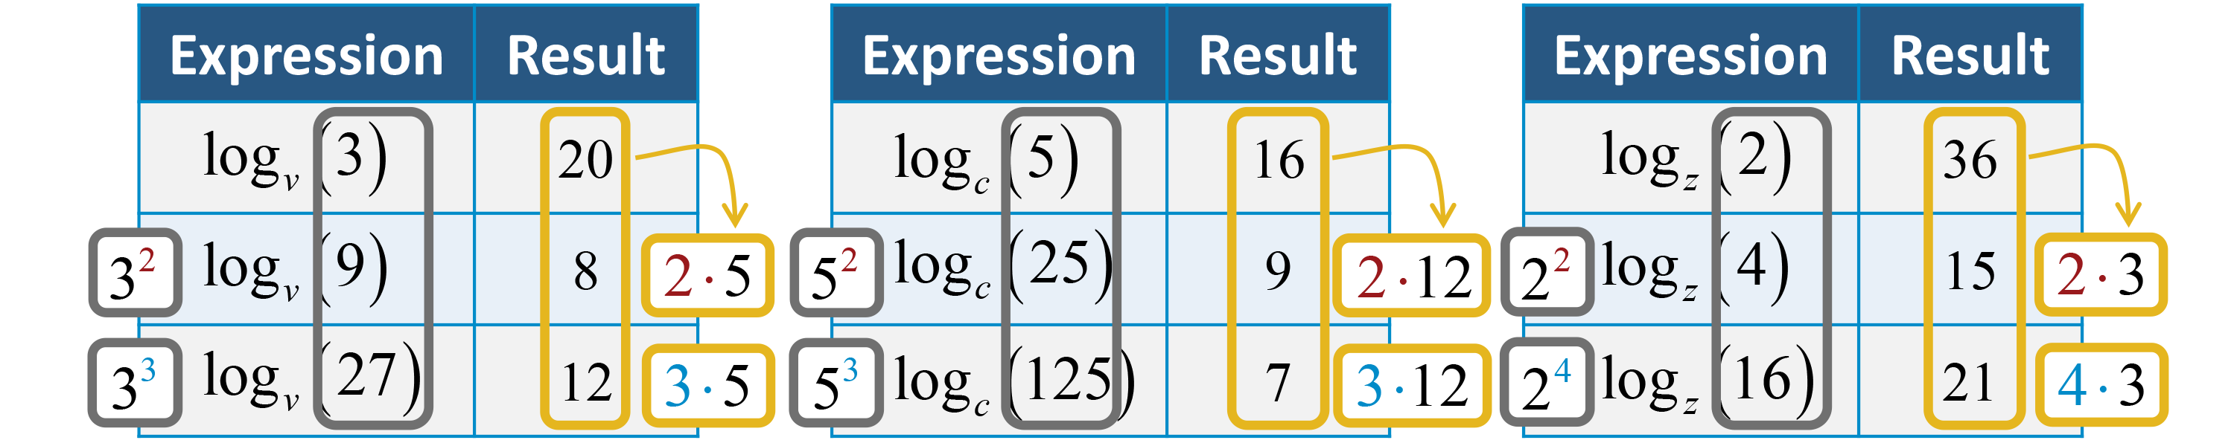
Finding Patterns: Pattern 3
Notice that the power of the inputs affects
the outputs.

Slide 11
Properties of Logarithms
  The logarithm of the product of two values is the same as the sum of the logarithms of each value.
  The logarithm of the quotient of two values is the logarithm of the numerator minus the logarithm
  of the denominator.

Slide 12
Properties of Logarithms
  The logarithm of a value to a power is the power times the logarithm of the value.

Slide 13
Properties of Logarithms
Change of Base:
  The logarithm with base b can be written as the common logarithm of the input over the common logarithm of b. A natural logarithm also can be used (or a logarithm with any base).

Slide 14
Change of Base: Proof

Slide 15
Guided Notes
Let’s complete the Guided Notes together.

Slide 16

Applying Properties: Solving
Work in pairs to solve each equation.
  Decide who is Student A and who is Student B.
Student A: Write the first step in solving question 1.
  Pass the paper to Student B.
Student B: Write the second step.
  Pass the paper to Student A.
Repeat.
Notes:
K20 Center. (n.d.). Pass the problem. Strategies. https://learn.k20center.ou.edu/strategy/151

Slide 17
Solving (Solution 1)
Notes:
K20 Center. (n.d.). Pass the problem. Strategies. https://learn.k20center.ou.edu/strategy/151

Slide 18
Solving (Solution 1 continued…)
Notes:
K20 Center. (n.d.). Pass the problem. Strategies. https://learn.k20center.ou.edu/strategy/151

Slide 19
Solving (Solution 2)
Notes:
K20 Center. (n.d.). Pass the problem. Strategies. https://learn.k20center.ou.edu/strategy/151

Slide 20
Solving (Solution 2 continued…)
Notes:
K20 Center. (n.d.). Pass the problem. Strategies. https://learn.k20center.ou.edu/strategy/151

Slide 21
Solving (Solution 3)
Notes:
K20 Center. (n.d.). Pass the problem. Strategies. https://learn.k20center.ou.edu/strategy/151

Slide 22
Solving (Solution 3 continued…)
Notes:
K20 Center. (n.d.). Pass the problem. Strategies. https://learn.k20center.ou.edu/strategy/151

Slide 23
Solving (Solution 4)
Notes:
K20 Center. (n.d.). Pass the problem. Strategies. https://learn.k20center.ou.edu/strategy/151

Slide 24
Solving (Solution 4 continued…)
Notes:
K20 Center. (n.d.). Pass the problem. Strategies. https://learn.k20center.ou.edu/strategy/151

Slide 25
Applying Properties: Evaluating
Use the given logarithms on the Applying Properties handout to evaluate each logarithmic expression.

Slide 26
Evaluating (Sample Responses 1)

Slide 27
Evaluating (Sample Responses 2)

Slide 28
Evaluating (Sample Responses 3)

Slide 29

Justified True or False
Determine if each of the following is true or false.
Justify your answer.
Notes:
K20 Center. (n.d.). Justified true or false. Strategies. https://learn.k20center.ou.edu/strategy/174

Slide 30
Justified True or False
Determine if each of the following is true or false .
Justify your answer.
F
Notes:
K20 Center. (n.d.). Justified true or false. Strategies. https://learn.k20center.ou.edu/strategy/174

Slide 31
Justified True or False
Determine if each of the following is true or false .
Justify your answer.
F
F
Notes:
K20 Center. (n.d.). Justified true or false. Strategies. https://learn.k20center.ou.edu/strategy/174

Slide 32
Justified True or False
Determine if each of the following is true or false .
Justify your answer.
F
F
T
Notes:
K20 Center. (n.d.). Justified true or false. Strategies. https://learn.k20center.ou.edu/strategy/174

Slide 33
Justified True or False
Determine if each of the following is true or false .
Justify your answer.
F
F
T
T
Notes:
K20 Center. (n.d.). Justified true or false. Strategies. https://learn.k20center.ou.edu/strategy/174

Slide 34
Justified True or False
Determine if each of the following is true or false .
Justify your answer.
F
F
T
T
T
Notes:
K20 Center. (n.d.). Justified true or false. Strategies. https://learn.k20center.ou.edu/strategy/174

Slide 35
Justified True or False
Determine if each of the following is true or false .
Justify your answer.
F
F
F
T
T
T
Notes:
K20 Center. (n.d.). Justified true or false. Strategies. https://learn.k20center.ou.edu/strategy/174

Slide 36
Justified True or False
Determine if each of the following is true or false .
Justify your answer.
F
F
F
F
T
T
T
Notes:
K20 Center. (n.d.). Justified true or false. Strategies. https://learn.k20center.ou.edu/strategy/174

Slide 37
Justified True or False
Determine if each of the following is true or false .
Justify your answer.
F
F
F
F
T
T
T
T
Notes:
K20 Center. (n.d.). Justified true or false. Strategies. https://learn.k20center.ou.edu/strategy/174

