Slide 2
To Secede or Not to Secede
American Civil War Era

Slide 3
Essential Question
How did supporters of secession justify leaving the Union?

Slide 4
Learning Objectives
Analyze the immediate impact of the presidential election of 1860.
Explain why slavery was the central cause of Southern secession.
Compare the perspectives of Union and Confederate supporters during the Civil War.

Slide 5

Preflection
What do you think led to the secession of Southern states from the United States?

Slide 6
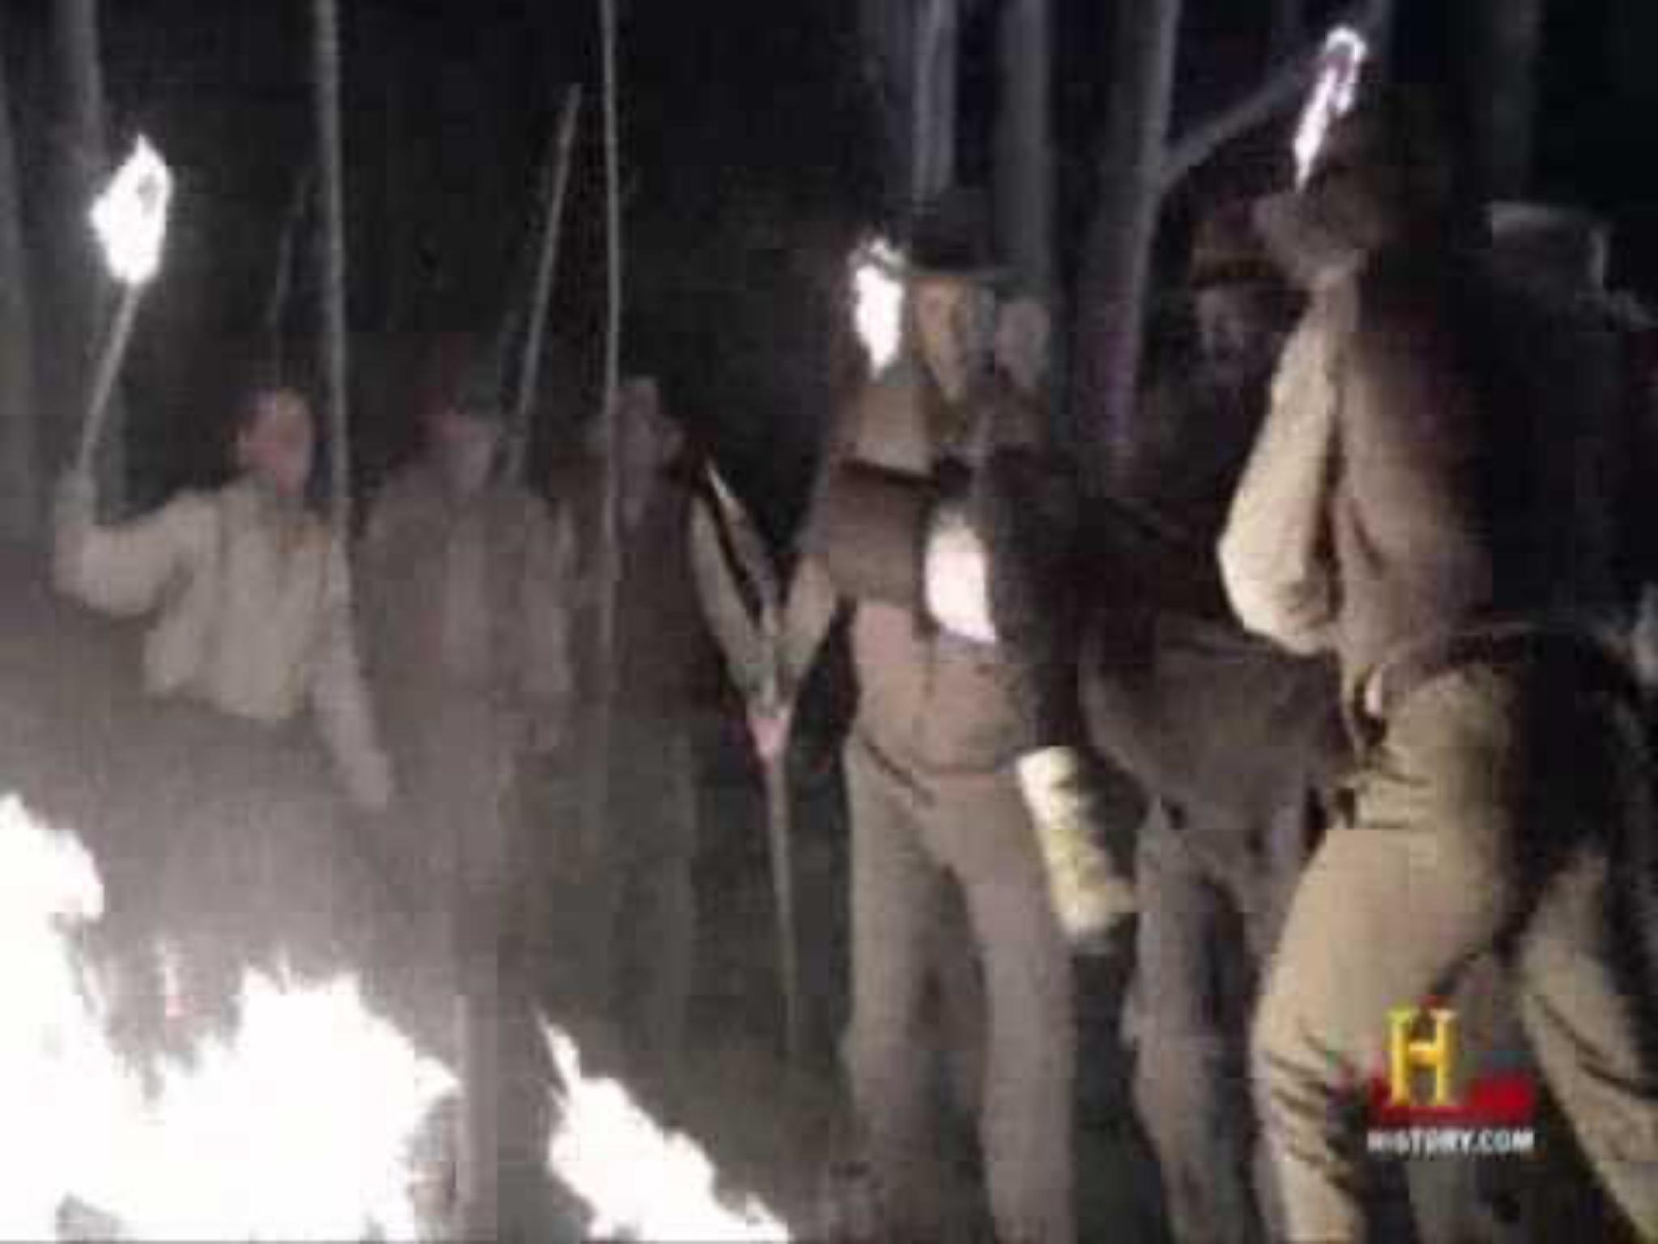
Civil War Election of 1860
Notes:
MGH. (n.d.). Civil War election of 1860 [Video]. YouTube. https://www.youtube.com/watch?v=TGg5uDYHEQA

Slide 7
Discuss
According to the video, what issues were facing the country?

Slide 8

South Carolina Secession
Read the document and highlight or underline evidence that answers the question:
  Why did South Carolina secede from the Union?

Slide 9

Union and Confederate Perspectives
Read the accounts written by a Union soldier and a Confederate soldier.
Highlight passages explaining why each soldier supports his cause.
In the margins, explain how each passage supports the writer’s cause.

Slide 10
Preflection Revisited
What led to the secession of Southern states from the United States?
Write a six-word memoir summarizing why the Southern states seceded from the Union.

