Slide 2
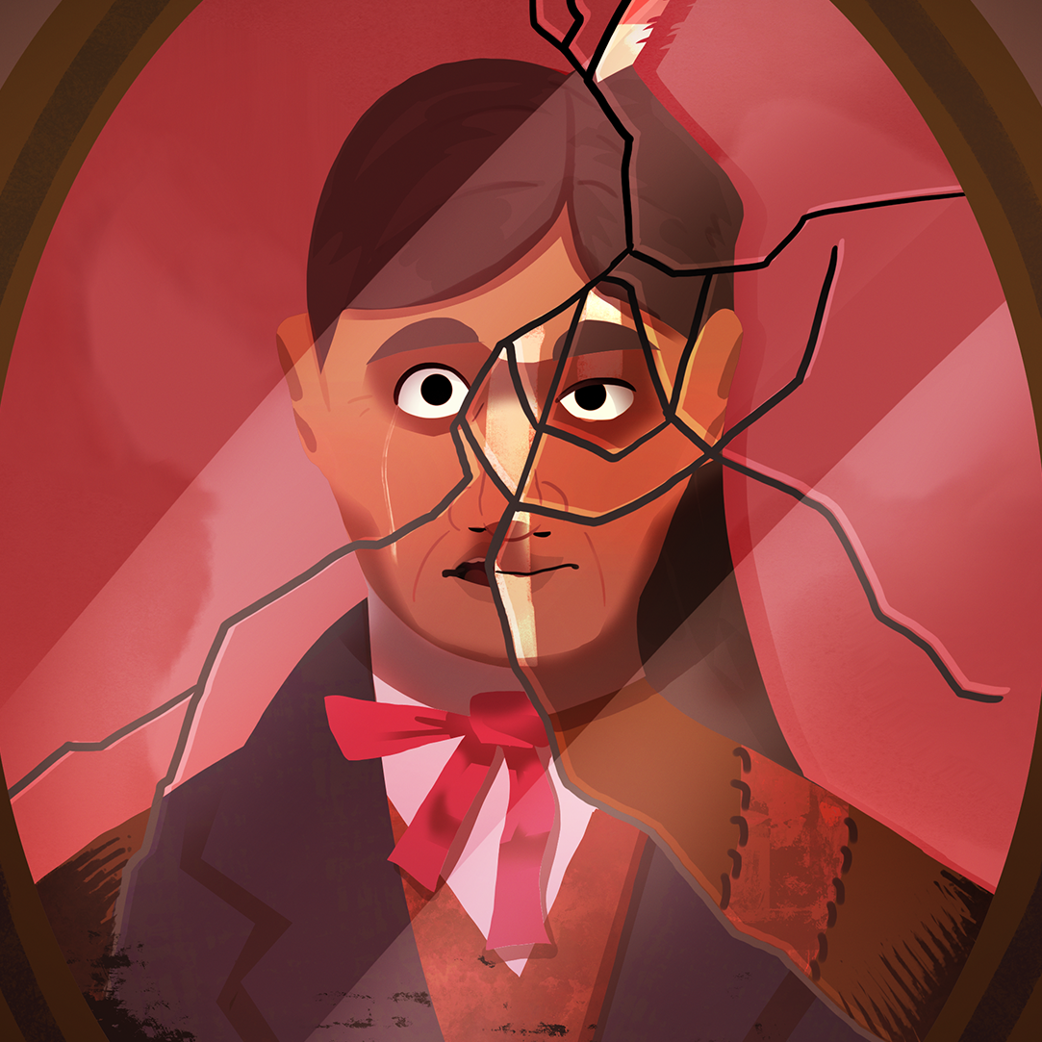
Surviving Assimilation
American Indian Boarding Schools

Slide 3
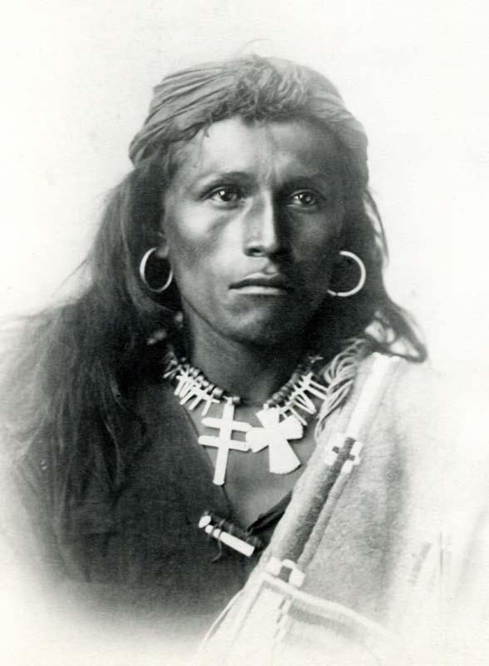
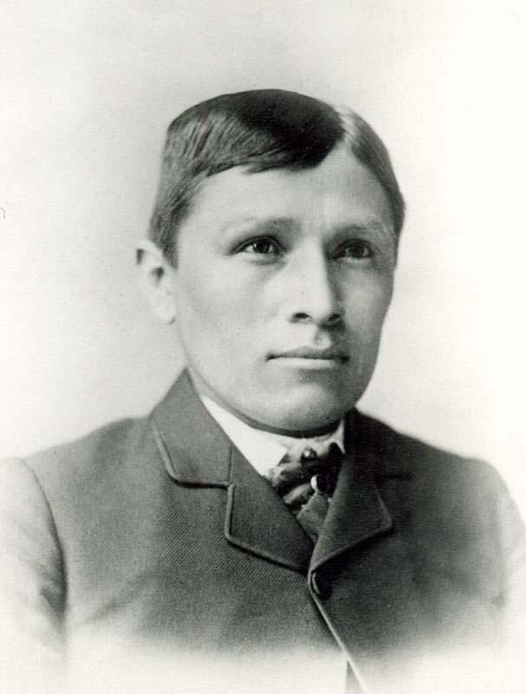
Notes:
Choate, J.N. (c. 1885). Tom Torlino – after [Photo]. Cumberland County Historical Society. https://carlisleindian.historicalsociety.com/images/tom-torlino-after/.
Choate, J.N. (c. 1882). Tom Torlino – Before [Photo]. Cumberland County Historical Society. https://carlisleindian.historicalsociety.com/images/tom-torlino-before/.

Slide 4
What do you notice about these two photos?
How are they similar? How do they differ?
Where do you think these two photos were taken?
When do you think they were taken?
Why do you think they were taken?
Who do you think took them?
Notes:
Choate, J.N. (c. 1885). Tom Torlino – after [Photo]. Cumberland County Historical Society. https://carlisleindian.historicalsociety.com/images/tom-torlino-after/.
Choate, J.N. (c. 1882). Tom Torlino – before [Photo]. Cumberland County Historical Society. https://carlisleindian.historicalsociety.com/images/tom-torlino-before/.

Slide 5
Tom Torlino
Citizen of the Navajo Nation in New Mexico
The first photo was taken in 1882 at the Carlisle Indian Industrial School in Carlisle, Pennsylvania.
The second photo was taken three or four years later.
The purpose of Carlisle and other boarding schools was to assimilate American Indians from around the country.

Slide 6
Assimilate (verb)
to cause (a person or group) to become part of a different society, country, etc.
to adopt the ways of another culture: to fully become part of a different society, country, etc.
Notes:
Source: Merriam-Webster. Assimilate. Merriam-Webster.com. https://www.merriam-webster.com/dictionary/assimilate

Slide 7
Essential Questions
How were American Indians assimilated in the past?
What effect did assimilation have on their identity and culture?

Slide 8
Learning Objectives
Explain the events and ideologies that led to the establishment of federally-funded and religious boarding schools for American Indians.
Examine the boarding school experiences of American Indians from Oklahoma and other states and territories.
Identify the ways in which American Indians resisted assimilation and preserved their cultural and individual identities during and after the time they spent at school.

Slide 9

Surprising, Interesting, Troubling
Read each quote.
As a group, discuss and highlight the part of each quote that is surprising, interesting, or troubling.
Notes:
K20 Center. (n.d.). S-I-T (Surprising, interesting, troubling). Strategies. https://learn.k20center.ou.edu/strategy/926

Slide 10

Window Notes
Go to https://k20.ou.edu/mf
Read the infographic and take notes in the four quadrants of the handout that identify your:
  Facts
  Feelings
  Questions
  Connections
Notes:
K20 Center. (n.d.). Window notes. Strategies. https://learn.k20center.ou.edu/strategy/189

Slide 11
Window Notes
Facts: Which facts do you find interesting?
Feelings: What are you feeling as you learn these facts?
Questions: What questions do you have now?
Connections: Can you relate what you have just read to prior experiences or things you learned before today?
Notes:
K20 Center. (n.d.). Window notes. Strategies. https://learn.k20center.ou.edu/strategy/189

Slide 12
H-Chart
Go to https://k20.ou.edu/mh
Choose a video from the left column and the right column to watch as a group.
Fill out the H-Chart as you view each video.
After watching two videos, respond to the prompt in the center of the H-Chart.
Notes:
K20 Center. (n.d.). Paired texts H-chart. Strategies. https://learn.k20center.ou.edu/strategy/132

Slide 13
Exit Ticket
If you were writing a book about the experiences of American Indian students at boarding schools, what is one thing you would want your readers to know? Why?
Notes:
K20 Center. (n.d.). Bell ringers and exit tickets. Strategies. https://learn.k20center.ou.edu/strategy/125

