Slide 2
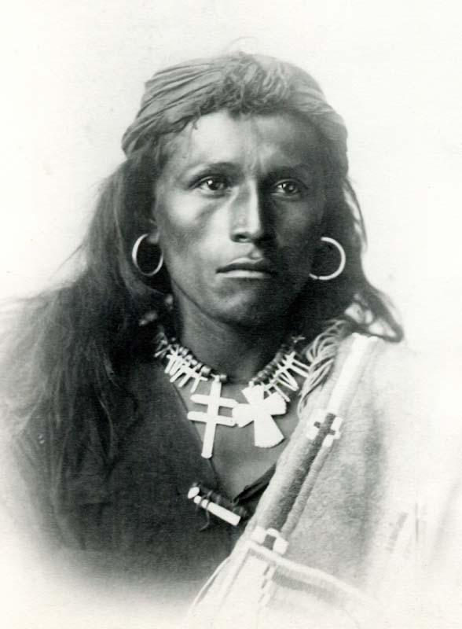
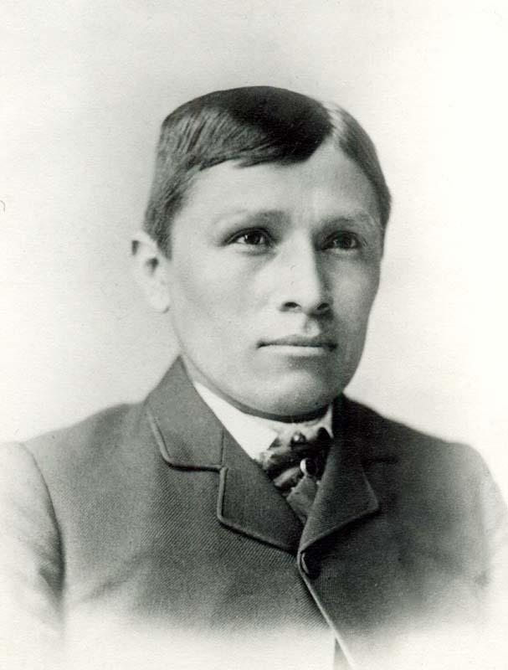
Notes:
Questions to ask:
What do you notice about these two photos? How are they similar? How do they differ?
Where do you think these photos were taken?
When do you think they were taken?
Why do you think they were taken?
Who do you think took them?
Sources:
Choate, J.N. (c. 1885). Tom Torlino - After. Cumberland County Historical Society. https://carlisleindian.historicalsociety.com/images/tom-torlino-after/.
Choate, J.N. (c. 1882). Tom Torlino - Before. Cumberland County Historical Society. https://carlisleindian.historicalsociety.com/images/tom-torlino-before/.

Slide 3
Assimilate (verb)
to cause (a person or group) to become part of a different society, country, etc.
to adopt the ways of another culture: to fully become part of a different society, country, etc.
Notes:
Source: Merriam-Webster. Assimilate. Merriam-Webster.com. https://www.merriam-webster.com/dictionary/assimilate

Slide 4
Surviving Assimilation
American Indian Boarding Schools

Slide 5
Essential Questions
How were American Indians assimilated in the past?
What effect did assimilation have on their identity and culture?

Slide 6
Lesson Objectives
Understand the events and ideologies that led to the establishment of federally-funded and religious boarding schools for American Indians.
Examine the boarding school experiences of American Indians from Oklahoma and other states and territories.
Identify the ways in which American Indians resisted assimilation and preserved their cultural and individual identities during and after the time they spent at school.

Slide 7
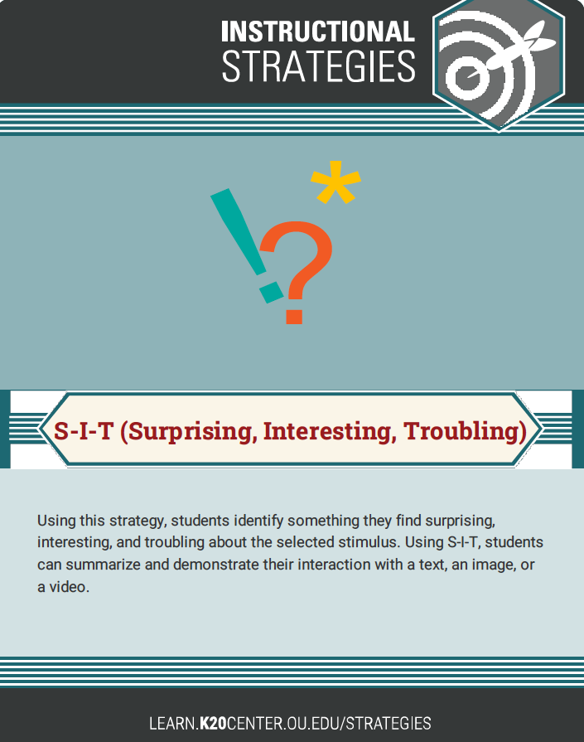
S-I-T (Surprising, Interesting, Troubling)
Read the quotations in the handout.
After you have read each quotation, discuss with your group members what surprised, interested, or troubled you in the reading.
Explain why you feel the way you do.
Choose a volunteer to share your reasoning with the class.
Notes:
K20 Center. (n.d.). S-I-T (Surprising, Interesting, Troubling). Strategies. https://learn.k20center.ou.edu/strategy/926

Slide 8
Window Notes
Click to access the Boarding Schools Infographic.
As you look through the infographic, write notes in the four quadrants of your Window Notes handout:
Facts
Feelings
Questions
Connections
Notes:
K20 Center. (n.d.). Window Notes. Strategies. https://learn.k20center.ou.edu/strategy/189
K20 Center. (2022). Boarding Schools Infographic. https://infogram.com/1pmn5z655017vyb3ypnxnd2633szle1len0?live

Slide 9
Window Notes (continued)
Facts: Which facts do you find interesting?
Feelings: What are you feeling as you learn these facts?
Questions: What questions do you have now?
Connections: Can you relate what you have just read to prior experiences or things you learned before today?
Notes:
K20 Center. (n.d.). Window Notes. Strategies. https://learn.k20center.ou.edu/strategy/189

Slide 10
H-Chart
Choose two videos from the Resource Choice Board to watch with your group: one from the left column and one from the right column.
For the video you choose from the left column, respond to the prompt on the left side of the H-Chart.
For the video you choose from the right column, respond to the prompt on the right side of the H-Chart.
Notes:
K20 Center. (n.d.). Choice Board. Strategies. https://learn.k20center.ou.edu/strategy/73

Slide 11
H-Chart (continued)
When you have watched both videos and responded to each of the prompts, write an answer to the prompt found in the center of the H-Chart.

Slide 12
Exit Ticket
On a piece of paper, answer the following question to the best of your ability. Complete your answer in about ten minutes.
If you were writing a book about the experiences of American Indian students at boarding schools, what is one thing you would want your readers to know? Why?
Notes:
K20 Center. (n.d.). Bell Ringers and Exit Tickets. Strategies. https://learn.k20center.ou.edu/strategy/125

